Slide 1
Sandhills Conservation Partnership Land Protection Work Group
June 12, 2024
Jeff Marcus, Matt Greene, Crystal Cockman, Barry Hull, Emily Callicutt, Brady Beck

Slide 2
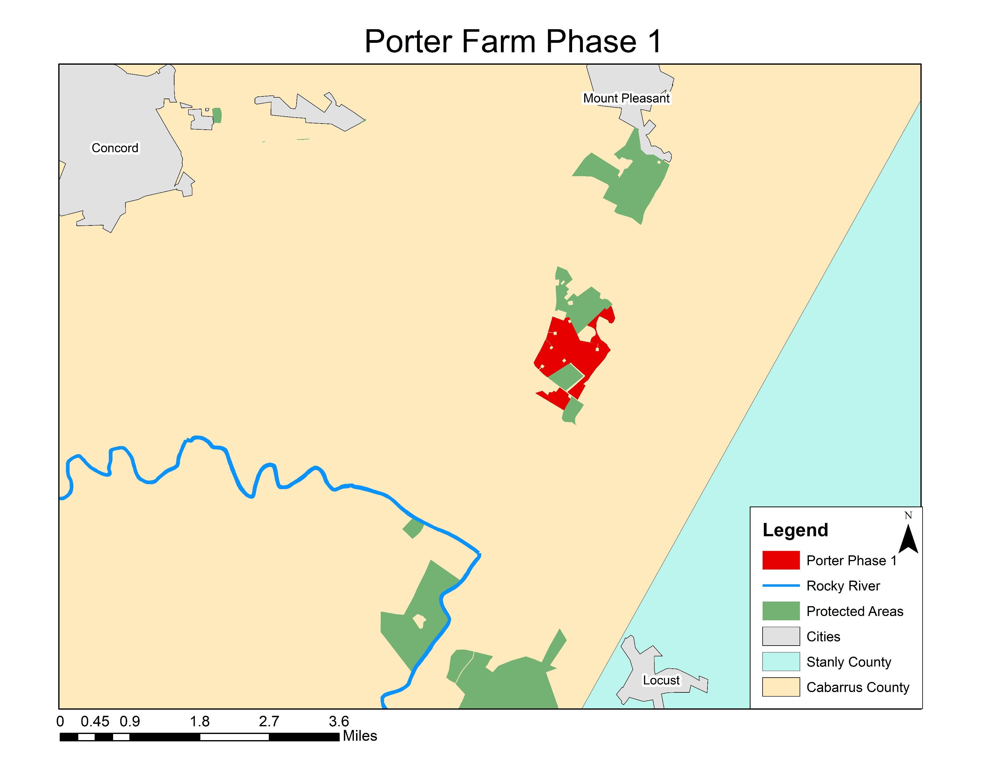
Porter- phase 1- 367ac
Cabarrus County

Slide 3
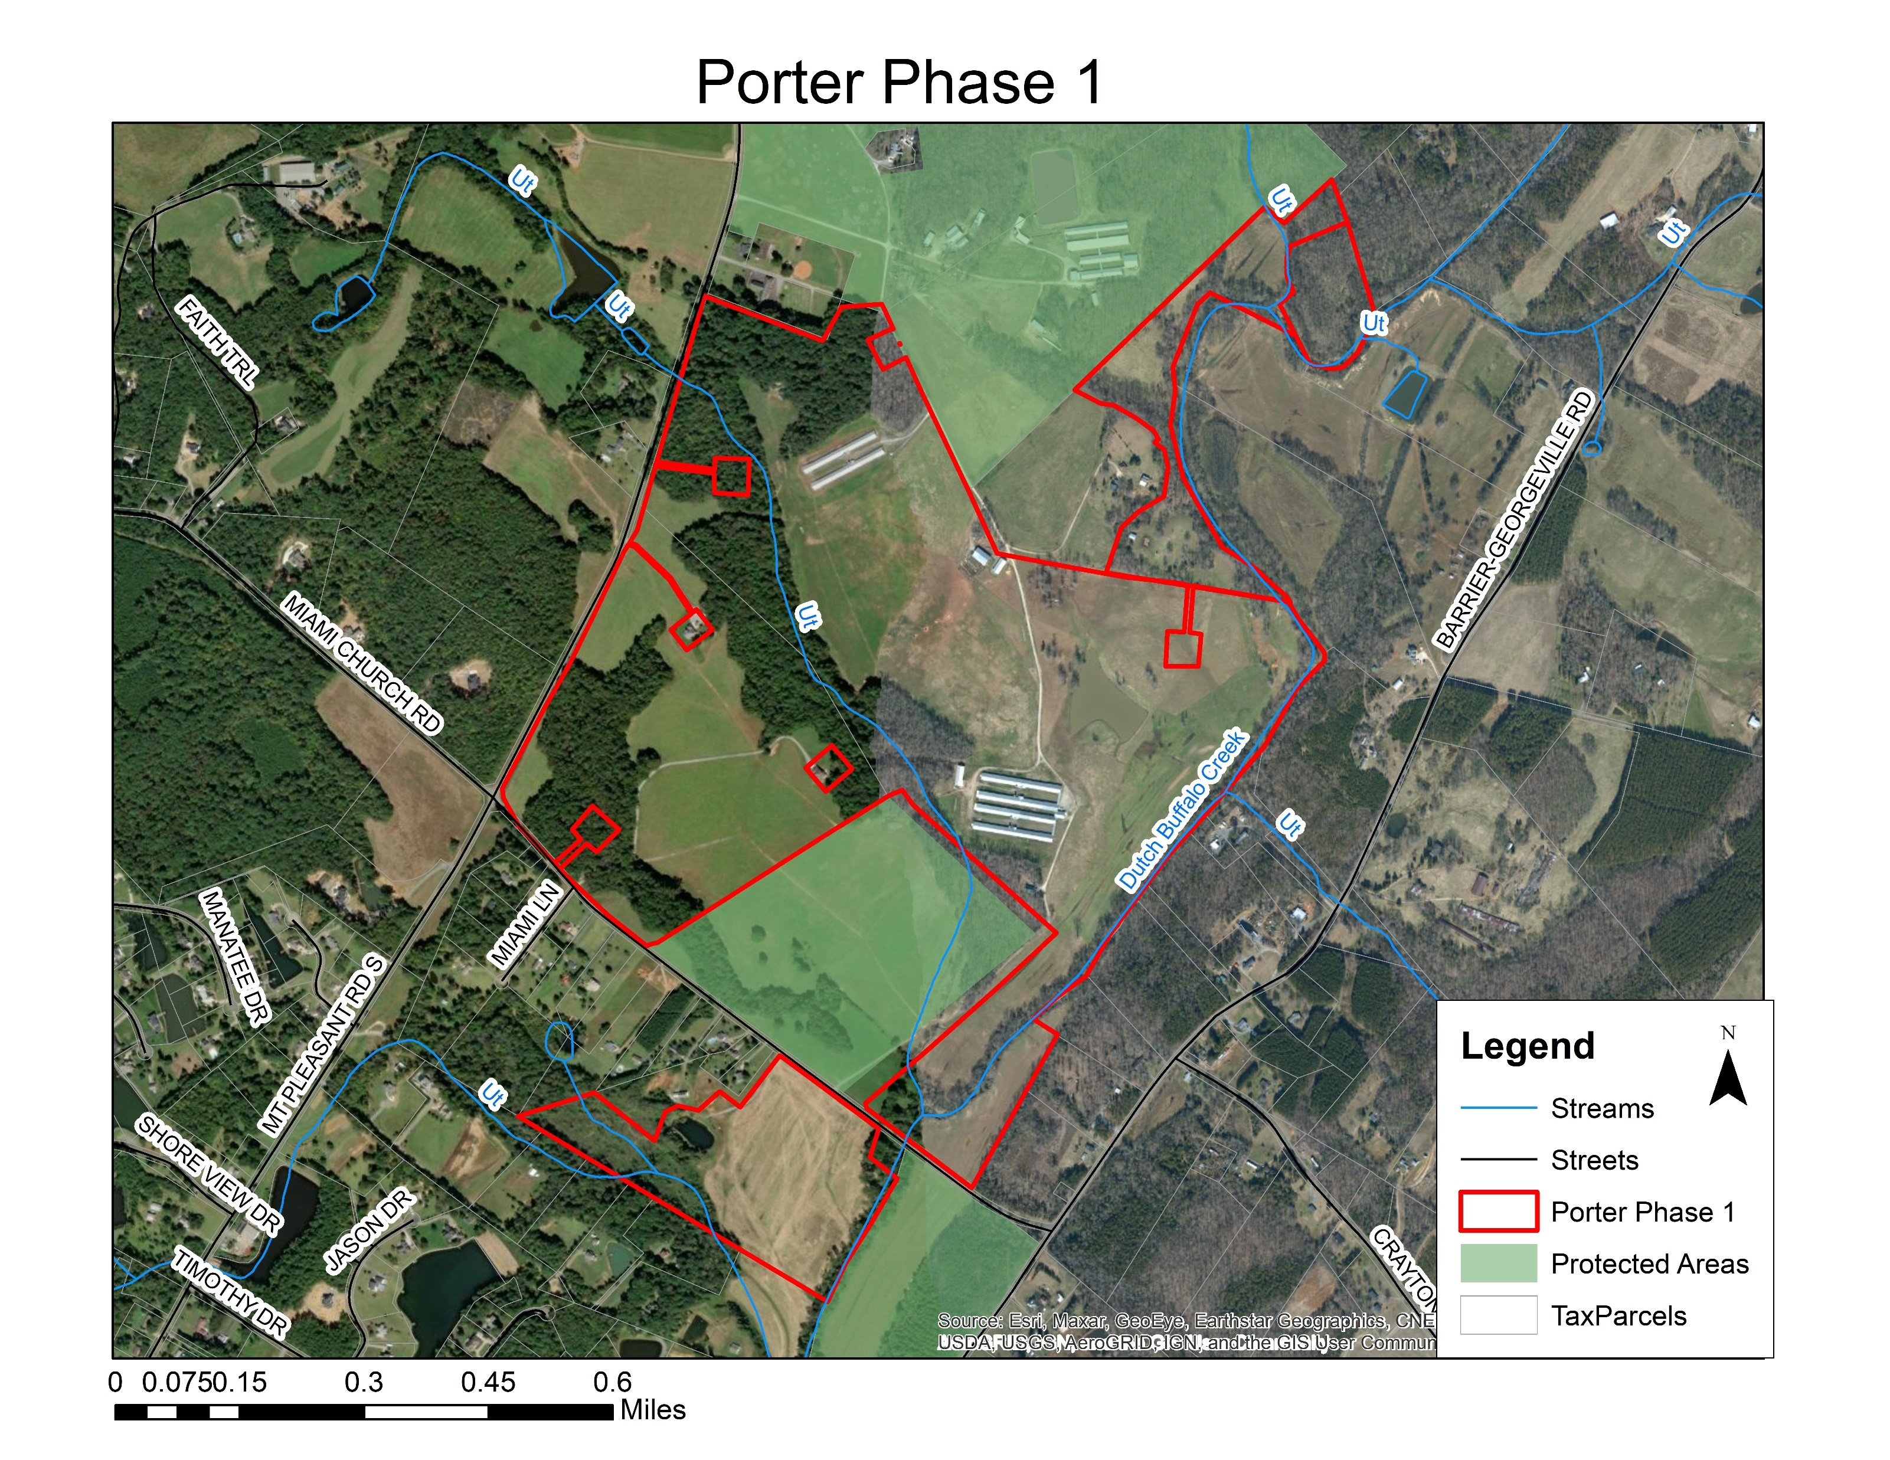
Porter- phase 1- 367ac
Agricultural Development and Farmland Preservation program/Agricultural Lands Easement program working lands easement on a cattle farm

Slide 4
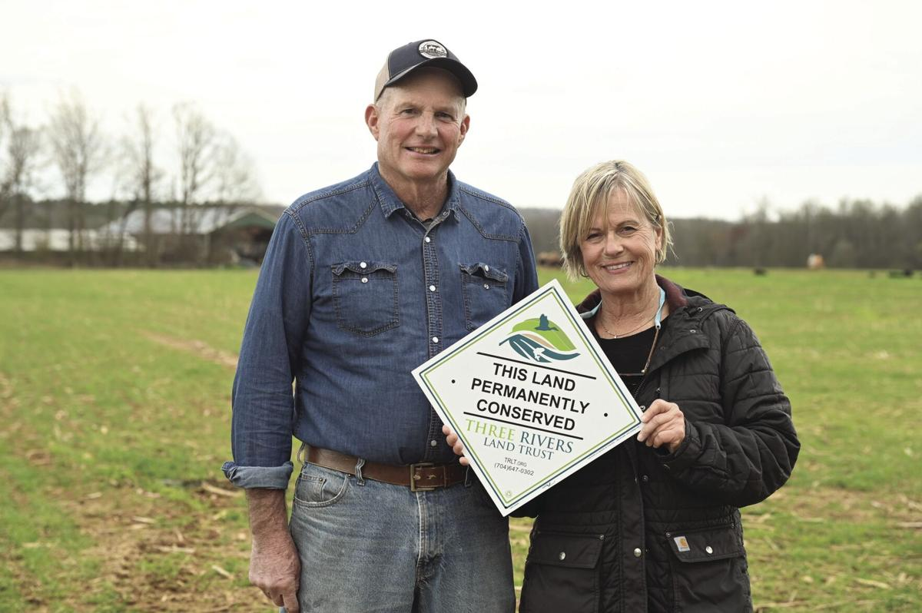
Porter- phase 1- 367ac

Slide 5
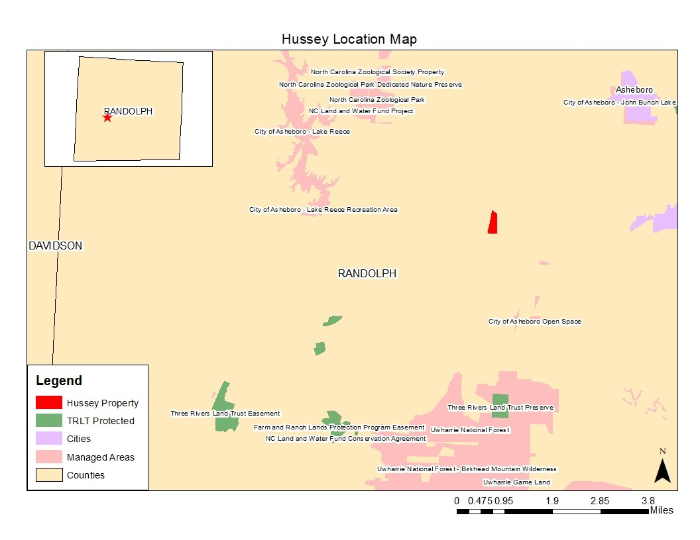
Hussey Family Donated Conservation Easement- 43ac
Randolph County

Slide 6
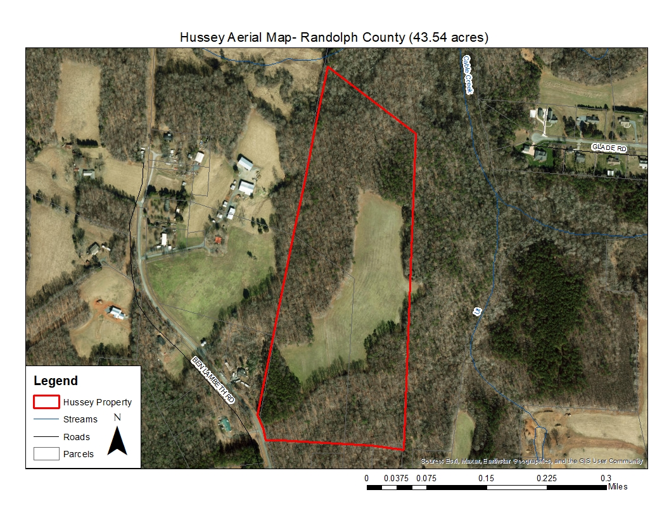
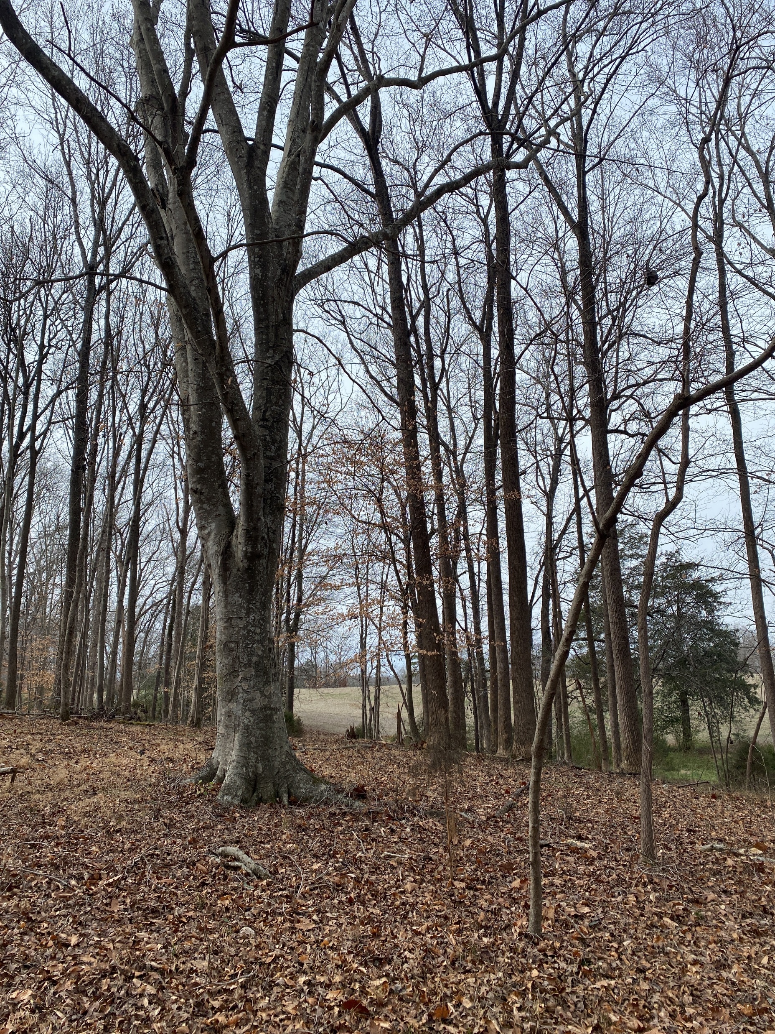
Hussey Family Donated Conservation Easement- 43ac

Slide 7
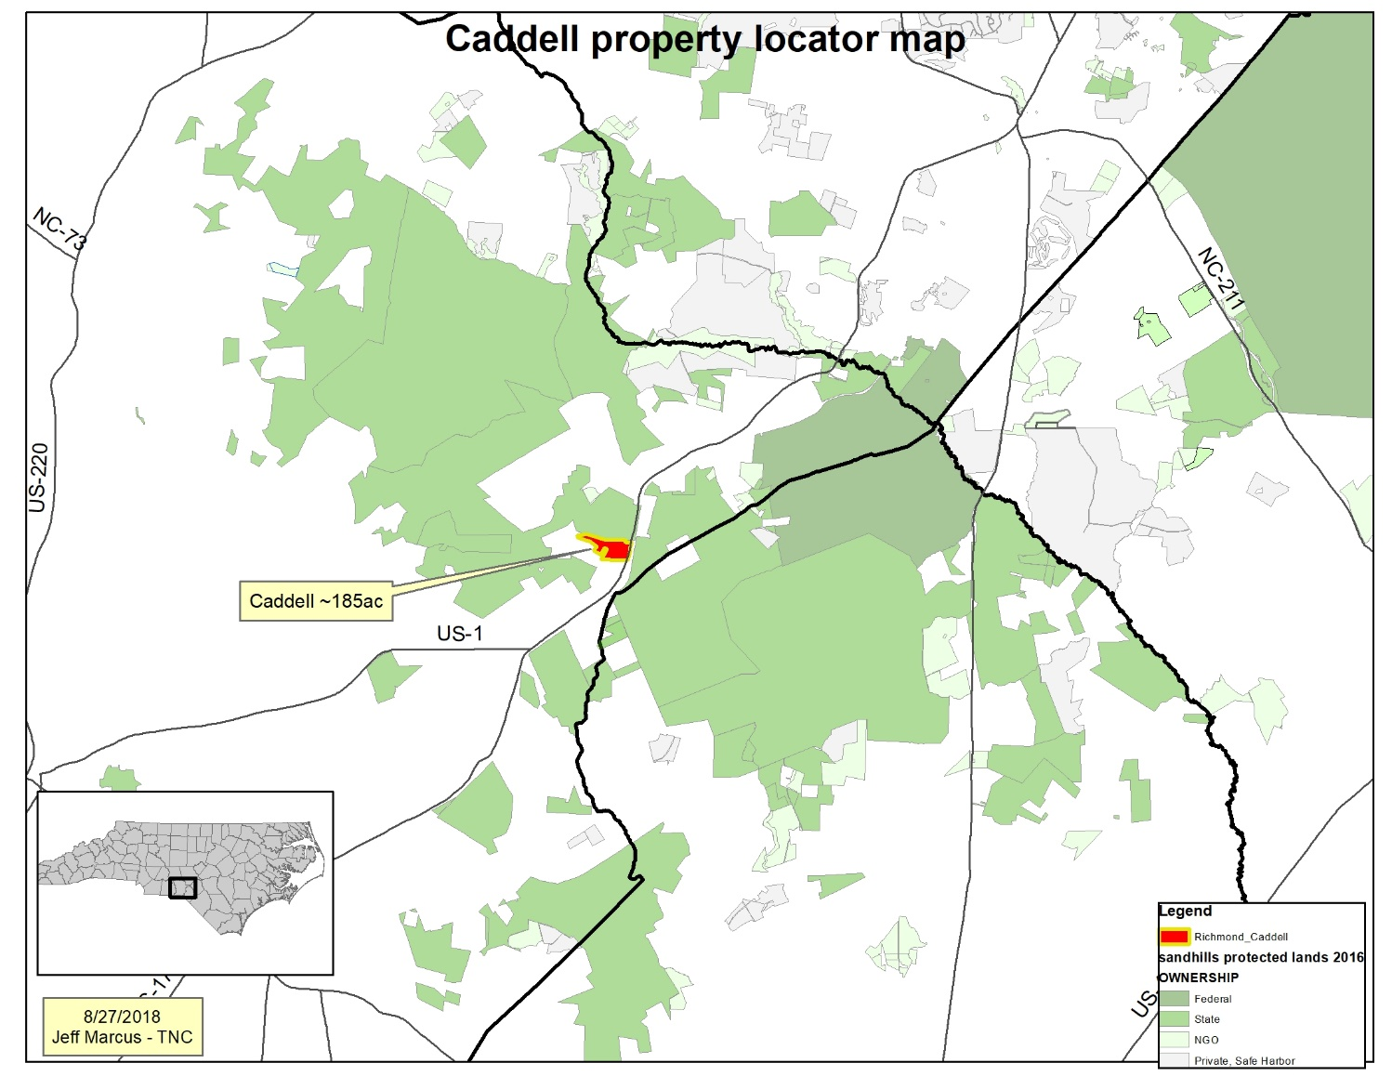
Caddell 190ac
Richmond County

Slide 8
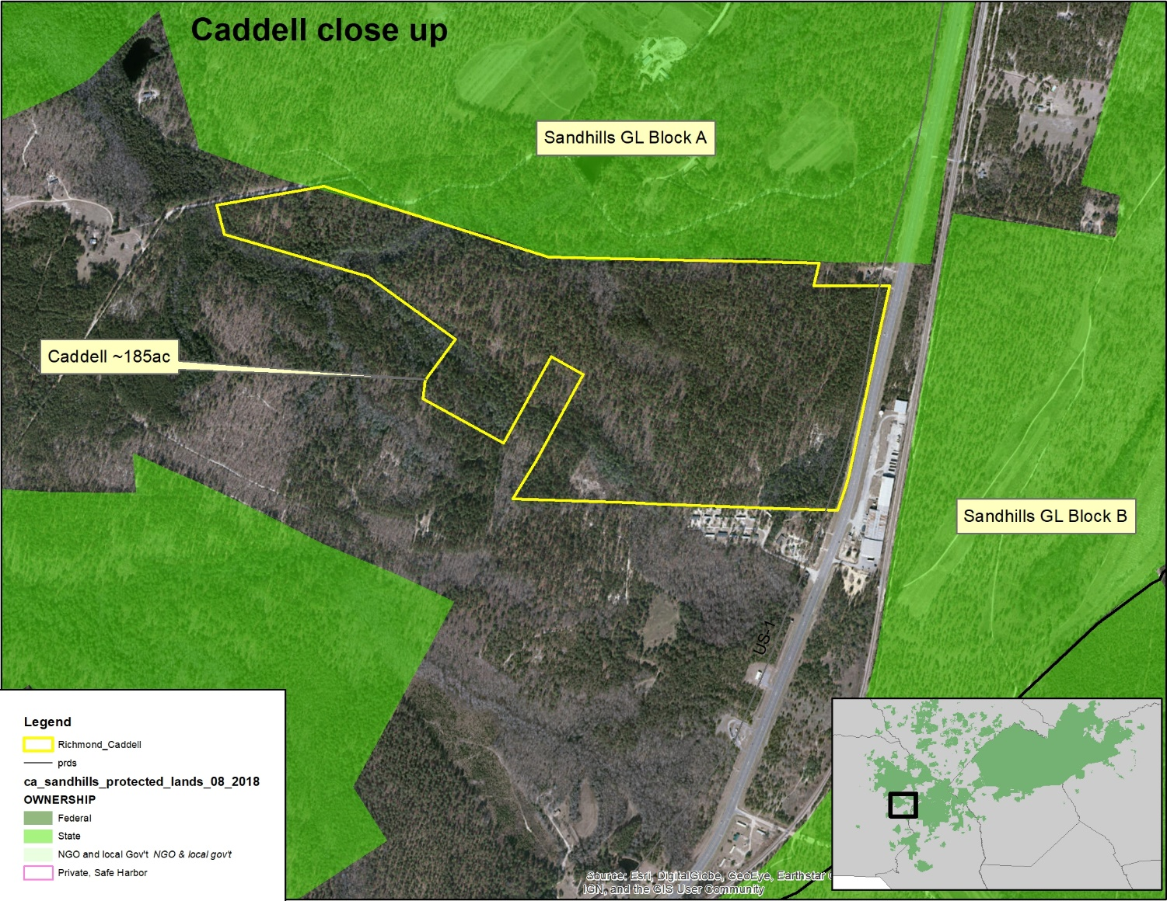
Caddell 190ac
Adjacent Sandhills Game Land depot and 30 ac BLATCO property
Connectivity between Block A & B
Protects nap-of-the-earth flight area

Slide 9
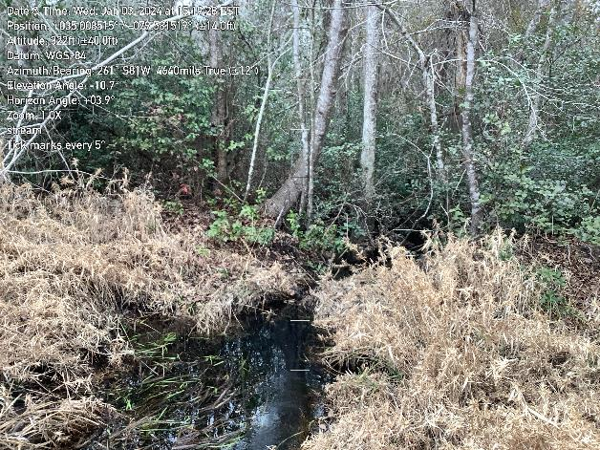
Caddell 190ac fee simple acquisition

