Slide 1
Connecting …
Sand Hills Conservation Partnership, Greater Uwharries Conservation Partnership, NC Longleaf Coalition
Dean Urban
12 June 2024
Notes:
Get their logos!

Slide 2
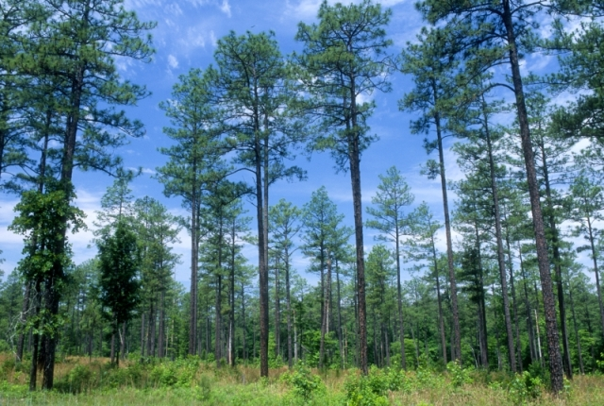
Agenda
Connectivity: everybody’s doing it
Theory
Practice
LCPs and corridors
Cost surfaces and resistance
Implementation
Climate connectivity
Closing comments/advice

Slide 3
Theory
Island biogeography (1960’s-70’s)
Immigration:
decreases with increasing species N cuz there are fewer opportunities to introduce a new species
Extinction:
Increases with increasing N cuz there are more opportunities for one to go extinct by chance
Notes:
(walk thru the IBT slide -> area, isolation effects
On click to reveal rules: (1) IBT doesn’t predict any of these things; (2) #2, SLOSS, is wrong.

Slide 4
Theory
Island biogeography (1960’s-70’s)
Area effect:
larger islands have lower extinction rates cuz of larger populations (less vulnerable); small islands are more vulnerable
Isolation effect:
“far” islands have lower immigration rates; “near” islands have a stronger dispersal subsidy
immigration
extinction
Notes:
(walk thru the IBT slide -> area, isolation effects
On click to reveal rules: (1) IBT doesn’t predict any of these things; (2) #2, SLOSS, is wrong.

Slide 5
Theory
Applied rules …
Island biogeography (1960’s-70’s)
“SLOSS”
immigration
extinction
better worse
Notes:
(walk thru the IBT slide -> area, isolation effects
On click to reveal rules: (1) IBT doesn’t predict any of these things; (2) #2, SLOSS, is wrong.

Slide 6
Theory (take-aways)
Habitat area is the most important driver of biodiversity (habitat loss is the most important driver of biodiversity loss)
Habitat condition/degradation comes next
Habitat configuration/connectivity comes next
This is really hard to demonstrate from field observations: you can only have fragmentation and isolation if you lose habitat (see #1 above)
Experiments show that constructed connections do work, and long-term
Notes:
e.g., for longleaf, it’s first area and then degradation (especially from fire exclusion, encroaching other species).

Slide 7
Theory: Metapopulations
Source patches have positive net reproduction and subsidize sink patches, which have negative net reproduction in the absence of dispersal
(Pulliam 1988)
Notes:
Walk thru the basics and how it’s been applied in conservation practice…

Slide 8
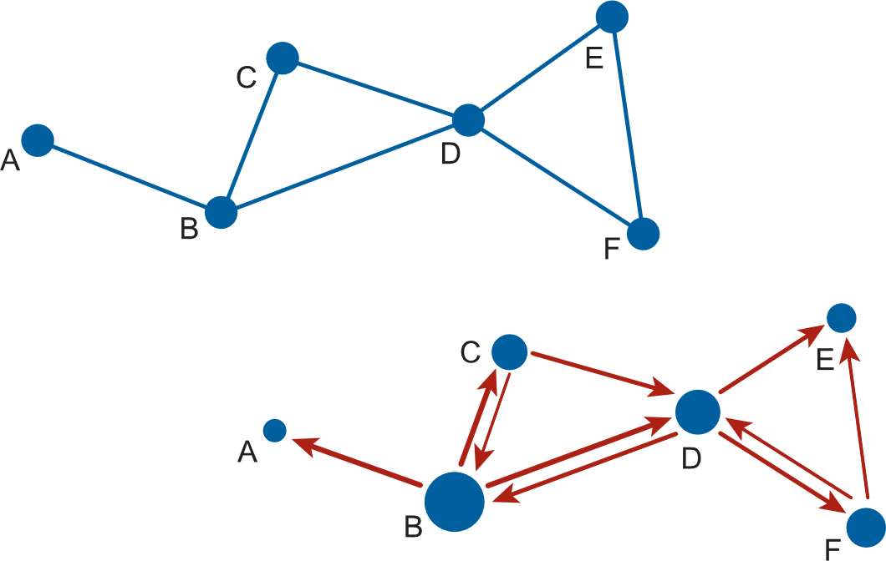
Practice
“Protect / Connect / Restore” clicks all the boxes
Connectivity is now almost universally based on network models
Dots (nodes): habitat patches
Lines (links): connections between patches (dispersal)
Notes:
n.b. the differences in the 2nd case, where we an attribute the nodes and define the links more functionally

Slide 9
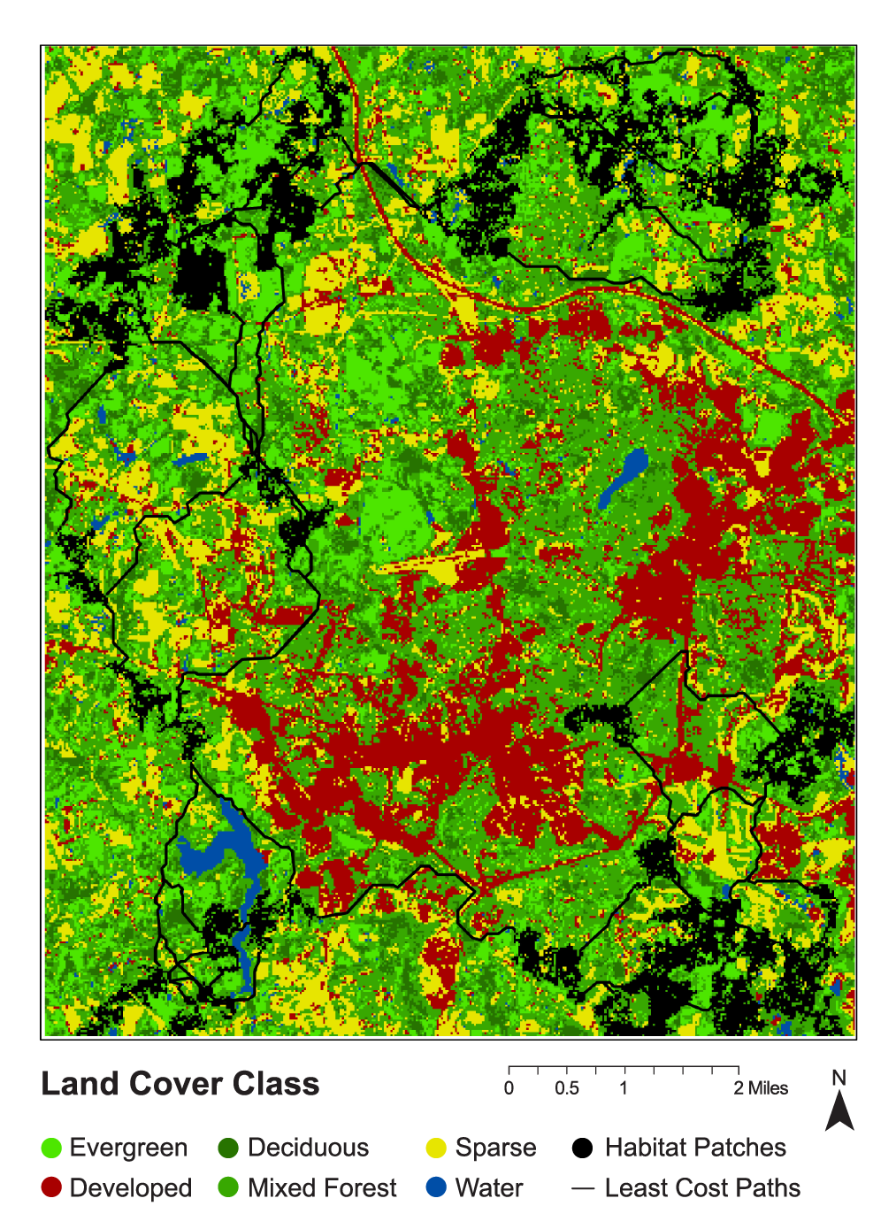
Connectivity: Tools
Cost surface:
Resistance to dispersal
Typically, cross-walked to land cover
Least-cost paths:
Routes with the minimum total cost (resistance) between two points (source, target)
Note:
these assume a lot of the species

Slide 10
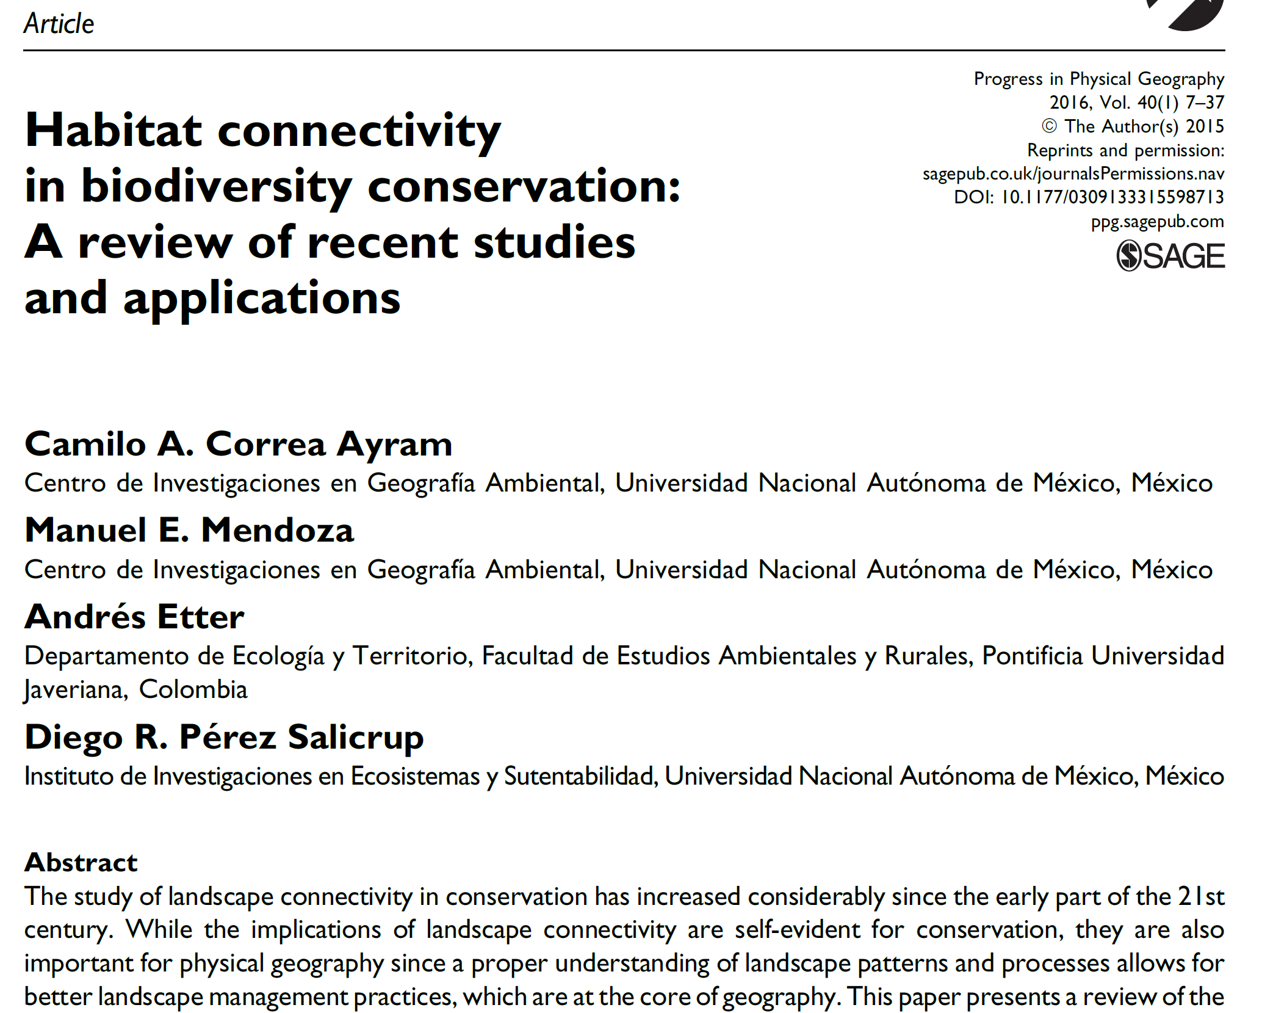
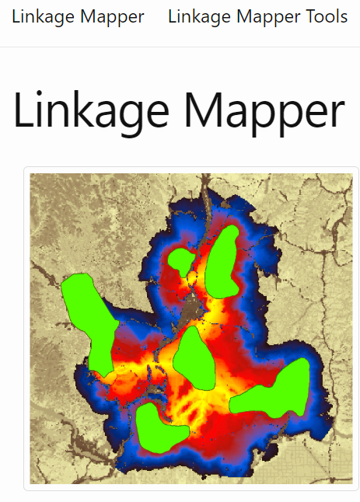
Connectivity: Tools

Slide 11
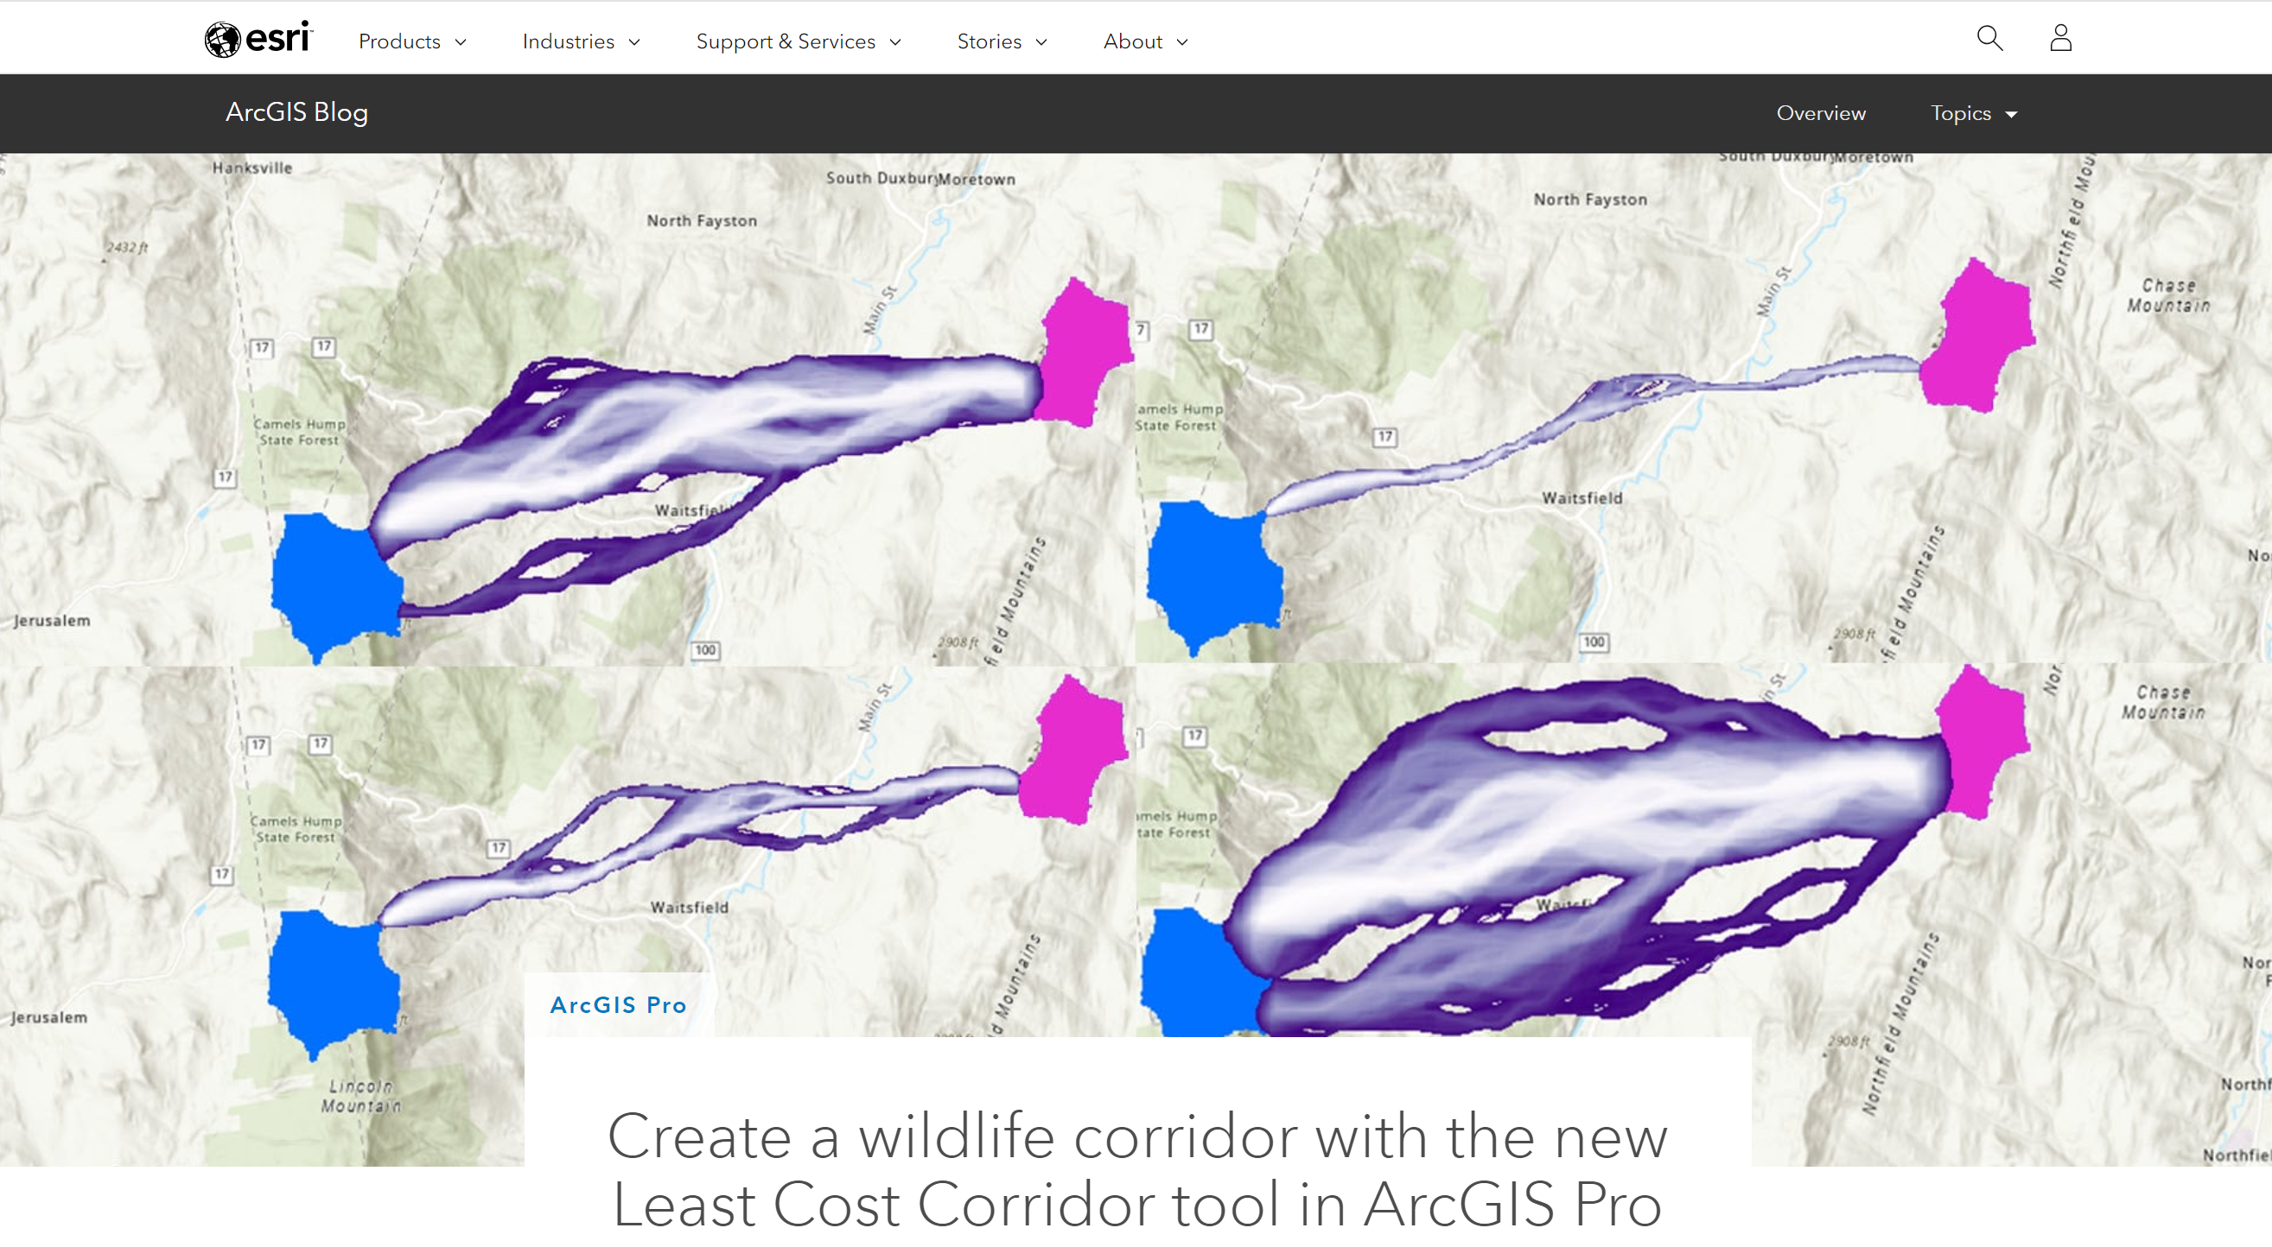
Connectivity: Tools
Notes:
A bi step: LCPs and corridors for the masses …

Slide 12
Pause …
It is really, really, easy (now) to construct a network model of regional connectivity
The tools are strictly BYOB: bring your own biology
What constitutes usable “habitat”?
Is dispersal habitat the same as breeding habitat?
What defines “resistance” to dispersal?
Does the focal species behave in a way to “choose” LCPs?
At what (threshold) distance is connectivity defined?

Slide 13
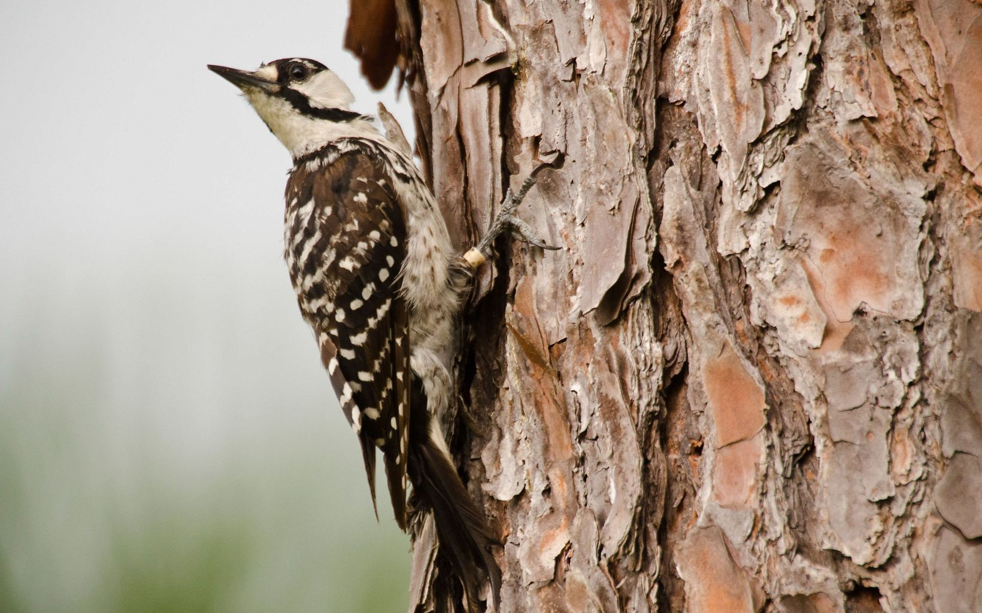
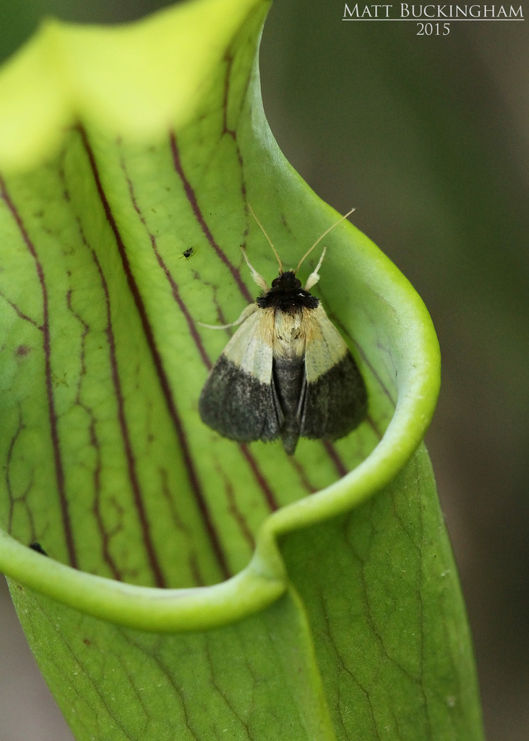
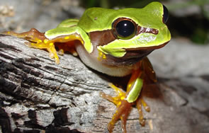
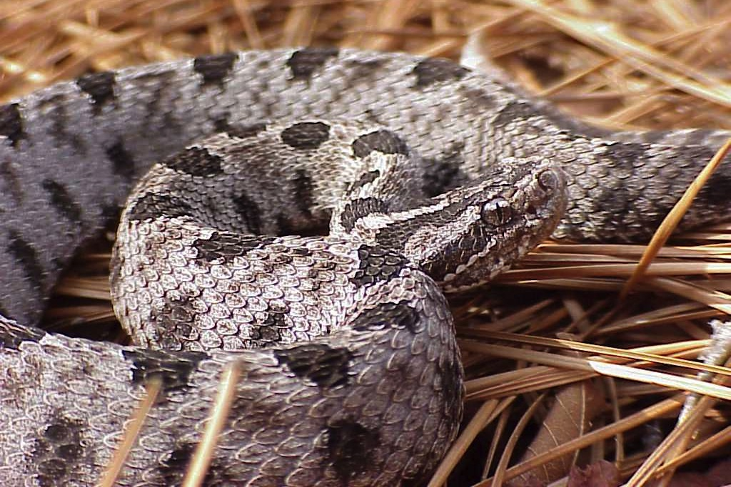
Connectivity: What to Connect?
Structural vs functional connectivity
Habitat guild?
Focal species
Umbrella species
Most-limited species?
Notes:
So, re: biology: what defines a “patch” or node? What counts as “habitat”? Habitat for what?

Slide 14
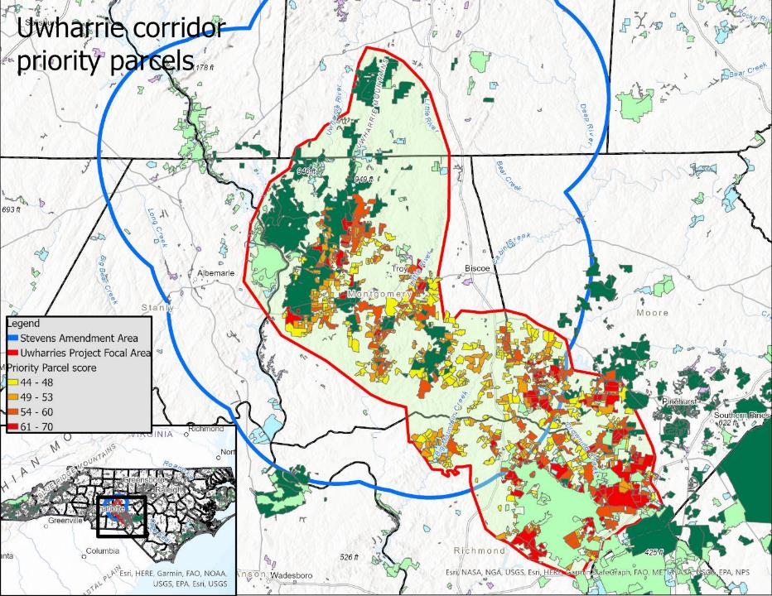
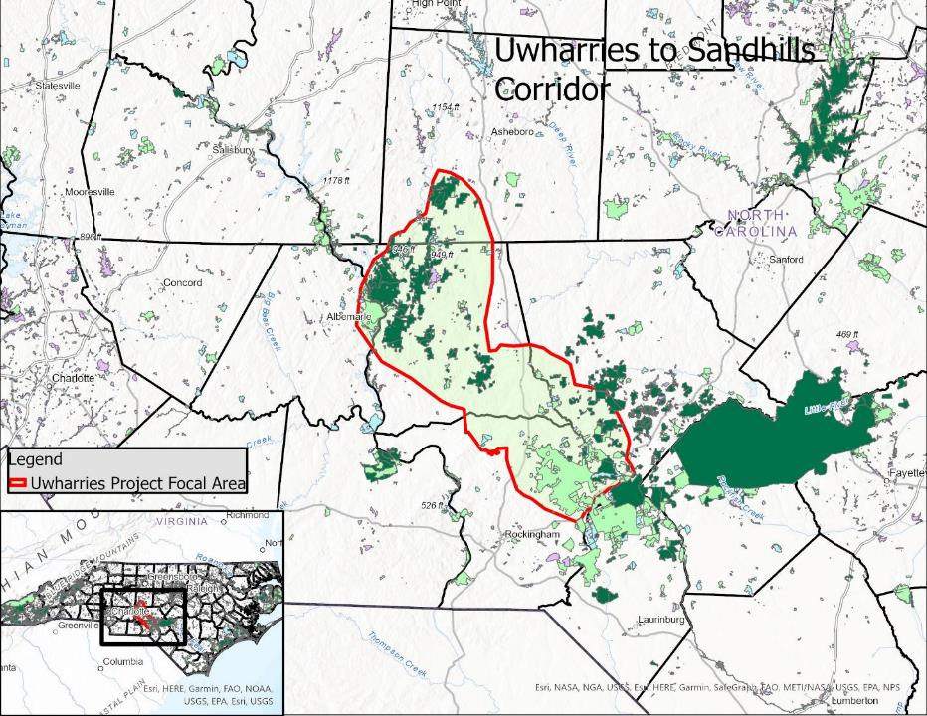
Connectivity: Planning
Parcel-level targets
Regional plan
Notes:
(this looks good, macroscopically and at the parcel level)

Slide 15
Connectivity: Network Assembly
Prioritization:
Most crucial links/bottlenecks?
Roads? (and possible crossings?)
Biggest chunks of the puzzle?
Most threatened/vulnerable?
Practitioners understand all this but work opportunistically … and that’s fine (it works)
But: keep the priorities top-of-mind and be persistent

Slide 16
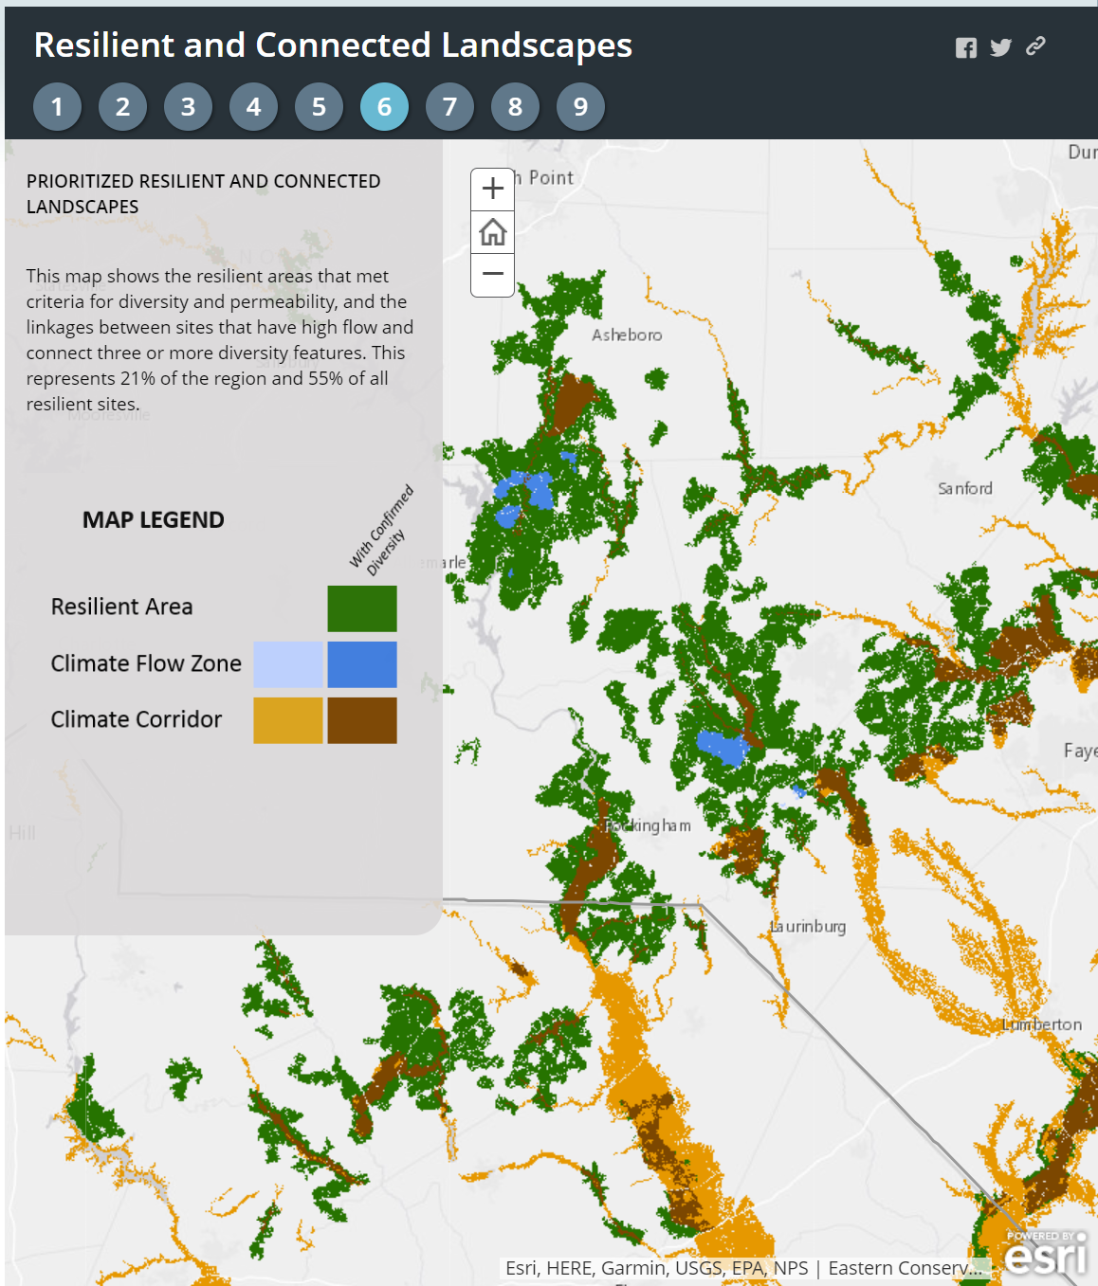
Climate Connectivity
Motivate: the future is here
What resilience means in the southeast:
Bigger is better (cooler)
Bottomland/riparian/riverine is better (cooler)
Permeable is better (local movement)
Long-distance (northward) connectivity probably moot here
Notes:
n.b. the temperature differences you can find in large bottomland tracts are of the same magnitude of anticipated warmings here (3-5 degrees F).

Slide 17
Conclusions
Parting advice:
Do what you’re doing (you got this)
Planning/routing is not the hard part
Be creative
Be persistent

