Slide 1
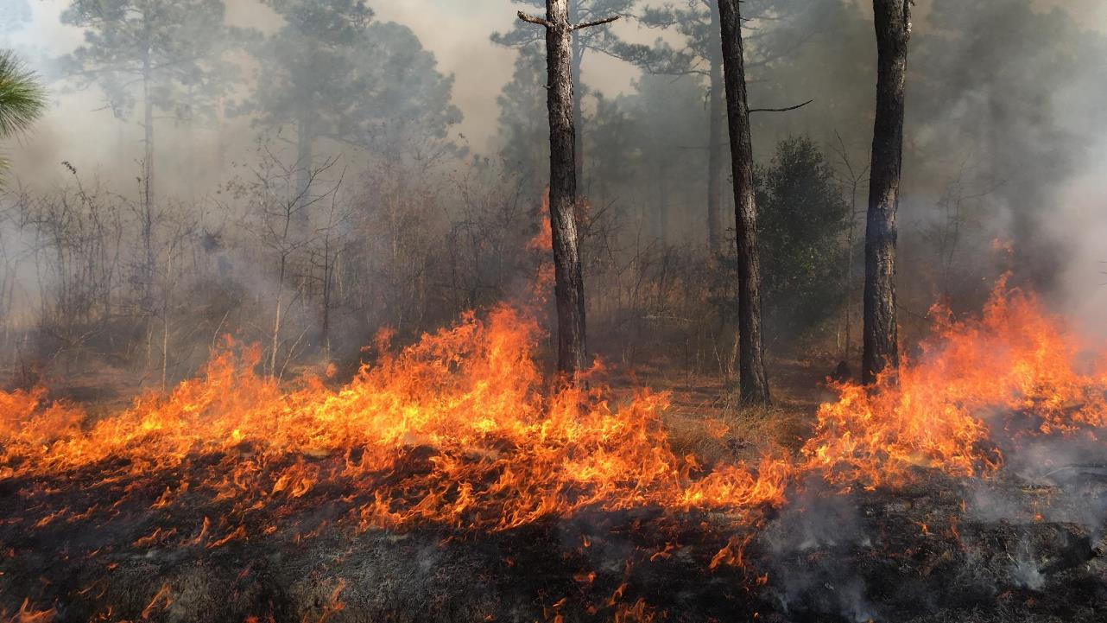

Background of Uwharrie Corridor project
Jeff Marcus, NC Longleaf Applied Scientist
The Nature Conservancy

Slide 2
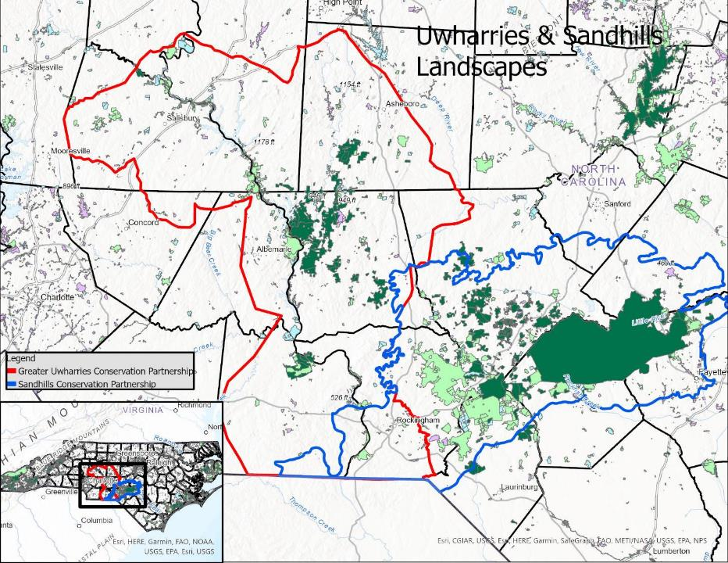

Slide 3
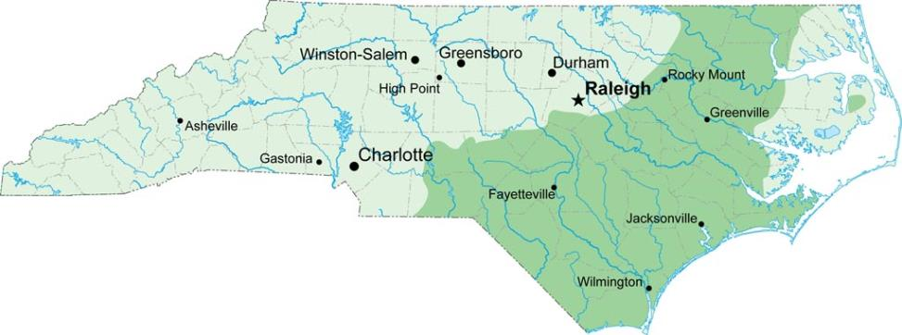
Historic Distribution of Longleaf in NC (Longleaf Alliance)

Slide 4
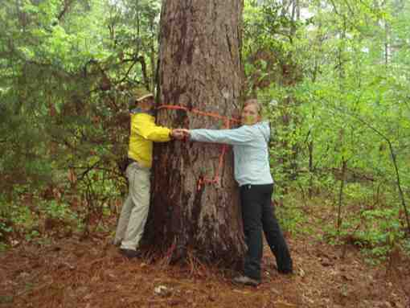
Longleaf in the Uwharries
A few examples of managed longleaf remain, much of the remaining longleaf fire suppressed
Many fire-managed pine species extirpated
Over previous few decades, isolated conservation efforts but no unified partnership effort
Uwharrie National Forest management plan calls for ~7k acres of longleaf and additional acres of fire-managed forest
September 2018 joint meeting of GUCP and NCSCP focuses attention
Old growth (and fire suppressed) longleaf in Montgomery Co

Slide 5
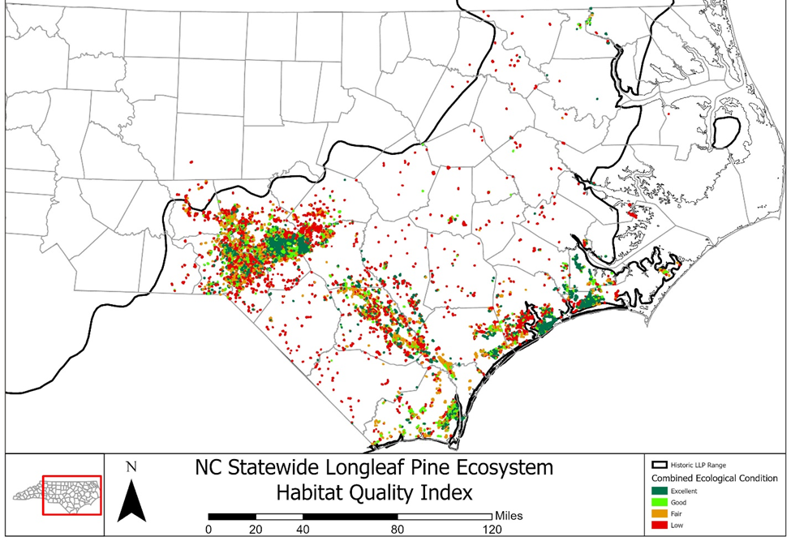
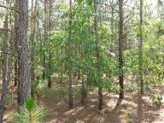
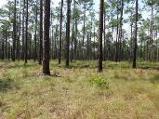
Excellent
Poor

Slide 6
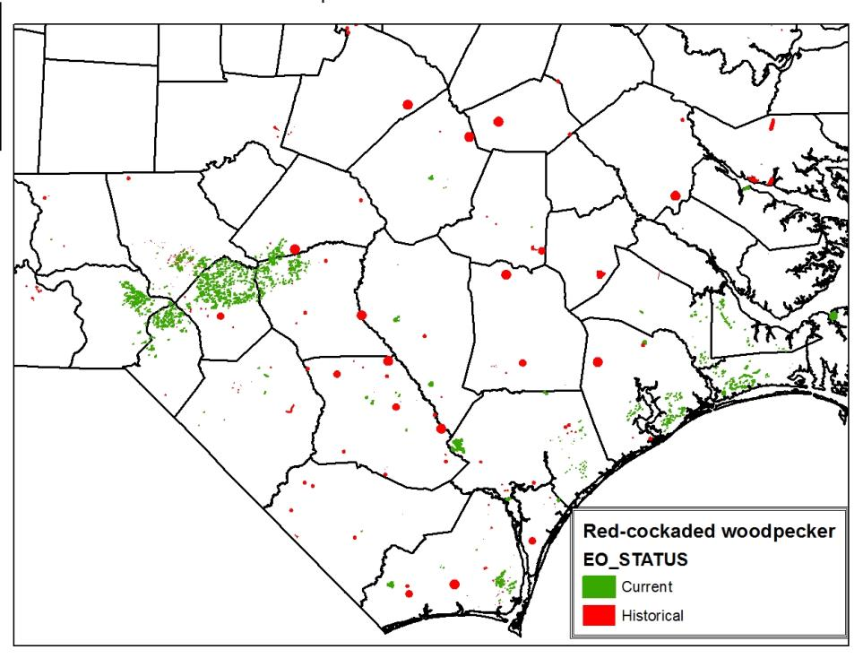
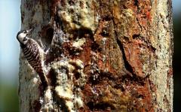
Red-cockaded woodpecker photo- Brady Beck

Slide 7
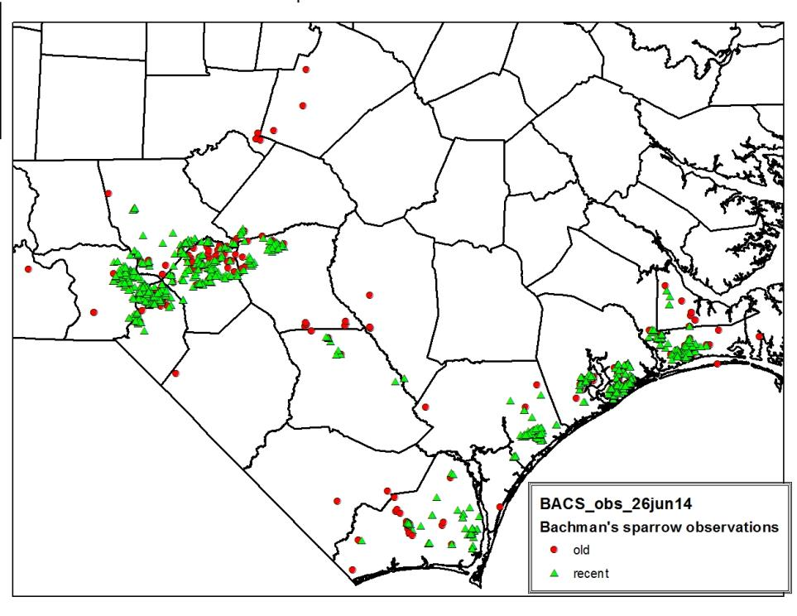
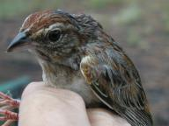
Bachman’s sparrow

Slide 8
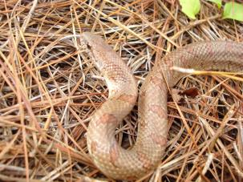
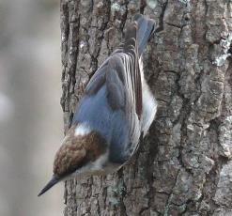
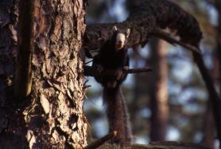
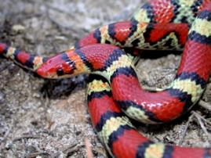
Longleaf-associated wildlife extant in Piedmont
Mole kingsnake
Brown headed nuthatch- Ken Thomas
Fox Squirrel- Brady Beck
N. Scarlet Snake- J.D. Willson

Slide 9
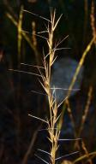
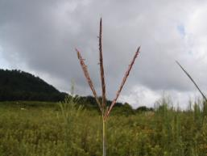
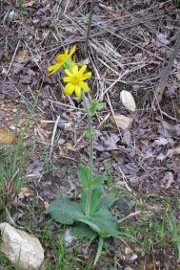
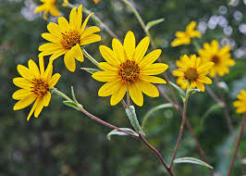
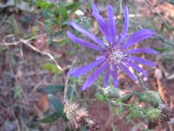
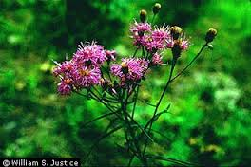
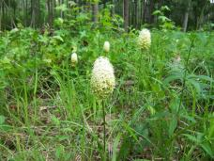
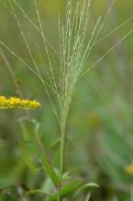
Fire-adapted plants of Piedmont Longleaf
Slimspike threeawn
Big bluestem
Nell Allen
Common leopardbane
Nell Allen
Schweinitz’ sunflower
Georgia aster
Bearded skeletongrass
Nell Allen
Stemless Ironweed
Fly poison

Slide 10
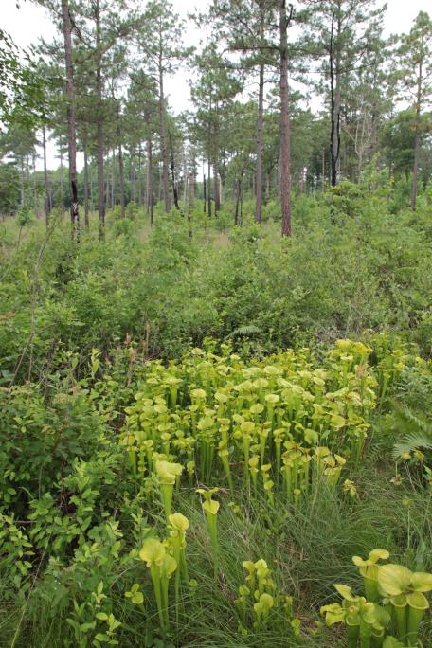
Piedmont bog communities
TNC’s Black Ankle Bog

Slide 11
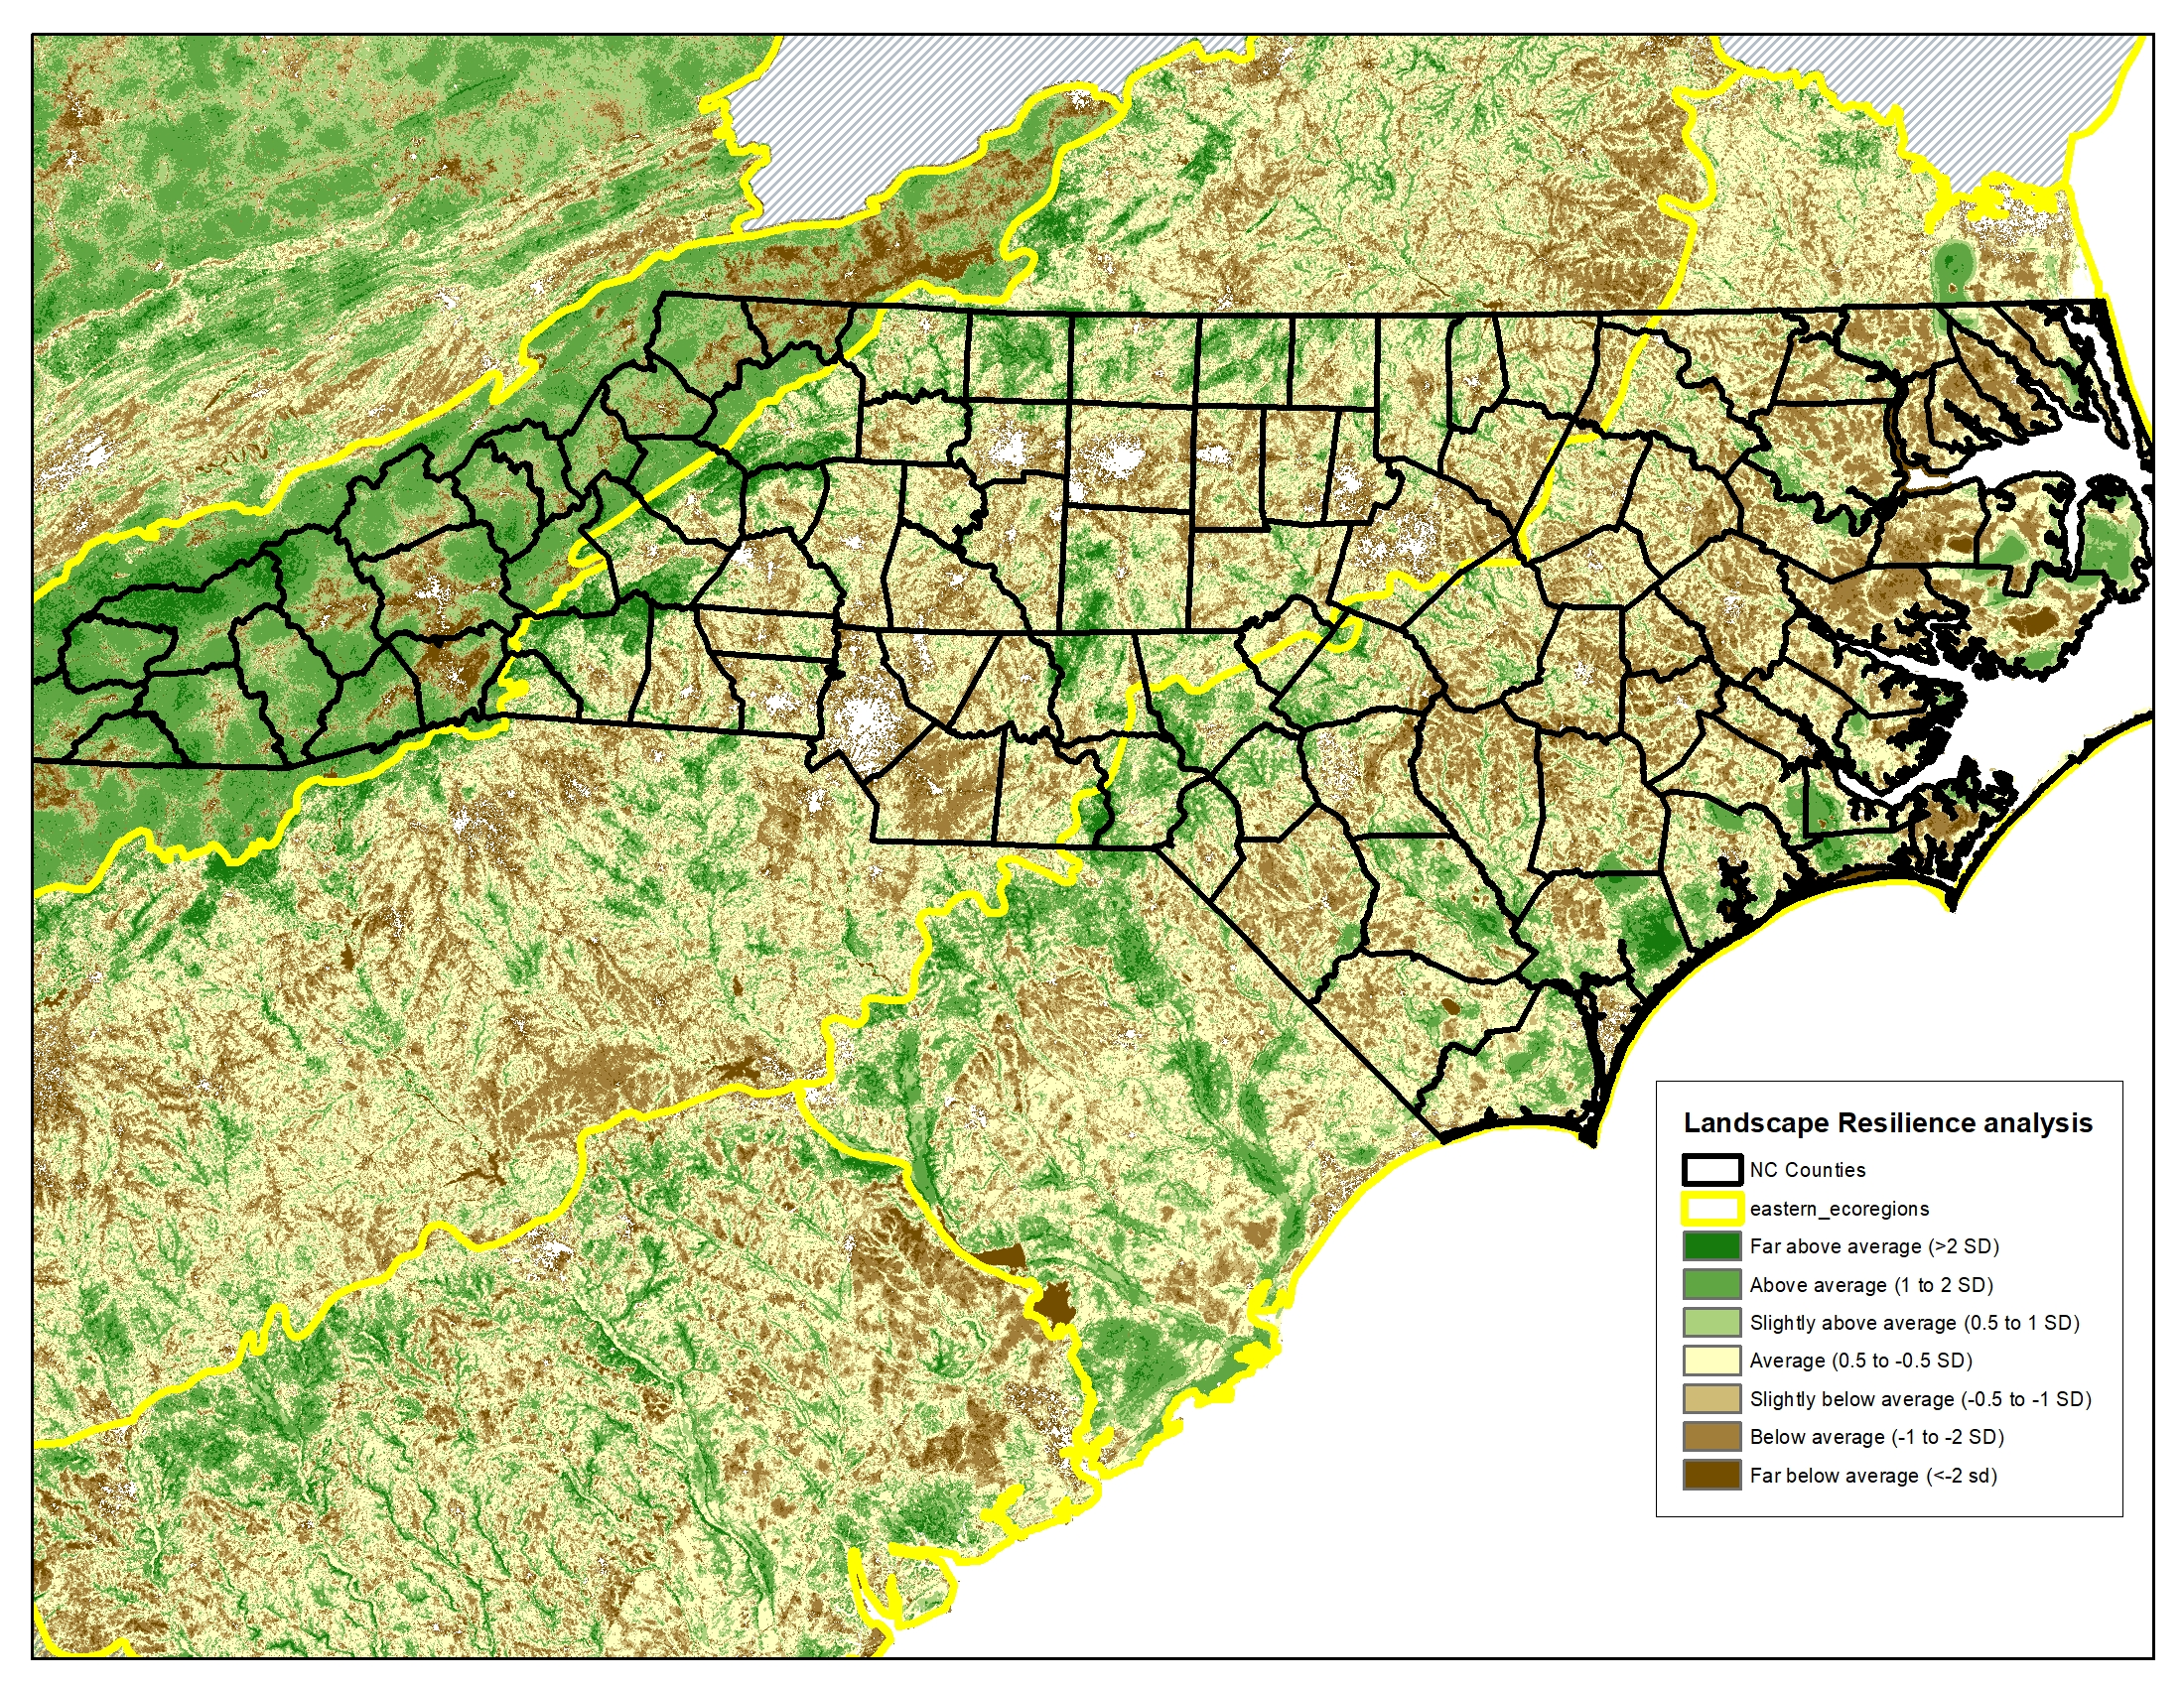

Slide 12
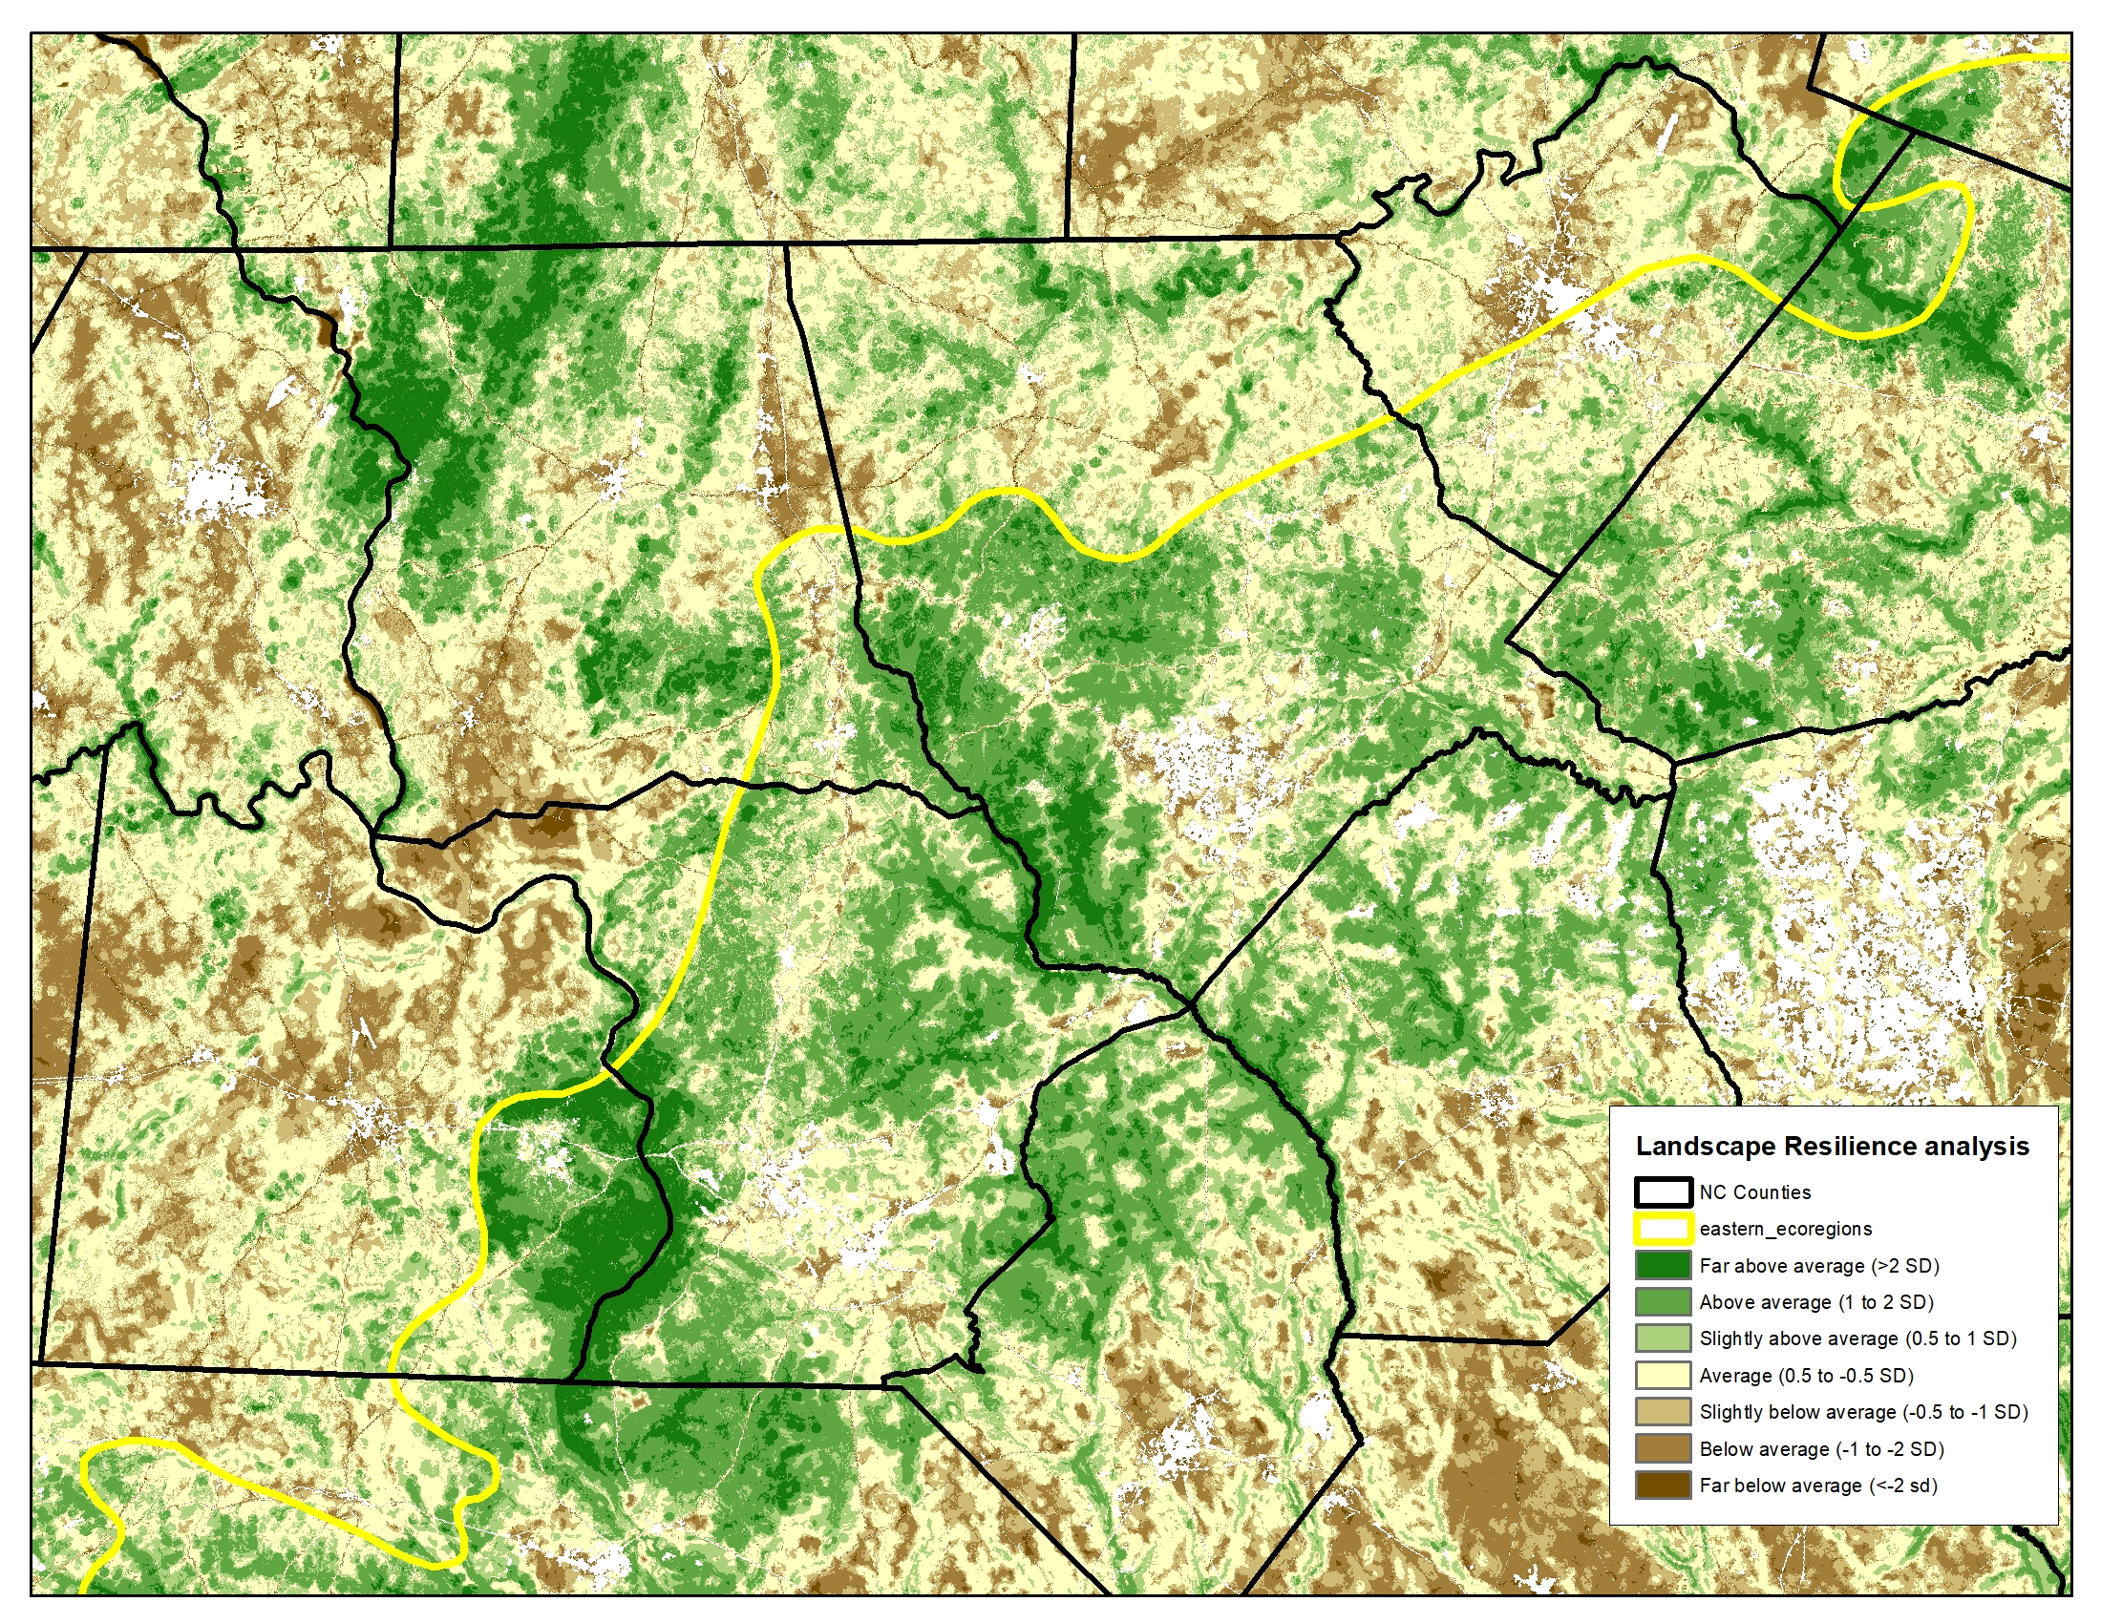

Slide 13
Bachman’s Sparrow predicted distribution
(Pickens et al 2017)
Current predicted distribution
Black = Predicted distribution
Gray = Protected areas
With Urban growth 2050
With Urban growth 2050 &
Green = additional distribution w/timber thinning
Pink = additional distribution w/burning

Slide 14
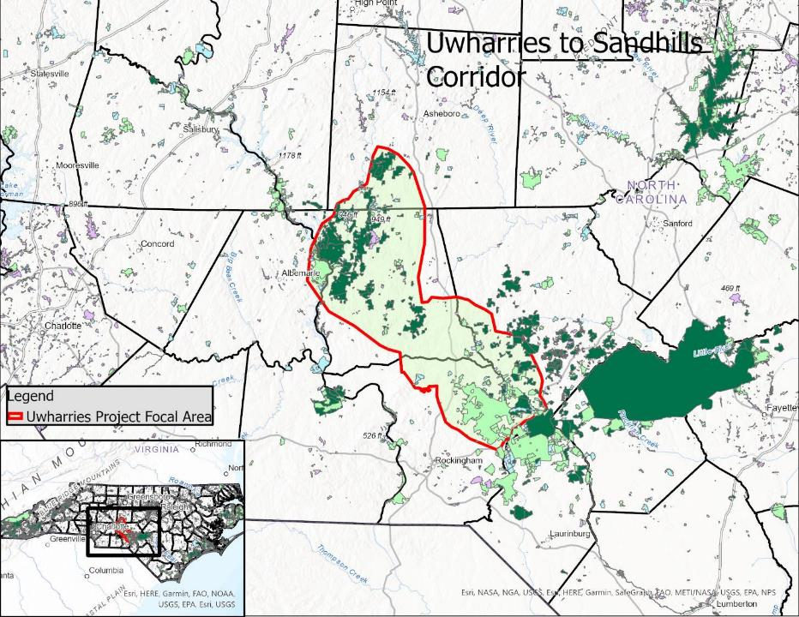

Slide 15
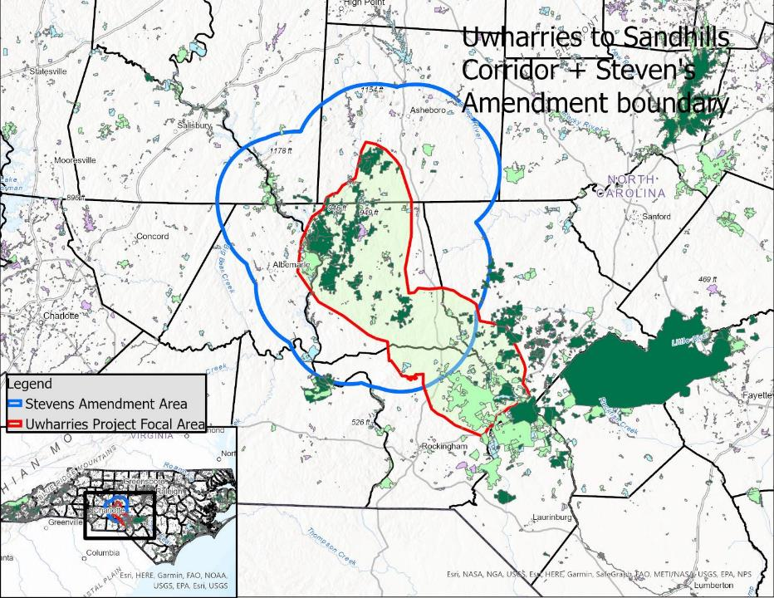

Slide 16
