Slide 1
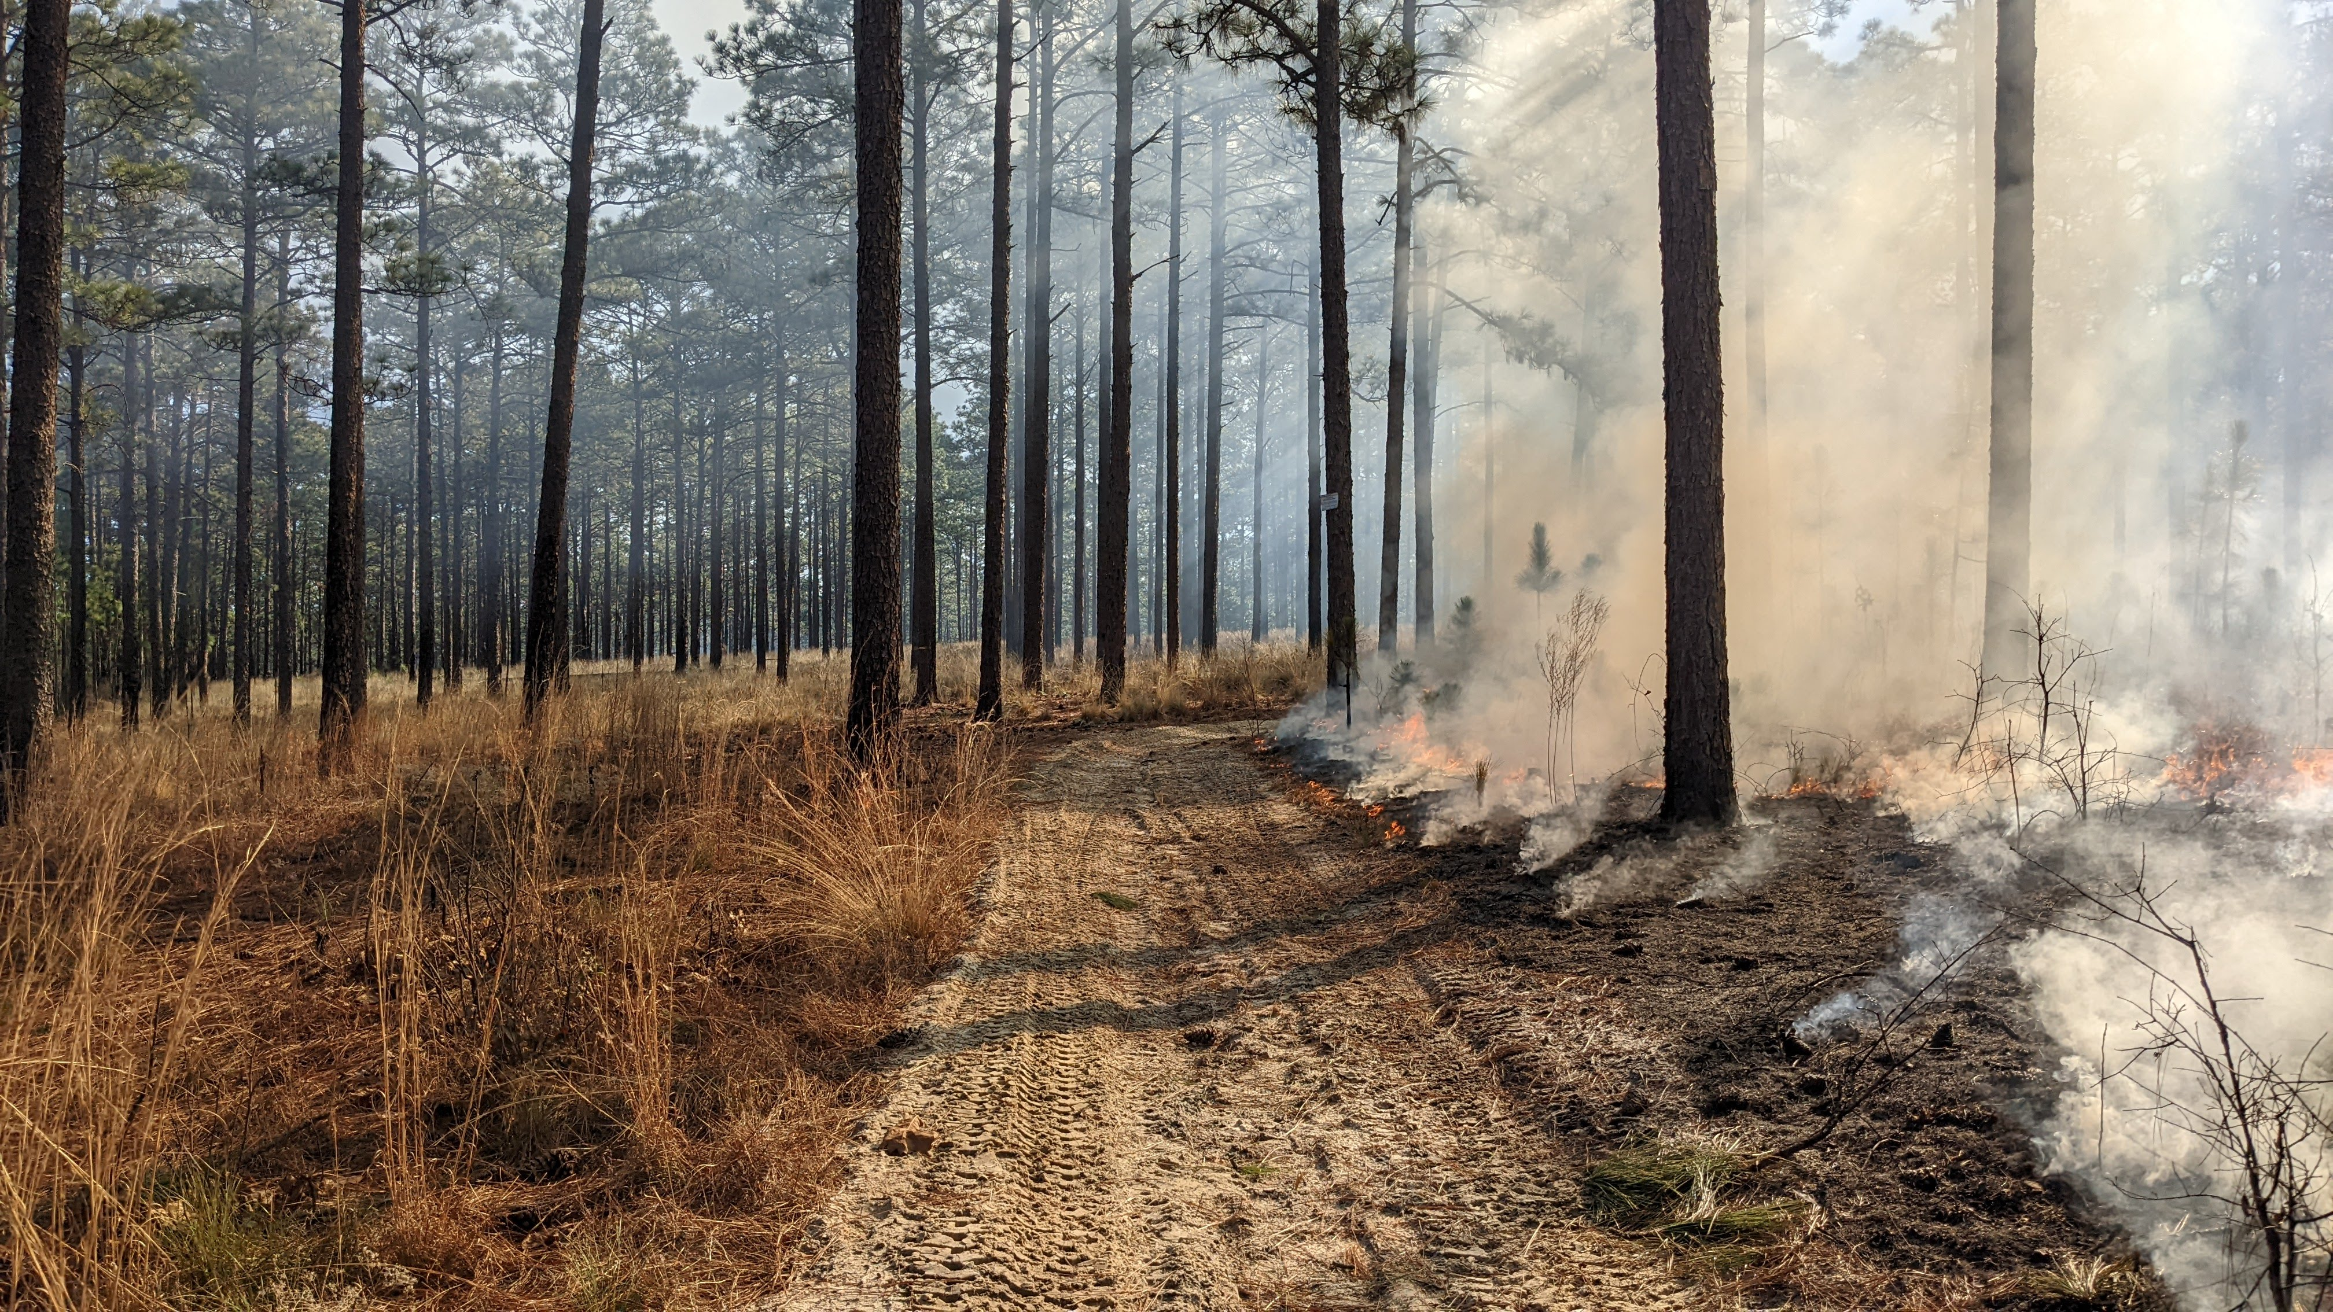
Air Quality

Slide 2
The Clean Air Act and National Ambient Air Quality Standards
(NAAQS)
6 Criteria Air Pollutants
Revised every 5 Years
Protect Sensitive Populations, No Economic Considerations
Most Critical for Smoke: PM2.5
  24 Hour Standard
  Annual Standard
Slide from Melanie Pitrolo
USFS Regional Air Program Manager

Slide 3
In February EPA Announced Revisions
Annual PM2.5 NAAQS was strengthened from 12 µg/m³ to 9 (25% lower)
This is a rolling 3-year average of 98th percentile 24-hr concentrations
No changes were made to the 24-hour standard of 35 µg/m³, however the Air Quality Index (AQI) thresholds did change
Green portions of AQI chart shrank and yellow portions expanded
Slide from Melanie Pitrolo
USFS Regional Air Program Manager

Slide 4
Notes:
21 Regulatory monitors are set to meet EPA standards, typically located around larger metropolitan statistical areas (MSAs).
Based on certified monitoring data from 2020-2022, all areas of North Carolina would have been meeting the new annual PM2.5 standard (9.0 μg/m3) during this time. Based on certified monitoring data for 2021-2023, Design Values for 19 of the 21 PM2.5 regulatory monitors are below the new annual standard (Fig. 2). The other two monitors (Mecklenburg, and Davidson counties) are slightly above the new standard due to the influences of Canadian wildfire smoke. Without the influence from Canadian wildfire smoke, none of North Carolina's monitors would have exceeded the new standard in 2023.

Slide 5
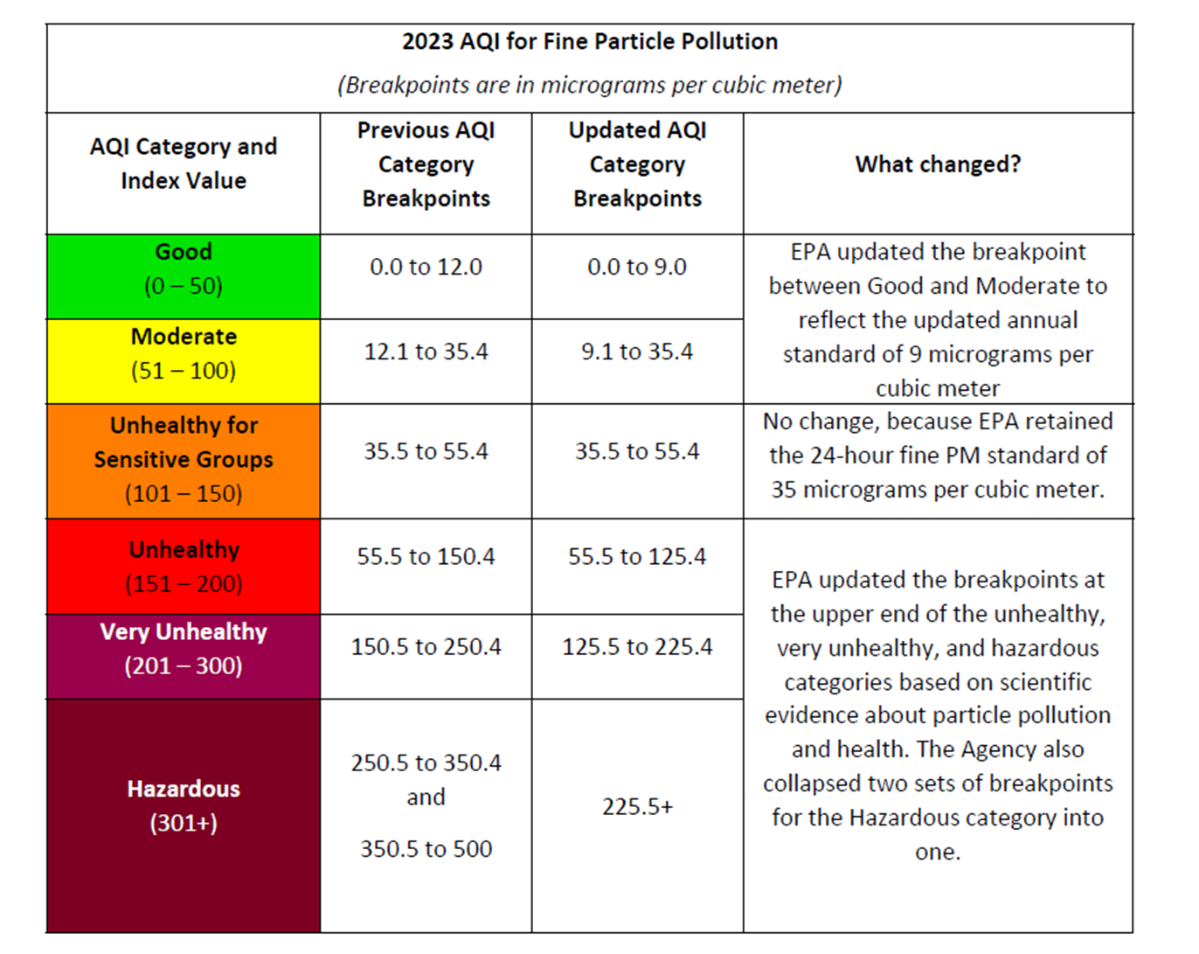
Slide from Melanie Pitrolo
USFS Regional Air Program Manager
Notes:
Here you can see the changes in AQI breakpoints

Slide 6
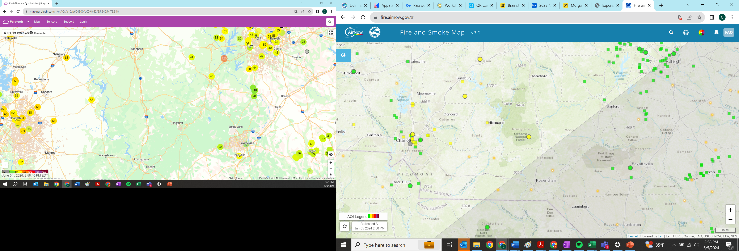
https://fire.airnow.gov/#
Notes:
Check AQI every morning prior to Ignition
If the AQI forecast for a given area is code Orange, Red, or Purple, it is highly recommended that burning not be done that day in that area.
DO NOT send smoke towards areas that are ORANGE, RED, or WORSE – even if burn location is GREEN

Slide 7
https://map.purpleair.com/1/mAQI/a10/p604800/cC0#11/35.7251/-81.6616
Notes:
The North Carolina Fire Environment Committee is looking at the gaps in PM2.5 monitoring across the state.
Pros
Having a monitor like the PurpleAir is a proactive step towards increasing public awareness of air quality.
Shows the EPA and public health staff that we are committed to caring about public health and where our smoke goes.
If burn bosses are following the NC Smoke Management Program, they should already be focusing on the air quality charts prior to their burn and not dumping smoke on population centers.
Fairly cheap to operate
Further engagement with PBAs to make sure they are aware of the sensor and the NC Smoke Management Program
Remember -- only regulatory monitors are used for regulatory decisions, such as calculation of exceedances.
Cons
We put a PurpleAir in Southern Pines and learn that our air is starting out an unhealthy point.
We unintentionally smoke out the monitor and put this area in non-attainment
We add additional burden to our burn programs to ensure we aren’t impacting the monitor

Slide 8
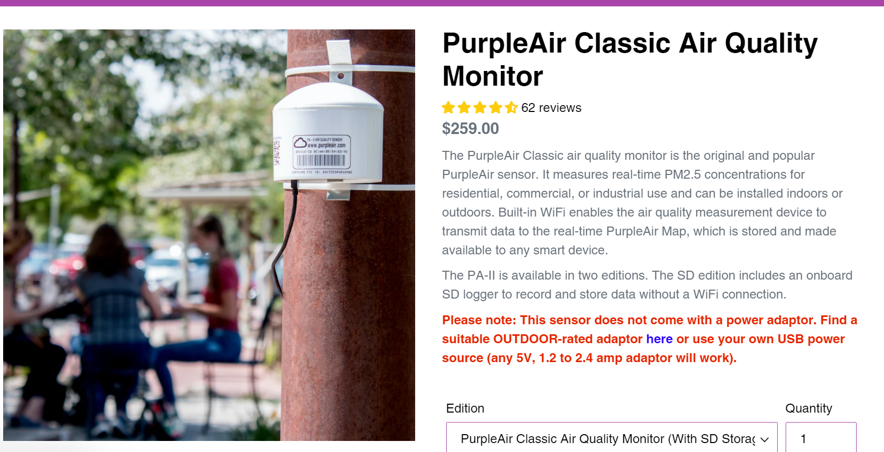
Notes:
~$300 to purchase a monitor and power adapter. Needs WiFi to be stored in the cloud and on the PurpleAir database, can also have data saved to an SD card and information call be pulled at a later time.
Classic PurpleAir PA-II particulate sensor
Pressure, Temperature & Humidity Sensor (BME280)
WiFi connectivity with data stored in the cloud

Slide 9
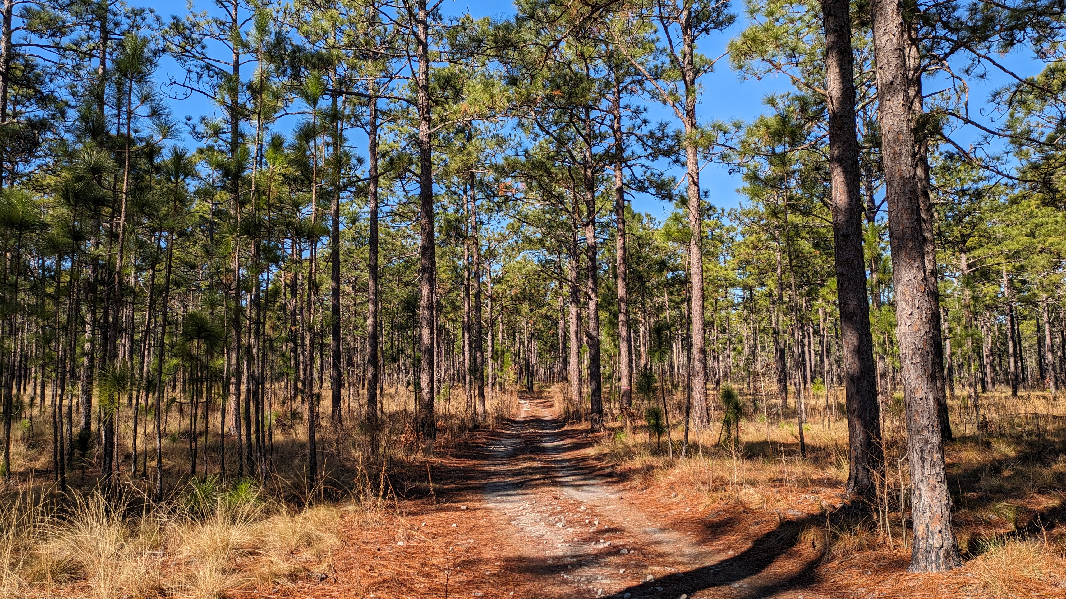
Next Steps:
Feedback from you!
Carmella Stirrat
Carmella.Stirrat@tnc.org
Notes:
The data does not have to be shared on the PurpleAir website, but it would make the information available to all partners doing RX work and private landowers.
Anyone have any feedback they would like to share with the group?

