Slide 1
Reserve Design Working Group
February 2016

Slide 2
Agenda
Welcome & Introductions
Conservation Planning/Prioritization
Finished Reserve Design Working Group Plan
Next steps
Research
Current
Future ideas

Slide 3
Conservation Planning
Current: potential upland area survey by Scott and Allison
Prioritize regions/parcels for conservation action or management
Identify corridors for key or a suite of species
State-and-transition models to examination effectiveness of specific conservation strategies

Slide 4
Conservation Prioritization Software
Combine all important features
Create targets for each
Assign weights/rankings to inputs
Use county parcel data as selection units
Assign costs and/or size limits
Create boundary penalty
Produces more compact reserve
Result: Prioritizes landscape for conservation action with known constraints

Slide 6
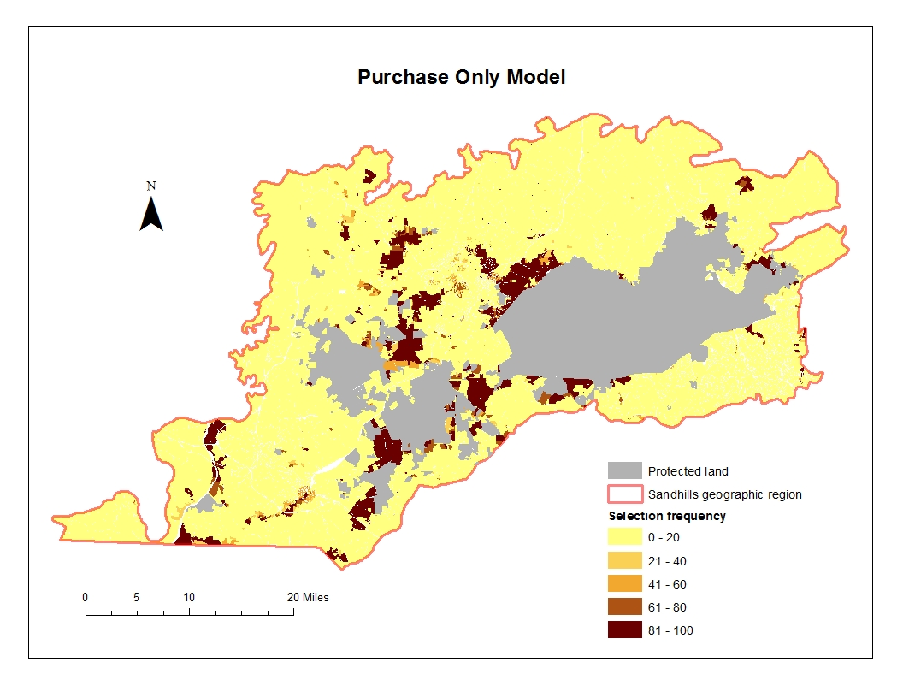
Prioritization Model for High Value Conservation Properties

Slide 7
Connectivity Analysis
Species-specific connectivity maps
USGS landcover data as base map
Select resistance values for different habitat types based on research or expert opinion
Combine all individual species maps to prioritize landscape

Slide 8
Connectivity for 12 Amphibian Species on Game Lands
Block B
Block T
Block C

Slide 9
State-and-Transition Model
Approach for describing and/or predicting vegetation change
Can be applied at any scale or ecological community
Well-suited for “what-if” analysis of possible future scenarios, including both management and natural disturbances
Identifies key unknowns, helping to direct future research and monitoring efforts
Potential collaboration with Jen Costanza at NC State

Slide 10
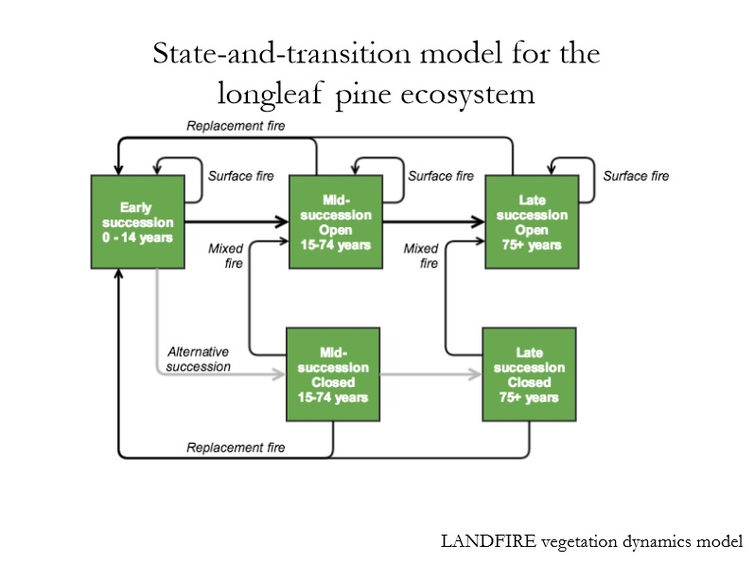

Slide 11
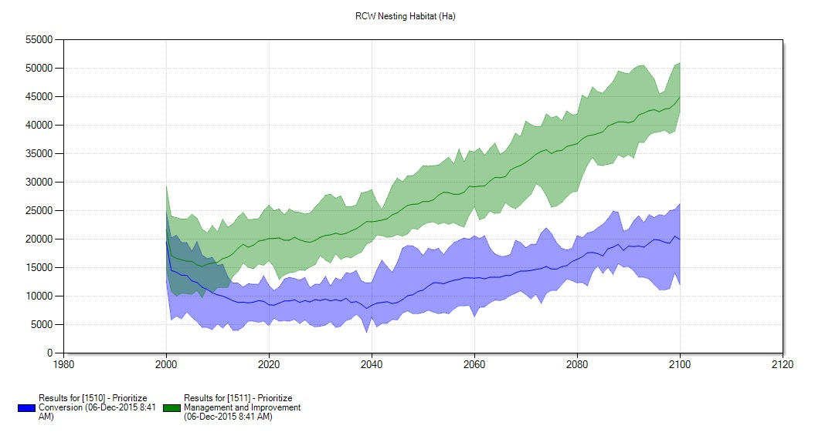
RCW Nesting Habitat (ha)

Slide 12
Conservation Planning - discussion
Prioritize regions/parcels for conservation action or management
Identify corridors for key or a suite of species
State-and-transition model to examination effectiveness of specific conservation strategies*
Other ideas?

Slide 13
Current Research
Habitat usage for pine barrens tree frog
Gopher frog captive breeding program
Relative importance of climate, habitat, and connectivity to amphibian population persistence
Continuing research on St. Francis satyr
Box turtle telemetry study at Weymouth Woods State Park

Slide 14
Research Opportunities
Partner with local universities/institutions
UNC Pembroke (chicken turtle)
Additional institutions could be contacted for interest
Specific ideas
Effects of fire seasonality on amphibians populations
Develop and ground-truth LIDAR model to understand forest structure across the landscape
Examine the potential threat of specific exotic species
Identify potential shifts in species’ ranges under climate change

Slide 15
Fire Seasonality
No empirical studies in longleaf pine
Some work on fire frequency
Anecdotal evidence dormant season burns negatively impact winter-breeding amphibians
Humphries and Sisson (2012) documented death of gopher frog to early season fire
Would require significant support from university

Slide 16
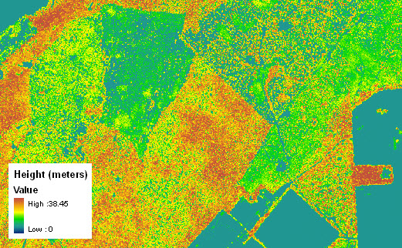
LIDAR Model
New raw data available for state
Determine signature of different forest structures
Calibrate with plots from wetland and upland monitoring
Help required from Doug Newcomb (FWS)

Slide 17
Exotic Invasion/Climate Change
Species distribution models
Need occurrence data across the range of the species
Climate and/or habitat data for model calibration and projection
For future projections, need future data

Slide 18
Exotic Species

Slide 19
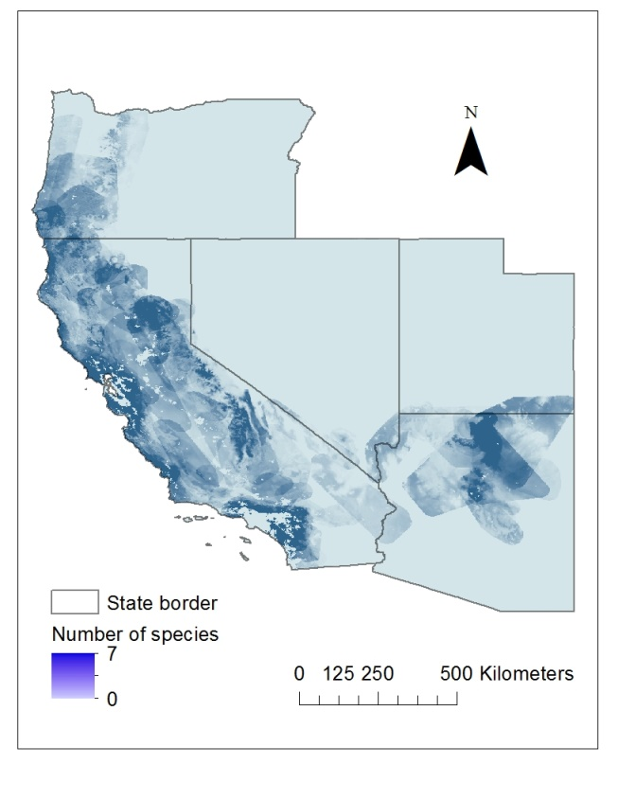
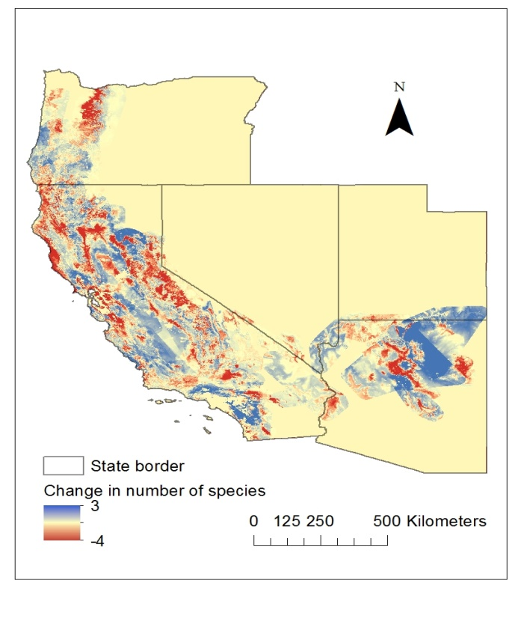
Climate Change
Current
Future
Turnover

Slide 20
Research Opportunities - discussion
Effects of fire seasonality on amphibians or reptile populations*
Develop LIDAR model to understand forest structure across the landscape*
Examine the potential threat of specific exotic species
Identify potential shifts in species ranges under climate change
Other ideas?

