Slide 1
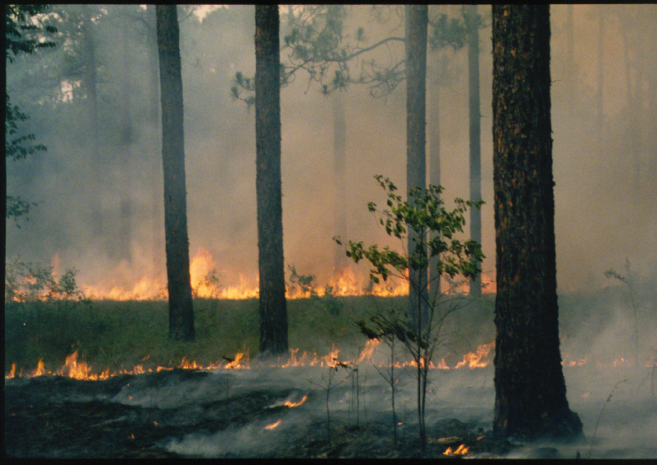
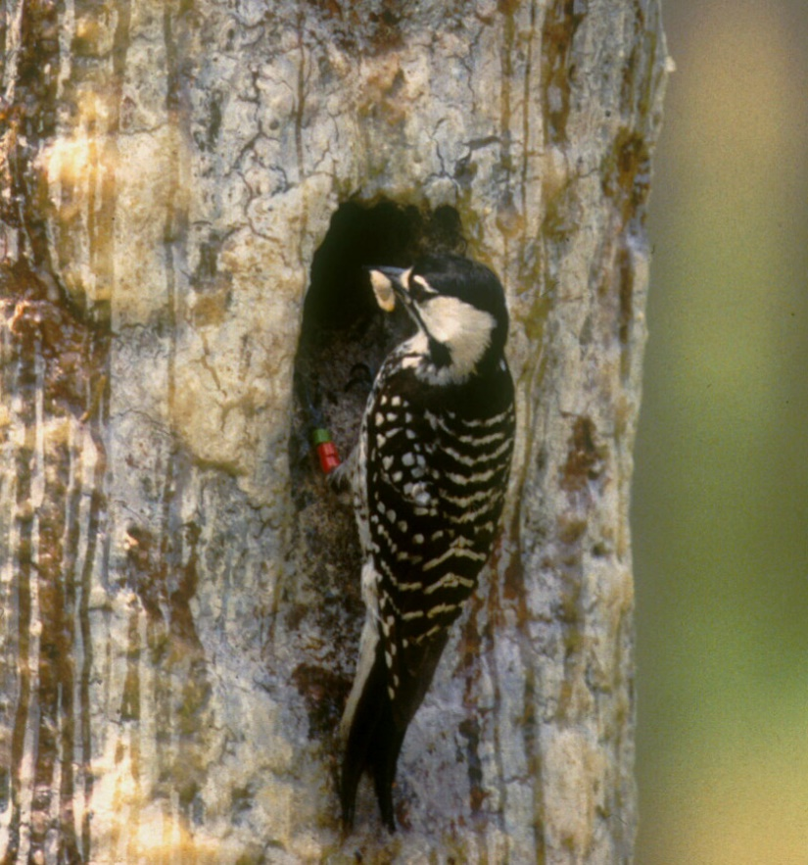
The Red-cockaded Woodpecker in North Carolina, 2023
Jeff Walters, Virginia Tech, 12/6/23

Slide 2
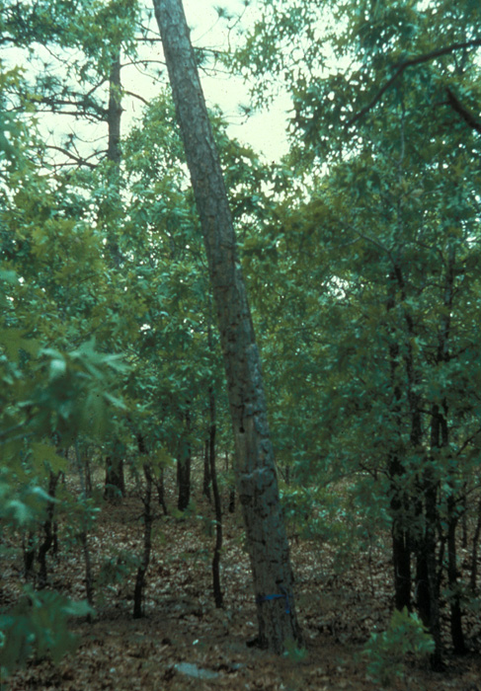
The Not Quite Recent Past
No reliable population estimate at time of listing
  1968/1970
Population reached low point 1980s, early 1990s
  Fire suppression, lack old growth / cavity trees
Recovery began 1990s with new management paradigm
  Prescribed burning, recruitment clusters, cavity management, translocation

Slide 3
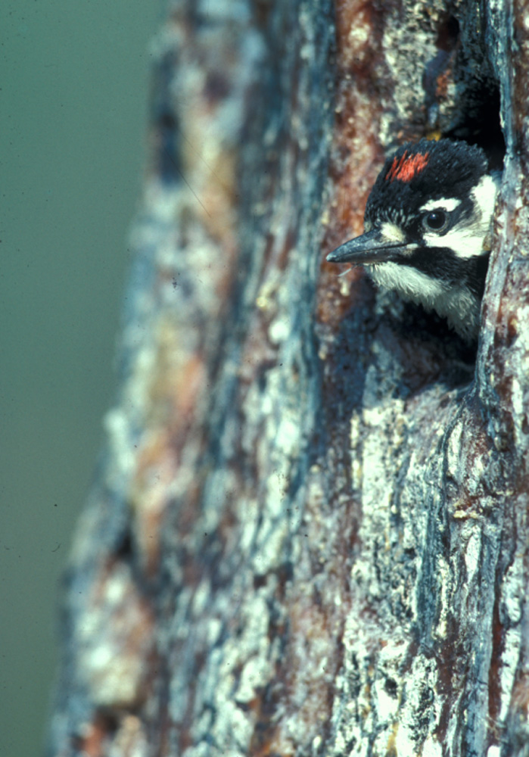
The Recent Past: 1998-2016
2003 Recovery Plan
  Uses 2000 population sizes
2018 Species Status Assessment
  Population growth 1998-2015/2016
Photo by Derrick Hamrick

Slide 4
North Carolina Populations in the 2003 Recovery Plan
Population | Type | Goal | 2000 Size
Coastal North Carolina | Primary Core | 350
Croatan National Forest |  |  | 62
Holly Shelter |  |  | 38
MCBCL |  |  | 59
Northeast North Carolina | Essential Support | 100 | 35
Sandhills East | Primary Core | 350 | 371
Sandhills West | Essential Support | 100 | 145
Sunny Point | Significant Support | 17 | 9
Bladen Lakes State Forest | Significant Support | 3 | 3
Jones Lake State Park | Significant Support | 4 | 1
Singletary Lake State Park | Significant Support | 6 | 4

Slide 5
SSA Analyses
Population | Goal | 1998 Size | 2015 Size
Coastal North Carolina | 350 | (160) | (231)
Croatan National Forest |  | 59 | 69
Holly Shelter |  | 42 | 38
MCBCL |  | 59 | 124
Northeast North Carolina | 100 | ? | 51 (85)*
Sandhills East | 350 | (516) | *781
Sandhills West | 100
Sunny Point | 17 | 6 | 19
*Corbett property | NA | ? | 22
Bladen Lakes State Forest, Jones Lake State Park,
Singletary Lake State Park not analyzed

Slide 6
Current Status
Sunny Point (MOTSU): slight increase
  19 active clusters 2015, 22 in 2023
  Part of larger population that includes private lands (Boiling Springs Lake, Orton Plantation, Sprunt property) and TNC Orton Creek Preserve
  Current total population size 46-47 (possibly more)
Bladen Lakes State Forest, Jones Lake State Park, Singletary Lake State Park
  Considered one population
  Current population size 16 active clusters (12 on Bladen Lakes), exceeds population goal in Recovery Plan (13)

Slide 7
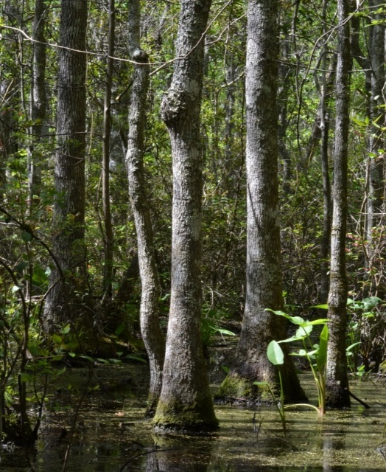
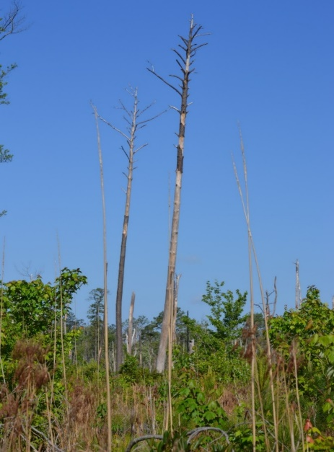
Northeast North Carolina
Swamp-dwelling RCWs
Difficult manage, monitor, estimate population size
2017 estimate based new helicopter surveys = 126 (nearly 50% increase over 85 previously known clusters), almost certainly an underestimate
Beyond Recovery Plan population goal (100), almost certainly more
B

Slide 8
Coastal North Carolina

Slide 9
Sandhills
PBG = potential breeding group, typically fewer than active clusters

Slide 10
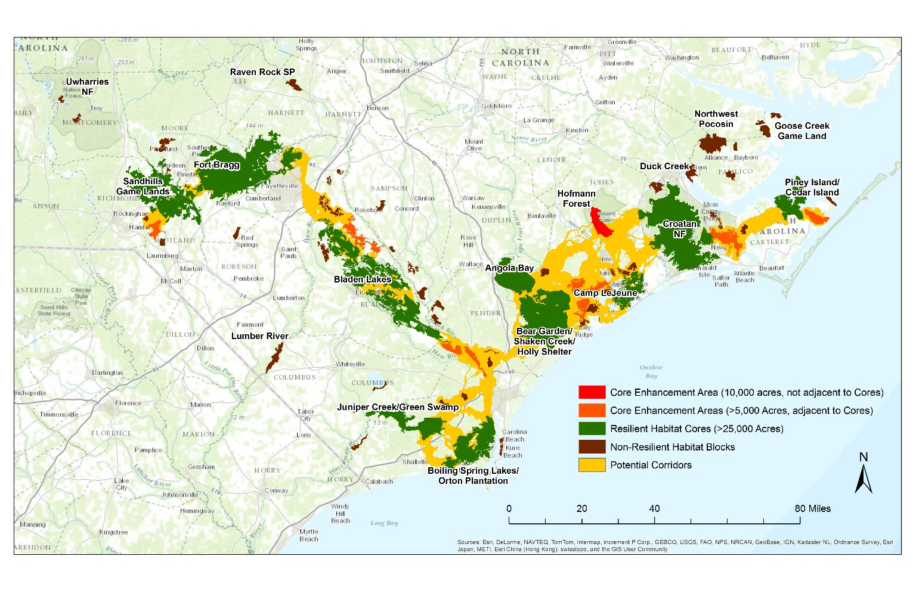
The Corbett Property
Among the top 5 populations in North Carolina
Critical to envisioned longleaf corridors (TNC)
Currently being sold off – high conservation priority

Slide 11
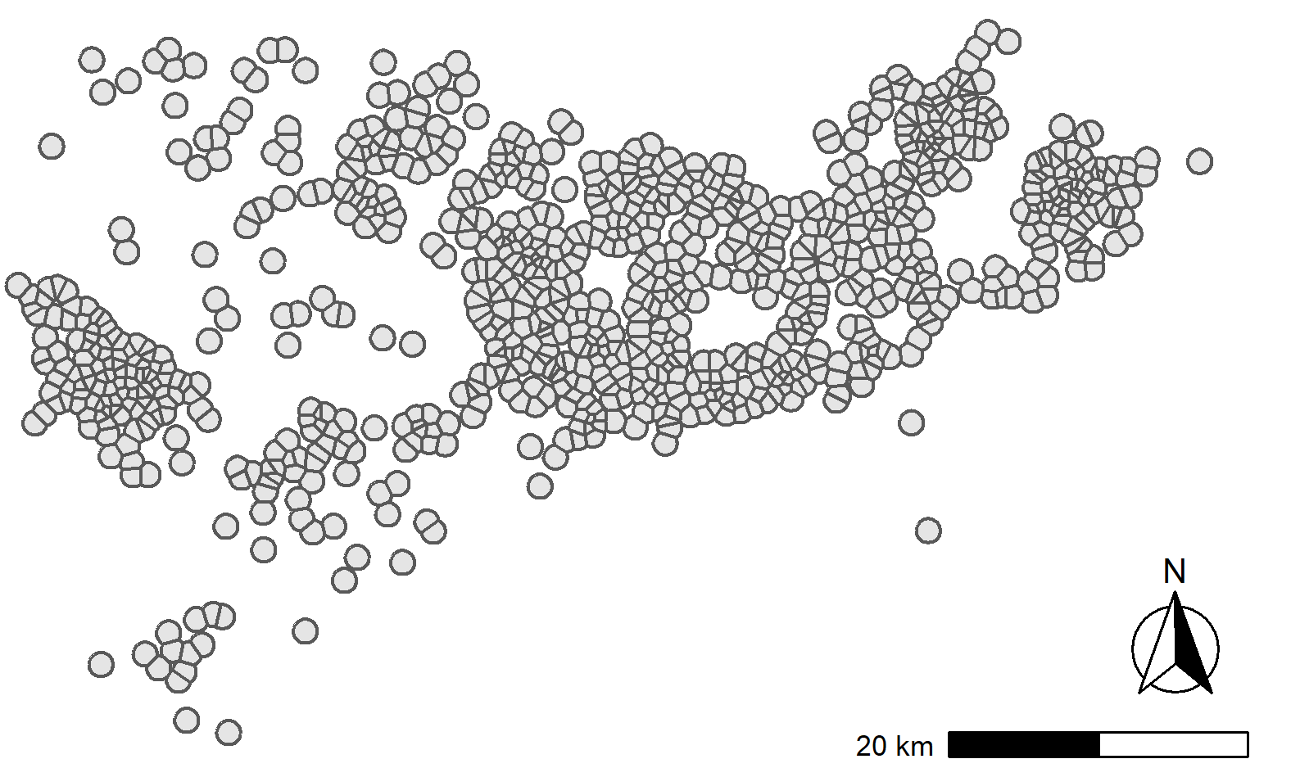
The future: potential for further growth
Habitat available for growth some places (CNF)
Others growing through increased density

Slide 12
The Future: Changes in Management?
Down-listing pending
  (5 years+ post-SSA)
How will requirements, management change?
Initial outcome of Fort Liberty tank range construction
  6 clusters housing 5 PBGs cleared
  7 new recruitment clusters created for displaced birds
  2 PBGs moved to recruitment clusters, 1 to previously existing cluster, 2 completely disappeared (4 adults + 3 fledglings each): net loss 3 PBGs
  2 new PBGs occupy recruitment clusters: net loss = 1

Slide 13
The 2023 Bottom Line for NC RCWs
2 large populations getting larger: Sandhills, Coastal Plain (MCBCL, CNF, Holly Shelter)
1 large population likely doing well, but hard to monitor: Northeast North Carolina
3 small populations with potential to persist and possibly increase, but facing challenges
  Bladen Lakes still very small
  Sunny Point/Boiling Springs Lake facing development pressure on private land component
  Corbett very small, future of property unclear

Slide 14
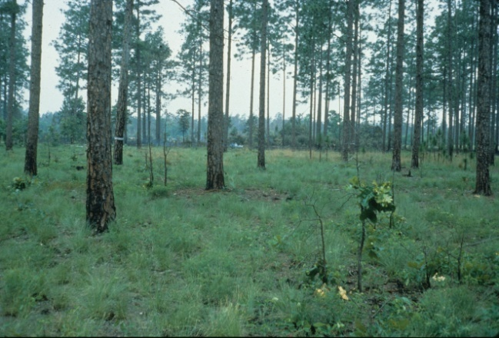
Questions?

