Slide 1
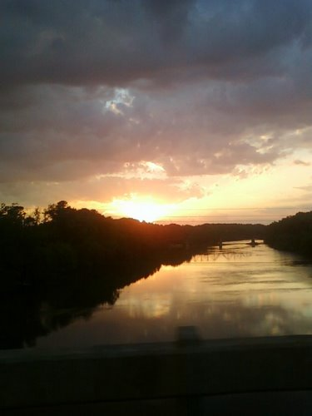
Harnett County
Harnett County Updates

Slide 2
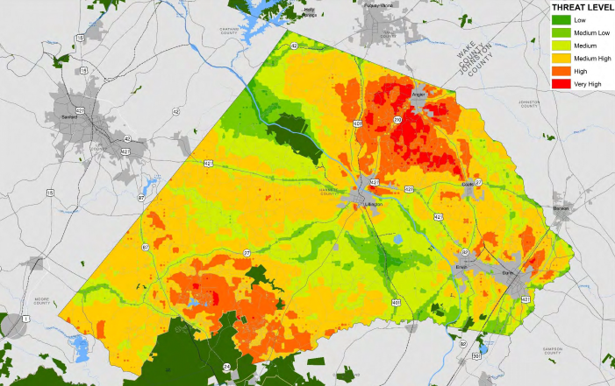
Residential Growth
Impact Areas
Notes:
Raleigh-Durham market is the 2nd hottest real estate market in the nation. Charlotte is the 4th. According to the NC Chamber, NC is positioned to be the 7th largest state in the nation by 2030.

Slide 3
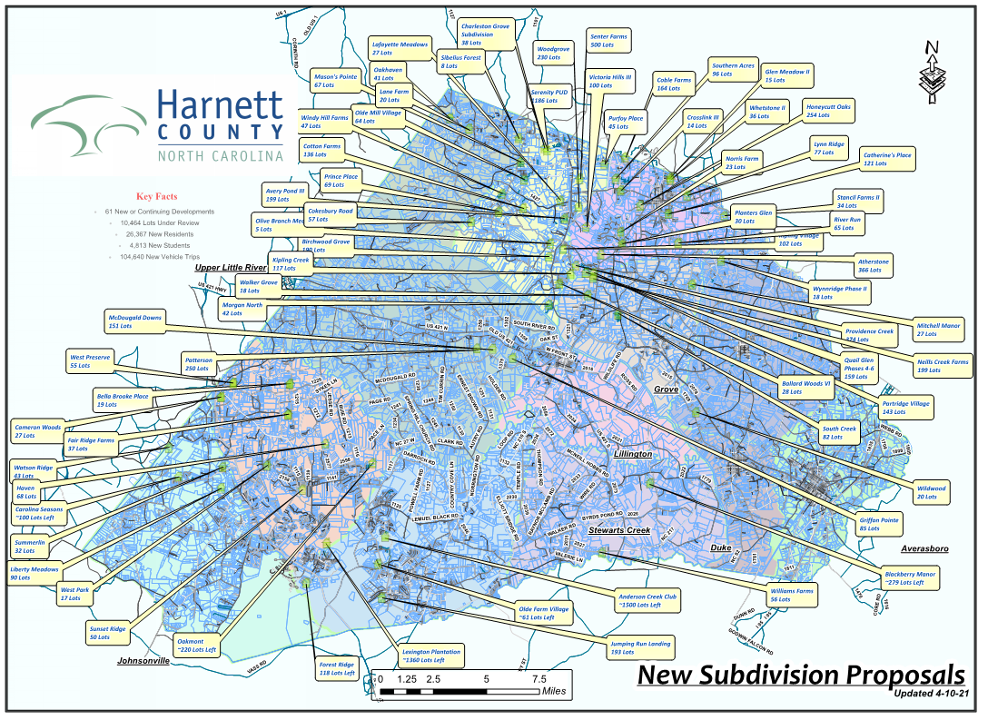

Slide 4
Conservation Efforts…
1,000+ acres preserved open space within new developments
17,800+ acres within Conservation zoning overlay
NC WRC Partners for Green Growth grant to help incorporate high value natural areas and habitat preservation into our 2015 Comprehensive Plan.
These areas traditionally dovetail into floodplains, wetlands, watersheds, and other critical zones so these will be referenced within the plan.

Slide 5
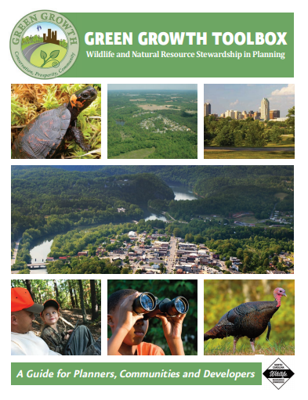
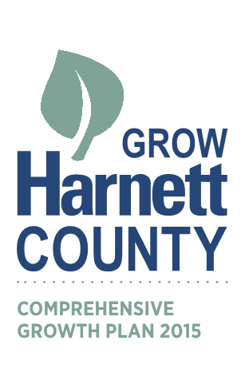
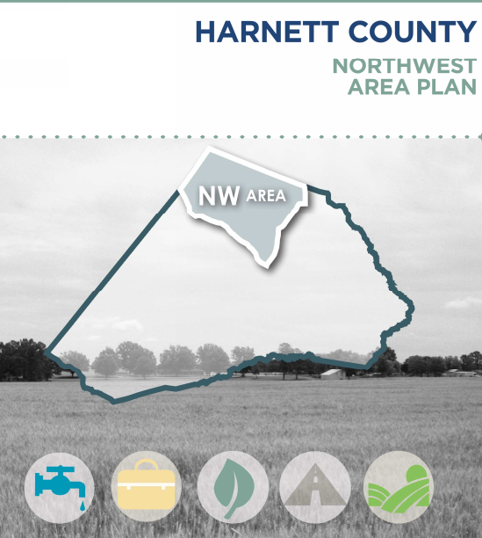
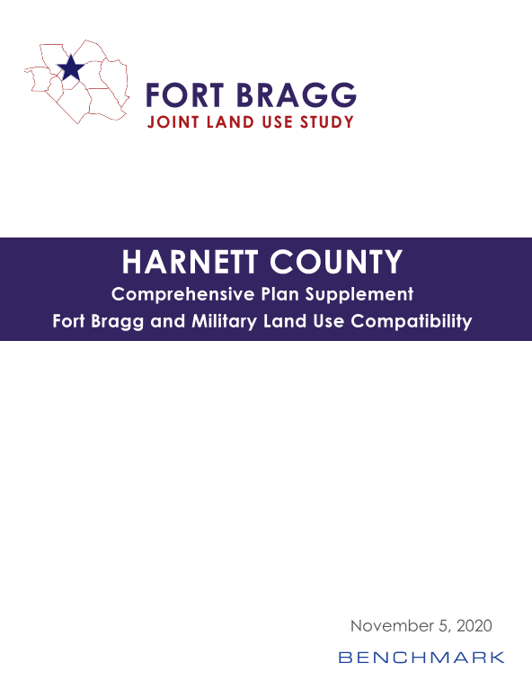
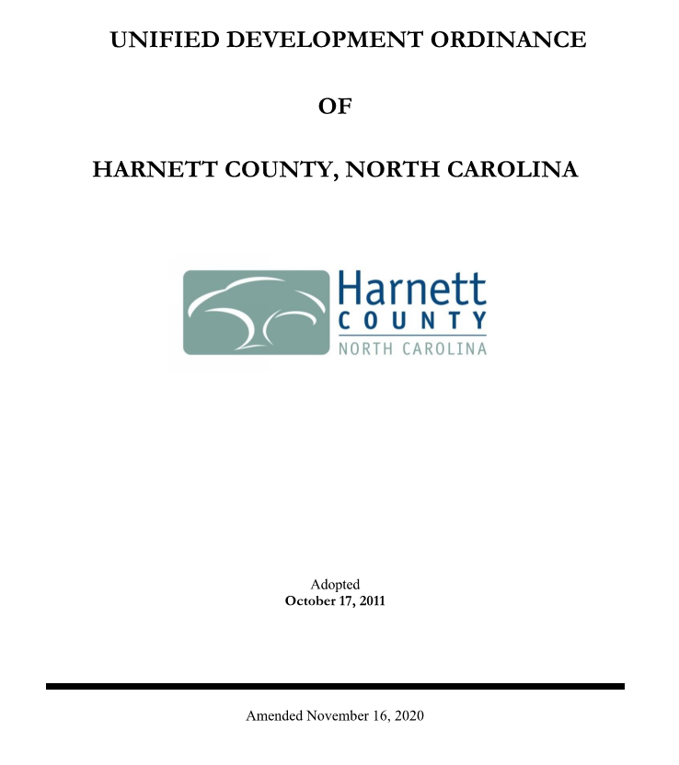
Harnett County: Plans & Studies
Harnett County Updates

Slide 6
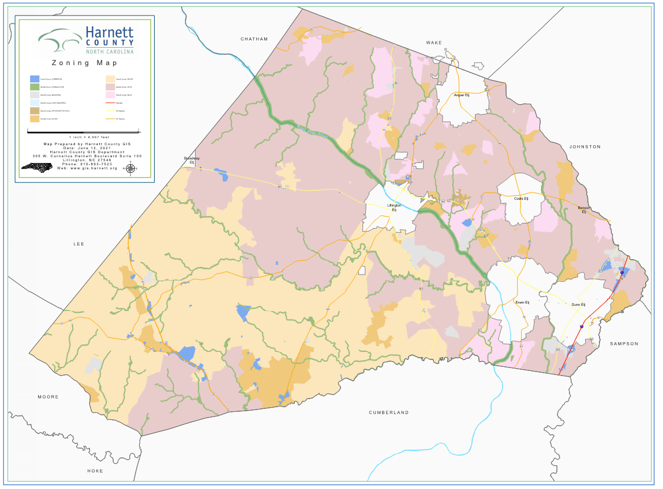
17,400+ acres within Conservation overly.
Cape Fear River = 500’
Black River = 300’
Other Rivers &
Streams = 200’

Slide 7
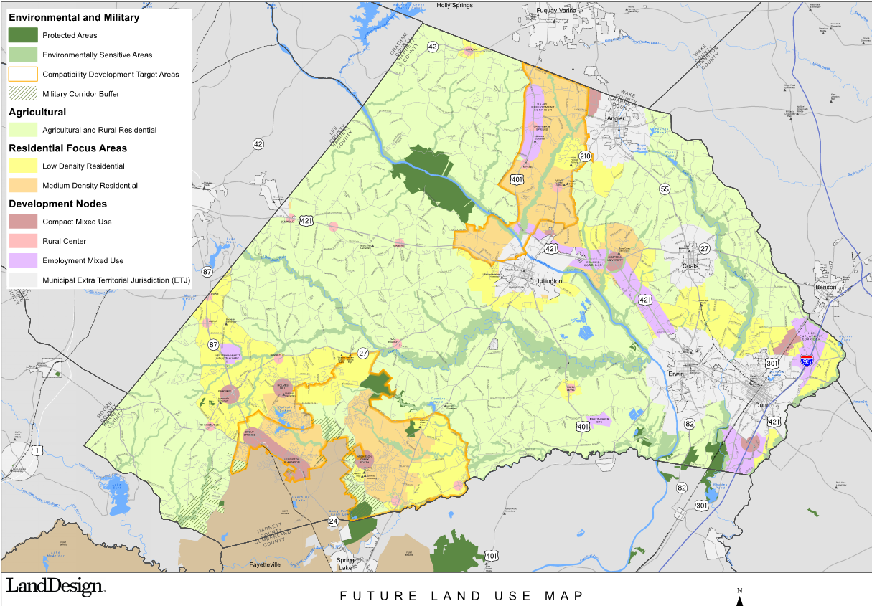
Land Use
Notes:
Raleigh-Durham market is the 2nd hottest real estate market in the nation. Charlotte is the 4th. According to the NC Chamber, NC is positioned to be the 7th largest state in the nation by 2030.

Slide 8
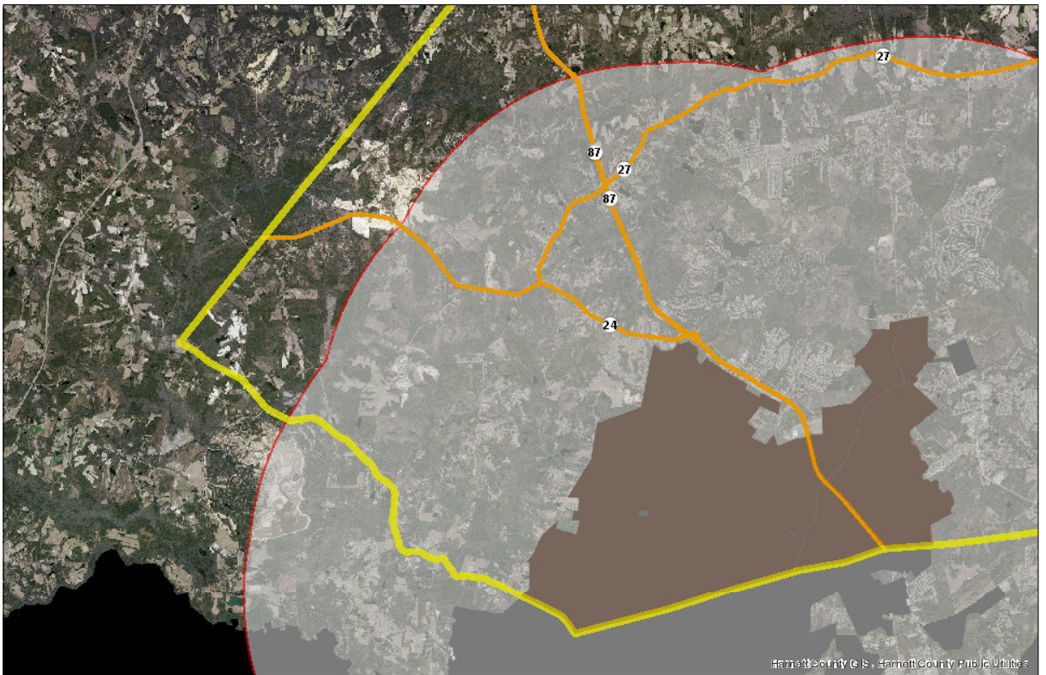
5 Mile Military Buffer

Slide 9
Military Efforts…
Approximately 83,000 acres within Harnerr’s 5 mile Military Buffer
Approximately 15,000 acres of Federally owned property in Harnett County
Send development applications to RULAC for review & comment.
Future UDO text amendment to include updated JULUS language
Development Notification on all non residential site plans and major subdivision
“This development is within the five mile Military Corridor Overlay Zone, and may be subject to military training activities.”

