Slide 1
Managing metapopulations of threatened species across jurisdictional boundaries: quantifying effects of climate change, environmental synchrony, dispersal, and corridors
Principal Investigator: William F. Morris
Lead Organization: Duke University

Slide 2
Project Team
William Morris and Natalie Kerr (postdoc), Duke University
  Project coordination; VFT/RCW/SFS demography
Erik Aschehoug, Norwegian University of Life Sciences
  SFS restoration
Nick Haddad, Michigan State University
  SFS restoration
Gina Himes Boor, Montana State University
  Spatially explicit individual-based modeling (RCW/SFS/VFT)
Allison Louthan, Kansas State University
  VFT and RCW demography
Jeff Walters and Traci DuBose (postdoc), Virginia Tech
  RCW demography
VFT = Venus flytrap
RCW = red-cockaded woodpecker
SFS = St. Francis satyr (butterfly)

Slide 3
Collaboration across jurisdictions allows:
Assessing population synchrony
Managing connectivity between populations
Determining if/how new habitat can be created
Substituting space for time to gain insight into factors driving demography of threatened species

Slide 4
Our Focus: Three Species Endemic to Longleaf Pine Ecosystems
Notes:
Main goal is to provide quantitative tools to improve cross-jurisdictional mgmt.; tools applicable beyond SE US
Tools will account for:
external factors: environmental synchrony; climate change; land use change (including restoration)
internal factors: demographic sensitivity to climate and management; dispersal
Specific goals: determine optimal frequency and spatial arrangement of restoration
guide construction of multi-species corridors to link populations on/off DoD lands

Slide 5
Population synchrony:
Positive correlation BAD for metapopulation persistence (red year bad in both nearby sites J1 and J2)
Weak (or better, negative) correlation GOOD for meta- population persistence (red year not bad in far site J3) [THINK DIVERSI-
FIED INVESTMENT STRATEGIES!]
Notes:
Conceptual background: Synchronous environmental fluctuations degrade the safety gained by having populations in multiple jurisdictions, because when bad years are shared across jurisdictions, all populations may go extinct simultaneously. But we expect synchrony to decline with the distance between jurisdictions (due to more independent climate fluctuations, etc.). Because lack of synchrony is so important for the advantages of multiple jurisdictions, we will assess the spatial scale of synchrony for our 2 focal species (RCW and SFS) that have multiple populations

Slide 6
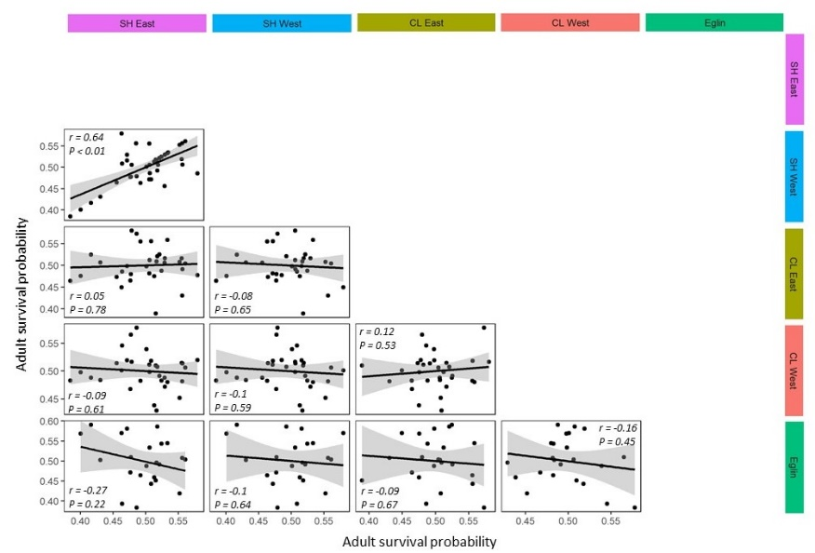
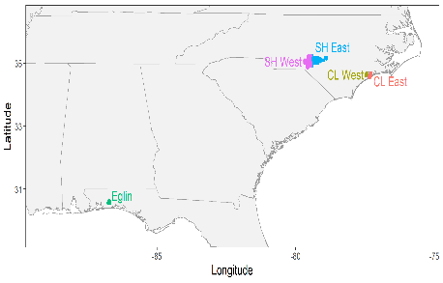
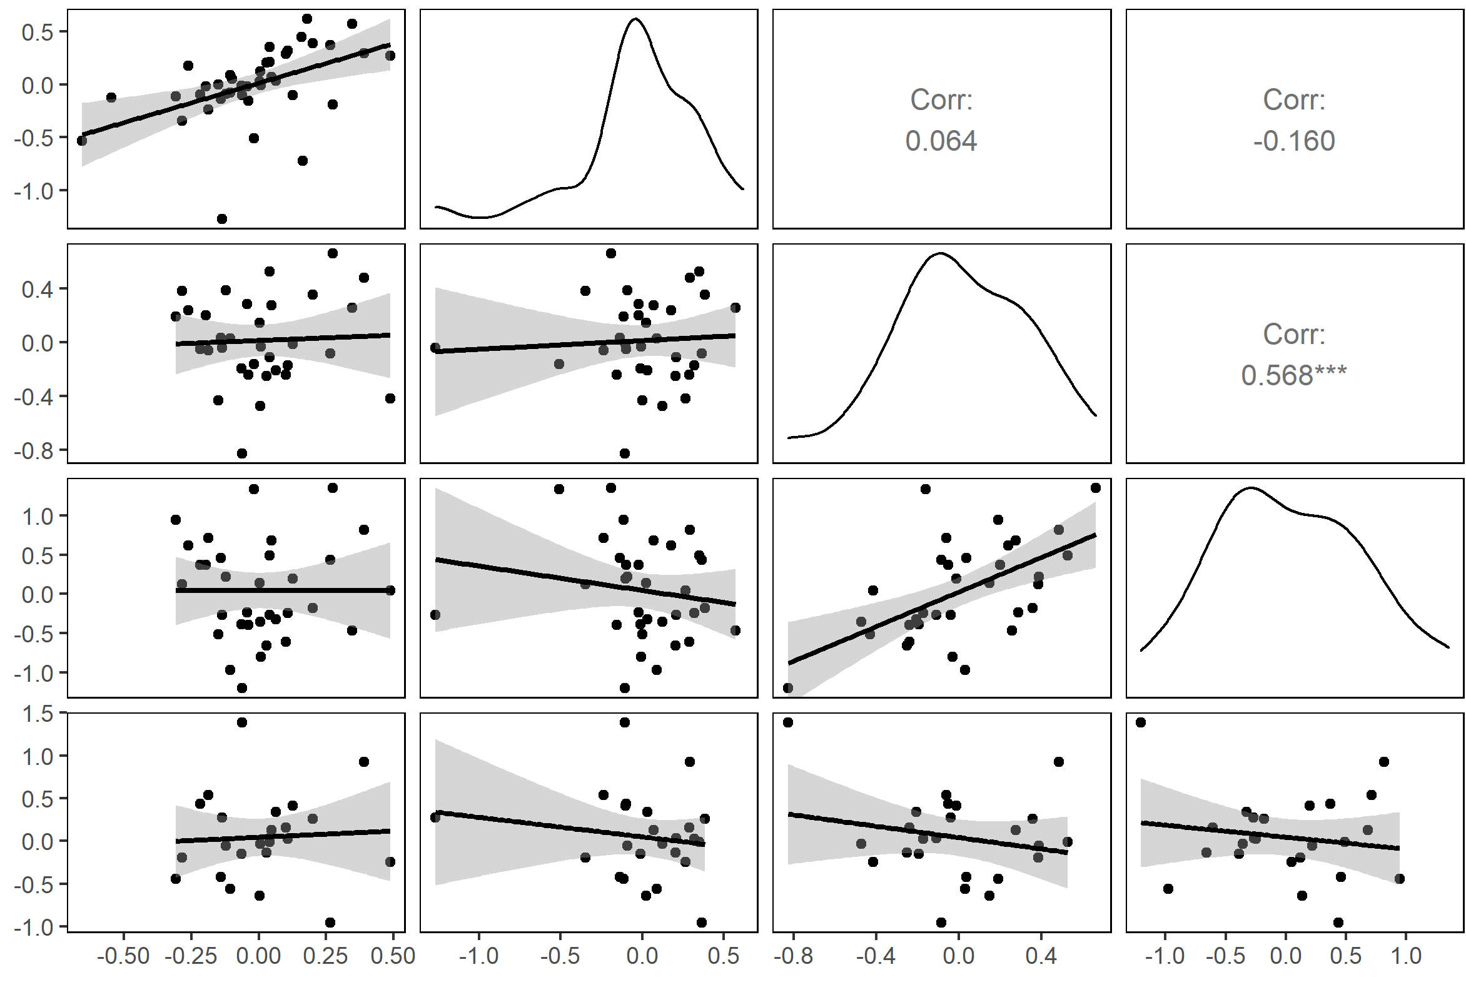
RCW Demographic Synchrony: Short-Distance Only
Population 1
r₁₀
Demographic rate
Population 2
0.48**
r₁₀
Year
Scatterplot:
Detrended Residuals
Residuals, adult breeder survival probability
Residuals, Pop. 2
0.43*
Residuals, Pop. 1
Residuals, adult breeder survival probability

Slide 7
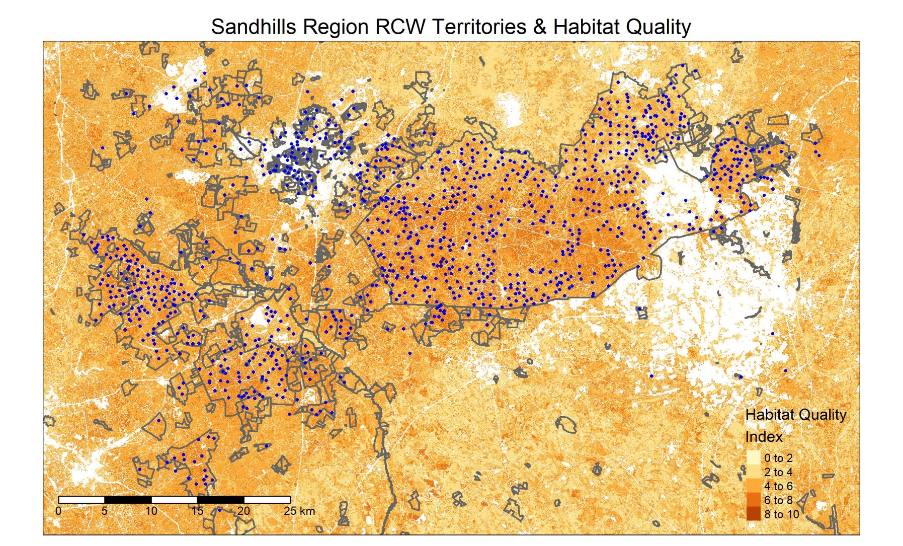
RCW: Managing connectivity between populations
Camp Mackall
Fort Bragg
Sandhills
Gamelands
Incipient dispersal corridor
Notes:
The bordered areas represent managed land (e.g., federal, state, and local government lands; reserves; land with easements, safe-harbor agreements, etc.) that may offer some level of protection for RCW
HQI – habitat quality index is from TNC based on model analysis showing quality of pine habitat (not exclusive to LLP, but is a pretty good surrogate). In the SEIBM we will use the HQI data to modify RCW movement, territory establishment and size, & likelihood of males staying in natal territory
The incipient corridor is an area prioritized by RCW working group and others
Under Coding Model I just put a few parts of the model that will be different than the original model – other things we could emphasize: the potential for the model to be user-friendly and provide a hands-on tool to explore what-if scenarios (one version of the old model was made to do this, but is no longer supported by the ArcGIS software it was linked to)

Slide 8
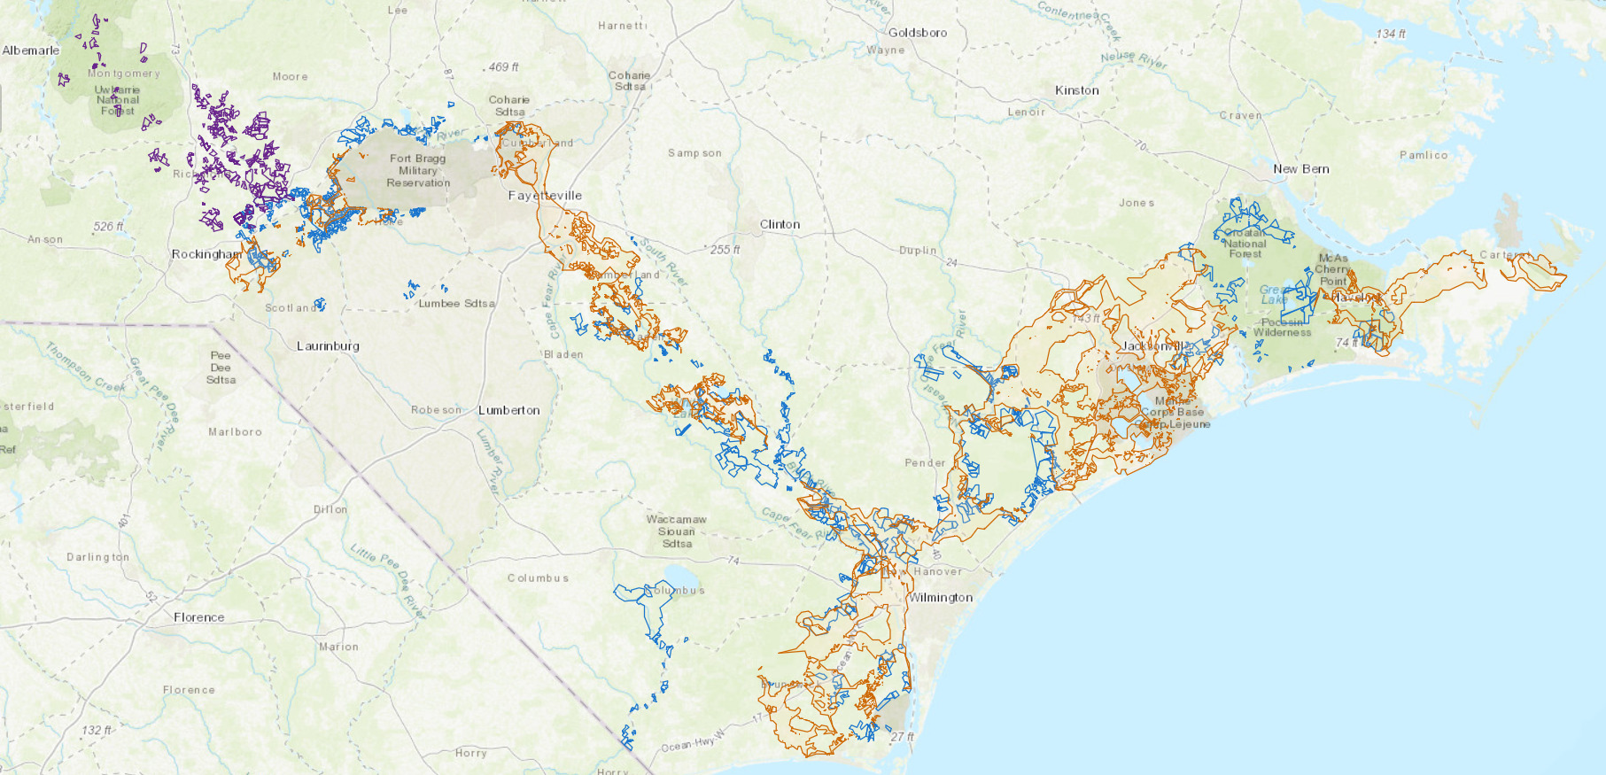
Larger-Scale Connectivity of RCW Populations
      Sandhills to Uwharrie
      Ft. Bragg to Sandhills
      Croatan to Holly Shelter
Notes:
Biggest picture: linking RCW management across the multiple jurisdictions with interest in managing long-leaf pine areas in North Carolina, which include:
multiple DoD bases (Bragg and Lejeune)
two national forests (Uwharrie and Croatan)
multiple NC State jurisdictions (gamelands, etc.)
NGOs (TNC)

Slide 9
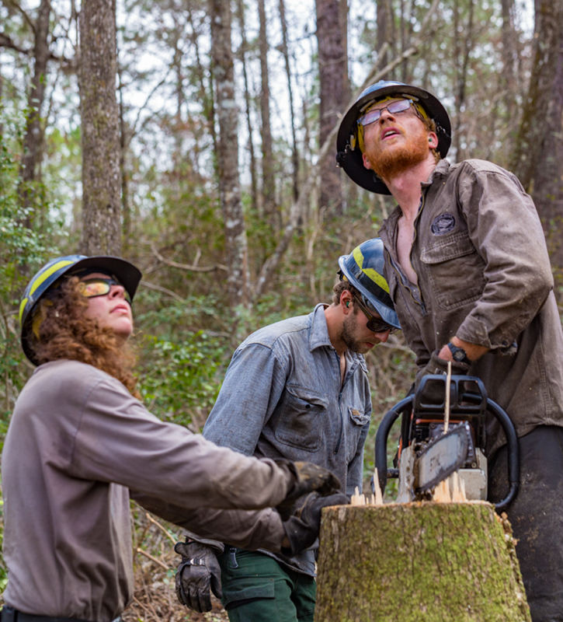
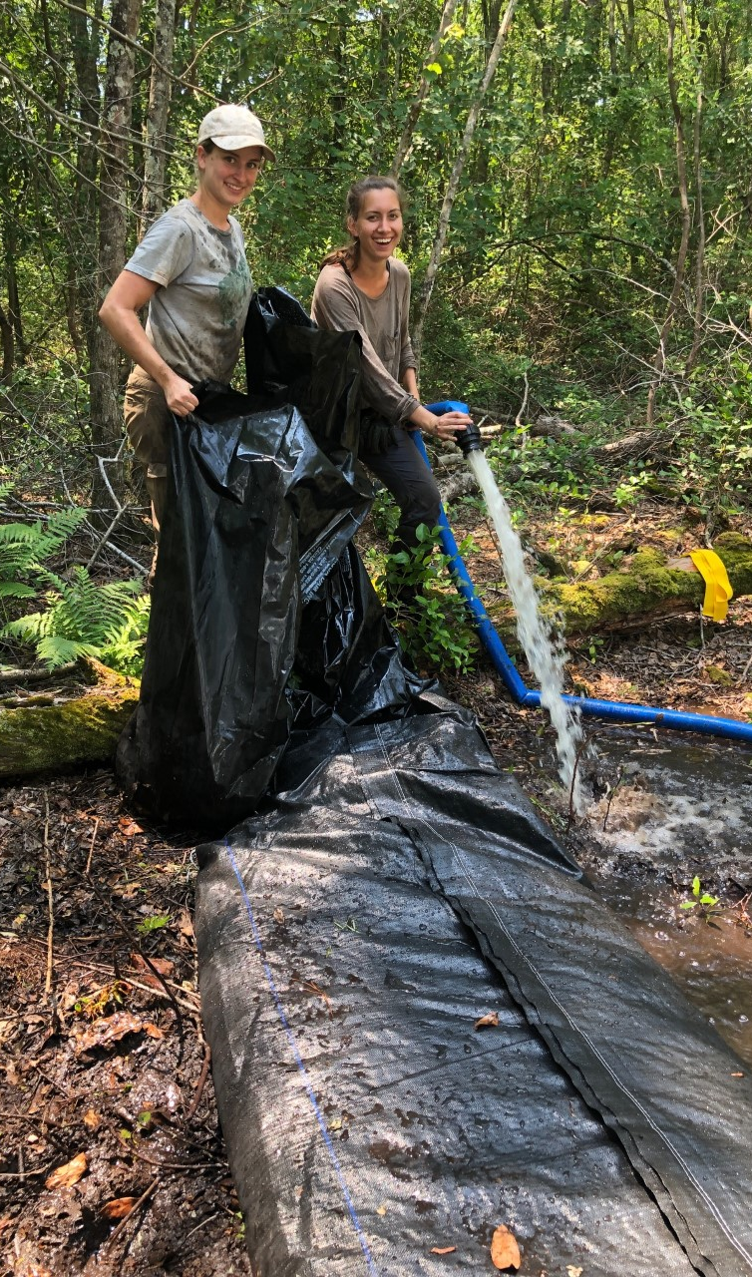
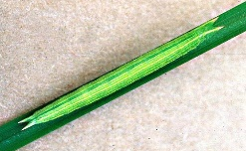
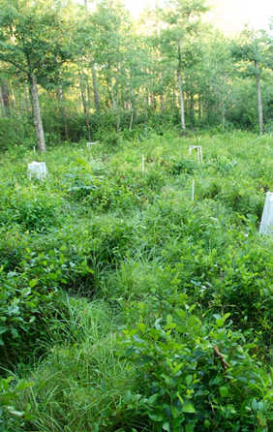
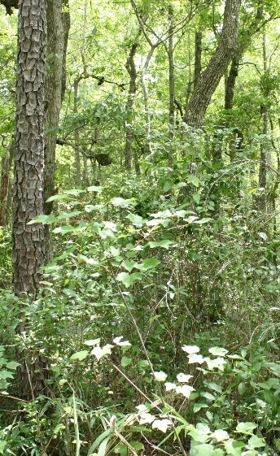
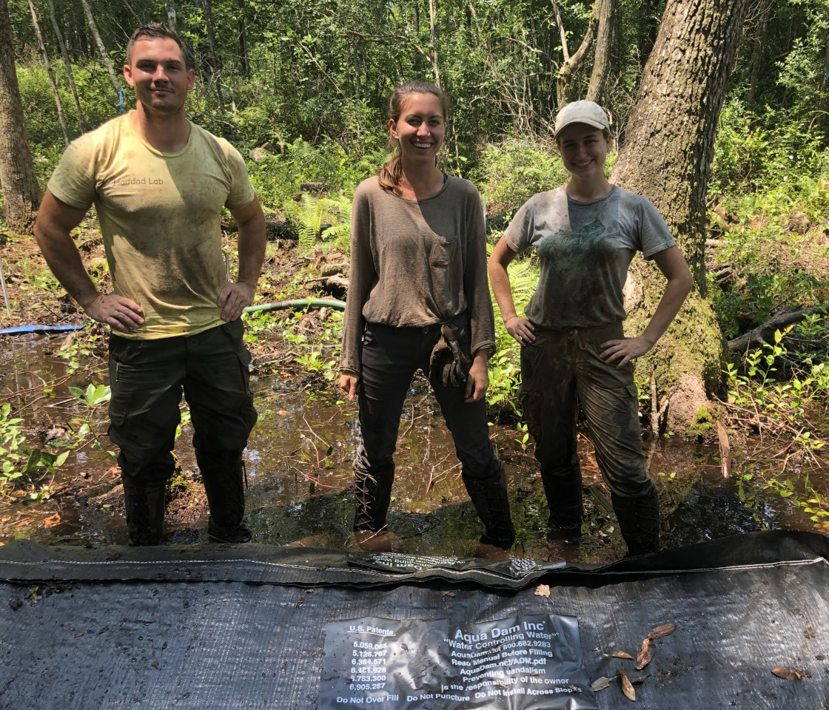
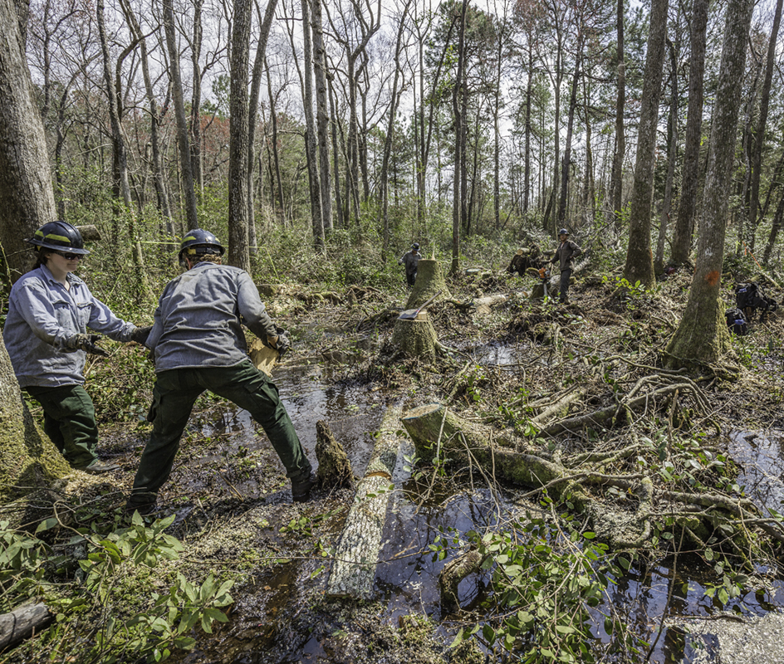
Habitat Restoration/Creation for SFS
SFS cater-pillar
Restored sedge meadow
Good for SFS
Riparian forest
Bad for SFS
Artificial dam
Notes:
SFS caterpillars feed on sedges; open sedge meadows reduced on landscape by: fire suppression, beaver extirpation
Ongoing restoration efforts aimed at recreating high quality sedge meadows, by cutting riparian trees and installing artificial dams
We are measuring cover of hostplants at all stages of the restoration/succession cycle; this is a key parameter needed for the SEIMBs we will use to determine optimal timing/spatial arrangement of restoration

Slide 10
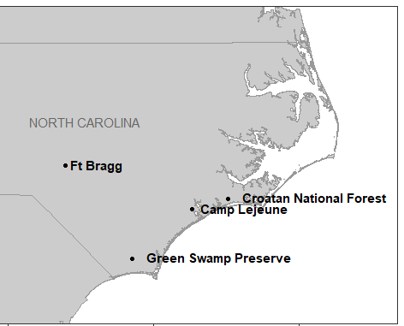
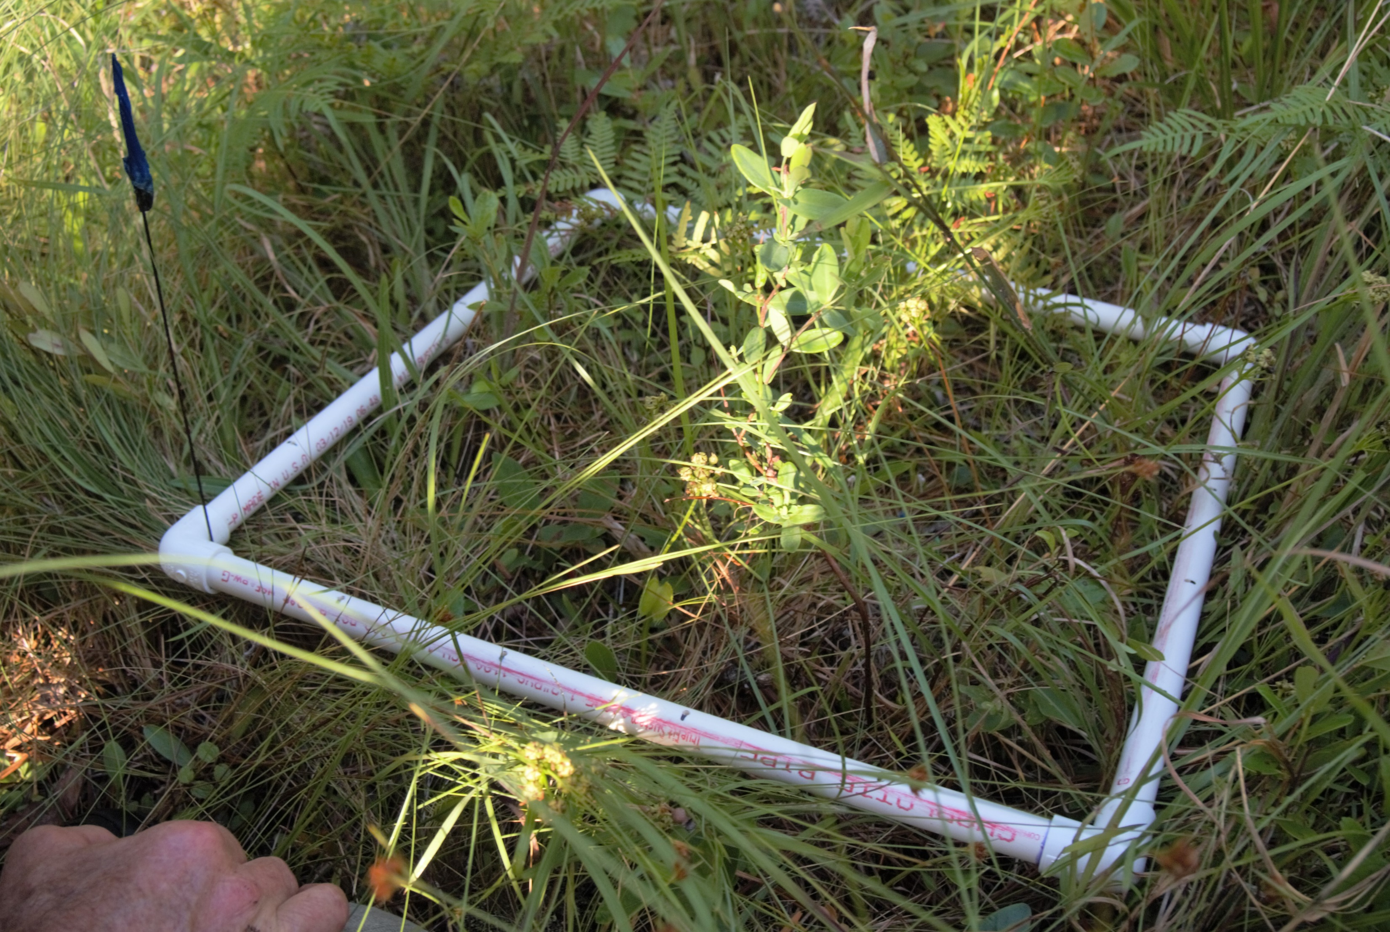
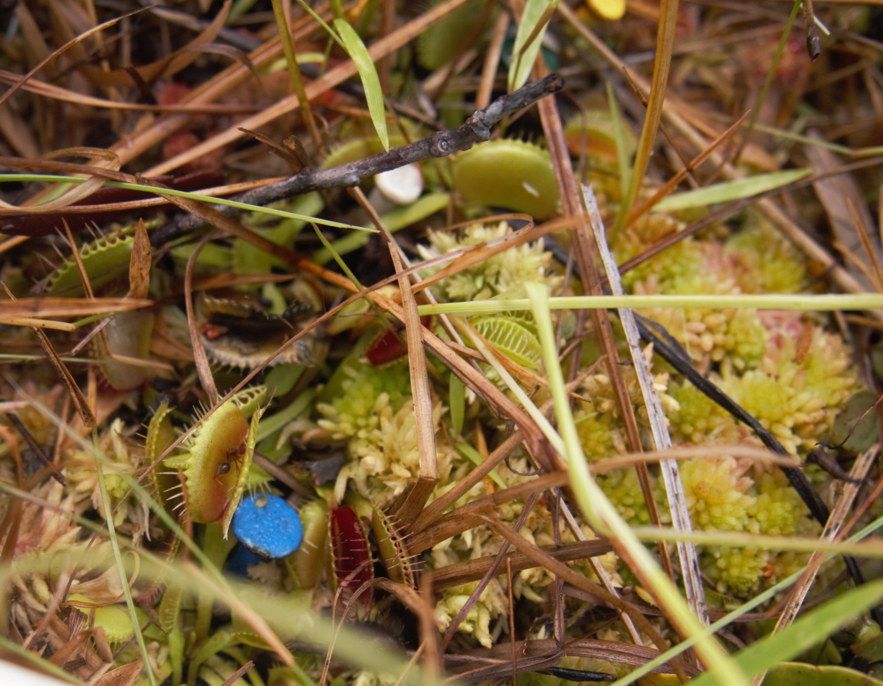
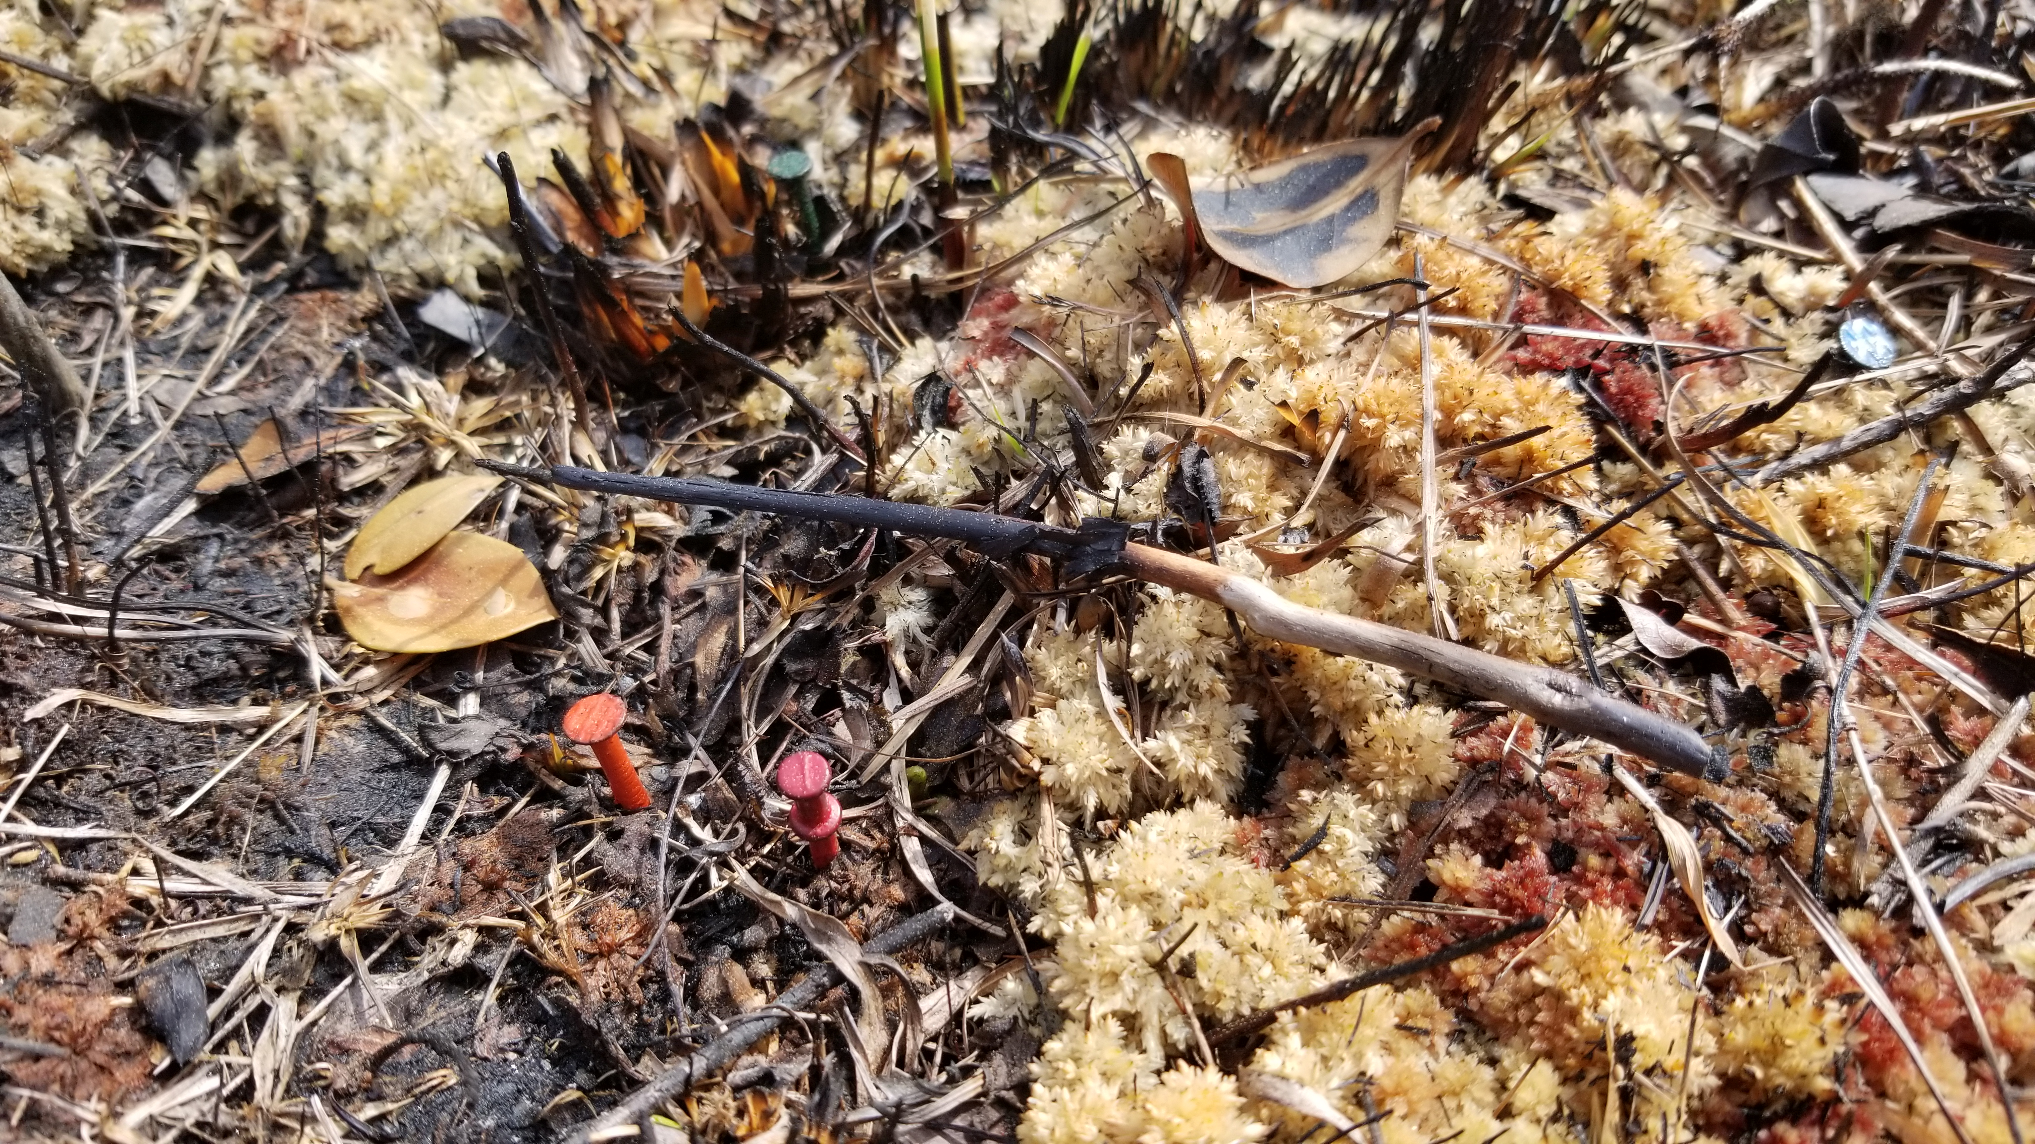
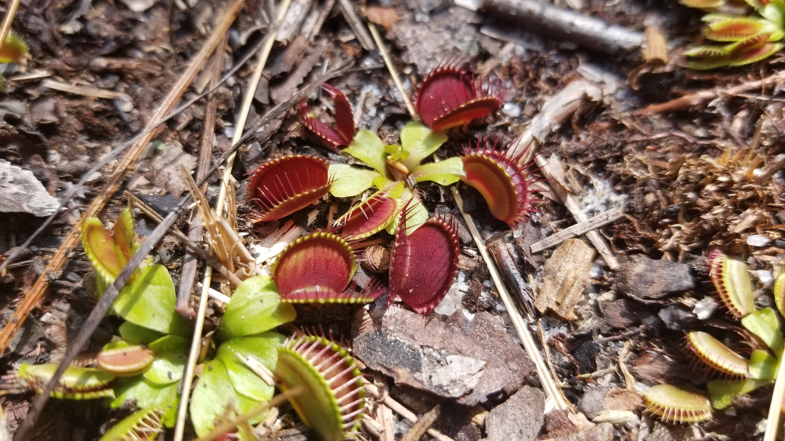
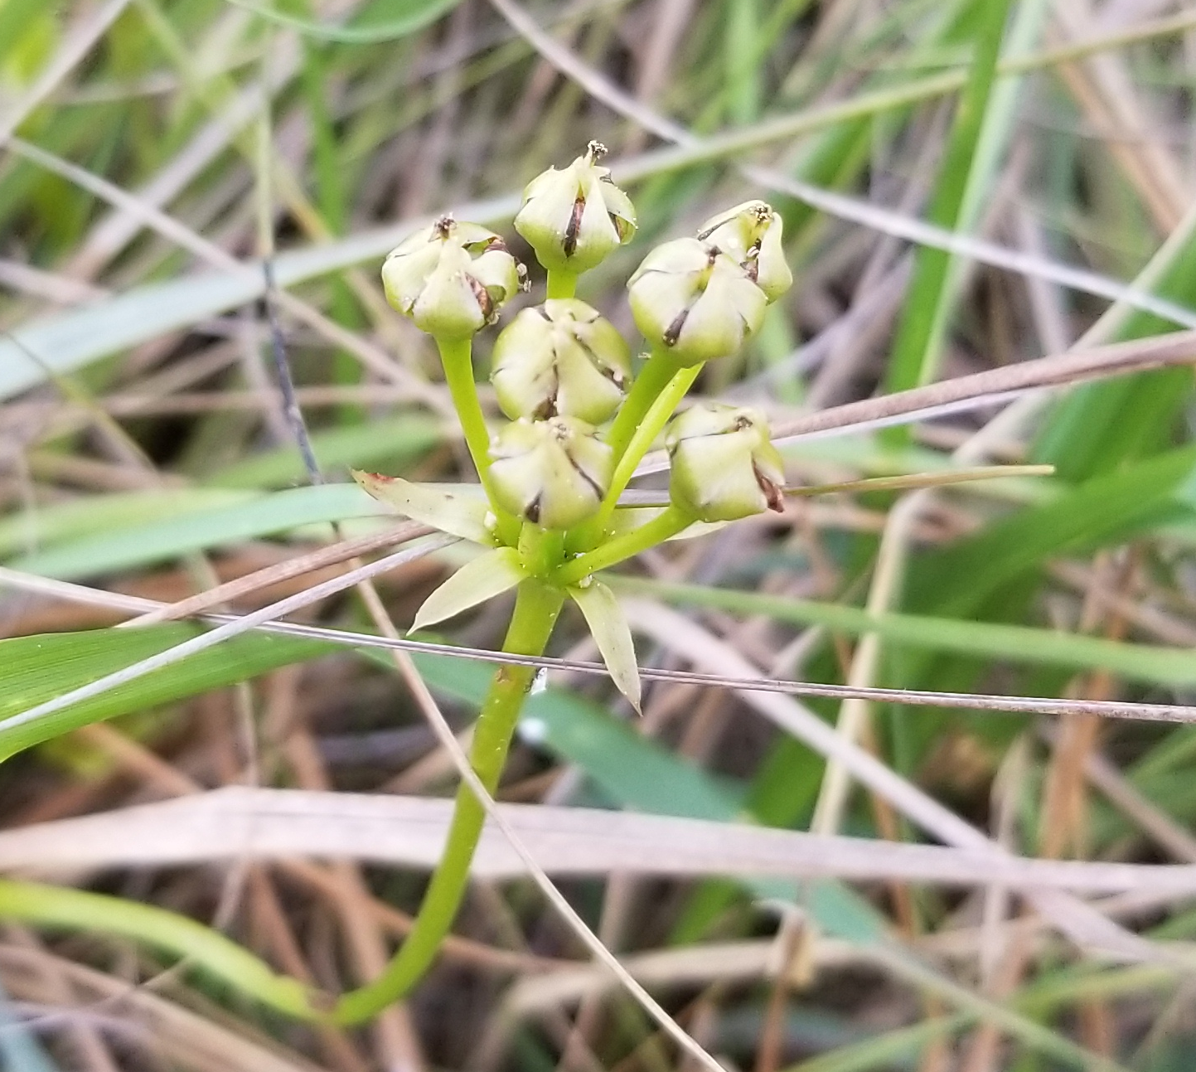
Substituting space for time to quantify drivers of VFT demography (fire, climate)
Global native range
(2015-2021)
(2015-2021)
(TNC)
(2018-2021)
Survival
Growth
Reproduction
Notes:
We are continuing to monitor all vital rates (survival, growth, reproduction, and recruitment) in 8 natural populations across VFT’s geographical distribution; Green Swamp (TNC) populations were added in this project. >2000 individually marked plants (see blue nail) are being followed. Provides data on: 1) climate effects on all vital rates; 2) effects of fire on all vital rates; 3) spatial scale of synchrony in all vital rates. Also performing greenhouse experiments using plants grown from seeds collected in all 8 populations, to ask: does tolerance to drought differ among populations (which populations more resilient to anticipated increase in drought frequency in SE USA?).

