Slide 1
Sandhills Conservation Partnership Land Protection Work Group
March 13, 2024
Jeff Marcus, Matt Greene, Crystal Cockman, Barry Hull, Emily Callicutt, Brady Beck

Slide 2
“Eastwood connector”- Harris tract, Moore Co

Slide 4
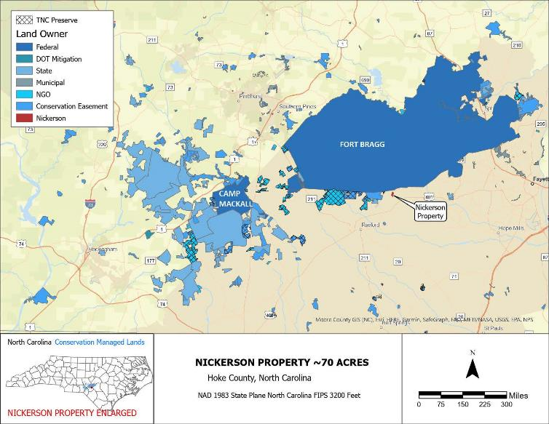
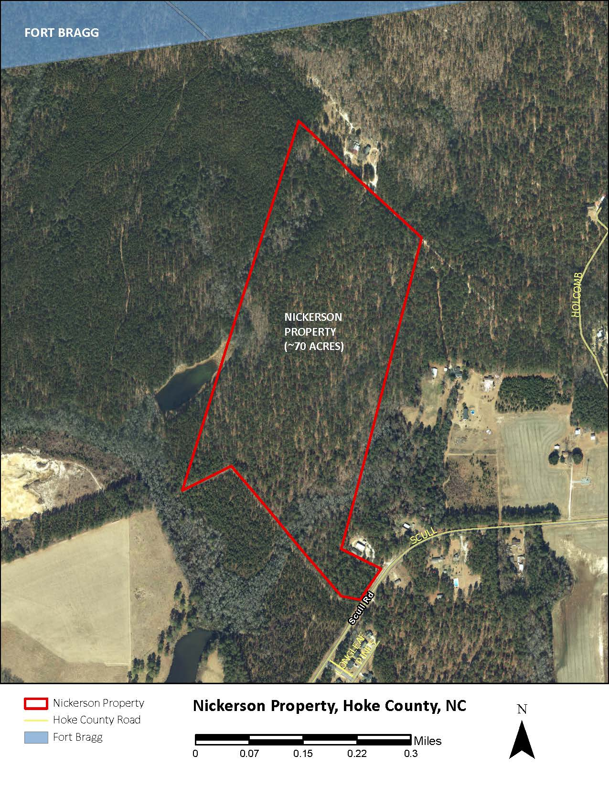
Nickerson 70 ac fee simple donation

Slide 5
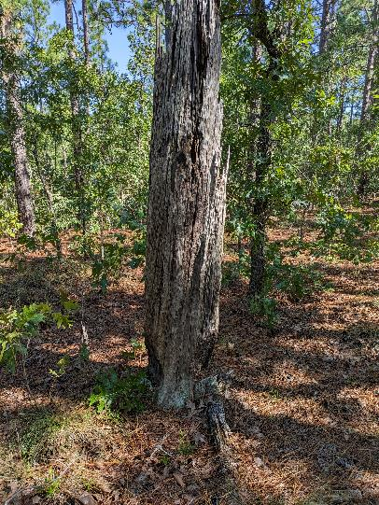
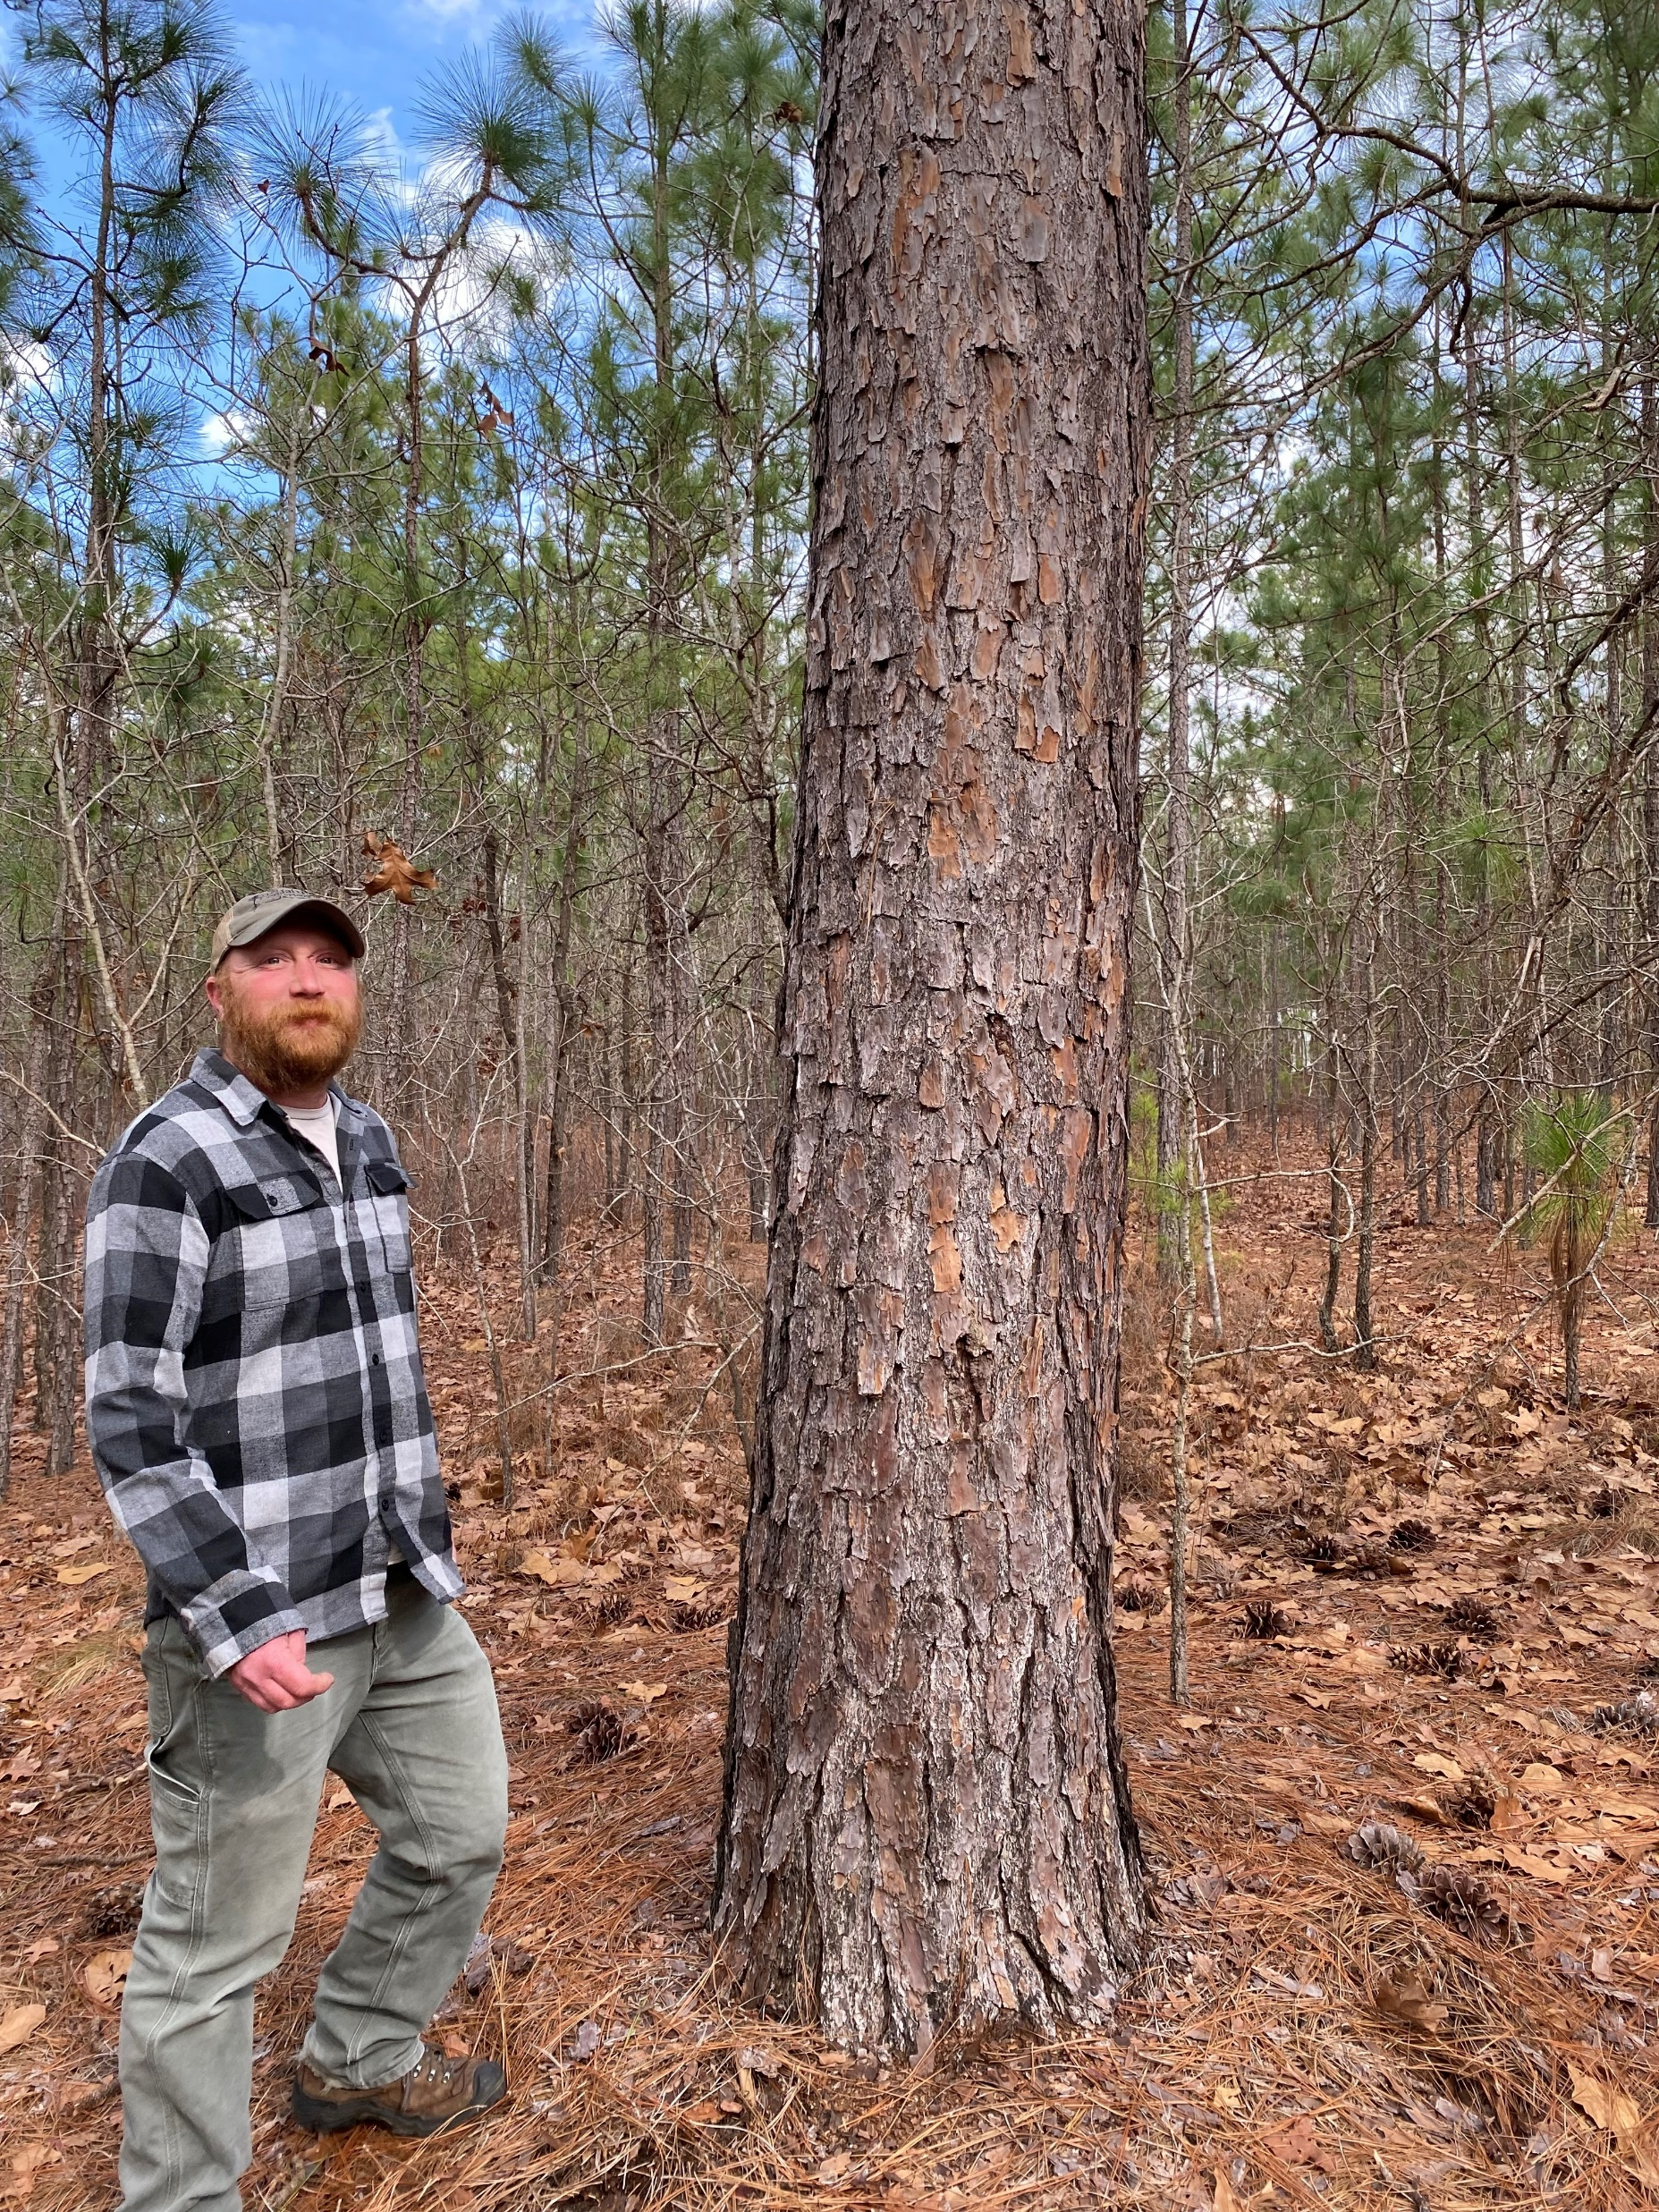
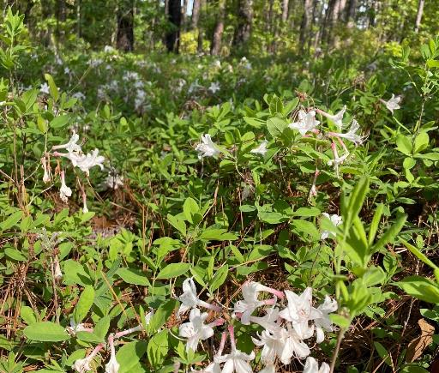
Nickerson 70 ac fee simple donation
Swamp azalea
Turpentine stump

Slide 6
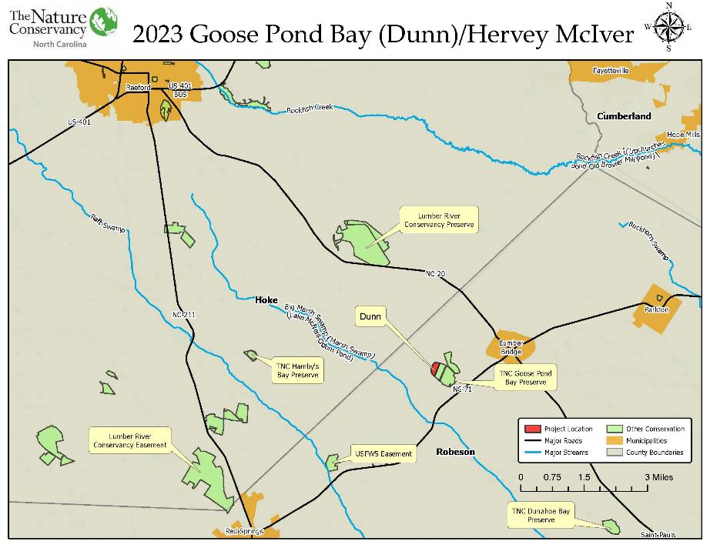

Slide 7
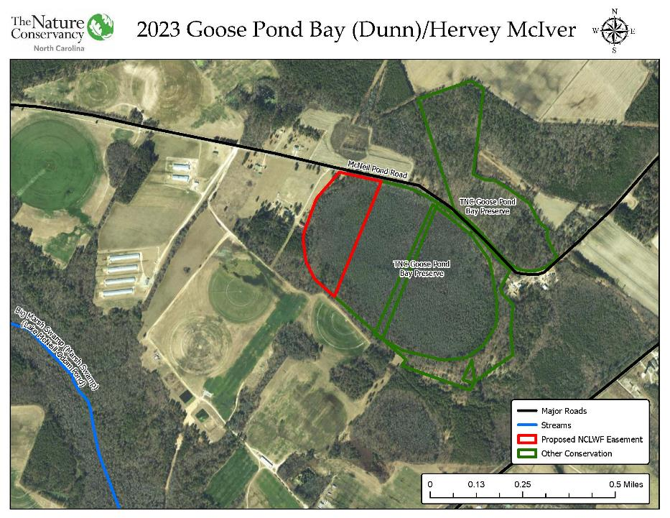

Slide 8
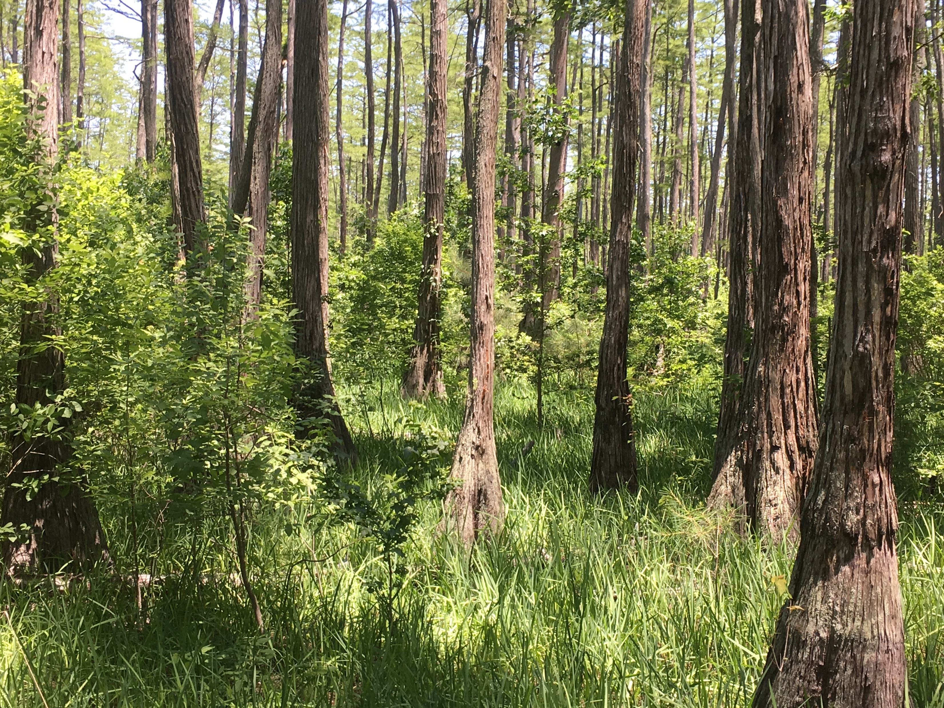
Dunn- Goose Pond Bay

