Slide 1
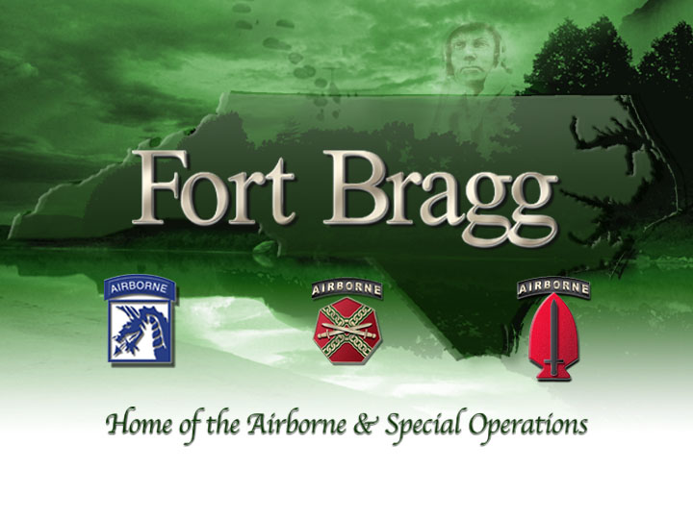

Slide 3
Ft Bragg: Moving Forward
Manage landscape with 1-3 year fire rotation
Maintain 4 suitable cavities at all RCW managed
clusters
Continue with the current level of monitoring;
100 % on Western FB (where 2 large ranges are scheduled to be build prior to 2025), within fragile “Greenbelt” corridor, and Camp Mackall
33% of the remainder of FB, using a sample across entire FB to verify productivity estimates

Slide 4
Future consideration:
If the RCW is removed from the Endangered status, how long will we be able to continue to fund Endangered species contracts (monitoring efforts, tree cavity surveys, fire prep around trees, etc.)

Slide 6
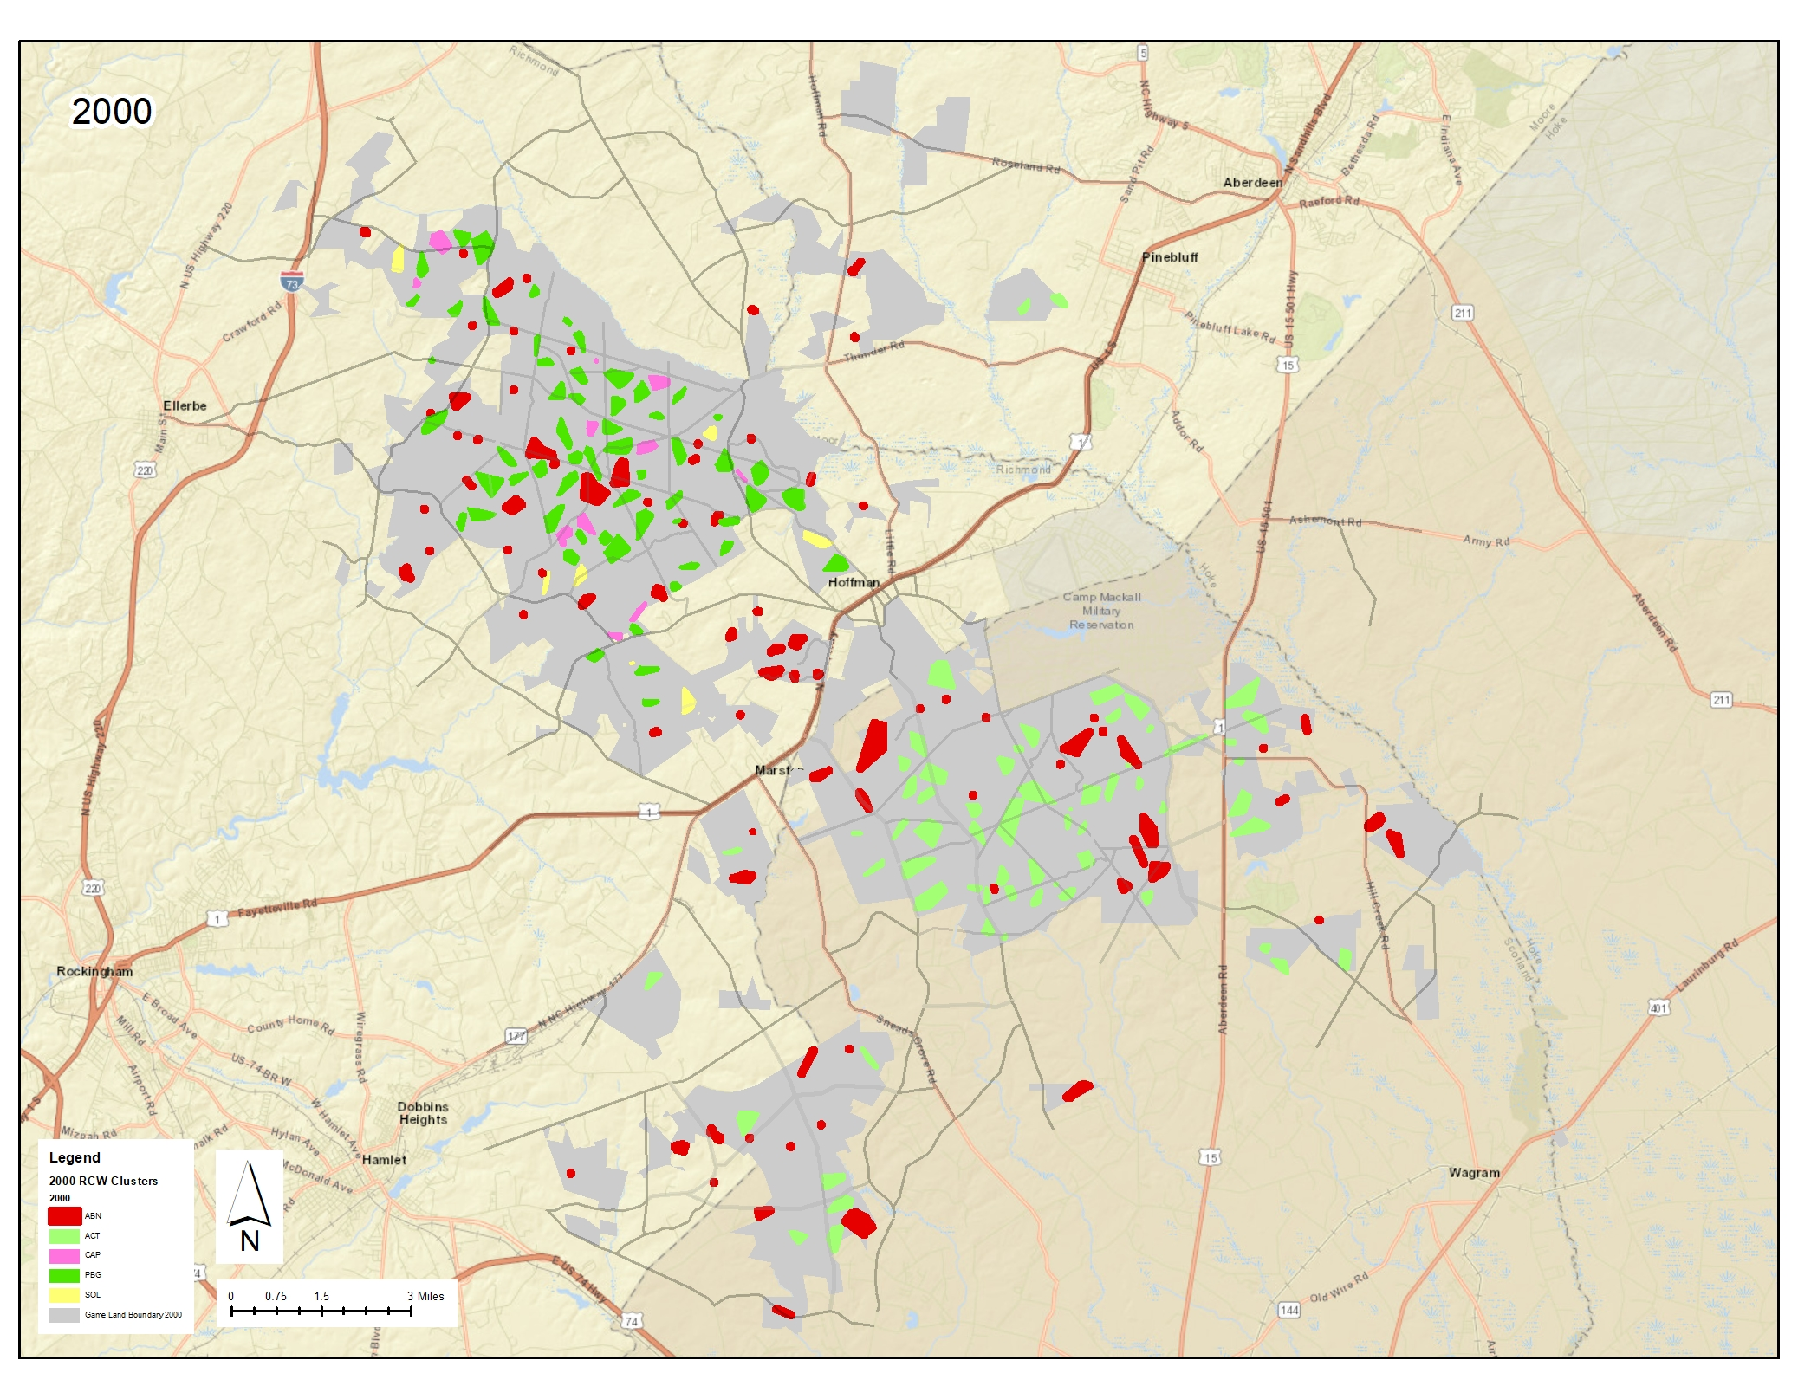

Slide 7
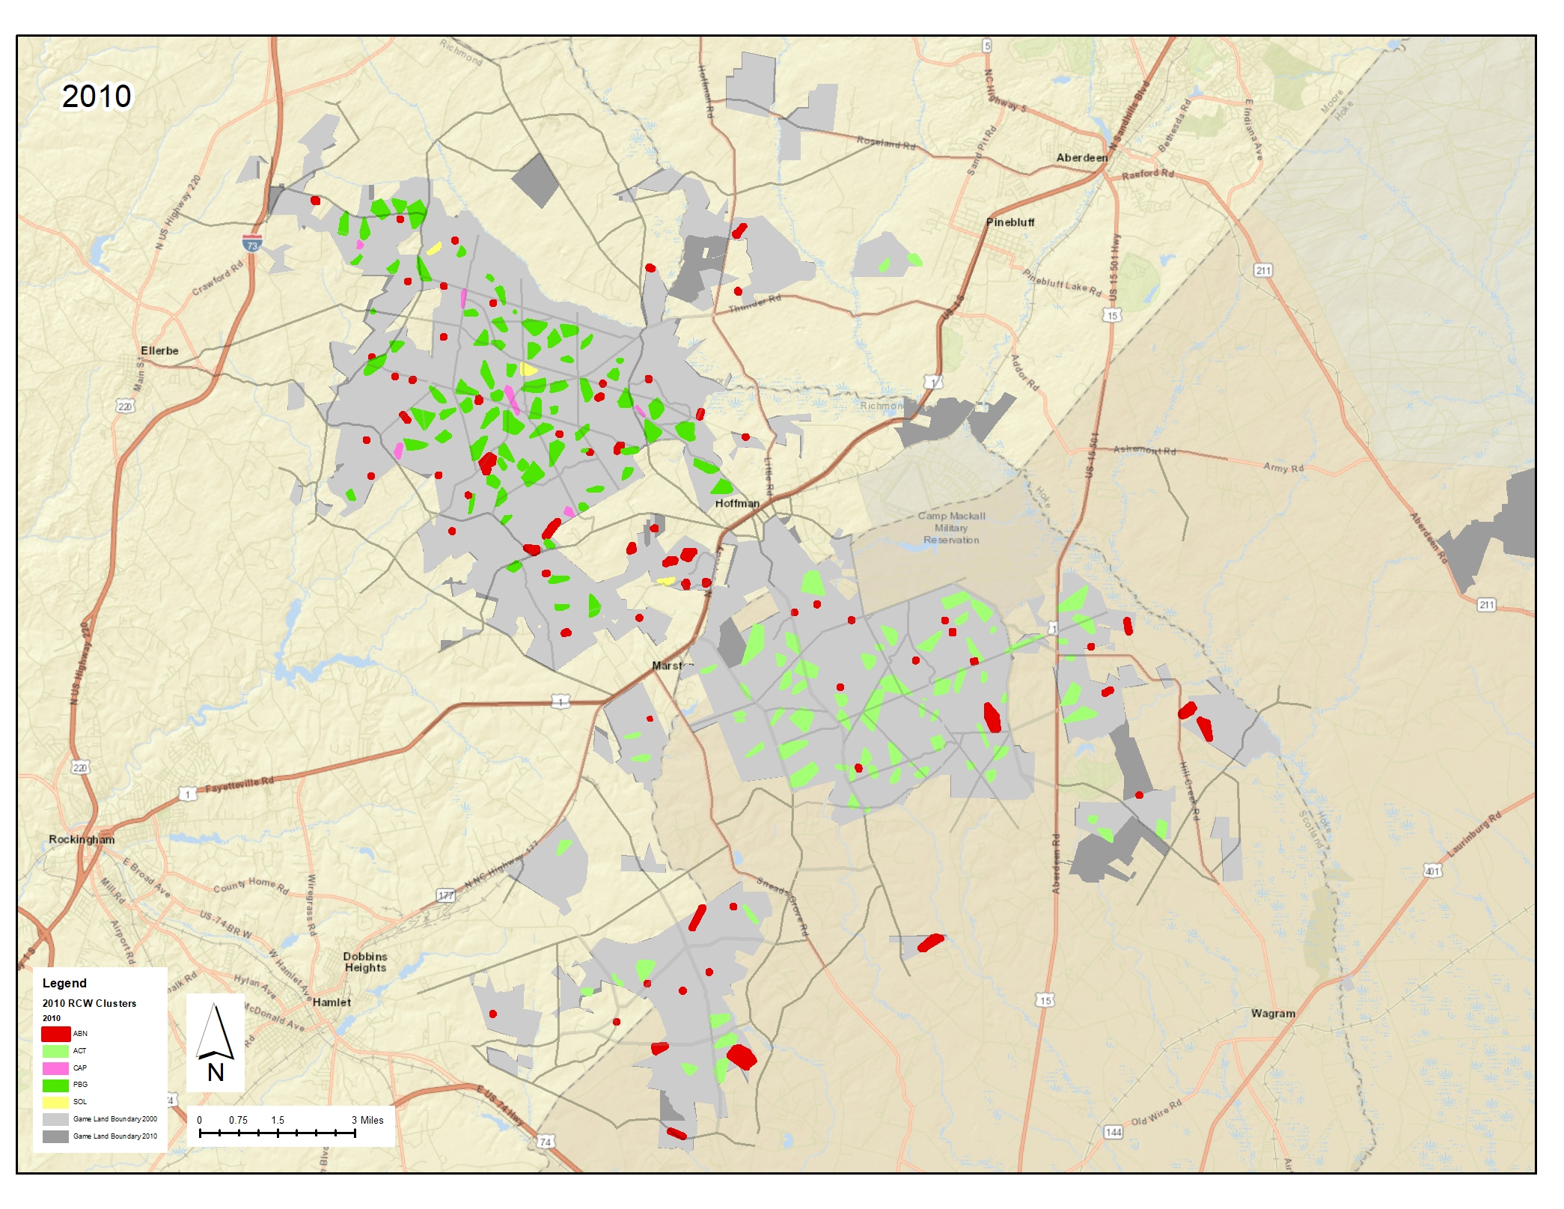

Slide 8
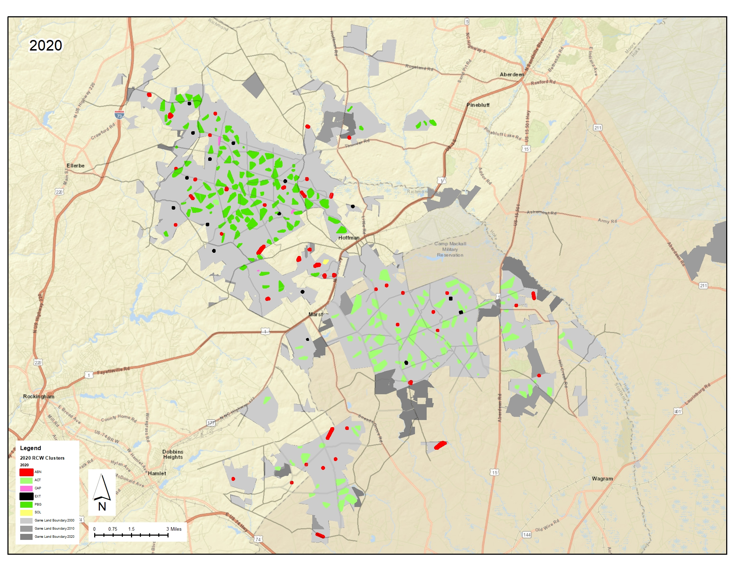

Slide 9
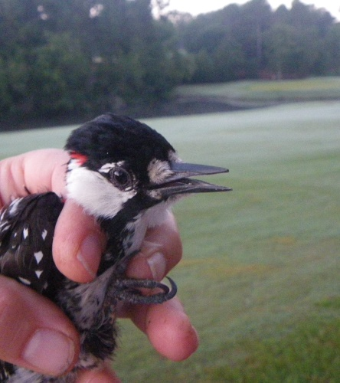
Private Lands RCW Recovery : SOPI/MOOR Significant Support Population * Southern Pines – Pinehurst (SOPI) * Greater Moore County (MOOR)
~ 40 SOPI RCW groups maintained since 2000
Territories /clusters challenged by:
Poor recruitment to replace breeders
Nesting habitat needs continual management (artificial cavs, restrictors)
Foraging habitat loss from intensified development
Longterm fire suppression
Groups stabilized and expanded through:
Artificial cavities and translocation
Creative solutions – 1995 FWS Flagship Safe Harbor Program
Fire where feasible – MOSS , WEWO + few working forests

Slide 10
Pioneered by Bragg ‘jumper’ mid 00s 75+ ac Working Forests in Safe Harbor Expansion by inserts + translocation Prescribed Burn Association (PBA) Western MOOR Sandhills East to West Connection MOOR jumper to Uwharries?
Notes:
0 to 22 in 200 years. MOOR groups pioneered by FB ‘jumpers’ in mid-00s
MOOR characterized by working forests (75 - several thousand acres)
↑ from considerable R-clusters and translocation effort
MOOR functions as alternate demographic connection to BLUE TRACT (THE GAP) linking Sandhills East and West
MOOR groups function to ‘rescue’ some SOPI groups from depressed recruitment; Jumpers? to establish an RCW presence in or near the Uwharrie

Slide 11
Future Work & Challenges
Promote RCW recovery actions on private lands via outreach
* routinely engage Safe Harbor participants through monitoring
Combine efforts w/ Prescribed Burn Association and Partners
* forest stewardship and management provide new areas for RCW recruitment
Supplement artificial cavities into foreseeable future within private lands clusters, esp. where fire not feasible
?
Downlisting + 4D rule
Avian Keratin Disorder (AKD)
↑ Sandhills development
Notes:
Annual and routine site visits over many years has enabled an open dialogue facilitated by Safe Harbor Program.

Slide 12
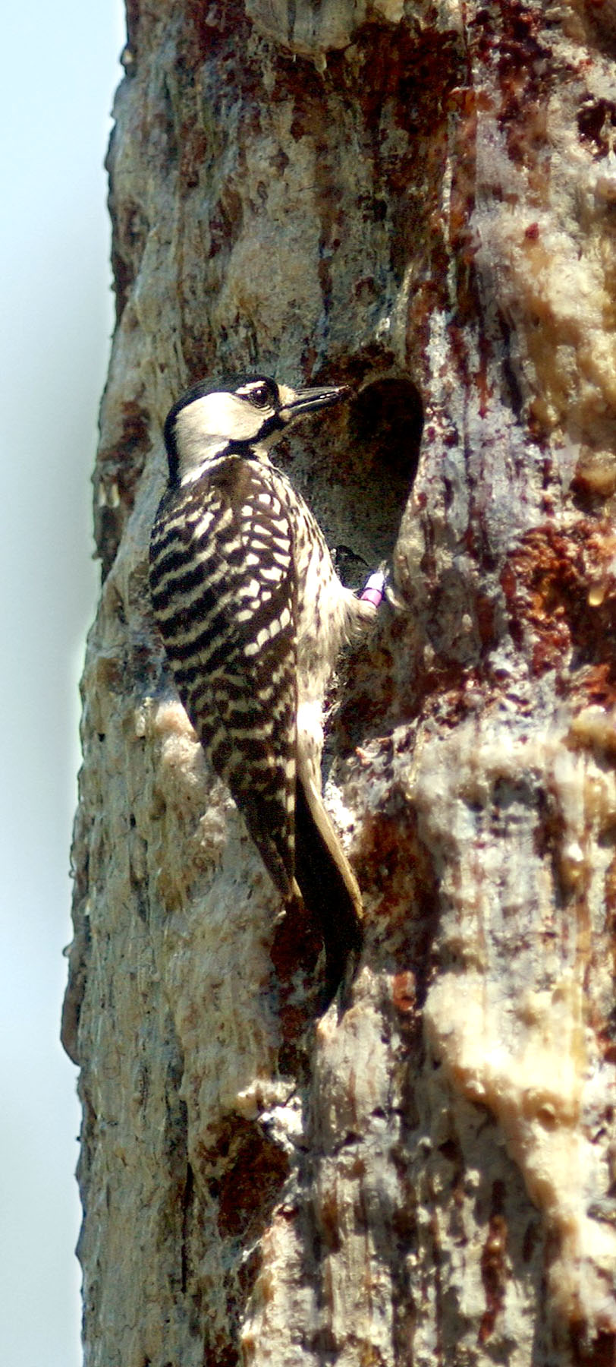
Additional points of consideration/discussion regarding the future of rcw in the Sandhills
How should management goals and techniques change when RCWs reach (or exceed) carrying capacity?
Where are the opportunities for inter-landscape connectivity?
SC Sandhills
Bladen Lakes
Uwharries
Impact of future tank ranges and other land clearing activities on Fort Bragg?
Future of USFWS staff presence in the Sandhills? How might this affect both proactive and reactive work by key partner?
Photo Brady Beck

