Slide 1
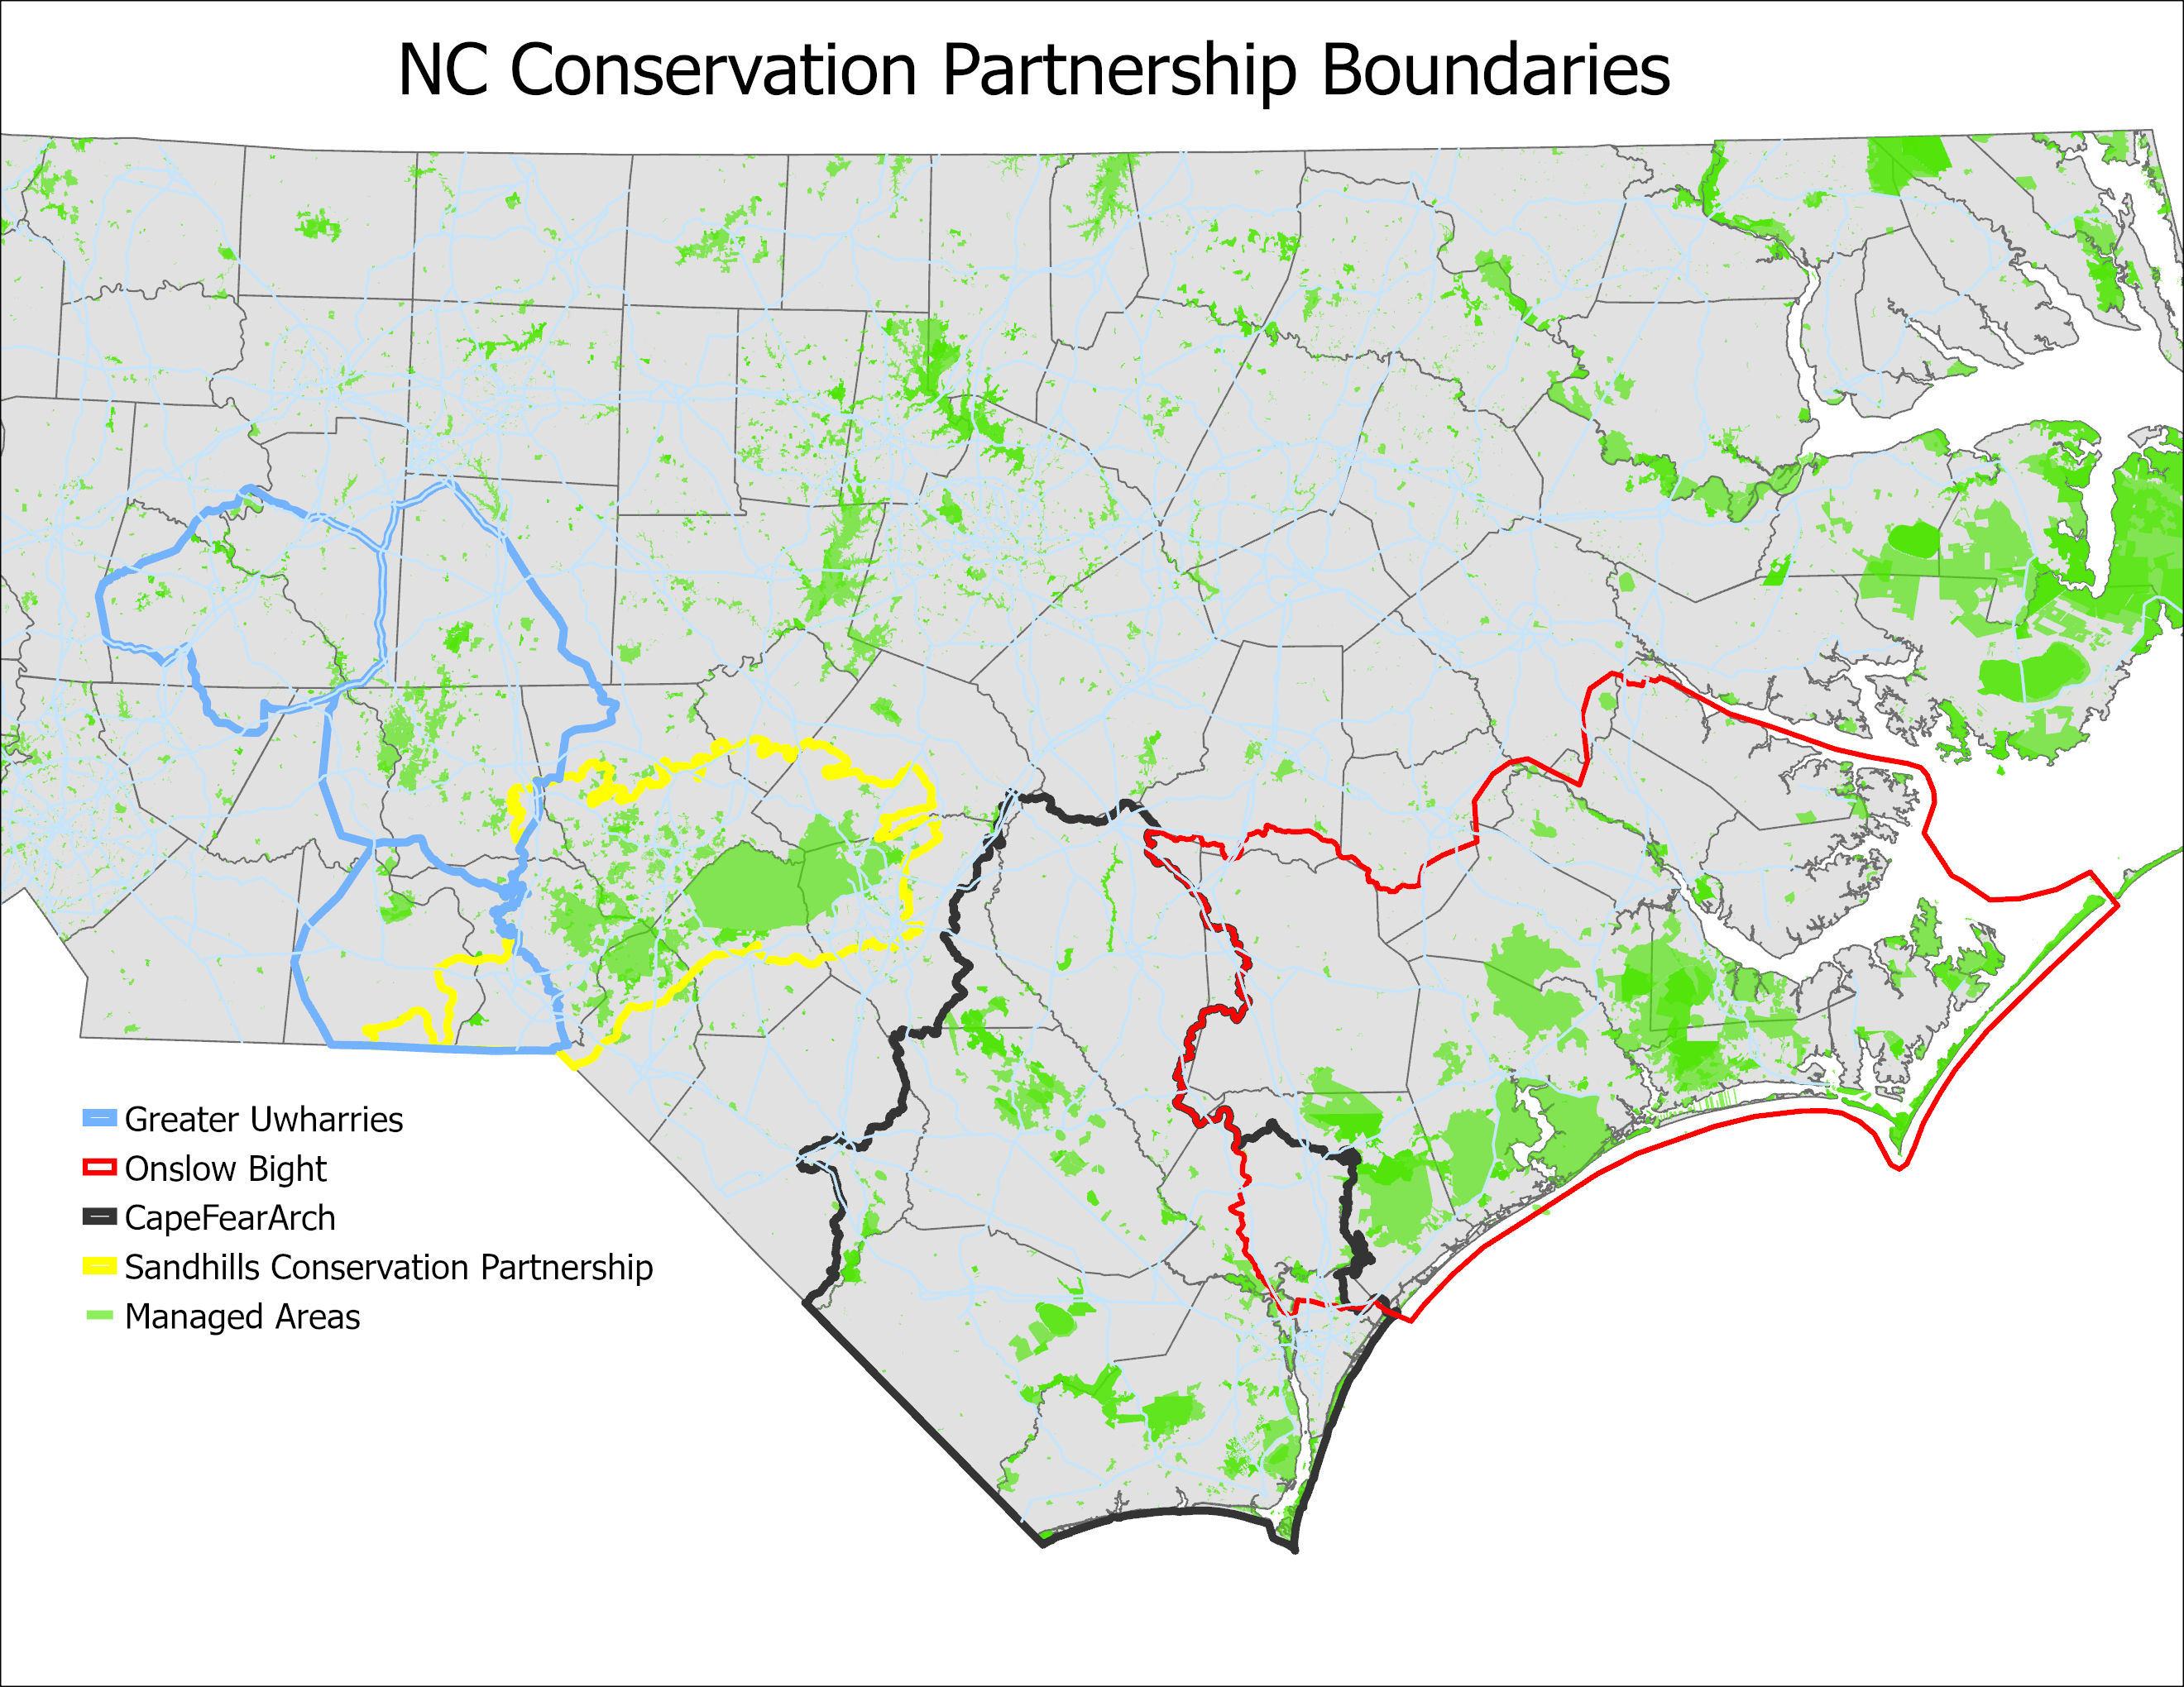

Slide 2
NC Sandhills Conservation Partnership
Updates December 6, 2023

Slide 3
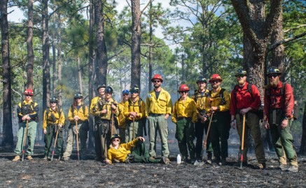
2024 National Fish and Wildlife Foundation Longleaf Landscape Stewardship Fund application
Partner planning meeting yesterday
Shared burn crew
Contract/Subawards
City of Fayetteville- Bonnie Doone midstory & invasives
NC State Parks
Three Rivers Land Trust- management support
NC Botanical Garden- propagate native plants
NC Biodiversity Project- invertebrate surveys
NC Wildlife Resources Commission- longleaf planting
NC Forest Service- Longleaf Coordinator and PBA mentors
Lumbee Tribe- longleaf restoration & PBA support
Compliments funding from REPI & partners

Slide 4
Conservation Plan
Completed in 2013
Update with new information
Update goals
What do we want Partnership to be?
Formal partnership with assigned roles and mutually agreed upon deliverables done on behalf of the Partnership
Informal information-sharing forum that inspires and leverages actions of individual organizations

Slide 5
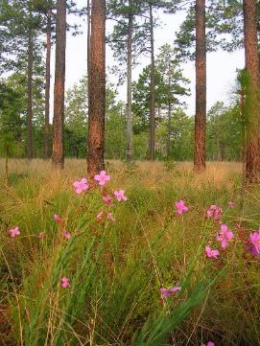
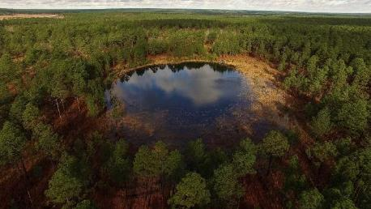
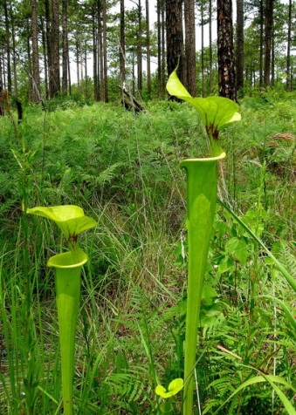
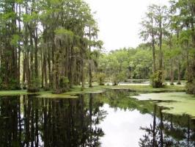
State of the Sandhills report
Partnership’s monitoring plan identifies 4 umbrella conservation targets to measure progress
Upland Longleaf Mosaic
Upland Depressional Wetlands
Blackwater Streams
Sandhills Seeps and Streamhead Pocosins
Monitoring led by ORISE Fellow
State of Sandhills report synthesizes what we know to date
Photo Brady Beck
Photo Jeff Marcus
Photo Jeff Marcus

Slide 6
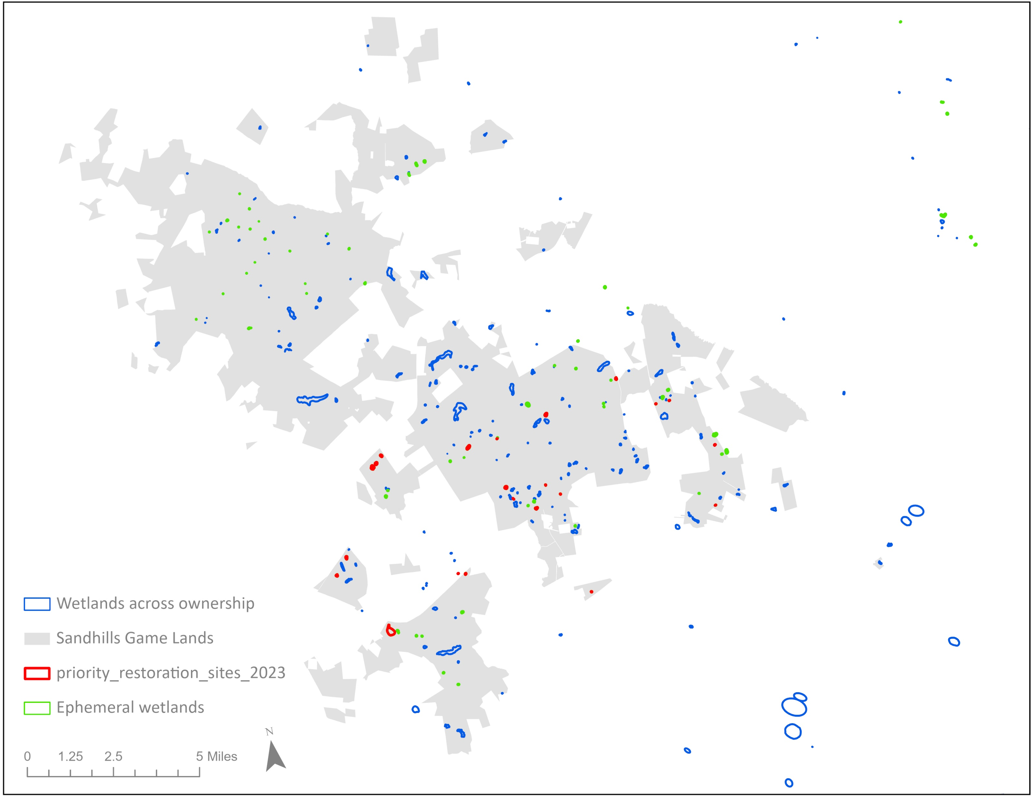
Predictive models to find isolated wetlands
TNC, NCWRC, and Duke University
>200 new wetland sites mapped on Sandhills Game Land
Including 13 previously unknown isolated depressional wetland locations
Prioritized top 20 for restoration
How-to document to expand project scope
Notes:
Zooming into just the SGL, this is what’s been mapped, and I can say with a lot of confidence that this probably reflects over 90% of what’s actually out there.
Everything in green is a depressional wetland, everything in red is a wetland that Mike & I have prioritized for restoration, and everything else in blue is a wetland of another type

Slide 7
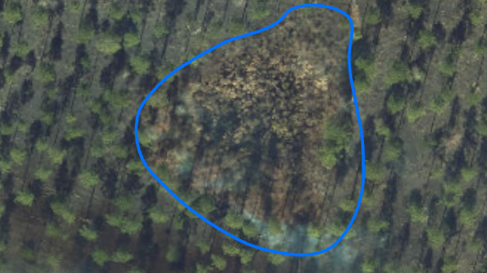
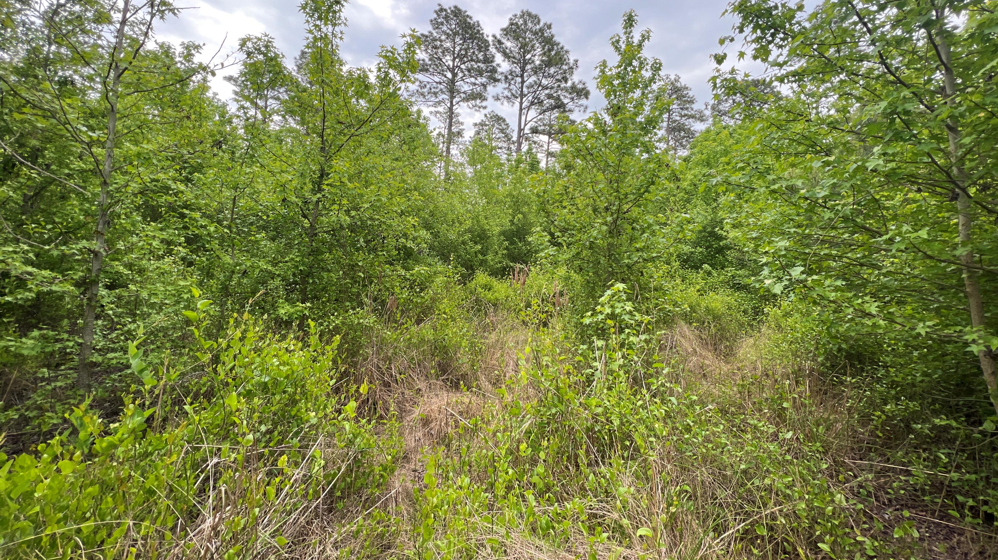
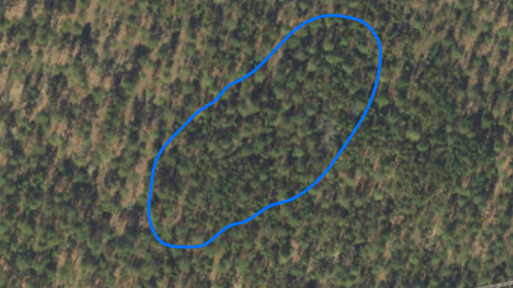
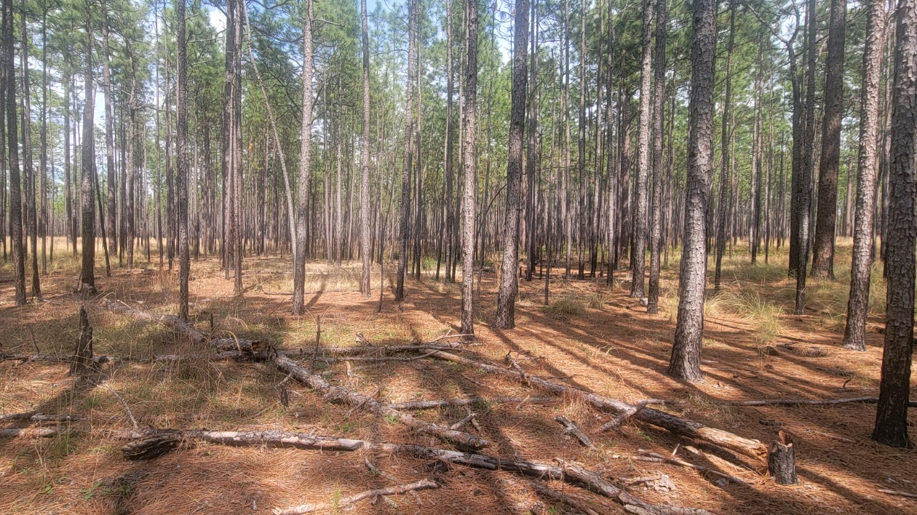

Slide 8
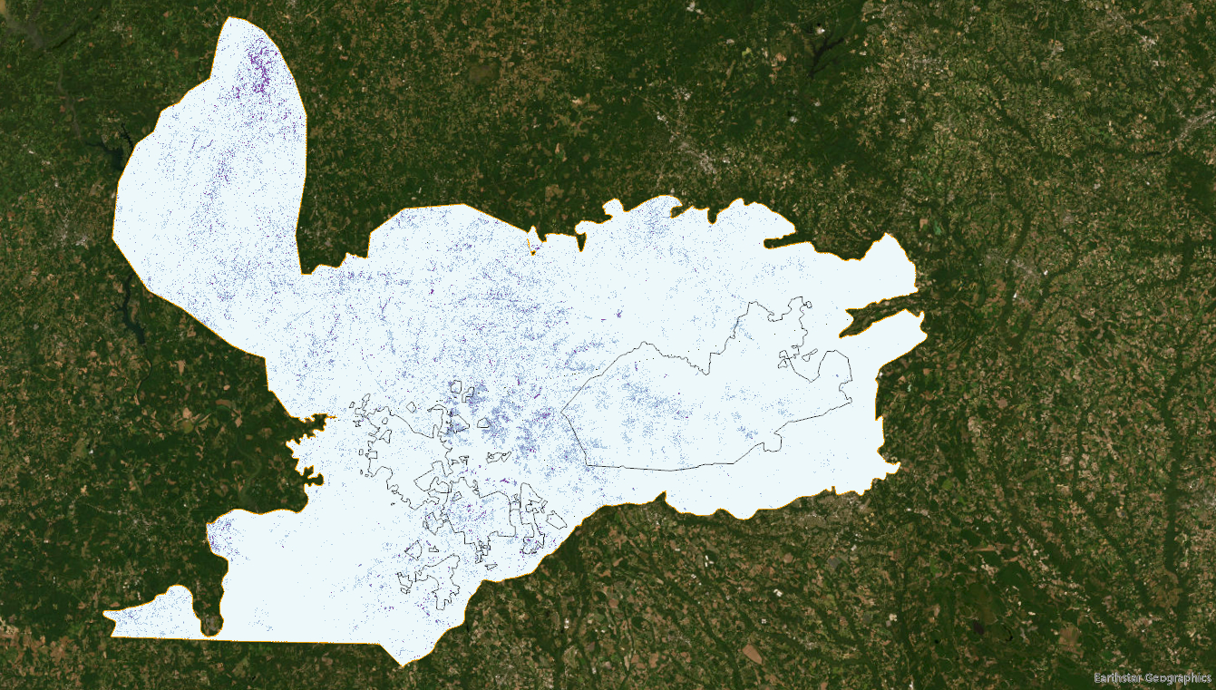
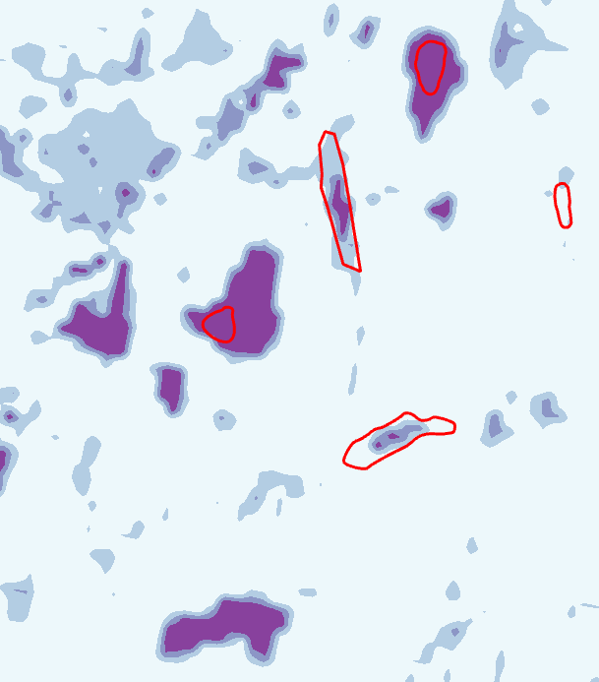
Notes:
Next step #1 already complete
Only used ephemeral type in training the model
Now need to ground-truth

Slide 9
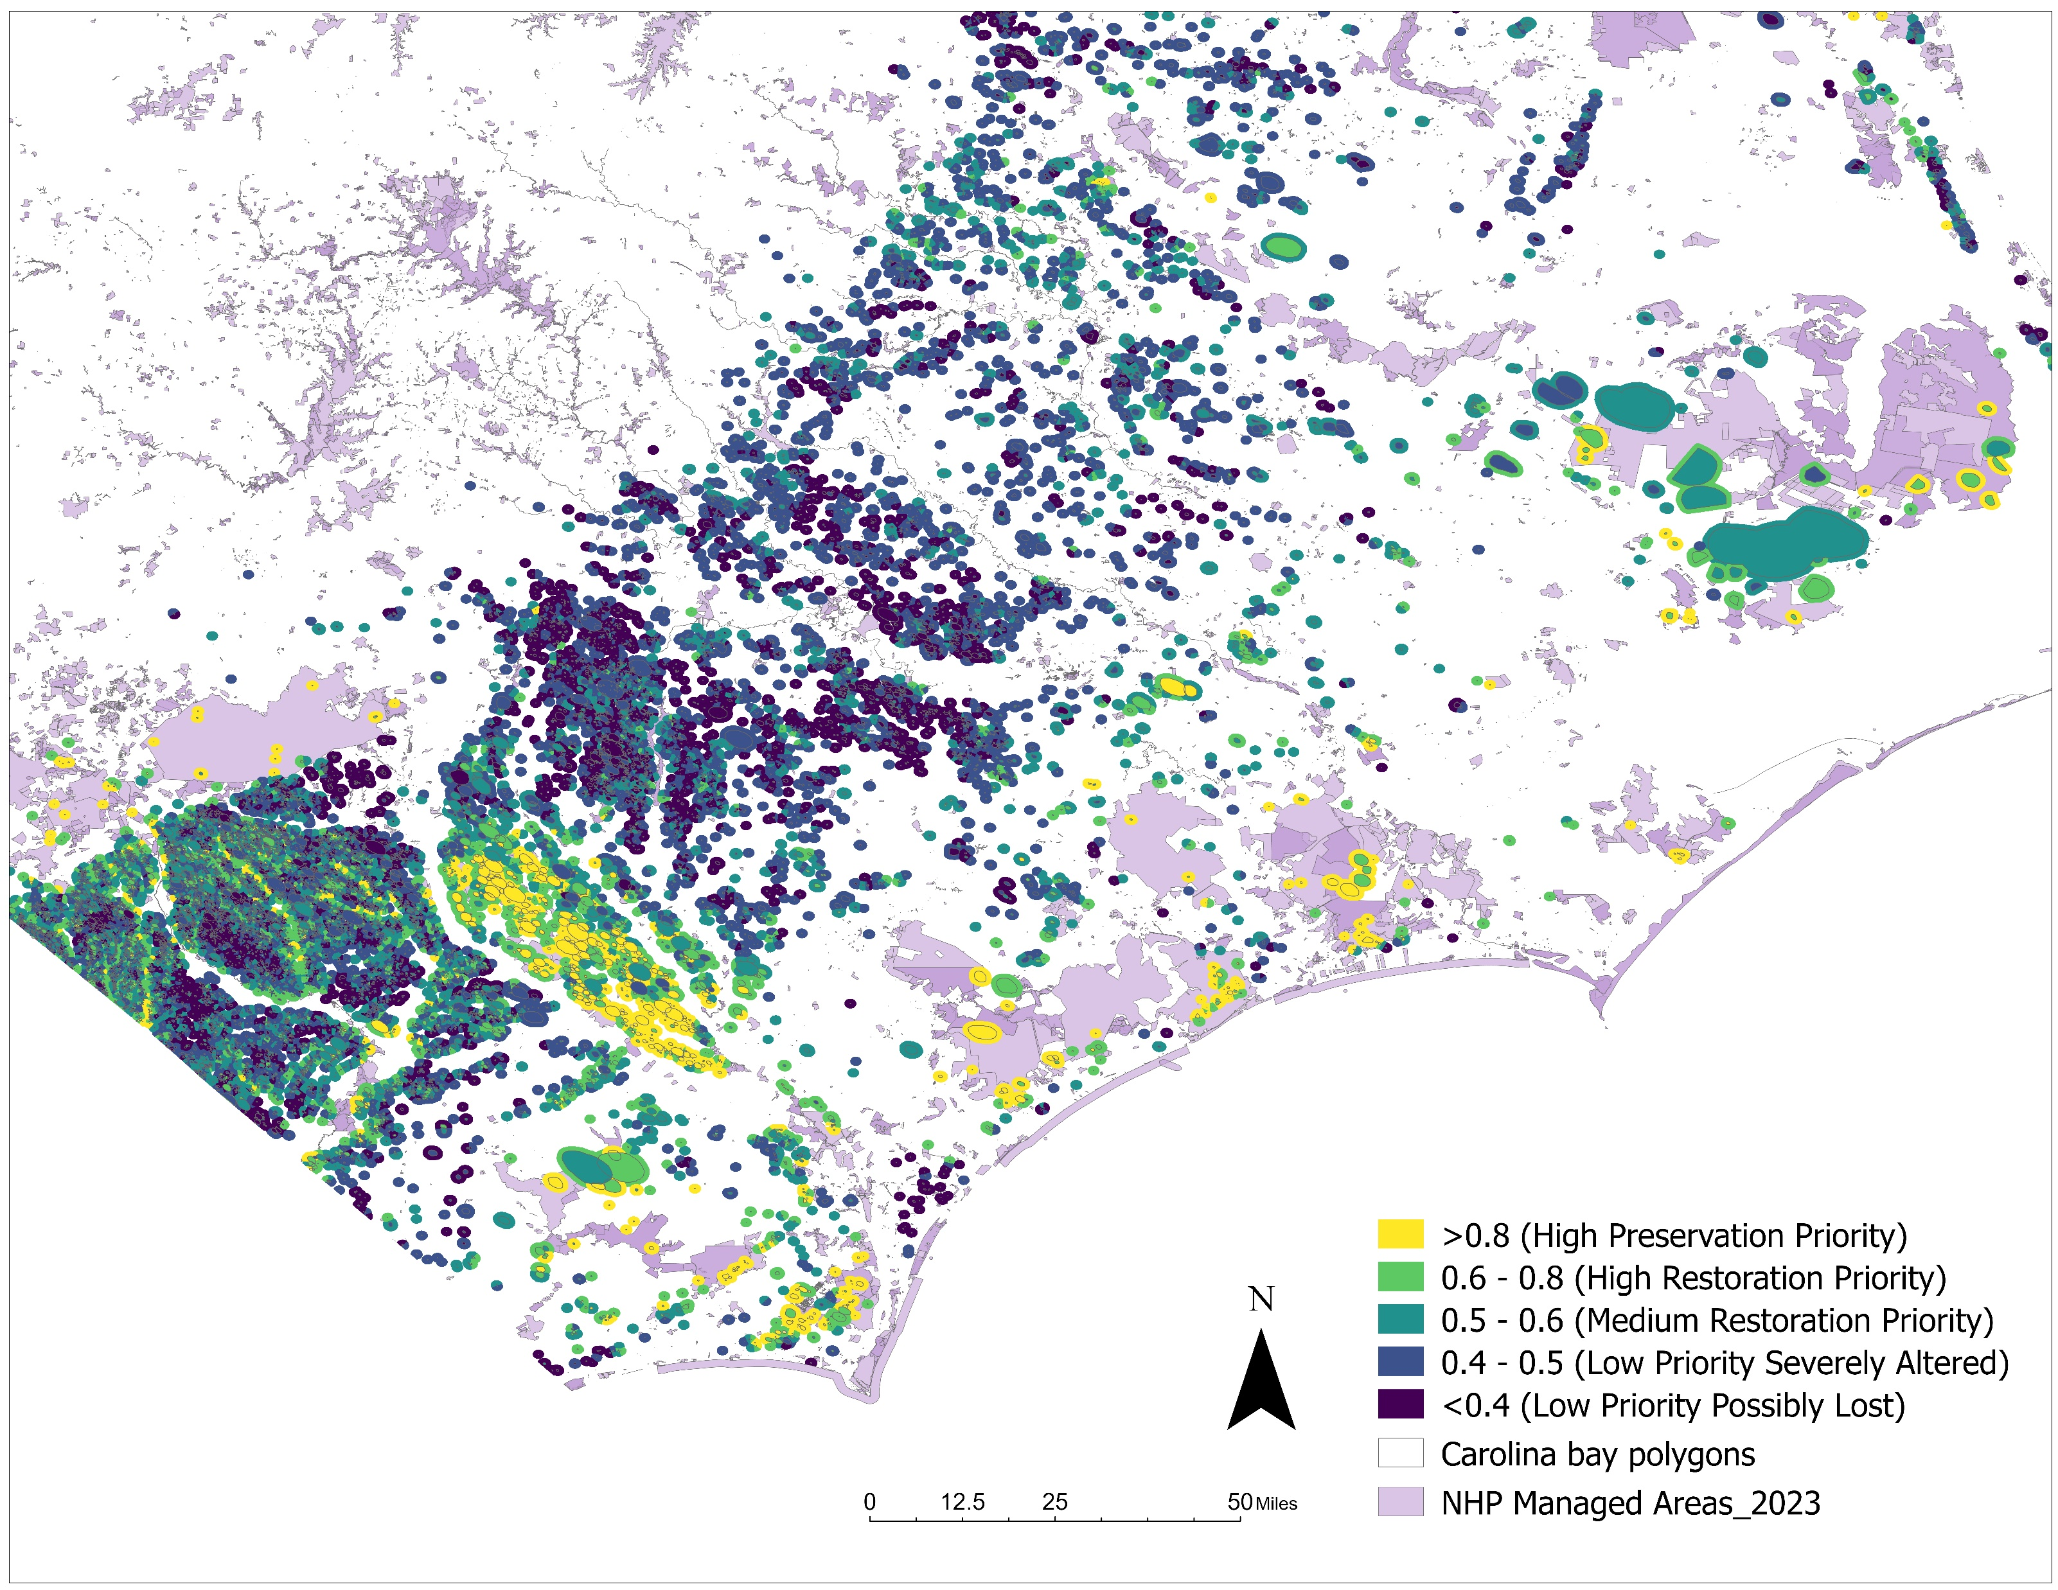
Carolina bays + 1km buffers ranked by conservation priority
Criteria
Quality: NLCD Land Cover
Climate resiliency: TNC Resilient and Connected Network
Wildlife value: NHP Biodiversity/Wildlife Habitat Assessment
Likelihood of occupation: SEGAP species distribution models for 4 SGCN amphibians
Connectivity: Distance from NHP managed area
Conservation practicality: Number of parcels/landowners

Slide 10
Other Partner updates
2023 National Wildlife Federation NFWF grant supporting Sandhills Prescribed Burn Association, Joint Chiefs project, and Lumbee Tribal Prescribed Burn Association.
Town of Southern Pines
Whitehall ~175 ac tract
New trails
Clear midstory for RCW
Invasive species control
Planning burn with NC Forest Service and Three Rivers Land Trust
River Flows study underway

