Slide 1
NCSCP Survey Results
March 2024 Quarterly Meeting
Notes:
- Obtained 13 responses over period from January 12 – February 8

Slide 2
Feedback on purpose, roles, responsibilities
Partnership coordinator:
Essential for:
Herding partnership
Synthesizing work and results of partners
Keeping partnership on track
Internal and external communications
Meeting coordination
Provides some stability where ORISE has high turnover
Some responsibilities could be spread among more people
+1

Slide 3
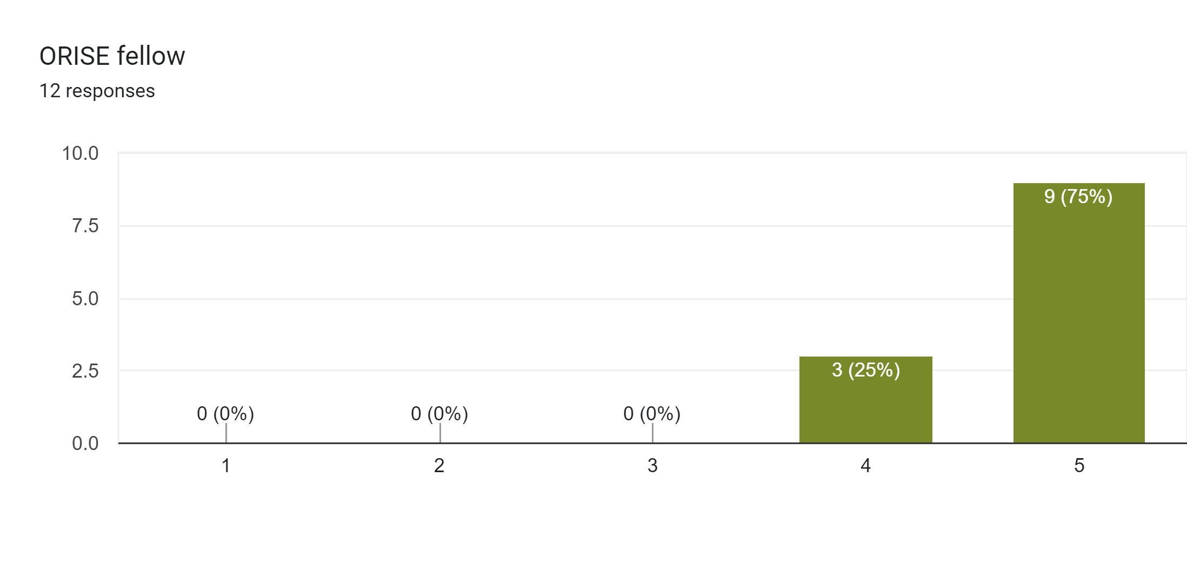
Feedback on purpose, roles, responsibilities
ORISE Fellow:
Essential for:
Supporting coordinator, who can only do so much
Leading target monitoring and finding answers to knowledge gaps
Freedom of role facilitates movement of work amongst partners
Information dissemination, reports, meeting coordination
Safe Harbor program
Secret sauce of partnership success
Position has high turnover which can lead to loose ends and poor follow-up
+1

Slide 4
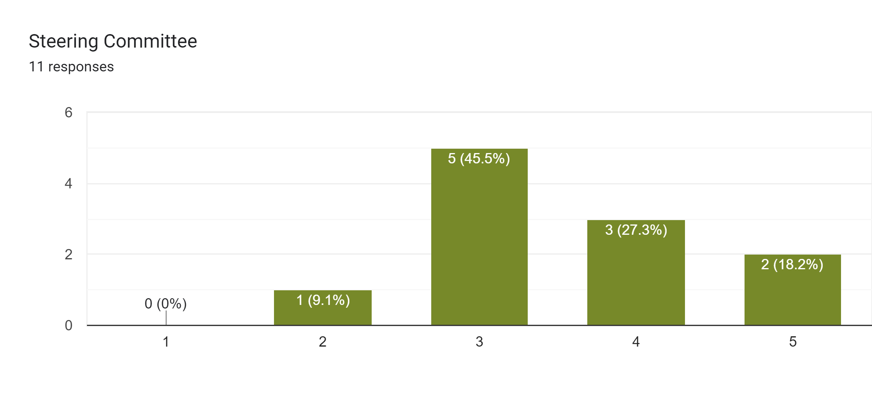
Feedback on purpose, roles, responsibilities
Steering Committee:
Essential for:
Setting and implementing long-term goals with full representation of partners
Building awareness of partnership direction
Reaching consensus on big changes/decisions
Overall desire for more action and involvement to see value
Would be another avenue for strengthened engagement, collaboration, and buy-in from partners
Would increase commitment and action from partners
+1

Slide 5
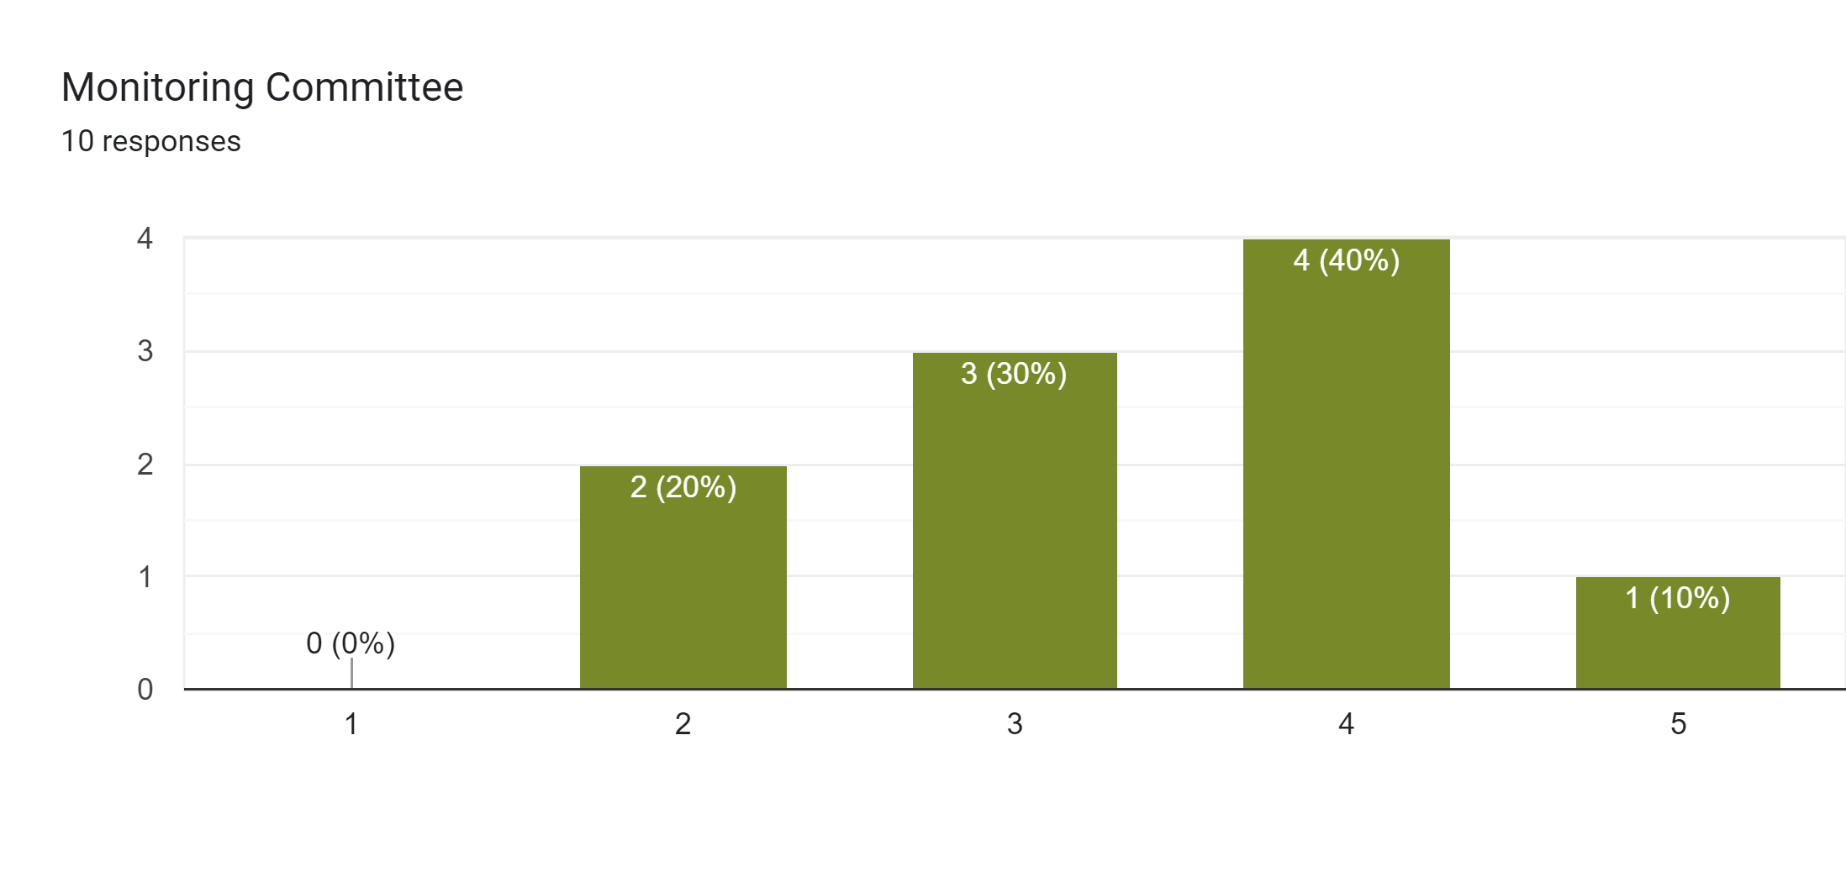
Feedback on purpose, roles, responsibilities
Monitoring Committee:
Not currently functioning
Reserve Design Working Group can also serve this purpose but doesn’t currently
ORISE fellows have largely taken the lead
Overall desire for more action and involvement
+1

Slide 6
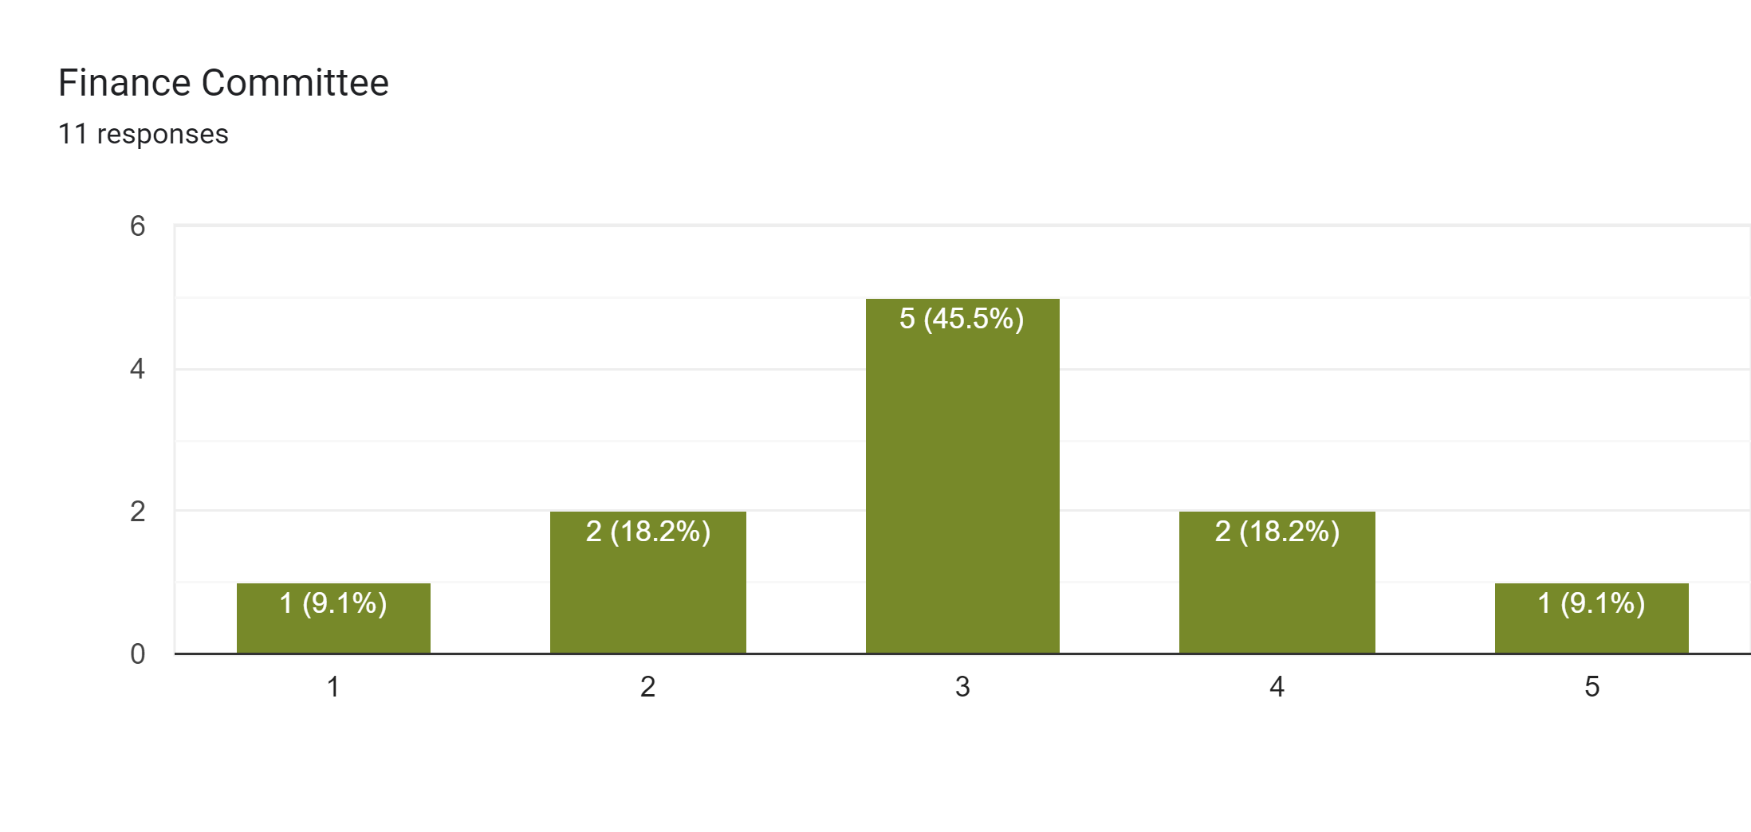
Feedback on purpose, roles, responsibilities
Finance Committee:
Currently nonexistent
Would be great to gather once per year to identify and address partnership-specific funding needs
Need for long-term funding plan for ORISE position and monitoring needs
NFWF has increased capacity for management by partners
TNC has led NFWF and ORISE efforts. Regional needs could be met even more if TNC had additional partner support
+1

Slide 7
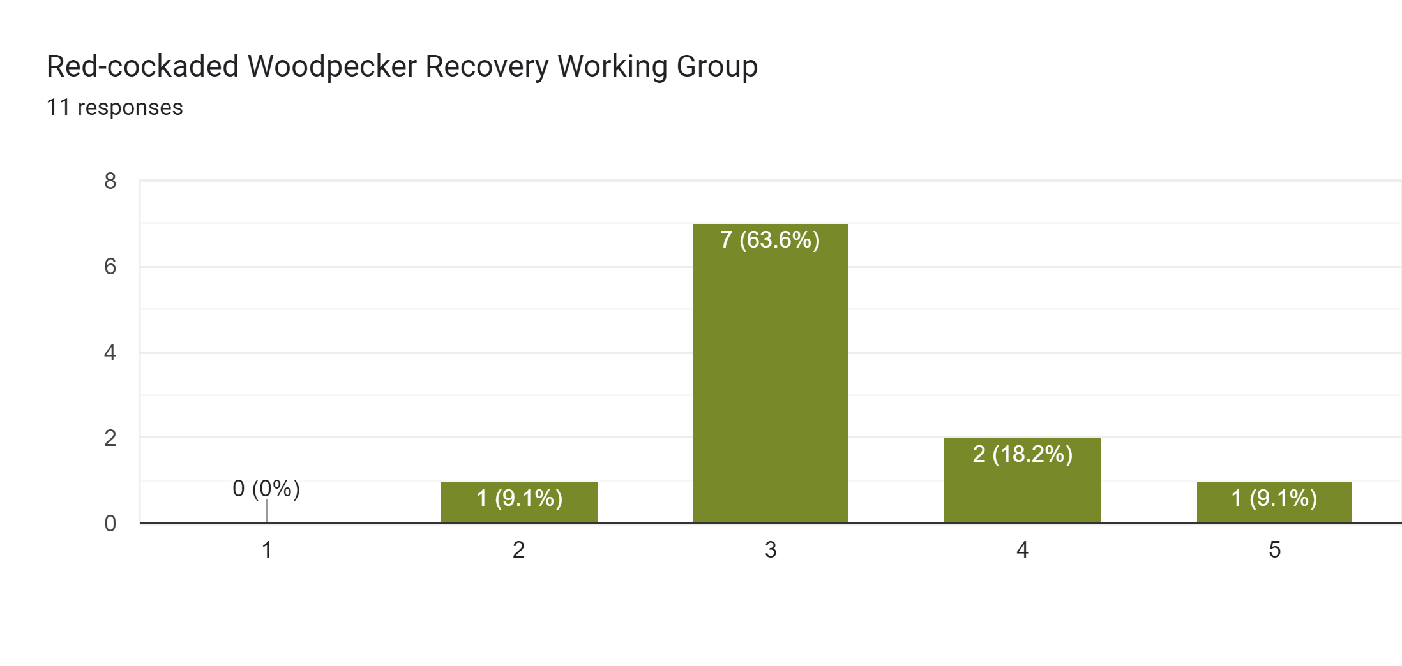
Feedback on purpose, roles, responsibilities
Red-cockaded Woodpecker Recovery Working Group:
Still important, but less so than it once was
We have achieved 2 greatest RCW goals
Success of efforts are apparent. Other species in greater need that could benefit from reallocation of resources going to RCW
Still worth having the group to ensure long-term monitoring and research continues
Could expand to “Endangered Spp Recovery WG”
Efforts could extend farther east
+1
+1

Slide 8
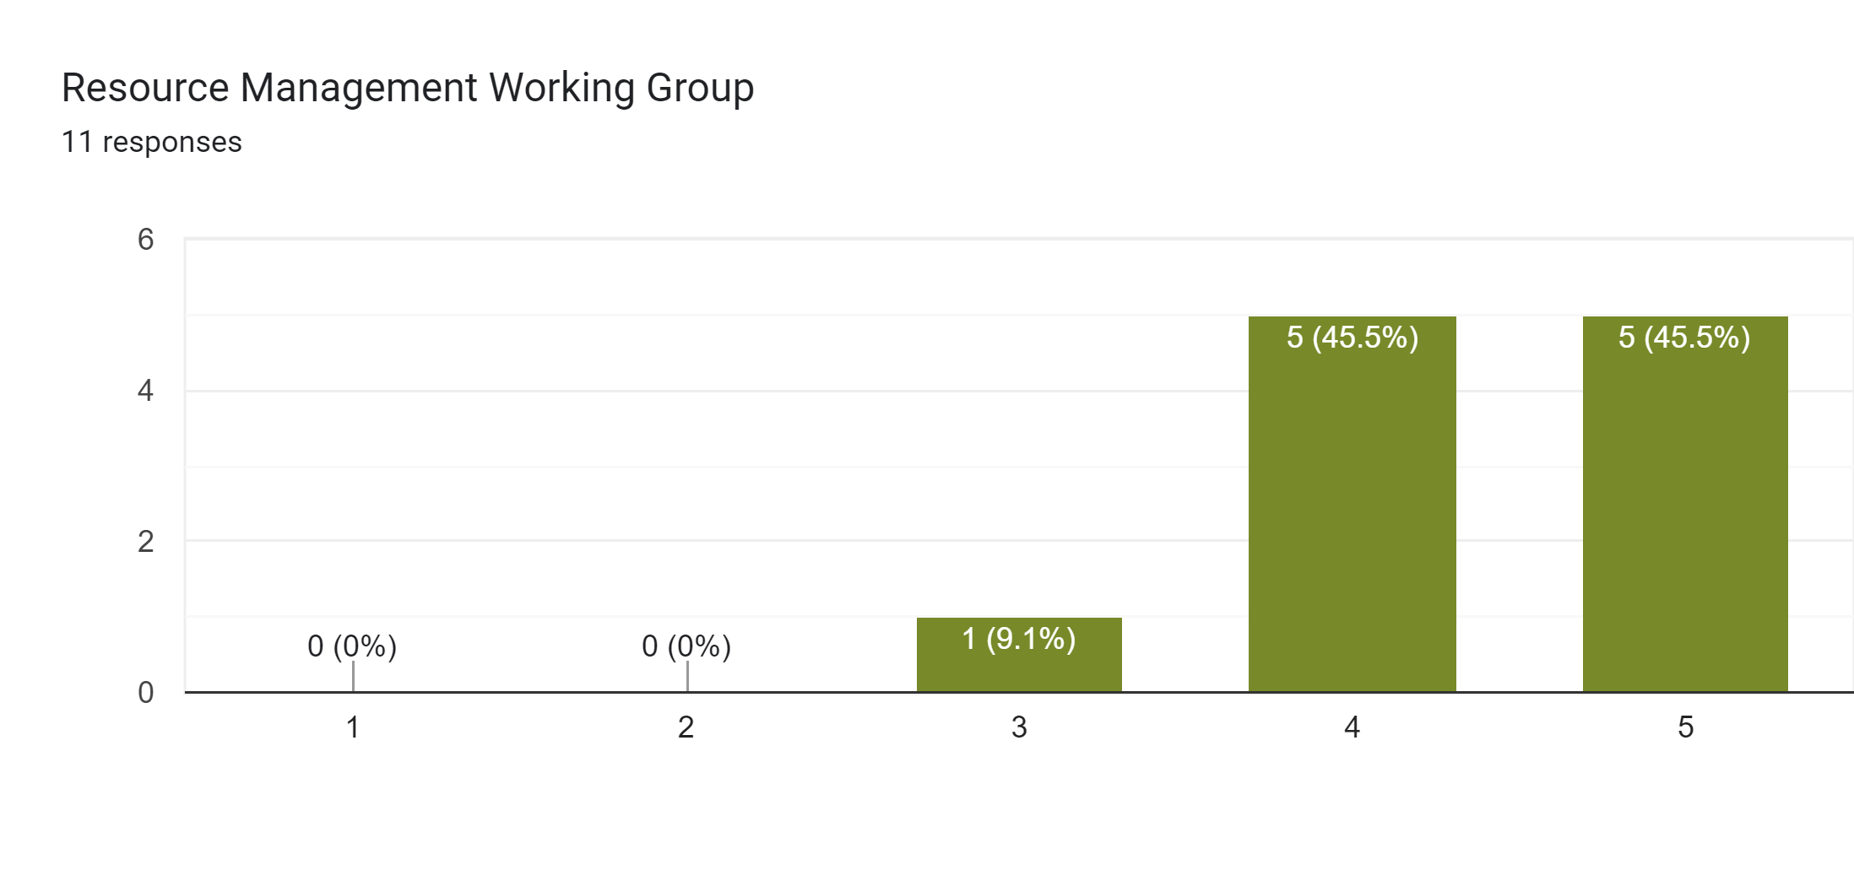
Feedback on purpose, roles, responsibilities
Resource Management Working Group:
Essential for bringing partners together to share info and resources
Field outings are fun and useful
Could benefit from more structured data sharing (restoration successes/failures, etc)
Best current organized mechanism for sharing best practices among land managers
+1
+1

Slide 9
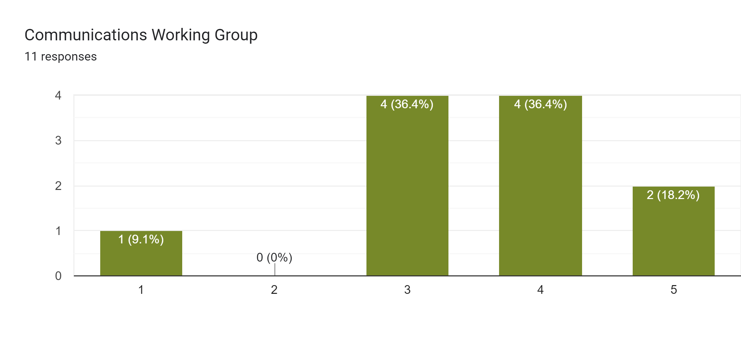
Feedback on purpose, roles, responsibilities
Communications Working Group:
A good idea, but needs are already met through ORISE fellow
Outreach is critical for engaging landowners with conservation, so more effort here is needed
If we want more external facing comms, we need partners to provide the capacity and focus
+1

Slide 10
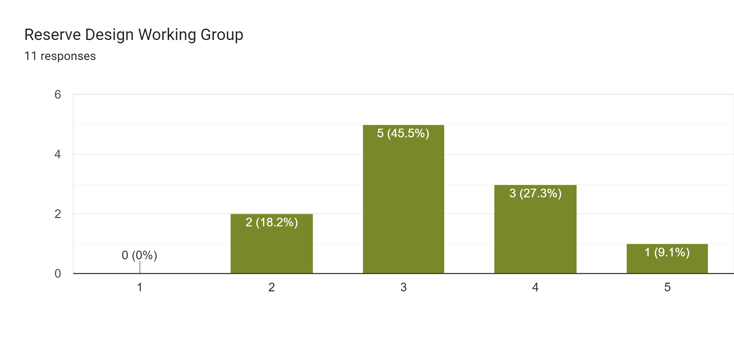
Feedback on purpose, roles, responsibilities
Reserve Design Working Group:
Sandhills design established, and needs more effort to accomplish (but close)
Should venture to Bladen Lakes and Uwharries more
Unless the group focuses more on monitoring, there are already several sufficient data sources/priority maps out there
Map could be useful for landowners
+1

Slide 11
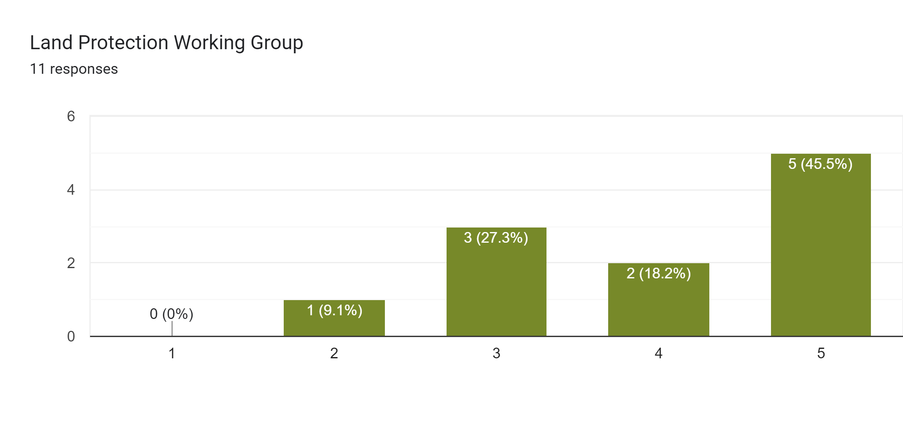
Feedback on purpose, roles, responsibilities
Land Protection Working Group:
Coordinated protection is simply essential
Needs to reconvene and share info/resources/strategy. Doing so with Reserve Design group or spatial ecologists would be worthwhile
There are really only 2 partners who buy land at scale (TRLT & TNC) with financial backing from state and fed. Formal group may not drastically improve situation
+1

Slide 12
STRENGTHS
AREAS FOR IMPROVEMENT
Communication & networking
Cohesion
Institutional knowledge
Diversity of partners & expertise
Data and resource sharing
Science
Landscape-scale impacts
Initial work done in 2000s has provided great focus that has been baked into partners
Monitoring of tougher targets
Private lands focus
Developers randomly call landowners asking about selling interest. We should do the same.
Reach a shared vision now that RCW goals have been met
Identify permanent sources of funding
Increase/start efforts for Carolina bays
Build relationships with elected officials
Develop clear understanding of Army protection priorities
More structured and assigned partner responsibilities
Improve external communications/outreach, especially when RCW is no primary driving force of conservation
More time during meetings focused on particular issue in landscape driven by partner discussion

Slide 13
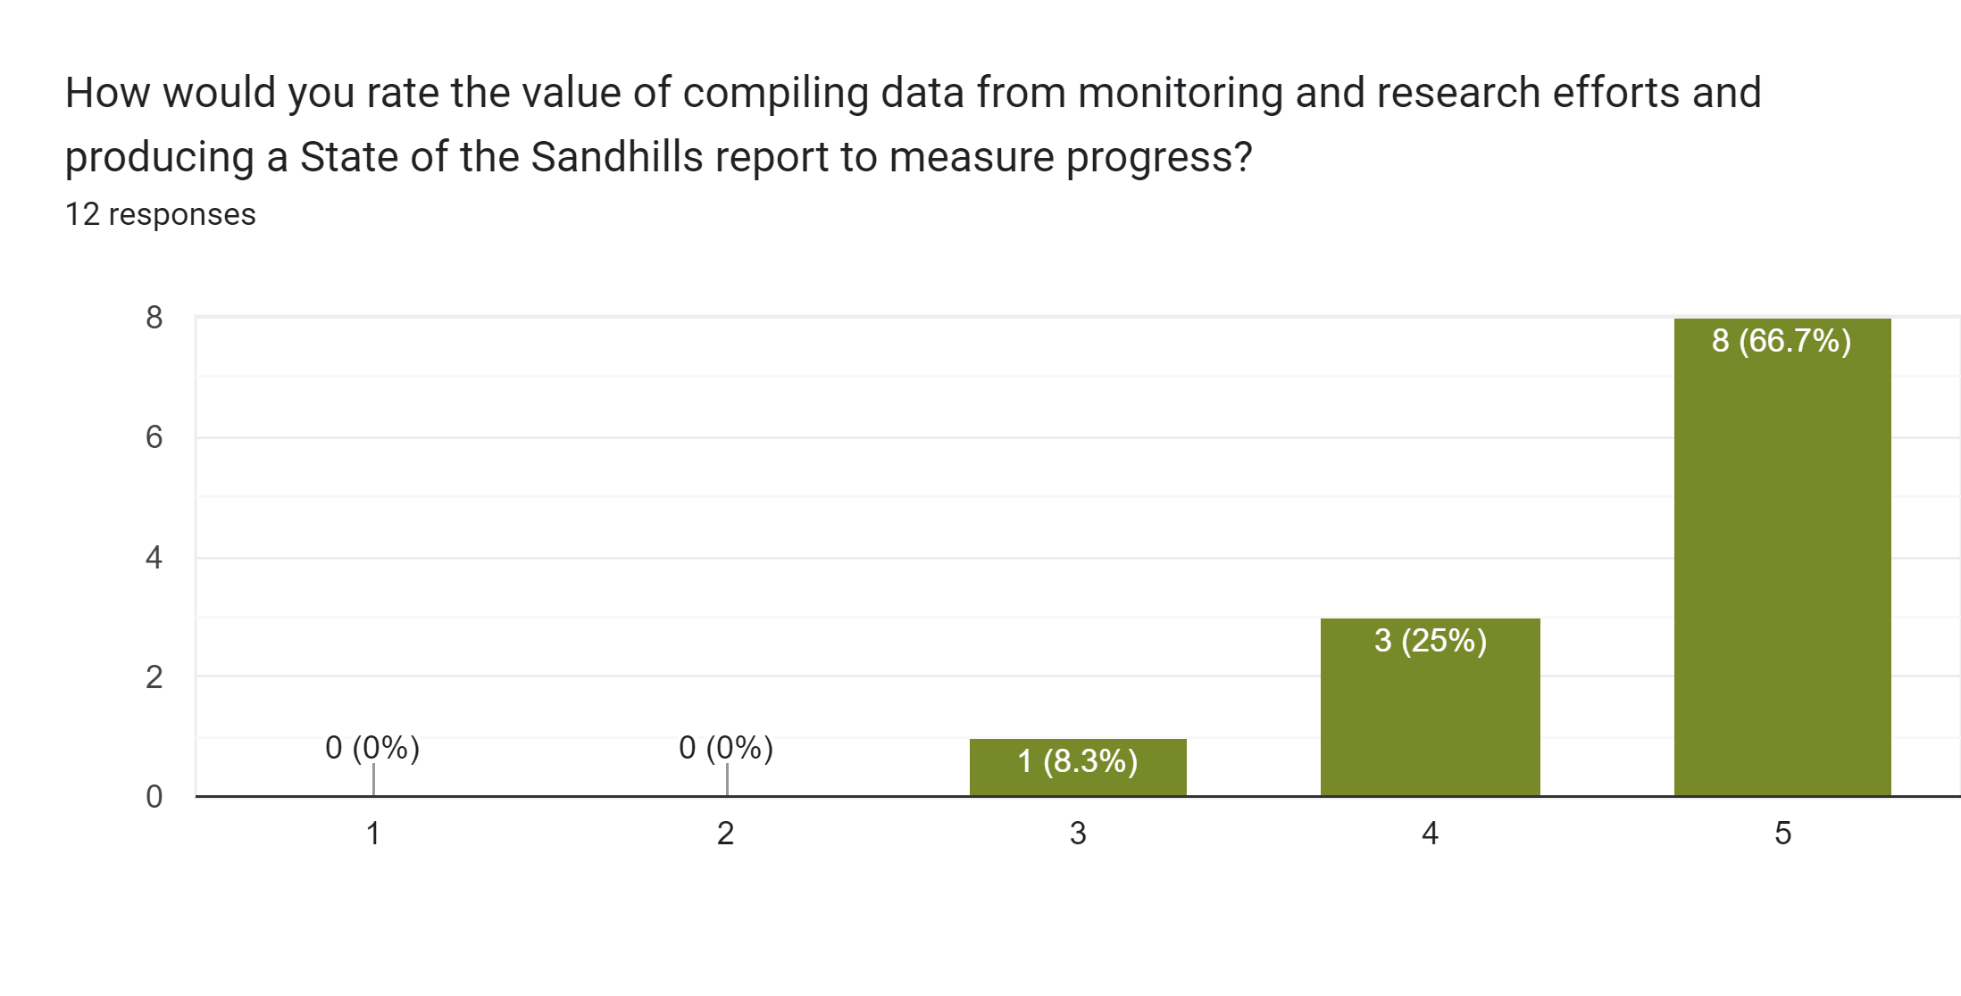
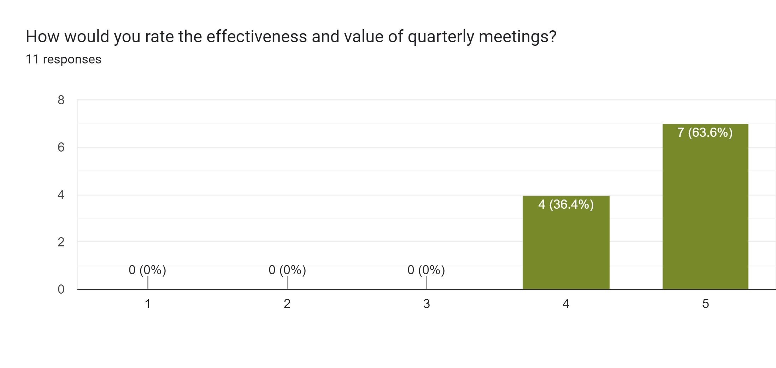
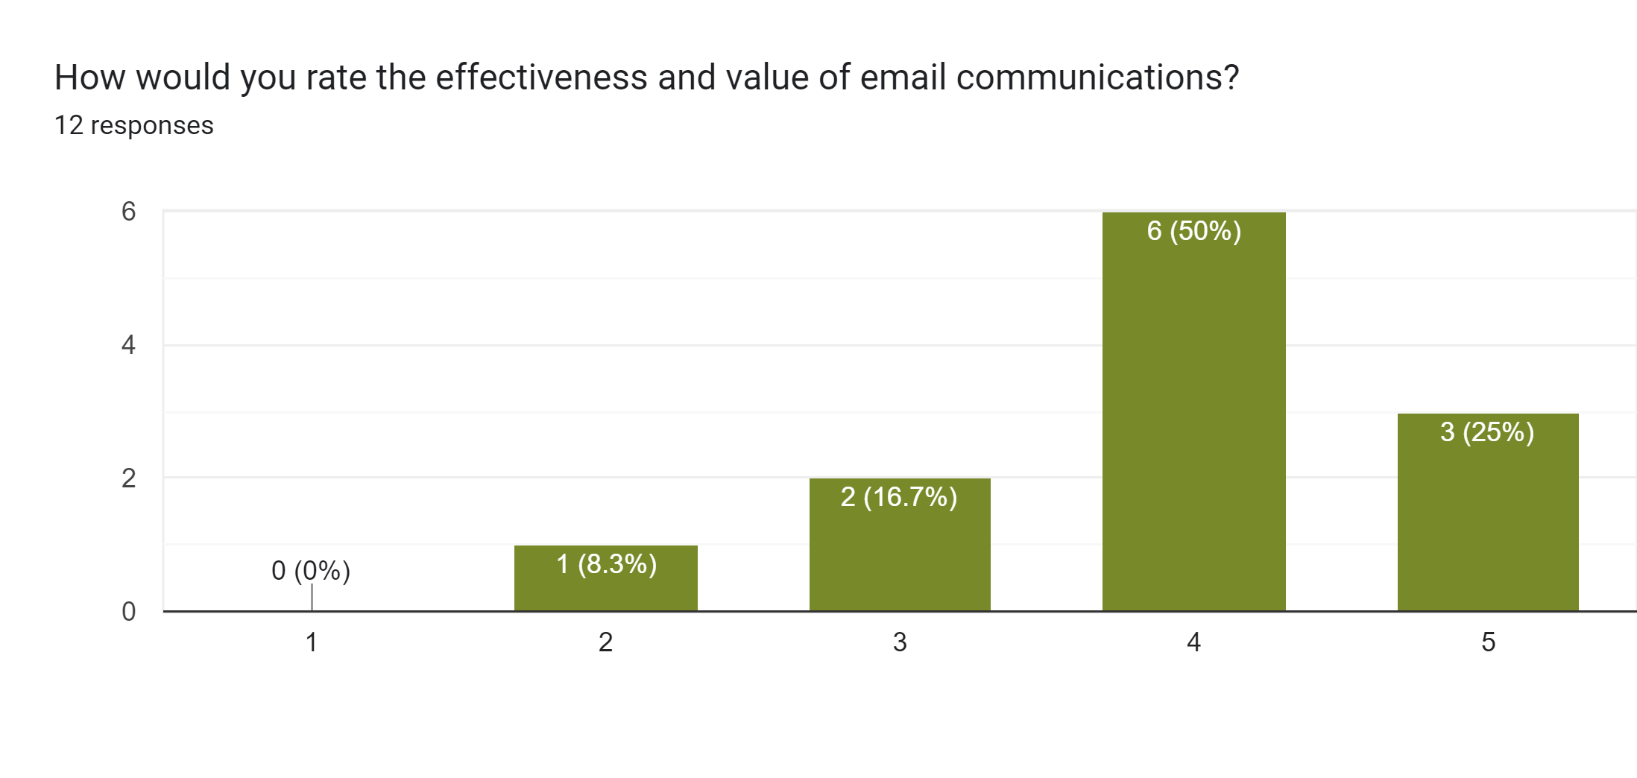

Slide 14
Suggestions for increasing and improving communications
INTERNAL
EXTERNAL
More in-depth conversations on RFPs during quarterly meetings
More informal gatherings
Assign roles and hold people accountable
Sustain the ORISE position
Energize Resource Management Working Group
Encourage greater collaboration between TRLT and TNC
Make State of Sandhills report more digestible for general public
Billboards and radio ads
Connect with elected officials and planning boards more
Invite media to meetings
Invite other industry and educational institutional partners to meetings
Offer internship opportunities for college students doing partnership work

Slide 15
Foreseen future challenges for NCSCP
Down- or delisting of RCW. Important for partnership to establish other sources of funding and shared goals
Changes in military funding, urban development pressure and zoning changes
Commercial and residential developmental pressure (including roads) on habitat and burning capabilities
More species being at risk and meeting their habitat needs in time
Land becoming more expensive
Loss of important insects due to lack of fire or too much dormant season burning
Loss of focus on overlapping interests between training needs and conservation
Achieving ambitious goals without assigned responsibilities to partners and metrics to measure success
Ageing out/retiring of important partnership leaders, as well turnover in a few key positions at TNC, WRC and Fort Liberty
Need to be thinking about the next generation of leaders in the partnership and bring them into leadership positions now

Slide 16
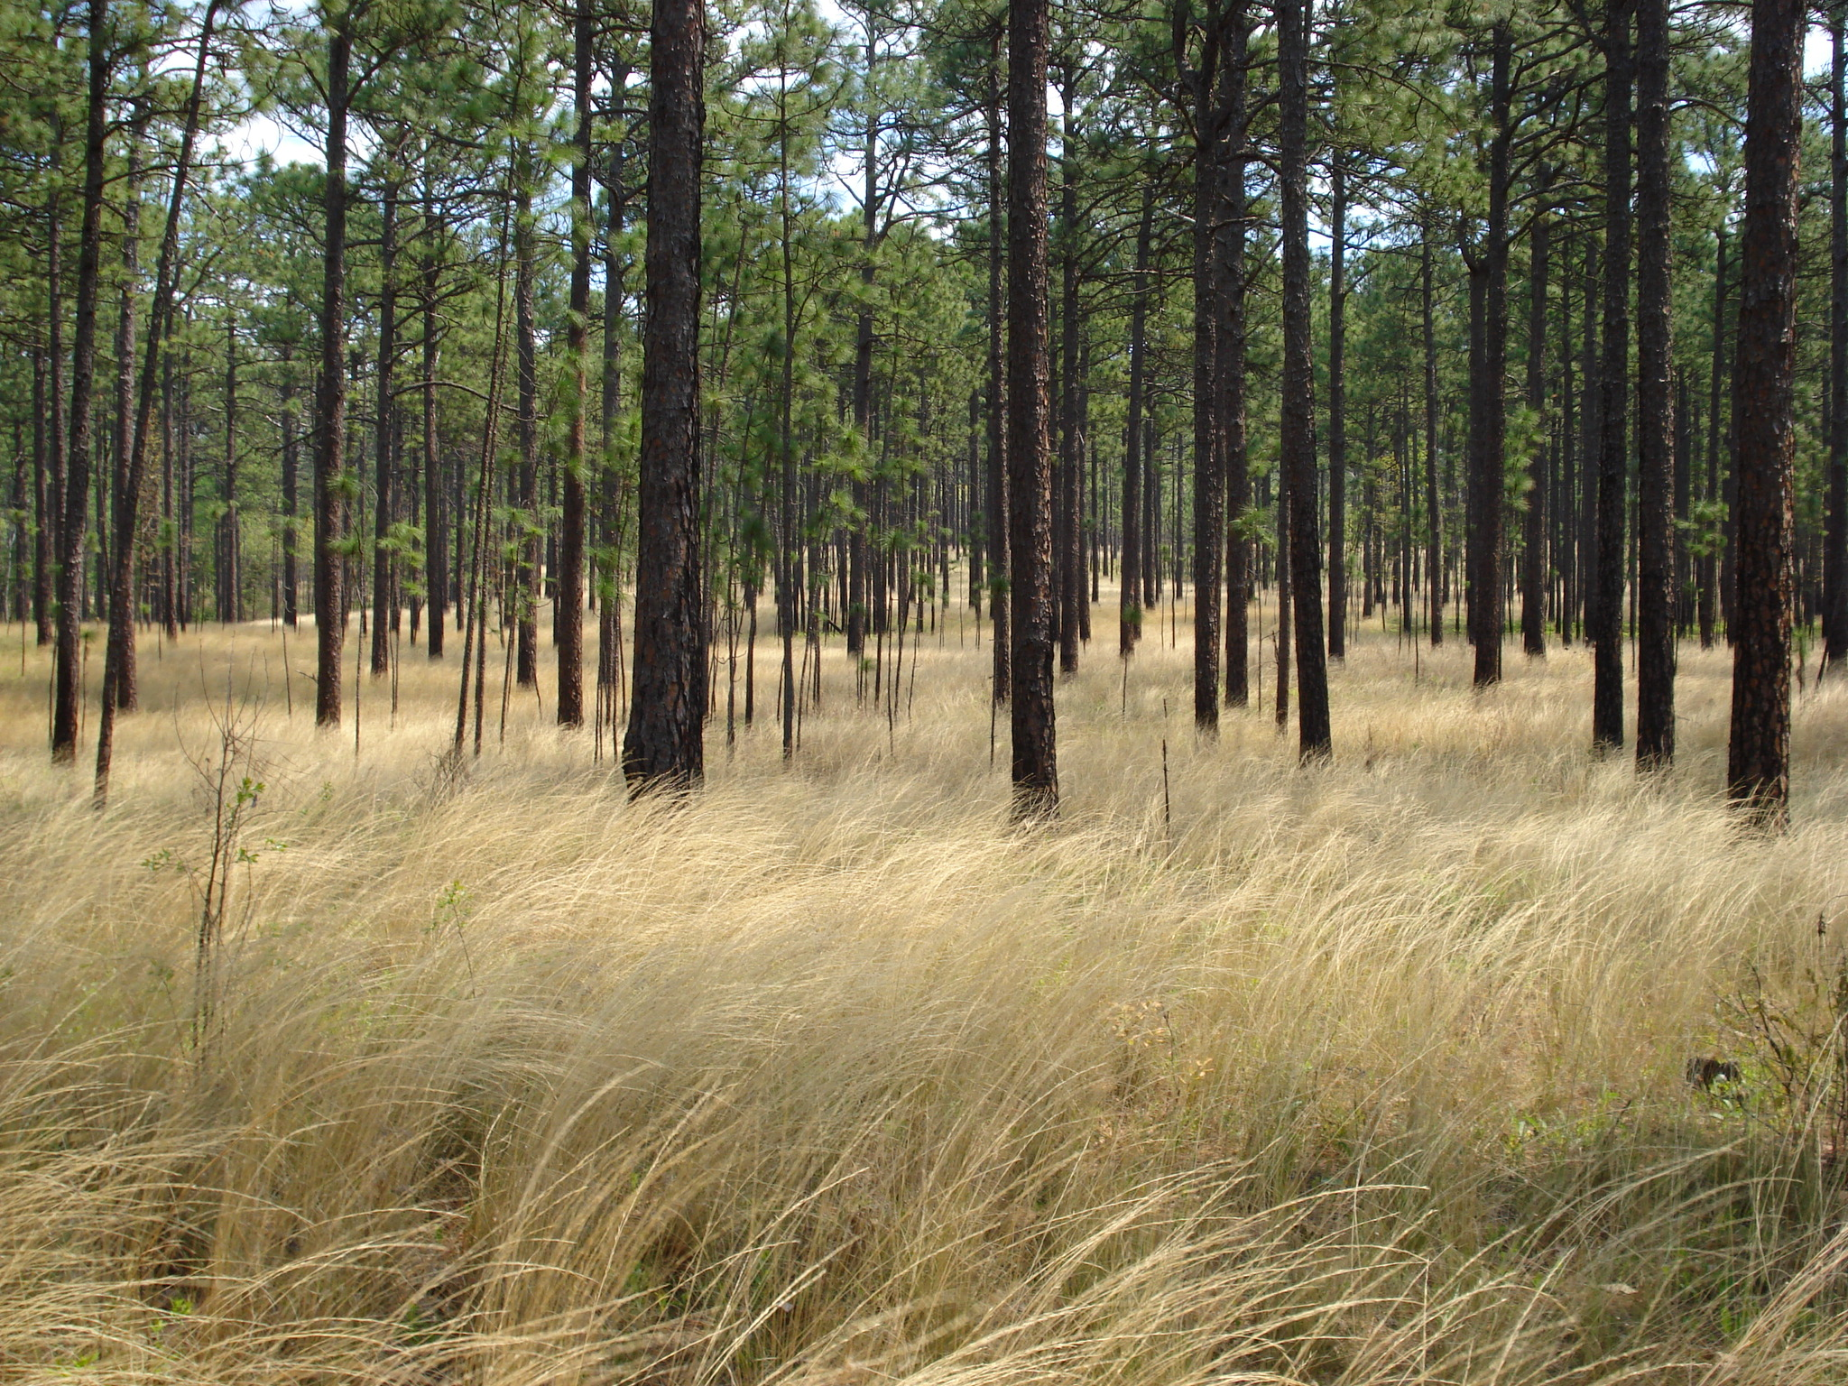
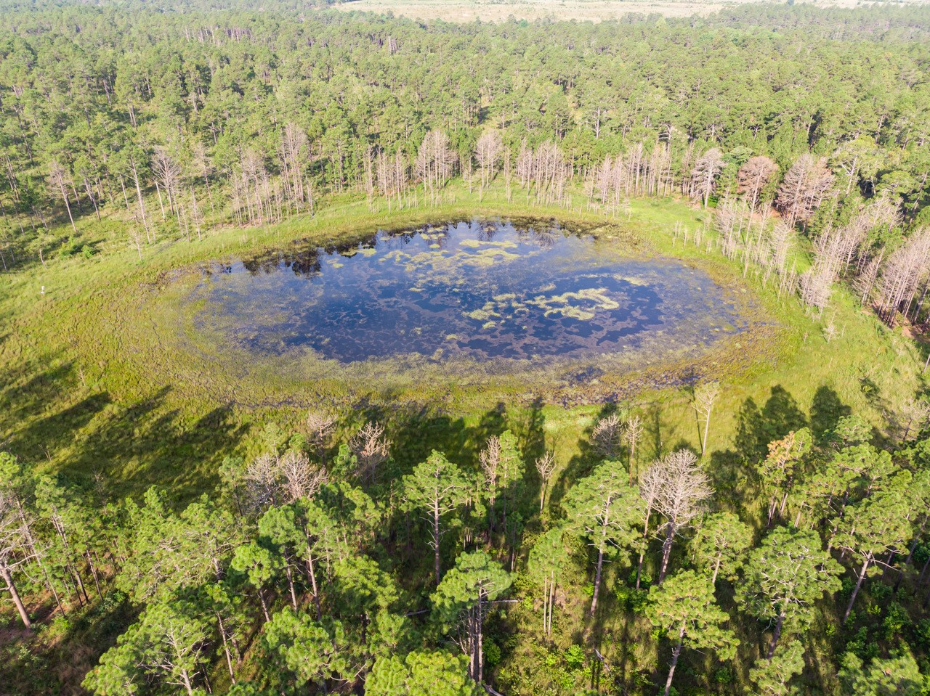
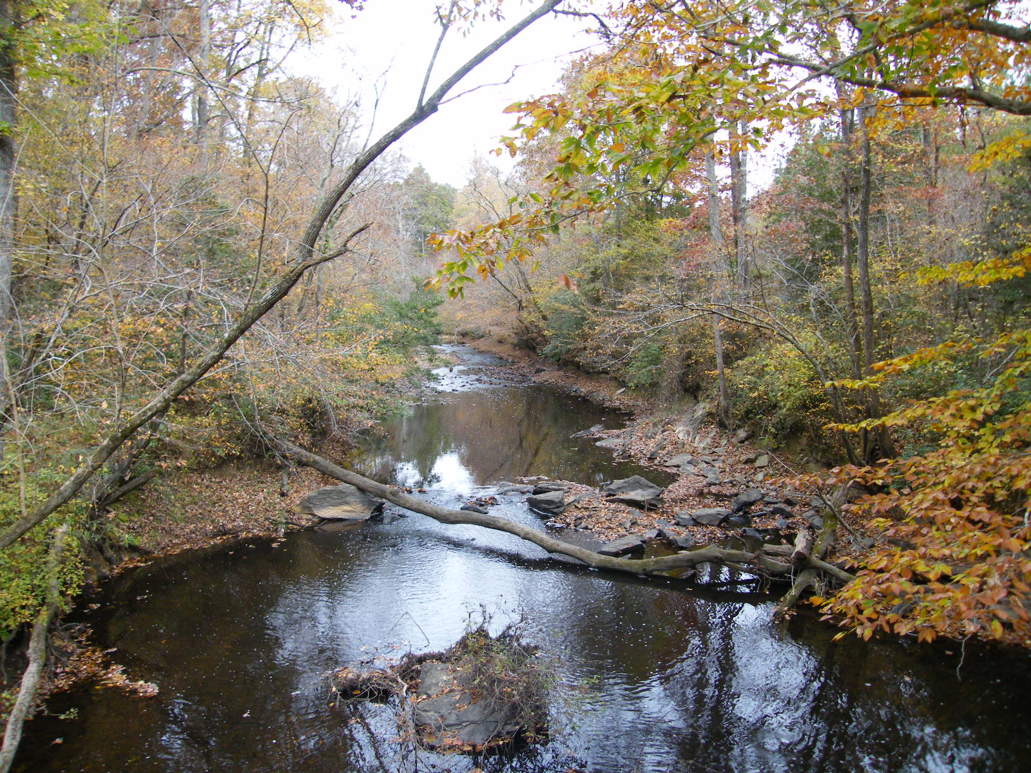
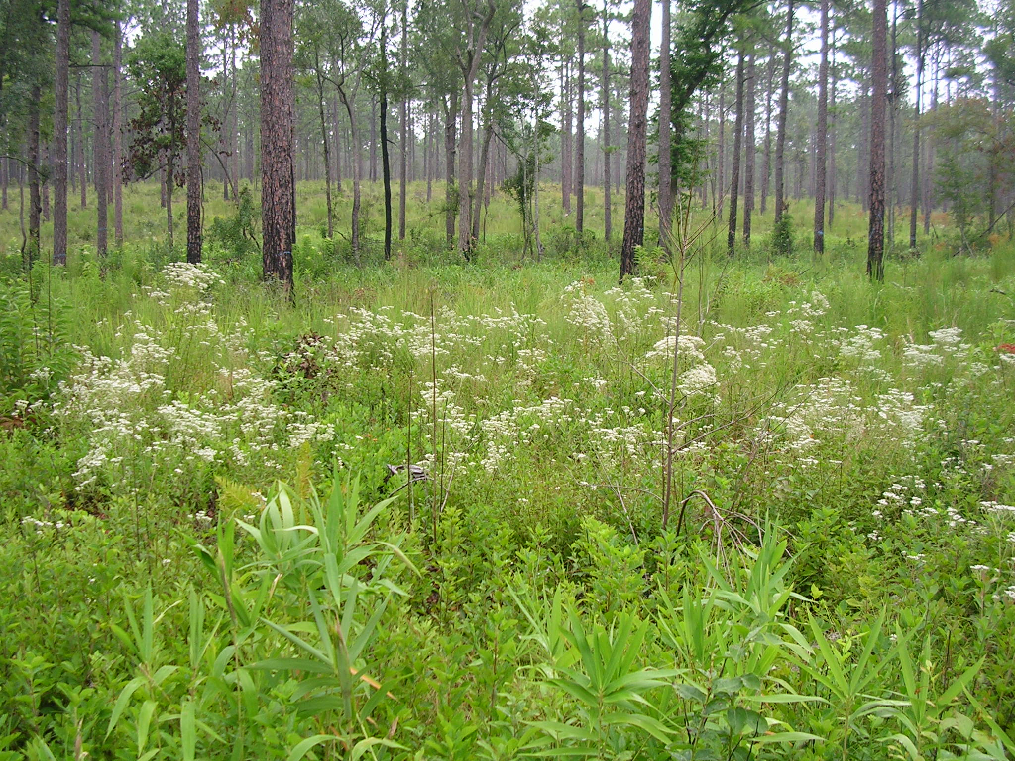
Conservation Target Goals
Longleaf Pine Mosaic
Upland Depressional Wetlands
Blackwater Streams
Streamhead Pocosins and Seeps
Notes:
What are we trying to conserve?
The Core Team chose four broader ecosystem and community level priorities, or conservation targets, to represent NC Sandhills biodiversity, which aligns with the landscape-scale work our partners do.
Conservation targets are elements of biodiversity: species, habitat/ecological systems, or ecological processes.
The only deviation from the 2004 Site Conservation Plan was that the Red-Cockaded Woodpecker, which was previously considered its own conservation target, is now part of the Longleaf Pine Mosaic as a nested target.

Slide 17
Feedback on goals for the Longleaf Pine Upland Mosaic
Overall accurate reflection of organization goals for those who took survey
Would like to see metrics and develop a reporting system to measure success
Anything past a 10-year goal is difficult to predict and focus on as a group of partners
Goals limited to RCW are too narrowly focused
“Restored” should be changed to “improved”. Some species will take hundreds of years to be considered "restored". But if we are making improvements to habitat and can document increases in species, that is a measured success
Connectivity is becoming harder but more important, so we should add connectors as well as core areas
Could set goals for total acres of longleaf and # of acres in good or excellent condition, like ALRI goals
Update to say sustain RCW population above recovery, and perhaps we can consider setting a more ambitious goal
We are currently over 800 PBGs- could we be one of the 1000 PBG super populations called for in the recovery plan?

Slide 18
Feedback on goals for Upland Depressional Wetlands
Overall accurate reflection of organization goals for those who took survey
Lofty goals and progress has been made, but more realistic timeline is needed, or more concerted and delegated effort
Need incentives for landowners to restore UDWs on their land as restoration can be expensive
Desperately needed, but ambitious
Need to define what restored population is for amphibians mentioned
Add in inventory/field validation of UDWs on private lands with landowner permission
Get other private lands staff to contribute during normal job duties

Slide 19
Feedback on goals for Blackwater Streams
Overall accurate reflection of organization goals for those who took survey; if not, still supported
Yes, need more data on hydrologic regime at surface, but also below ground
We are behind and should set a more realistic time goal of 10 years from now
Need more concerted effort for species monitoring, otherwise we will not meet bioclassification goals
Goals are too broad and hard to measure. Would benefit from:
More specific goals (e.g. restore baseflows in Drowning Creek, mitigate flooding on Lower Little River, etc.)
More intermediate goals that are achievable and demonstrate tangible progress

Slide 20
Feedback on goals for Streamhead Pocosins and Seeps
Overall accurate reflection of organization goals for those who took survey, but all agree are too ambitious
Need more data before we can define any tangible goals
Might be better to have an indicator-species-approach here to start with as we learn more about these systems

Slide 21
What goals are critical but not currently represented?
What goals should be highest priority going forward?
Active management of private lands
Concerted efforts in Carolina bay complexes
Curbing development
As strong a focus on other T & E species as RCW has
Key is to focus on goals that all/most partners commonly share. Exceeding 500 PBGs was seen as beneficial to every partner, it was a tangible, understandable, and achievable goal, and most partners could influence progress towards the goal in some way. Achieving that goal brought a lot of additional conservation (and even Army training) goals along with it. We need to identify the next goal that meets all these criteria and elevate it to the headline.
Connecting public and protected lands with the involvement and input of private landowners
Better communication about the Partnership's work to the larger population
Establishing new objectives and goals, as well as looking for additional funding sources
Preventing extinction, protection in cores and corridors, and curbing development
Increased efforts in protecting species to be up-listed
ALRI goal around Maintenance Class longleaf

Slide 22
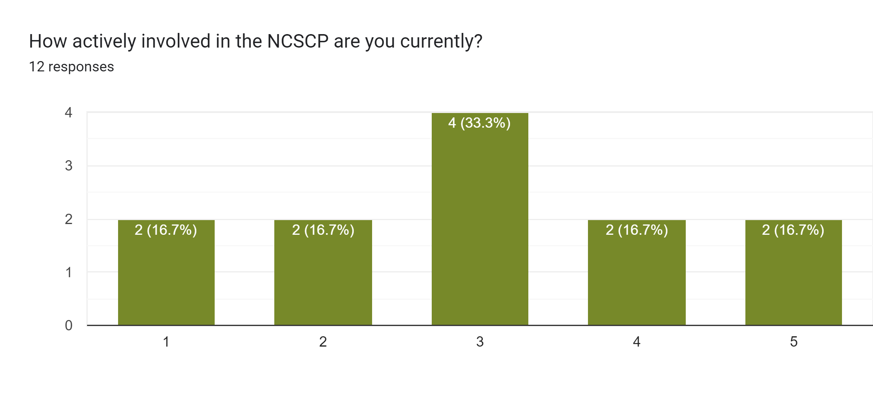
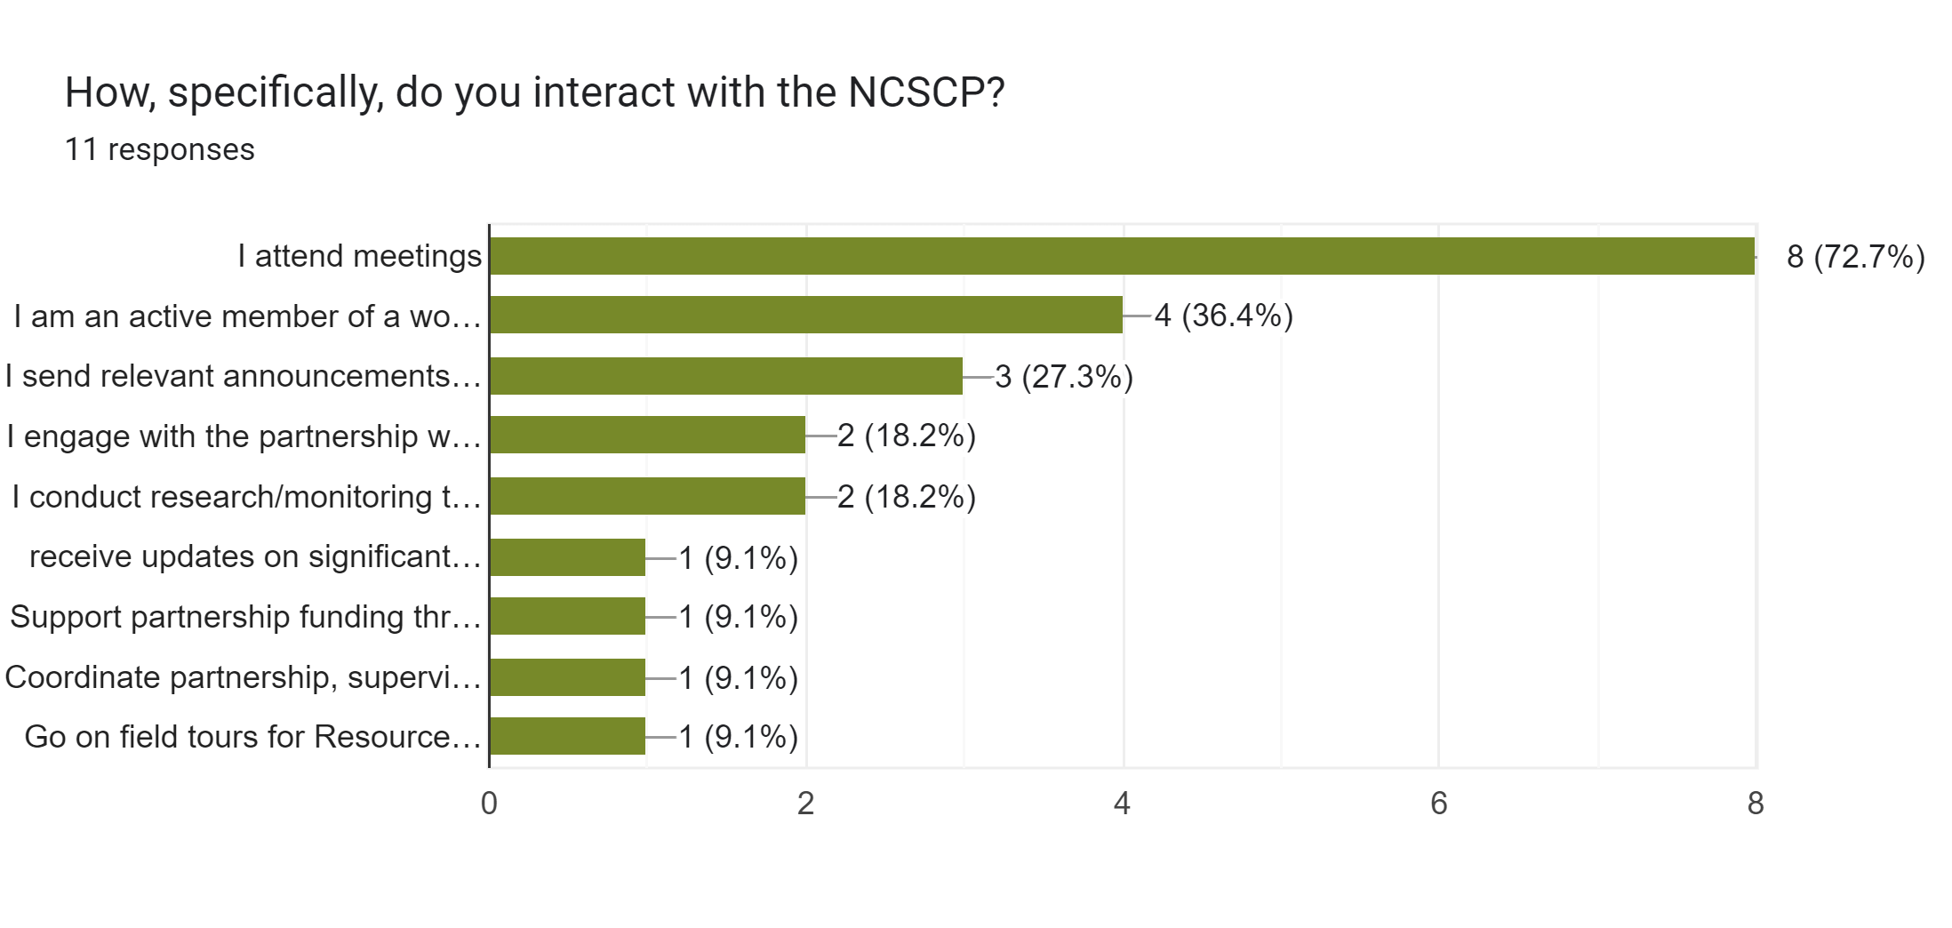

Slide 23
Barriers to participation
ways to increase involvement
More alignment with job requirements
If there were specific roles and responsibilities
More field tours
Home baked cookies

Slide 24
Positive experiences shared by those surveyed
Time with partnership is seminal to how to approach conservation biology/planning, partner collaboration, and work in general
Partners have become mentors & friends
Feel it is one of the largest reasons a position was created with QF in the area. The partners highlighted a need, had the work, and had partners willing to contribute funding. The NCSCP has made it easy to establish relationships with other professionals that resulted in landowner contacts and habitat improvement.
Our latest format where we have content rich presentations are very important to me and the projects I'm part of
The opportunity to visit other lands and see how other managers are operating and handling challenges
Learning about conservation progress, research/monitoring reports and partner updates has been beneficial in bringing the information to my classroom and community
Too many to list
NCSCP has been a significant help in networking and building trust. Played a major role in TNC being able to protect over 24k acres of land. It was beneficial in laying the groundwork of trust and shared values that helped lead to fire crew and other resource sharing agreements between partners, and it has helped to keep us informed about what is happening within the landscape

Slide 25
Questions/Comments?
Notes:
- Obtained 13 responses over period from January 12 – February 8

