Slide 1
Reserve Design Working Group
Finalizing inputs for a Sandhills GGT Appendix
February 23, 2010
Notes:
Welcome, Purpose of meeting, Updates – Since last time, work on action items related to GGT, etc.

Slide 2
Sandhills appendix
Tier 1 Resources: Sensitive Wildlife and Natural Resource Areas
Based on current knowledge, these wildlife habitats are the most sensitive to development. These areas tend to be relatively small in size, and there is a high degree of knowledge about the value of the resources. Green Growth Toolbox recommendations are to set aside these areas from development as much as possible. If development must occur in these areas, it is recommended that conservation development design principles be used to minimize impact to these areas (see Section 4 and 5 of the Green Growth Toolbox handbook).
Tier 2 Resources: Wildlife Habitat Landscapes
Based on current knowledge, these areas contain wildlife habitats, wildlife corridors, and buffers for lands on which wildlife management or recreational activities take place. These areas are generally larger and occur within a greater variety of land uses than the Tier 1 habitats. Wildlife in these locations are sensitive to extensive residential and road development but less sensitive to rural land uses. Green Growth Toolbox recommendations are to encourage placement of working lands within Tier 2 areas.

Slide 3
Tier 1 Resources Map Layers
Significant Natural Heritage Areas | Significant_Natural_ Heritage_Areas | Quarterly | X | X | X
Rare Species Habitats | Rare_Species_Habitats | Irregular | X | X | X
Potential Upland Habitats | Potential_Upland_ Habitats | Irregular | X | X | X
RCW Foraging Habitats | RCW_Foraging_Habitats | Yearly | X | X | X
Aquatic Significant Natural Heritage Areas | Aquatic_SNHA | Irregular | X | X | X
Streams & Riparian Resources with Fed T&E | Streams_Buffers_FedTE | Irregular | X | X | X
Other Streams & Riparian Resources | Streams_Buffers | Irregular | X | X | X
Floodplain Boundaries | Floodplains | Irregular | X | X | X
Tier 2 Resources Map Layers
Animal Guild Habitats | Animal_Guild_Habitats | Irregular | X | X | X
Sparsely-Settled Habitats | Sparsely_Settled_Habitats | Irregular | X | X | X
RCW Corridors | RCW_Corridors | Irregular | X | X | X
Smoke Awareness Areas | Smoke_Awareness_Areas | Irregular | X | X | X
Hunting Safety Buffers | Hunting_Safety_Buffers | Yearly | X | X | X

Slide 4
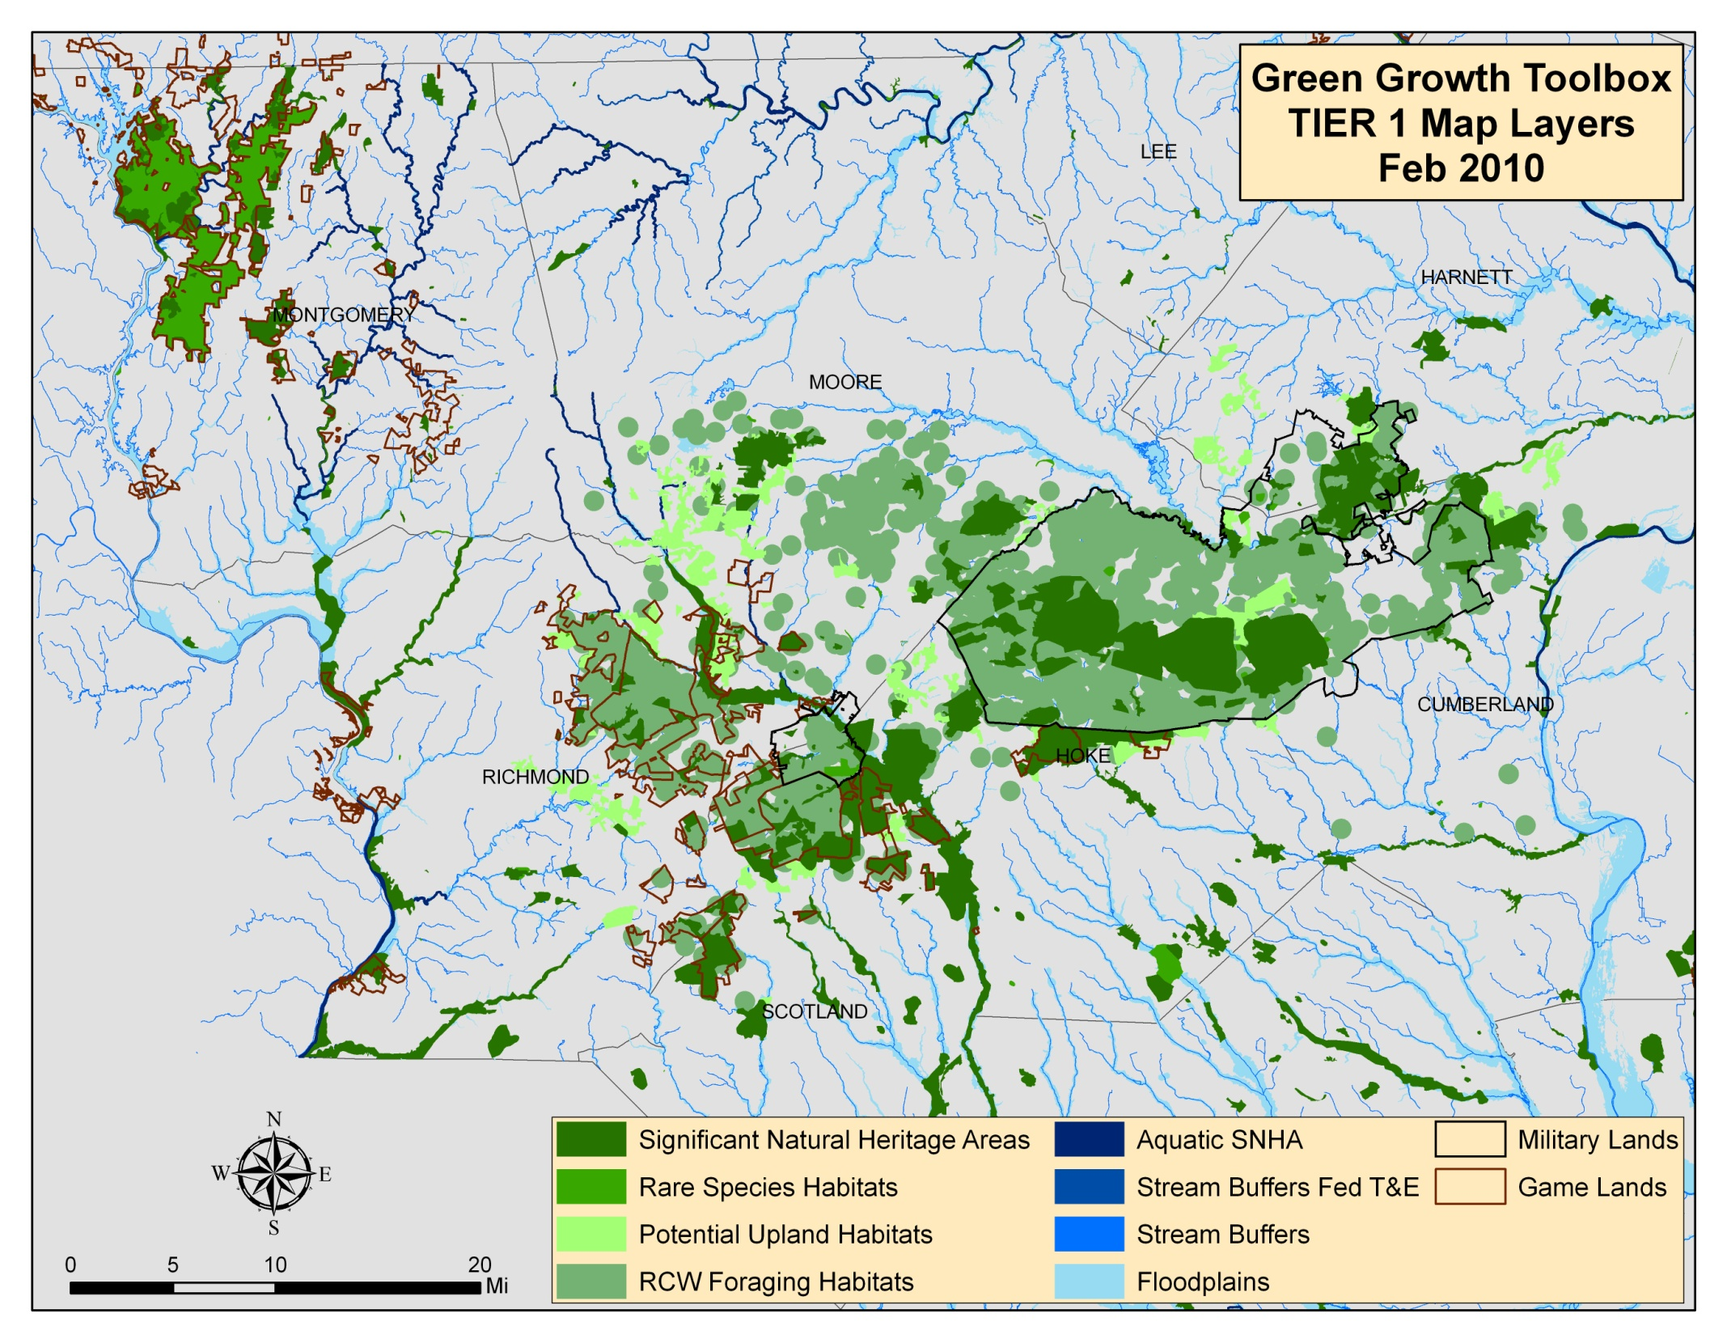

Slide 5
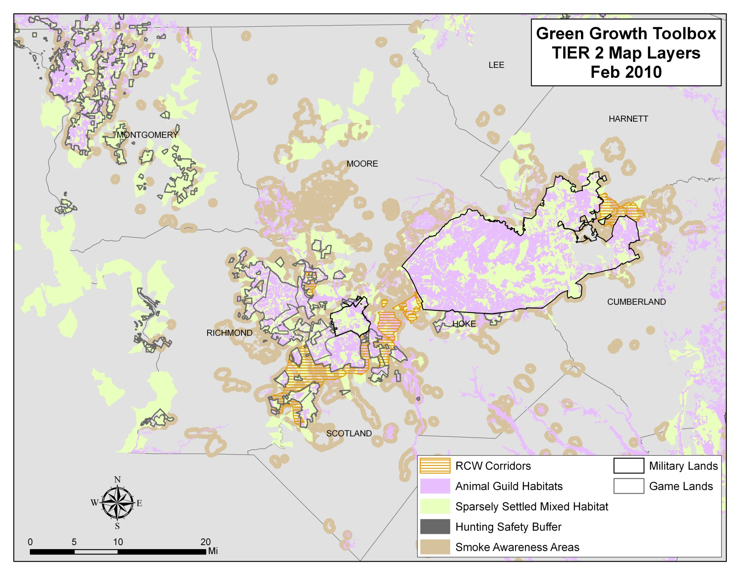

Slide 6
Action Item 2
Notes:
Action Item 2: Pre-assigning priority. Is the Tier 1 versus Tier 2 enough? Is there added value in breaking it up further into Very High, High, and Medium Conservation priority?

Slide 7
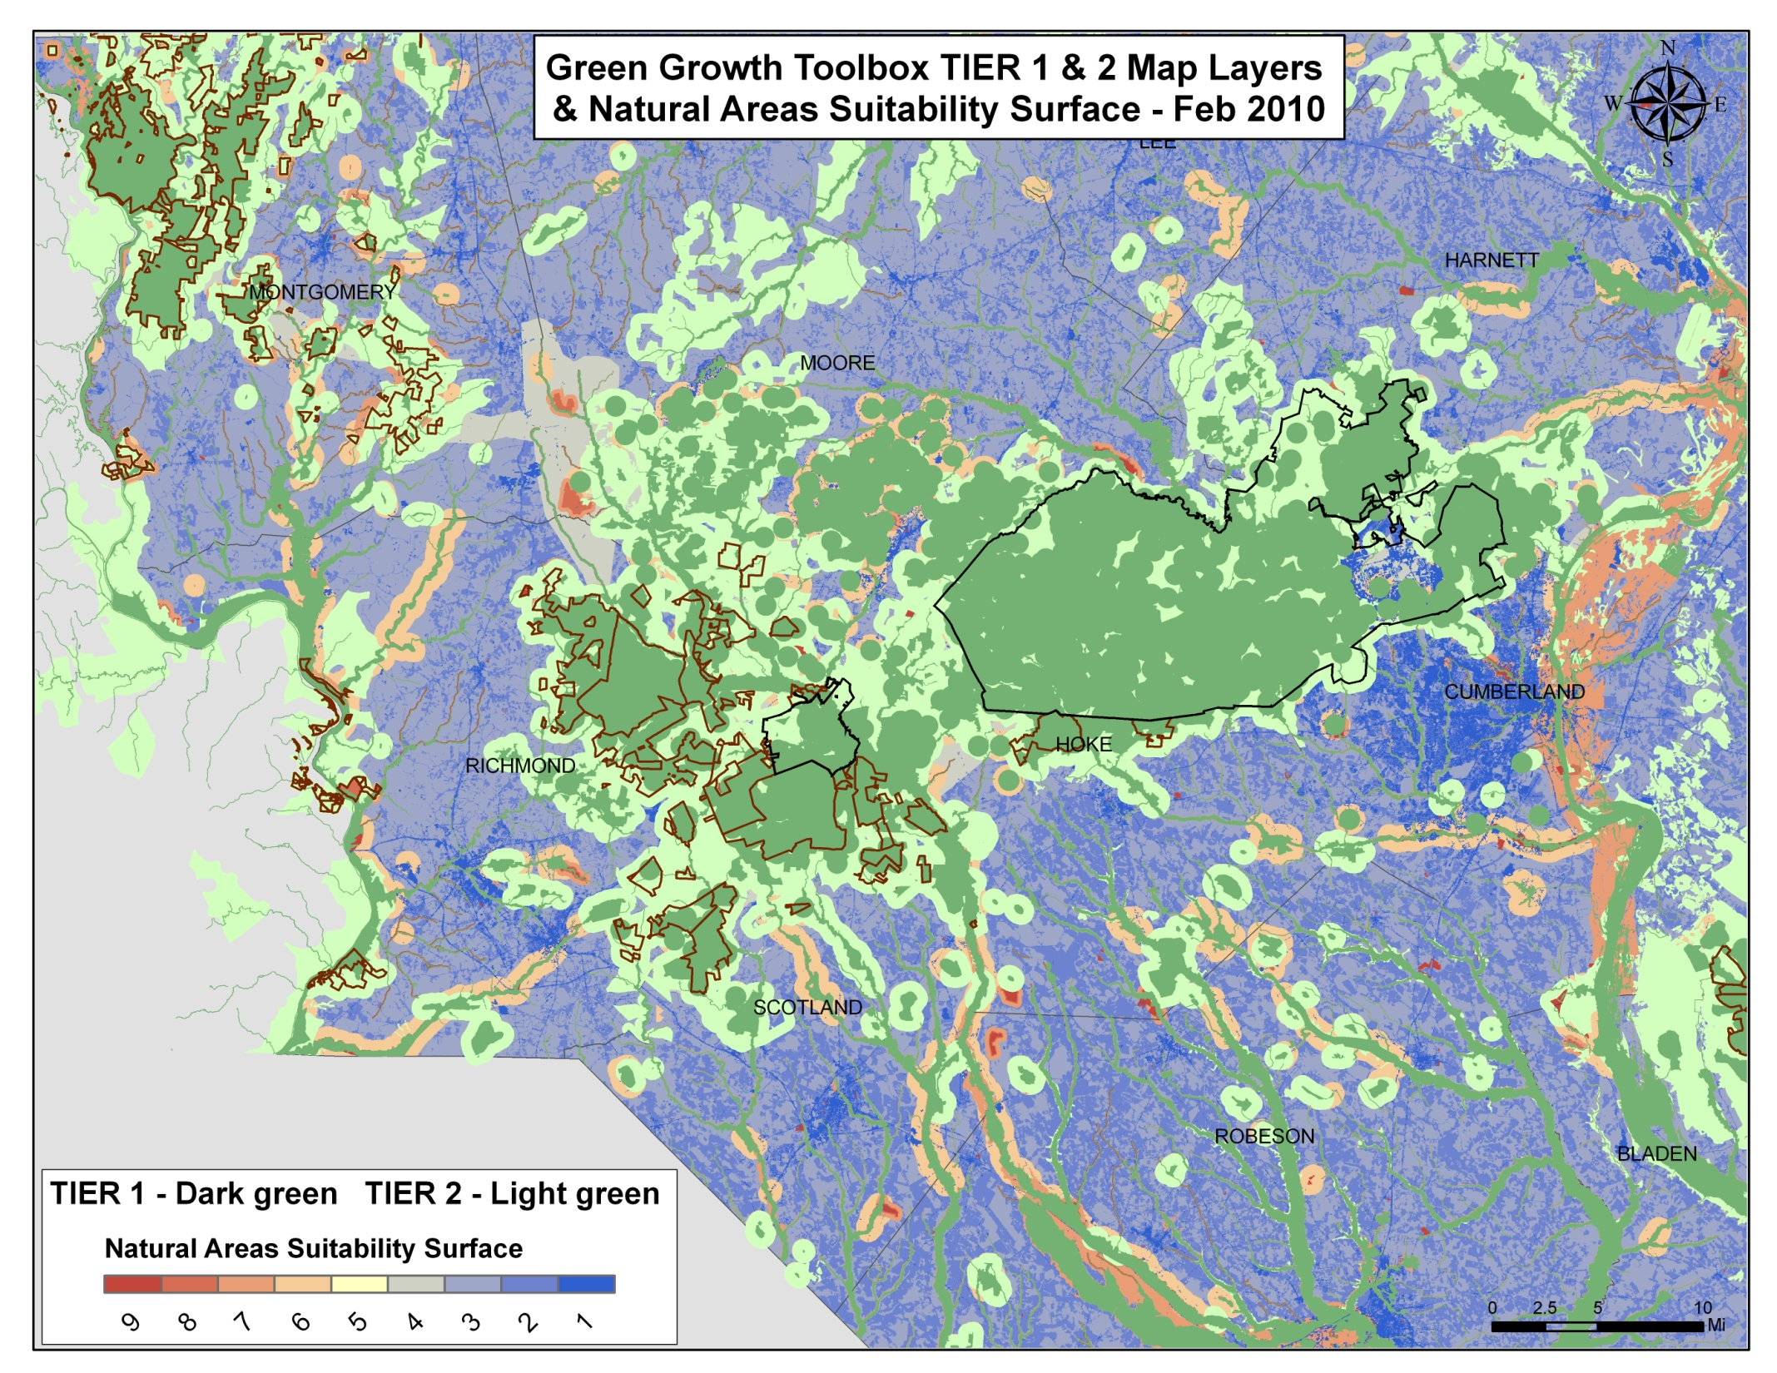
Notes:
Overall – good coverage by Tier 1 and Tier 2 map layers
Discrepancies –
NASS 9/8 (reddish – pink) – Protos eliminated due to lack of corresponding EO
NASS 4 (gray) – we’ve eliminated proposed corridor study areas and guild core connectors for purposes of GGT
NASS 7 (pink) – corrected incorrect display of 500 year floodplains in NASS
NASS 6 (lt. orange) – potential, guilds, outside RCW partitions, areas within .5 mi buffer drawn around upland areas for smoke buffers have been determined to be unnecessary

Slide 8
Animal Guild Habitats
Steve Hall’s findings
2,341 records representing 525 animal species
Species breakdown: 115 vertebrates - 408 insects - 2 land snails
Indicator Species: 10 of the species (482 records)
21 guild/core areas identified: only 3 are ‘mappable’ (have EO rank of A or B), 6 are potential but need more surveys
Sandhills Seeps Habitats = Most Threatened
Pitcher Plant Meadows & General Wet, Herbaceous Swales (alt. Herbaceous Peatlands and Pitcher Plant Meadows)
Sandhill Seeps and Wet Sandy Herbaceous Swales (alt. ? Savannas and Wet, Sandy, Herbaceous Swales)
Sandhill Streamhead Mires

Slide 9
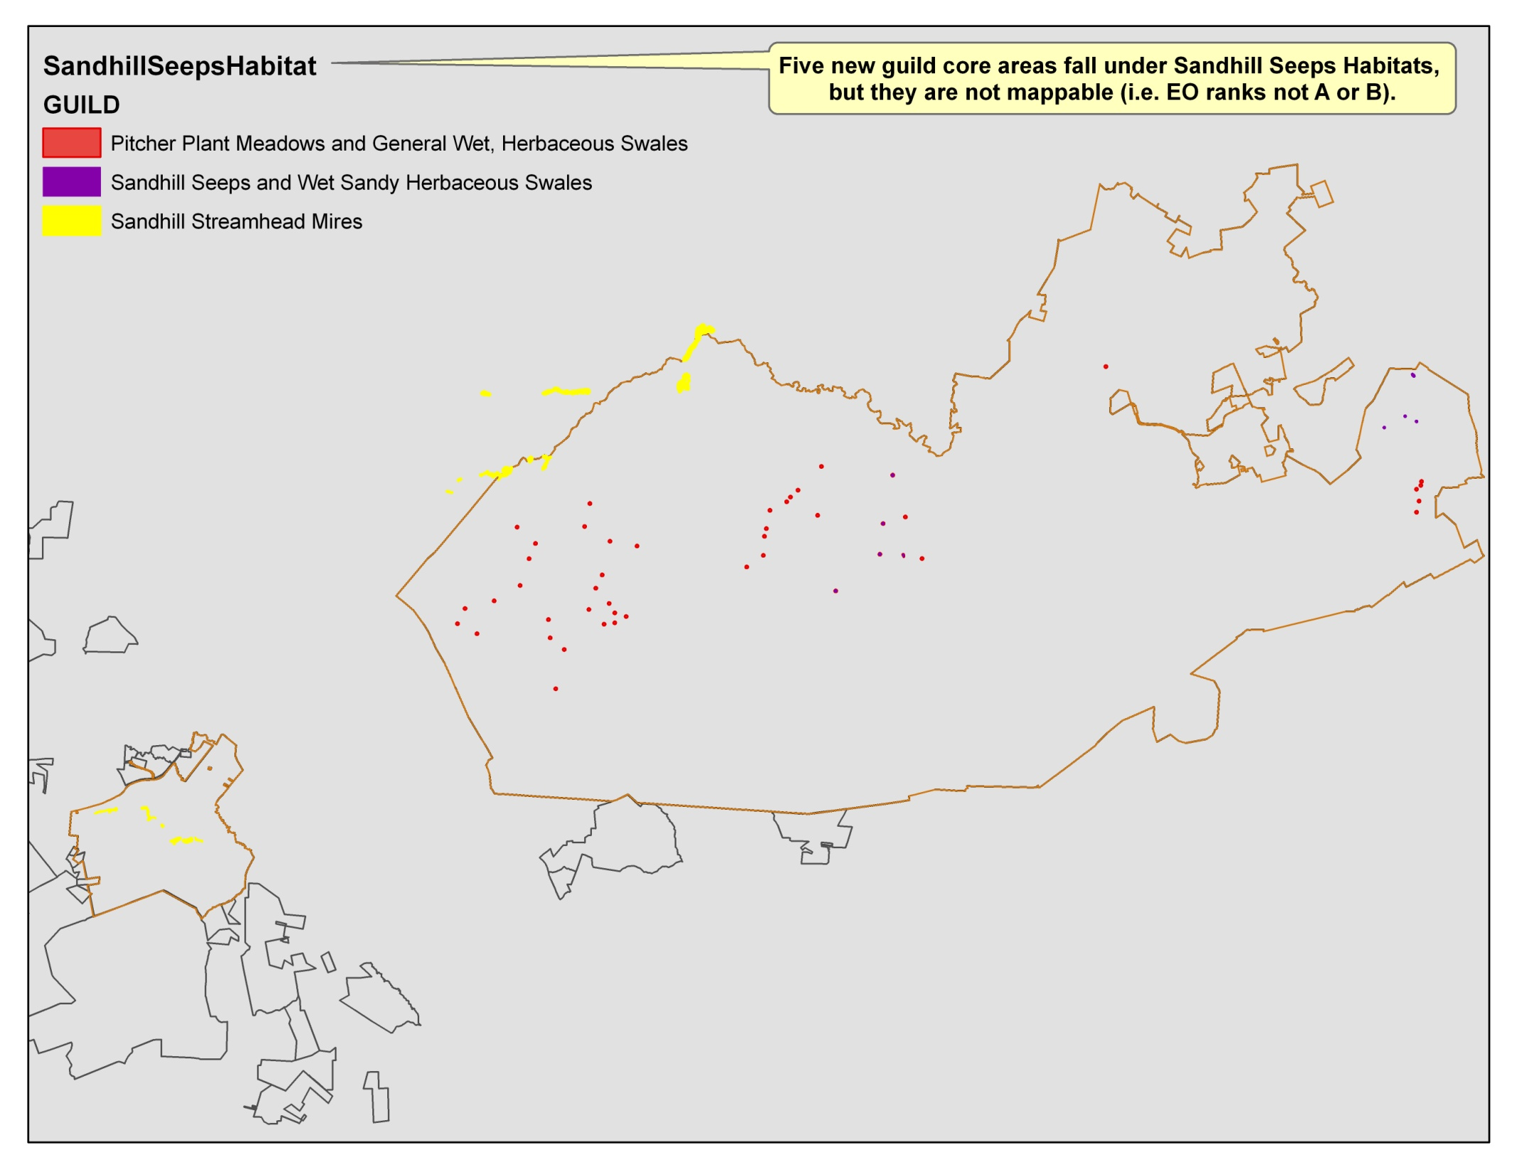
Notes:
Some Sandhill Seeps Habitat occurs outside of existing protected or managed lands.

Slide 10
Animal Guild habitats
Steve’s findings, cont.
Animals assoc. with seeps and filled-in beaver ponds nearly absent outside of Ft. Bragg
Seeps – problem with altered fire regime coupled with loss of landscape integrity
Streamhead mires – unsure of problem but herbaceous vegetation different than sites occupied by St. Francis Satyr
KEY CONSERVATION ACTIONS:
Entire power line linking seeps on PCP preserve (N of 73) to those on Wilson tract (~3.5 mi)
Protect overall process of beaver pond creation and abandonment rather than individual examples
Beavers working on restoring sedge mires, but more work to determine status of fauna

Slide 12
Animal Guild habitats
Using the data
Areas surveyed during ‘09 field season have greater certainty but shapefiles not yet available (and only 3 are ‘mappable’)
No longer mapping C-ranked core areas but 12 previously mapped (3 SSMH – 340K, 9 other – 150K)
23 habitat/indicator guilds identified in Sandhills but Freshwater Marshes not mapped
Of the 22 mapped, 5 have less than 500 total acres
Pitcher Plants (T, 114), Seeps (T, 23), Streamhead (T, 348), Atlantic White (60), Wet-Mesic Pine (14)

Slide 13
Action Item 6

Slide 14
Animal Guild habitats
Using the data, cont.
Currently included as Tier 2. Should any be included as Tier 1?
See table
Layer description and recommendation:
Animal Guild Habitats are identified by a landscape-level analysis of habitat types and the groups of animals that use them. Each habitat type occurs in the landscape within a single or multiple core areas. A core area contains habitat with sufficient connectivity to support a group of indicator species, or guilds. Guild species are both habitat specialists and sensitive to fragmentation. Green Growth Toolbox recommendations for these areas include: locating development on the edges of these habitats without completely surrounding any given habitat patch; maintaining forested parcels and lots; and minimizing tree removal.

Slide 15
Other (higher priority)
Smoke Awareness Areas
Distinction between known and desired/expected future
See pdf
Significant Natural Heritage Areas
Distinction between primary and secondary areas
See jpeg
Layer description
SNHA site boundaries are derived from a variety of information sources which vary in their positional accuracy. For this reason, the NC Natural Heritage Program recommends that if a project falls within several kilometers of a SNHA, then it should indicate the need for more information. The effects of a project can vary depending upon the species or communities contained within the SNHA. An assessment of those effects should be performed by ecologists familiar with the site.

Slide 17
Other (lower priority)
Rare Species Habitat
Attribute Information – How access?
Compatibility/use with statewide available NHEO
Wetland Element Occurrences
Isolate from NHEO data?
At least 2 of 26 floodplain pool, upland depression, or vernal pool EO warrant further investigation as Protosites or Rare Species Habitats
Hillside seepage bog, low elevation seep, small depression pocosin, and upland depression swamp forest included in Rare Species Habitats layer
Restoration Areas
Guild Core Connectors

Slide 18
Next meeting
Action Items remaining from Oct 2009 and Jan 2010 meetings

