Slide 1
Fort Bragg Climate Resiliency
Brian Williams
DPTMS - ITAM / REPI /
RTLA/ACUB Coordinator
USAG-Fort Bragg
Potential Impacts to Readiness
Version Number 3
As of 01 SEP 2022

Slide 2
Abstract
Climate Resiliency on Fort Bragg
Development of strategies began in 2018
Minimal guidance on how to proceed
Primary focus areas
Riverine Flooding
Wildfires
Fort Bragg has one of the most overly pressured training lands within the DoD
Notes:
Climate resiliency is relatively new thought process within the DoD.
We don’t know what we don’t know
Primary focus areas are flooding and wildfires
Flooding impacts affects the installation on several levels:
Potentially blocks access to training area
Soldier and Civilian Resources spent in assessment and repair
Prescribed burning number one toolbox for managing the longleaf ecosystem. If it we lose the ability to burn
Habitat will fail, populations could suffer, creating training restrictions, reducing the availability of lands

Slide 3
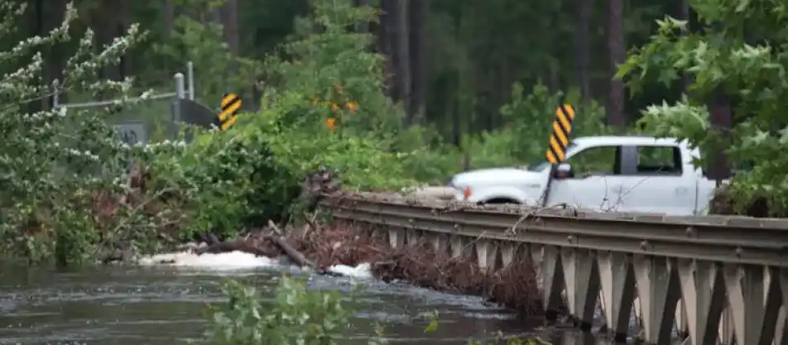
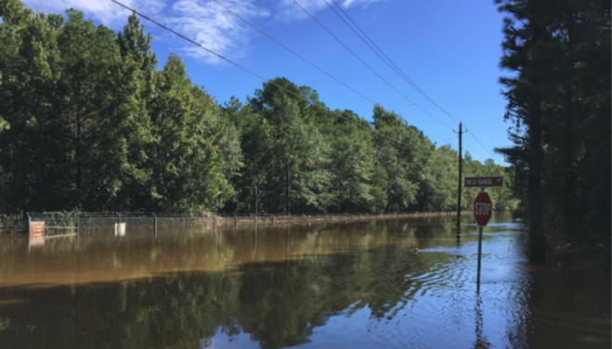
Hurricane Frequency
Hurricane activity impacting Fort Bragg has increased over the past 60 years
5” rain event within 6 hours on FB 29 SEP 16
08 OCT 16 Hurricane Matthew dumped 12” of rain 12 hours
Hurricane Florence 14” over three days
Notes:
The signs we’re already seeing on the installation are:
More frequent drought periods
Extreme temperatures
More intense storms
Typical summer storms
Hurricanes
Matthew was intense but quick (more damage)
Florence was less intense, but stretched over 3 days (more flooding)

Slide 4
Flood Issues and Potential Effects
Issues
Urbanization has increased stormwater runoff
Aging infrastructure is not sized to handle increased rain events
Potential Effects
Fort Bragg deployment nodes could be impacted by heavier, more intense events
Greatly reduced access to the installation and training area
Notes:
A developed acre of land on Fort Bragg has typically 9x more runoff than an acre riparian area
Culverts that were more adequately sized 40 years ago can’t handle the amount of runoff that comes to them now.
Flooded airfield prevents Fort Bragg from maintaining the ability to be anywhere in the world within 24 hours
Major road failures impact all aspects of the installation
Recovery efforts required from troops and civilians interrupt and derail all other missions on the installation

Slide 5
Fire Management Issues
Training activity across the installation has increased since pullout from Iraq and Afghanistan
Weather variations are expected to reduce the burn window to conduct prescribed fire
Heat
Drought
Humidity
Wind

Slide 6
Potential Effects
Increased fuel loads due to loss of quality burn days
Increase and severity of wildfires
Increase in conflicts between prescribed burning and training
Degradation of longleaf pine ecosystem
Potential increase in training restrictions due to loss of habitat effecting overall readiness
Notes:
Compounding effect of shortened burn window
Currently, the loose SOP is that training takes priority; could result in burning taking priority

Slide 7
How We’re Adapting
Seasonally lowering lake levels on Fort Bragg
Multiple watershed research projects within the cantonment area of Fort Bragg
Replacing aging infrastructure with associated new construction
Closing non-strategic firebreaks and reconfiguring burn blocks
Continue to research and develop new strategies to adjust for climate change

Slide 8
Questions/Discussion? brian.g.wiliams10.civ@army.mil
Barry Hull/DPTMS/910907-4374/barry.s.hull.civ@army.mil
Notes:
We’re basically building an aircraft in flight. It is going to take time, resources, and considerable effort to develop solid climate resiliency.

