Slide 1
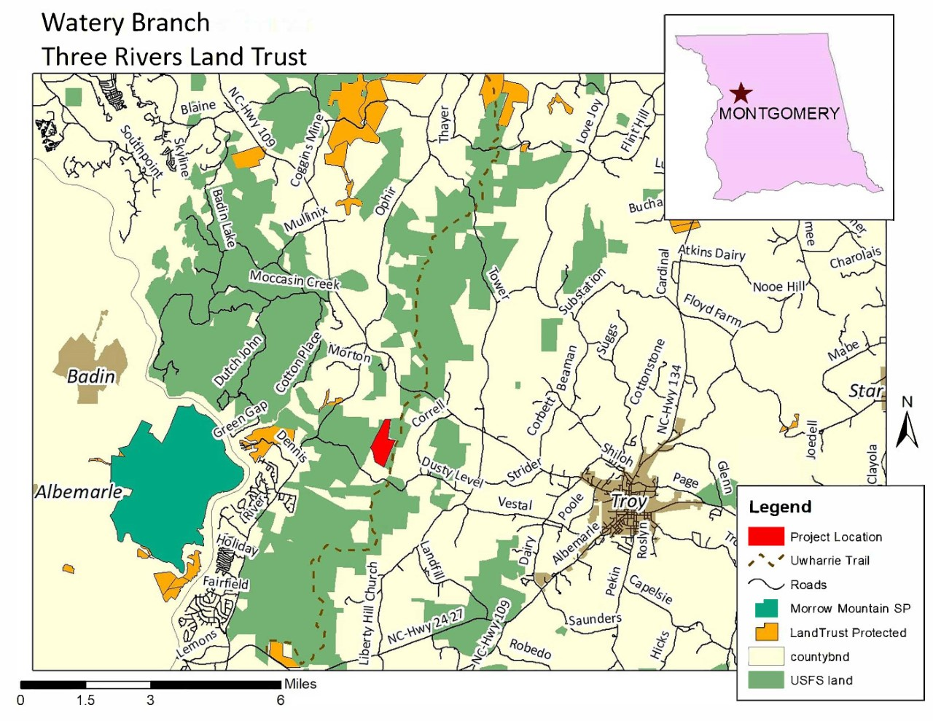
Notes:
The watery branch tract is a 210 acre project that was purchased by TRLT and transferred to the Uwharrie National forest at the end of last year. The project is very close to the Uwharrie Trail and contains the headwaters of Watery Branch.

Slide 2
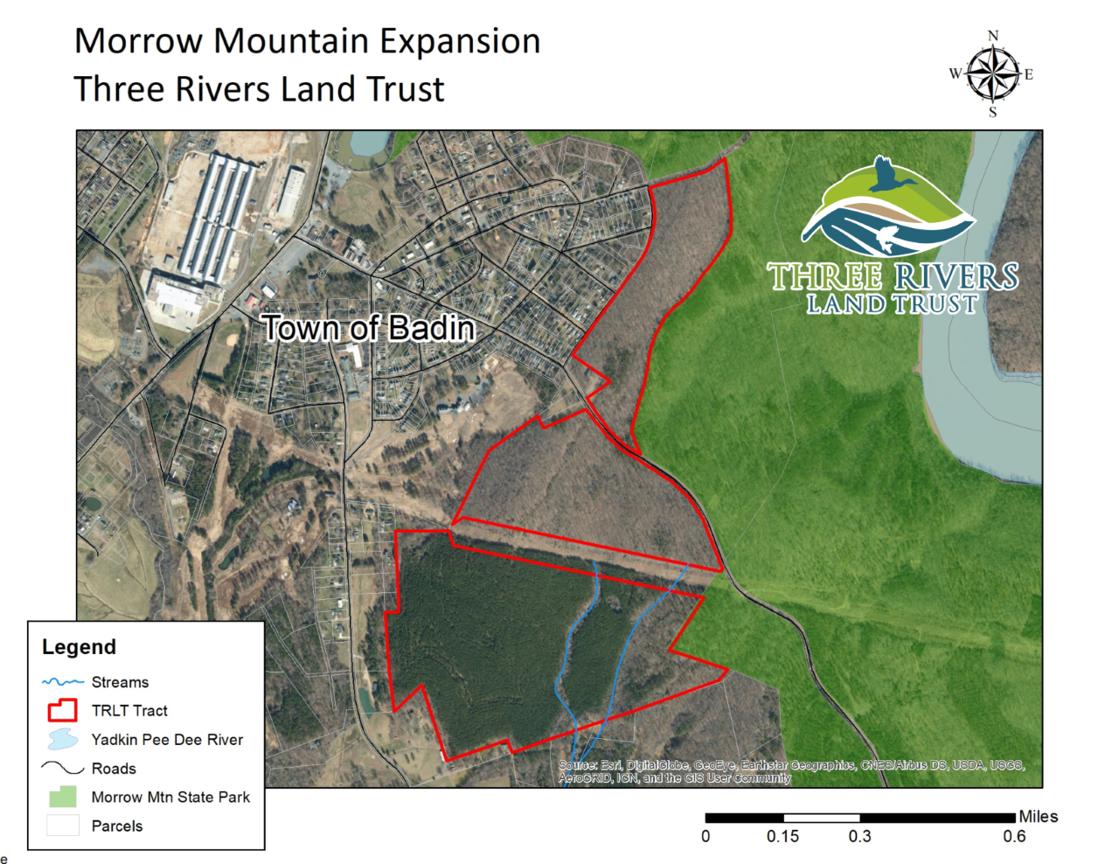
Notes:
The Morrow Mountain expansion is a 215 acre tract that was purchased by TRLT and transferred to Morrow Mountain State Park also at the end of last year. Funding for this project came in part from NCLWF. The property is half-mile away from the Hardaway Site, a National Historic Landmark known for its Native American significance and contains a tributary of Little Mountain Creek. This project connects the park to the town of Badin.

