Slide 1
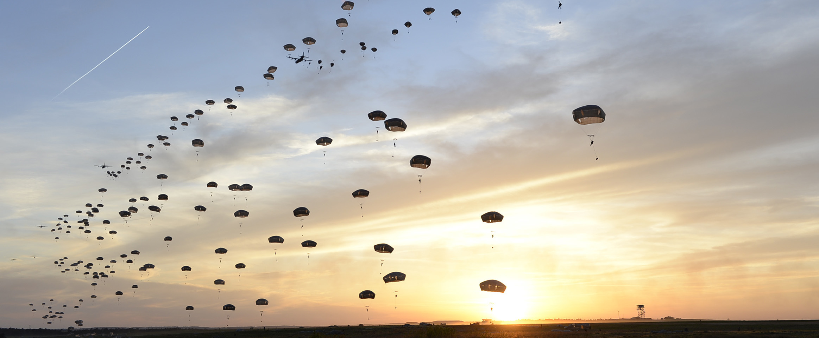
Regional Land Use Advisory Commission
Sandhills Conservation Partnership – March 13, 2024

Slide 2
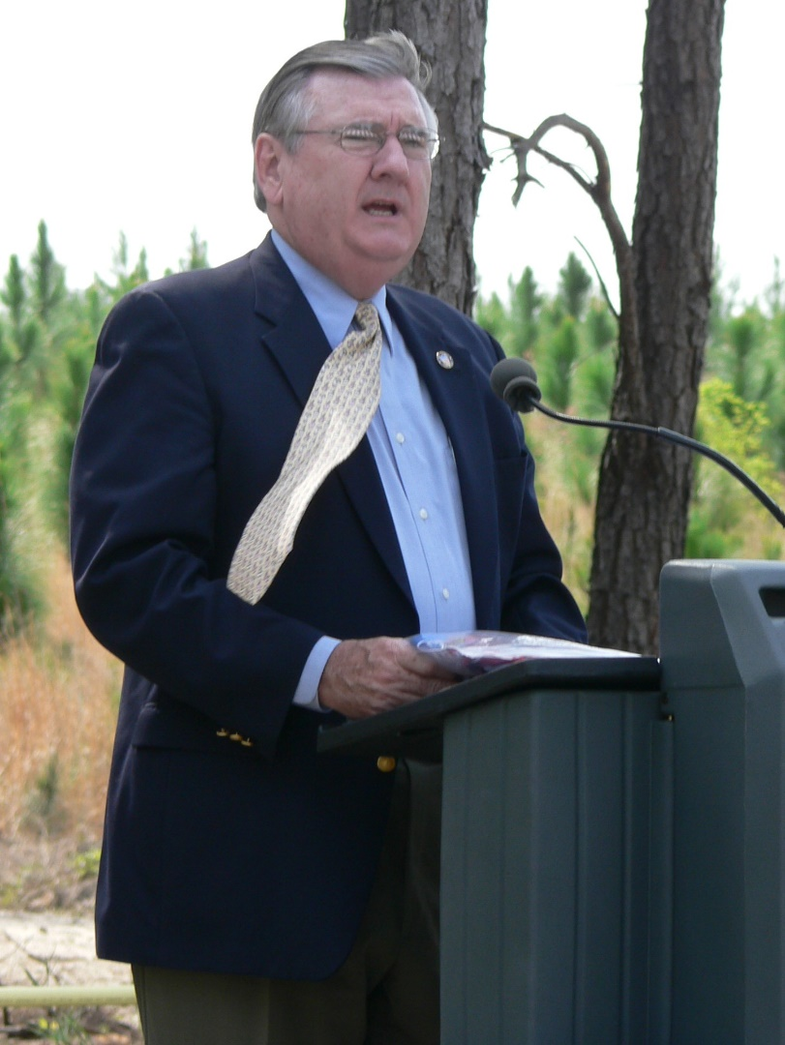
RLUAC - Origins and Evolution
RLUAC was initially established based on a recommendation of the 1991 Fort Bragg Joint Land Use Study.
After a brief hiatus in the late 1990s, RLUAC was reformed as a voluntary association in 2000 with a focus on the 2003 Joint Land Use Study.
Formally established under NCGS 160A-461 by the founding member governments in January 2005, and a part time Executive Director was hired to administer the organization.
New Strategic Plan adopted in 2020 followed by a major overhaul of the bylaws in 2021 to modernize the organization and governance of RLUAC.
Senator Tony Rand Speaking to RLUAC Members on Fort Bragg - 2006

Slide 3
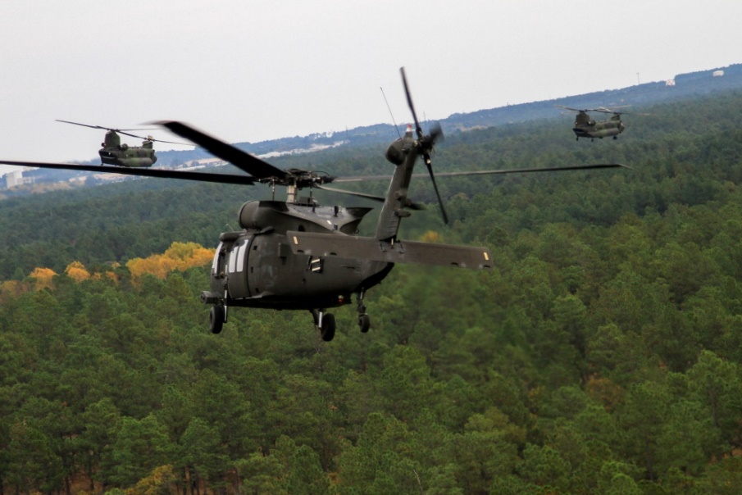
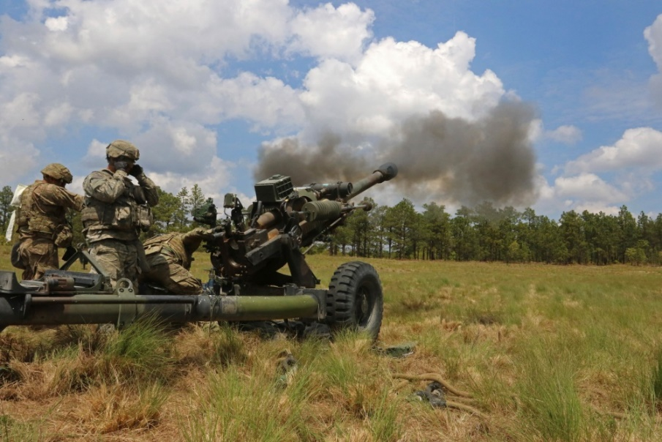
RLUAC’s Mission
Preserve and protect Fort Liberty’s training and operational mission from incompatible civilian development patterns and environmental degradation.
Provide a forum for communication between Fort Liberty and local governments.
Educate local governments, the public, and development interests regarding compatible growth and environmental issues.
Provide credible and authoritative analysis of land use and development proposals to local governments.
Assist local governments with planning initiatives and policy development.

Slide 4
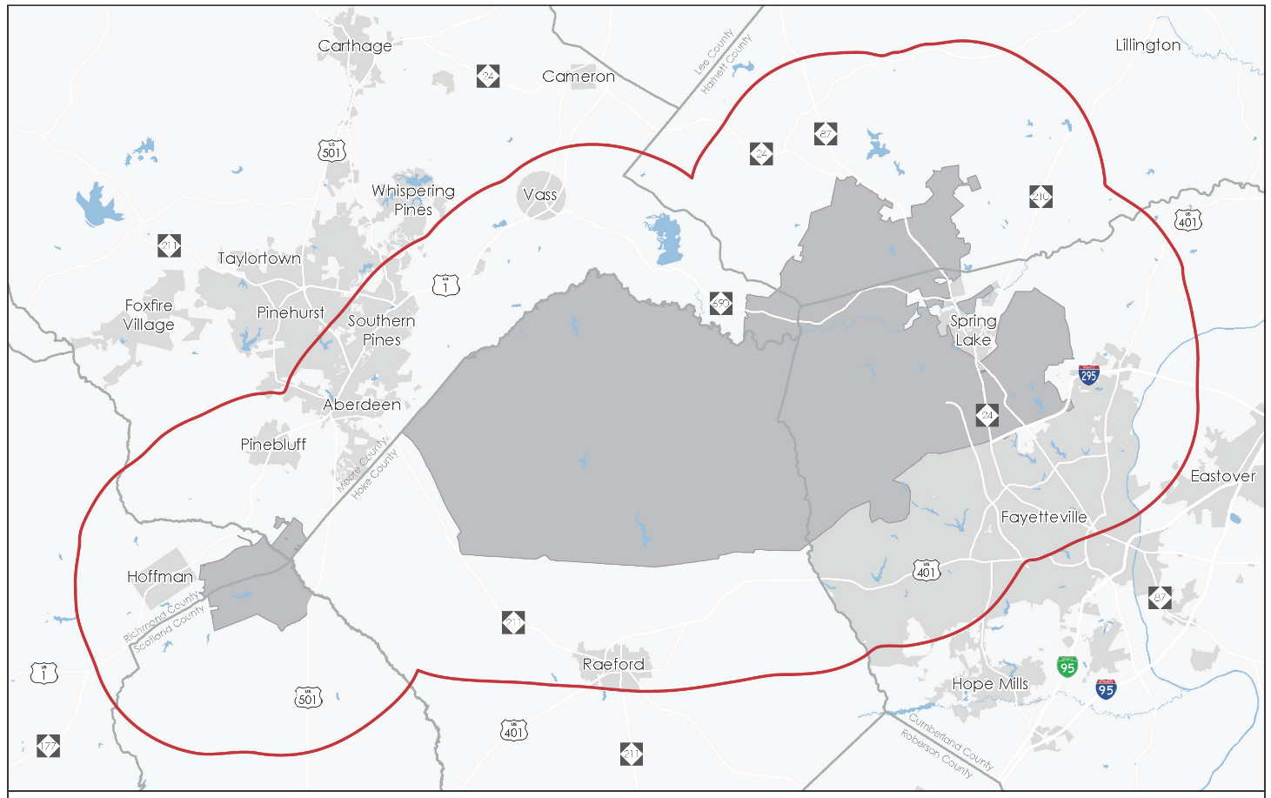
Membership structure
Local Governments (Voting Members):
8 Counties
15 Municipalities
Fort Liberty Garrison
Partner Organizations:
US Fish & Wildlife
NC Commerce
The Nature Conservancy
NC Wildlife Resources Commission
Sustainable Sandhills
NC Military and Veterans Affairs
Individual Associate Members
HARNETT
MOORE
RICHMOND
HOKE
SCOTLAND
CUMBERLAND
Primary RLUAC Local Government Membership Area

Slide 5
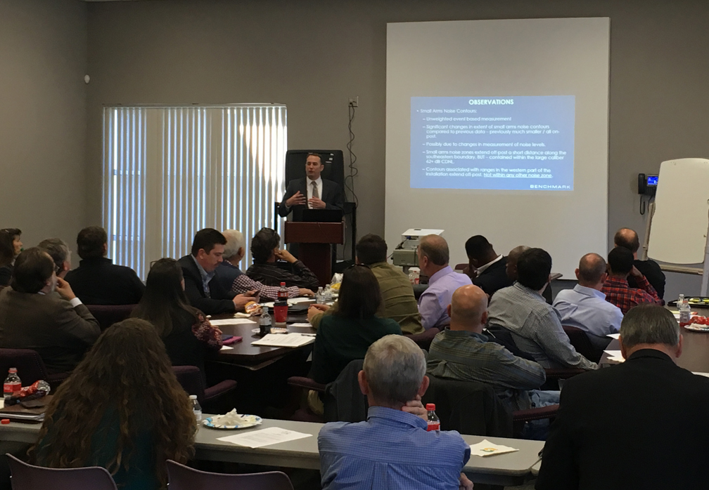
Governance
RLUAC is led by a 9 member Board of Directors
6 Local Government Seats
3 At-Large Seats
2 Year Terms (no more than 3 consecutive)
Quarterly Board Meetings
Recommend actions to the full voting membership.
Chairman is responsible for:
Leading the Executive and Nominating Committees
Appointing other standing and ad hoc committees
Appointing ex officio members to the Board
RLUAC Quarterly Membership Meeting

Slide 6
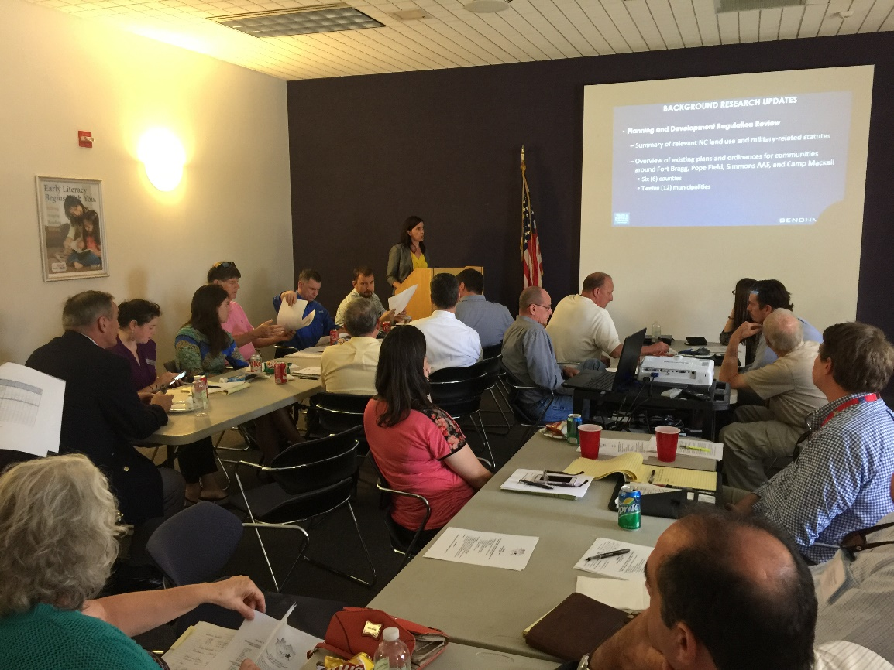
ADMINISTRATION AND FINANCE
Executive Director and Deputy Director administer the organization (part-time contract).
Mid Carolina Council of Governments serves as the fiscal agent for RLUAC.
Two primary funding sources:
25% from local government members
75% through Fort Liberty Intergovernmental Support Agreement for statutory land use reviews (MCCOG pass-through).
RLUAC Quarterly Membership Meeting

Slide 7
Land Use Compatibility Reviews
RLUAC provides statutory reviews for military land use compatibility mandated by GS 160D-601(b) through an MOA (2007) and IGSA (2021) with Fort Liberty.
Service extends beyond zoning changes to all land use related matters (comp plans, subdivisions, by-right commercial and large scale development review).
Reviews coordinated with Fort Liberty Garrison staff subject matter experts.
Non-binding recommendations provided to local governments, agencies, property owners.
2023 completed 550+ reviews with approximately 10-15% of cases identified as impacting areas deemed either “critical” or “important” to protect.

Slide 8
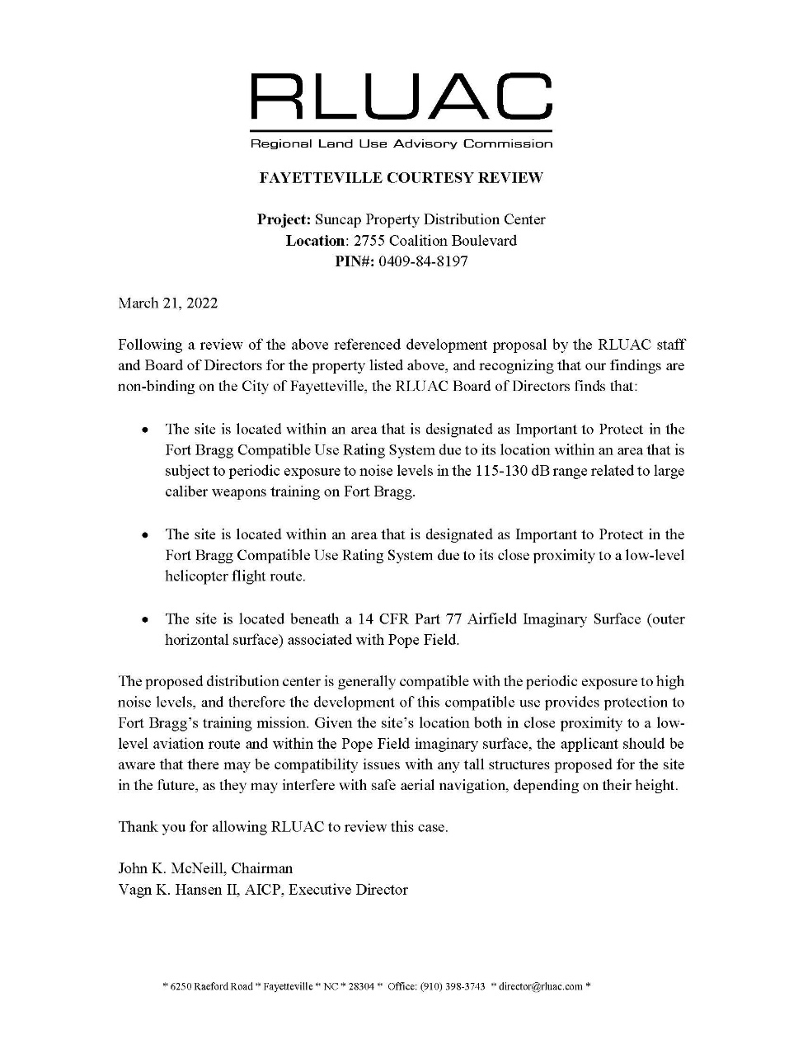
COMPATIBILE USE RATING SYSTEM
Classifies land within 5 miles of the installation as either “Critical” or “Important” to protect based on military impacts and environmental qualities.
Used as an objective tool in statutory land use reviews.
Exploring options for regular updates outside of JLUS / CUS.
NC Commerce partners to provide online hosting of compatible use GIS data.
RLUAC Review Letter

Slide 9
Compatible growth CRITERIA
Compatibility evaluation criteria for “CRITICAL” conservation areas:
130+ dB PK15 Large Caliber Noise Contour
70+ dB CDNL Large Caliber Noise Contour
104+ dB Small Arms Noise Contour
75+ dB ADNL Aviation Noise Contour
Clear Zones
Accident Potential Zone 1
Red Cockaded Woodpecker Active Foraging Areas
Areas Located Under: UAS Corridor
Wildlife Habitat Connector Areas

Slide 10
Compatible growth CRITERIA
Compatibility evaluation criteria for “IMPORTANT” conservation areas:
115+ dB PK15 Large Caliber Noise Contour
62+ dB CDNL Large Caliber Noise Contour
87+ dB Small Arms Noise Contour
65+ dB ADNL Aviation Noise Contour
Accident Potential Zone 2
Areas Located Under: Air Corridors, Aviation Routes
Biodiversity / Wildlife Habitat Rating of 7+
Within High Quality / Outstanding Resource Waters Area

Slide 11
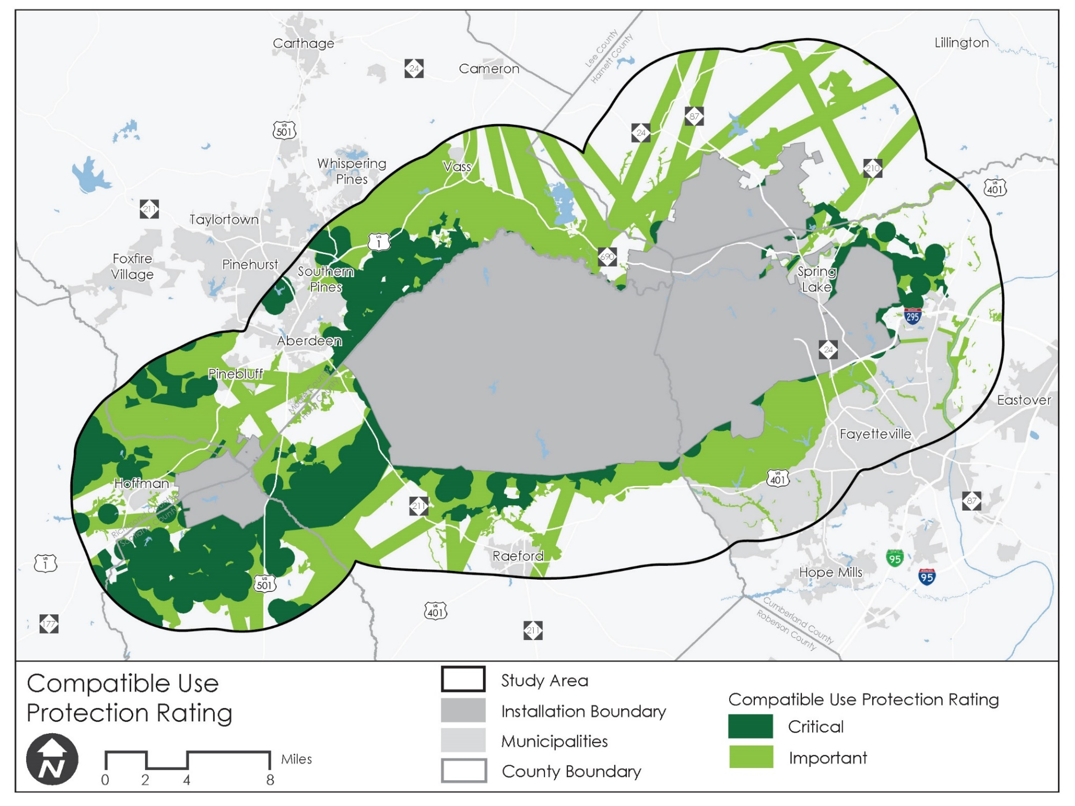
Compatible Use Rating System Map
Example Compatibility Factors:
UAS Corridor
Accident Potential Zones
Low Level Flight Routes
Large Caliber Weapons Noise Zones
Endangered Species Habitat

Slide 12
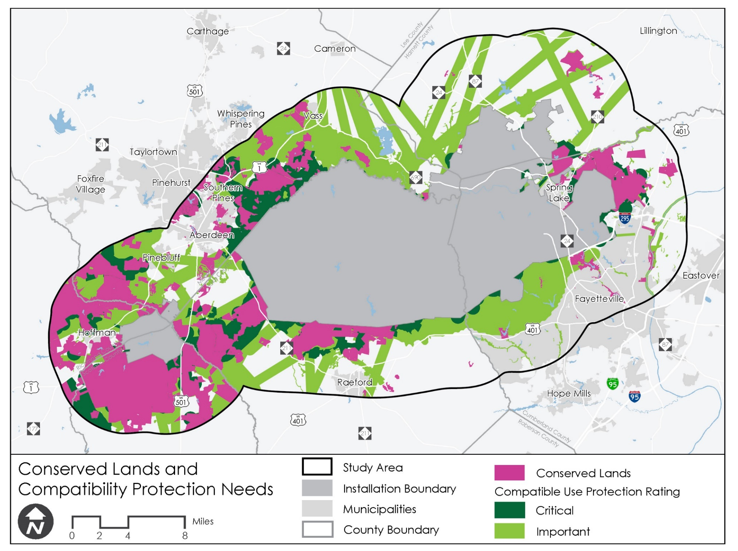
Conservation Lands and Compatibility Protection Needs
Many of the critical areas are now protected
Compatibility work still remains

Slide 13
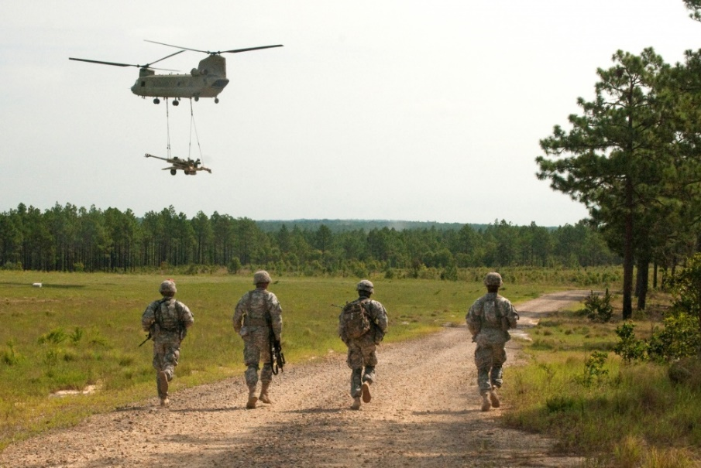
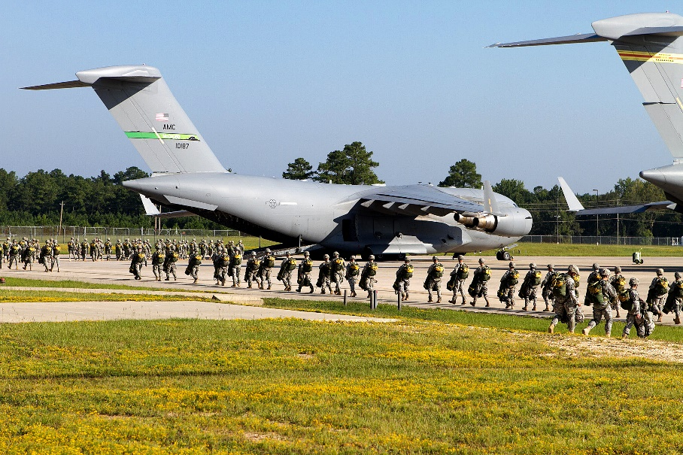
Land Use Compatibility CHALLENGES
Training airspace exceeds the area covered by the statutory land use notice / review mandate.
Protection of off-installation UAS corridor from Mackall to Bragg.
Residential growth continues to move into rural areas following infrastructure improvements.
Absent a BRAC threat, local governments have less focus on compatible growth issues.

Slide 14
Compatibility review case examples

Slide 15
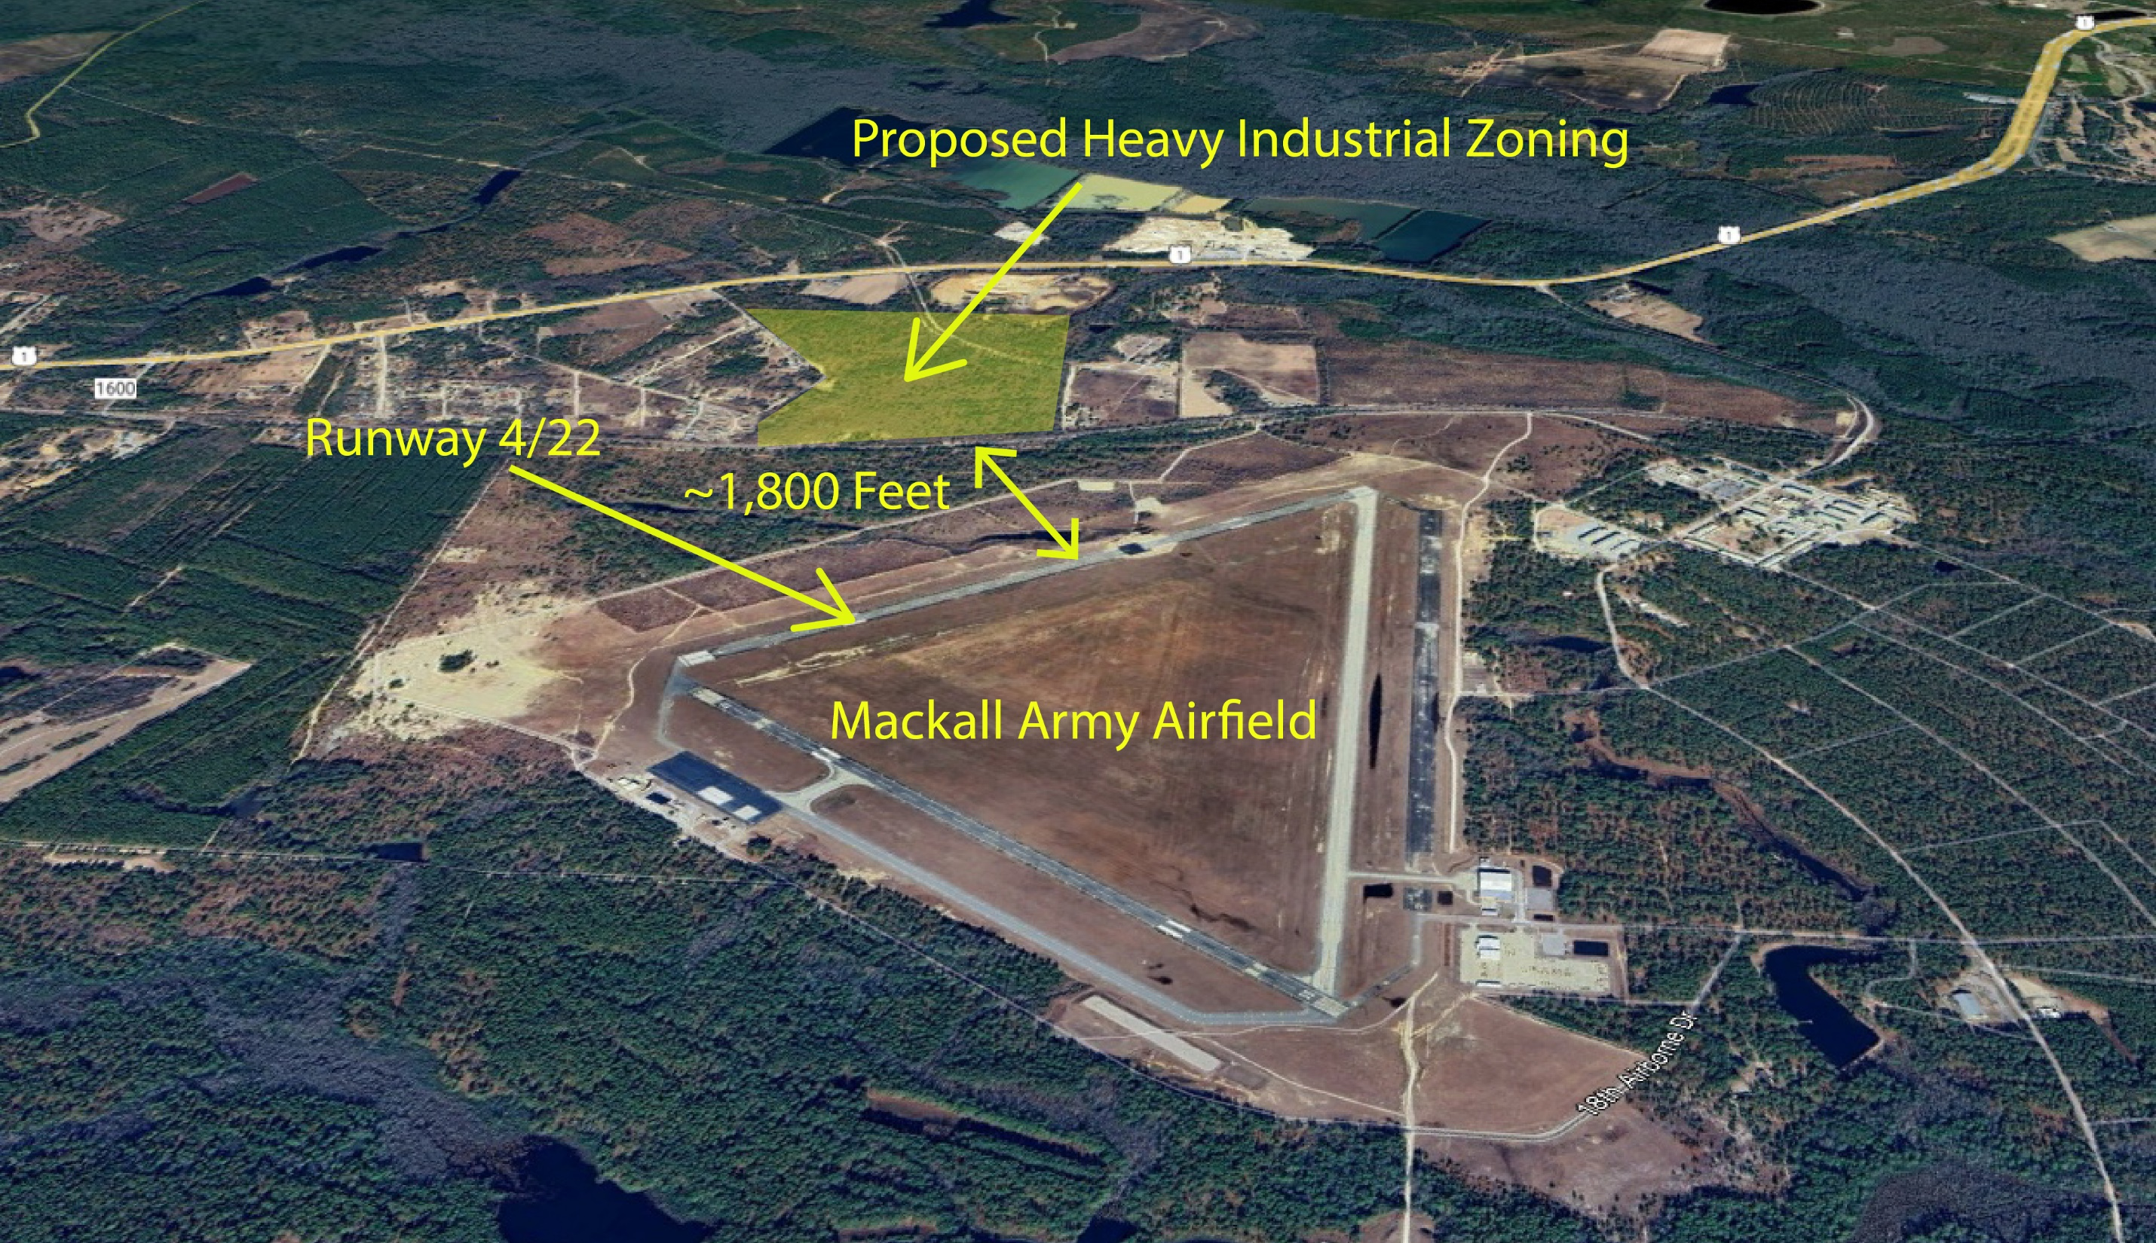

Slide 16
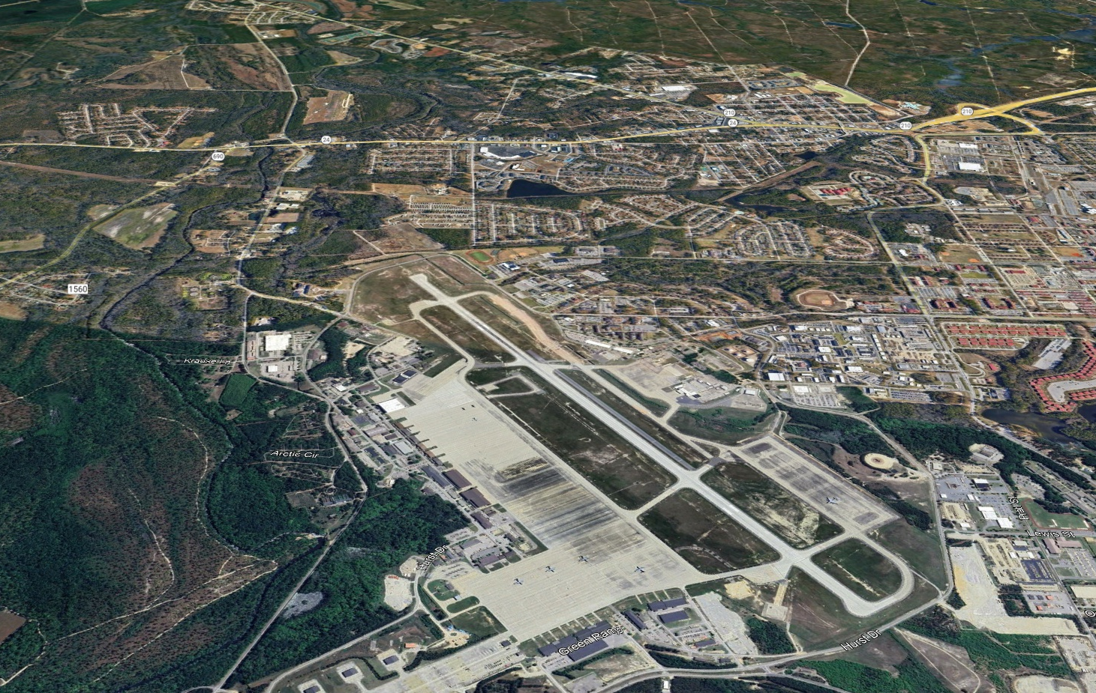
Proposed Asphalt Plan
~6,000 Feet
Runway 5/23
Pope Field

Slide 17
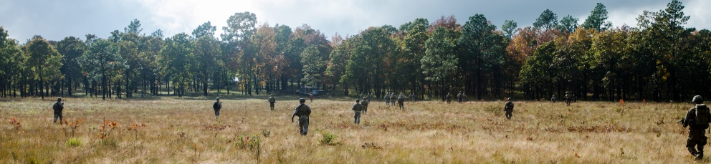
MOVING FORWARD
Exploring additional funding options to support new initiatives
Expanding ongoing education and outreach to local governments.
Developing relationships with new partners to achieve the mission.
Improving the quality and currency of data in the Compatible Use Rating System
Exploring opportunities for OLDCC Compatible Use Planning Studies

Slide 18
Regional Land Use Advisory Commission
Sandhills Conservation Partnership – March 13, 2024

