Slide 1
RCW Recovery Working Group 2020
2020 Effort - Year 40 of long-term research and monitoring
Sandhills Ecological Institute (Andy Van Lanen, Anna Prinz and Kerry Brust )
NC Wildlife Resources Commission (Brady Beck)
Dr. J.H. Carter Associates (Jeanette Sabo and Kevin Oday)
Fort Bragg Endangered Species Branch (ESB biologists )
Intensively monitored 370 of est. 760 RCW family groups in NC Sandhills
Exceptionally cool, wet spring – numerous nest failures
Fledgling success was decreased this season
Followed pattern of ↑ brood reduction of older nestlings in recent years
EOY meeting provide final estimate Potential Breeding Groups

Slide 2
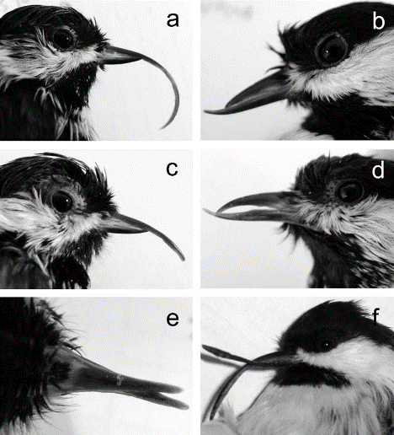
Avian Keratin Disorder (AKD)
AKD first described in Alaskan Black-capped Chickadees (BCCH) during the 1990s by the USGS Alaska Science Center (Handel et al. 2010)
Zylberberg at al. 2016 identified a novel picornavirus POECIVIRUS present in BCCH [ n=19 ]with AKD
Around the mid-2000s, RCWs with elongated or malformed bills were first detected in the North Carolina Sandhills.

Slide 3
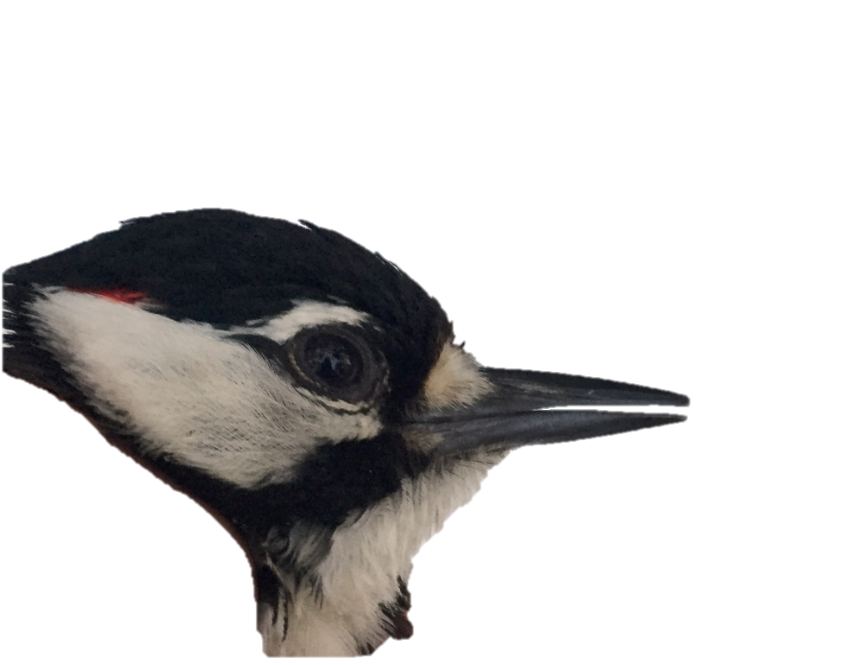
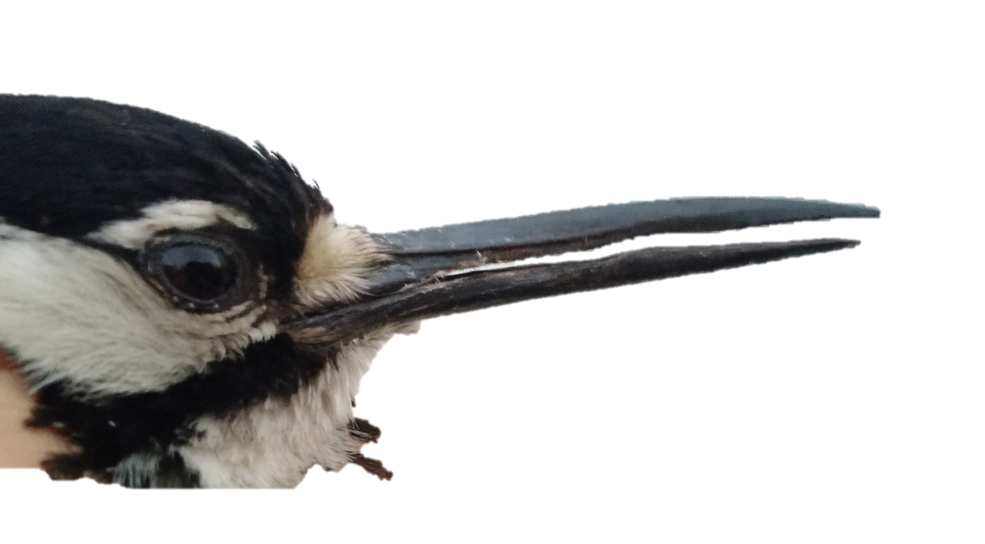
Normal
Avian Keratin Disorder (AKD)
in Red-Cockaded Woodpeckers
Longbill
Severe Longbill

Slide 4
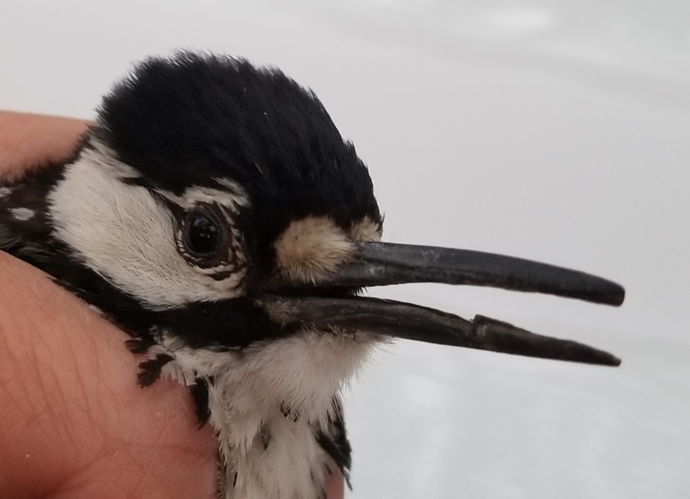
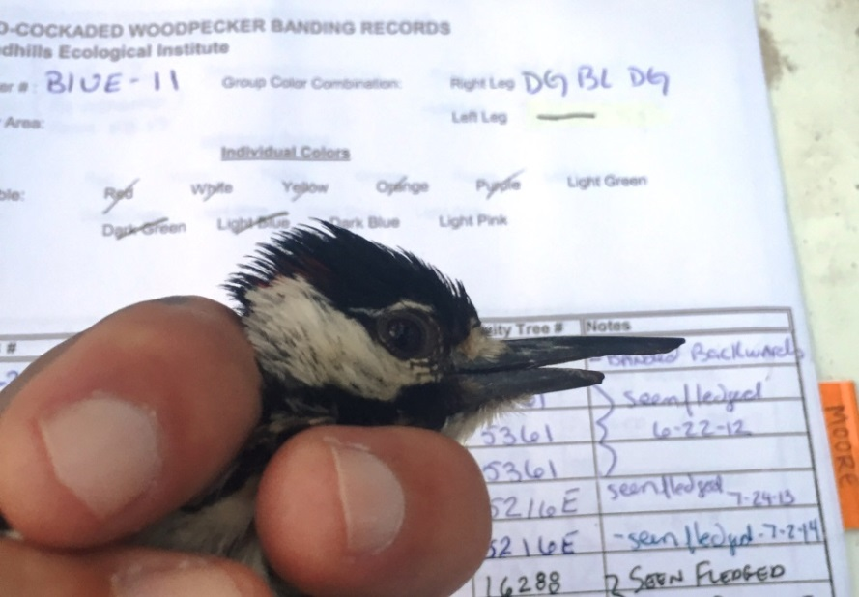
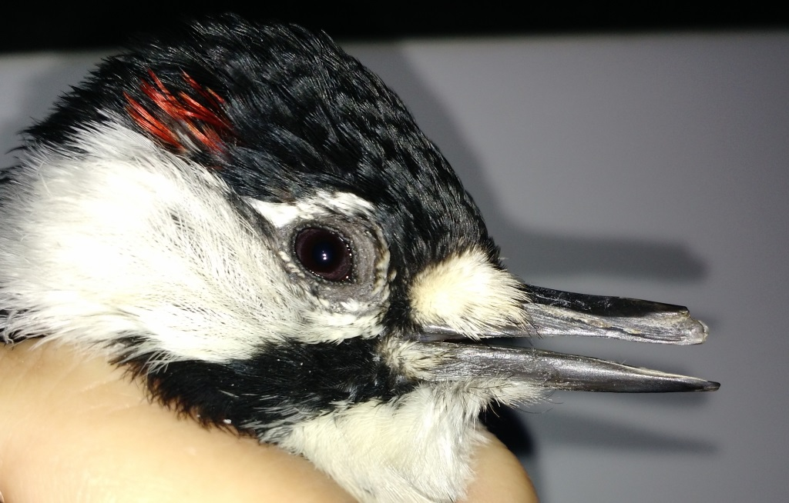
‘Longbilled’ RCWs
Condition at peak ~ late May to early fall
Longbills can break off - resulting in
noticeable gaps, overbites and underbites
Breeder adults with AKD have maintained
breeder status (8Y- male below)
Photo J. Patten
Photo A. Van Lanen
Photo K. Brust

Slide 5
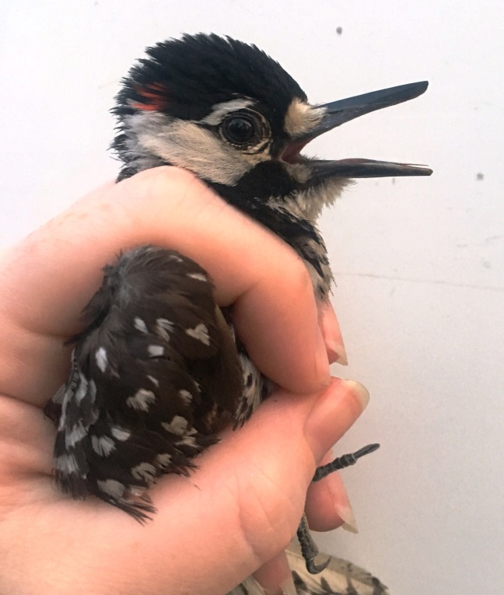
2019 RCW swab sampling (n=62) for Poecivirus
Sampling period between August and October 2019
Western FB, Mackall, SGL, Blue, Calloway, McCain
& Southern Pines - Pinehurst (SOPI)
29 longbills, 33 controls
Shipped to USGS Alaska Science Center, Danielle Gerik
Used target PCR - primers that detected Poecivirus
in BCCH
All 62 swabs tested negative for Poecivirus
Possible reasons?
Virus is rare in samples or Poecivirus has mutated such that primers unable to detect
Sampling period missed viral shedding
Freezer insufficient where samples stored
Photo A. Prinz
FUTURE STEPS
Once Covid19 restrictions are lifted, USGS Alaska Lab will screen swabs with high-throughput sequencing.

