Slide 1
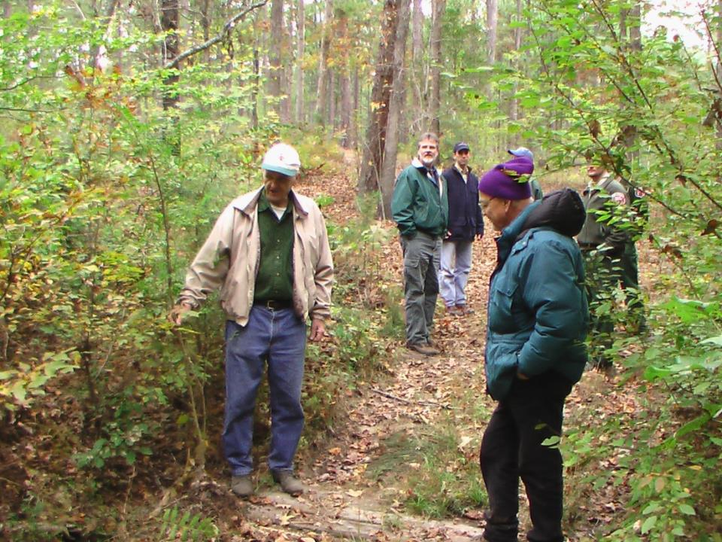
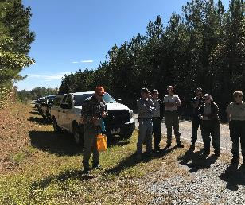
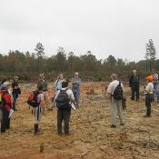
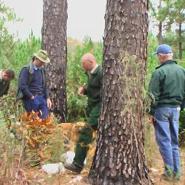
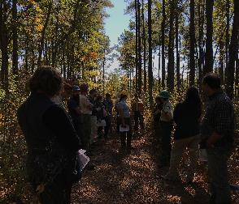
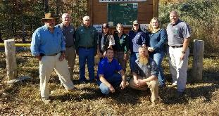
Working Together to
Conserve Wildlife & Biodiversity in the Uwharries
Greater Uwharries Conservation Partnership
Share information
& leverage conservation resources

Slide 2
The need for stewardship of natural habitats: Forests under pressure
Raleigh
Predicted
2030
Chatham Co.
Developed
Undeveloped
Charlotte
Union Co.
Renaissance Computing Institute UNC Charlotte

Slide 3


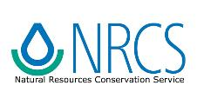



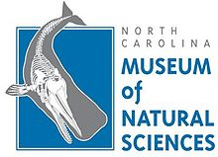
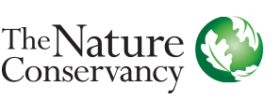
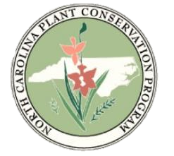

Piedmont Longleaf
Most needs to be restored to Longleaf - Shortleaf, & some hardwood systems.
Last RCWs extirpated by the 1990s
Research shows Bachman’s Sparrow restoration is important here.
Notes:
A partnership of natural resources organizations focused in the Uwharries ecological region
- If you are interested in using the natural heritage data to help meet landowner objectives, then we are a resources for you inside and outside of this region.

Slide 4
Greater Uwharrie Conservation Partnership
Partner Updates
Three Rivers Land Trust:
  Top of Dark Mountain in the Uwharrie National Forest
  >200 acres for Morrow Mountain State Park
Three Rivers Land Trust & NC Wildlife Commission: 2,424 acres and 31 miles of shoreline on the eastern shore of the Tuckertown Reservoir on the Yadkin River.
NC Wildlife Commission: Private Lands Program - 6 new agreements Wildlife Conservation Land Program, 568 acres.
  Birds: Banding station on restored prairie, private land, Randolph County, 7 years
  Bats: Winter monitoring of Boone’s cave and various mines – one mine in Montgomery County had 3 tricolored bats with White-Nose Syndrome

Slide 5
Greater Uwharrie Conservation Partnership Partner Updates
Joint Chiefs Landscape Restoration Collaborative Grant Awarded
(first in NC)!
Goal: Restore “fire-managed pine forests” on private & public land, on & adjacent to the Uwharrie National Forest, & eventually in the corridor to the Sandhills.
$2.2 Million over 3 years administered by the USFS & NRCS
Matching funds: Sandhills Rx Burn Association & NCWRC – landowner workshops & outreach support, TNC & NCWRC project coordination assistance
Primary use of funds toward project goal on 7,500 ac. private & 18,000 ac. USFS:
$600,000 to NRCS special EQIP pot for private lands
Most of the remaining to USFS to contract a NEW 5 person burn crew to ramp up Rx fire on private lands under the Stevens Amendment – working with the NCFS - & on the Uwharrie National Forest.
Some for direct water quality improvement through USFS recreation management & specific habitat treatments by USFS

Slide 6
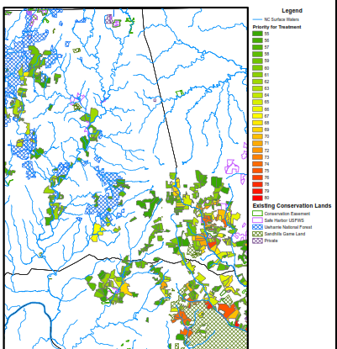
Uwharrie National Forest
(Private parcels)
Sandhills Game Lands

