Slide 1

The Strategic Conservation Plan:
10 years later
Sarah Hecocks - Sandhills Conservation Planner/ORISE Fellow
Jeff Marcus - Longleaf Applied Scientist & LIT Coordinator
Notes:
Thank you for being here & thank you to Ryan & Pete for providing that background info that segways into this presentation on the contents of the Strategic Conservation Plan.

Slide 2
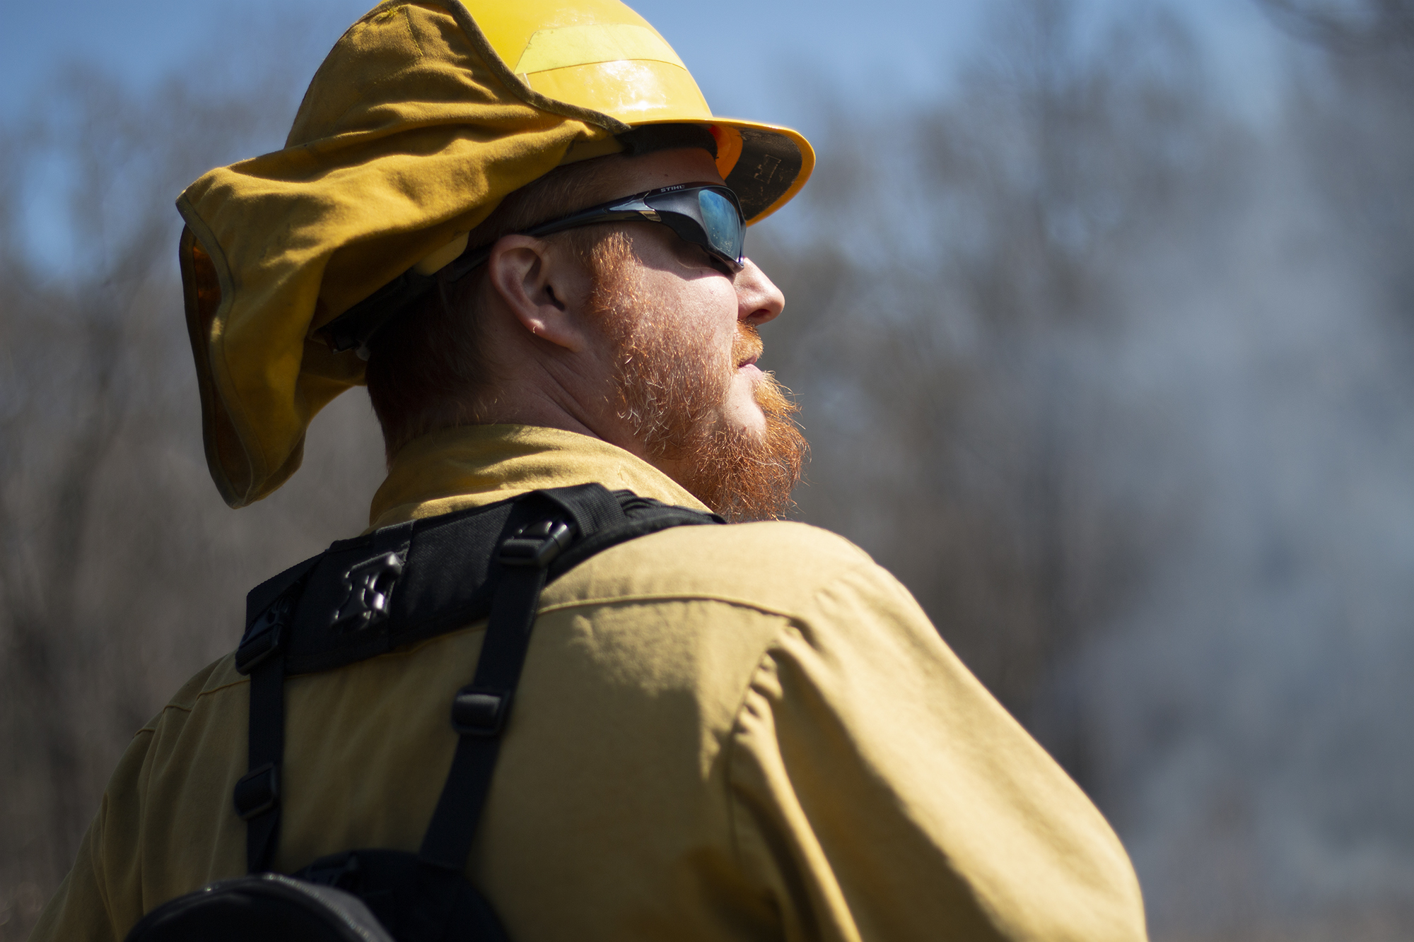
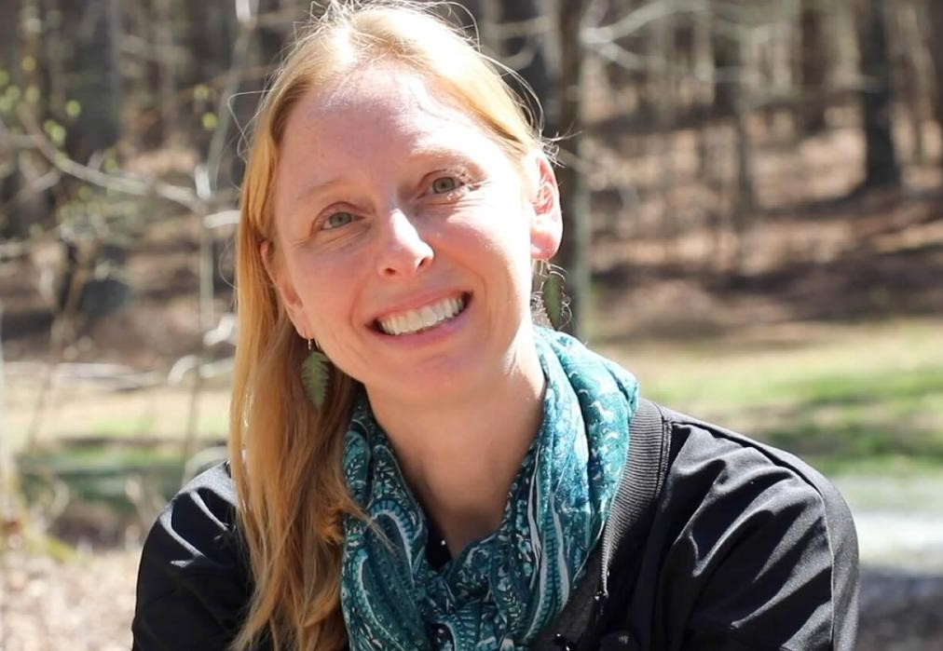
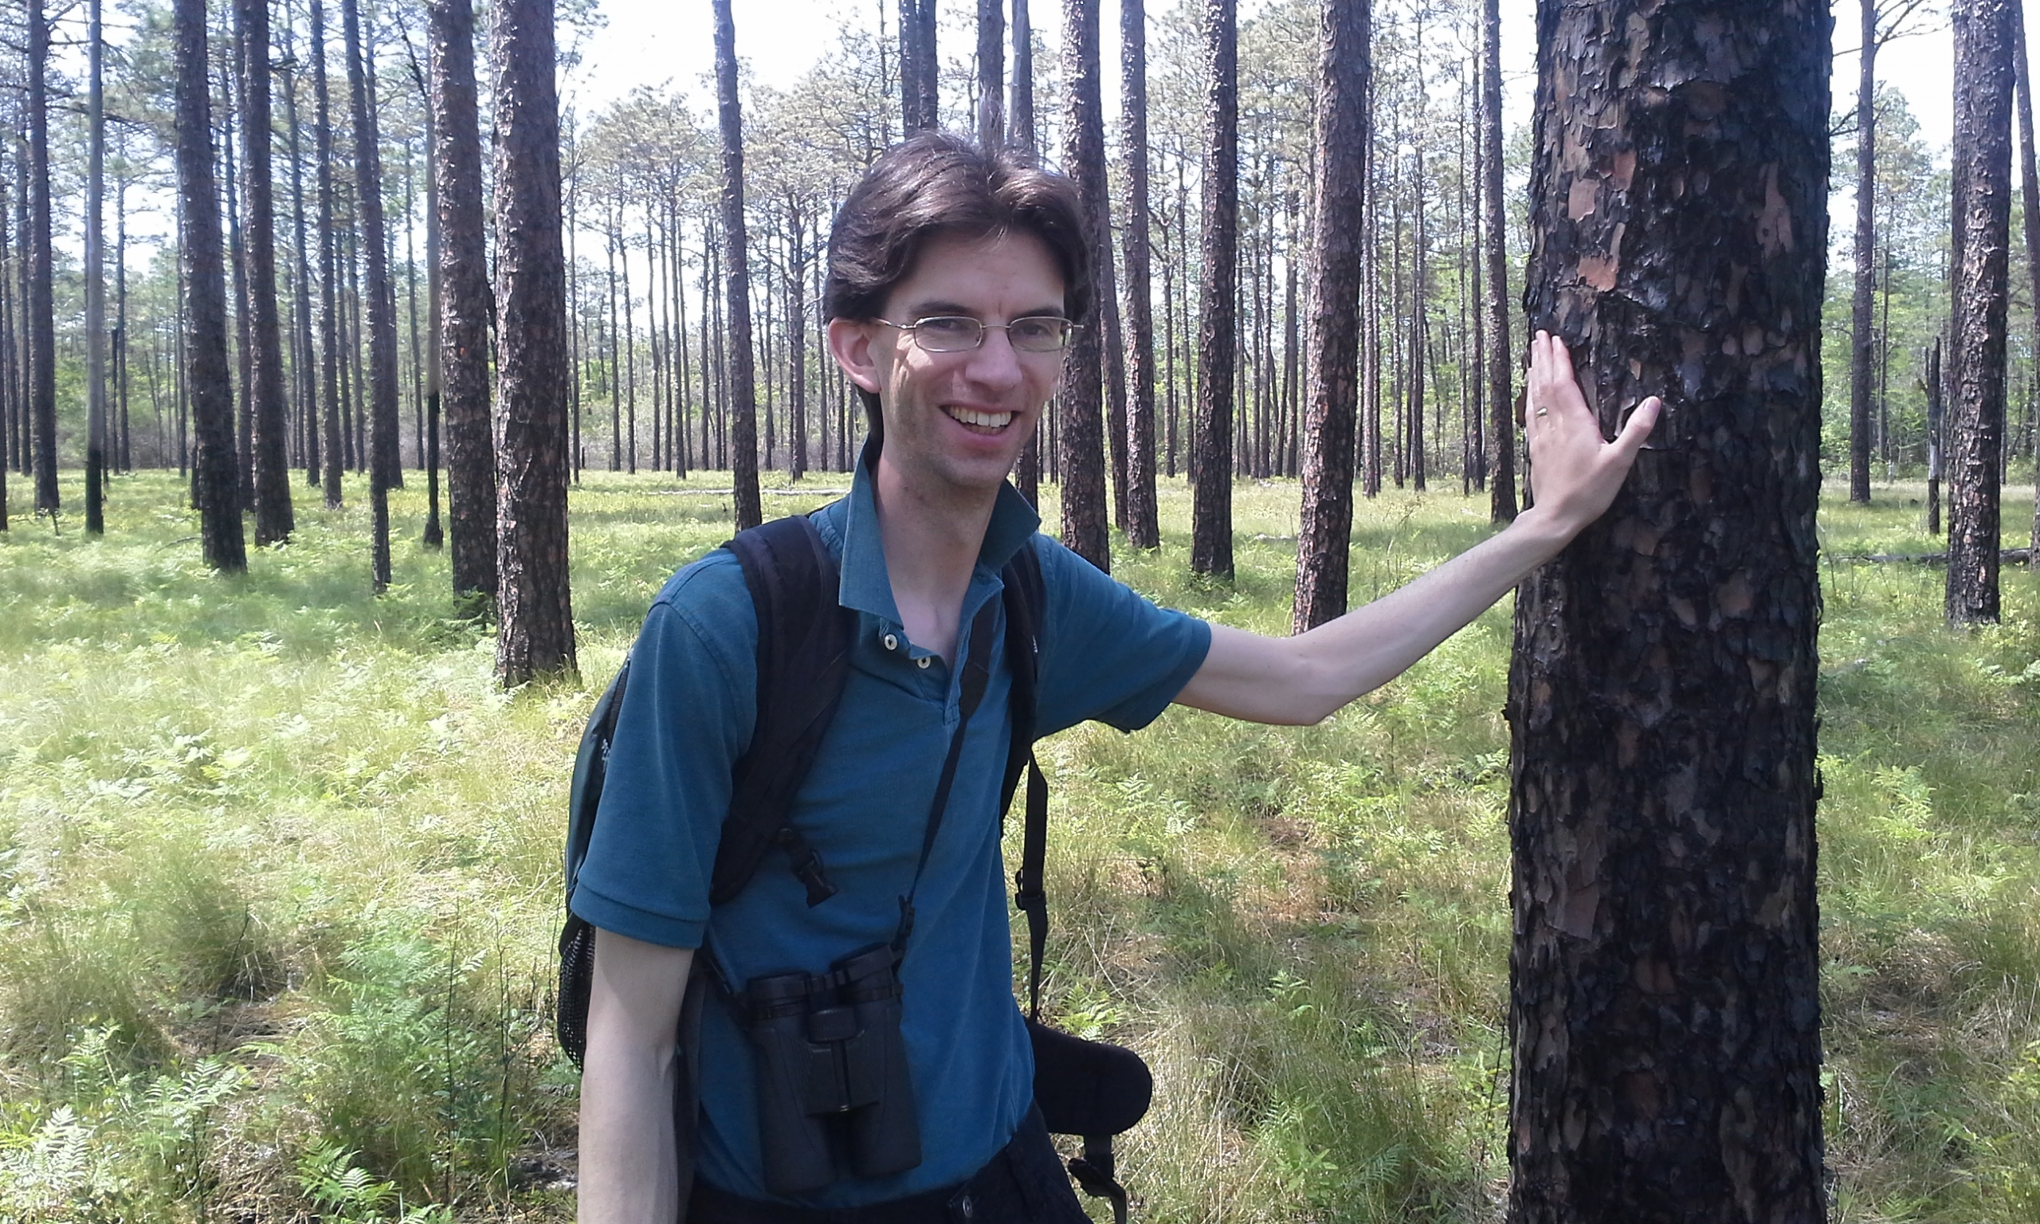
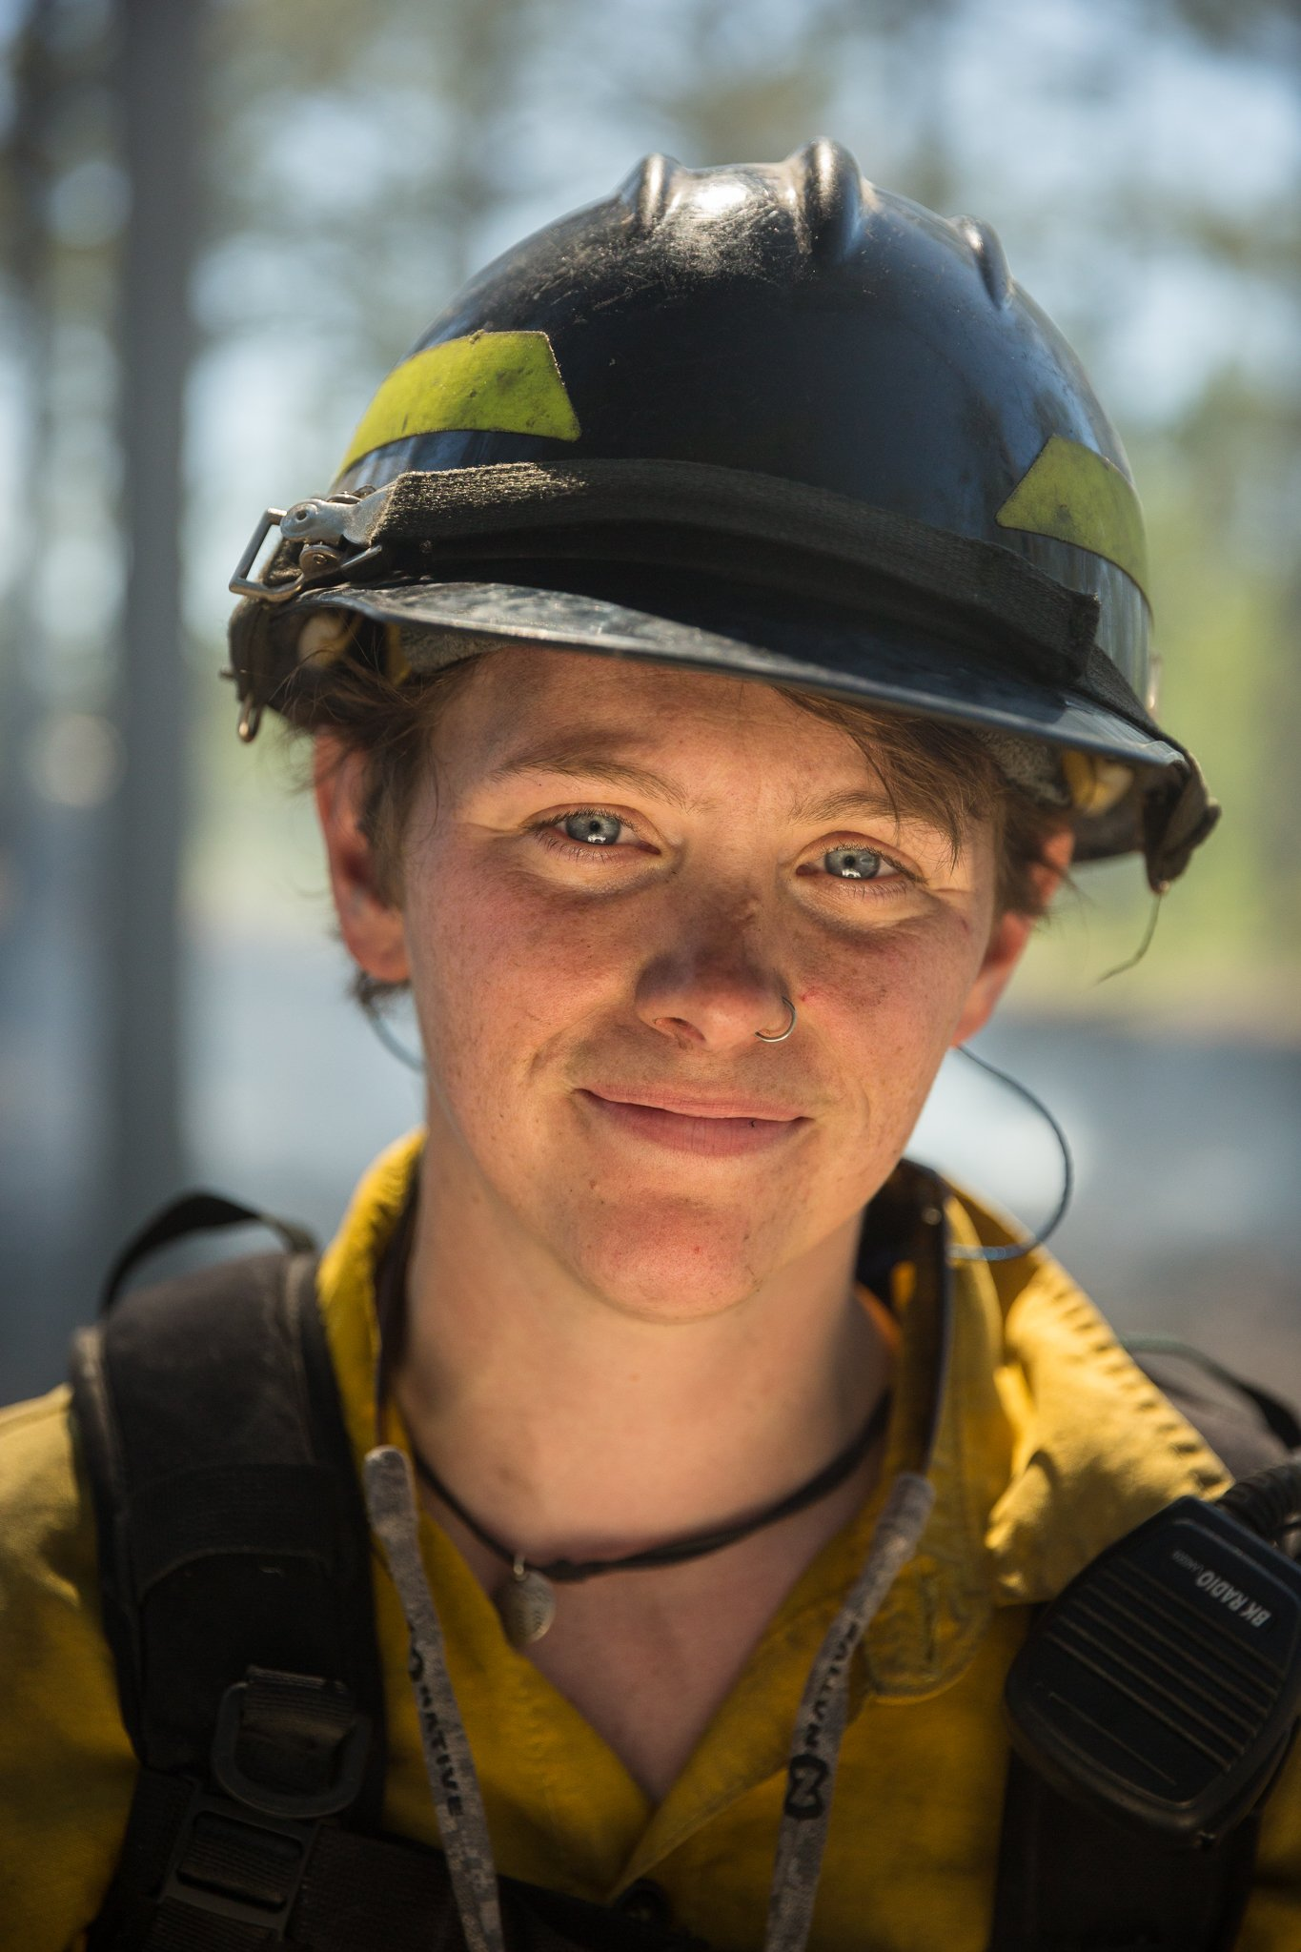
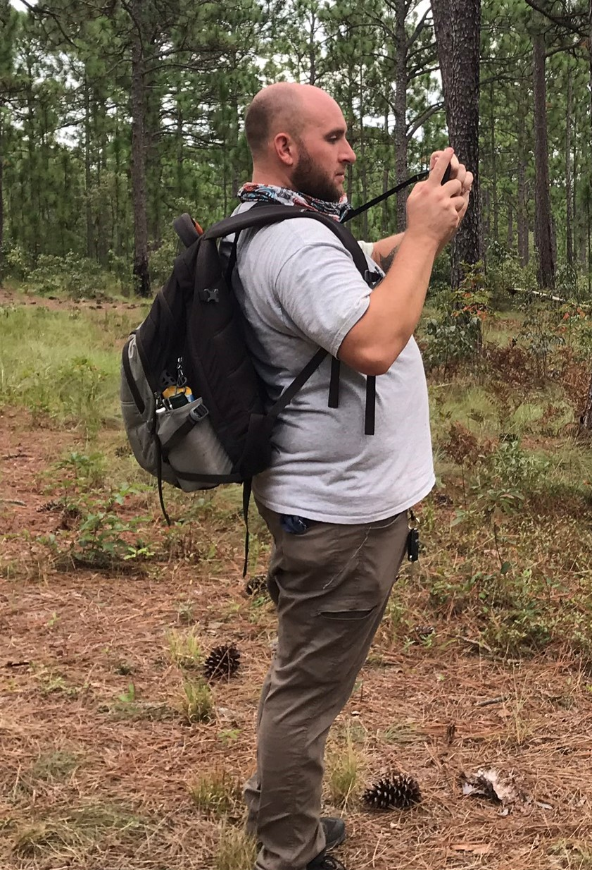
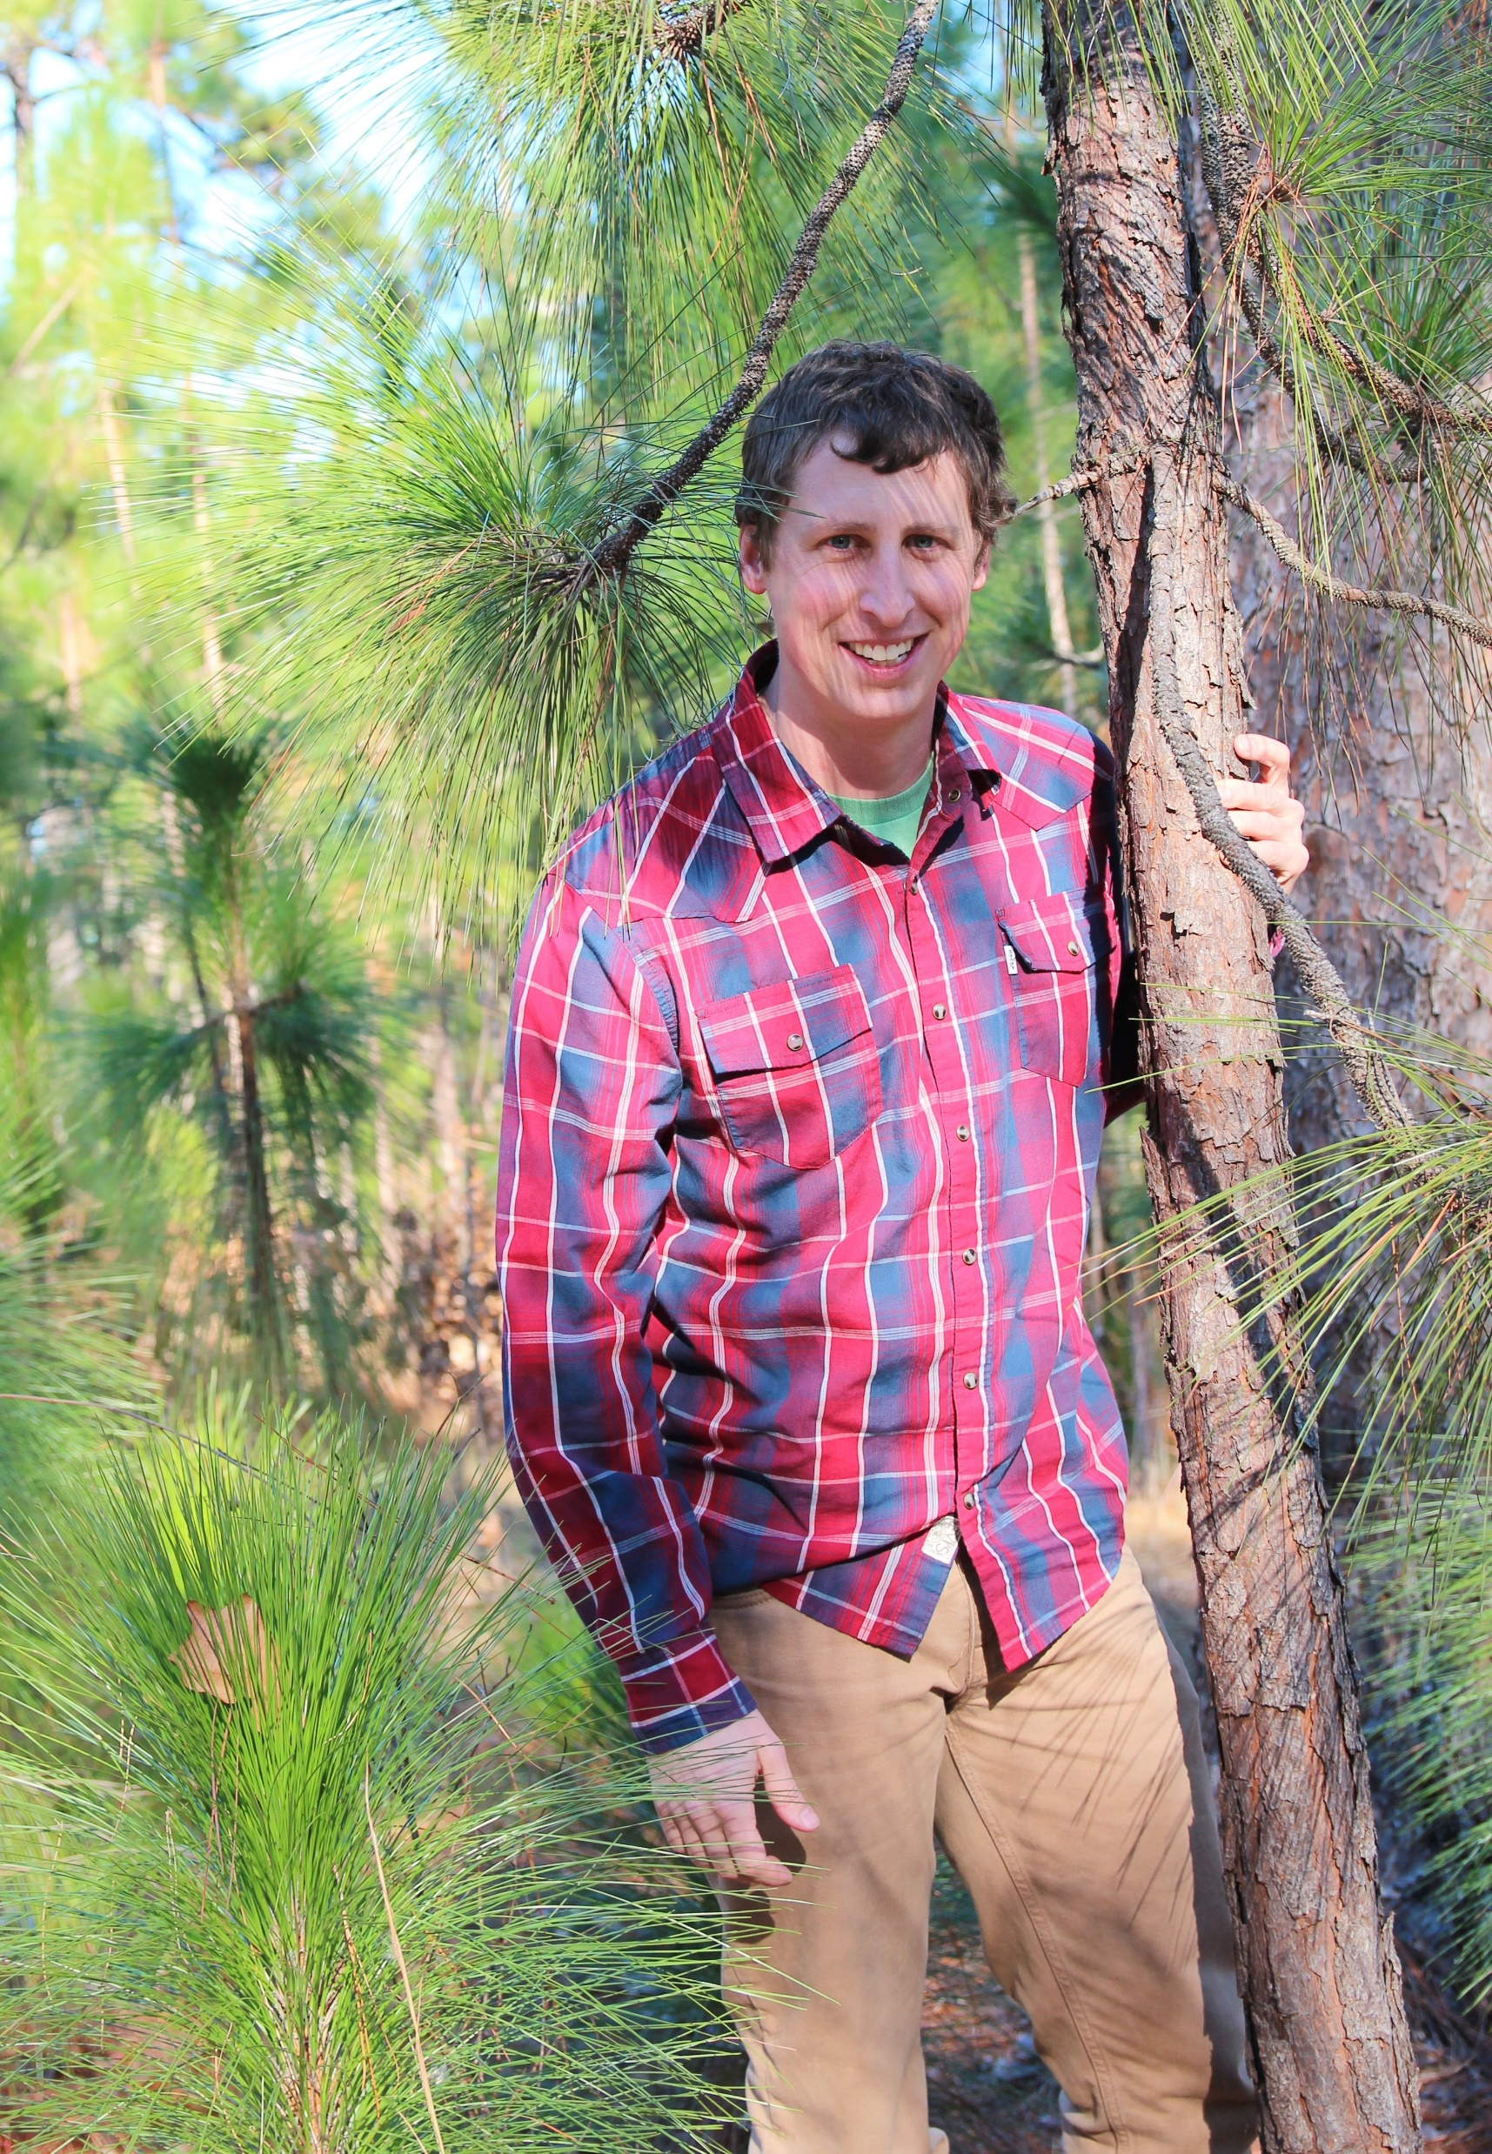
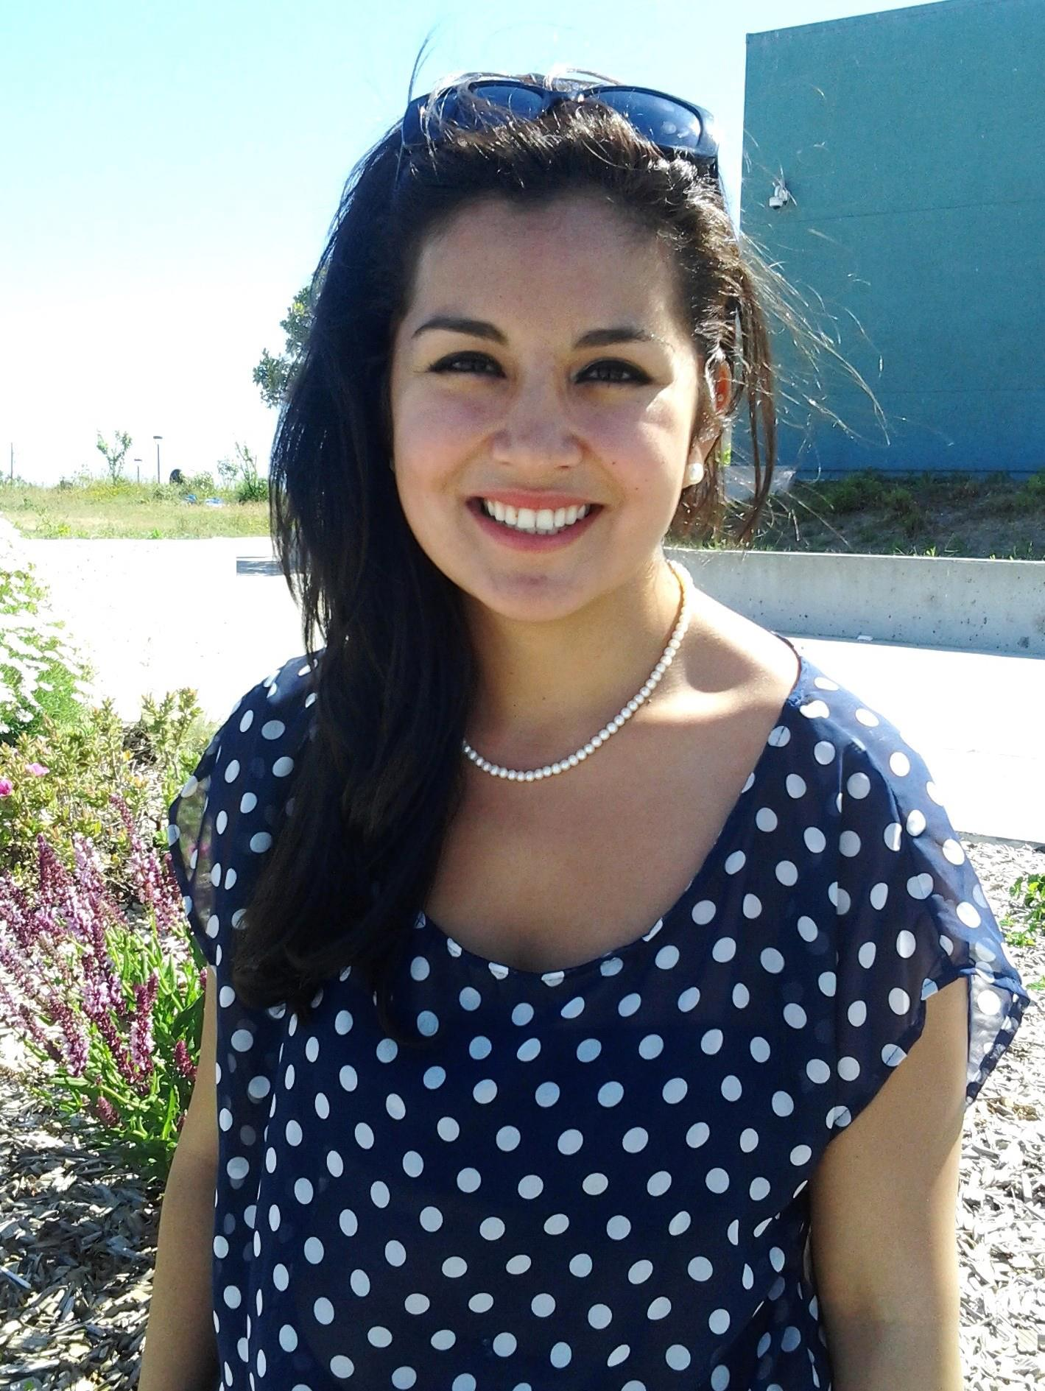
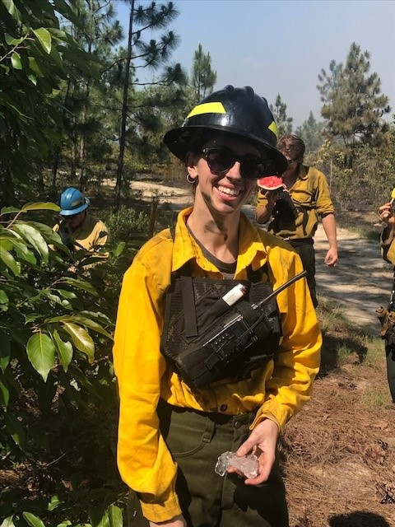
Moment of appreciation for contributions of ORISE Fellows
Neville Handel
Sarah Childs
Matthew Moskwik
Katie Sauerbrey
Dan Hannon
Ryan Bollinger
Ana Castillo
Sarah Hecocks

Slide 3
The Strategic Conservation Plan
2000
Partnership formed
Working groups formed
2010
10-year review conducted
2013
Conservation Plan drafted
Monitoring Plan drafted
Approval for new Conservation Plan
2020
20th anniversary planned for 2021
2023
Assess the path ahead!
New partnership coordinator
Questionnaires sent to partners
New partnership coordinator
Notes:
2000: The NCSCP was formed with the specific intent to facilitate collaboration between various federal, state and non-profit conservation groups for the purpose of conserving the vanishing longleaf pine ecosystem and recovering the endangered red-cockaded woodpecker
2010: 10-year review conducted and consensus on developing new conservation plan. Building from the 2004 Site Conservation Plan for the NC Sandhills, the Strategic Conservation Plan sought to develop a comprehensive guide for Partnership activities and addressed many of the concerns identified in the 10-year review by incorporating work plans, monitoring, and metrics of success.
2013: Plans drafted and implemented
2020: 20th anniversary.. No review conducted. Questionnaires sent out to partners for a press release. LIT coordinator changed from Susan to Jeff. Celebration foiled by COVID-19!
2023: Entering post-covid era, what’s the path forward?

Slide 4
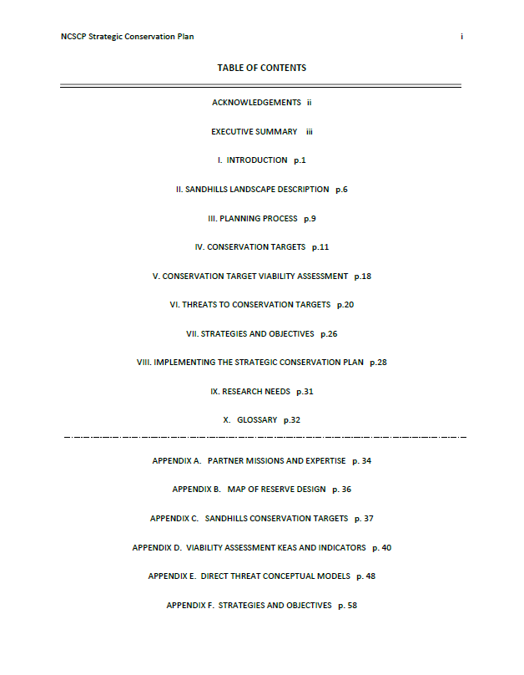
Contents of the NCSCP Strategic Conservation Plan (2013)

Slide 5
Partnership Mission
To “coordinate the development and implementation of conservation strategies for the red-cockaded woodpecker, other native biota, longleaf pine and other ecosystems in the Sandhills of North Carolina compatible with the land use objective of the partners.”
Notes:
The region contains over 150,000 acres of intact natural longleaf pine community and the second largest RCW population in existence.
However, land use changes and fire exclusion across much of the native longleaf pine ecosystem in the NC Sandhills has resulted in degradation and loss of habitat.
Since the late 1970s, public lands including Fort Bragg/Camp Mackall, Weymouth Woods SP, McCain Forest, and the Sandhills Game Lands have become the last strongholds of large extents of longleaf pine habitat in the NC Sandhills.
Connecting these core blocks and ensuring this ecosystem persists into the future is entirely dependent on effective conservation efforts and collaboration across public and private sectors.
The NCSCP was established to meet this need.

Slide 6
2010:
10-year review results
Benefits to involvement
Ability to leverage funding
Areas for improvement
Need to reassess roles, responsibilities, & objectives of steering committee & working groups
Stronger relationships prevent major issues
Access to data & other info
Demonstrated effectiveness of partnerships to conservation community
Improve internal & external communication
Determine how to better document progress
Notes:
Results from the 10-Year Review identified the numerous benefits received through participation in the Partnership. These included:
The ability to leverage funding for acquisition and resource management, the establishment of stronger relationships that consistently help prevent major issues before they arise, and access to data and other information that increase knowledge and ease work flows. Partners also highlighted contributions the Partnership has made to the greater conservation community, including demonstrating the effectiveness of a collaborative approach to conservation.
Partner responses captured by the survey also identified several common themes for the Partnership to consider going forward. These included:
The need to reassess the Steering Committee and working groups’ roles, responsibilities, and objectives; improve internal and external communication; explore mechanisms for documenting progress and achievements; improve public outreach and influence public perceptions; and confirm continued commitment to acquisition and management while considering other conservation strategies and challenges.
Partner responses suggest there is not a common understanding about how the Partnership documents progress toward accomplishing its mission. No formal process within the Partnership has required such assessments to be regularly conducted and reported. This Plan was conceived as a way to increase the effectiveness of the Partnership towards achieving its’ mission.
Regional Conservation Efforts:
The Partnership supports the efforts of America’s Longleaf Conservation Initiative. The Initiative’s Range-wide Conservation Plan for Longleaf Pine 15-year goal is an increase in longleaf from 3.4 to 8.0 million acres, with half of this acreage targeted in the 16 range-wide "Significant Landscapes" in ways to support a majority of ecological and species' needs7. The NC Sandhills is identified as one of the Initiative’s 16 Significant Landscapes.
The North Carolina Longleaf Coalition was created in 2010 as a state implementation team for America’s Longleaf effort. The Partnership works with the North Carolina Longleaf Coalition which aims to provide the state/local level leadership called for in the regional plan. The North Carolina Longleaf Coalition coordinates closely with on-the-ground restoration efforts of the Partnership, the Onslow Bight Conservation Forum and the Cape Fear Arch.

Slide 7
Planning Process
Notes:
2010-2013: Planning Process
A Core Team was assigned and that team applied steps 1 and 2 of this Open Standards framework to draft the plan.
Step 1: What are our goals and what are the challenges to achieving those goals?

Slide 8
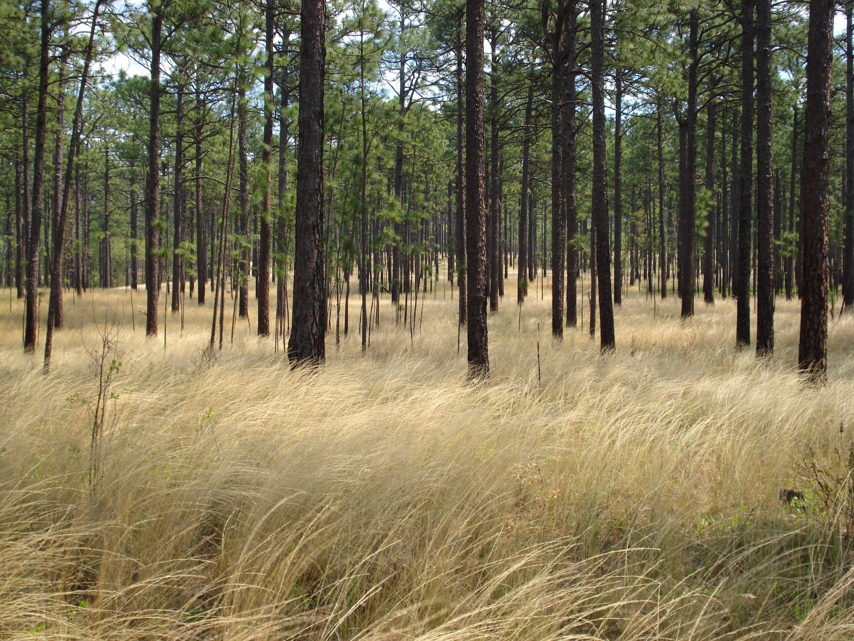
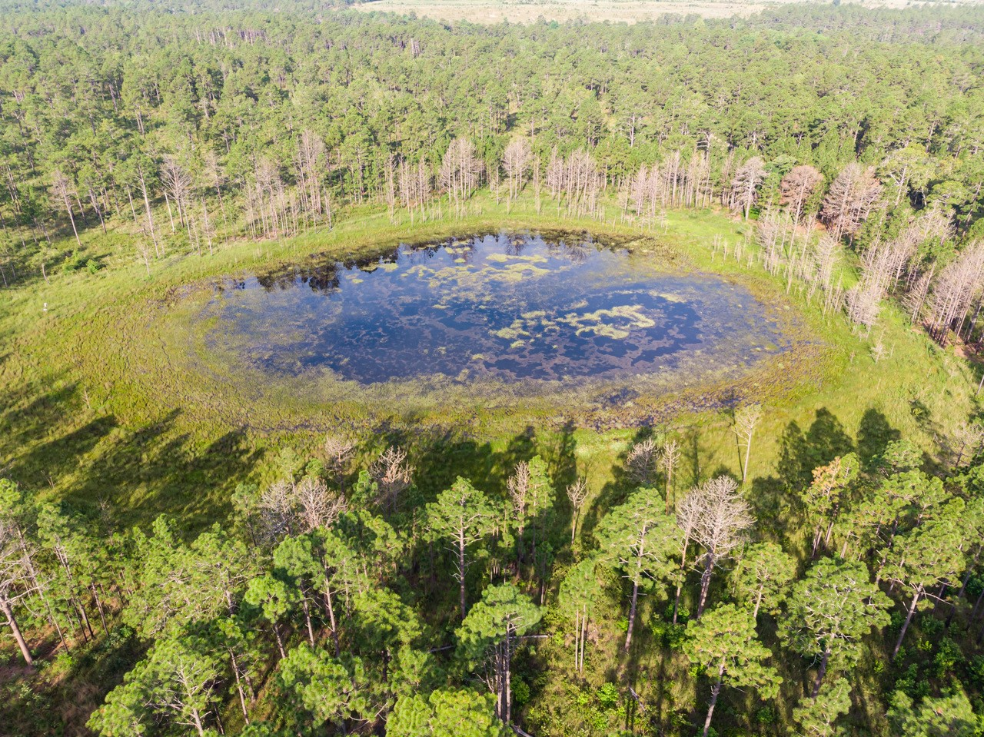
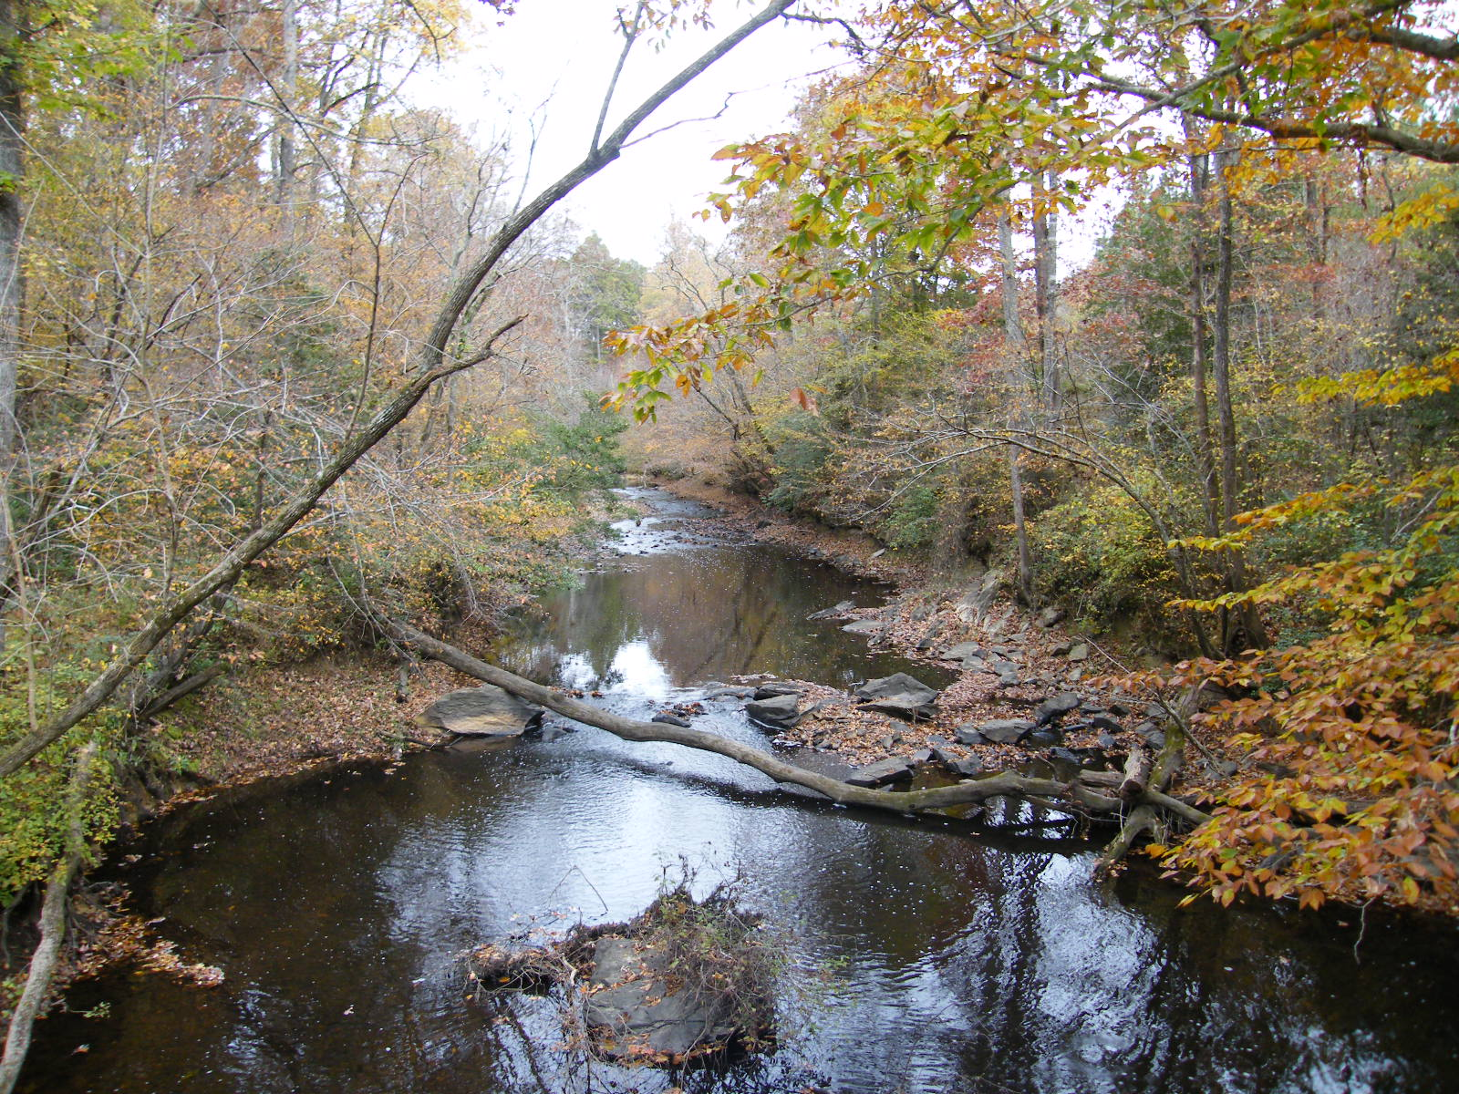
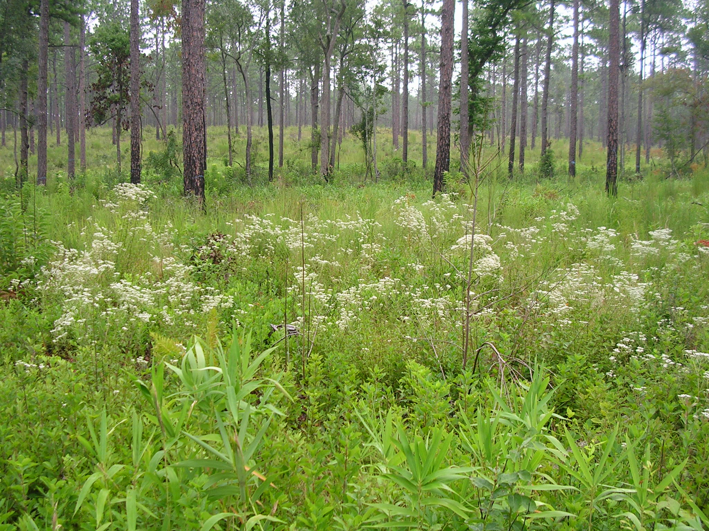
Conservation Targets
Longleaf Pine Mosaic
Upland Depressional Wetlands
Blackwater Streams
Streamhead Pocosins and Seeps
Notes:
What are we trying to conserve?
The Core Team chose four broader ecosystem and community level priorities, or conservation targets, to represent NC Sandhills biodiversity, which aligns with the landscape-scale work our partners do.
Conservation targets are elements of biodiversity: species, habitat/ecological systems, or ecological processes.
The only deviation from the 2004 Site Conservation Plan was that the Red-Cockaded Woodpecker, which was previously considered its own conservation target, is now part of the Longleaf Pine Mosaic as a nested target.

Slide 9
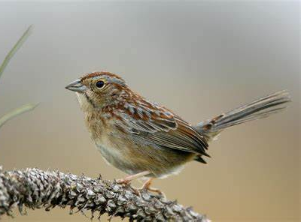
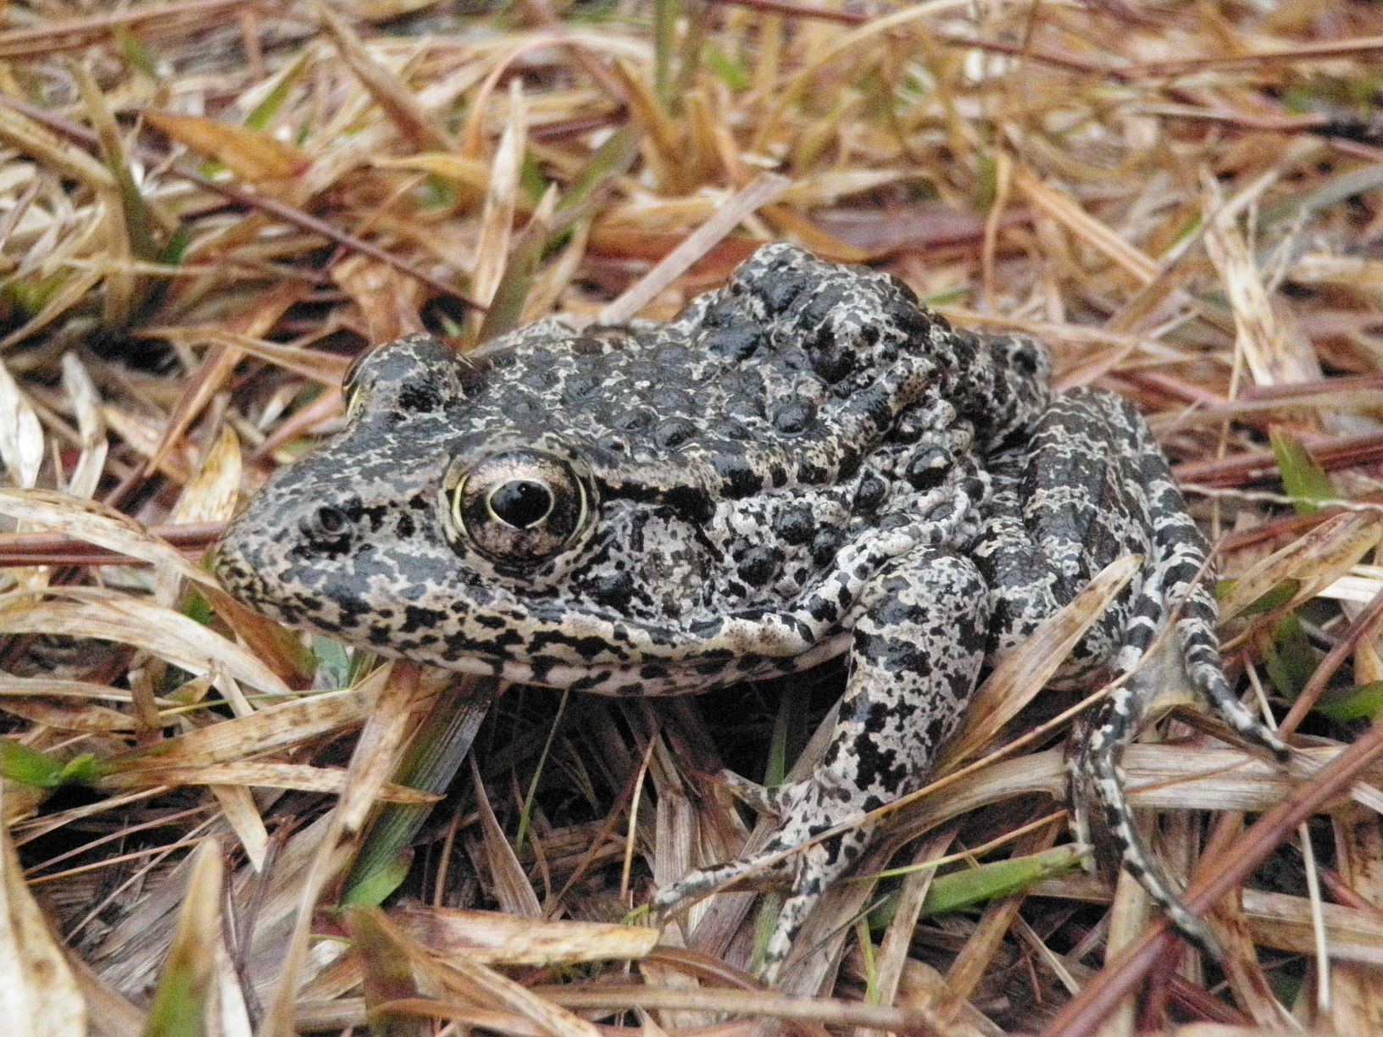
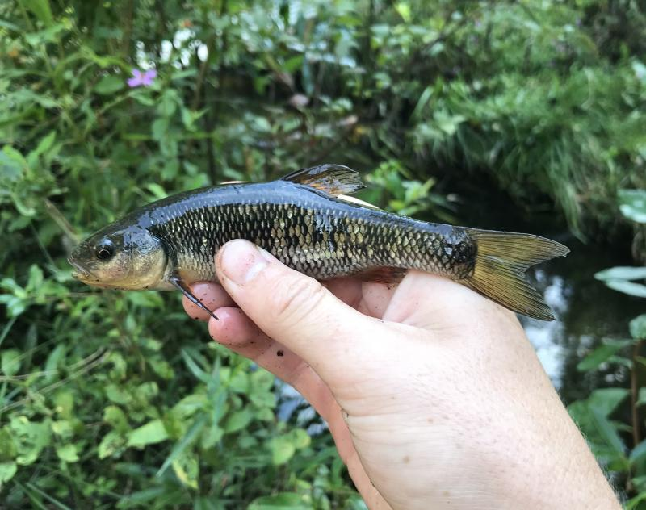
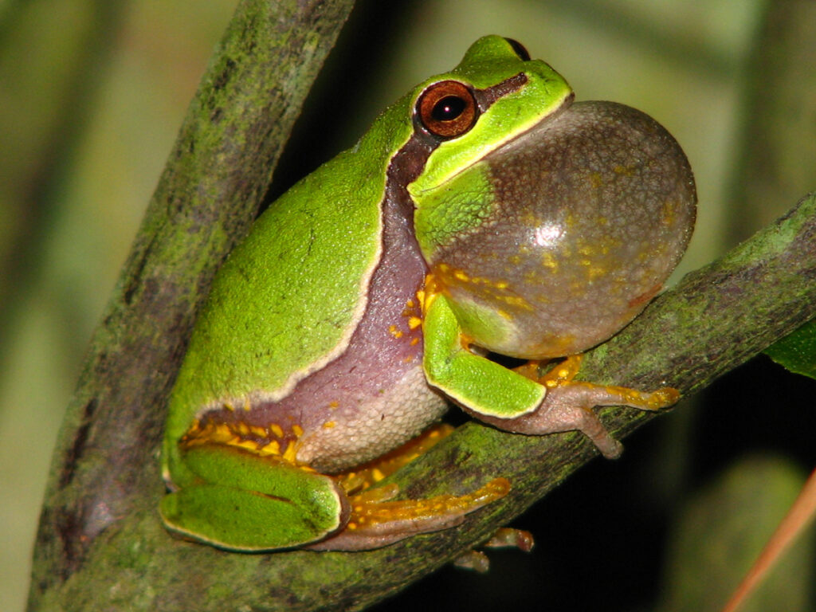
Notes:
Within each conservation target are nested targets, which are species as well as specific ecological communities whose conservation needs are subsumed in one or more focal conservation targets.
Nested targets perform critical roles in their respective ecosystem, but don’t warrant individual listing as conservation targets because they are too specific.
Entire lists of the nested targets chosen to include in the plan can be found there

Slide 10
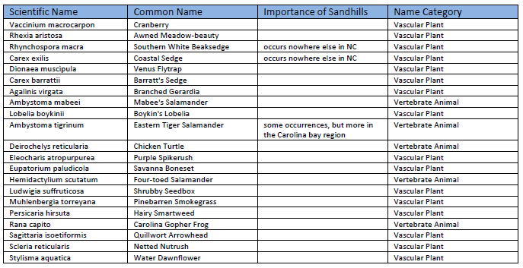
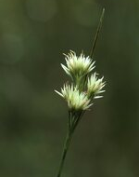
Nested Conservation targets associated with upland depressional wetland habitats
Notes:
Target species list
Rare species (NHP)
“Responsibility spp”: most/majority of global population occurs in Sandhills
Southern white beaksedge: Mostly just the Sandhills, but disjunct far to the east in the Croatan NF
Gopher frog: substantial populations throughout southern portion of SE coastal plain, but blinking out in the NC Sandhills

Slide 11
Longleaf Pine Mosaic
2025 Goals
LLP communities restored in core areas, buffers & connectors
Knowledge Gaps
Indicator species for monitoring
Methods for monitoring extent & condition
Condition & fire info for private lands
E & W RCW populations have demographic connectivity & min 500 PBGs
Anticipated impacts of climate change
Notes:
GOALS OF LONGLEAF PINE MOSAIC (LLP):
1. By 2025, natural longleaf pine communities* containing healthy assemblages** of longleaf pine associated species are restored within core areas***, buffers, and connectors**** as defined by the Reserve Design.
*Natural longleaf pine communities have the appropriate ground cover and native pine distribution for each specific community type, e.g. upland LLP has wire-grass dominated herbaceous ground cover, minimal or patchy hardwood mid-story, and an uneven-aged LLP component.
** A healthy assemblage is a defined suite of longleaf pine generalists and specialists from NHP’s Landscape Habitat Indicator Guilds
*** Core areas are defined as fire maintained habitats on permanently protected lands including Ft. Bragg, Camp Mackall, Blocks A, B, C and D of the Sandhills Game Lands, and contiguous conservation lands.
****Buffers and connectors are generally forested habitat with minimal development suitable to buffer/link core areas for animal movement and maintenance of critical ecological processes
WHAT WE NEED TO KNOW
• Indicator species to be identified for LLP Monitoring (see Appendix C)
• Methodologies for monitoring extent and condition of longleaf pine communities
• Longleaf Pine condition and prescribed fire information for private lands
• Identify anticipated impacts of climate change on the LLP in the NC Sandhills
2. By 2025, the Sandhills East and West RCW populations have achieved demographic connectivity with a minimum 500 breeding pairs.
WHAT WE NEED TO KNOW
• Follow-up demographic connectivity study of RCWs in Sandhills at a future date

Slide 12
Upland Depressional Wetlands
2025 Goals
Restore structure of & connectivity between all known UDWs on protected lands & 50% private
Knowledge Gaps
Location, spatial relationship, & condition
Connectivity metrics for target species
Vegetative structure goals & metrics
Notes:
GOALS FOR UPLAND DEPRESSIONAL WETLANDS:
1. By 2025, vegetative structure and connectivity with associated habitats are restored for all known intact or restorable UDWs on protected lands and 50% of UDWs on private lands within reserve design.
WHAT WE NEED TO KNOW
• Location, spatial relationship (regarding herpetofauna), and condition of all UDWs
• Define connectivity metrics for target species
• Define vegetative structure goals and metrics

Slide 13
Blackwater Streams
2020 Goals
Priority streams support forest communities & meet requirements for supporting nested target species
Knowledge Gaps
Priority streams
Aquatic & forest community habitat requirements
Dam locations and release dates
Water quality in priority streams meet or exceed good rating
Spatial occurrence of community targets
Monitoring sites, water quality metrics, and point source locations
Notes:
GOALS OF BLACKWATER STREAMS:
1. By 2020, the hydrologic regime of priority blackwater streams supports associated forest communities that meet the habitat requirements for healthy assemblages* of common and nested target species.
*A healthy assemblage is defined as a suite of generalists and specialists from NHP’s Landscape Habitat Indicator Guilds
WHAT WE NEED TO KNOW
• Strategic Environmental Research and Development Program(SERDP) Report on Blackwater Streams (Deliverables starting 2012)
• Identify priority blackwater streams
• Spatial occurrence data on community targets (investigate Fort Bragg and DENR datasets)
• Define/describe aquatic and forest community habitat requirements
• Locations of dams and levees, as well as release rates from dams
2. By 2020, the water quality in all priority blackwater streams meets or exceeds the minimum criteria for a good rating as defined in the stream bioclassification metrics (criteria forthcoming from SERDP funded project)
WHAT WE NEED TO KNOW
• DENR monitoring sites and type of data collected for water quality metrics
• Appropriate water quality metrics (SERDP Report pending)
• Point source locations such as NPDES permitted locations

Slide 14
Streamhead Pocosins/Seeps
2020 Goals
All known SPS on protected lands & 75% of seeps & 25% of pocosins in connectors & buffers on private lands support target communities
Knowledge Gaps
Location/condition of all SPS
Indicator spp for monitoring
Desired veg structure
Connectivity metrics
Notes:
GOALS OF STREAMHEAD POCOSINS/SEEPS:
1. By 2020, all known pocosins and seeps on protected lands support appropriate biological communities including vegetative structure and presence of a minimum number of indicator plant and animal species.
2. By 2020, 75% of seeps and 25% of streamhead pocosins within connectors and buffers on private lands support appropriate biological communities including vegetative structure and presence of a minimum number of indicator plant and animal species.
WHAT WE NEED TO KNOW
• Location and condition of all SPS within Reserve Design
• Indicator species to be identified for SPS monitoring (see Appendix C)
• Determine desired vegetative structure for SPS communities (Reference habitat from NHP?)
• Define connectivity metrics for SPS conservation targets (see Appendix C)

Slide 15
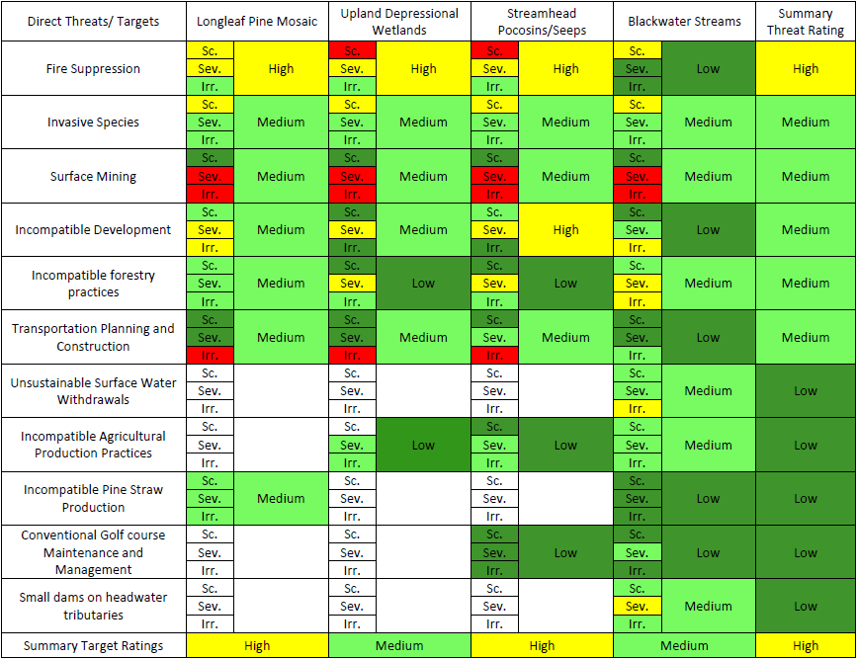
Threats to Conservation Targets
Notes:
Eleven direct threats were identified, which are essentially barriers to achieving our conservation target goals. The impact of each threat was ranked according to its scope, severity, and irreversibility.
Scope (Sc.): proportion of the target affected by an actual threat or likely to be affected by a potential threat
Severity (Sev.): level of damage it would cause to the target
Irreversibility (Irr.): extent to which the effects of the threat can be undone and the target restored
Describe how this chart works; walk through 1 example (fire suppression)

Slide 16
Notes:
Theory of change: what are some of the things that can be done about the threats identified?
Blue = actions
Yellow = desired outcomes
Purple = overall objective
Green = conservation target affected (improved condition)
Place to go if looking for ideas on how to address challenges
Could also use this to leverage funding

Slide 17
Planning Process
Notes:
Returning to this figure of the planning process, I’ll now be presenting the sections of the plan pertaining to how to achieve the goals that were set

Slide 18
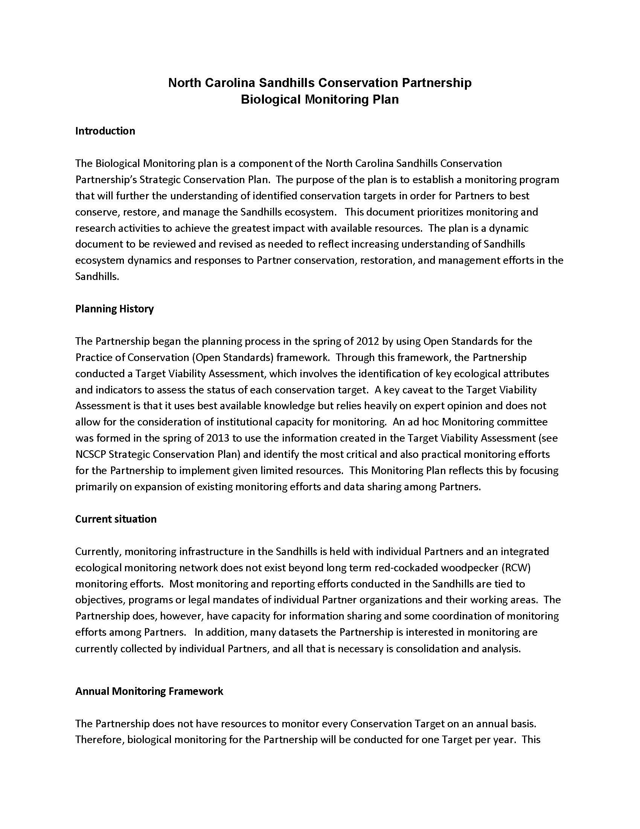
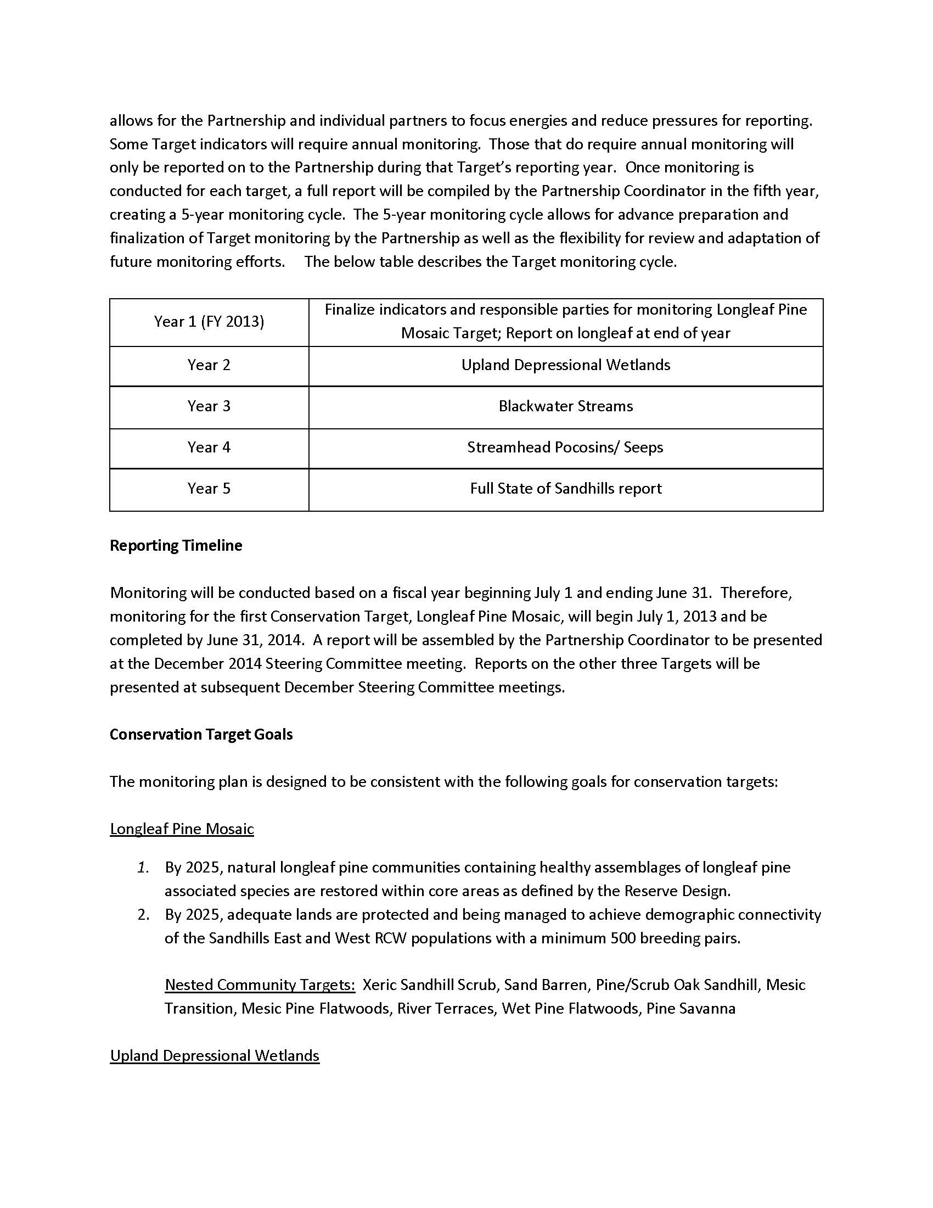
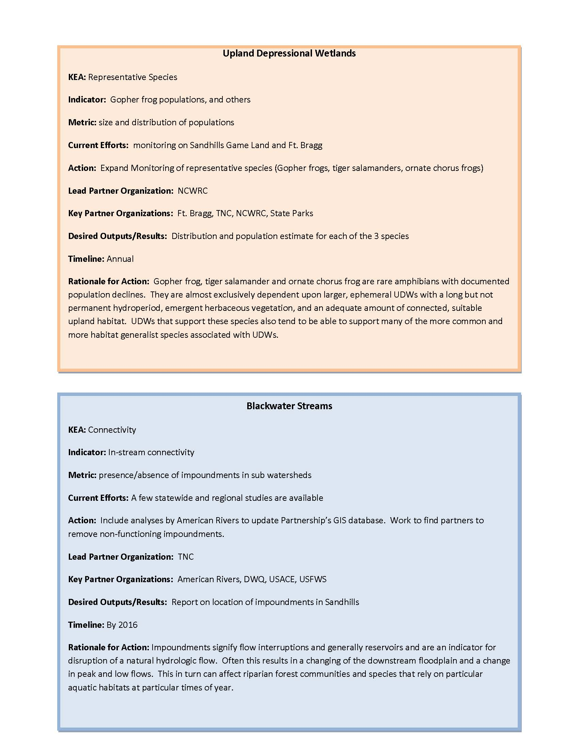
NCSCP Monitoring Plan
Notes:
The Monitoring Plan was created to guide our efforts towards achieving conservation target goals, including filling necessary knowledge gaps.
This last section represents the specific efforts to be undertaken by the Partnership to evaluate the baseline status of each Conservation Target.
Each colored box represents an action needed to evaluate a chosen ecological indicator or KEA (Key Ecological Attribute)
Each color represents a different Conservation Target.
In a nutshell, these boxes provide guidance on how we monitor indicators to track progress and needs towards achieving set goals

Slide 19
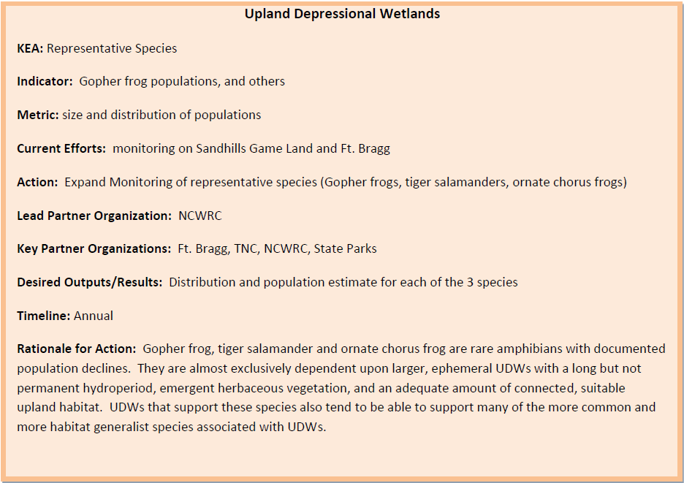
NCSCP Monitoring Plan

Slide 20
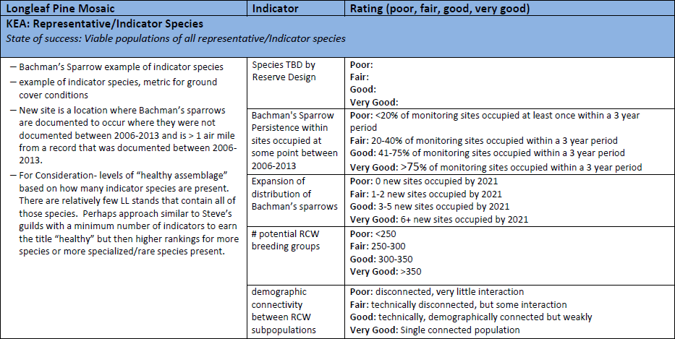
Notes:
To assess our progress, there are “State of Success” tables in the Appendix of the Conservation Plan that associate ranges of values with rankings from poor to excellent. These can help us assess how close we are to achieving a set goal.

Slide 21
Implementation of the Strategic Conservation Plan
Prioritize strategies
Implement activities
Document progress
Annual status report
Review & update plan
Assess additional target needs
Build capacity (funding)
1 year
Notes:
Monitoring and subsequent management activities for a given target were set to operate on an annual basis, meaning that one year would be focused on uplands, the next on wetlands, and so forth, cycling back through each target until set goals had been accomplished.
This was largely to conserve limited resources, and ensure that each target was being prioritized equally.
We haven’t really operated this way though, in part due to the nature of some important projects simply requiring more than 1 year, but also because, while implied in the plan, our partnership has functioned less as an organization and more like an information-sharing forum.
We collaborate on many things where objectives are compatible, and the goals of the partnership have shaped much of the work that’s been done in the region to date, but our partners and the people within them aren’t necessarily shaping their priorities based on those outlined in this plan. Our partners have varying objectives, opportunities, and structural differences that simply don’t always fit within the confines of this plan’s implementation strategy.
So, the annual framework is a good goal to have, but not always realistic.

Slide 22
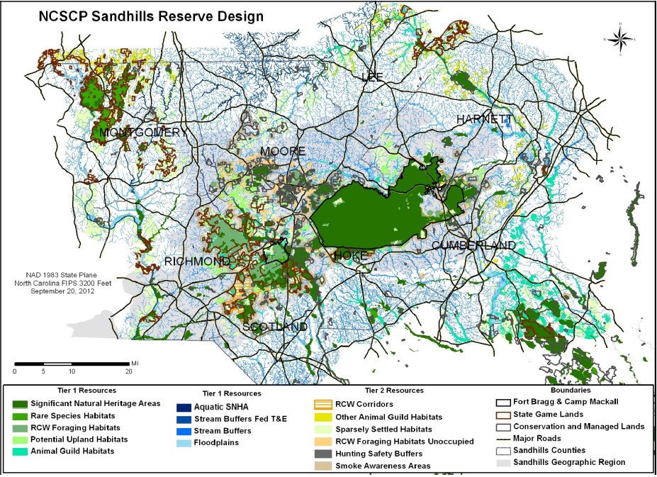
Reserve Design
2013 Version
Notes:
Component parts & use

Slide 23
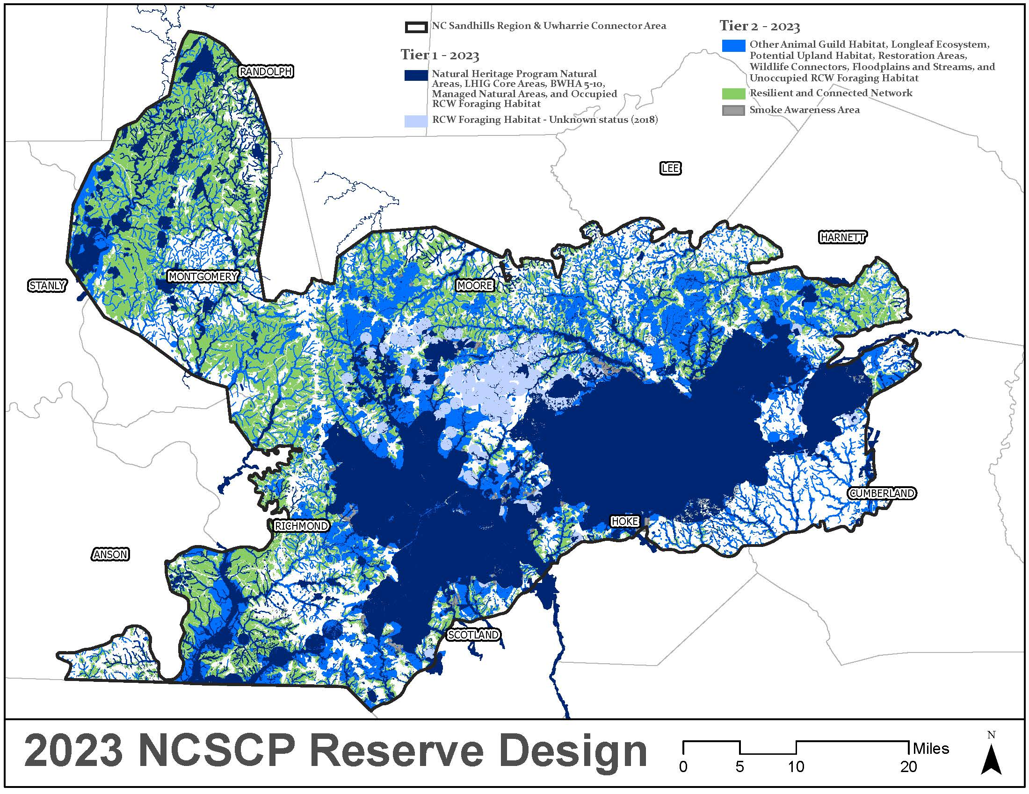
Reserve Design
2023 Update

Slide 24
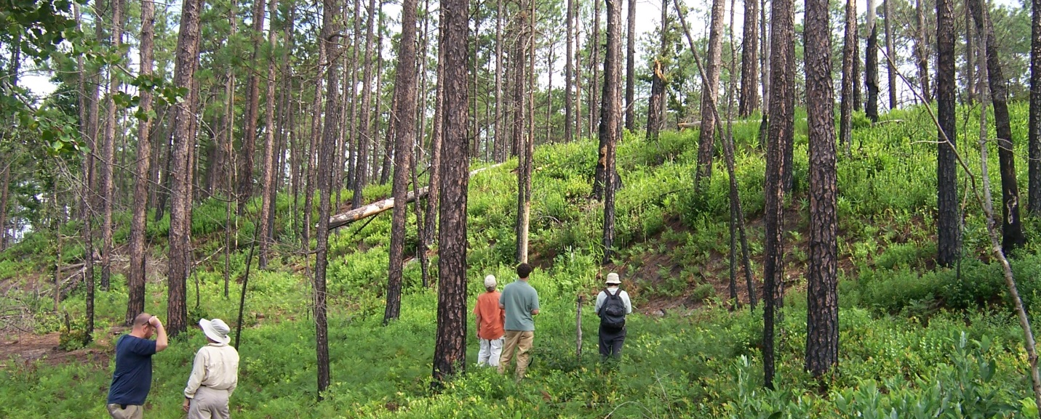
NCSCP Accomplishments since 2013

Slide 25
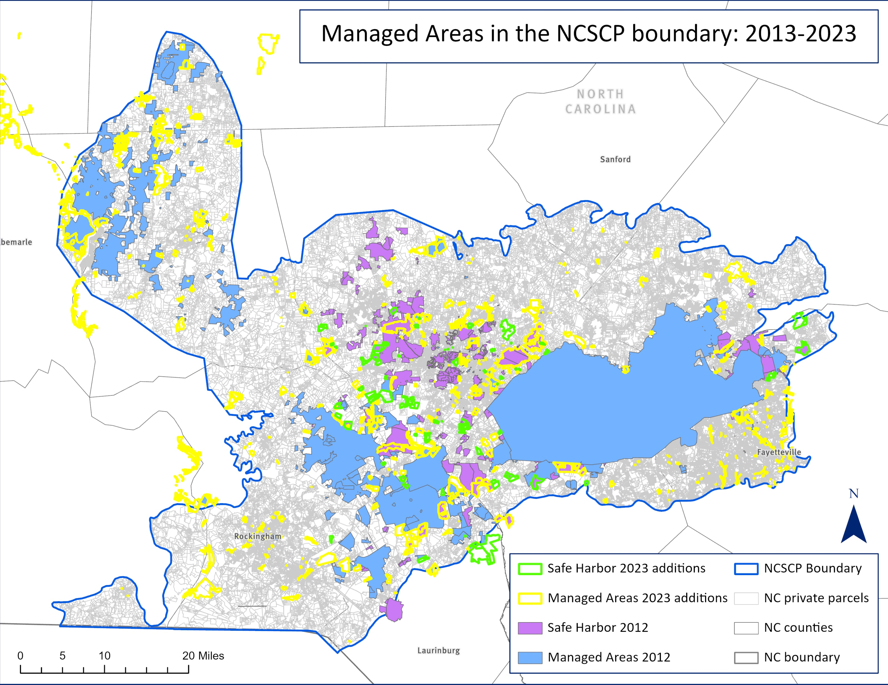

Slide 26
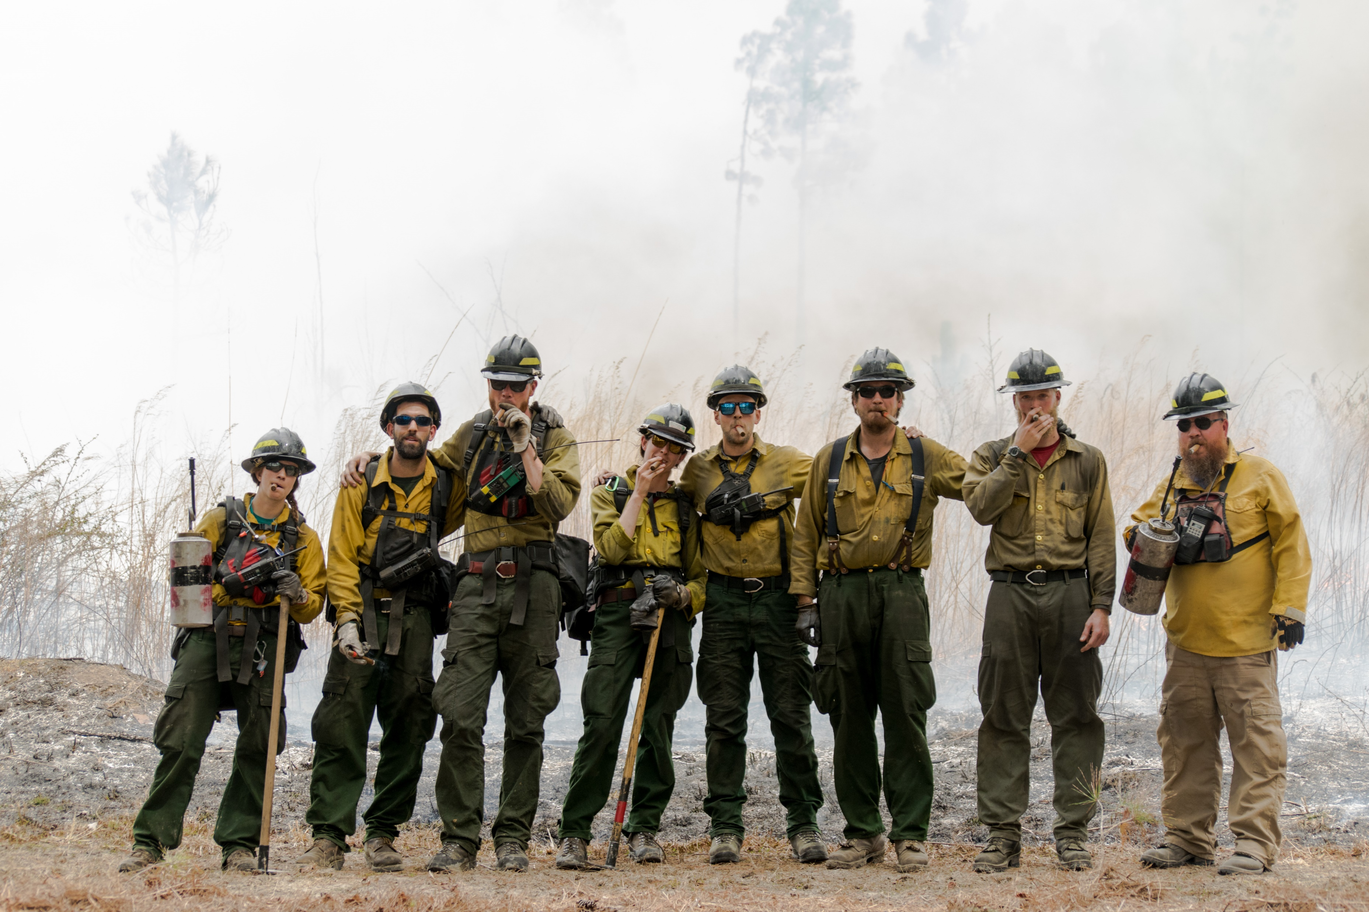
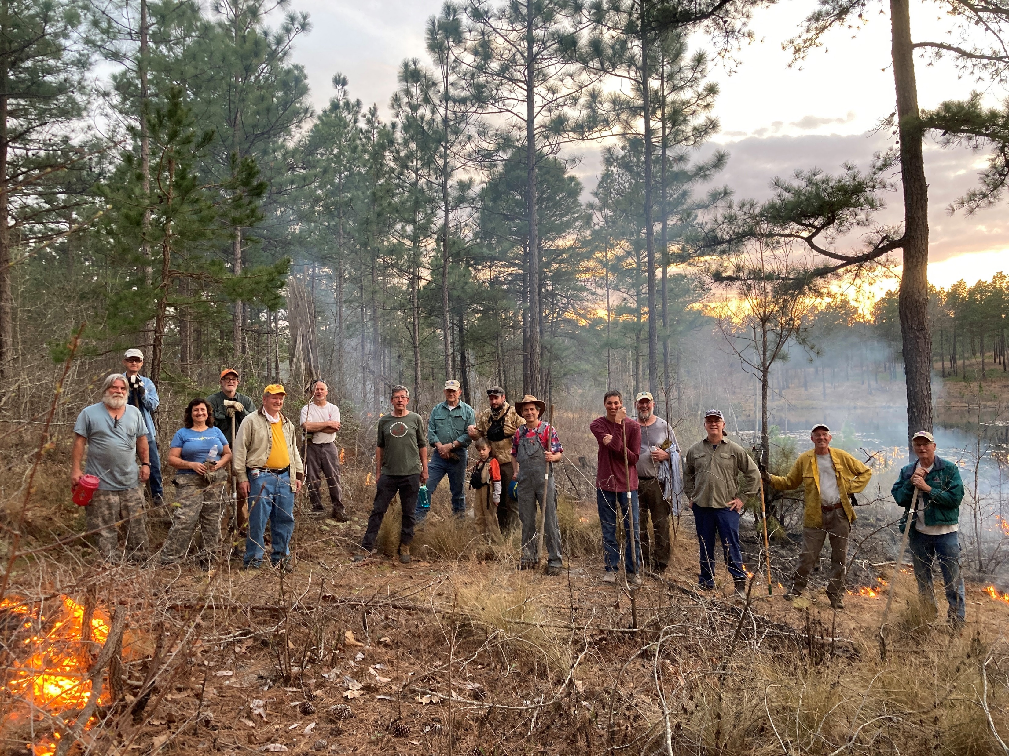
Management accomplishments since 2013
National Fish and Wildlife Foundation Funding
  Shared burn crew
  Contractual funding for burning, invasive control, midstory control, longleaf planting, wiregrass planting, landowner outreach and training
  10+ organizations directly supported
NC Sandhills Prescribed Burn Association
  Equipment, training, support for private landowners
Many partners have “upped their game”
Several organizations sharing personnel, equipment, expertise
TNC shared burn crew
Sandhills PBA
Notes:
Do we need numbers?

Slide 27
Longleaf Upland Mosaic
Increased protection, management & restoration of longleaf in buffers & corridors
Establishment and continued success of Sandhills PBA
Standardized method for assessing longleaf quality, with range-wide assessment of longleaf quality completed
Demographic connectivity of Sandhills E & W RCW populations & population recovery goal achieved well ahead of target date
Landscape-wide assessment of Bachman’s sparrow distribution and abundance
Accomplishments since 2013

Slide 28
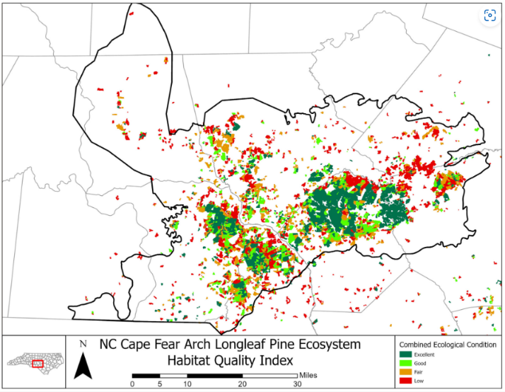
Longleaf Ecosystem Occurrences (LEO) Project
NCSCP

Slide 29
Longleaf Pine Mosaic
2025 Goals
LLP communities restored in core areas, buffers & connectors
Knowledge Gaps
Indicator species for monitoring
Methods for monitoring extent & condition
Condition & fire info for private lands
E & W RCW populations have demographic connectivity & min 500 PBGs
Anticipated impacts of climate change
Notes:
Of the 4 targets, we’ve really nailed it with the uplands, and have a clear path forward for continued success. This target also often contains the other 3 targets within it, so when we approach management of this target from an ecosystem perspective, we can largely accomplish goals set for all 4 targets.
Knowledge gaps:
We have reliable and relative simple indicator species we can monitor (RCW, BACS), but there’s opportunity to expand by putting greater emphasis on upland snakes and rare plants
We have improved methods for assessing longleaf quality through LEO
SE Fire Map is one way we can continue to assess progress on condition across the landscape
Room for improvement on tracking private lands management
Even have some more clarity on climate impacts due to past partnership meeting on climate change & resiliency; REPI challenge grant is addressing some of those issues

Slide 30
Longleaf Upland Mosaic
What amount of RCW monitoring can be sustained? When to shift resources/focus?
How to increase capacity for working with land use planners & other tools to keep forests on private lands?
How can we better address threats outside of our normal wheelhouse?
Connectivity between landscapes
Going forward

Slide 31
Upland Depressional Wetlands
Better herp inventory data
Discovery of several previously unknown wetlands
Improved understanding of connectivity needs
Several dozen wetlands restored on Sandhills Game Lands, Calloway, McIntosh Bay, and others
Strengthened information sharing
Accomplishments since 2013

Slide 32
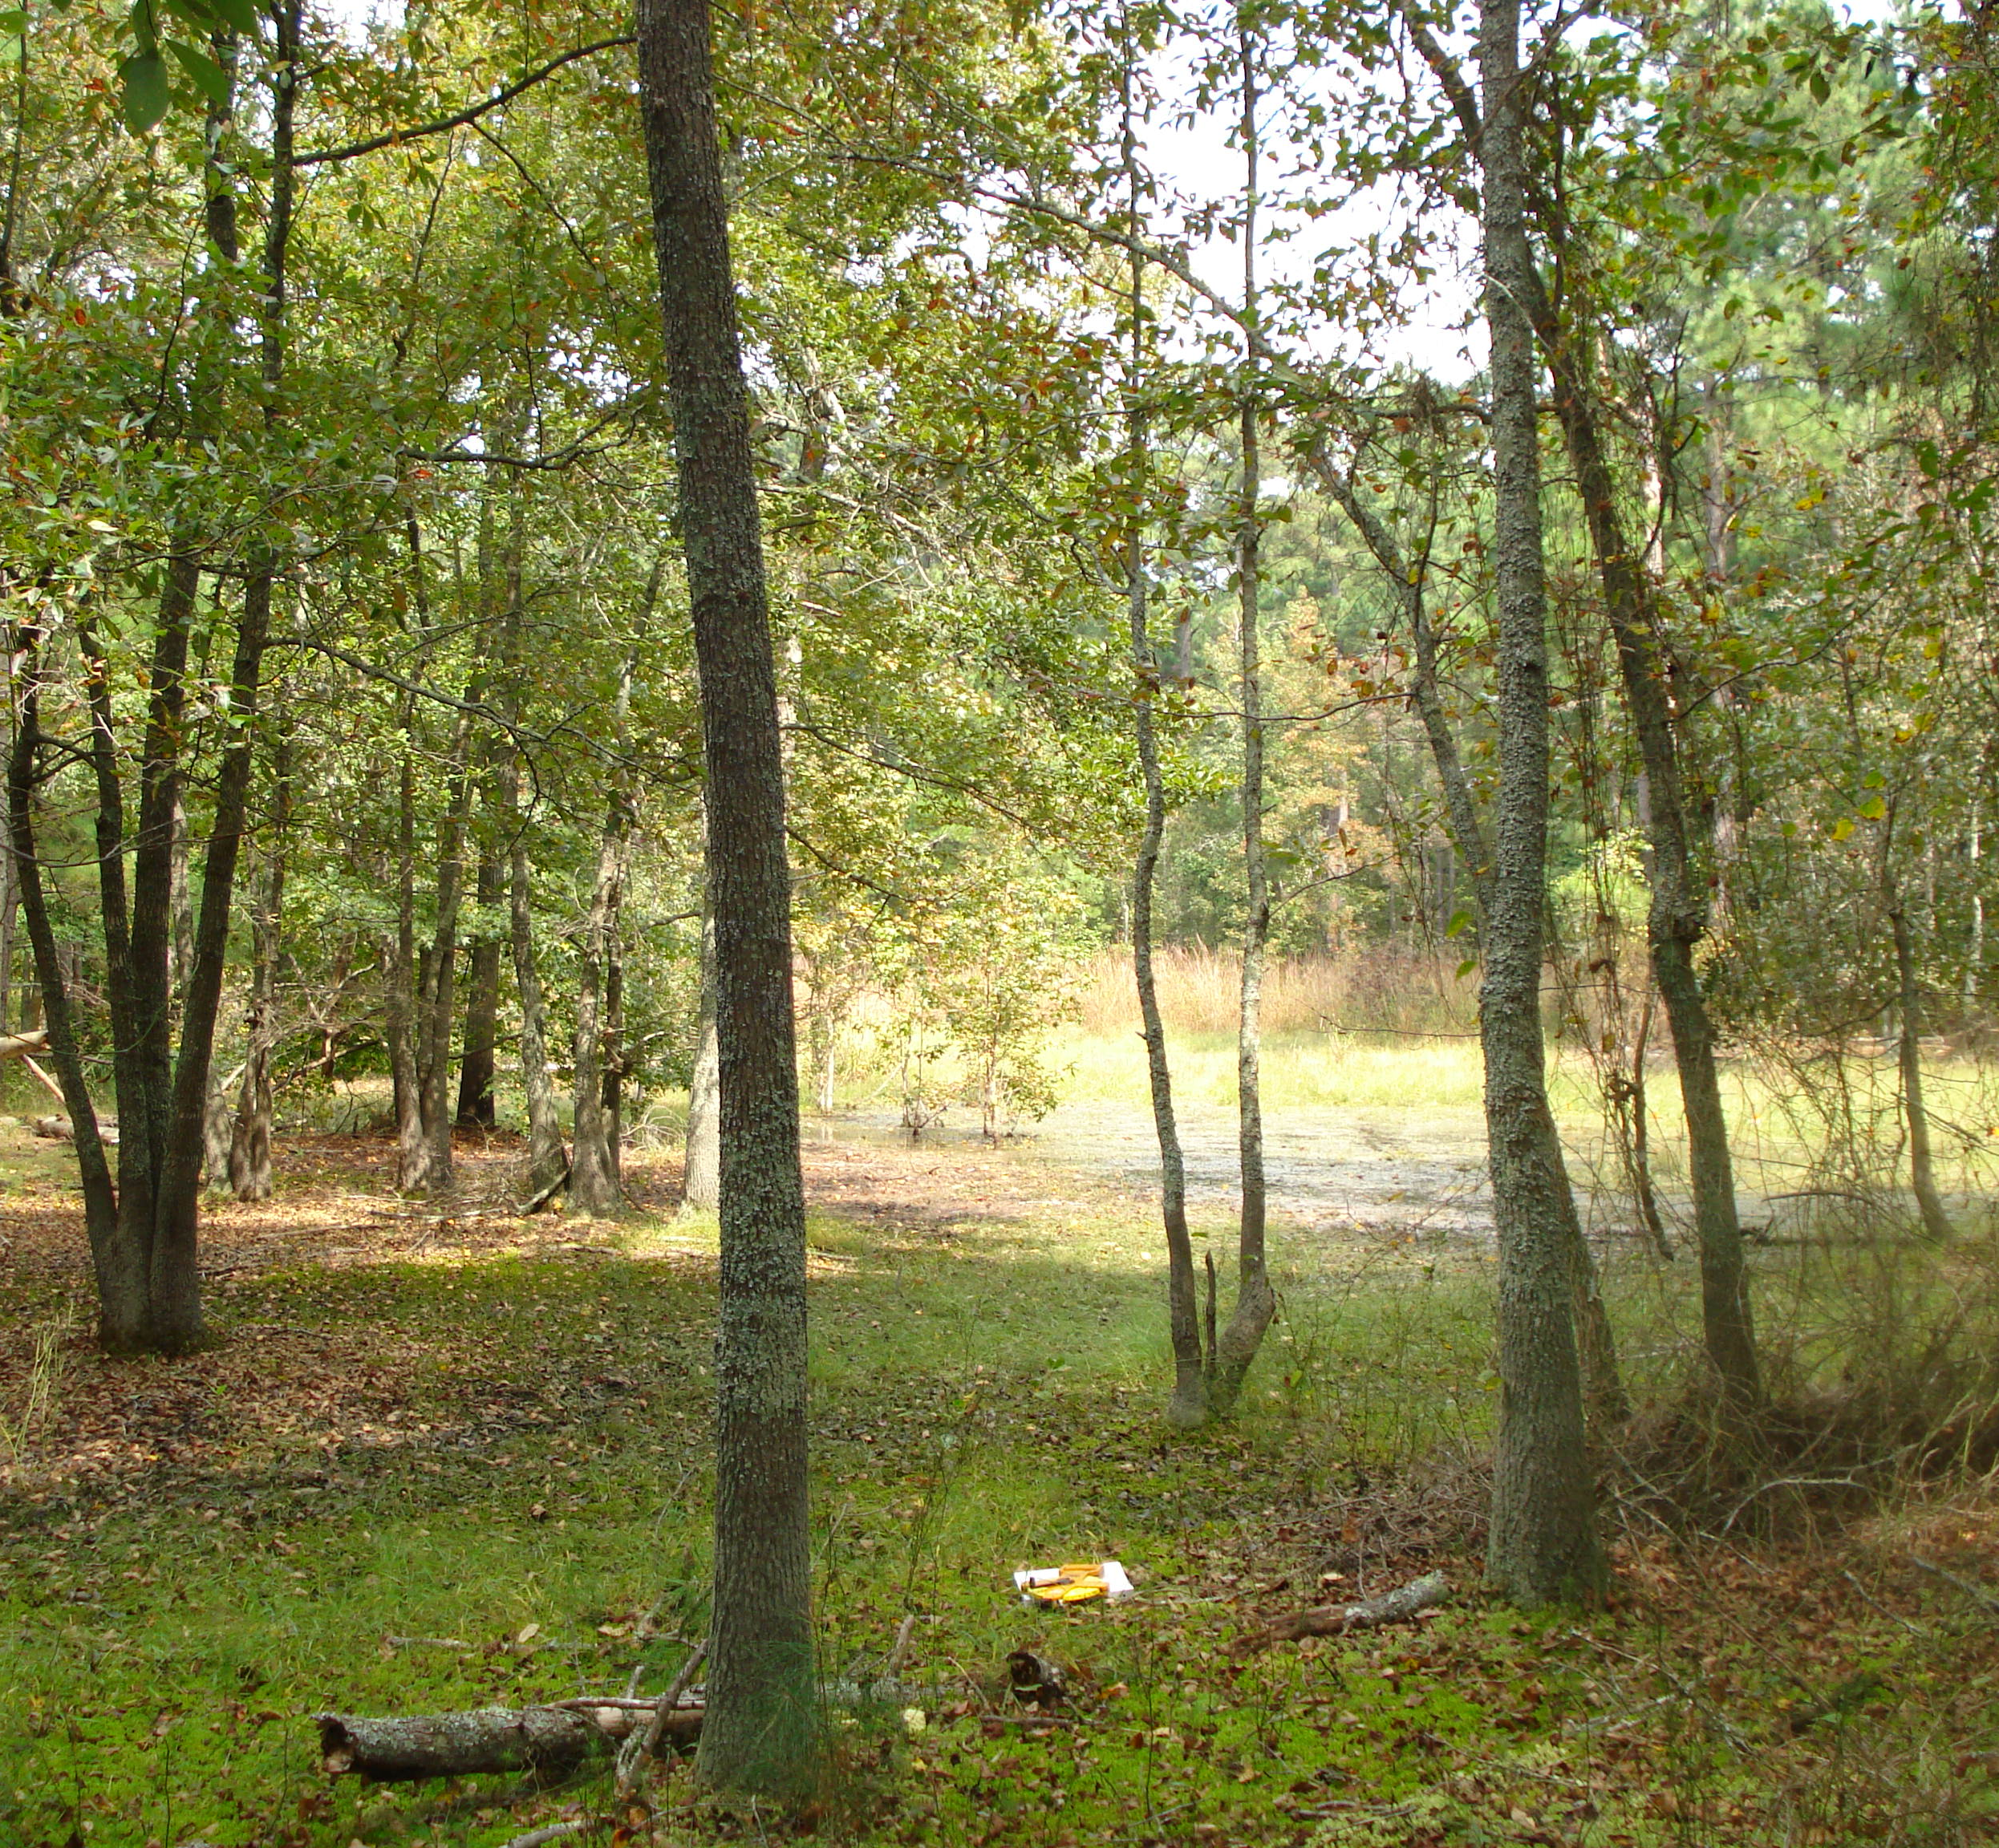
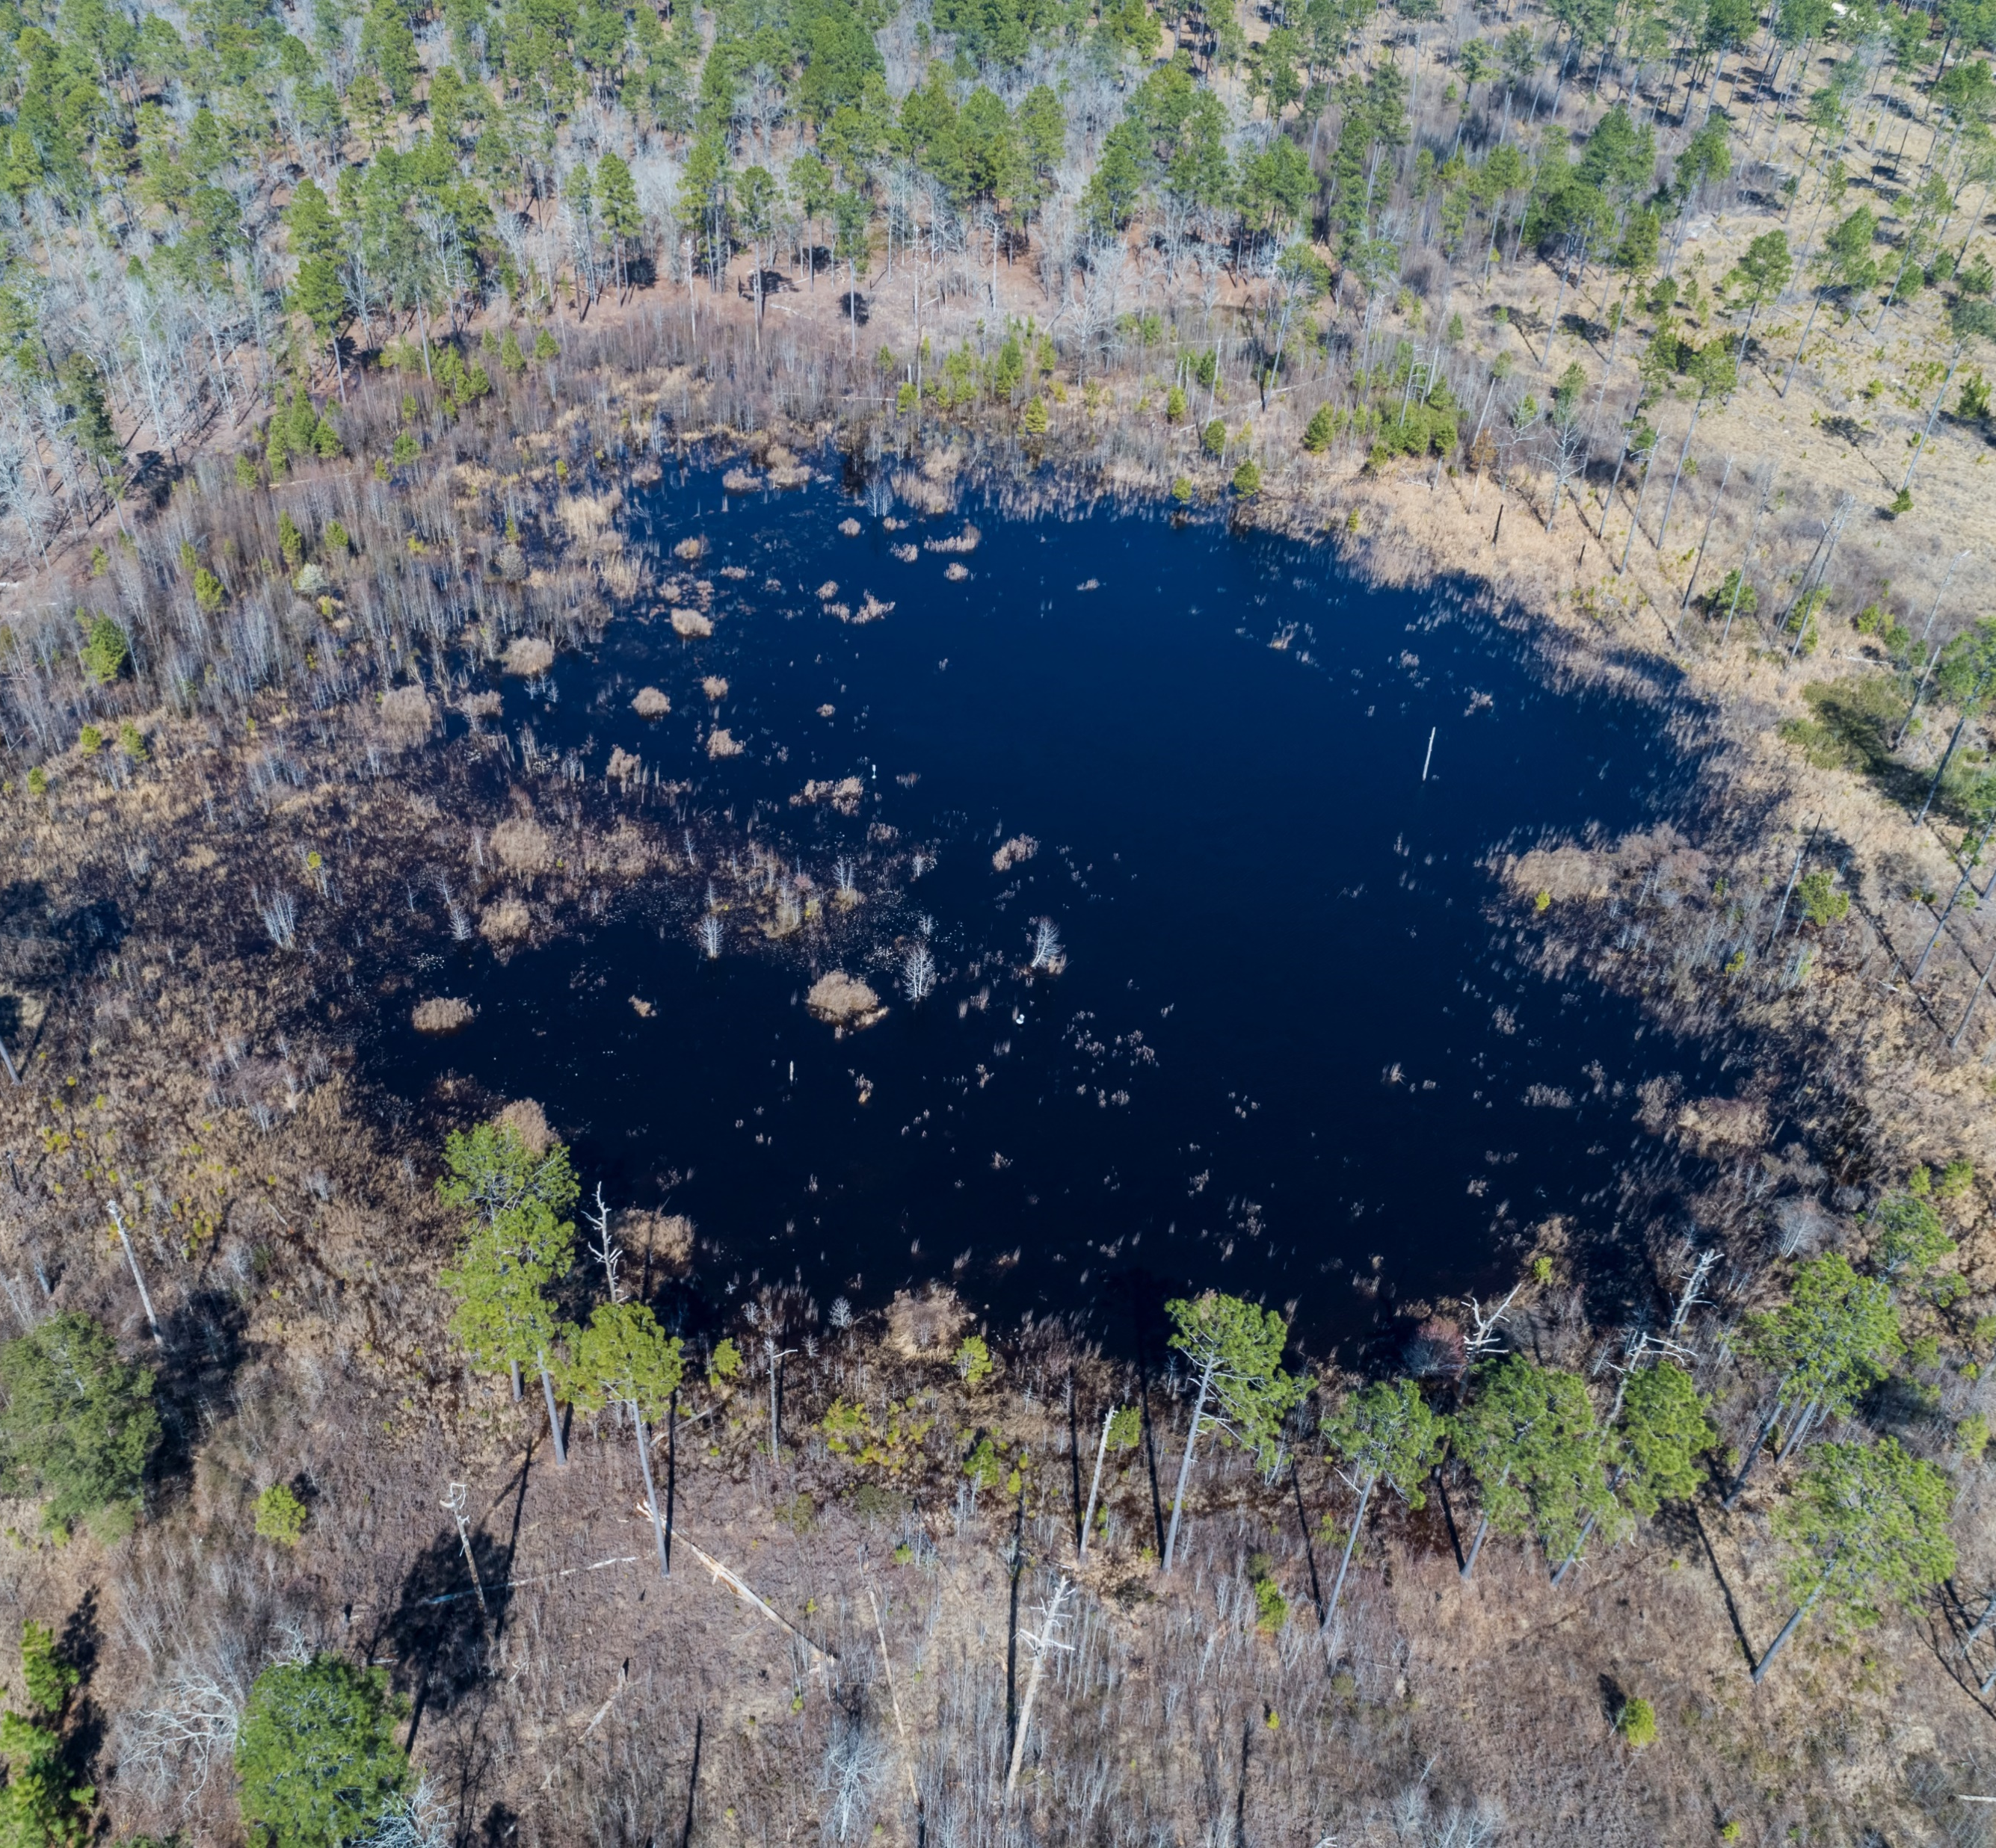
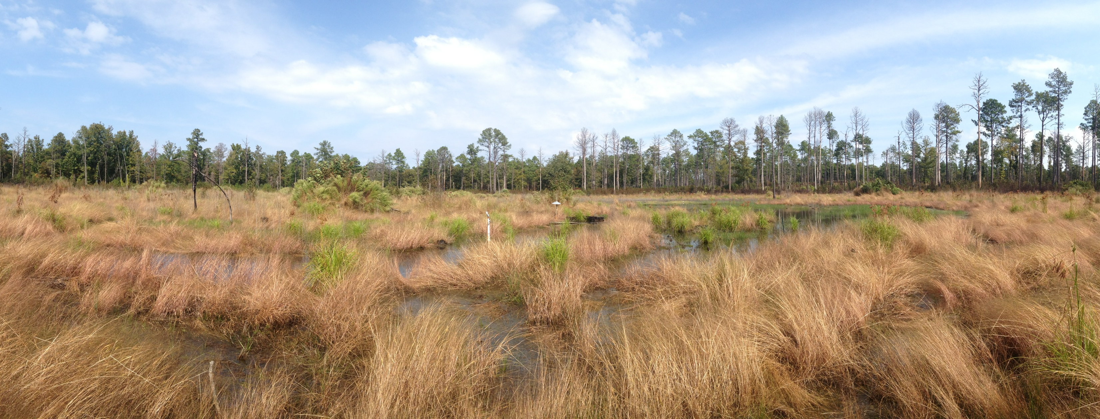
Block T Wetland Restoration (Sandhills Game Lands)
2008
2021
2014

Slide 33
Upland Depressional Wetlands
2025 Goals
Restore structure of & connectivity between all known protected UDWs on protected lands & 50% private
Knowledge Gaps
Location, spatial relationship, & condition
Connectivity metrics for target species
Vegetative structure goals & metrics
Notes:
Working on it! Really not sure where we’re at with private lands
Past and current mapping projects as well as dedicated field personnel (Mike Martin) have greatly improved our spatial knowledge of UDWs in the Sandhills, although largely on protected lands
Matt Moskwik created wetland scoring criteria; are we using it?

Slide 34
Upland Depressional Wetlands
How can we ensure restoration actions last?
How to control fire ants?
How can we increase capacity to better protect & manage Carolina bays?
What level of monitoring can be sustained?
Going forward
Notes:
“While each of the conservation targets is important within the longleaf ecosystem, the NCSCP is poised to contribute greatly to the conservation and restoration of UDWs. The NCSCP has a history of work in these communities and institutional knowledge held within its members. Species at high risk of extirpation, e.g. the Carolina gopher frog, are still present on protected lands, though successful breeding events are becoming increasingly rare and unpredictable. Of all the conservation targets, UDWs appear to be the target of highest need and urgency as evidenced by continued declines in habitat and breeding events. It is recommended that a working group dedicated to wetlands be established for focused work on restoration and issues associated with UDWs and Carolina bays.”

Slide 35
Blackwater Streams
Identified several issues surrounding declining base flows, flood events, water quality, and aquatic species communities
Secured REPI challenge funding to better understand base flows and flooding
Obtained baseline data on impoundment locations
Accomplishments since 2013

Slide 36
Blackwater Streams
2020 Goals
Priority streams support forest communities & meet requirements for supporting nested target species
Knowledge Gaps
Priority streams
Aquatic & forest community habitat requirements
Dam locations and release dates
Water quality in priority streams meet or exceed good rating
Spatial occurrence of community targets
Monitoring sites, water quality metrics, and point source locations
Notes:
We have the baseline data, now we need to take action
Land protection is one of the most important tools in addressing aquatic biodiversity and water quality issues
Potential to highlight this issue for outreach in the community, especially with increasing development
Continue to work with local stakeholders to promote use of Green Growth Toolbox and promote compatible development in the community

Slide 37
Blackwater Streams
How can we impact water quality & quantity at a watershed scale?
How do we galvanize more conservation action from local governments & landowners?
Can we identify impoundments that would be beneficial to remove?
What are the root causes of declining base flows & flooding?
Going forward

Slide 38
Streamhead Pocosins & Seeps
Improved field identification of seeps
Better data on pine barrens tree frog
Accomplishments since 2013

Slide 39
Streamhead Pocosins & Seeps
2020 Goals
All known SPS on protected lands & 75% of seeps & 25% of pocosins in connectors & buffers on private lands support target communities
Knowledge Gaps
Location/condition of all SPS
Indicator spp for monitoring
Desired veg structure
Connectivity metrics

Slide 40
Streamhead Pocosins & Seeps
How can we strengthen our understanding of connectivity in seep communities?
How can we better define the target communities we are aiming for?
In addition to regular burning of drains, how do we create and maintain the right soil and hydrologic conditions to improve seep quality?
Going forward

Slide 41
Open Discussion
BREAK OUT GROUP INSTRUCTIONS:
Get into groups
Assign a note-taker to report out
Allocate the next 20 minutes to discussing the following questions:
  Does the current Strategic Conservation Plan help to inform your work? If not, are there ways that it can be made more useful?
  Does this plan still represent our collective priorities? Is there anything missing?
  How can working groups & the steering committee more effectively support conservation efforts? What level of responsibility should they have in tracking progress?
Reconvene and share discussion points (25 minutes)
Notes:
6-10 people per group
“Each identified strategy has been designated as falling under the purview of one the five working groups. Designated working groups will decide how a strategy and associated activities are executed and will be responsible for documenting progress. Working group leaders and the Partnership Coordinator are responsible for identifying and prioritizing activities in order to implement strategies and report to the Steering Committee. Working groups will provide annual status reports of their prioritized strategies and the status of strategies being implemented to the Partnership Coordinator. Where conflicts arise or coordination among working groups is necessary, working group chairs and the Partnership Coordinator will be responsible for overseeing necessary communications and actions in order to ensure that the work of the Partnership moves forward. A Finance Subcommittee will be established by the Steering Committee with the mission of overcoming financial obstacles of the Partnership and building capacity for monitoring and applied research. The Finance Subcommittee will meet as necessary and report to the Steering Committee. In order to evaluate Partnership success and progress, an Annual Report will be provided to the Steering Committee. Every 2 years, working groups will conduct a review of strategy implementation and monitoring efforts to assess the effectiveness towards meeting the identified goals. This review will focus on the status of indicators and metrics, and identify additional research needs. A standardized reporting template for this bi-annual review will be created by the Partnership Coordinator for working groups to submit to the Steering Committee. In 5 years, the Strategic Conservation plan will be reviewed and updated by a subcommittee who will consider the successes and failures of the Plan, adapt existing methodologies or propose new ones to strengthen the Partnership, and address new threats and changing conditions of conservation targets. A cooperative Monitoring Plan will be created to guide the Partnership’s monitoring program and delineate monitoring responsibilities among the various partners. The State of the Sandhills report will be an annual outreach document produced by the Communications Working Group for the public that outlines the accomplishments and issues faced by the Partnership and details how the NC Sandhills ecosystem is faring.”

