Slide 1
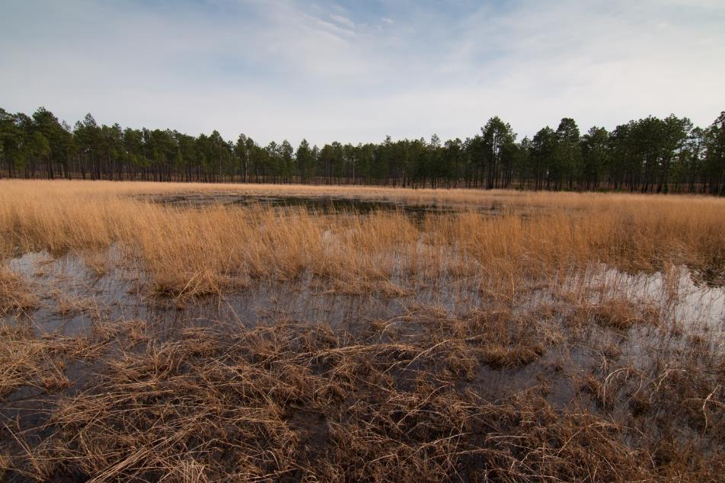
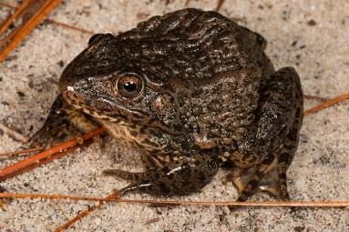
Climate Change and the Uncertain Future of Isolated Pond Breeding Amphibians
Nathan Shepard, Eastern Region Field Biologist www.ncnhp.org
Notes:
But the state of North Carolina is really a magical place.

Slide 2
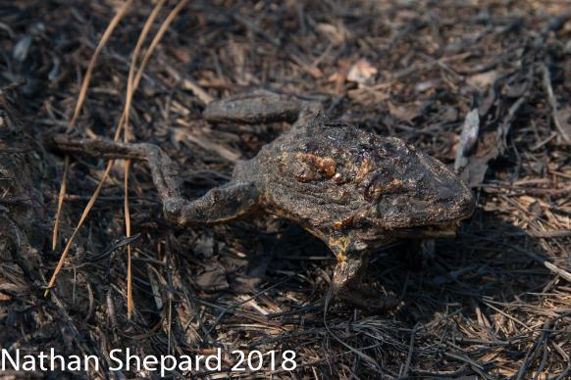
Amphibian Decline
Lots of factors:
UV radiation
Fragmentation
Loss of habitat
Disease
Pollution
Lack of natural fire regimes
Climate Change
OFTEN SYNERGISTIC

Slide 3
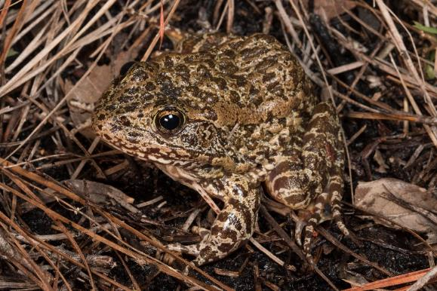
Rare Amphibian Species of Focus
Gopher Frog (Rana capito)

Slide 4
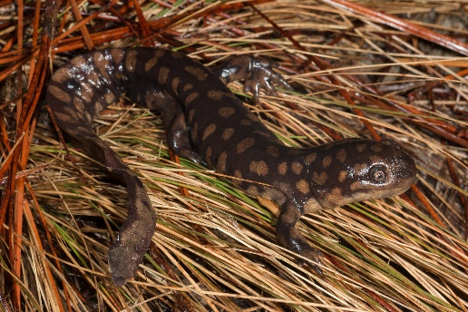
Rare Amphibian Species of Focus
Gopher Frog (Rana capito)
Tiger Salamander (Ambystoma tigrinum)

Slide 5
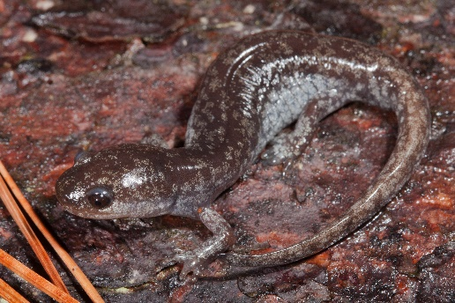
Rare Amphibian Species of Focus
Gopher Frog (Rana capito)
Tiger Salamander (Ambystoma tigrinum)
Mabee’s Salamander (Ambystoma mabeei)

Slide 6
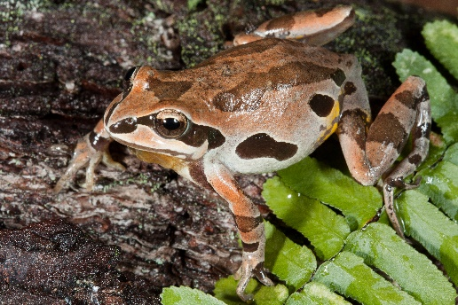
Rare Amphibian Species of Focus
Gopher Frog (Rana capito)
Tiger Salamander (Ambystoma tigrinum)
Mabee’s Salamander (Ambystoma mabeei)
Ornate Chorus Frog (Pseudacris ornata)

Slide 7
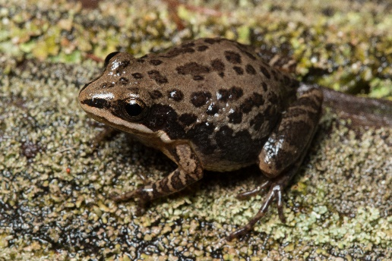
Rare Amphibian Species of Focus
Gopher Frog (Rana capito)
Tiger Salamander (Ambystoma tigrinum)
Mabee’s Salamander (Ambystoma mabeei)
Ornate Chorus Frog (Pseudacris ornata)
Southern Chorus Frog (Pseudacris nigrita)

Slide 8
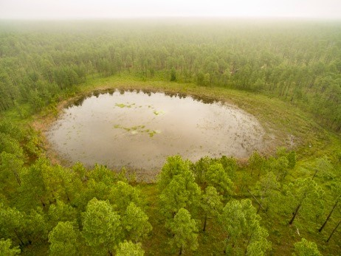
Isolated Wetlands
Not connected to other waterbodies

Slide 9
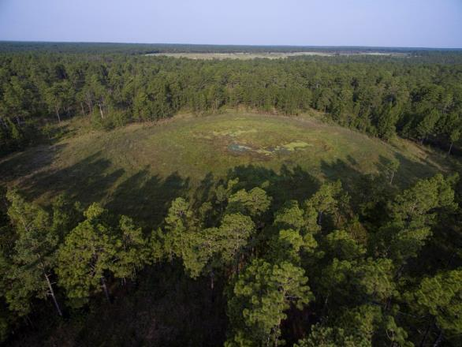
Isolated Wetlands
Not connected to other waterbodies
Open canopy with a grassy herb layer

Slide 10
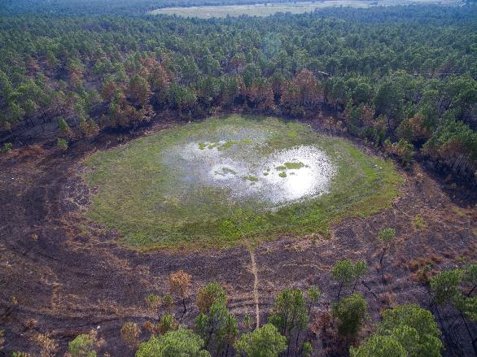
Isolated Wetlands
Not connected to other waterbodies
Open canopy with a grassy herb layer
Fire maintained

Slide 11
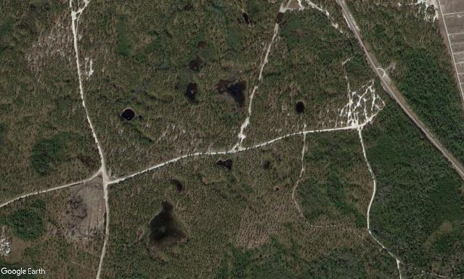
Isolated Wetlands
Not connected to other waterbodies
Open canopy with a grassy herb layer
Fire maintained
Divers are fire and hydroperiod
Vary in size, shape, and type
Possibly vary in function

Slide 12
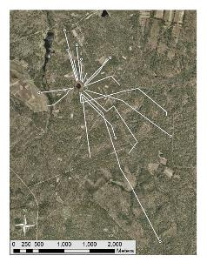
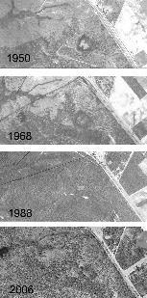
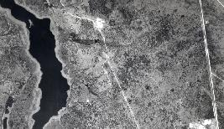
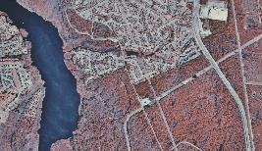
Pressures on Isolated Wetlands and Amphibians
Loss of Habitat
Poor habitat management
Loss of quality breeding wetlands
Road Mortality
Ground Disturbance
Fragmentation
Loss of Gene Flow / connectivity
Lack of suitable refugia
Water usage

Slide 13
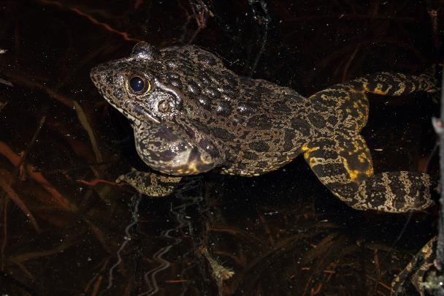
What could a changing Climate Mean?
Shifting Phenology

Slide 14
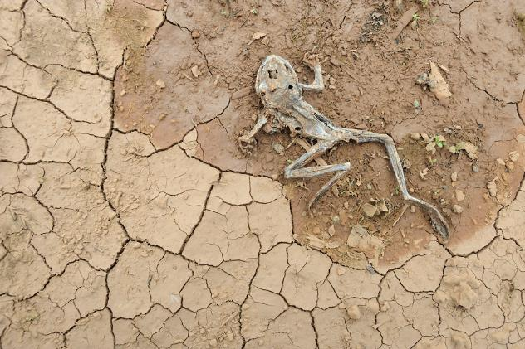
What could a changing Climate Mean?
Shifting Phenology
Variability in rainfall
Droughts?

Slide 15
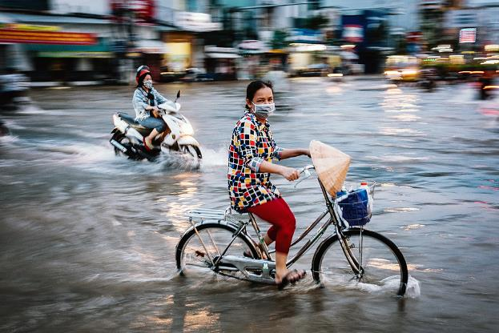
What could a changing Climate Mean?
Shifting Phenology
Variability in rainfall
Droughts?
Sea Level Rise
Many NC populations within 5 miles of the ocean
Range wide implications
Combined with tropical storms and Hurricanes

Slide 16
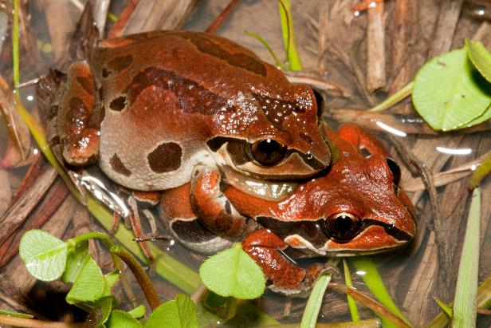
What could a changing Climate Mean?
Shifting Phenology
Variability in rainfall
Droughts!
Sea Level Rise
Many NC populations within 5 miles of the ocean
Range wide implications
Combined with tropical storms and Hurricanes

Slide 17
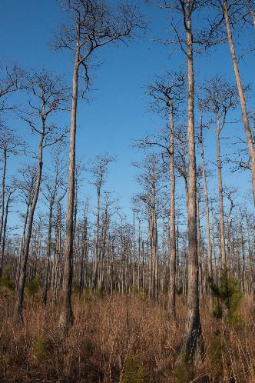
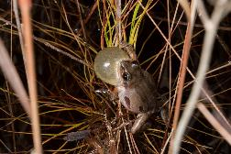
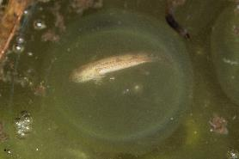
Examples of local extirpation in the Sandhills
Examples of the last 30 years:
Gopher Frogs
Tunstall Bay (early 1990s), Goose Pond Bay
Ornate Chorus Frogs
Tunstall Bay (2008), Antioch Bay, Goose Pond Bay, 17 Frog Pond (80/90s), DOT Borrow pits (mid-00s), State Line Prairie Bay
Southern Chorus Frogs
Tunstall Bay (2013)
Mabee’s Salamander
17 Frog Pond (80s/90s)
Tiger Salamanders:
Antioch Bay, Goose Pond Bay*

Slide 18
Examples of local extirpation in the Sandhills
Examples of the last 30 years:
Gopher Frogs
Tunstall Bay (early 1990s), Goose Pond Bay
Ornate Chorus Frogs
Tunstall Bay (2008), Antioch Bay, Goose Pond Bay, 17 Frog Pond (80/90s), DOT Borrow pits (mid-00s), State Line Prairie Bay
Southern Chorus Frogs
Tunstall Bay (2013)
Mabee’s Salamander
17 Frog Pond (80s/90s)
Tiger Salamanders:
Antioch Bay, Goose Pond Bay*

Slide 19
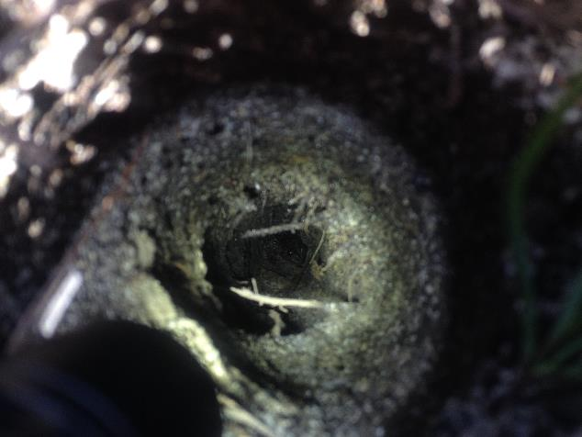
I’m getting thirsty…
Why drought?
Some species are short lived
Lack of healthy metapopulation dynamics
Low connectivity / gene flow
Already a fragmented and altered landscape
Low number of suitable of ponds
Woody material encroach into ponds
Desiccation/high predation
Little recruitment
Long-term – loss of breeding adults, extirpation
Lack of suitable refugia
Refugia choice

Slide 20
So, What the Hell Do We Do?!

Slide 21
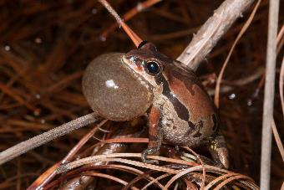
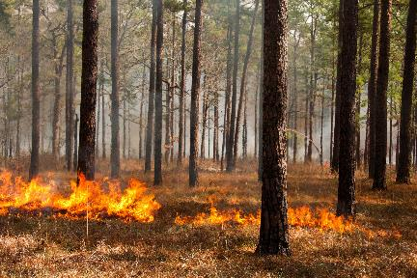
So, What the Hell Do We Do?!
Increase collectivity between populations/sites
Restoring upland Longleaf habitat
Restoring isolated ponds
Population augmentation and translocation

Slide 22
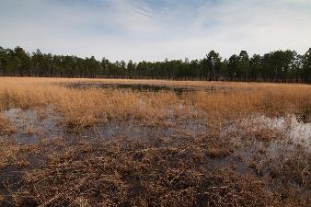
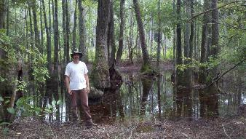
So, What the Hell Do We Do?!
Increase collectivity between populations/sites
Restoring upland Longleaf habitat
Restoring isolated ponds
Population augmentation and translocation
Increase number of ponds at a population/site
Rule of 3 per population

Slide 23
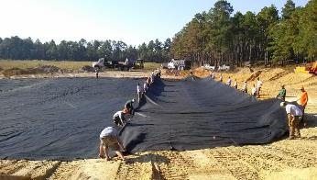
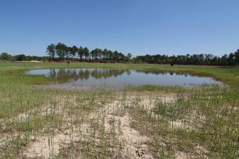
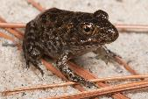
So, What the Hell Do We Do?!
Increase collectivity between populations/sites
Restoring upland Longleaf habitat
Restoring isolated ponds
Population augmentation and translocation
Increase number of ponds at a population/site
Rule of 3 per population
More experimenting with pond creation!
Liner or compact clay
Esp. in populations where suitable restoration ponds are not present
One day we will have new populations on restored landscape with entirely created ponds (less ideal but every population matters)

Slide 24
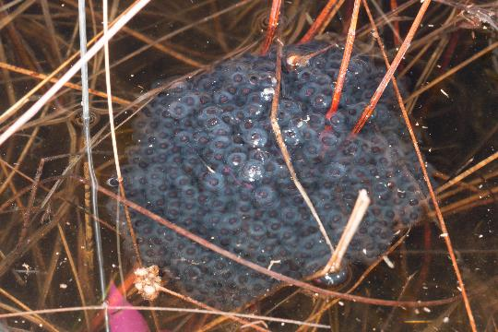
Take Aways…
Long-term Monitoring is KEY
No end game

Slide 25
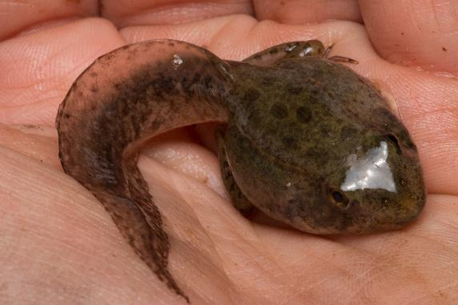
Take Aways…
Long-term Monitoring is KEY
No end game
Intensive Surveys take years
Find new populations
Monitor hard to access populations

Slide 26
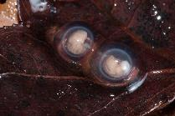
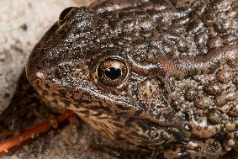
Take Aways…
Long-term Monitoring is KEY
No end game
Intensive Surveys take years
Find new populations
Monitor hard to access populations
Reshaping our communication skills with the people that matter:
Land managers, landowners, foresters, farmers, indigenous peoples
People connected to the landscape!

Slide 27
Acknowledgements
Colleagues: Dr. Jeff Humphries, Jeff Hall, Brady Beck, Jeff Marcus, Mike Martin, Mike Sisson, Dustin Smith, Chris Shupp, Alvin Braswell, Jeff Beane
Photo Credits: Jeff Hall, Dr. Jeff Humphries, Brady Beck, and Mike Martin

Slide 28
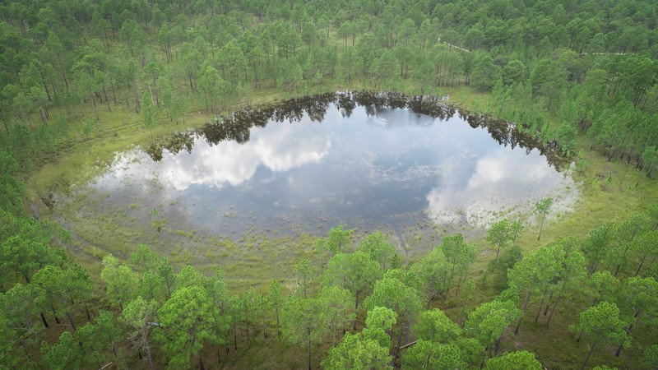
Questions?! Nathan Shepard NC Natural Heritage Program nathan.shepard@ncdcr.gov

