Slide 1
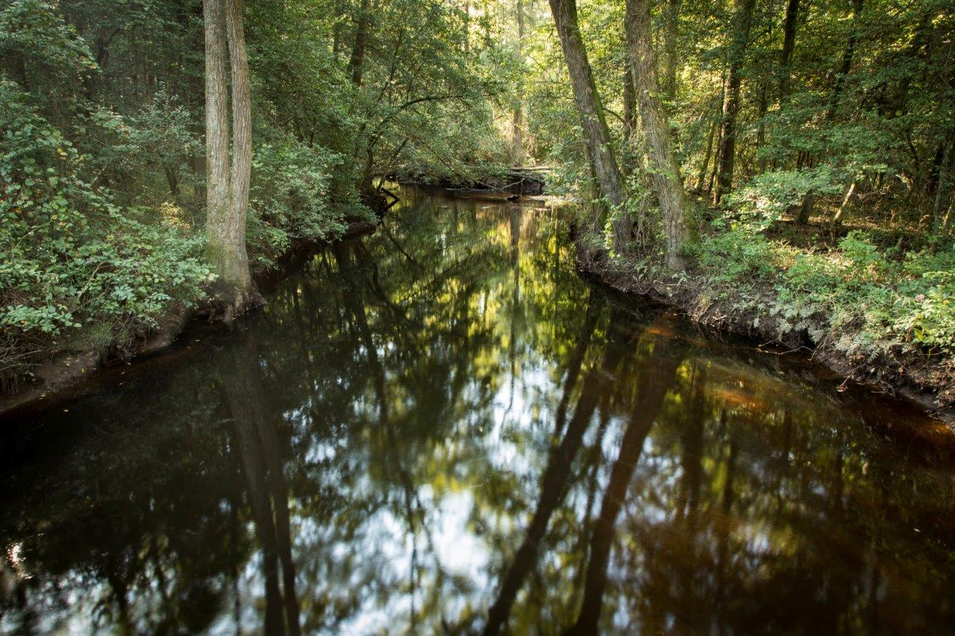
Watershed protection and the NC Sandhills Conservation Partnership
March 17, 2021
Photo: Drowning Creek
Credit: Brady Beck
Notes:
Hello everyone, and welcome again to the NC Sandhills Conservation Partnership meeting. The theme for today is learning about watershed protection.

Slide 2
Watershed protection and the NC Sandhills Conservation Partnership
How does terrestrial conservation and management affect watershed quality?
How can watershed protection initiatives help terrestrial conservation work?
What’s the relevance to the NC Sandhills?
Notes:
Many of us focus much of our time and energy on terrestrial conservation and land/forest management, so today’s meeting will focus on how our terrestrial conservation efforts affect aquatic systems and, on the flip side of that, how watershed protection initiatives can help advance our terrestrial work.

Slide 3
Watershed protection and the NC Sandhills Conservation Partnership
Drowning Creek:
Long term trend of declining base flows
Water supply for the Town of Southern Pines
Importance piece in the puzzle to connect Sandhills and Uwharries
Habitat for rare aquatic species
NCNHP blackwater stream community type and conservation site
Water conservation and the Joint Chiefs Grant
Land and Water Fund (Clean Water Management Trust Fund)
City of Fayetteville Public Works – Bonnie Doone restoration project
Notes:
Thinking of the relevance to the partnership, the first thing that may come to mind is the results of the blackwater stream monitoring project done by Matt Moscewicz a few years back. In his results, Matt flagged Drowning creek as a high priority for conservation due t several factors including the long-term trend of declining baseflows coupled with the fact that the stream in the water supply for the town of southern pines, an important piece in the puzzle to link the sandhills to the uwharries, it provides habitat for rare aquatics, and it’s a NCNHP tracked blackwater stream community type and conservation site.
We’re hoping that this meeting will help revive the conservation about conservation and land management in the Drowning Creek watershed.
Another important link between the partnership and water conservation relates to the Joint Chiefs grant. The grant was submitted with the GUCP to fund a 5 person shared burn crew for conducting prescribed fire on public and private land in the GUCP region. The grant was unsuccessful, and lacking ties to water conservation was among the reasons it was not funded.
Of course, thinking about conservation funding, the Land and Water Fund (CWTF) also looks at and prioritizes projects that show ties between tewrrestrial and aquatic conservation.
Also, the City of Fayetteville Public Works has been a key partner, and their restoration work at Bonnie Doone provides a clear link between longleaf restoration and management and water protection.

Slide 4
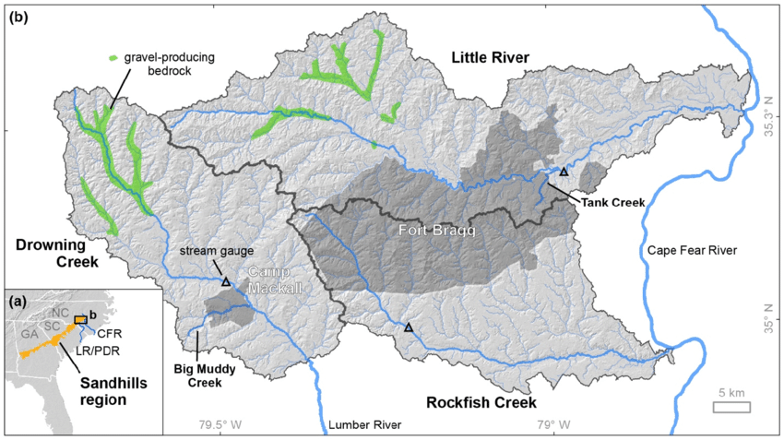
Drowning Creek
Map credit: Freshwater Bivalve Survey for Endangered Species Branch Fort Bragg, NC (Levine et al 2018).

Slide 5
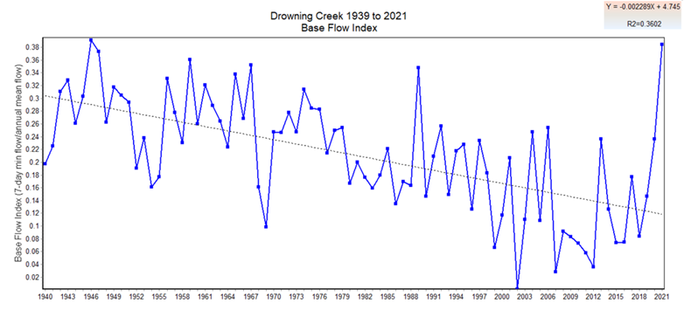
Drowning Creek

