Slide 1
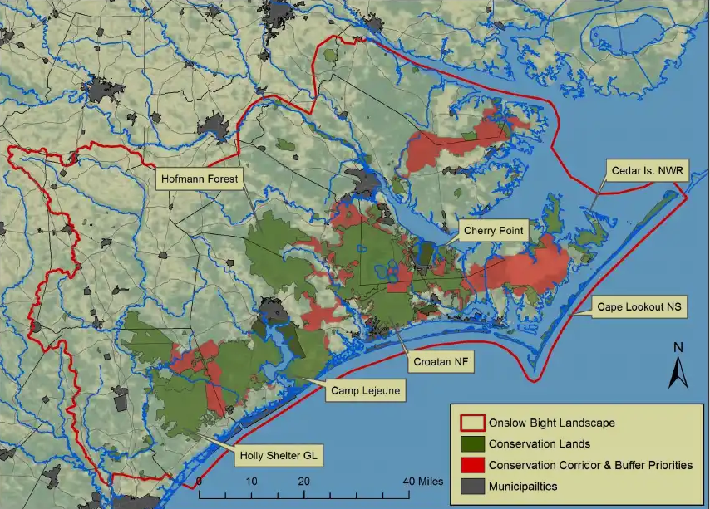
Onslow Bight Conservation Forum
Partner Updates

Slide 2
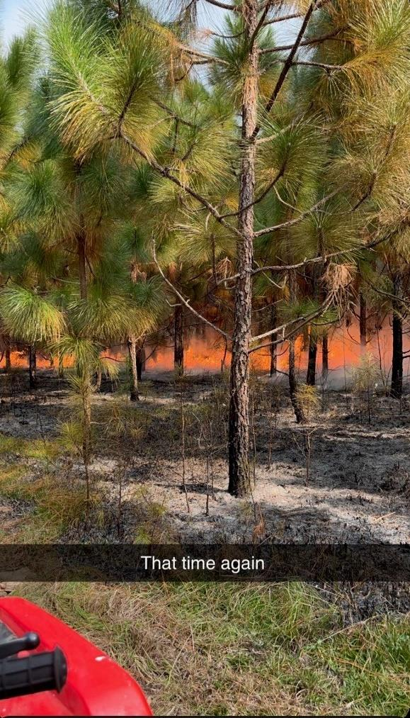
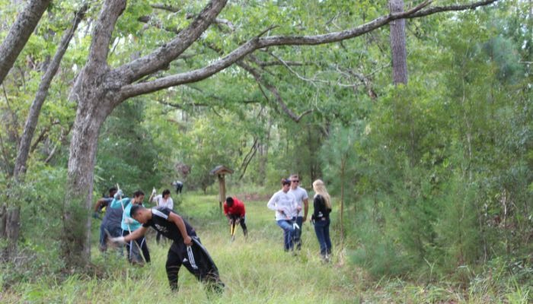
North Carolina Coastal Land Trust
NC Coastal Land Trust recently completed a contract prescribed burn on about 30-acres of our Everett Creek Preserve in Onslow County which included both natural and planted longleaf pine stands.
NC Coastal Land Trust has acquired several properties adjacent to the Croatan National Forest including;
923-acre Bern Preserve (Craven County),
1,436-acre Newport River Tract (Carteret County),
247-acre Island Creek Preserve (Jones County), and
113-acre Gales Creek/Talton Tract (Carteret County).
We have also acquired and transferred two inholdings to U.S. Forest Service to include as part of the Croatan National Forest;
349-acre Bate Tract and
181-acre Davis Tract in Craven County.
NC Coastal Land Trust planted 80-acres in longleaf on the Bern Preserve in Craven County with funding assistance from the U.S. Fish and Wildlife Service.

Slide 3
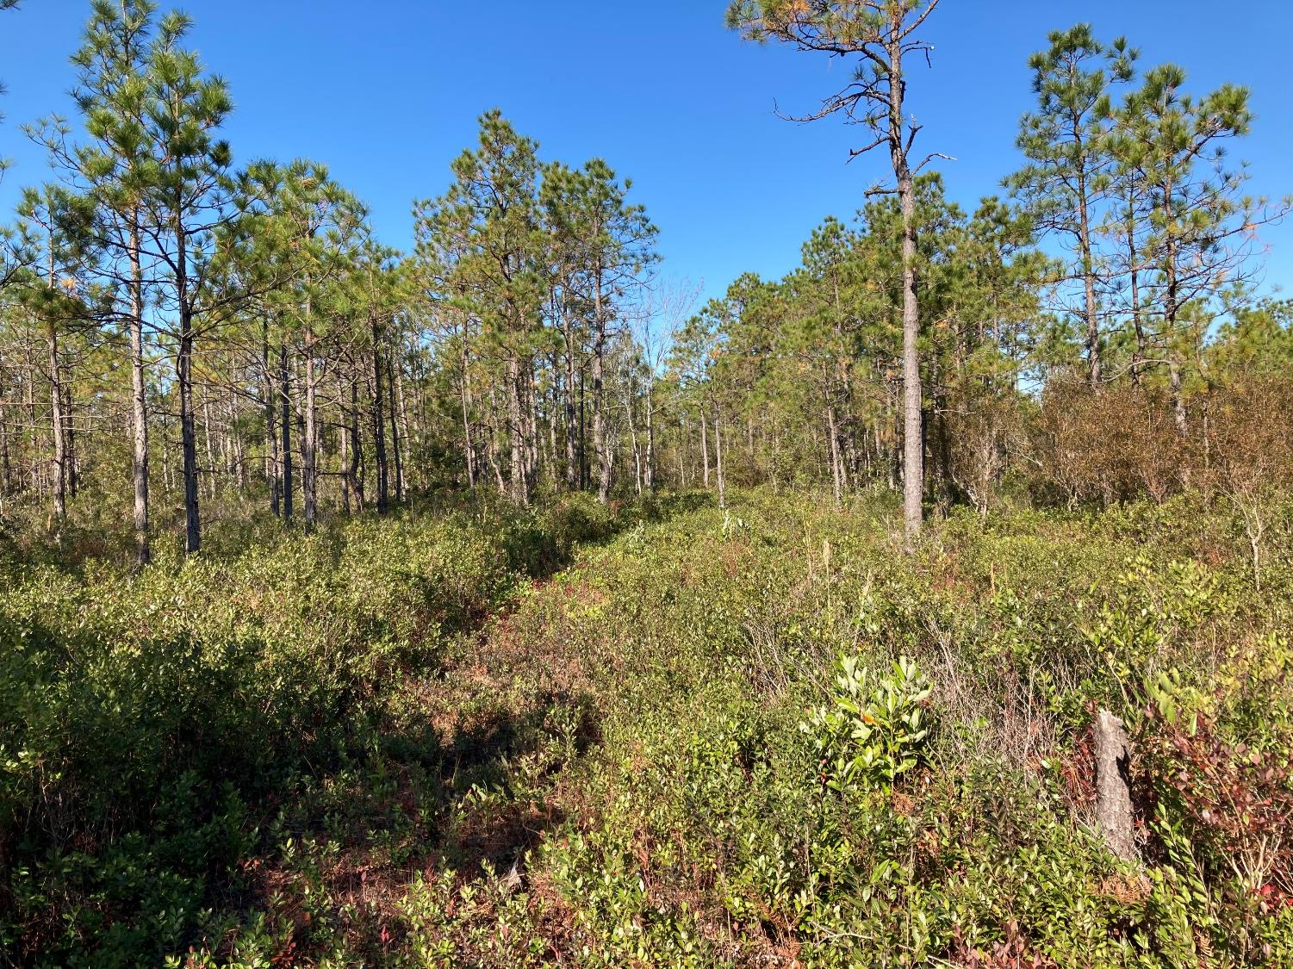
Matthews Tract, Horse Swamp
The Nature Conservancy (TNC)
Protected 5291 acres, the majority of which will go to the NCWRC
Burned ~1066 acres on TNC lands

Slide 4
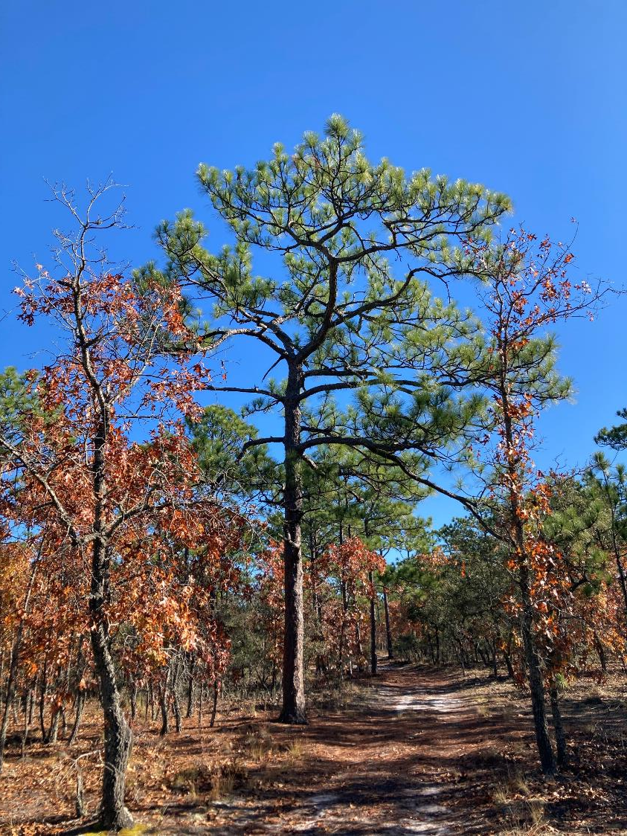
Goldsboro Milling Co. Tract (aka Sleepy Creek Farms)
TNC (cont’d)
Assisted Partners on 3839 acres of burning
Implemented aerial ignition drone into our fire management program

Slide 5
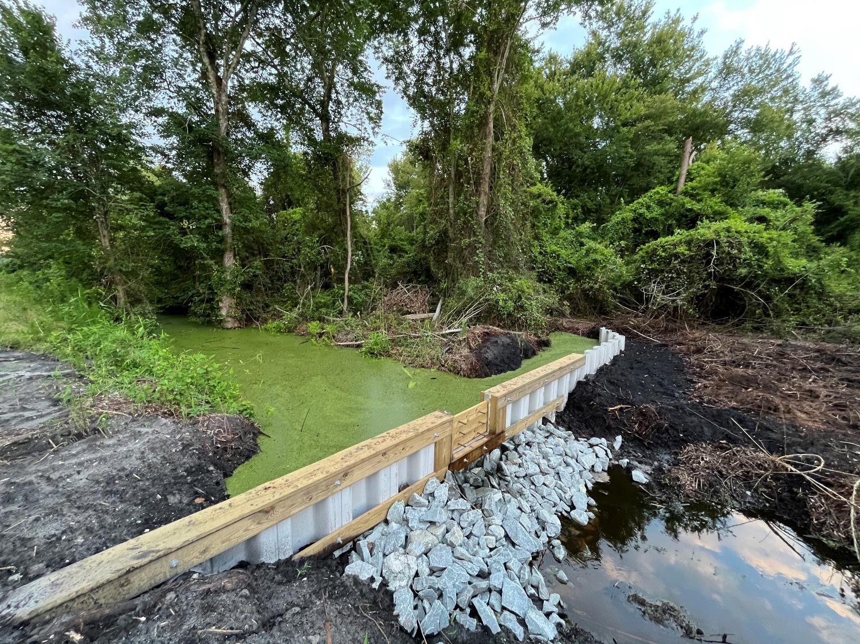
TNC (cont’d) Co-lead, with NC WRC, the rehydration of over 7500 acres of peatland at Angola Bay Game Land to benefit pocosin restoration, to mitigate wildfire risk, and increase carbon storage (project ongoing). A functioning weir at Angola Bay Game Land in one of the ditches as part of the 7500 ac peatland rehydration / restoration project.

Slide 6
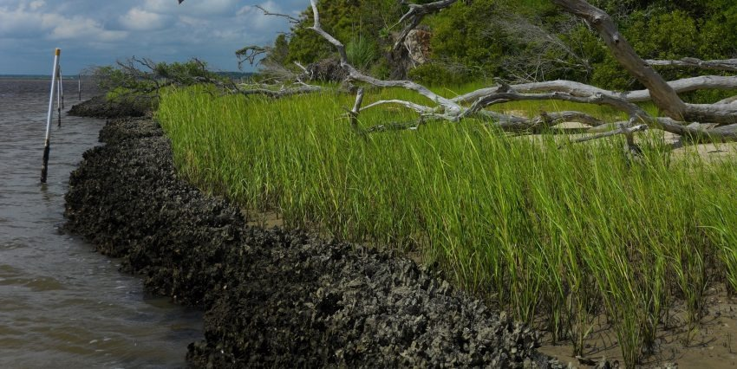
NC Coastal Federation
We've been working closely with Janice on the Weyerhaeuser acquisitions along the Newport River over the last couple of years.
We have $1.6 million from NC Land and Water Fund in hand for hydrologic restoration of the Phase 1 tract (1400 acres total).
Could use some expertise from this group on whether or not this area would be suitable for longleaf restoration and if so we are interested in pursuing funding to supplement the restoration.

