Slide 1

Sandhills conservation partnership Update nc longleaf pine summit
March 9, 2022

Slide 2
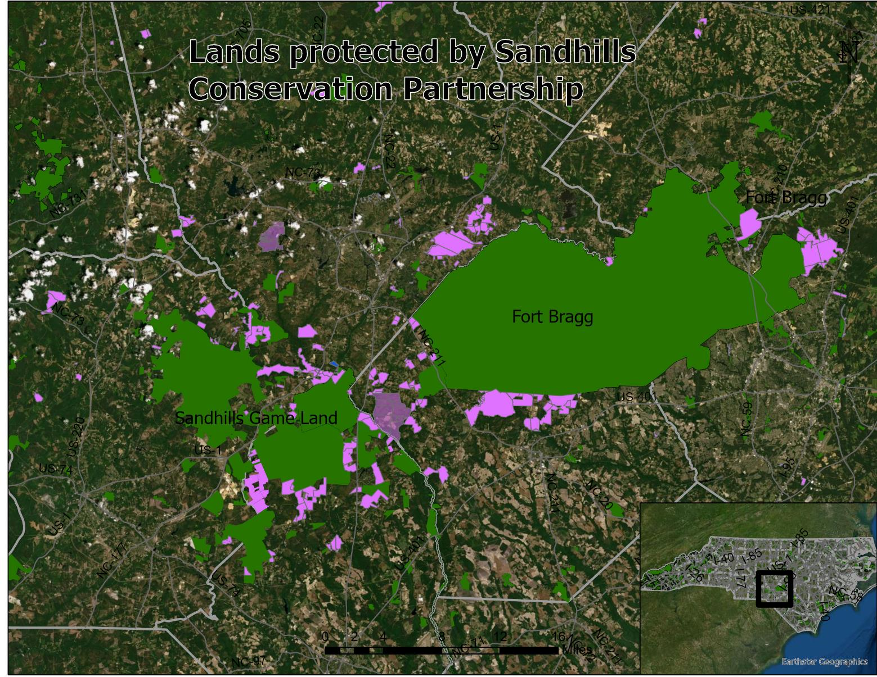

Slide 3
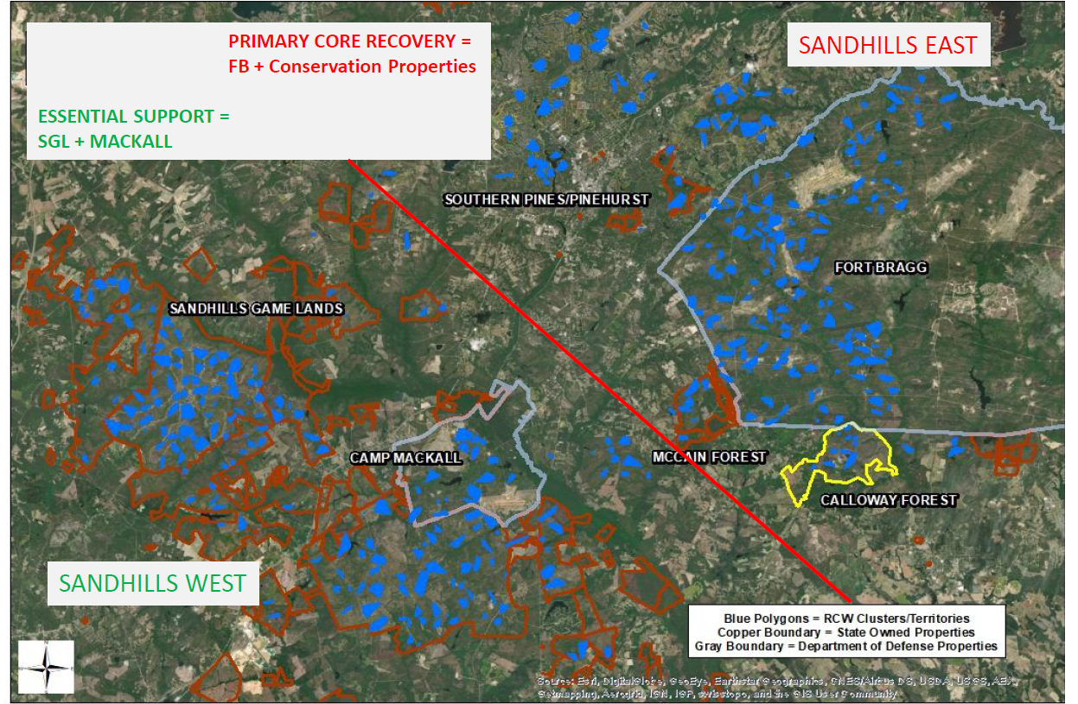
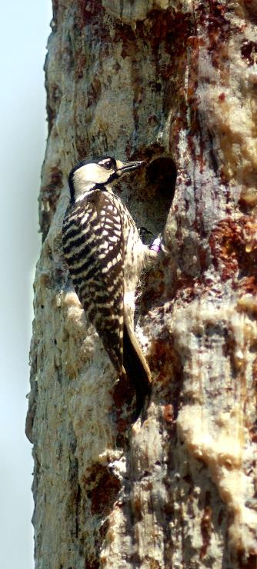
Red Cockaded Woodpeckerrecovery
777 Potential Breeding Groups in 2021
Photo Brady Beck

Slide 4
grants
2022 National Fish and Wildlife Foundation Longleaf Landscape Stewardship Fund
  $614,300 request for 3 years
  Shared burn crew
  Project funds for PCP, 3 Rivers, Fayetteville Public Works, State Parks
  Farm Bill biologist to support Joint Chiefs
  ForestHer workshops
REPI Challenge- climate resiliency
  $991,307 request for 4 years
  Fire capacity- assistant land steward, year-round fire crew lead, fire drone
  Studies of RCW productivity (Lauren Pharr, NCSU) & river flows
Joint Chiefs
  $2.2m over 3 years
  Shared burn crew and NRCS cost share

Slide 5
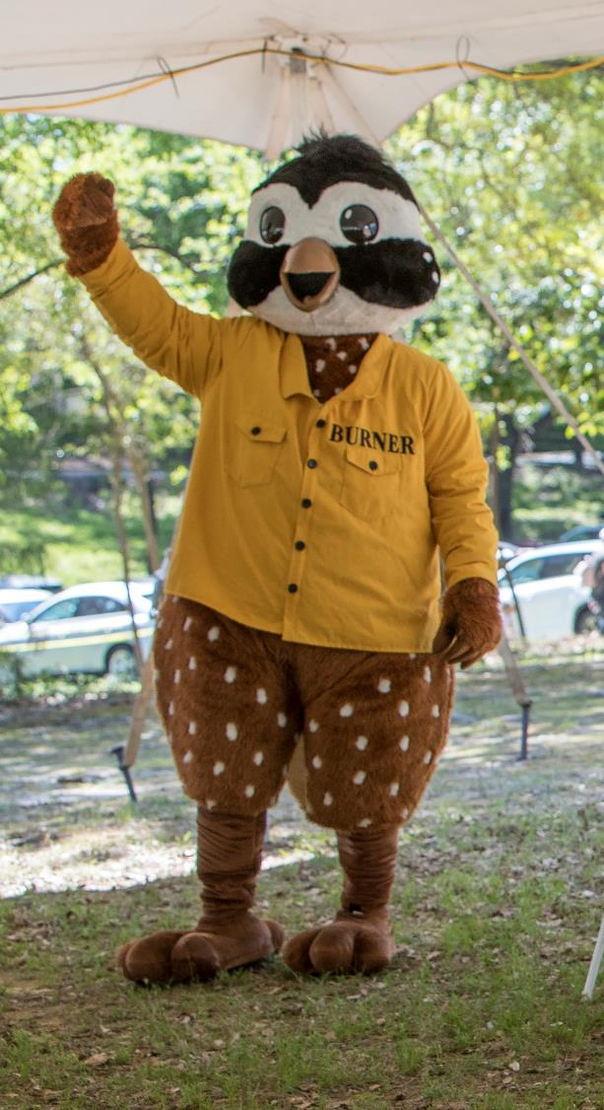
Party for the Pine April 23
Burn season up and going

Slide 6
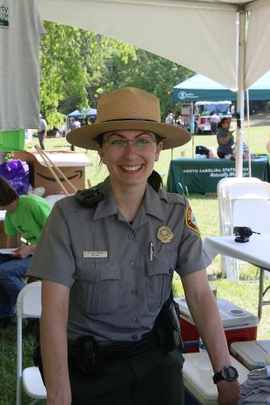
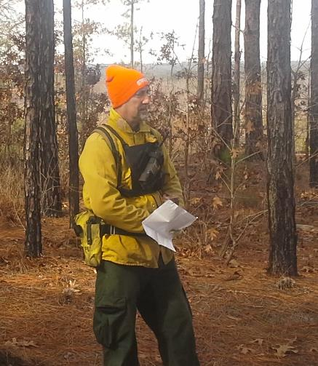
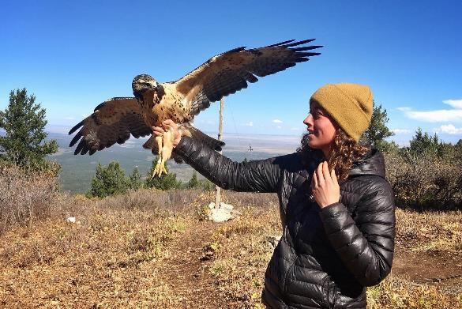
Personnel moves
Nancy Williamson
State Parks
Jon Blanchard
State Parks
Sarah Hecocks
ORISE
TNC/USFWS
Erick Reitschier
SH Land Steward
TNC

