Slide 1
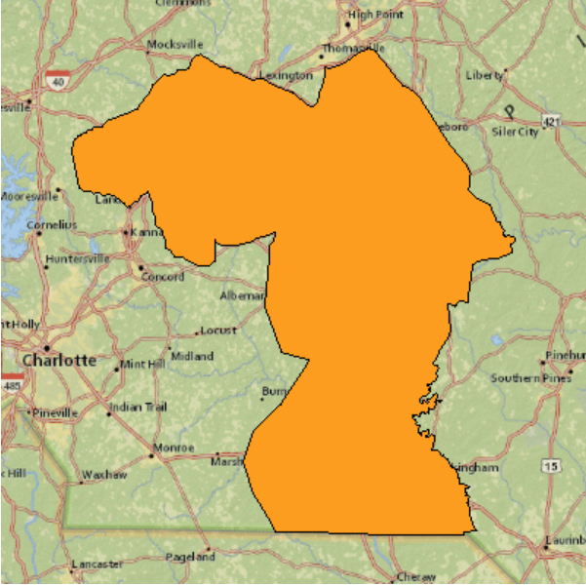
Greater Uwharrie Conservation Partnership (GUCP)
Mission: The mission of the GUCP is to work for the long-term conservation and enhancement of biological diversity and ecosystem sustainability throughout the Greater Uwharrie Landscape, compatible with the land use, conservation and management objectives of participating organizations and agencies.
Major Current Project:
Joint Chiefs Project - Uwharries to Sandhills Landscape Collaborative
Seeking a New Chairperson
For more information contact:
John Langdon – john.Langdon@usda.gov
Zone Partnership Coordinator
Uwharrie and Croatan National Forests

Slide 2
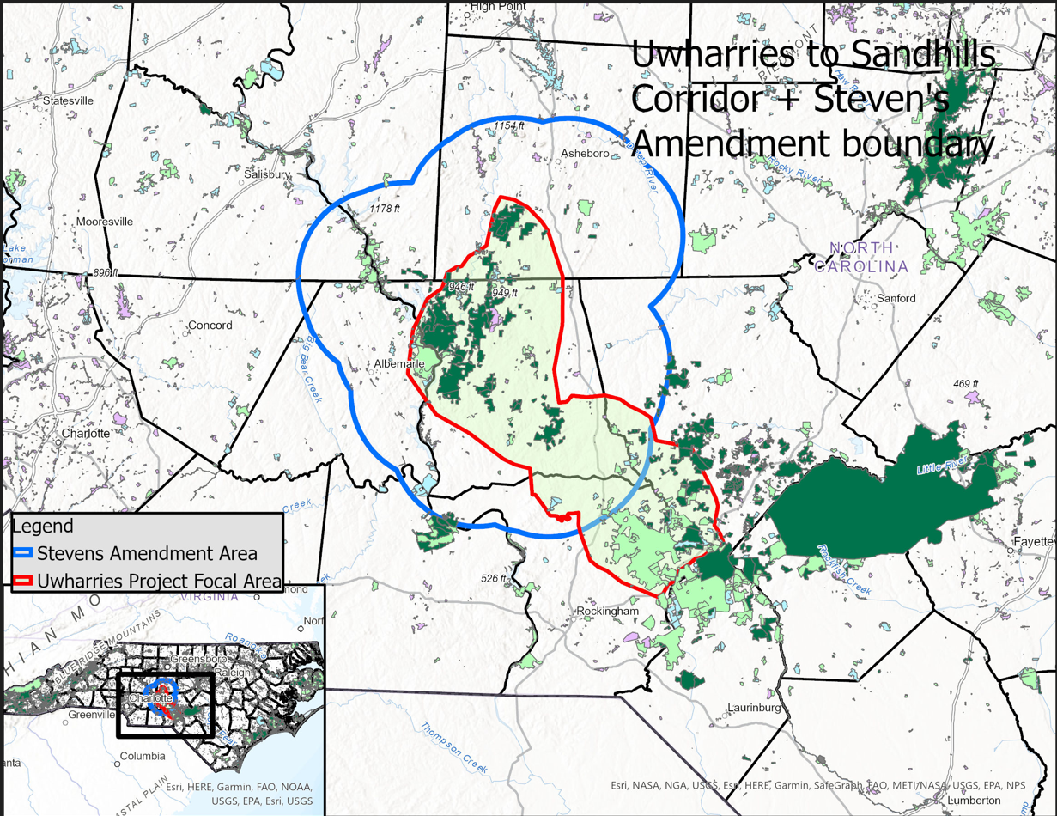
Project Summery
The Uwharries to Sandhills Landscape Collaborative (USLC) will improve forest health by restoring privately and publicly owned pine forests to an open-canopy condition (Habitat) in and around Uwharrie National Forest (UNF), and in a habitat corridor (the Corridor) between the Uwharries and the NC Sandhills ecoregion. To sustain project outcomes private landowners will be trained and mentored to conduct prescribed burning on their land by the Sandhills Prescribed Burn Association (PBA), and project partners.
Objectives
Objective 1. Reduce and mitigate wildfire threats to communities and landowners
Objective 2. Protect water quality and supply for communities and industry
Objective 3. Improve habitat conditions for at-risk species
Highlights
$2.3 million over three years, FY22-24
Cross Boundary Resource Objectives:
Restore ~25,000 acres of public and private lands
Establish “steppingstones” of habitat linking the UNF to the Sandhills.
Improve flows / water quality in Drowning Creek and the Little River and associated streams.
Focus the Steven's Amendment (SA) burns and NRCS funded burns on the highest Habitat priority private parcels with the highest wildfire threat.
Current Status:
Notes:
Reduce and mitigate wildfire threats to communities and landowners
We anticipate reducing wildfire fuel loads by at least 166.5 thousand tons . This projection is
based on an underestimate of the expected NC fuels reduction provided by the NCFS Fire
Environment Working Group. On the UNF , we estimate that most thinning and burning will
occur in pine and pine hardwood stands with medium fuel load (basal area 40 95 sq/ft),
which equates to a fuel reduction of 6 tons per acre . We estimated that half of private land
burns would be comprised of pine stands with medium and high ( 12 tons per acre ) fuel
load.
Protect water quality and supply for communities and industry
Two new, undescribed, endemic mussel species occur in the Uwharrie region’s Little River.The Greater UwharriesConservation Plan identifies further 7 irreplaceable mussel species and over 100 species of greatest conservation need in the Uwharries.
Improve habitat conditions for at risk species
Our vision is to restore populations of fire
dependent species that have been extirpated
from the Uwharries and the Corridor ,
including red cockaded woodpecker,
Bachman’s sparrow, pine barrens treefrog,
and Micheaux’s sumac.
Research by The Nature Conservancy
determined that a core area of 25,000 acres
is needed to maintain longleaf associated
species . Habitat in the Uwharries is suitable
to sustain Bachman’s sparrows.
On at least 3,000 ac. Increase landowner participation in NRCS programs via the requested NRCS funding for practices that advance all JCLRP objectives (see spreadsheet for details).
On at least 4,500 ac. USFS Contracted burn crew will work with the NCFS (on SA enrolled properties), and Sandhills PBA to prepare for and conduct prescribed burns

Slide 3
Ember Alliance Crew Accomplishments
Goal over 3 years
Improve or restore at least 25,500 acres of habitat within the Uwharries to Sandhills Collaborative Project area through prescribed fire and silvicultural treatments.
At least 60 acres of longleaf pine planting.
40 trail closure signs installed each year around Badin Lake Recreation Area.
Three miles of eroded trail maintenance each year around Badin Lake Recreation Area .
Three shoreline and dispersed campsite trash cleanup days each year around Badin Lake Recreation Area.
Accomplished 2023
5163 Acres
27.5 Acres
1 Sign
15.1 Miles
6 Days

