Slide 1
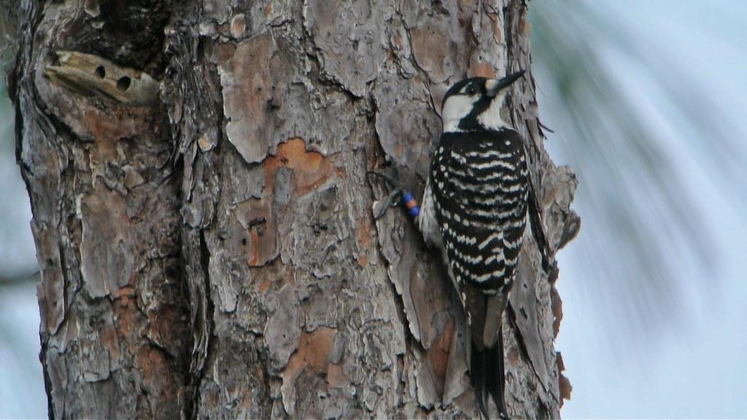
Linking TNC North Carolina HQI to red-cockaded woodpecker habitat
Traci DuBose, Gina Himes Boor, Jeffrey Walters
Andy Reago & Chrissy McClarren Flickr (CC BY 2.0)
Notes:
Project coauthors: Margaret Fields, Liz Kalies, Ana Costillo, Matthew P. Moskwik,

Slide 2
Longleaf Habitat Quality Index
Goal: to assess the condition of longleaf pine forests in NC using:
Forest Inventory Analysis
National Agricultural Imagery Program
Moskwik, Fields, Marcus, and Castillo; Hogland et al. (2018)
Singh et al. 2018; Burrill et al. 2021

Slide 3
Longleaf Habitat Quality Index
Goal: to assess the condition of longleaf pine forests in NC using:
Uses ALRI maintenance stand criteria
Matches measures of RCW foraging habitat
Moskwik, Fields, Marcus, and Castillo; Hogland et al. (2018)

Slide 4
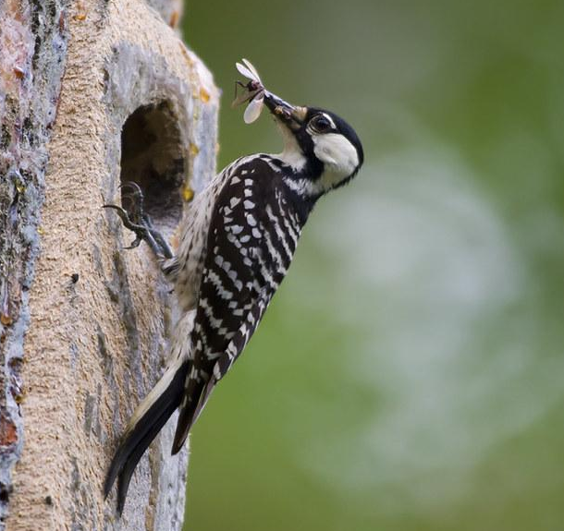
If RCW presence, group size, and fledgling production are correlated with the HQI, it could aid conservation decisions
Plus, we could use the HQI to describe habitat quality in the SEIBM
USFWS/Flickr (CC BY 2.0)

Slide 5
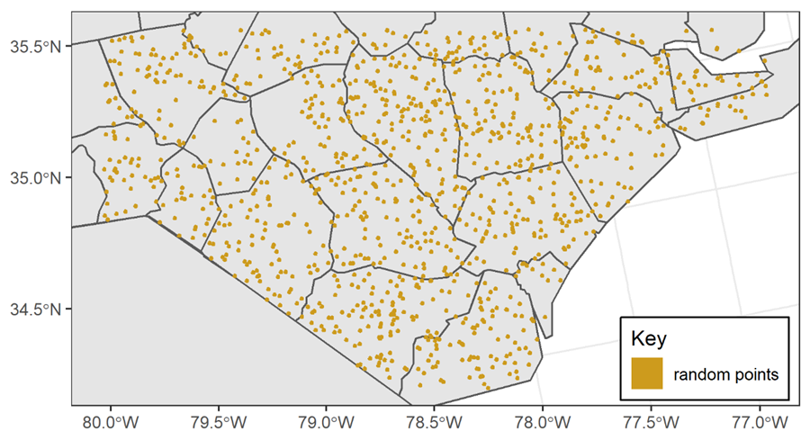
Is RCW presence correlated with the HQI?
use-availability approach to assess habitat use (Keating & Cherry 2004)
Two use types:
Cavity tree polygon use (n = 840)
Foraging partition use (n = 1201)
EXPECTATIONS
HQI
Prob. of
Use
HQI

Slide 6
HQI is correlated with foraging & tree cluster use
With each unit increase in a foraging polygon’s HQI, there is a ~16 times greater chance of RCW use.
HQI
HQI
HQI

Slide 7
Is RCW group size and/or fledgling production correlated with the HQI?
Structural equation modelling approach
direct & indirect relationships
leverages prior knowledge of the system
428 clusters
Breeder Male Age
Breeder Female Age
Last Year’s Fledglings
Group Size
Eggs Laid
TNC HQI
Fledglings
Cluster Density

Slide 8
Demographic performance not correlated with HQI
no effect
strong effect

Slide 9
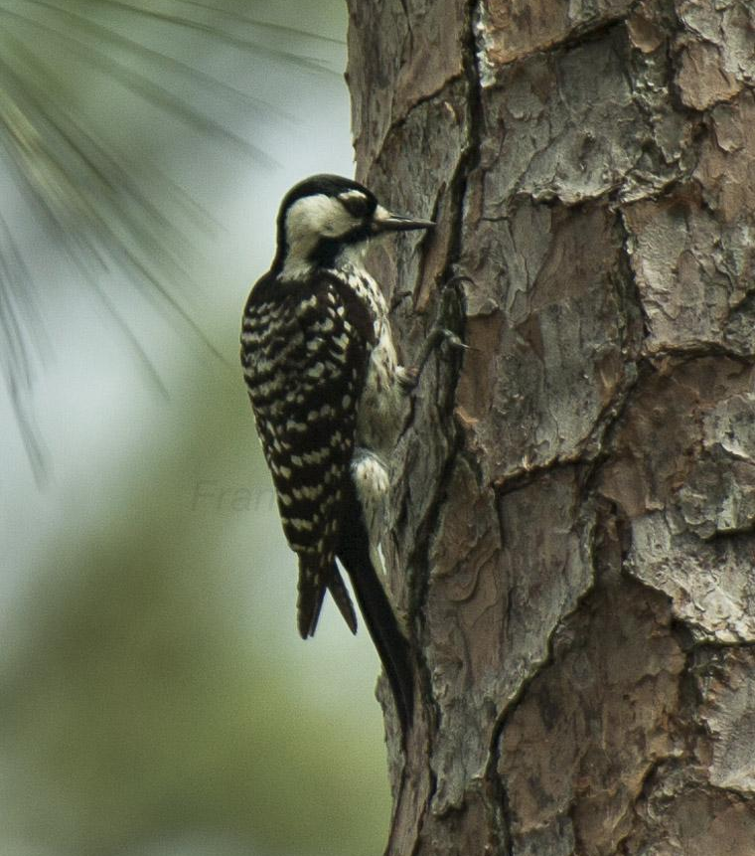
HQI captures habitat suitable for RCWs
but not habitat quality within suitable habitat
Francesco Veronesi

Slide 10
Conservation implications
RCW are surrogate taxa, so HQI likely identifies other endemic animal habitat
HQI capitalizes on publicly available data at large spatial scales
Identifying possible habitat aids RCW conservation and ALRI 8 million acres goal
Francesco Veronesi

Slide 11
Acknowledgements
Project coauthors
Margaret Fields
Liz Kalies
Ana Costillo
Matthew P. Moskwik
William F. Morris for comments
RC18-1065
Andy Reago & Chrissy McClarren Flickr (CC BY 2.0)

