Slide 1
Longleaf Ecosystem Occurrence Database Surveys
NC Sandhills – Fall 2020

Slide 2
LEO Surveys in the Sandhills
Began at the end of August 2020
Aimed to visit 500 stands in the Sandhills
In total we had:
  498 longleaf pine stands surveyed
  47 stands where longleaf pine was absent
  75 sites that were inaccessible

Slide 3
Sandhill LEO Survey Summary
Ecological Rank | Site Count | Total Acres | Mean Stand Acreage
Excellent | 32 | 4395 | 137
Good | 72 | 5364 | 71
Fair | 124 | 6495 | 55
Low | 200 | 8026 | 36
Total* | 428 | 24280 | 75
Not Visited | 380 | 21660 | 65

Slide 4
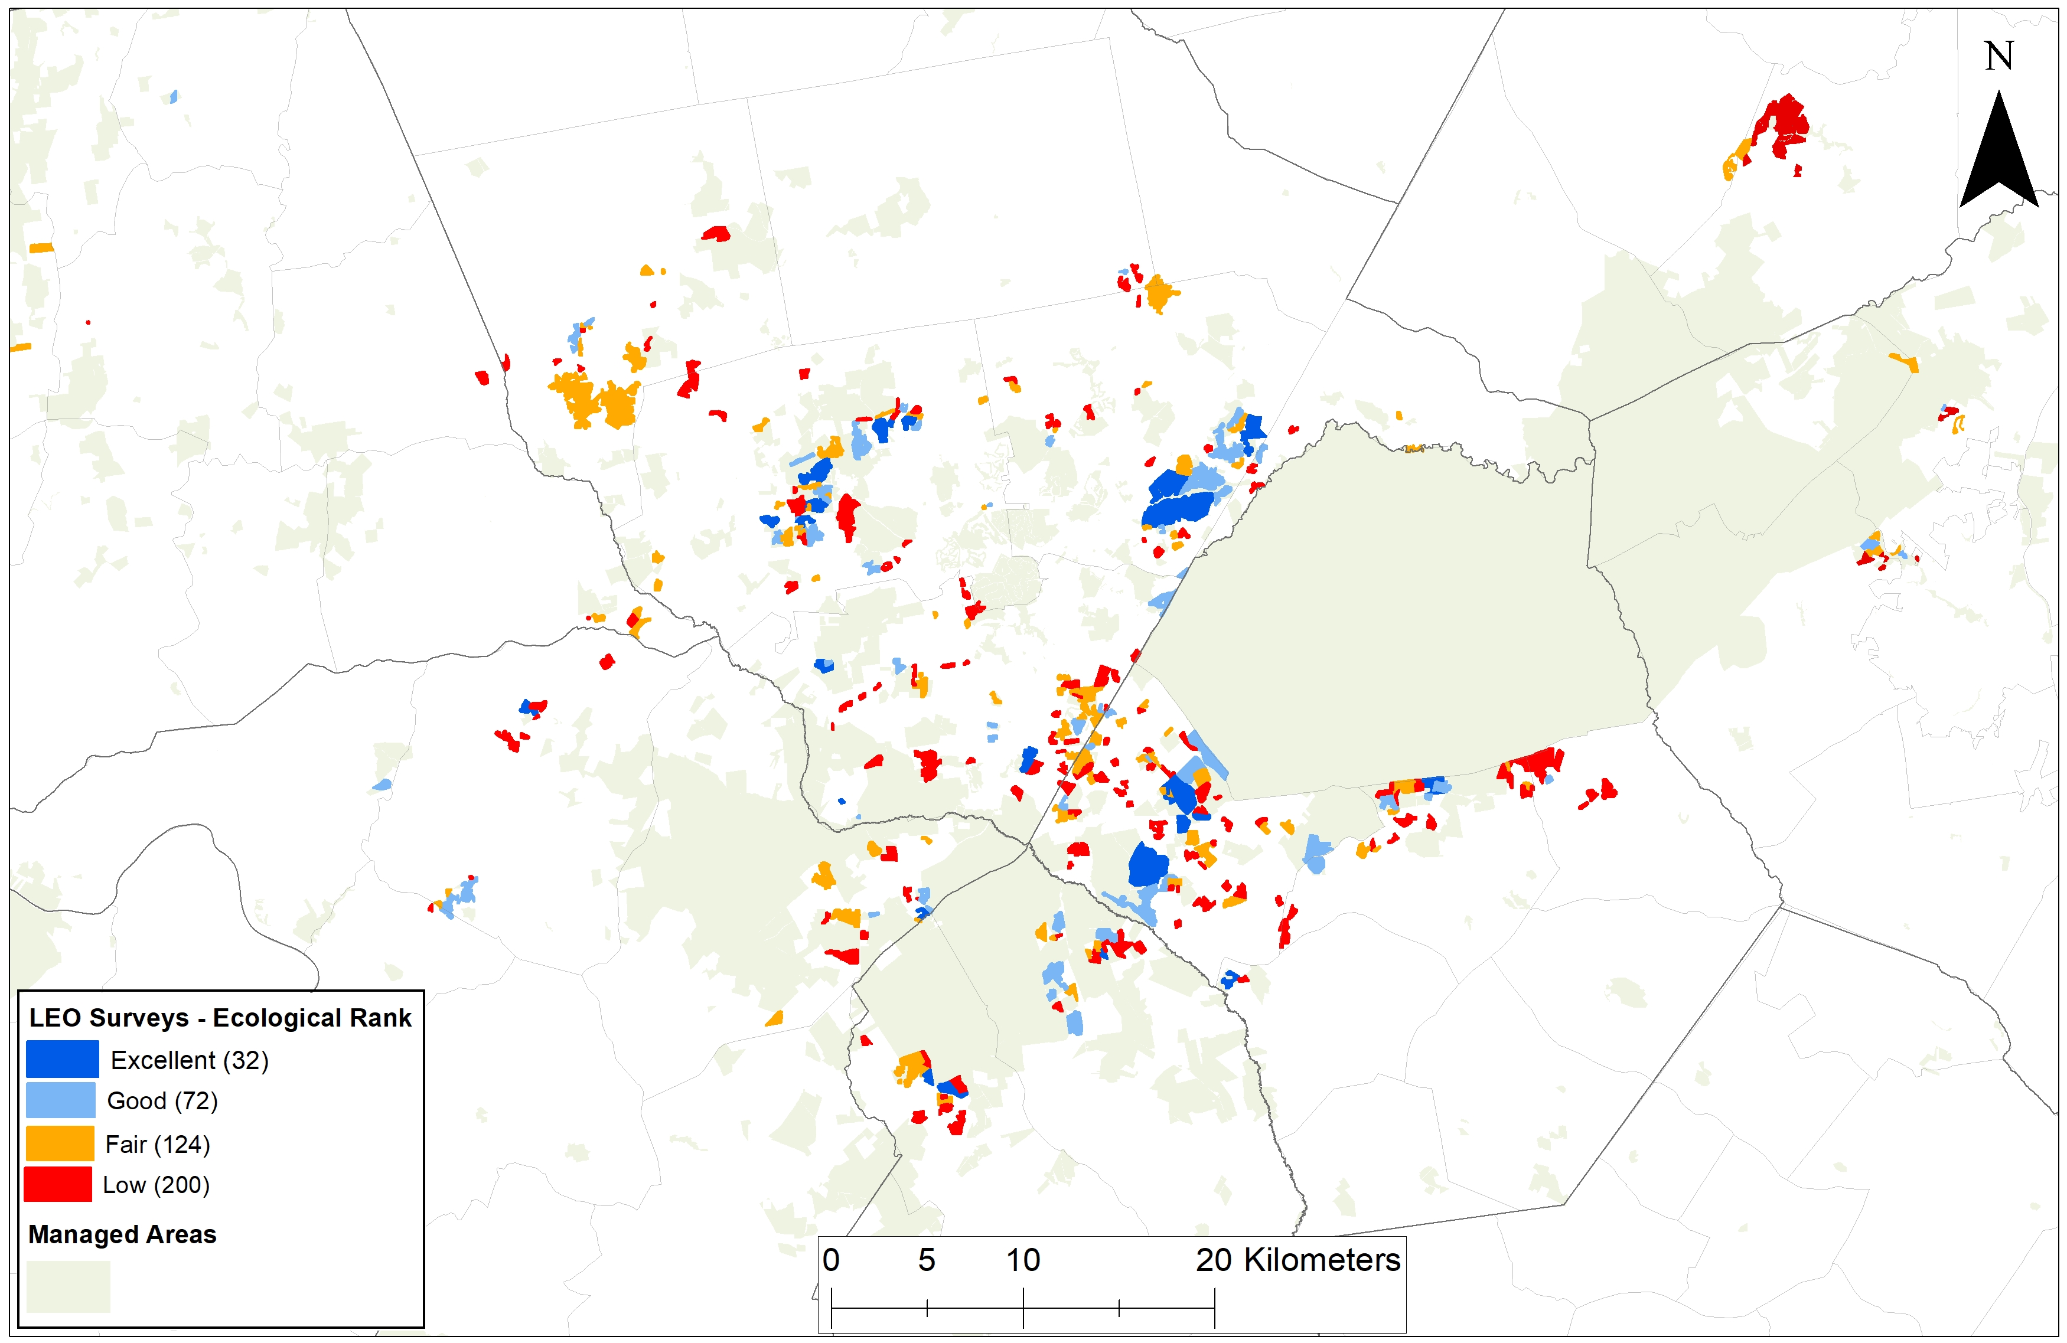

Slide 5
Next steps
Continuing surveys in Sandhills with TNC staff and volunteers
Repeating this effort in Cape Fear Arch and Onslow Bight
Summarizing data and classifying condition based on survey data rather than subjective surveyor rankings

