Slide 1
Using decision support tools and consensus building to predict future terrestrial plant invasions
Deah Lieurance
University of Florida IFAS
September 14, 2022

Slide 2
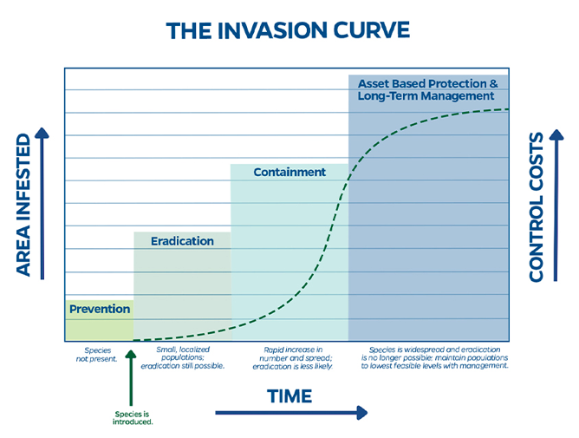
ERADICATION SUCCESS
Notes:
The invasion curve is an invasion classic! Best to walk the audience through the graph. The x-axis is time. The left y-axis is area and the right y-axis shows management costs. Once a species is introduced, as you move through time the area invaded and control costs increase. Next walk them through the phases: prevention, eradication containment, and control/management. These are your opportunities to achieve these goals. As the introduction spreads, the likelihood of eradication, containment become less likely. Prevention is the best option and second best is to identify and act ASAP to try to eradicate (think early detection/rapid response

Slide 3
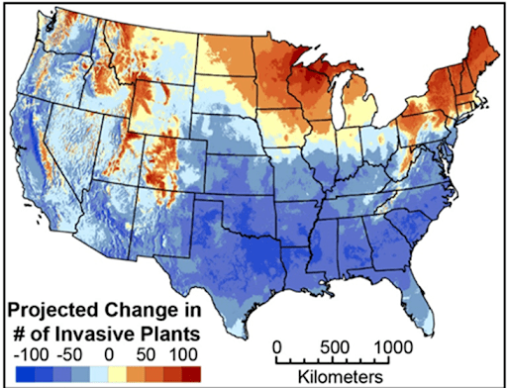
Invasive plants and climate change
Climate.gov Media
Allen and Bradley, 2016

Slide 4
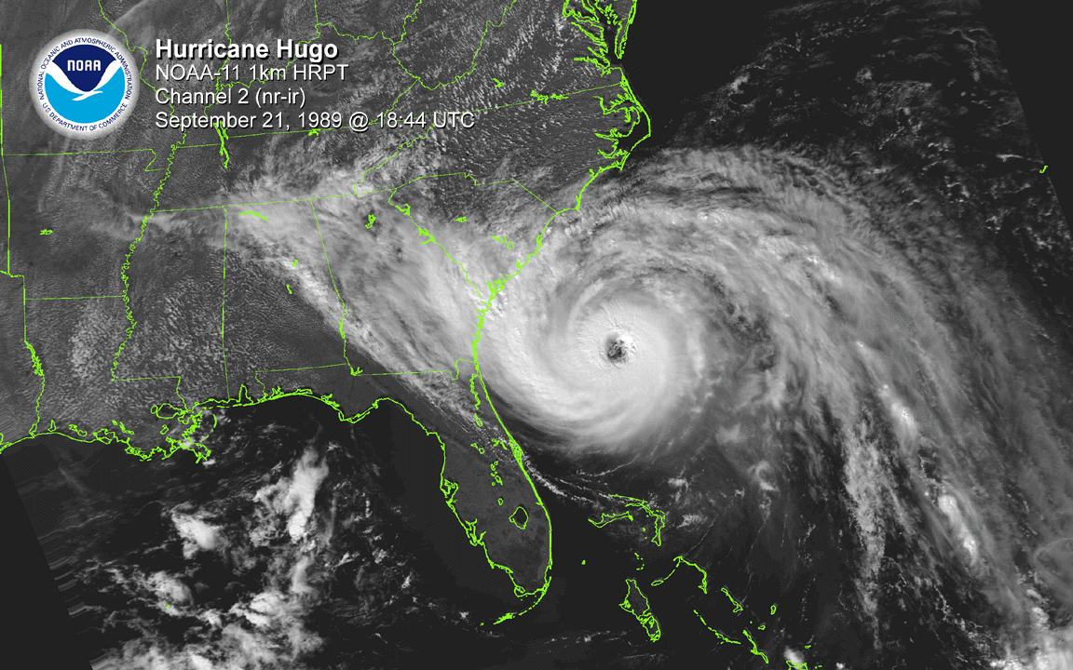
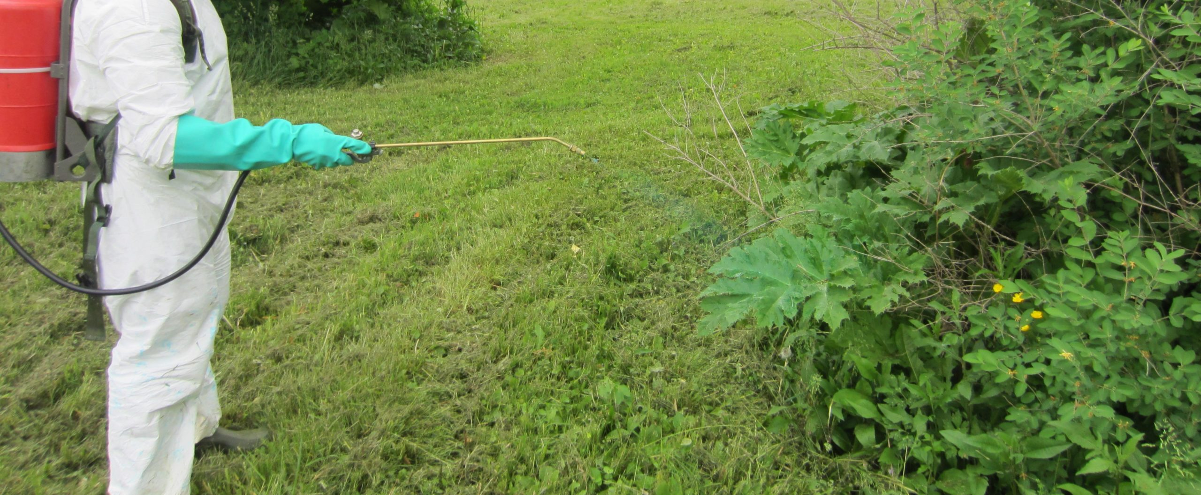
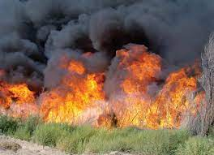
Consequences of climate change for invasive plants
Altered transport and introduction mechanisms
Establishment of new invasive species
Altered impact of existing invasive species
Altered distribution of existing invasive species
Altered effectiveness of control strategies.
Hellmen et al. 2011
https://woodyinvasives.org/management/foliar-herbicide/
https://www.fws.gov/

Slide 5
How do we predict & prevent future invasive plant invasions?

Slide 6
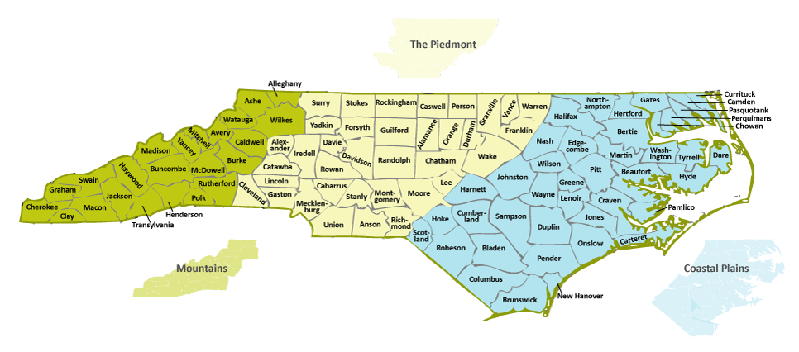
Invasive Range Expanders Listing Tool
Invasive plants are expected to shift their ranges in response to changing climate
This tool provides lists of invasive plants expected to expand ranges into the chosen region by 2040-2060
Lists include species that haven’t been observed within focal area, don’t currently have suitable climate, but are projected to have suitable climate by 2040-2060
Projections are based on 13 future models and users select the level of consensus (# of models) required to add a species to the state or county list
Can filter to species currently observed within a chosen geographic proximity to the focal county or state

Slide 9
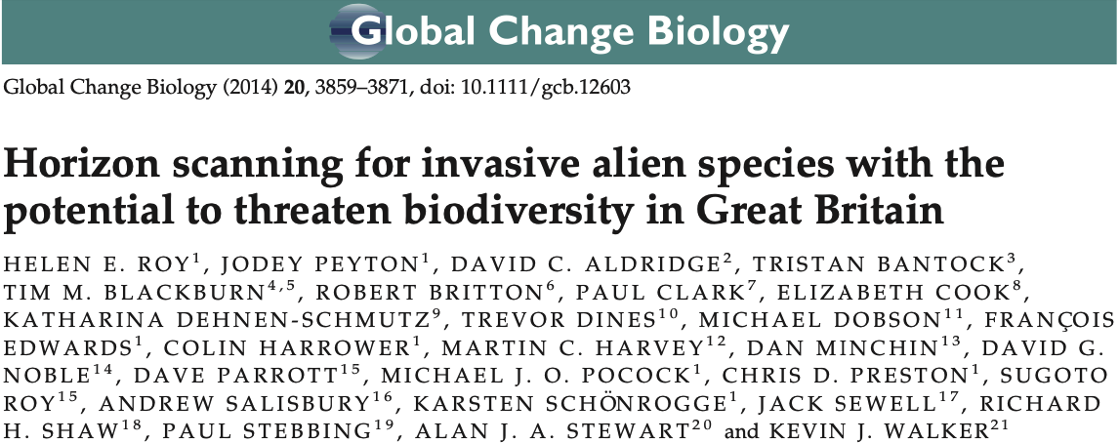
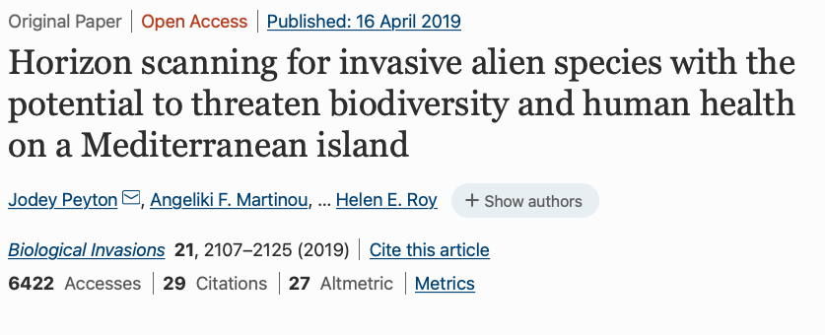
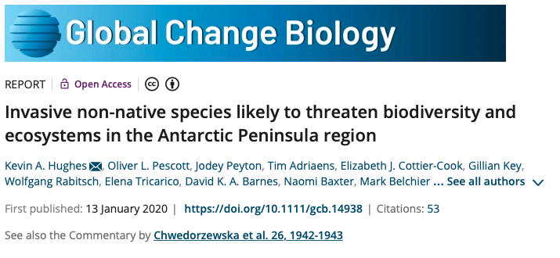
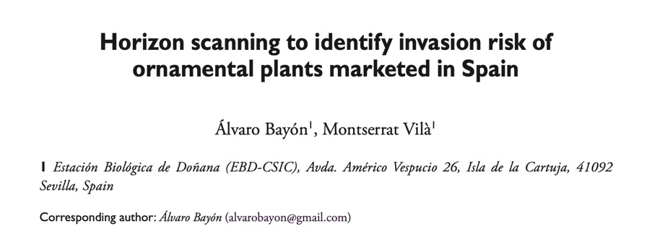
Horizon scanning is a method used to identify potential threats and emerging issues to inform policy, regulations, & decision-making

Slide 10
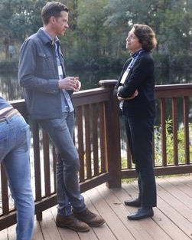
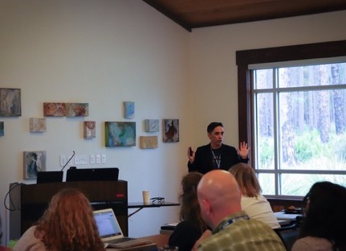
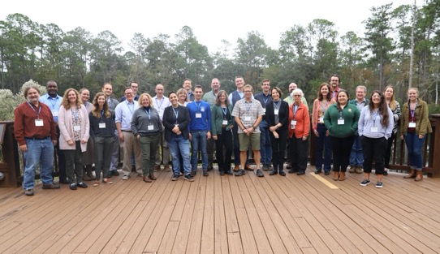
Horizon scanning to prioritize future threats
Objective
Provide a ranked list of plant taxa
Identify pathways for movement
Categorize potential impacts
The process
Build a list for consideration—Start big then narrow
Workshop-training and organization
Rapid assessments, peer review, and rank
Use prioritized list for next steps (i.e., full risk assessment, impact classification, policy decisions)

Slide 11
List narrowing
Start big, then prioritize & narrow to a reasonable number for the time-frame
For the FL horizon scan
Synonym correction
Climate matching
Present in Florida
Naturalization & invasion history

Slide 12
Rapid Risk Assessment
Maximum score 125
>64 High Risk
27-63 Moderate Risk
<27 Low Risk
Confidence
For each likelihood score
An overall confidence estimate for the final score
high, moderate, low, very low/data deficient

Slide 13
Provide a rubric for scoring

Slide 14
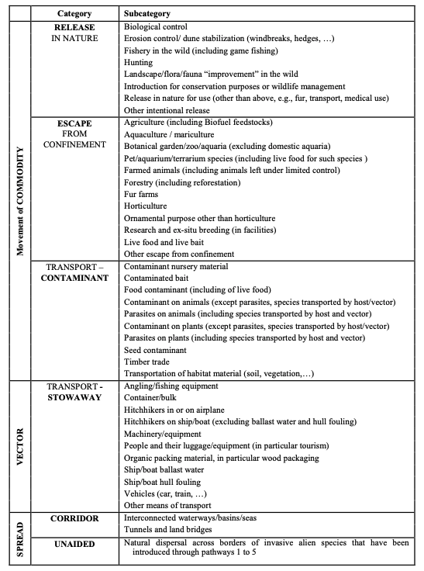
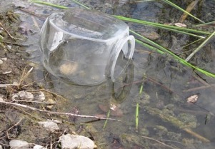
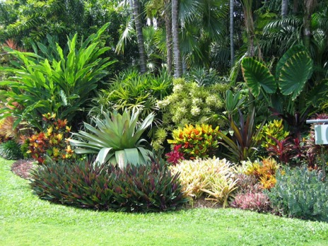
Pathways
Use CBD Pathway classification as a standard
Release In Nature
Transport STOW
UNAIDED
Escape From Conf

Slide 15
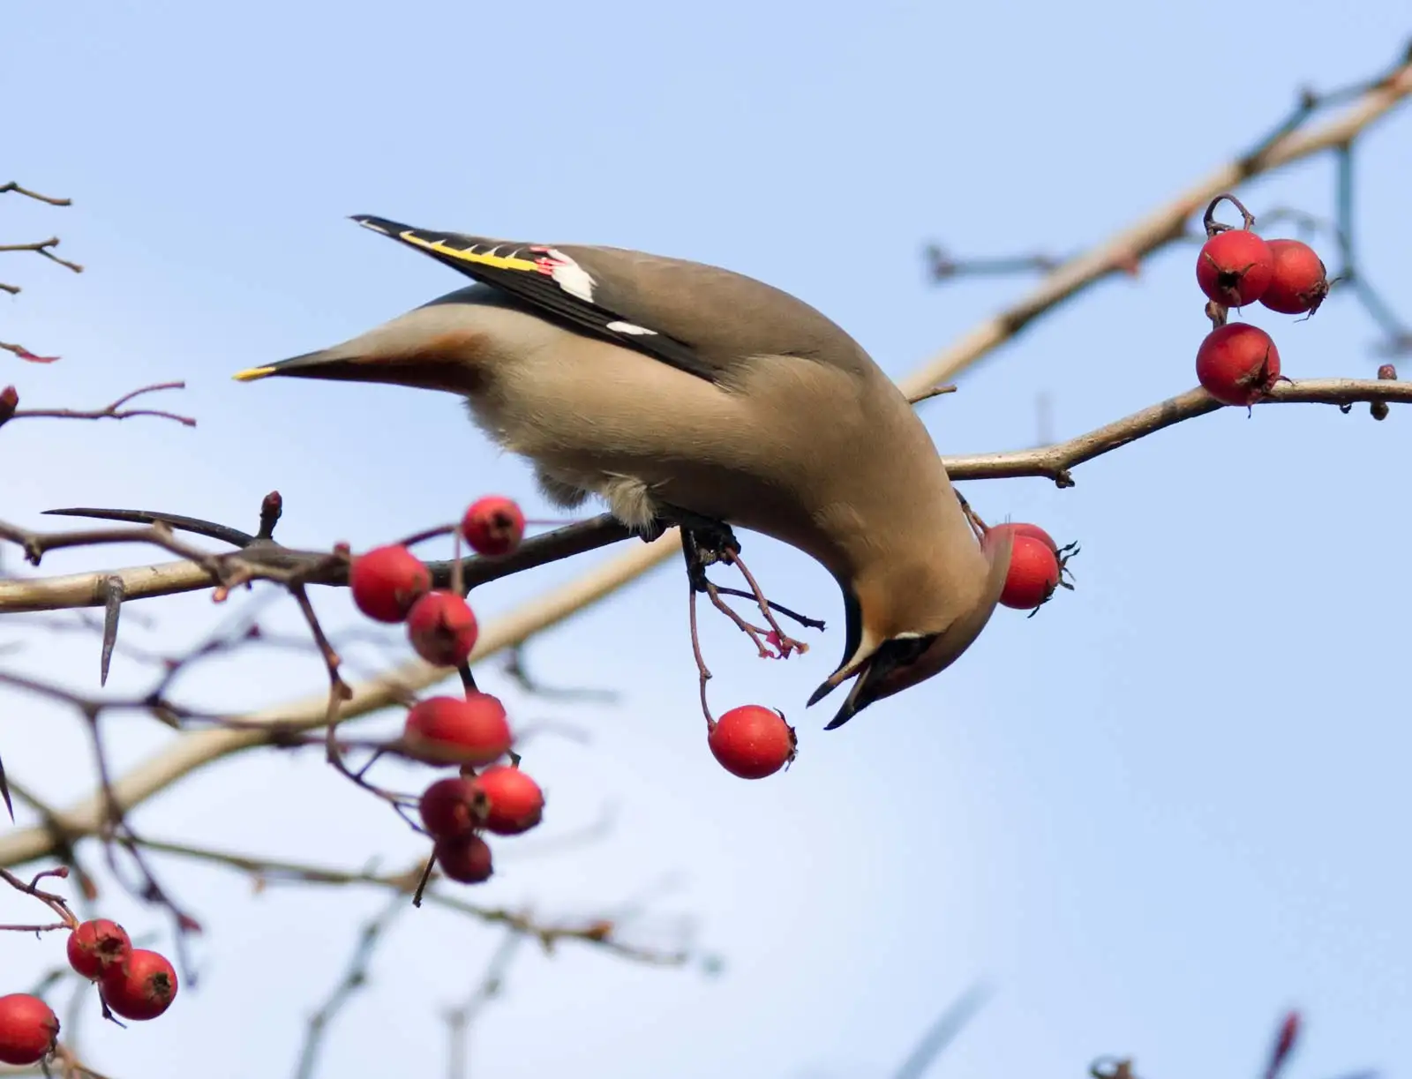
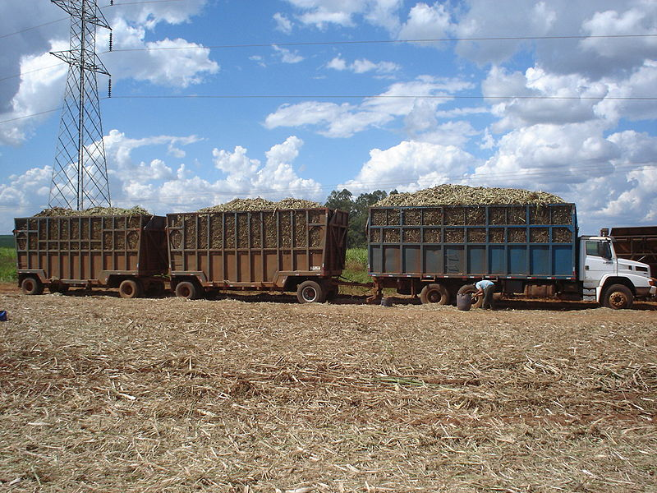
Identify pathways for migration
Horticulture/agriculture/forestry
Natural dispersal (e.g., wind, water, animal)
Accidental dispersal (e.g., hitchhiker, dropped in transport)
https://www.britannica.com
https://www.bioenergyconsult.com/biomass-exchange/

Slide 16
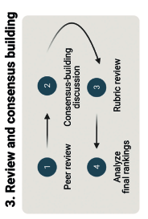
Review & consensus building
Peer review within groups
Edit based on comments
Within taxa consensus
All species compiled for final consensus

Slide 17
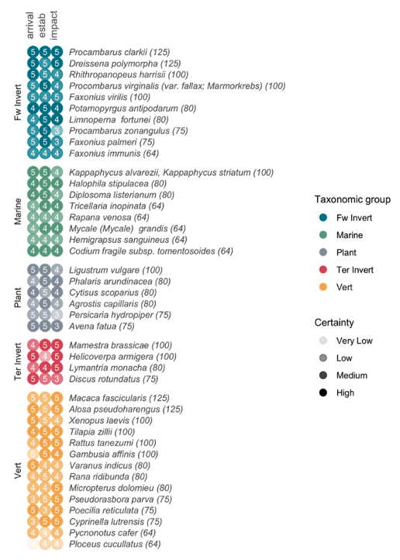
4 received the maximum score

Slide 18
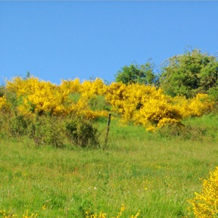
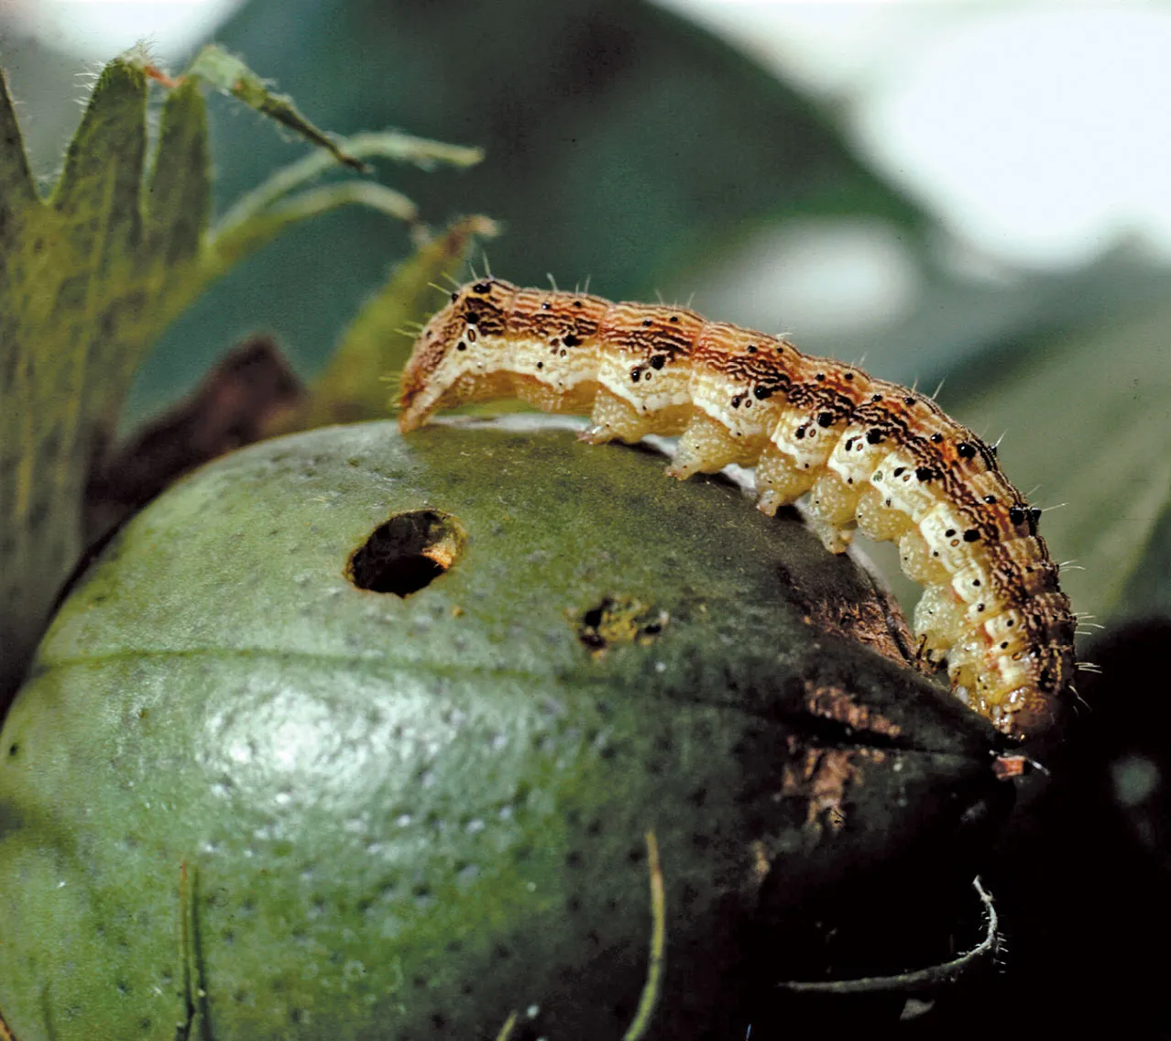
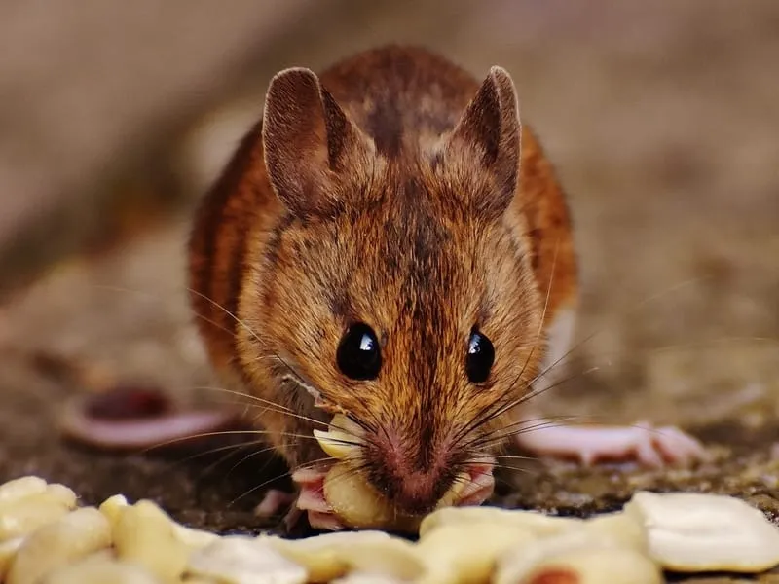
Impact classifications
Ecological
Cytisus scoparius
88% Ecological impacts
Native species declines, ecosystem engineers, disruptions in food webs, disease vectors, etc.
48% Economic impacts
Reduced yields in agriculture, degradation of recreation areas and infrastructure (primarily through biofouling)
10% Human health impacts
Disease vectors and allergens (minor-plants)
Economic
Helicoverpa armigera
Human Health
Rattus tanezumi
https://kidadl.com/facts/animals/tanezumi-rat-facts

Slide 19
Methods to scan for changing climate
Assemble working group
Develop rubric with new scoring elements
Start with EDDMapS list & narrow
Assess and review
Rank and build consensus
Work on management & prevention plans (e.g., watchlist, EDRR strike plans, public awareness)

Slide 20
Invasive Species Centre, https://www.invasivespeciescentre.ca
Thank you
Contact Dmlieurance@ufl.edu

