Slide 1
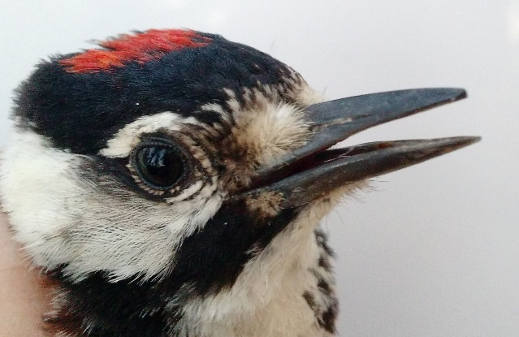
RCW RECOVERY 2023 Nesting Season Data Collection Year 44 of Long-term Study
SEI & Partners intensively monitored ~ 400 of est. 800 Sandhills RCW Groups
Kerry Brust, Andy Van Lanen, Anna Prinz (SEI)
Jan Goodson and Deven Davidson (JCA)
Lauren Pharr (NCSU)
Brady Beck (WRC) Support on A-Block
Work made possible thanks to:
Army @ Ft. Liberty - Jessie Schillaci & Jackie Britcher
The Nature Conservancy - Jeff Marcus
NC Dept of Agriculture - Robert Ross
Private Donations

Slide 2
RCW RECOVERY 2023 Nesting Season – Recap
20 New RCW Groups Regionwide
Ft. Liberty (10), SGL (5)
Moss Foundation + Private Lands (4)
High nest failure rate at BLUE (6/10) and western Ft. Liberty (30/119)
Poor year / low fledging success Coastal RCWs - Camp LeJeune/ Sunny Point
Early nesting year
Specifically SGL , + 2 double brooded groups on SGL (a first), though both failed at nest # 2

Slide 3
RCW RECOVERY Private Lands – Strategic Plan review
Nurture Relationships with Safe Harbor Landowners
Protect legacy working forests and forested corridors
Downlisting impacts to general public response and Safe Harbor?
Pursue Outreach to nearby Landowners
RCW Pioneering on new/ adjacent properties particularly challenging
Turn up Dialogue with Golf Course Managers + Local Govt
Opportunity at new Southern Pines Park (past Sherman property)

