Slide 1
NC Plant Conservation Program
Sandhills Conservation Partnership Meeting
June 15 2022

Slide 2
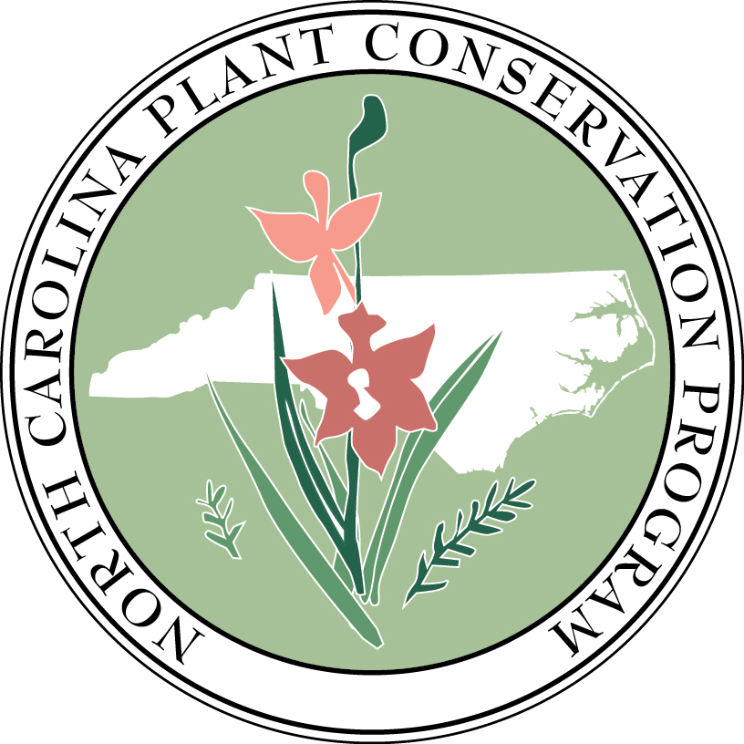
NC PCP
Writes the NC list of protected plant species
Regulates activities concerning listed plants
Establishes and manages nature preserves to protect plants in their natural habitats
Monitors rare plant populations to update species’ statuses and trends
Conducts research on the biology, habitat requirements, and management needs of rare plants
Notes:
So, who is PCP? The Plant Conservation Program is a part of the NC Department of Agriculture & Consumer Services. We have five major tasks: we write the state list of protected plant species, regulate activities concerning listed plants, establish and manage nature preserves for the targeted purpose of imperiled plant protection, monitor rare plants, and conduct research on rare plant species’ biology, habitat requirements, and management needs.

Slide 3
NC PCP
Writes the NC list of protected plant species
Regulates activities concerning listed plants
Establishes and manages nature preserves to protect plants in their natural habitats
Monitors rare plant populations to update species’ statuses and trends
Conducts research on the biology, habitat requirements, and management needs of rare plants
Notes:
Although each of these tasks is important, we spend a significant amount of our time focusing on establishing and managing what we call Plant Conservation Preserves. These are state-dedicated nature preserves which specifically target at least one state-listed plant species in its natural habitat. Our goals are site specific and tailored to the target plant species; however, it’s always true that we aim to restore and maintain the natural communities and natural processes that make a habitat suitable for these target species.
So… how do we figure out what should be protected?

Slide 4
What should be protected?
Consensus formed (2000) for need to collate all needs and prioritize
Sites with federally listed species were first target
Prioritize most viable populations
Build portfolio based on NCNHP data
How to represent diversity across the state?
Notes:
Because there is more work than any of us can do– all of us need to come up with priorities to define the real mission or goal, and add structure to future plans.
A very brief history of how we got to where we are now is as follows:
First: the really obvious and well-known needs were put into a list. Our program had support from our Board, but there was a looming question of “with all of the land conservation in NC, isn’t someone else already doing this?? With the many thousands of acres protected in national and state parks, national and state forests, etc., isn’t this work already being done??”
Looking further, the answer became clearer– there IS a lot of protection going on, but not all needed future projects are suitable to the players already in the game. Some sites are too small, too degraded, too far from other protected lands or work stations, or lack other features that fit into existing protection portfolios.
And so, to address what the need really looked like, we set out to make a portfolio from which to work.
To do this, we borrowed an old idea… a minimum conservation goal was established for each species: to protect at least two populations, aiming for the two best, or most viable populations. This minimum redundancy gave us at least that much insurance against total loss in the state.
We used the NC NHP database of element occurrences to determine the best populations for conservation. Viability was determined from EO-ranks primarily, but we also considered their context in the landscape, and occasionally their distribution across parcels of land.
However, many species occupy a variety of habitats in NC, and protecting that diversity was also recognized as important, perhaps especially when a species may be faring better in one area relative to another. In other words, focusing on just two populations might be too limiting for some of NC’s rare, but variable, species. Next, we had to consider how to evaluate and prioritize between populations in different ecosystems.

Slide 5
Ecoregions
Goal: Protect the two most viable populations of each listed plant species in each ecoregion where it occurs
Notes:
And so, we expanded the idea to include the two “best” populations in each ecoregion in which they naturally occur across the state. For very range-restricted species, this may result in a minimum conservation goal of one or two populations; however, for other species, expanding the goal by ecoregion resulted in 10+ prioritized sites.
The final portfolio resulted in 610 sites, these were from the Natural Heritage Program’s database of significant natural heritage areas, several of which were identified as a conservation target for more than one species, making them more “efficient” in a certain way. Several identified priorities were already protected by the time the PCP portfolio was put together, some of which were already PCP Preserves.
PCP also took note of which priority sites should be acquisition targets versus partnerships that our program may enter into to facilitate ongoing support or management for the benefit of rare plants.

Slide 6
Portfolio Protection Status
Notes:
So, the portfolio of important plant areas has been a great tool for focusing PCP’s efforts for conservation of our state’s rare plants.
Using this portfolio, we’re also able to check in and assess our progress.
To do this, we’ve tallied the protected vs. not protected priority sites per species and then binned the species into three categories:
all priority sites are protected and so the goal is met,
some, but not all of the priority sites being protected, so partially done, and
none of the priority sites being protected, in many cases, this is equivalent to zero protected populations, period.
The fourth category here is historical only. Species with no extant populations in the state are typically not prioritized above protected extant populations.
We can see that more than one third of our 419 protected plant species in NC have the minimum protection goal already met. This is a great thing—and worth paying attention to! It’s also encouraging to see that nearly half of all listed species have at least one priority population in conservation. Together that’s 82% of NC’s imperiled plant species under at least some protection, and not just “some” protection but with at least one of the best, most viable, populations protected. Checking-in in this way really helps us focus on the areas of remaining greatest need and highlighting those species which are falling through the cracks– of special note are the 9% (n=38) of our listed species with no protection thus far.

Slide 7
Ecoregions
Notes:
And so, we expanded the idea to include the two “best” populations in each ecoregion in which they naturally occur across the state. For very range-restricted species, this may result in a minimum conservation goal of one or two populations; however, for other species, expanding the goal by ecoregion resulted in 10+ prioritized sites.
The final portfolio resulted in 610 sites, these were from the Natural Heritage Program’s database of significant natural heritage areas, several of which were identified as a conservation target for more than one species, making them more “efficient” in a certain way. Several identified priorities were already protected by the time the PCP portfolio was put together, some of which were already PCP Preserves.
PCP also took note of which priority sites should be acquisition targets versus partnerships that our program may enter into to facilitate ongoing support or management for the benefit of rare plants.

Slide 8
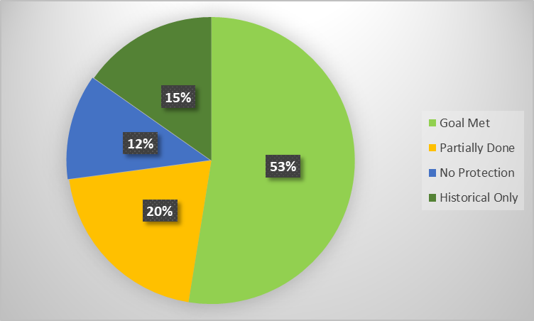
Listed species in the sandhills
59 species with Status of Endangered, Threatened, or Special Concern-Vulnerable
PCP is currently updating the portfolio to reflect 2021 Protected Plant List changes.
Notes:
No protection (2010):
Agalinis virgata
Clinopodium georgianum
Euphorbia mercurialina
Paronychia herniaroides*
Persicaria hirsuta

Slide 9
Future Need
Notes:
Of course, there are many prioritized sites not yet under protection. This map shows the number of prioritized sites per ecoregion that are yet to be protected. Although you can see that there are hotspots in various corners of the state, I want to also point out that we have identified conservation targets in every ecoregion of North Carolina, meaning we’re interested in working across the state.
We have this dataset ready to share with conservation partners so that they can know PCP’s priority areas, should a collaborative project in their region become active. Please be in touch with me if you’d like us to send this to you or your organization.

Slide 10
PCP Preserves

Slide 11
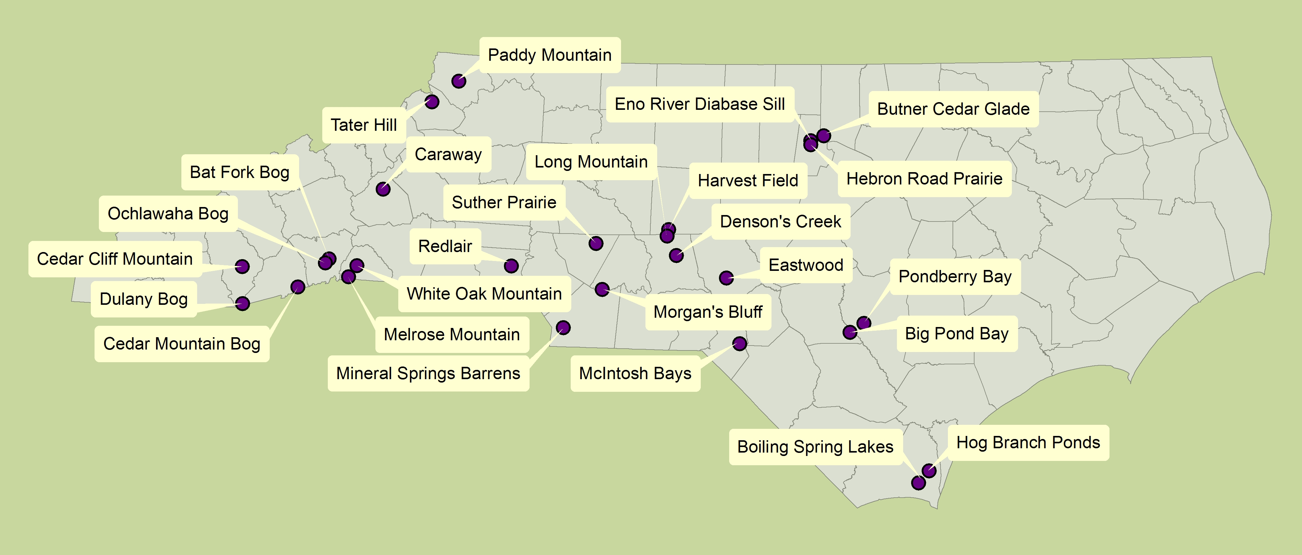
Notes:
As for the PCP, we have 26 Plant Conservation Preserves across North Carolina, from the mountains to the coast.
These properties total ~14,500 acres (a drop in the bucket compared to most of our conservation partners!) and protect over 80 listed species—note this does not account for the repeat protection of some species at multiple preserves: as an example, Schweinitz’s sunflowers are protected at four PCP Preserves.
Dedicated nature preserves as dedicated by NCNHP- restricts the activities allowed.

Slide 12
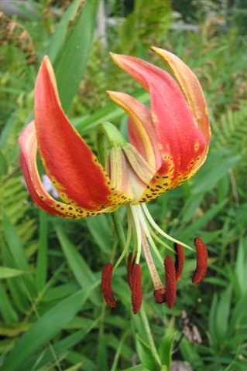
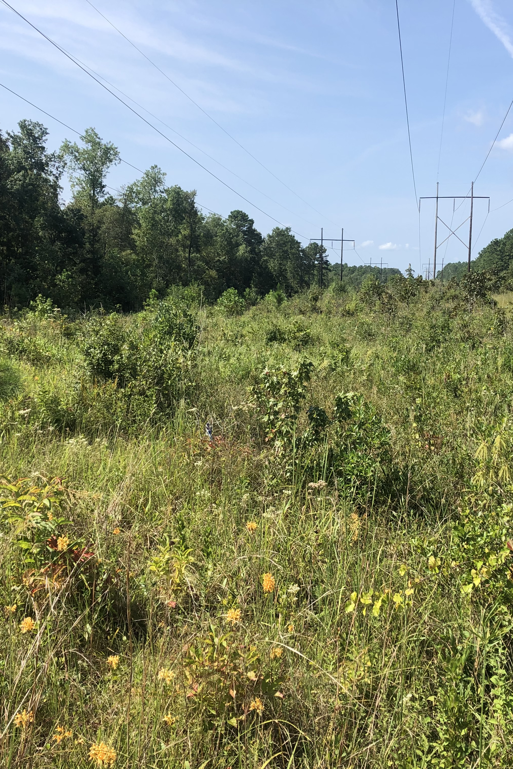
Eastwood PCP Preserve
Notes:
Dedicated in 2010, 2007 donation by Tufts family
Sandhills Lily
Moore county

Slide 13
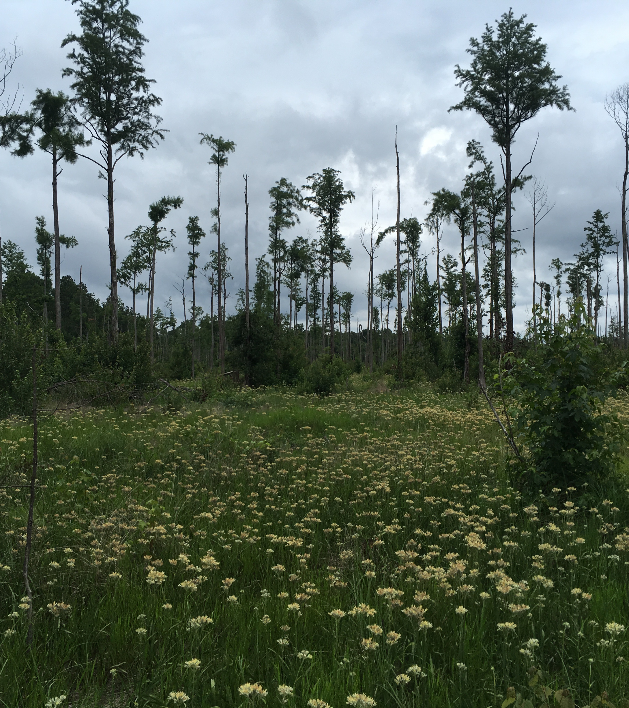
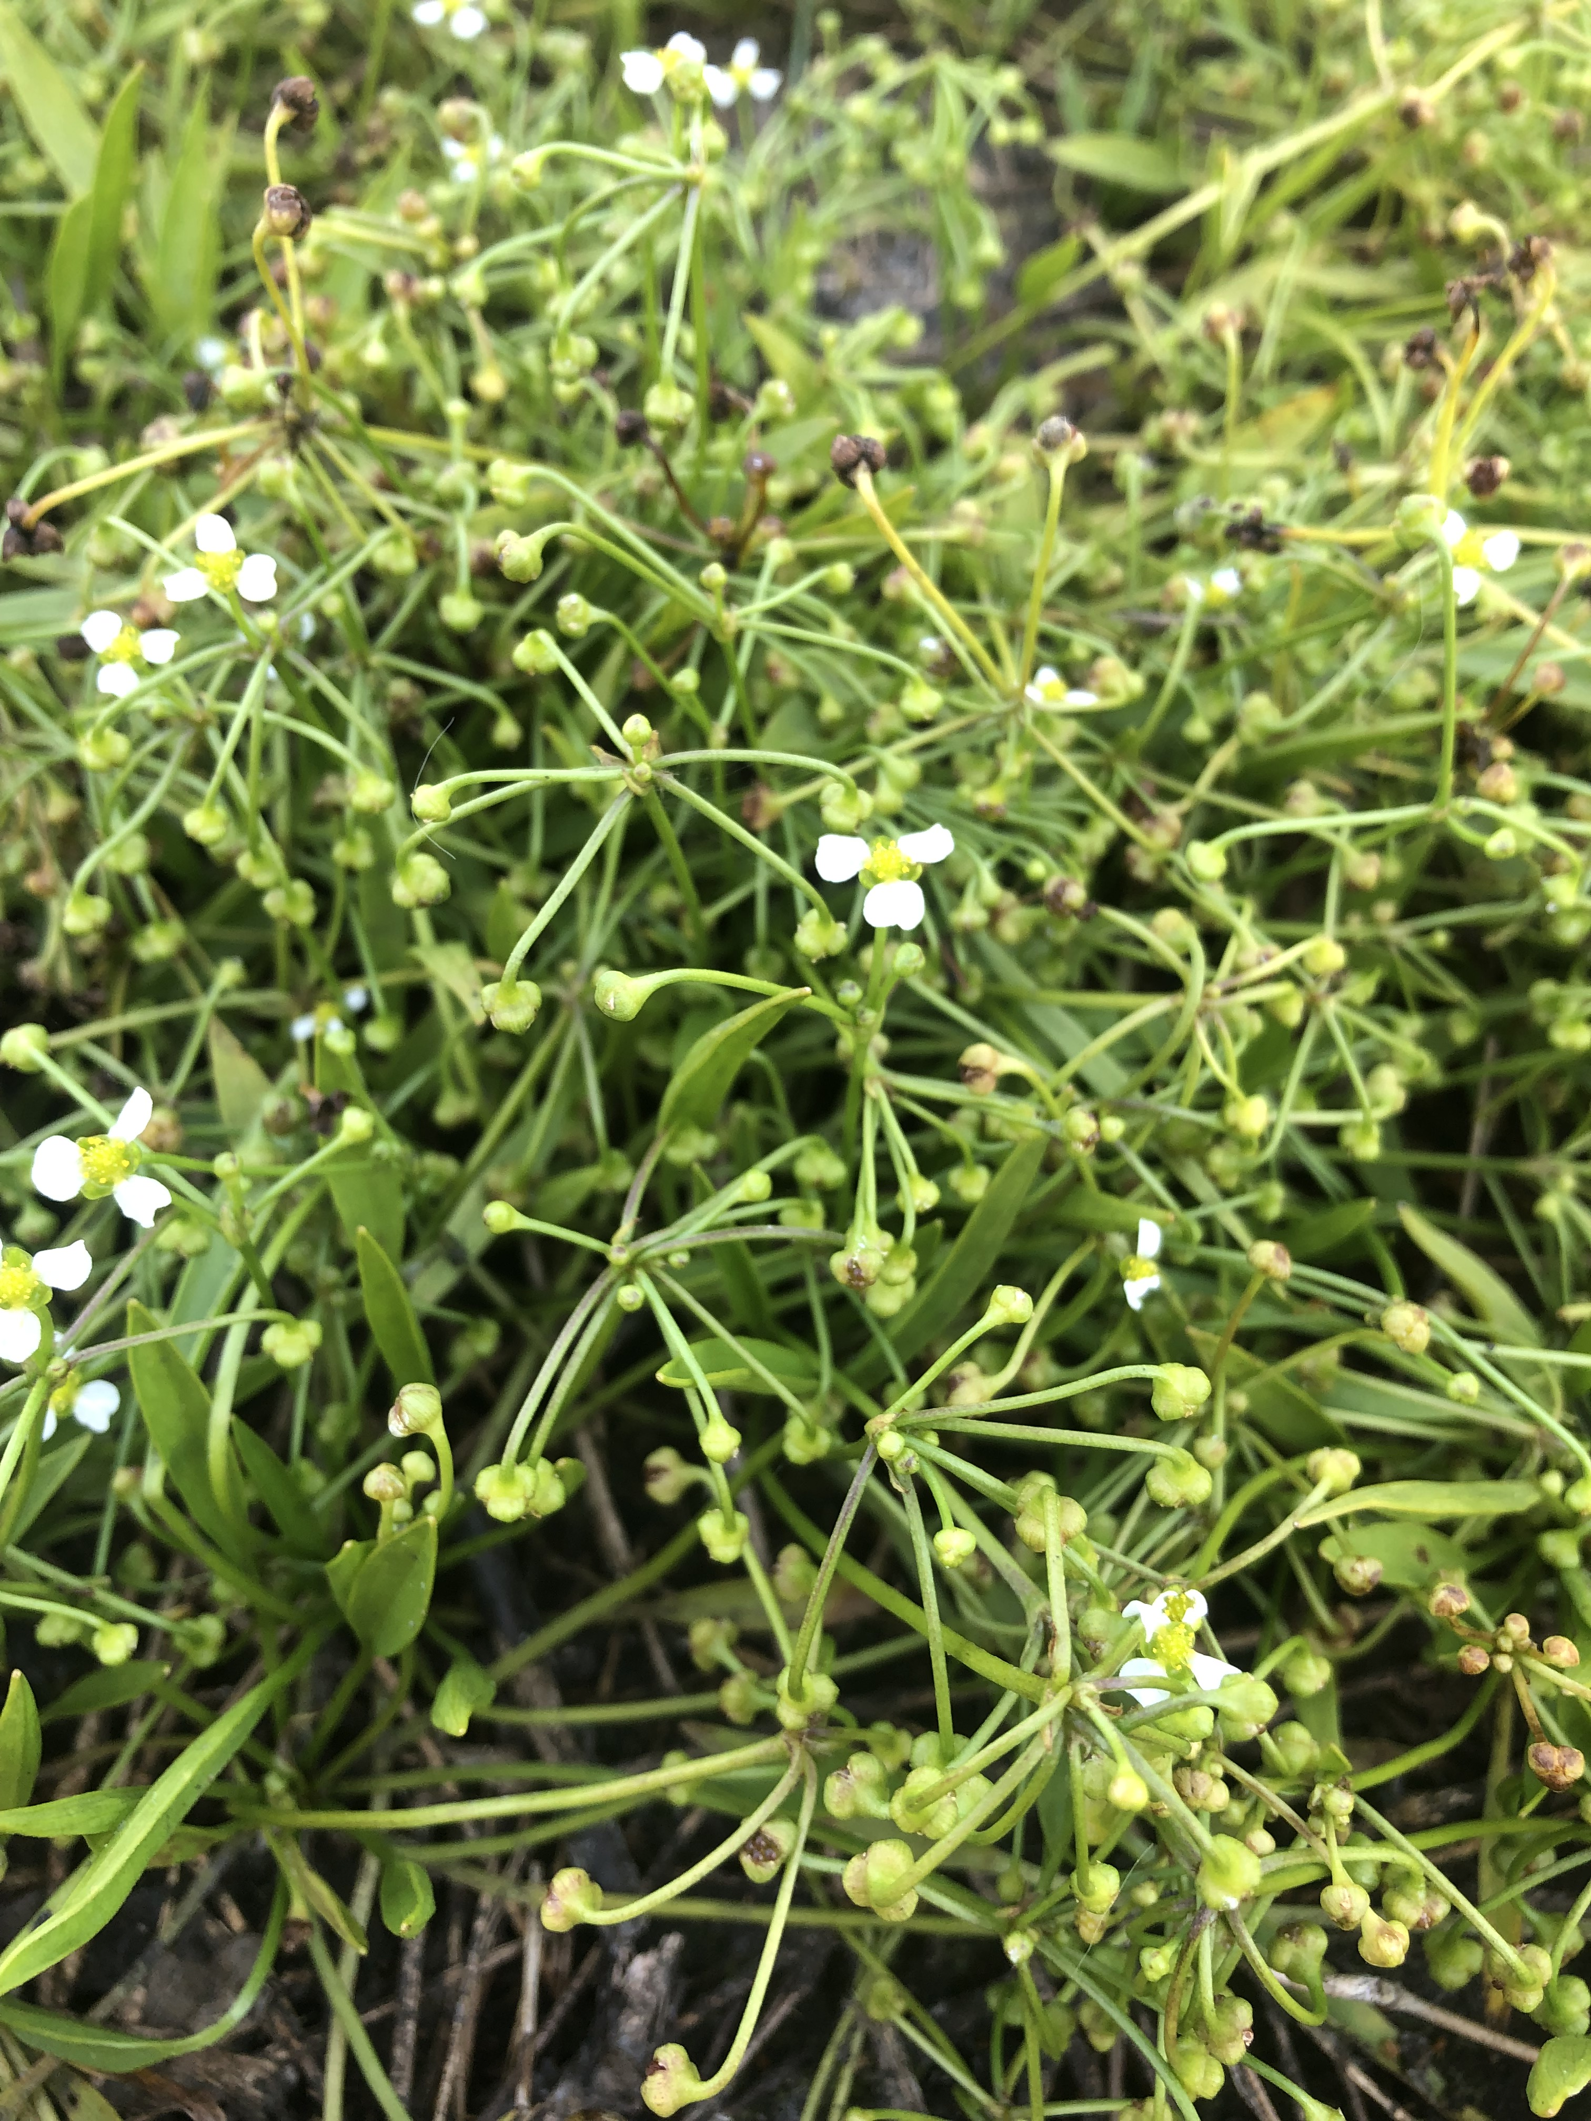
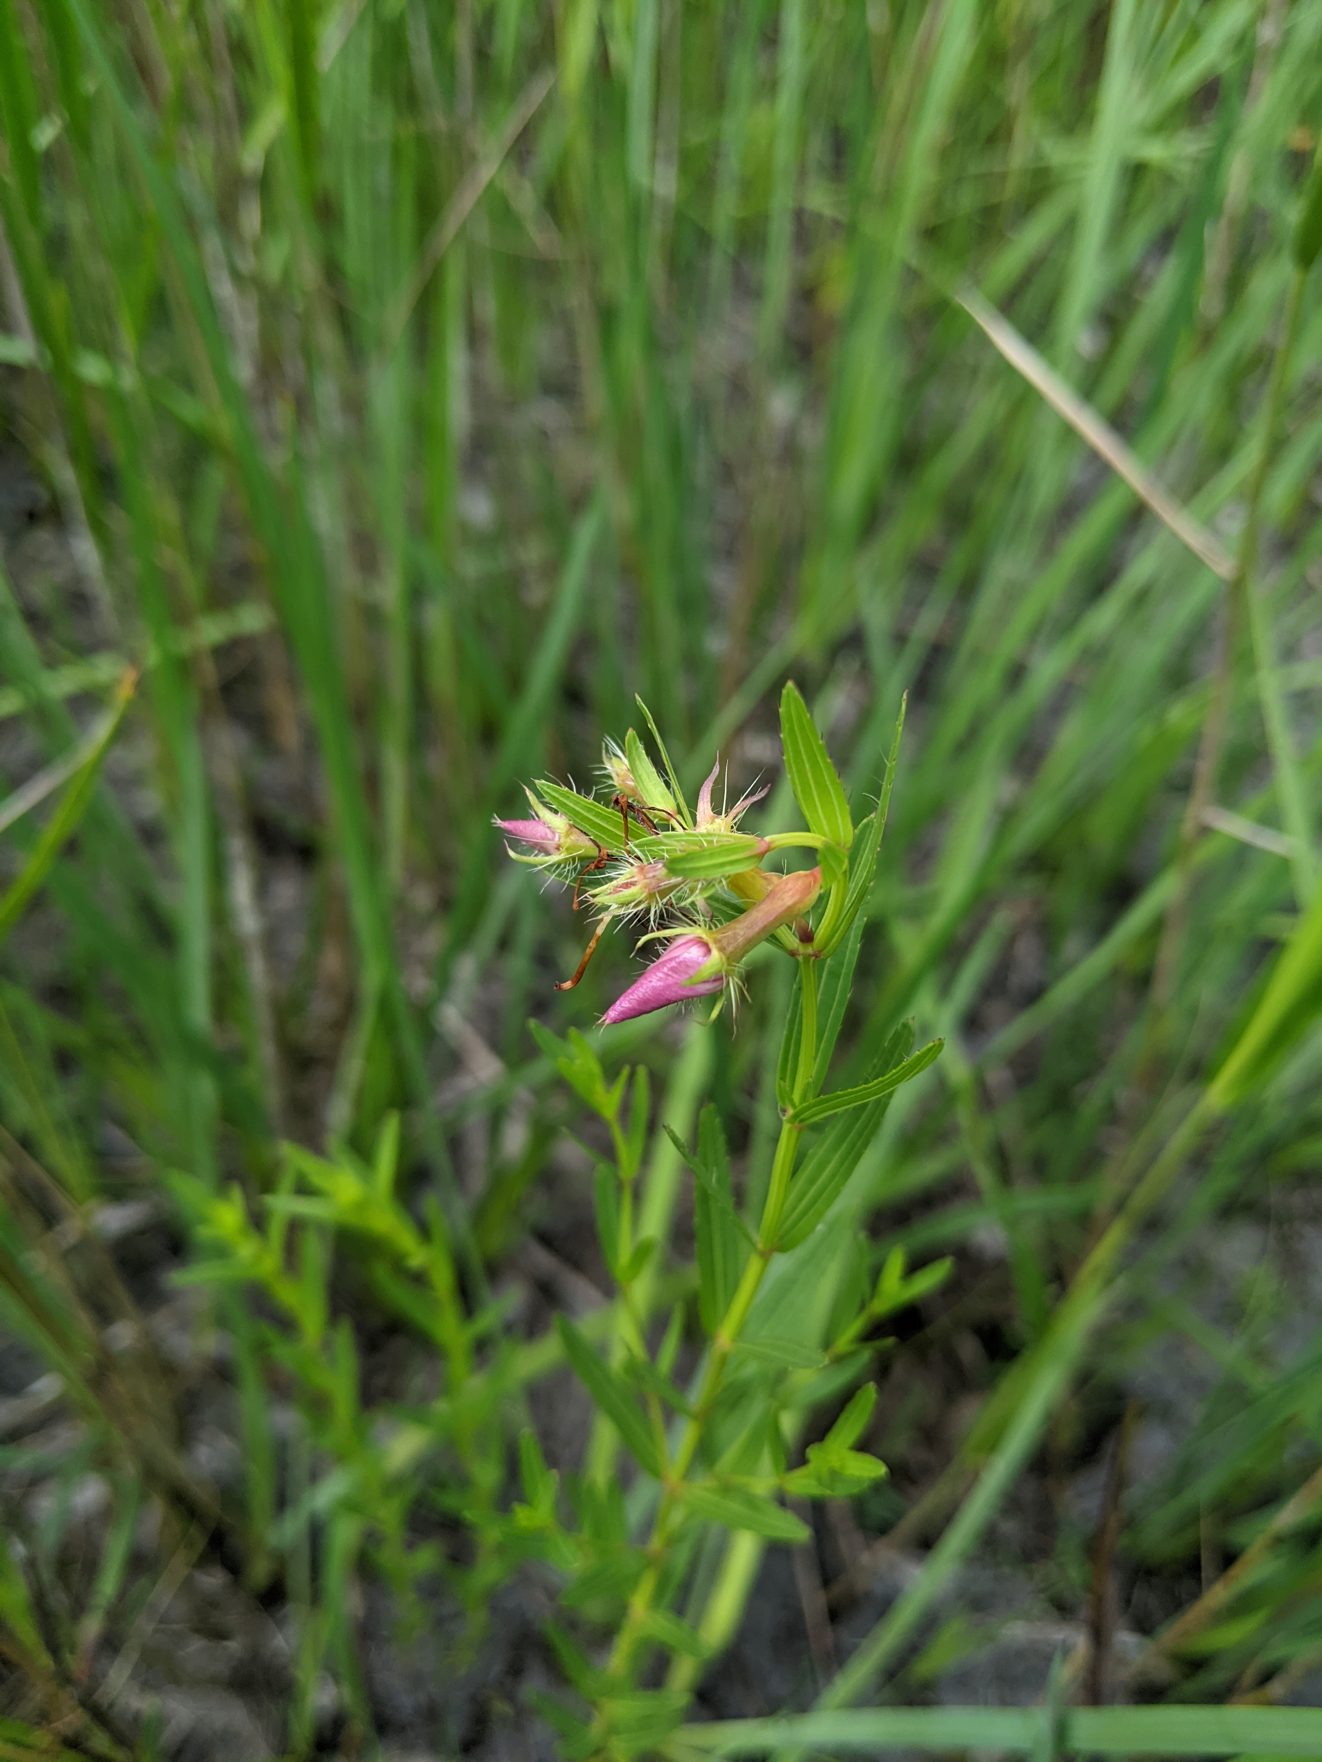
McIntosh Bays PCP Preserve
Notes:
2018, help from TNC.
Historic site for Canby’s dropwort. +10 state listed.
Scotland county

Slide 14
Plant Conservation Funding and Policy

Slide 15
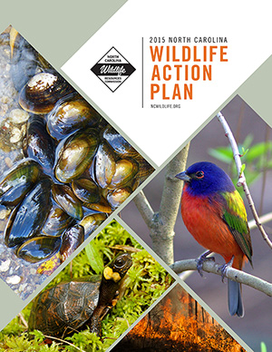
NC Wildlife Action Plan
Written by NC Wildlife Resources Commission as state conservation strategy (2005, 2015)
Keeping common species common (i.e. reduce listing)
Avoiding extirpations/extinctions
Directly tied to federal funding
State Wildlife Grants
Emphasis on Species of Greatest Conservation Need (SGCN)
Fauna only
Conservation concern AND knowledge-gap priorities
Notes:
Many of you are likely deeply familiar with the state’s wildlife action plan, but to be sure, I will give a bit of background so that we’re all on the same page.
At the encouragement of the US Fish and Wildlife Service, the states have each created wildlife action plans to serve as a conservation plan or conservation strategy for their state. Wildlife Action Plans all strive to avoid or prevent species extinctions or extirpations. This involves focusing attention on already-imperiled species; at-risk species which may become imperiled in the near future, or that are under review to determine if listing is warranted; and also more common species to head off or redirect declines before more herculean efforts at recovery are ever necessary.
State Wildlife Action Plans are typically put together by the agency charged with protecting wildlife, which in NC is the Wildlife Resources Commission.
These plans are to be updated every 10 years, our last update was in 2015.
These plans are directly tied to federal funding, specifically through the state wildlife grants. With few exceptions, for projects to be funded, they should address a priority action for a species of greatest conservation need. In many cases, only wildlife species were considered.

Slide 16
National Overview
Notes:
To put North Carolina in context, we can examine the ways other states and territories have handled plants in their wildlife action plans.
Despite some limitations or restrictions on funding, the states have been given flexibility in determining their own SGCNs. To that end, nearly 1/3rd of states and territories have included plants directly. Another 18% have included plants in an alternative list, sometimes as an appendix. The remaining 50%, including NC, have not included plants at all.
Part of the explanation is an assumption that plants are covered by ‘habitat’

Slide 17
Adding plants to state plans
Encouraged by the Association of Fish and Wildlife Agencies
2012 Best Practices document
Including plants = increased partners and projects in NC
Can help provide additional matching funds to projects by partnering
Notes:
Since 2005, we’ve seen the percentage of states and territories with plants in their plans go from 14% to 50%. This is great progress, and it didn’t’ happen by accident. There has been a lot of encouragement to go this way.
For example, this has been directly suggested by the Association of Fish and Wildlife Agencies, AFWA, the national consortium of agencies like NC’s Wildlife Resources Commission. In their 2012 Best Practices document, they specifically highlighted that adding plants and other underrepresented taxonomic groups to the state wildlife action plans should be a priority.
Not only would adding plants into state wildlife actions plans be advantageous to states like North Carolina right now—to broaden the partner and project pool for state wildlife grant funding—it would also be advantageous in the future.

Slide 18
Recovering America’s Wildlife Act
Will secure $1.3 billion in recurring annual funding for states.
NC would see $26 million, directly to the SWAP—in particular, Species of Greatest Conservation Need.
5% bonus funding to states that include plants.
Will require state matching funds.
Updated language: SGCN can be any species of fauna or flora.
Additional emphasis on at-risk plant species.
Notes:
One opportunity on the horizon is the Recovering America’s Wildlife Act or RAWA, which has been gaining traction for more than the past year.
RAWA is poised to accomplish several notable goals:
First, a significant infusion of recurring funding to the states, tied directly to Wildlife Action Plans—especially the SGCNs. Notably, there will be a 5% bonus in funding to states that include plants in their plans.
Second, this bill proposes to update the Pittman-Robertson Act which defined wildlife as fauna only, allowing for these “wildlife” funds to be spent on a wider swath of each state’s biodiversity.
At-risk species will also be getting special attention with this act with a goal of rapidly assessing and addressing species on the cusp of becoming imperiled so that their declining trajectories can be leveled off or turned around.
Your parents, teachers, and other role models probably taught you that avoiding or stopping a problem from getting out of hand is always better than to try to clean up after the fact—this wisdom applies to the realm of conservation too. In other words, these extra resources are aimed at avoiding species listings and difficult recovery programs for better outcomes overall.

Slide 19
RAWA in Progress
North Carolina representatives among house and senate co-sponsors
HR 2773 passed the House 231-190 on June 14, 2022!!
Now awaiting Senate approval S.2372
Notes:
So, where are we with this process?
A bill was introduced in the US House in April by Representative Debbie Dingell from Michigan and Jeff Fortenberry of Nebraska. This bill includes 101 co-sponsors including NC’s David Rouzer and Deborah Ross. This bill has made it through several subcommittee hearings thus far.
In mid-July, a companion bill was introduced in the US Senate by Senator Martin Heinrich of New Mexico and Roy Blunt of Missouri and has support and co-sponsorship from NC Senators Tillis and Burr.
So, at this point, we have two introduced bills and we will be watching closely for next steps. They will need to be reconciled in the end, but the teams are working together to make this a success.
I know the National Wildlife Federation has been providing great updates on this process through their website, social media, etc.
So, you may be asking---What are we waiting on?? Let’s get plants included in the NC WAP, right?!

Slide 20
Updating the NCWAP
In April-May WRC welcomed public comments on a proposed Addendum to the WAP to include the protected plant list as SGCN.
The next scheduled update to the NC Plan will occur in 2025.
PCP aims to develop a comprehensive list of plant species of greatest conservation need for the scheduled 2025 update.
Notes:
Not to worry, PCP has been working with WRC for over a year now to plan out how to make this happen.
First, you should know that updates to the WAP are categorized as Major Revisions or Minor Revisions, but all revisions must be reviewed and approved by the US Fish and Wildlife Service. We first looked into adding the NC Protected Plant List as a minor revision, but feedback from the Service was that this change would be too substantial and constitutes a major revision. And so, we are working through the process to go that route instead. We have several more steps to complete, but we are aiming to submit this for review later this year.
By starting with the NC Protected Plant List as a plant list of species of greatest conservation need, we will only be including the most imperiled plant species of the state. This will therefore not match the rest of the document which includes a wider array of species. We will need to create a new evaluation process for plants in the wildlife action plan that will be broader in scope. Our goal is to be able to complete this larger review in time for the scheduled 2025 update to the plan.

Slide 21
Next Steps: Plant SGCN Phase II
Plant SGCN Working Group (part of newly-formed NC Plant Conservation Alliance)
Work with upcoming evaluation process for wildlife SGCN to develop a parallel for plants
Develop more comprehensive SGCN list:
Significantly Rare and Watch List species
Federal at-risk species
Notes:
This June, the Commission will review the evaluation criteria and process for designating wildlife SGCN.
The Plant SGCN Working Group (part of the newly formed NC Plant Conservation Alliance) will meet with the WRC State Wildlife Action Plan Coordinator to hear updates and discuss designating plant SGCN for the 2025 Wildlife Action Plan regularly-scheduled major revision.
Phase II will be much more comprehensive than the NC Protected Plant List. We will likely see many Significantly Rare and maybe Watch List species from the Rare Plant List added to the SGCN list in 2025. There will also be an emphasis on federal at-risk species, some of which are state listed, others only Watch List.

Slide 22
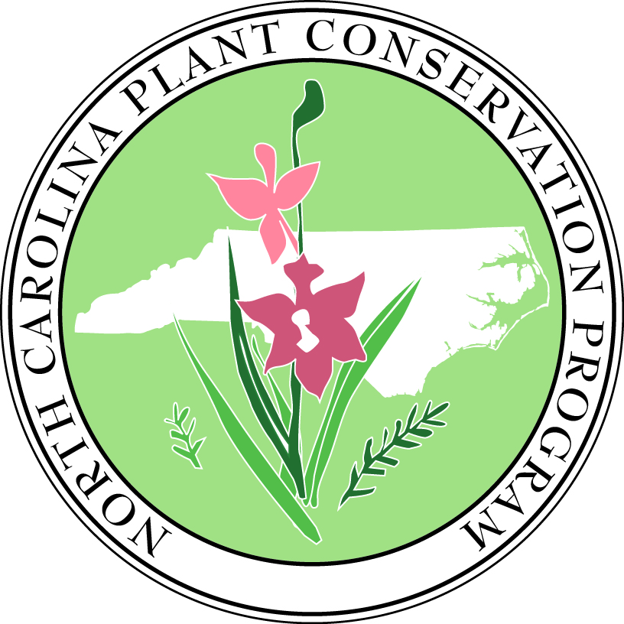
Questions?
katherine.culatta@ncagr.gov
Ncplants.com
Ncplantfriends.org
Notes:
So, what can you do?
Stay tuned or look for updates on the status of RAWA and for updates to the Wildlife Action Plan. If you want to learn more about plant conservation in North Carolina or to get involved, I encourage you to reach out to the Friends of Plant Conservation to learn more about ways to connect.

