Slide 1
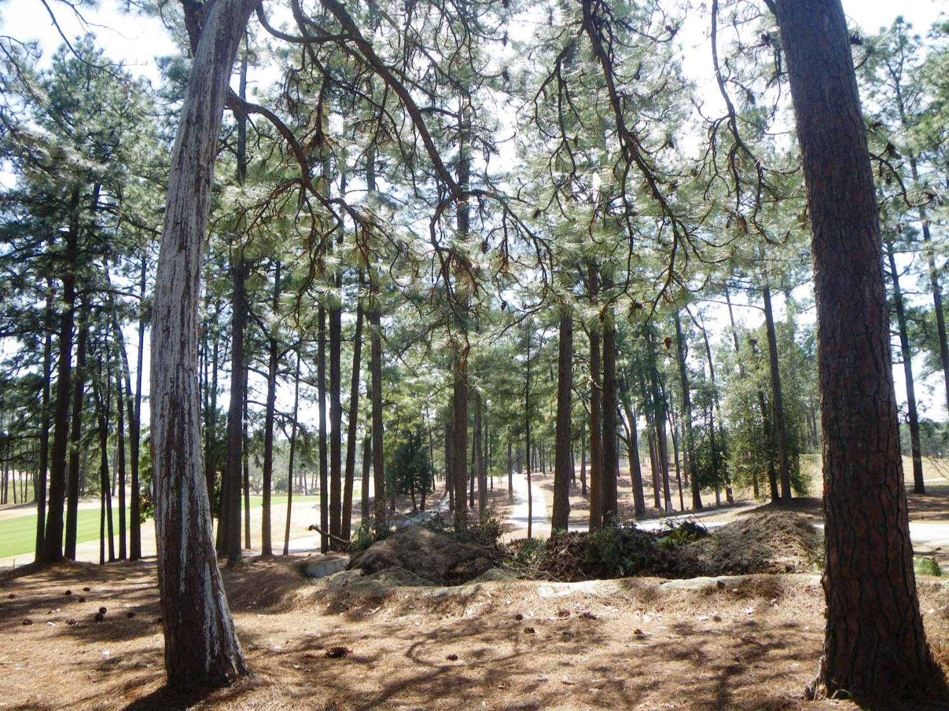

NC Sandhills
Private Lands RCWs
Kerry Brust
Andy Van Lanen
Anna Prinz
Southern Pines, NC

Slide 2
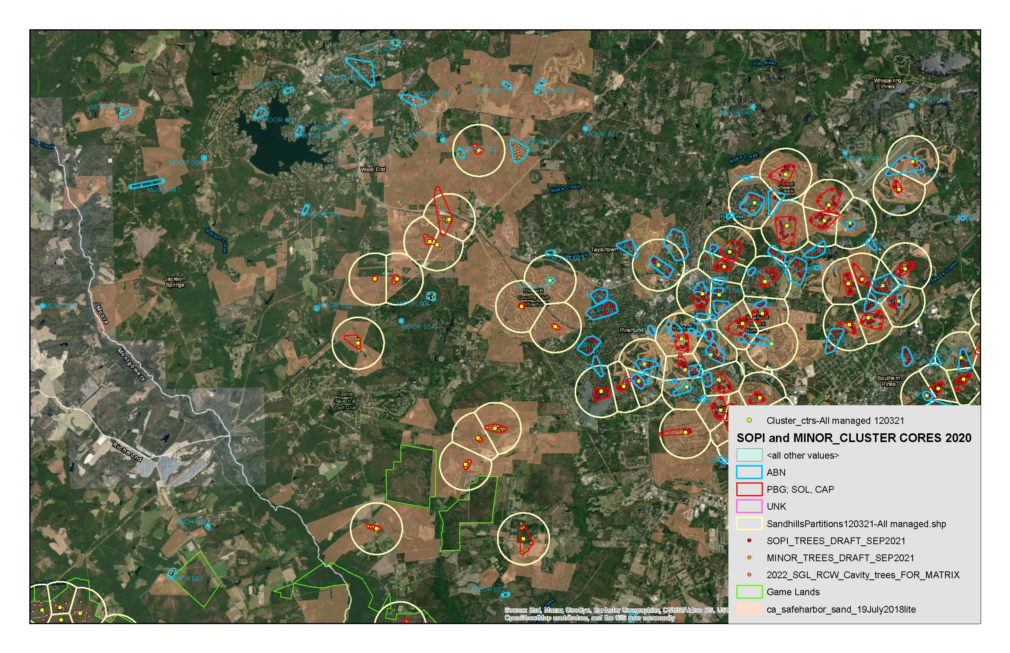
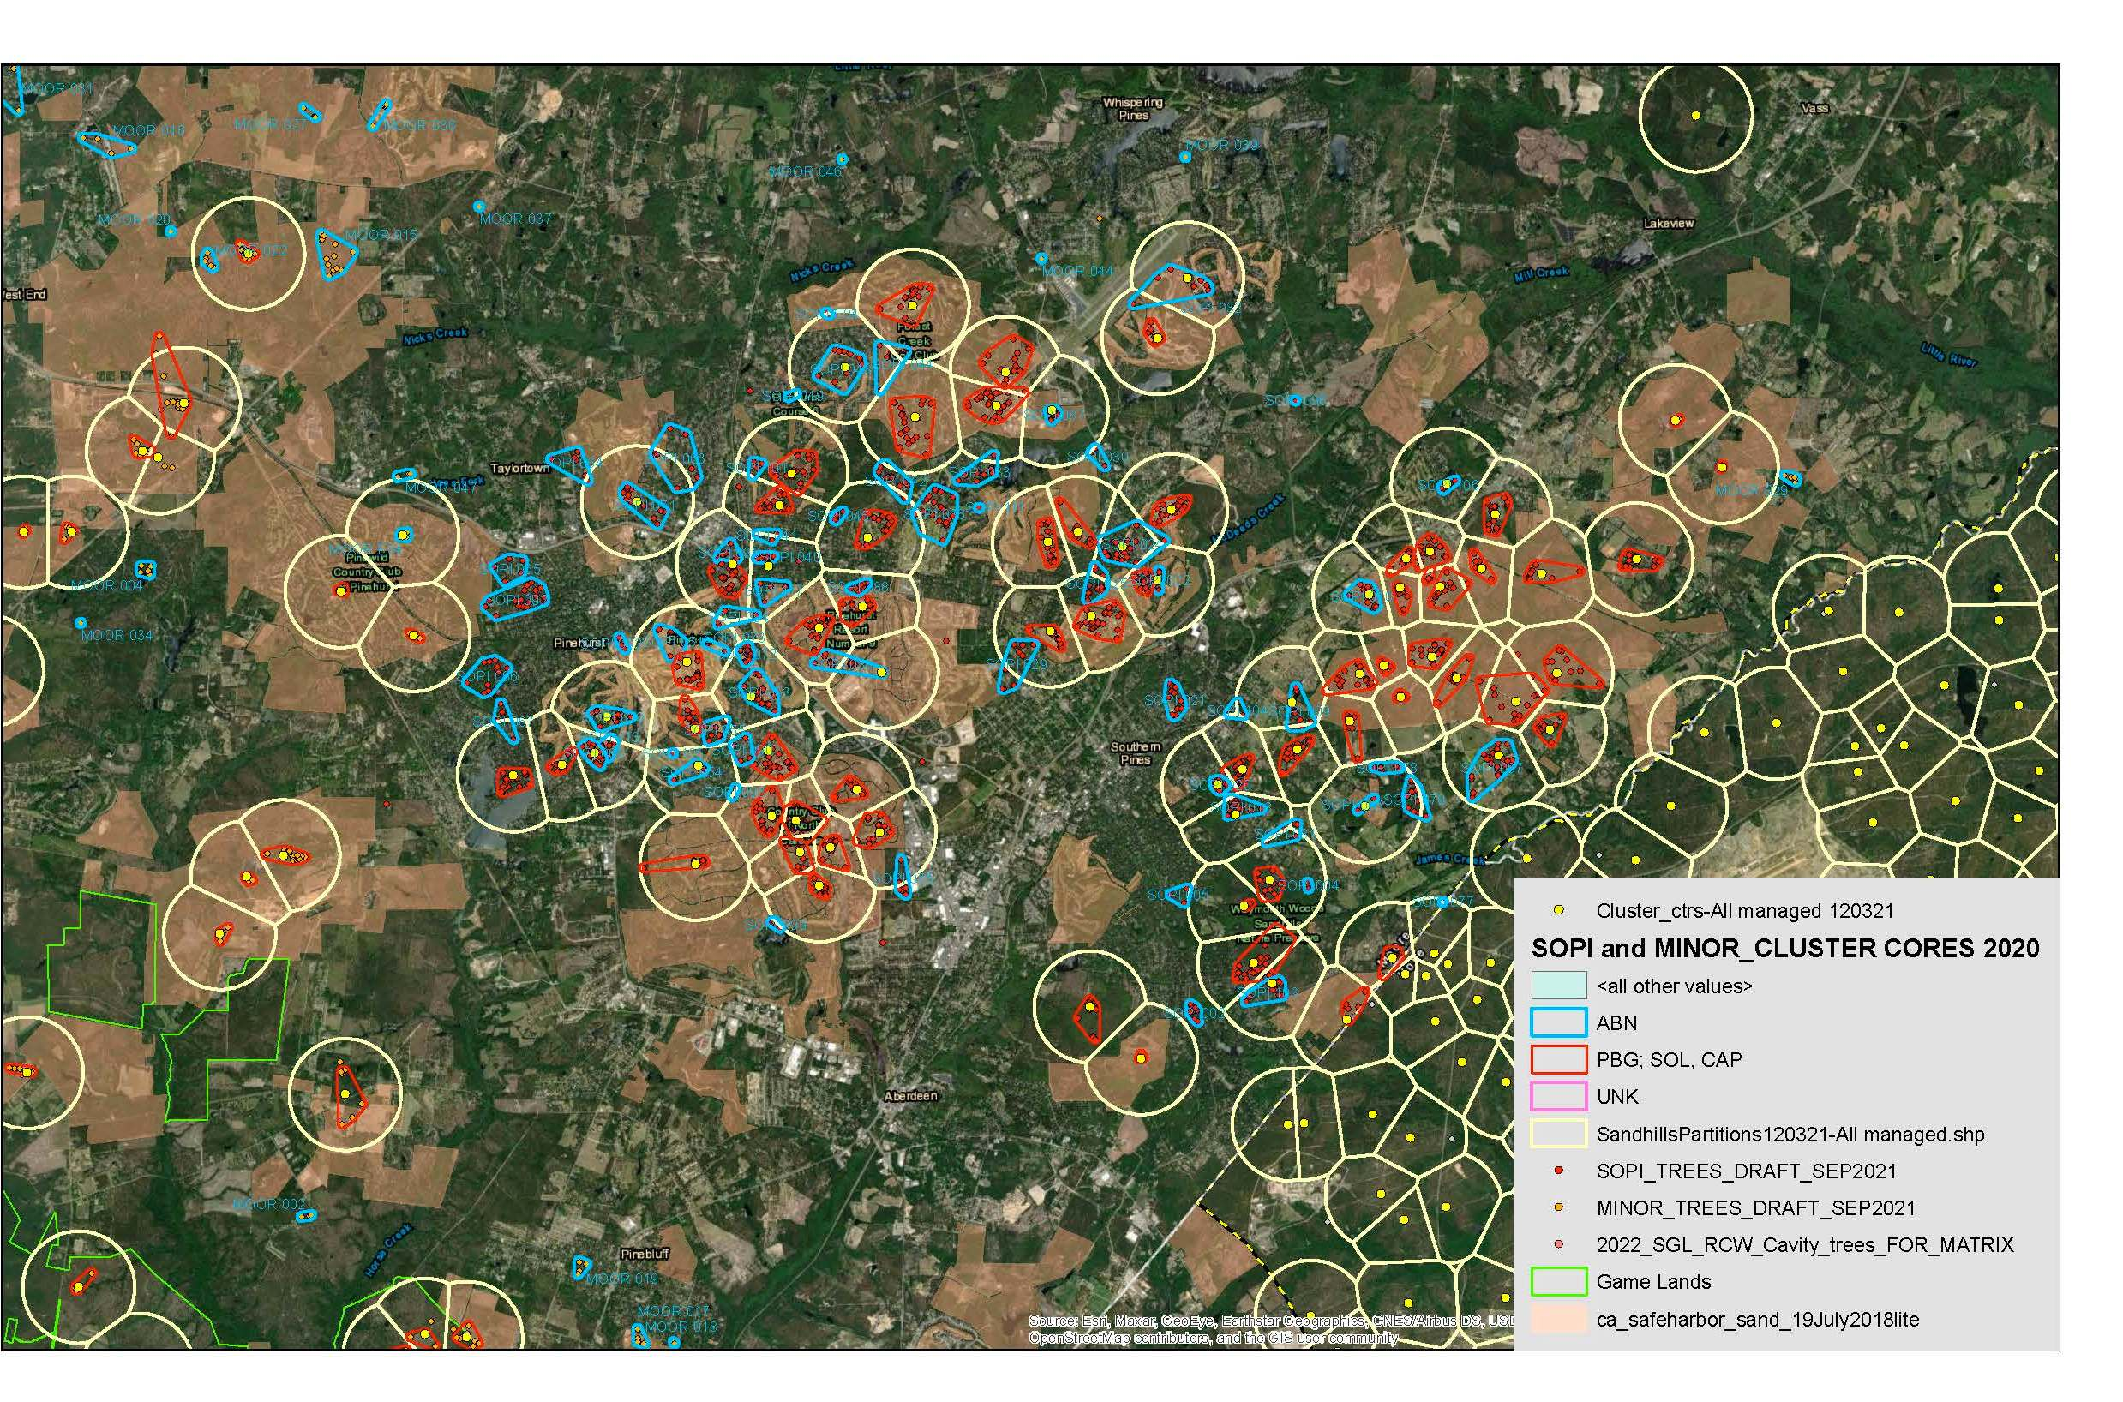
MOORE COUNTY, NC PRIVATE LANDS RCW CLUSTERS
SOPI = SOUTHERN PINES / PINEHURST
MOOR = MOORE COUNTY outside SOPI
US HWY 1
SOPI
MOOR
Western
Fort Bragg
ABERDEEN
Sandhills Game Land

Slide 3
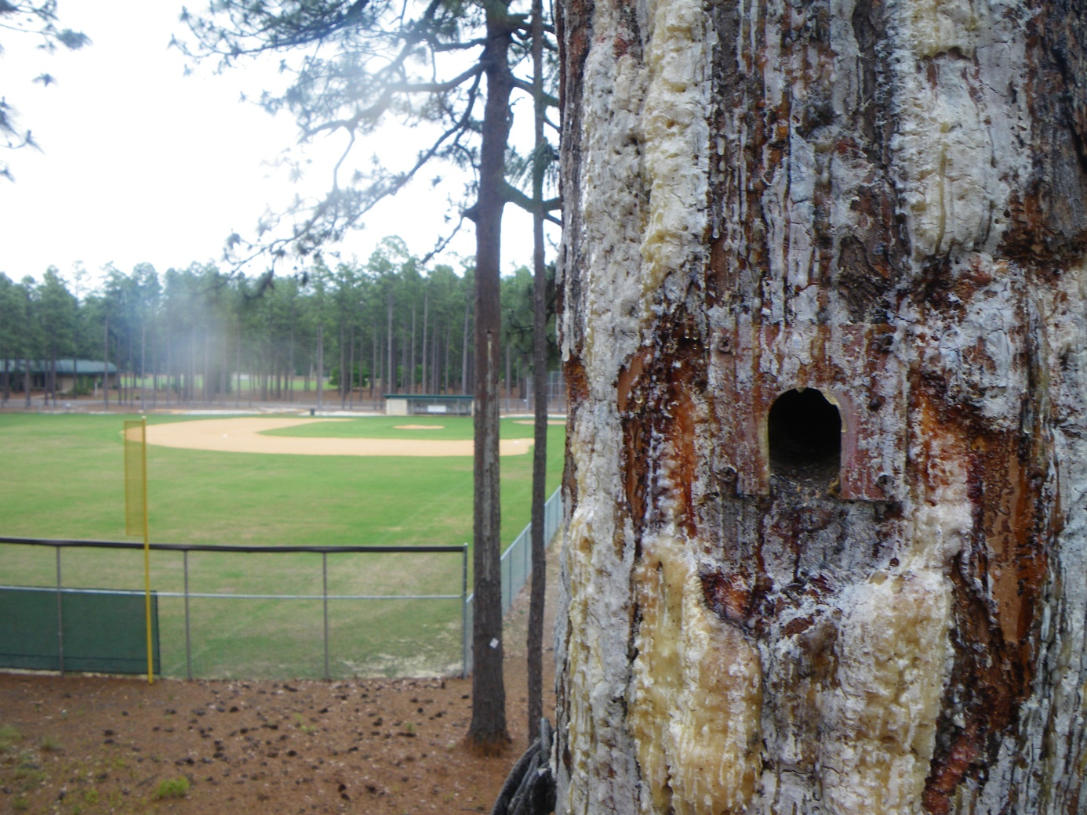
Conservation Value of Private Lands RCWs:
10% of Potential Breeding Groups (PBG) in Greater Sandhills Population
(80 of the ~ 800 PBGs)
Provide connectivity among subpops

Slide 4
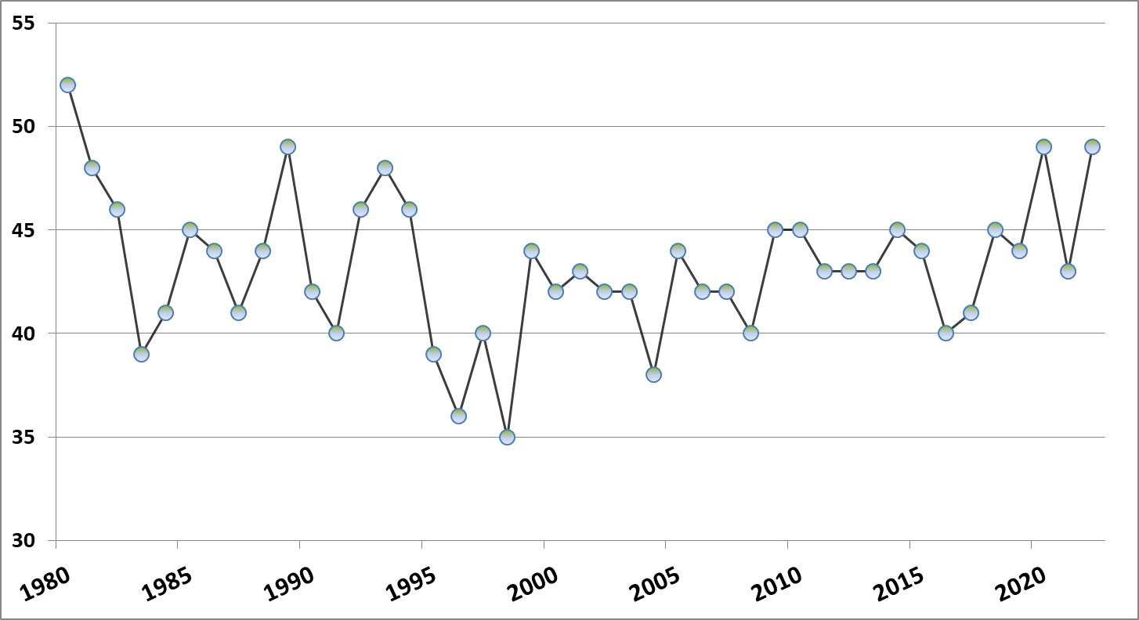
SOPI RCW Groups 1980 - 2022
52
49
Safe Harbor (1995)

Slide 5
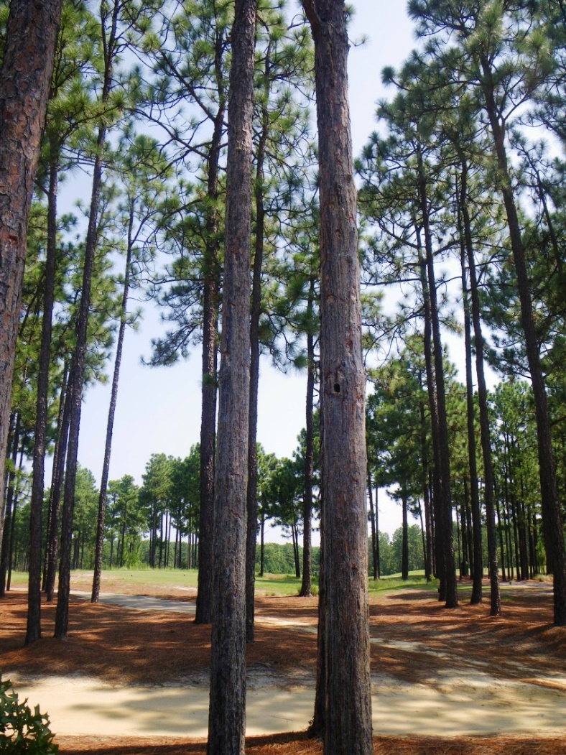
SOPI Golf Course Clusters
Nesting & Foraging Habitat
Cavity limitation (e.g. RHWO)
Fragmentation
Lack of fire
MORGANTON Rd

Slide 6
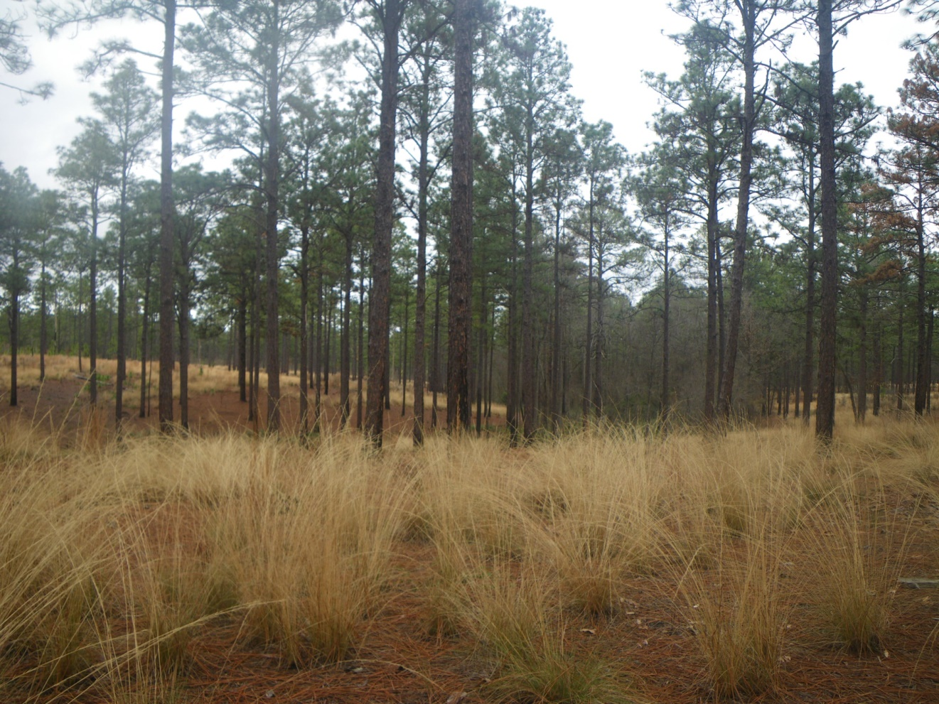
Walthour Moss Foundation (MOSS)
+
Weymouth Woods SNP (WEWO)
Less fragmented habitat
Proper Fire Regime

Slide 7
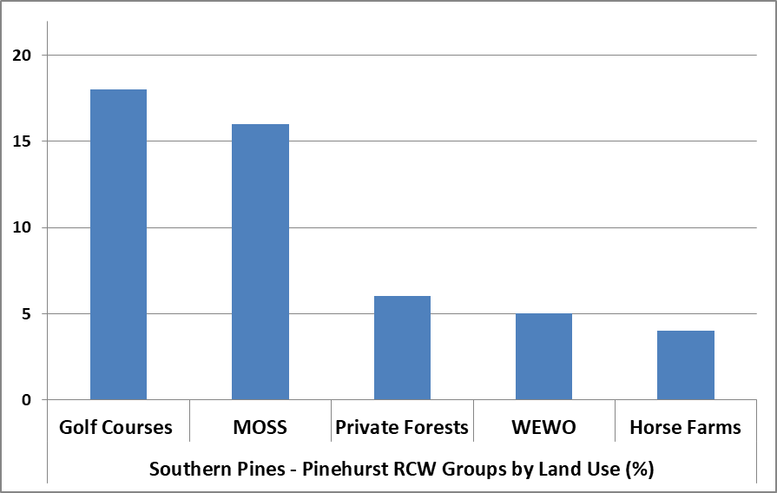
37 %
2022 TOTAL = 49 groups
33 %
12 %
10 %
8 %

Slide 8
3.25
2.52

Slide 9
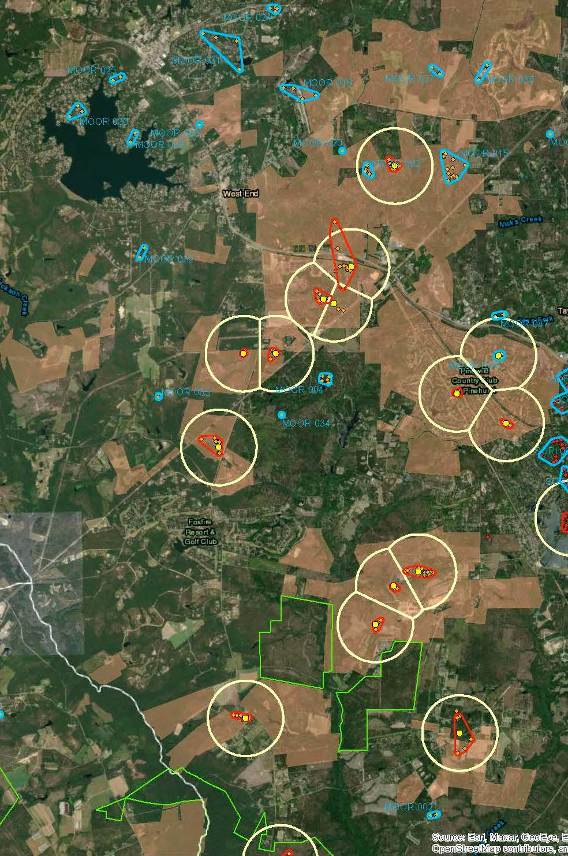
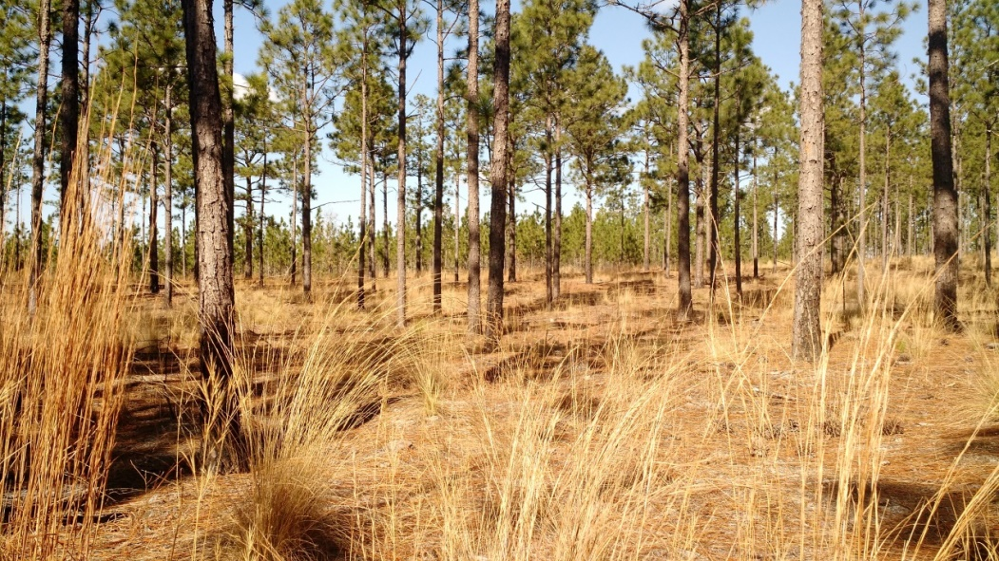
Western MOOR Private Lands
Majority Safe Harbor Properties
Large Working Forests
  Pine straw harvest and timber
Prescribed Fire – winter burning
RCW reoccupation within the last decade

Slide 10
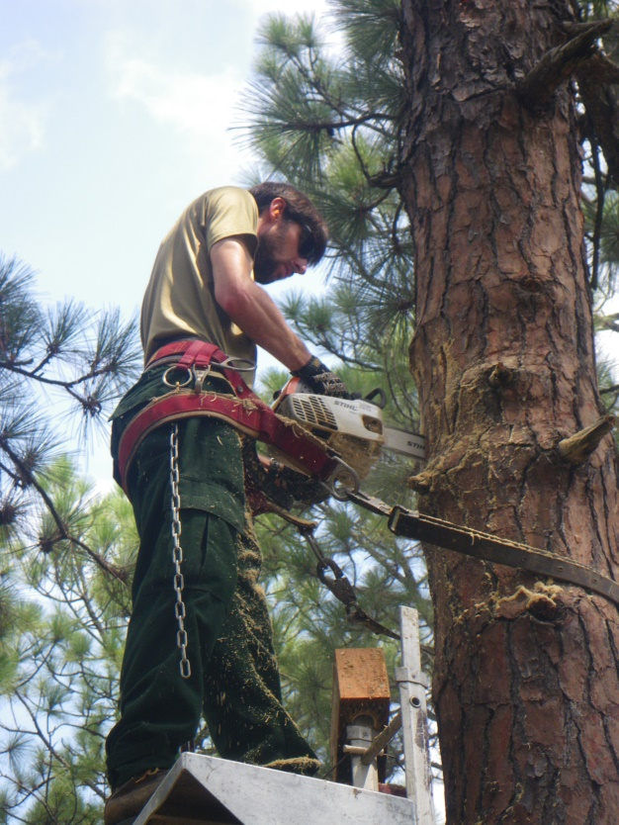
RCW Private Lands Recovery Effort
Artificial Cavities and Recruitment* Clusters, 2002-2022
* Several artificial cavities installed in suitable unoccupied and abandoned habitat
  300 artificial cavities cost ~ $100,000
    225 (SOPI) (4.2 /cluster)
    75 (MOOR) (3.4 /cluster)
  # Recruitment Clusters Installed
    17 (SOPI)
    13 (MOOR)
  % of Recruitment Clusters occupied by RCWs (i.e., active) in 2022:
  SOPI 18%
  MOOR 85 %

Slide 11
RESULTS
34 juvenile RCWs moved from Ft. Bragg (Donor) to SOPI/MOOR
These translocated birds have produced 103 fledglings within SOPI/MOOR
As of 2022, 7 of the 34 RCWs remain as breeders within SOPI/MOOR
RCW Private Lands Recovery Effort, cont’d
Translocation by SEI with FB ESB and USFWS help, 2012-2017

Slide 12
MOORE COUNTY (MOOR) RCW GROUPS outside of SOPI

Slide 13
3.25
2.52
3.16

Slide 14
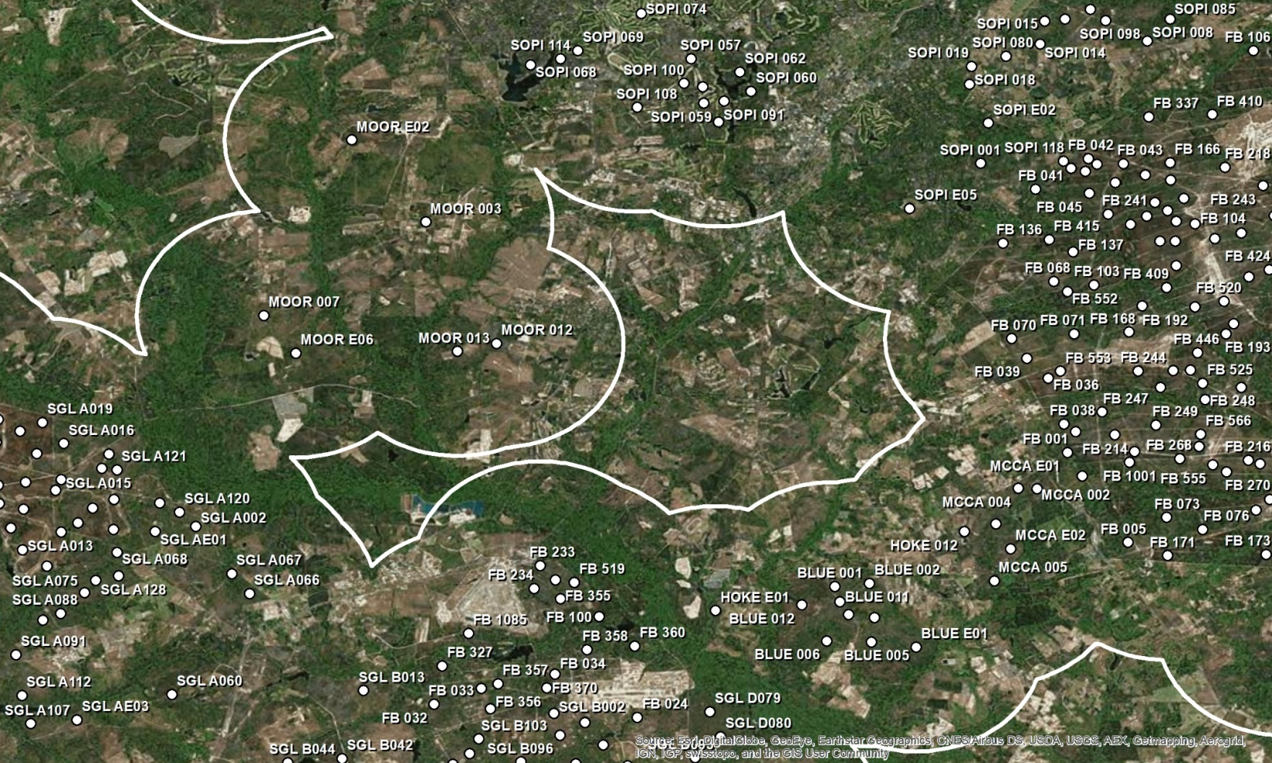
Importance of W. Moore Co. (~ Gap Area 3E) to
sub-population connectivity
(Walters and DeMay - SSA)
GAP AREA 3E
HISTORIC GAP
BLUE TRACT
Map from 2017 SSA (Walters and DeMay)

Slide 15
Bolstering connectivity in W. MOOR
New RCW Groups since 2017
GAP AREA 3E
HISTORIC GAP
BLUE TRACT
Map from 2017 SSA (Walters and DeMay)

Slide 18
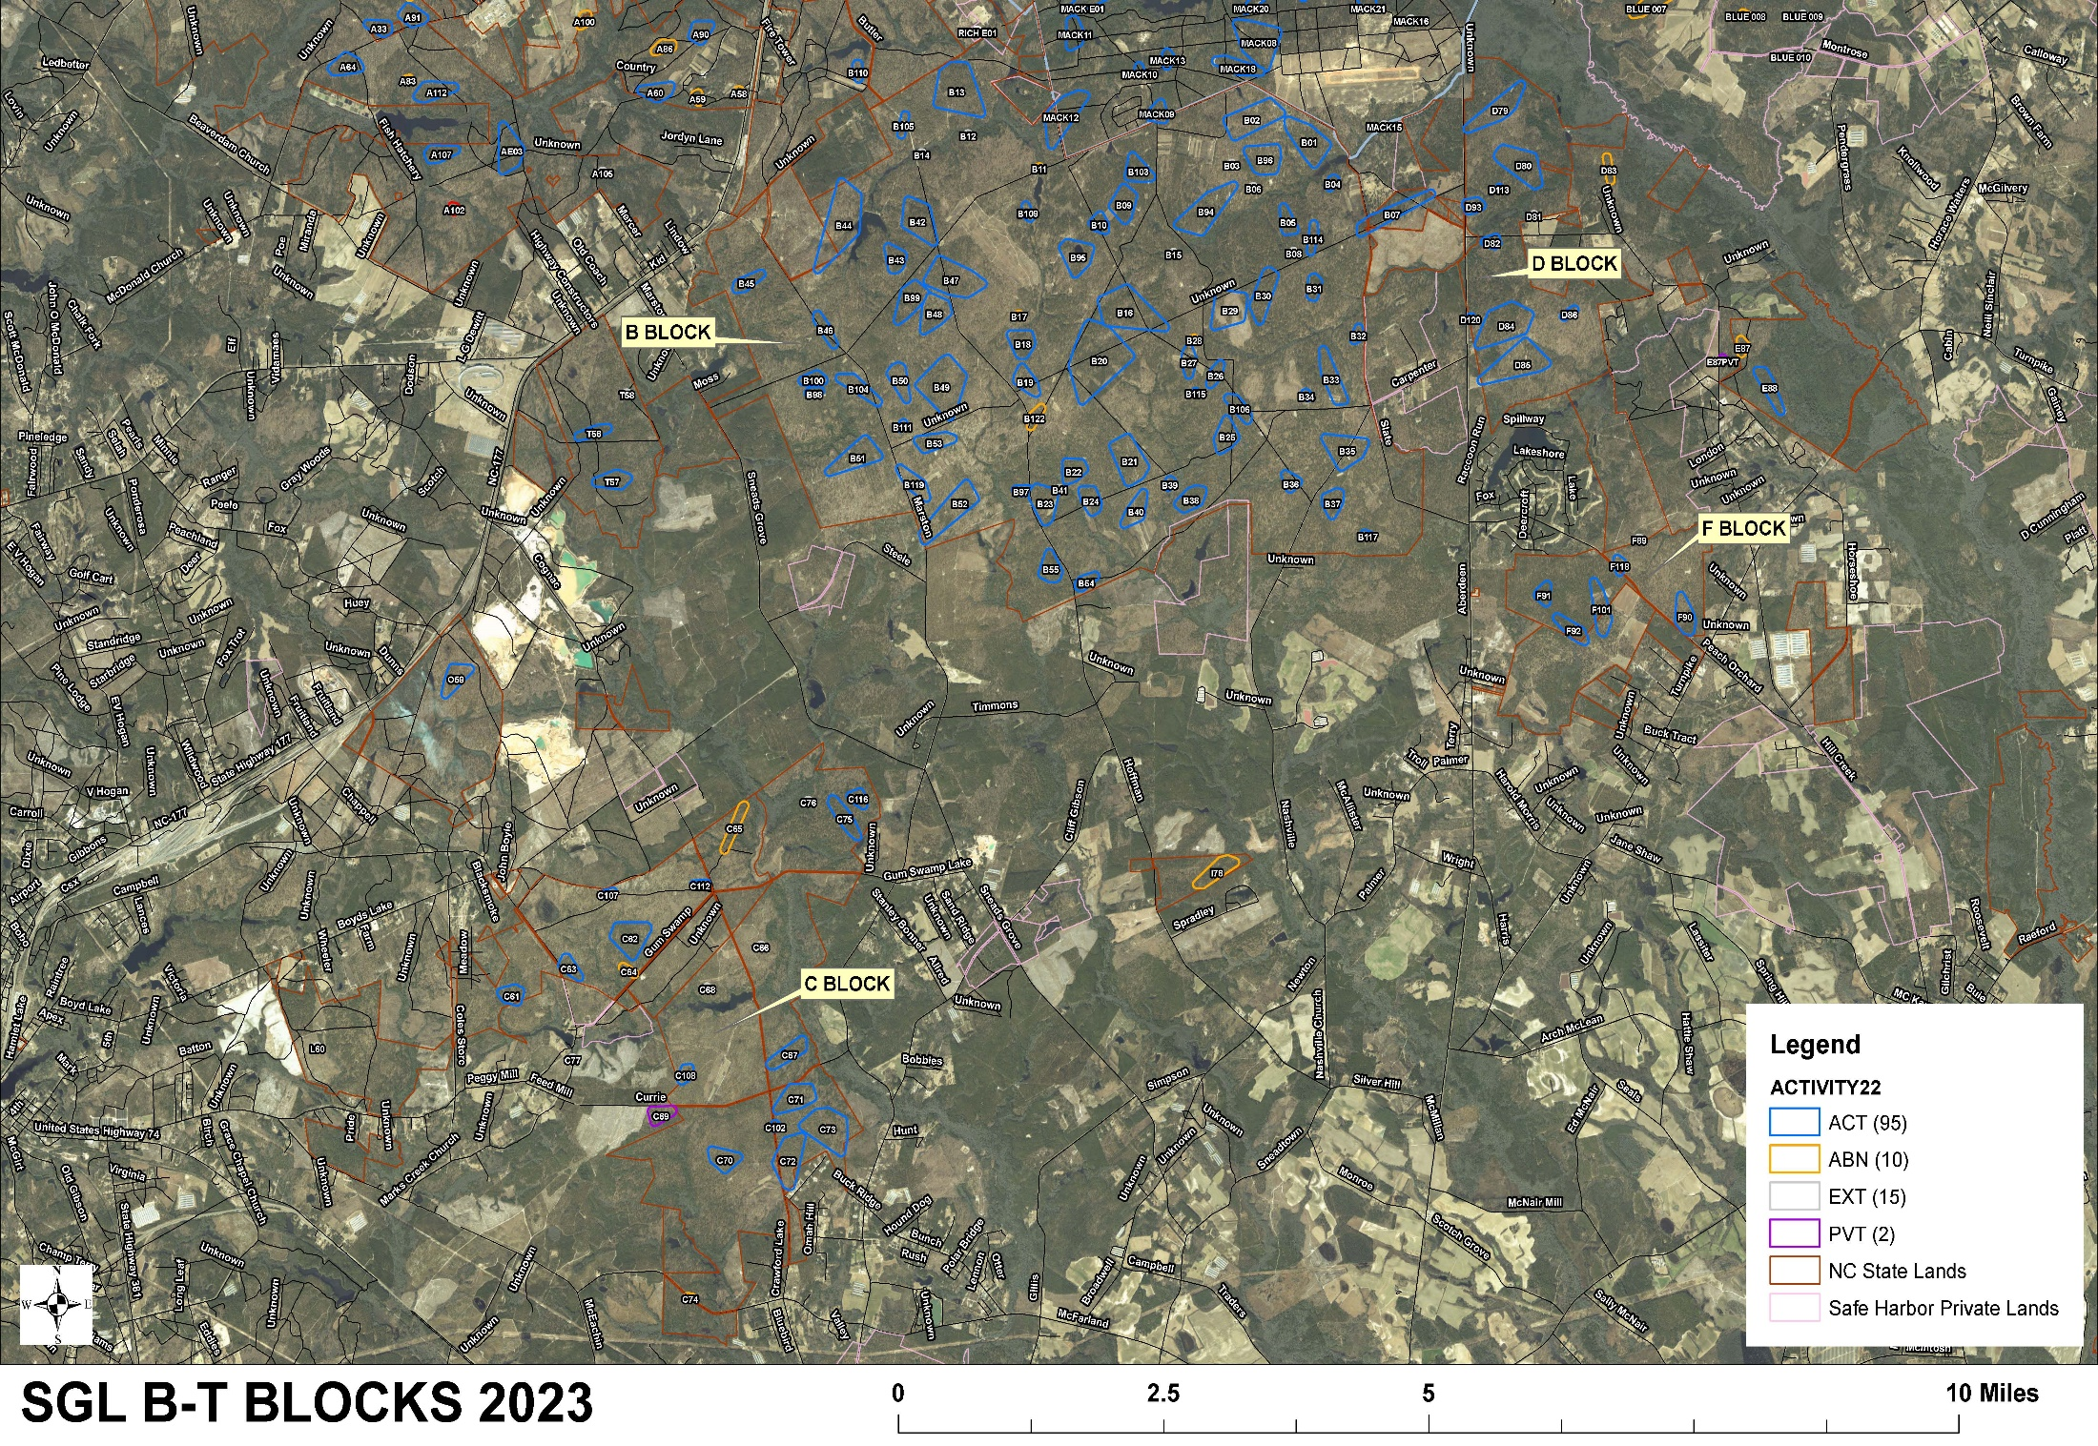

Slide 19
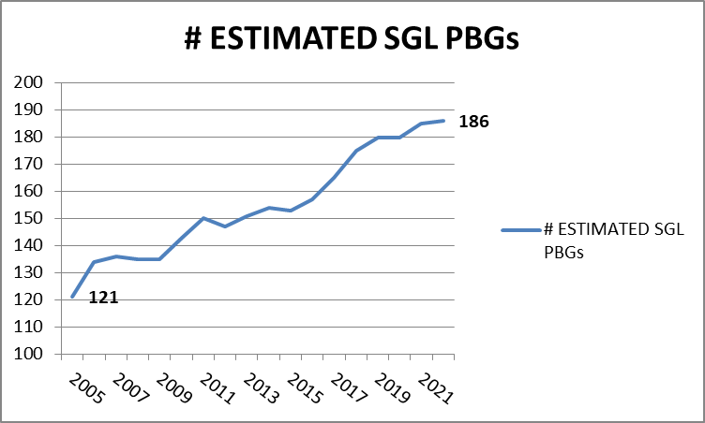
Sandhills Game Land (SGL) RCW Groups
35% increase

Slide 20
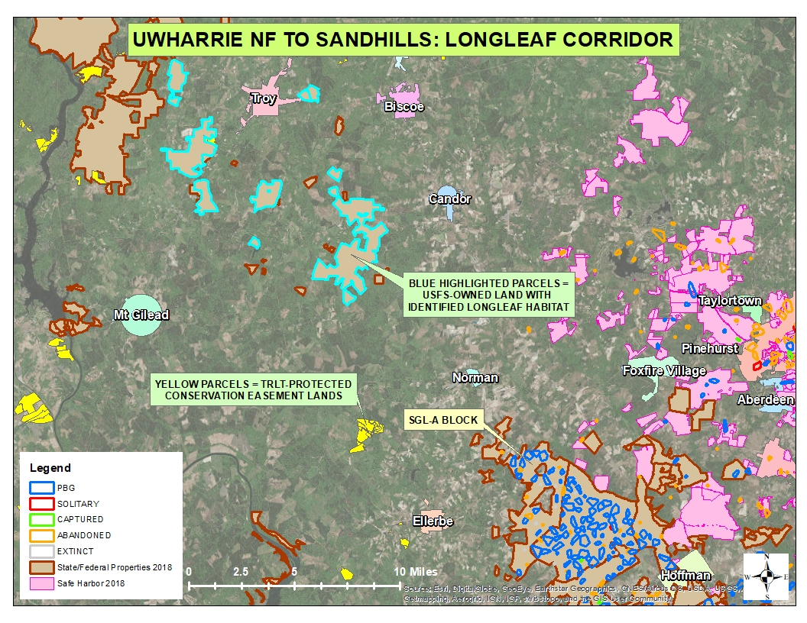
Western MOOR
Map by A. Van Lanen – SEI

