Slide 1
Management Insights for the St. Francis’ Satyr butterfly
2022 North Carolina Longleaf Pine Summit
March 9, 2022
Dave Pavlik – Haddad Lab, Michigan State University
Heather Cayton – Haddad Lab, Michigan State University
Gina Himes Boor – Montana State University
Nick Haddad – Michigan State University
Erik Aschehoug – Norwegian University of Life Sciences

Slide 2
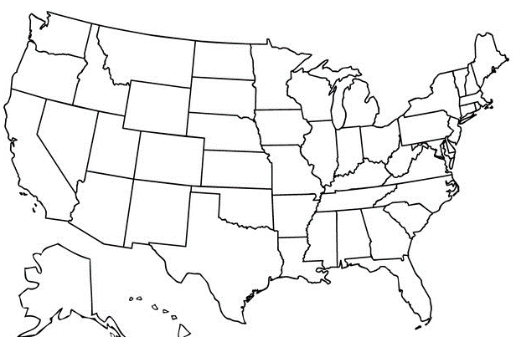
Where to find St. Francis’ Satyr
St. Francis’ Satyr

Slide 3
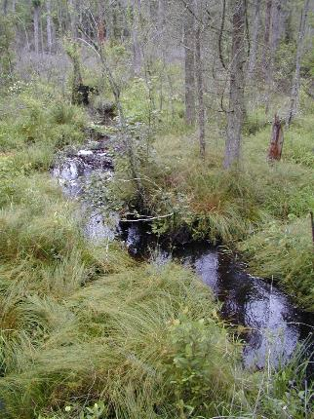
St. Francis’ Satyr lives in small wetlands along stream

Slide 4
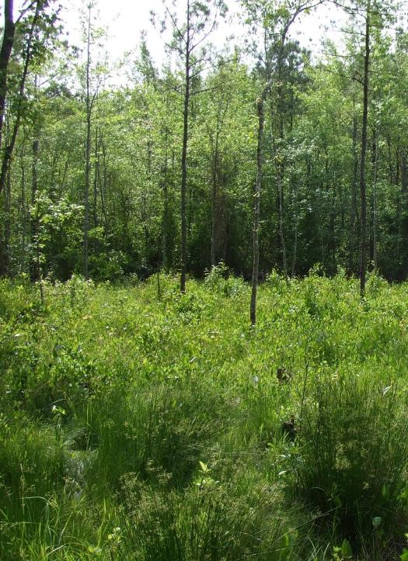
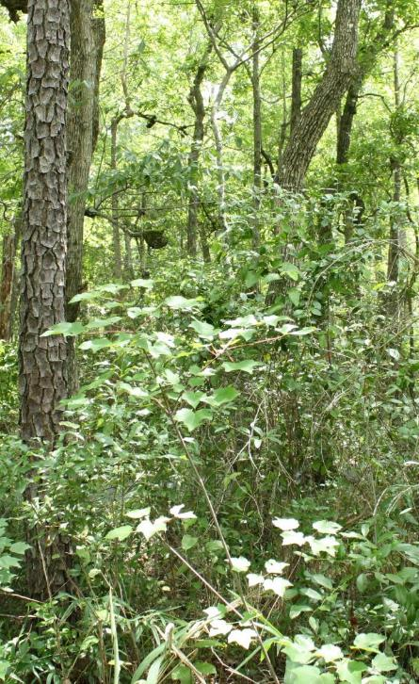
Natural process of plant succession degrades St. Francis’ Satyr habitat

Slide 5
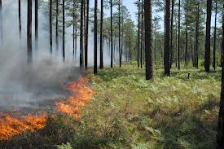
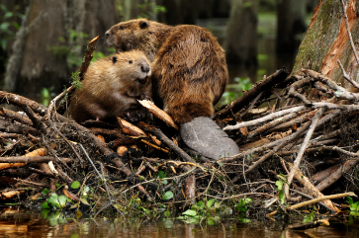
Population loss is inevitable
Disturbance is required for long term population survival

Slide 6
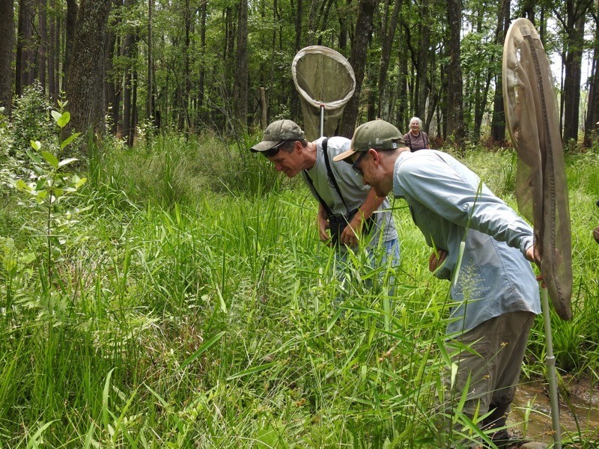
SFS Research
Population monitoring since 2002
Restoration and habitat monitoring since 2011

Slide 7
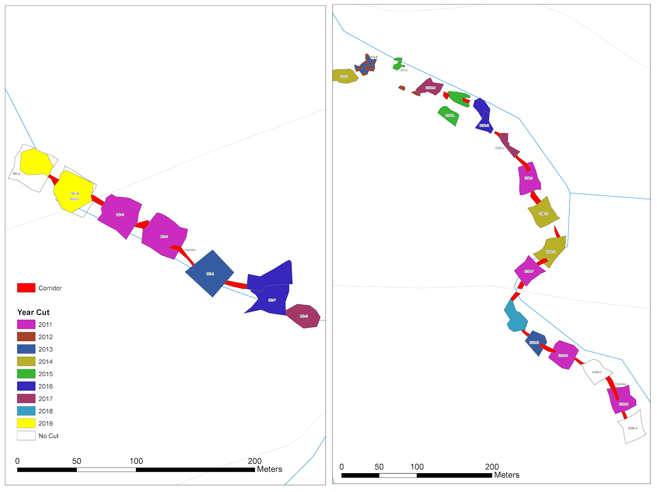

Slide 8
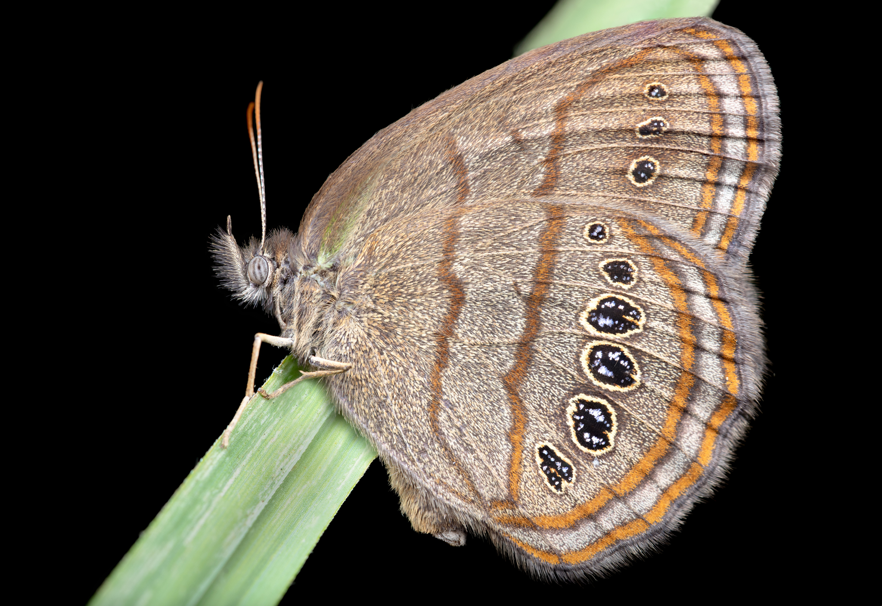
SERDP Tasks
Perform SFS Habitat Restoration
Monitor Habitat Quality
Monitor Dispersal
Assess Demography

Slide 9
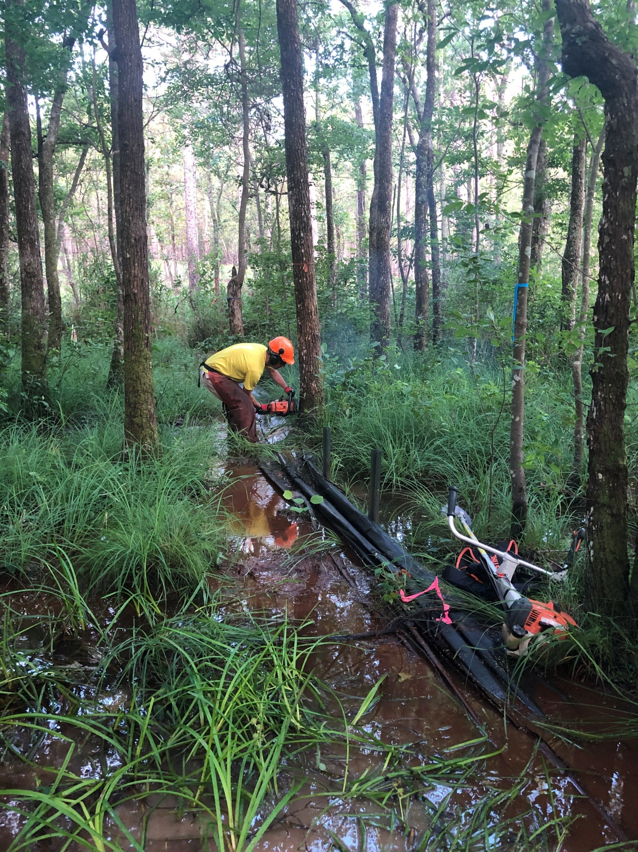
Habitat Restoration
Create New Plots (6)
Re-restoration of established plots (8)
Corridors
Installed 5m wide corridors
Connected restored plots
Notes:
In addition to what we already had restored since 2011

Slide 10
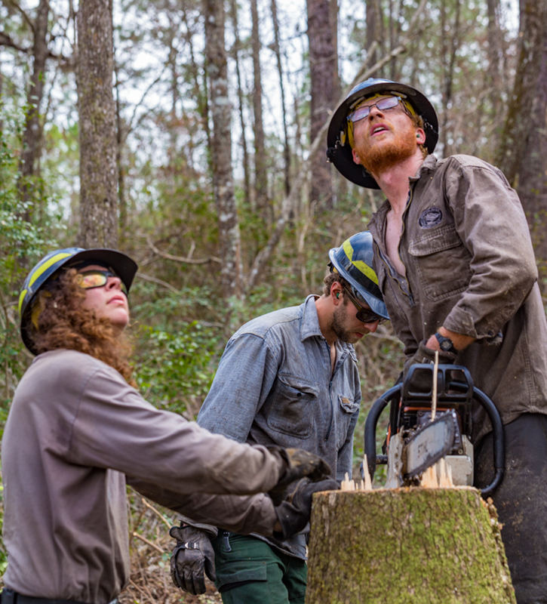
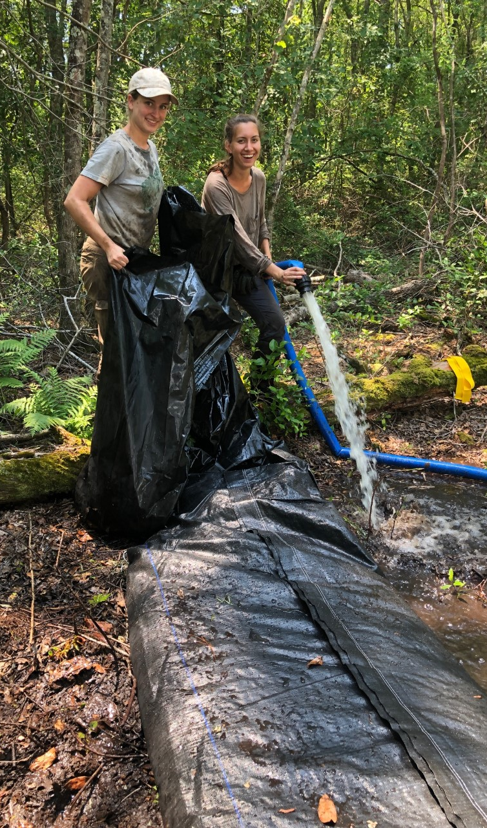
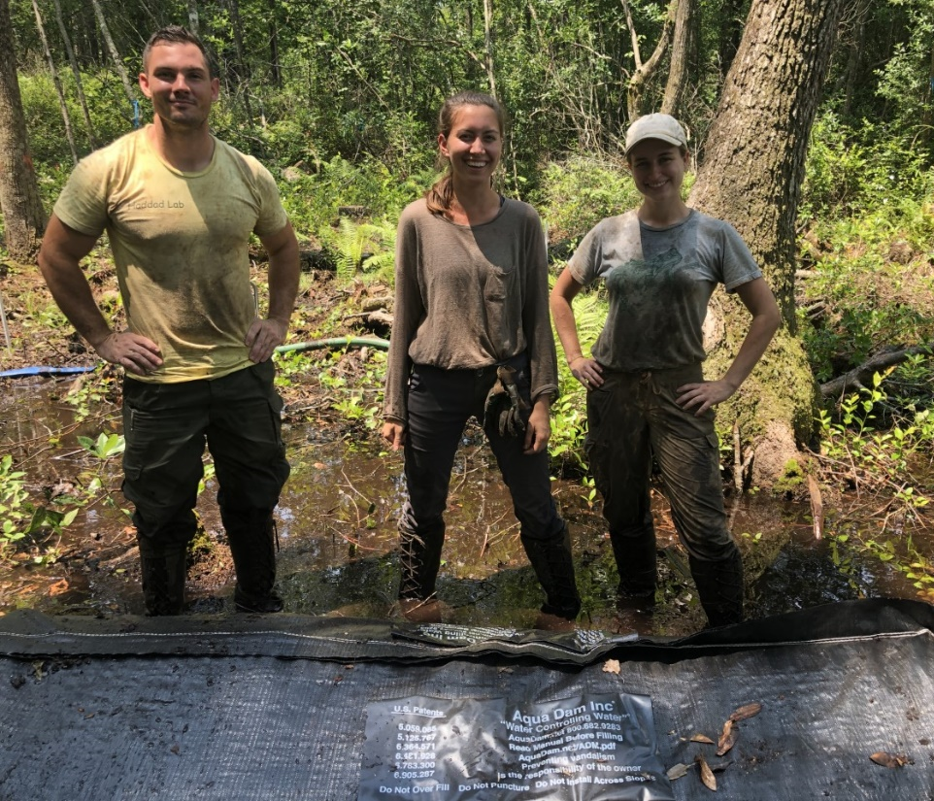
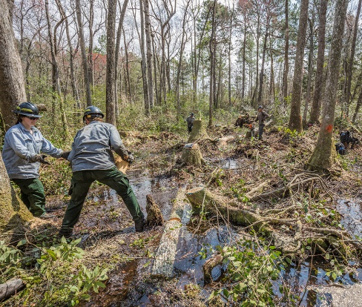
Habitat Restoration
Calloway Forest Preserve
Created 9 new 15m x 15m plots
Installed dams
Vegetation Poles and Surveys
Seeded Plots
Planted Sedges
Stream structure and vegetation composition may determine restoration success
Notes:
Formed a partnership with The Nature Conservancy to test our habitat restoration methods off-base. This is significant because it represents the first off-base attempt to create satyr habitat.

Slide 11
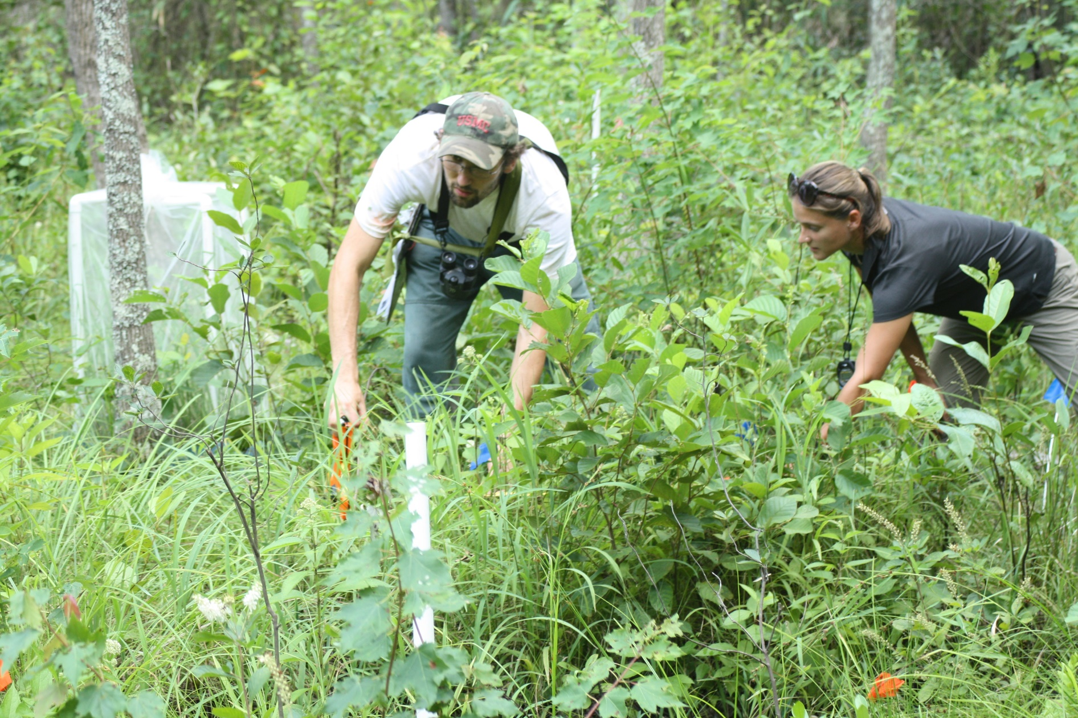
Monitoring Habitat Quality
Long-term monitoring from 2011-2021
Annual census of vegetation structure with focus on sedges
Assess sedge and butterfly response over time

Slide 12
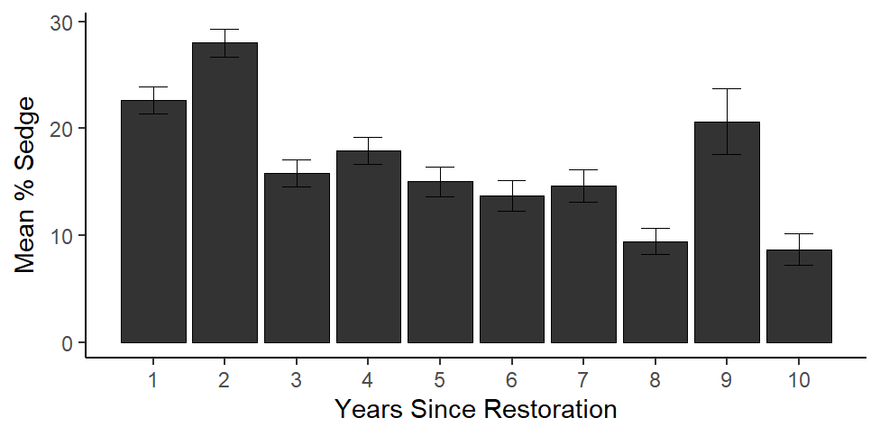
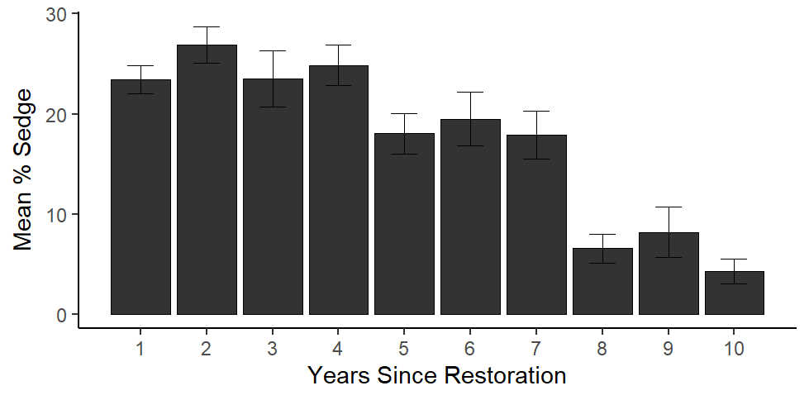
Site M
Site D

Slide 13
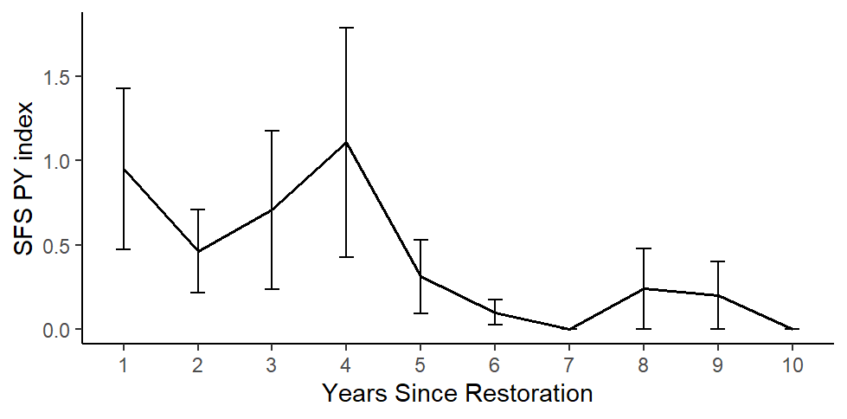
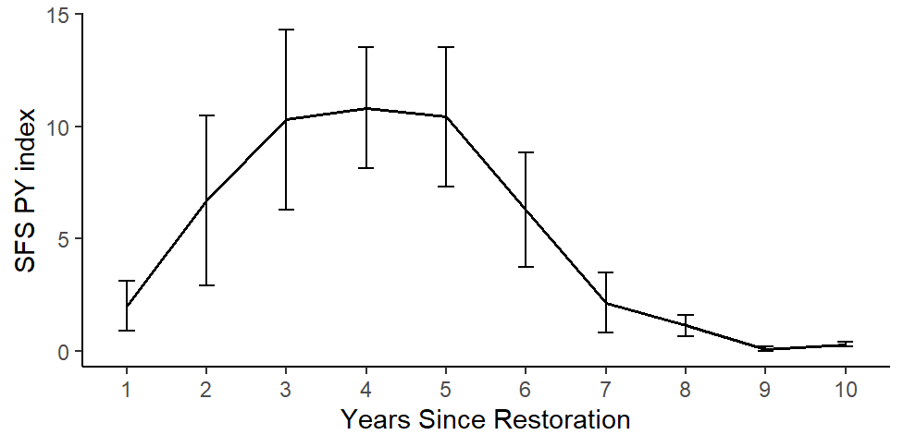
Site M
Site D

Slide 14
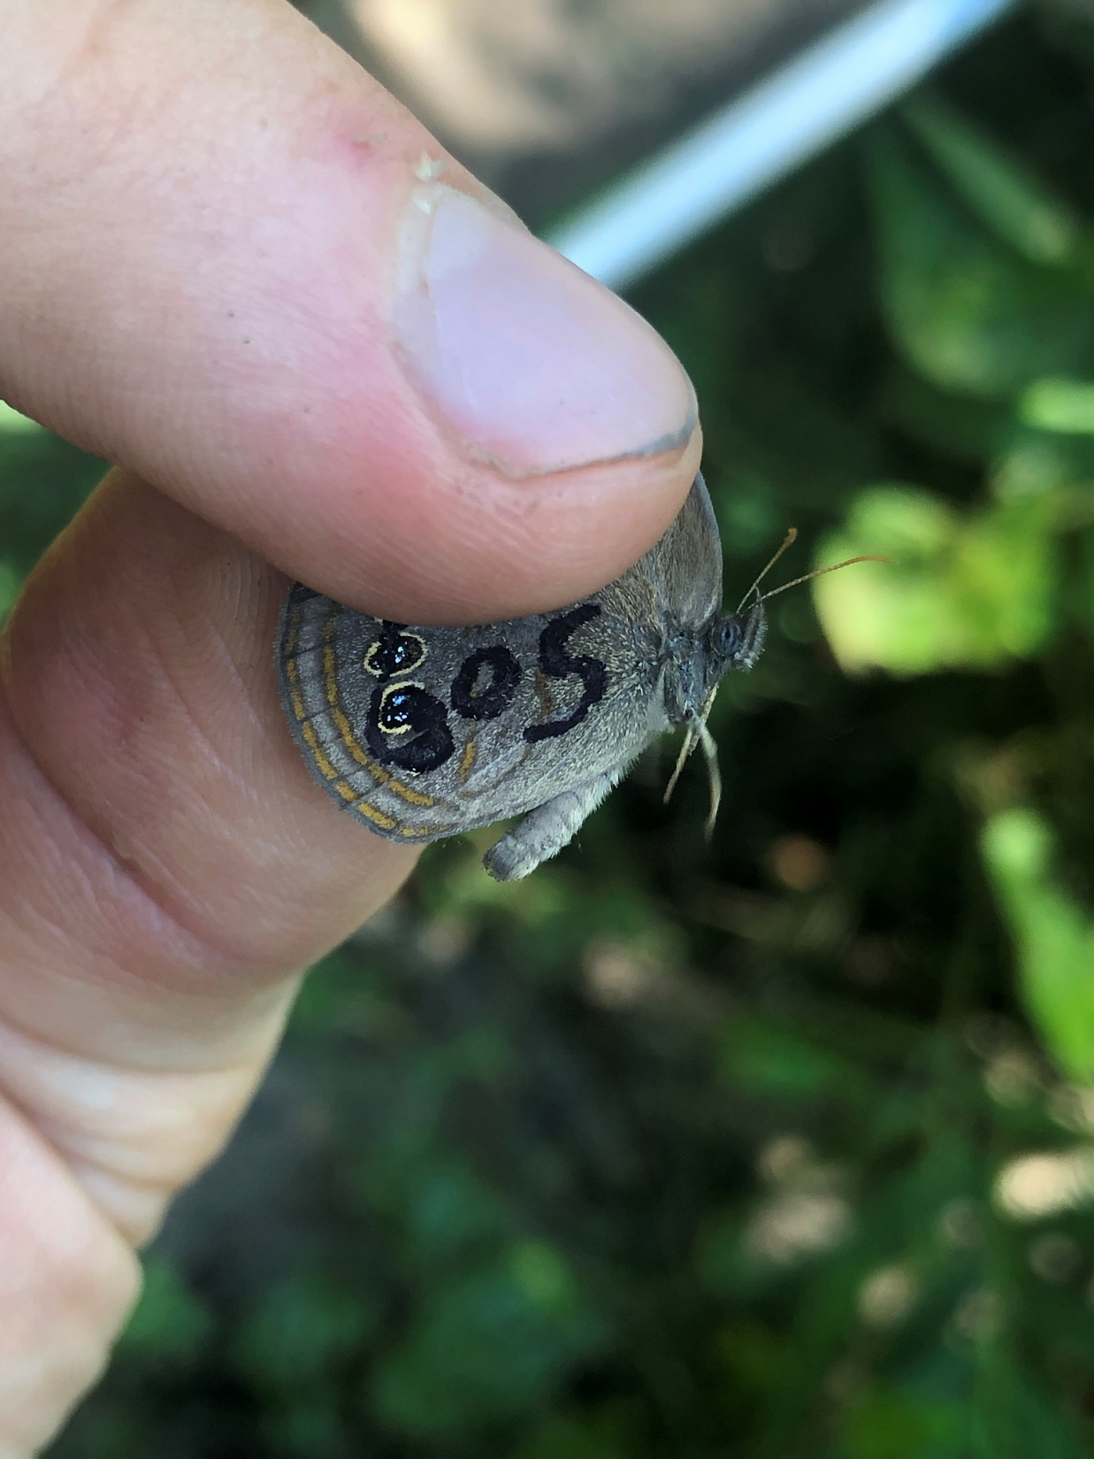
SFS Dispersal
Mark-Recapture Method
2018-2021
Plots divided into subplots
Determine daily survival, detection probability, and probability of dispersal
Limited ability to disperse long distances

Slide 15
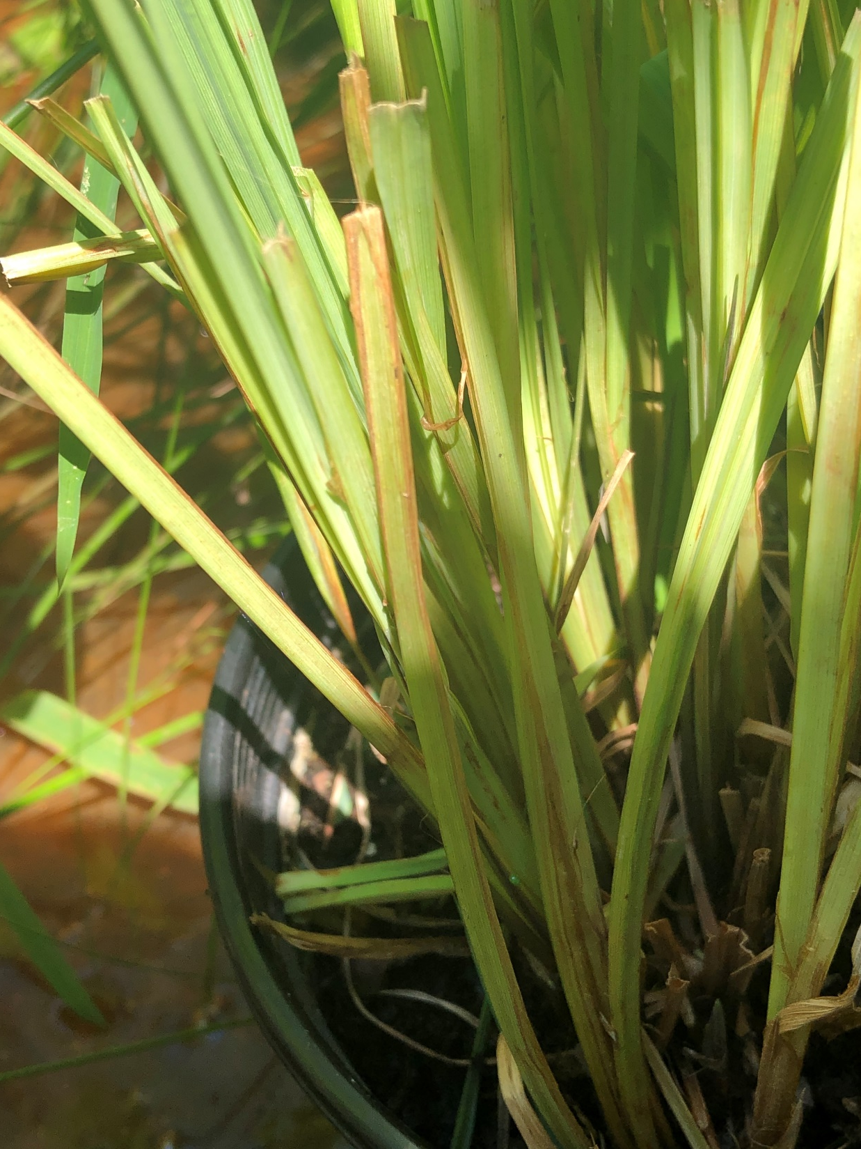
SFS Demography
Survival experiments eggs/larvae
2018 – 39 eggs in 8 experimental pots
2019 – 29 eggs in 5 pots, 51 eggs in 7 pots
Overall high egg survival in the wild
Daily egg survival 2019

Slide 16
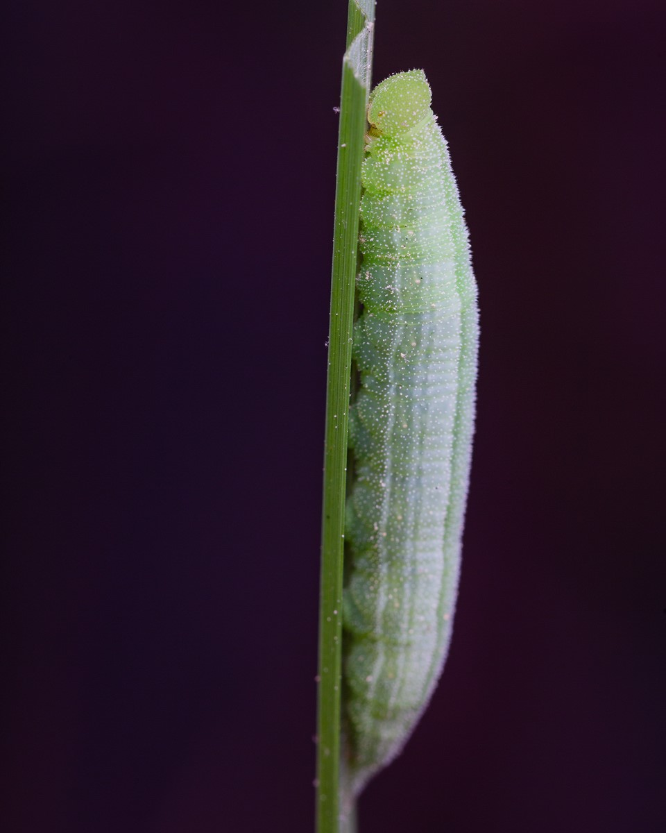
SFS Demography
2018 – 40 larvae in 8 experimental corrals (restored)
Between first and second flight period
9/40 survived (0.23)
2019 – 56 larvae in 8 experimental corrals (restored)
Deployed at the end of the second flight period
8/56 survived (0.14)
Survival rate much lower overwinter than between flight periods

Slide 17
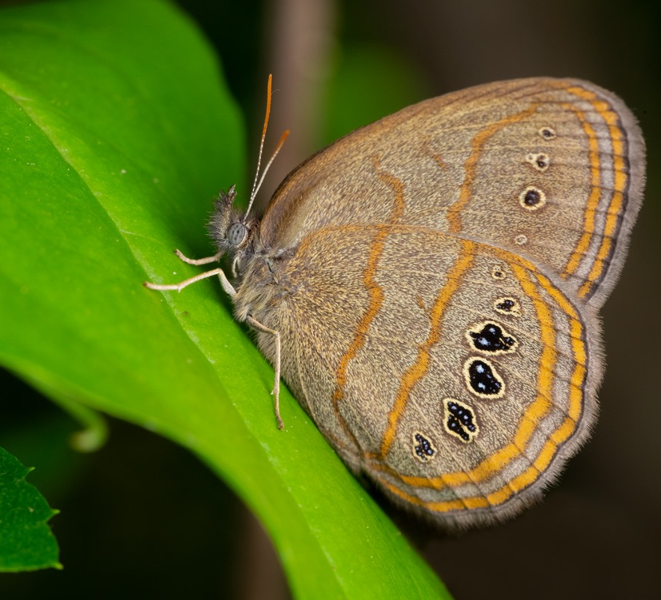
Summary
Accomplished SERDP Tasks
Working Partnership with TNC
Increased knowledge of SFS behavior and demography to inform management
Long-term vegetation analysis better informs adaptive management plans for successful restoration on and off base

