Slide 1
Monitoring Plan for Upland Depressional Wetlands in the Sandhills

Slide 2
Upland Depressional Wetlands
High richness of plant and amphibian species
Support amphibians unable to coexist with fish
Provide habitat for invertebrates, reptiles, mammals, and birds
NCSCP Monitoring Plan

Slide 3
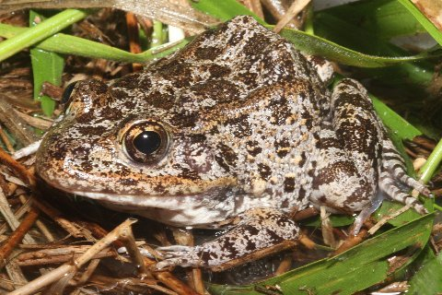
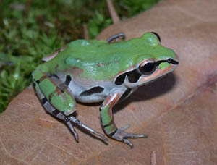
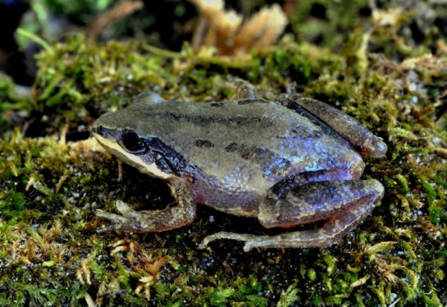
Importance of Monitoring Amphibians
Several species are declining in our region
Example: Gopher Frog
Declines across much of range
Candidate for listing under ESA
Serve as ‘umbrella’ species

Slide 4
Objectives of Plan
Inventory species of concern
Determine where species were currently and historically found
2. Develop amphibian monitoring protocols
Assess current efforts
Begin new ones if necessary
3. Assess habitat quality of inventoried wetlands
Establish ‘reference’ site for restoration using species’ presence/absence data
Identify wetlands in need of work
4. Identify key wetlands to maintain/re-establish network connectivity
Prioritize wetlands for restoration efforts
Consider creating new wetlands
Identify overland barriers to dispersal
Determine whether upland restoration and/or land protection needed

Slide 5
1. Inventory
7 amphibian, 11 plant, and 1 turtle species
Data Sources
North Carolina Natural Heritage Data
Museum records from the Global Biodiversity Information Facility
Records from members of the NCSCP Wetland Committee
Carolina Herp Atlas
Herpetological Education & Research Project
HerpMapper

Slide 6
Wetlands with Conservation Targets

Slide 7
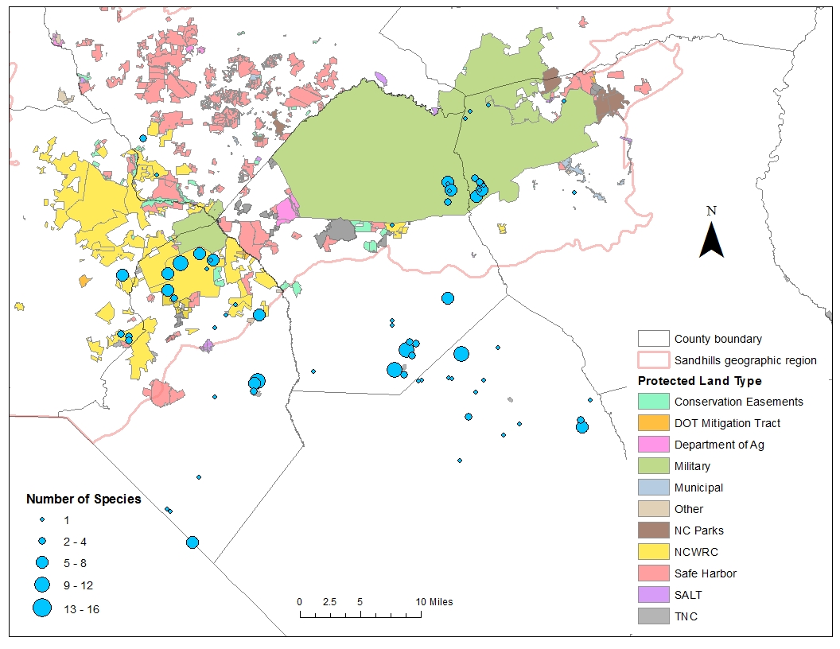
Wetlands with Conservation Targets (since ‘96)

Slide 8
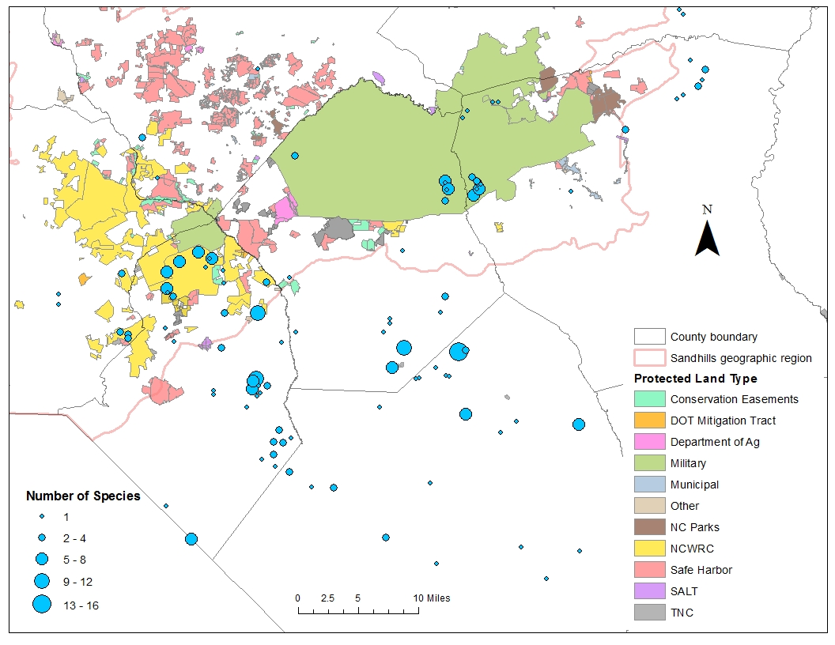
Amphibians

Slide 9
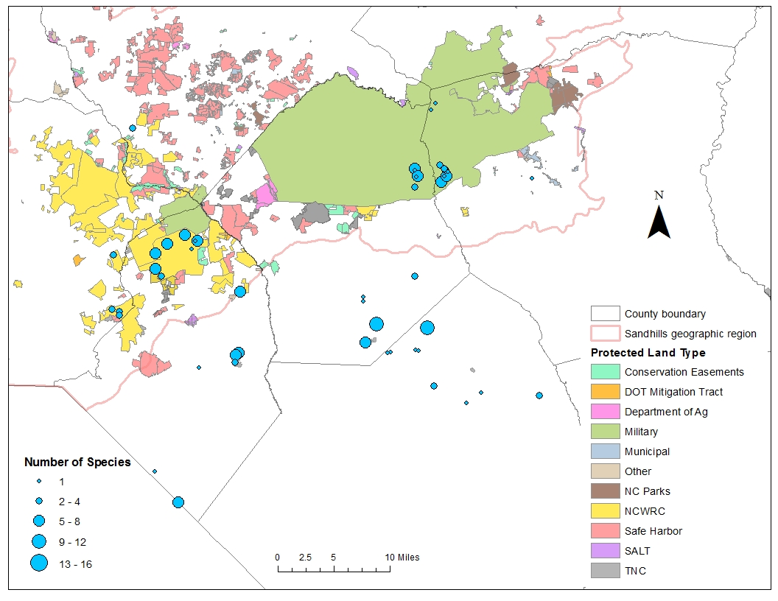
Amphibians (since ‘96)

Slide 10
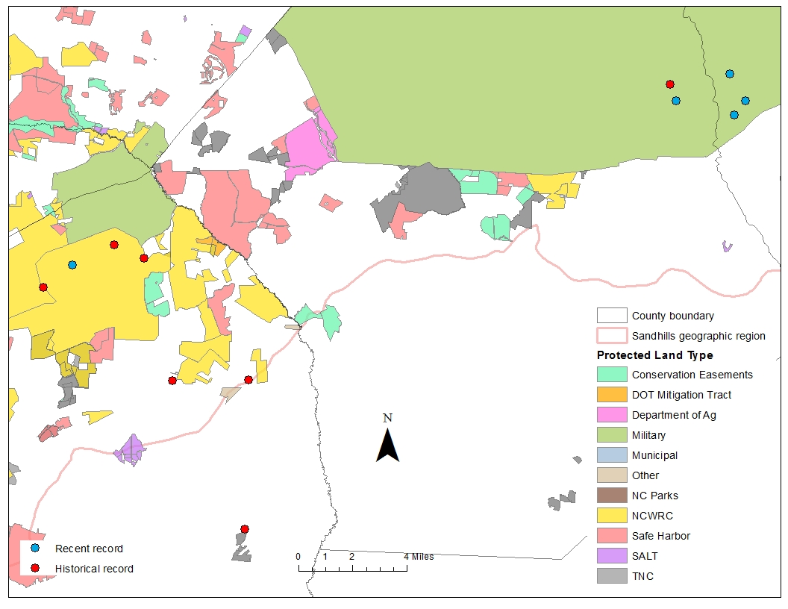
Gopher Frog

Slide 11
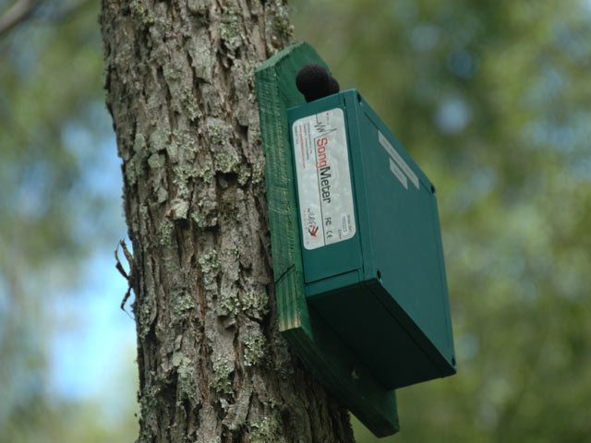
2. Monitoring
State monitors amphibians on Game Lands
Fort Bragg and clay-based bays
Place autonomic recording devices (Frogloggers) into key wetlands this winter
Potentially expand monitoring to spring/summer

Slide 12
3. Habitat Quality Assessment
Assess wetland and upland habitats
Visit Sandhills wetlands during Feb/Mar 2016
If time, expand to clay-based bays

Slide 13
Habitat Quality Assessment: Sandhills Wetland
Physical – size, slope, water depth, and PH
Pool vegetation – emergent and submerged
Midstory and shrub cover
Overstory – pine and hardwood cover

Slide 14
Habitat Quality Assessment: Sandhills Upland
N
150 m
W
300 m
S

Slide 15
Habitat Quality Assessment: Sandhills Upland
Overstory – longleaf and hardwood DBH
Mid-story and shrub cover
Ground cover – herbaceous; native pyrophytic grasses

Slide 16
‘Reference’ Wetlands
Build statistical models for tiger salamanders and gopher frogs
Determine difference in habitat features between presence and absence locations
This may be expanded for additional species (i.e., ornate and southern chorus frogs)
Used to identify restoration needs at historical or potential sites
Notes:
I may need to visit some additional sites where there are no records of species of concern in order to get enough absence locations to create the model.

Slide 17
4 & 5. Connectivity for Amphibians
Network centrality and dispersal barriers
Methods
Maximum dispersal distances: 11km for frogs and 8km for salamanders (Smith & Green 2005)
Resistance layer: USGS GAP Landcover data
Created for ‘recent’ (since 1996) records

Slide 18
Gopher Frog

Slide 19
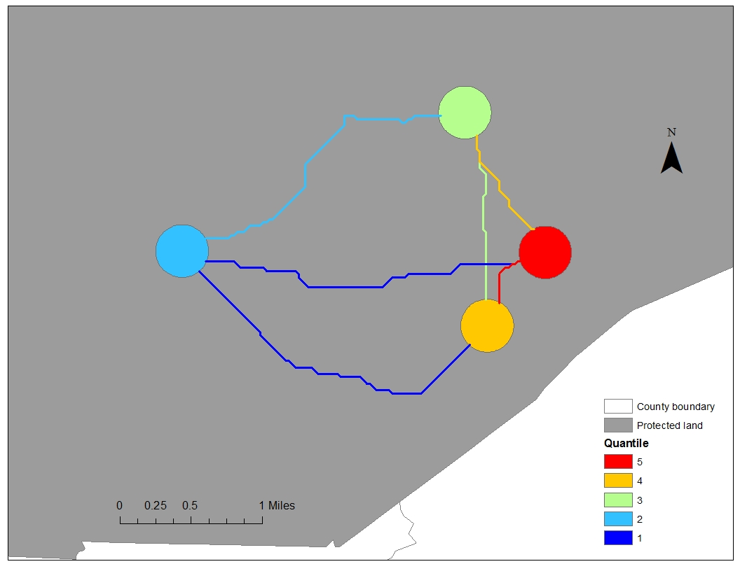
Network – Gopher Frog

Slide 20
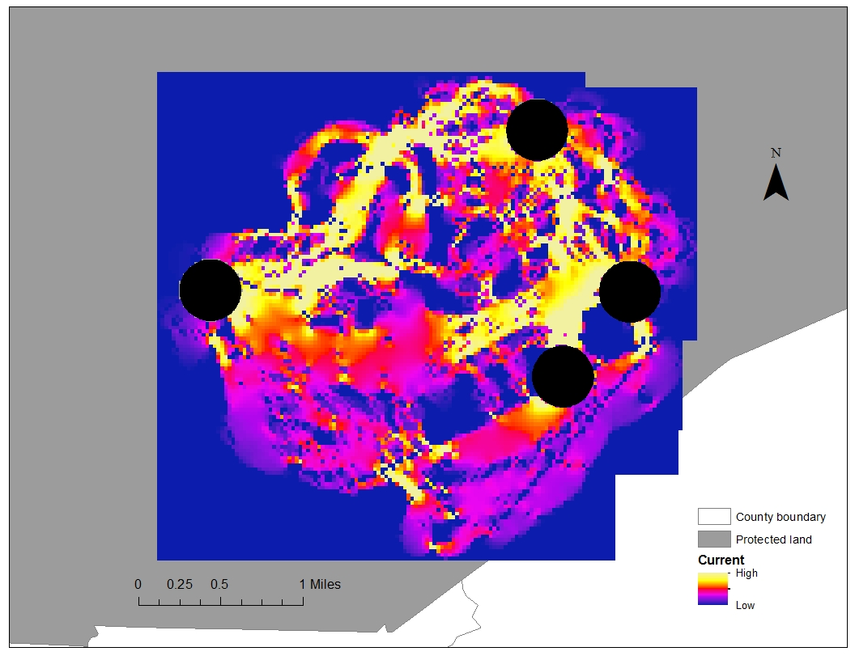
Dispersal – Gopher Frog

Slide 21
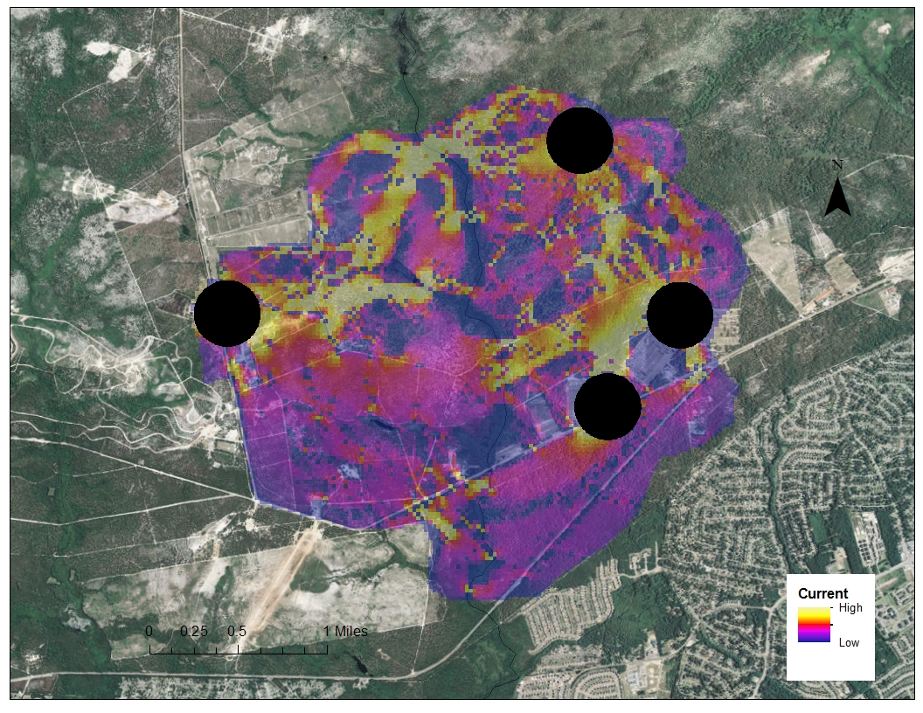
Dispersal – Gopher Frog

Slide 22
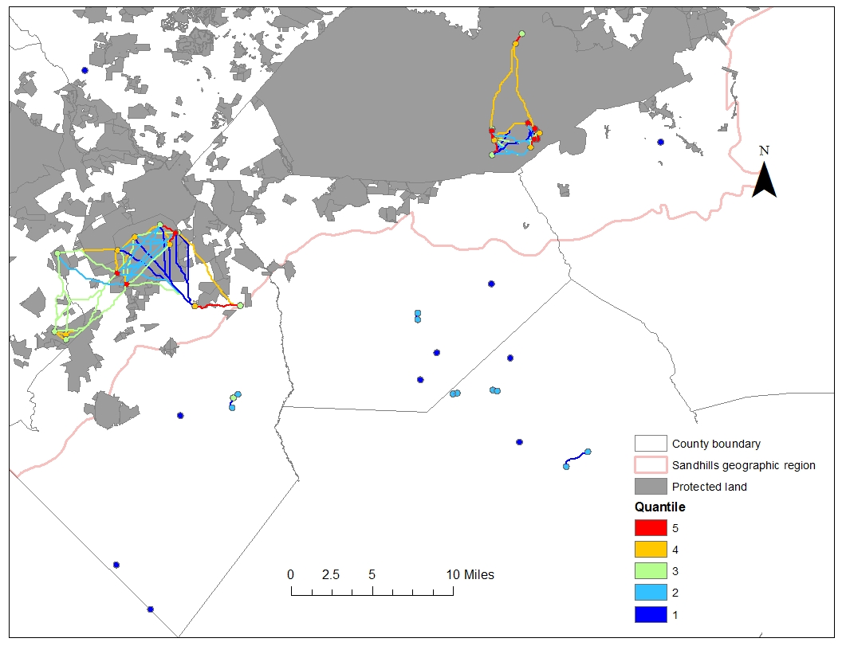
Network - Amphibians

Slide 23
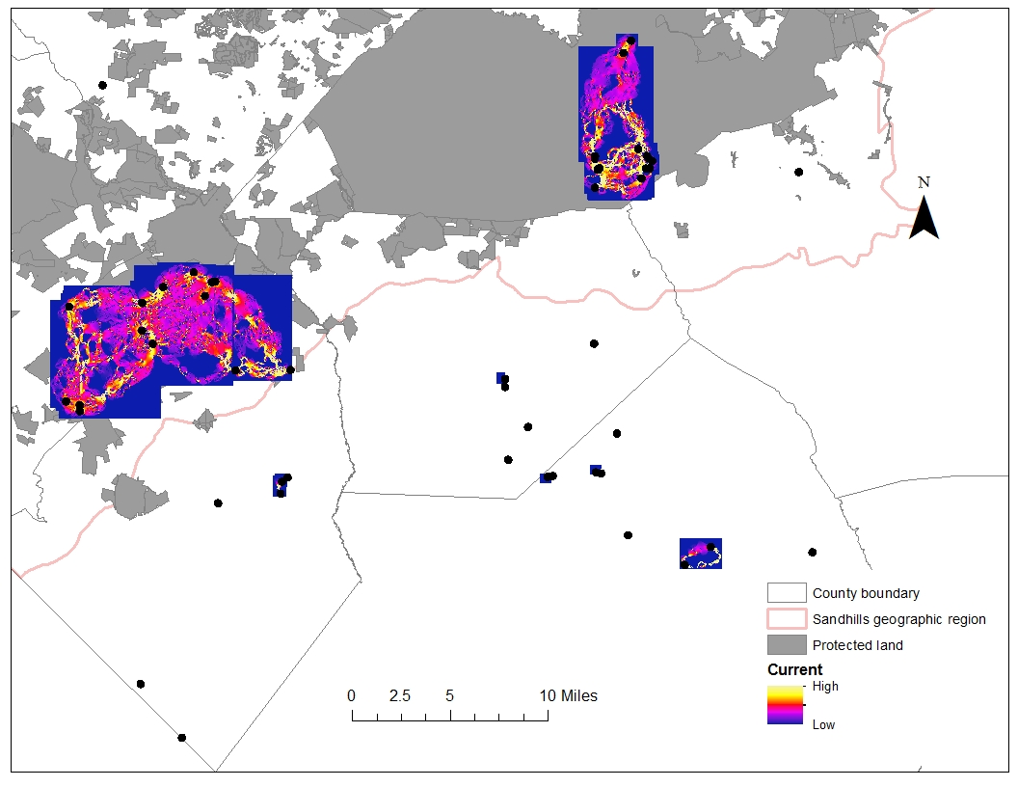
Dispersal – Amphibians

Slide 24
Outcomes/Deliverables
Identify wetlands for restoration
Wetland habitat assessment using ‘reference’ sites
Historical occurrence
Network centrality analysis
Identify uplands for restoration/protection
Upland habitat assessment using ‘reference’ sites
Dispersal barrier analysis
Measure success: Monitoring
Track changes as restoration continues

Slide 25
Acknowledgements
Bruce Sorrie Jeff Marcus
Brian Ball Susan Miller
Jeff Humphries
Jeff Beane
Nate Shepard

