Slide 1
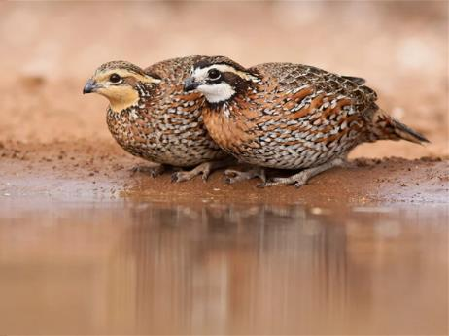
Northern Bobwhite
Hannah Plumpton
Upland Game Bird Biologist
North Carolina Wildlife Resources Commission

Slide 2
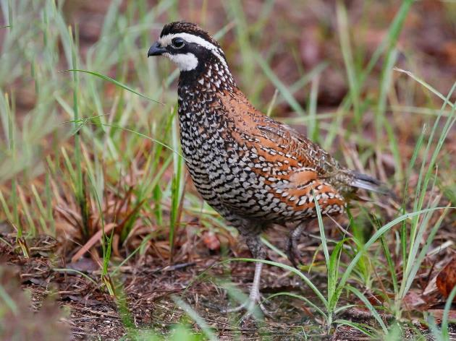
Bobwhite Quail
Upland Game Bird
Populations may change 50% annually
Annual nesting success – 25%-75%
Annual Survival – 20%
High reproductive capacity
Large clutches
Multiple nesting attempts
Potential for high population growth
© Tom Mast | Macaulay Library

Slide 3
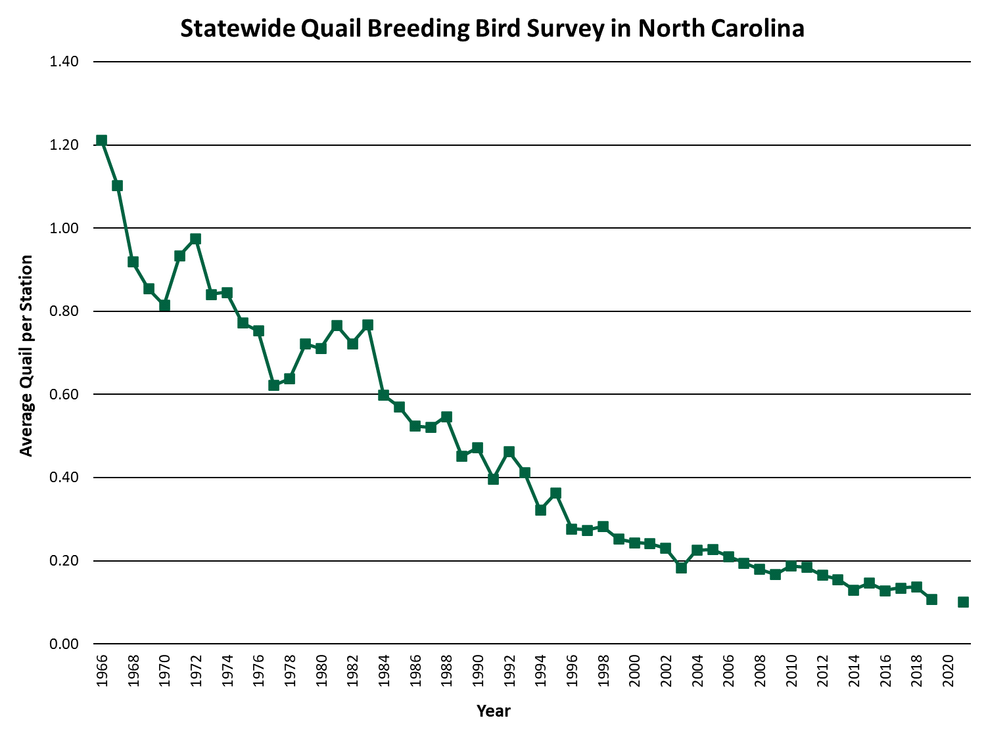

Slide 4
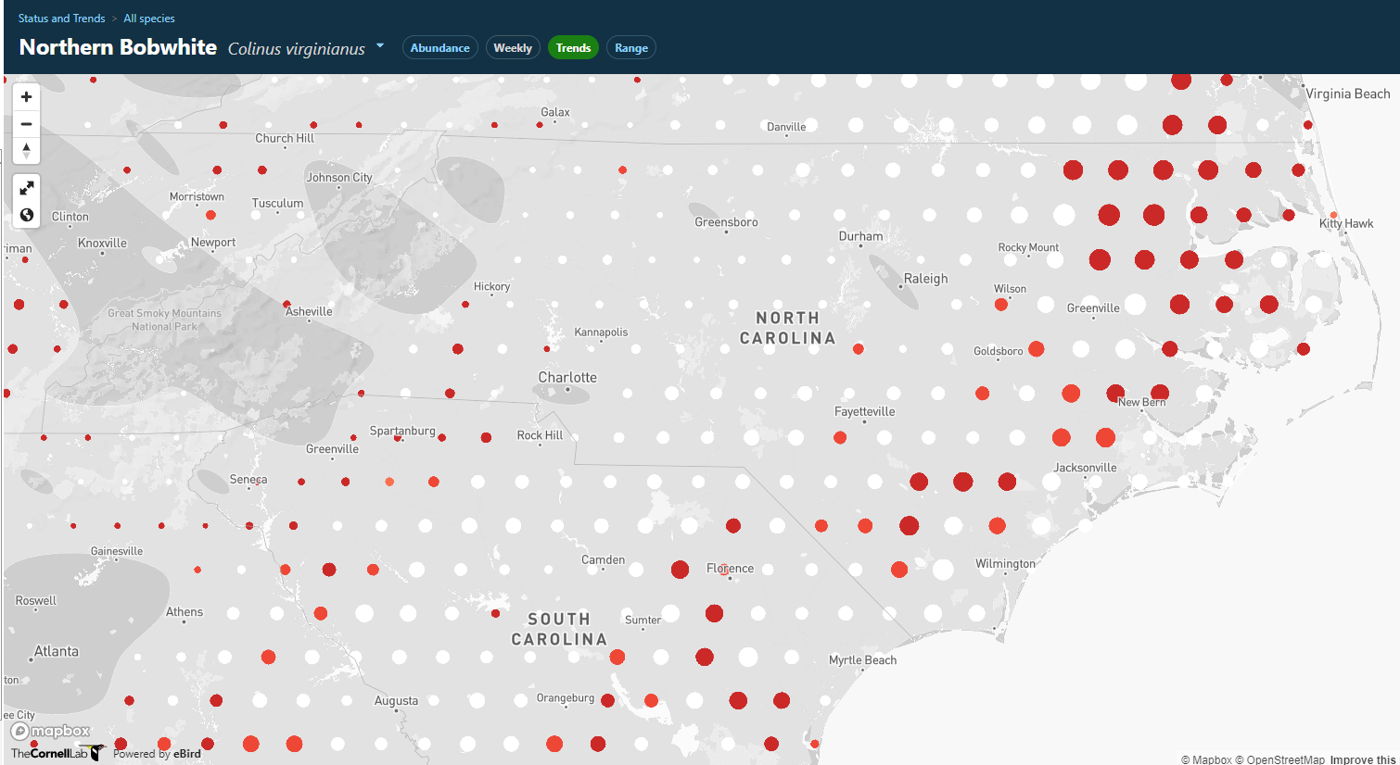
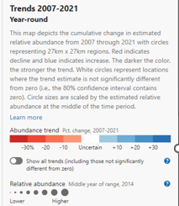

Slide 5
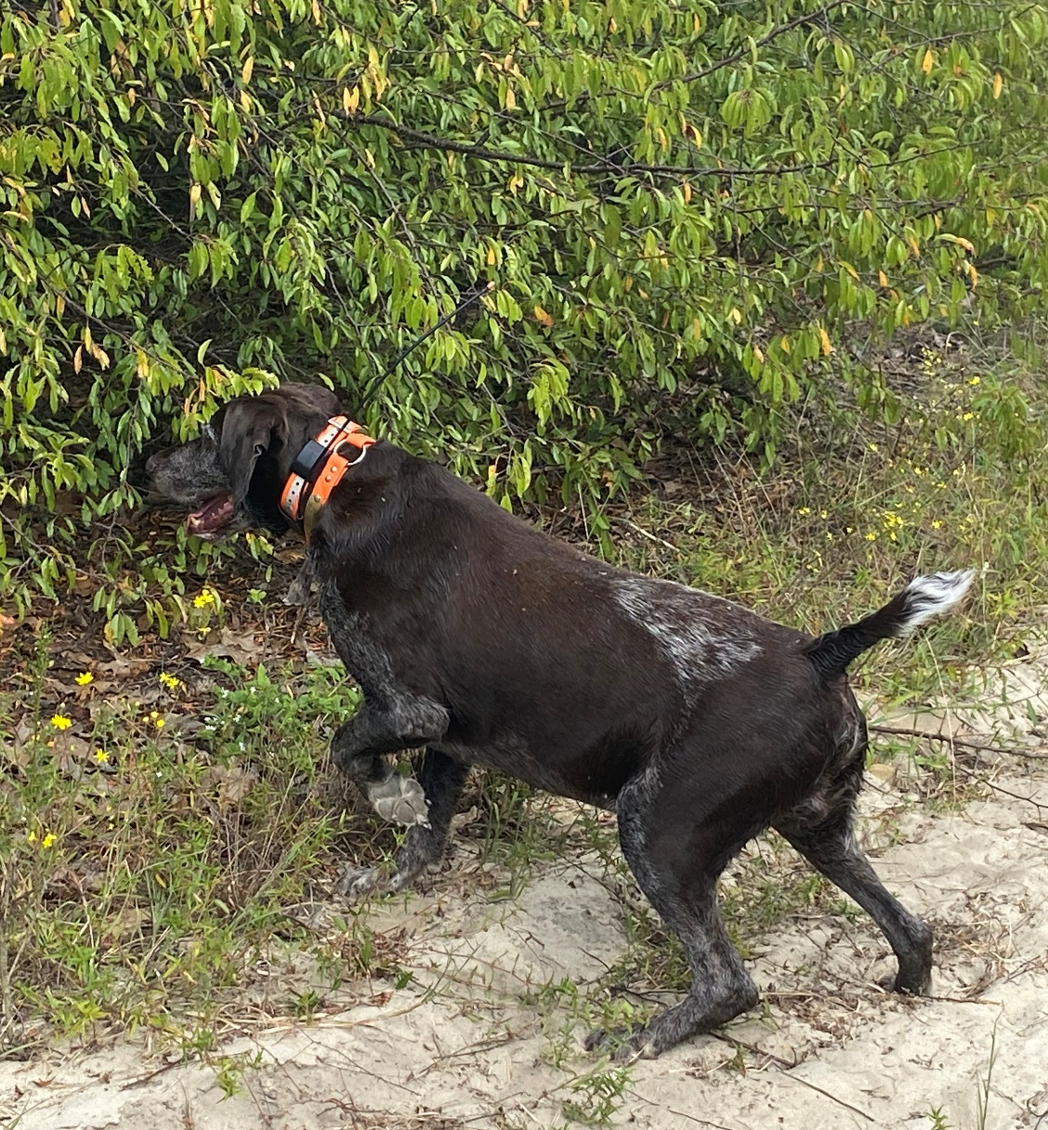
Bobwhite Quail
85% overall decline range wide
1966 to 2014 BBS data
NC Species of Greatest Conservation Need
Valuable game species
NC 2022-23
Estimated 6,164 hunters
Estimated 21,673 birds harvested

Slide 6
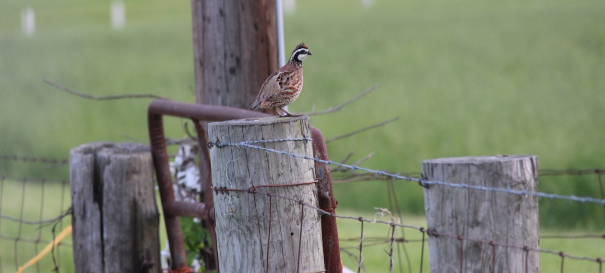
Current Challenges
Prefer grassland/rangelands
Areas with bare ground
Lots of forbs (broad leaf plants)
Shrubs for cover
Can be found in open woodlands, pine savannahs, agricultural areas

Slide 7
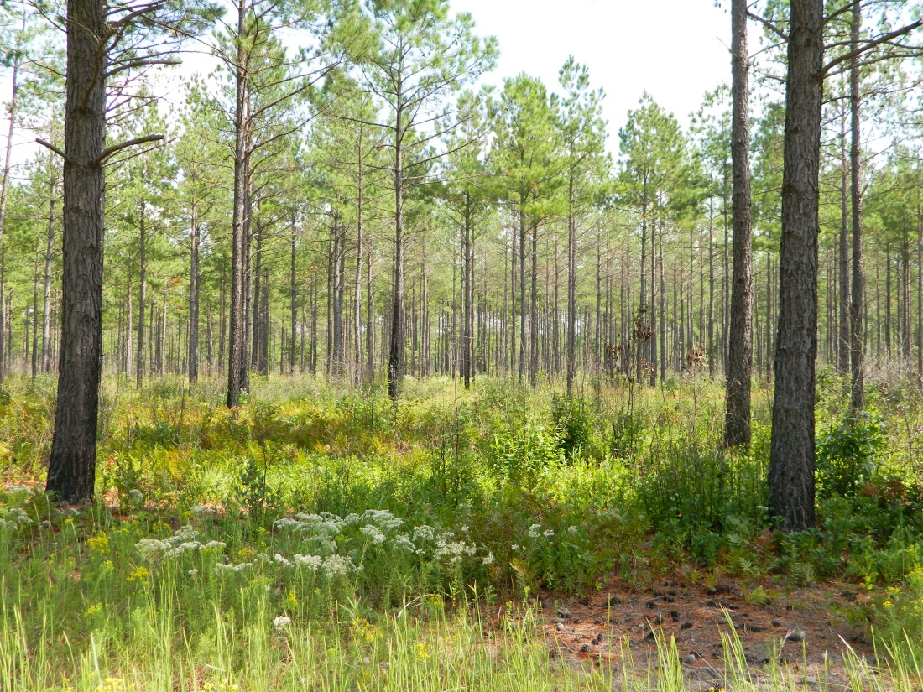
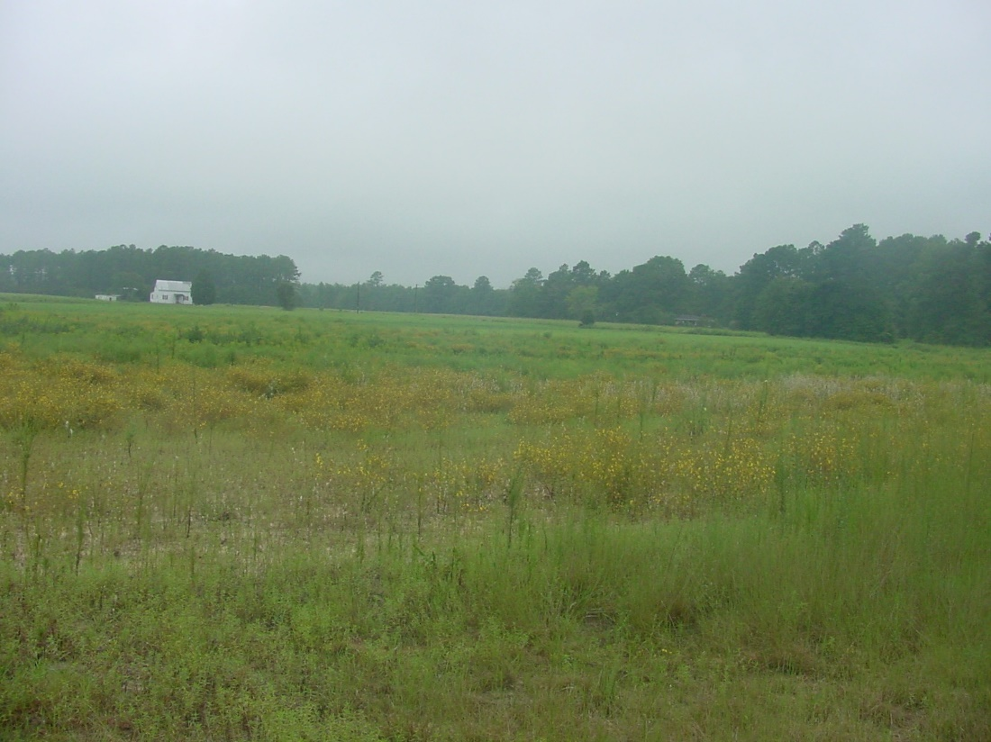
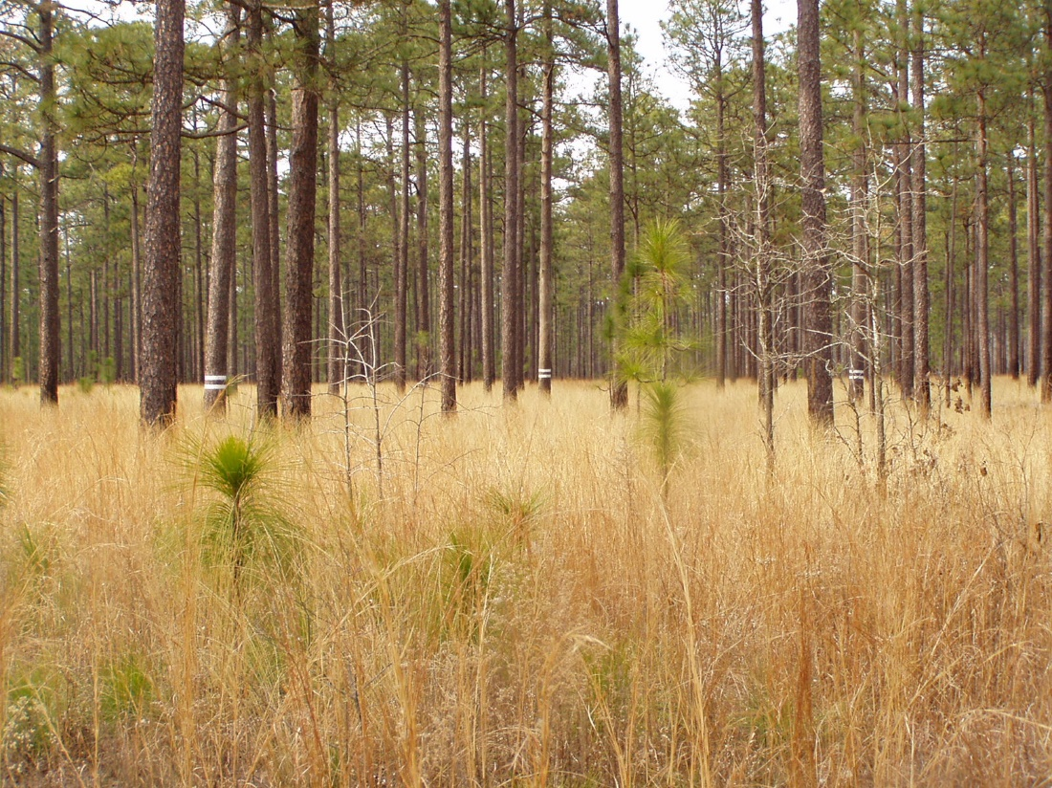
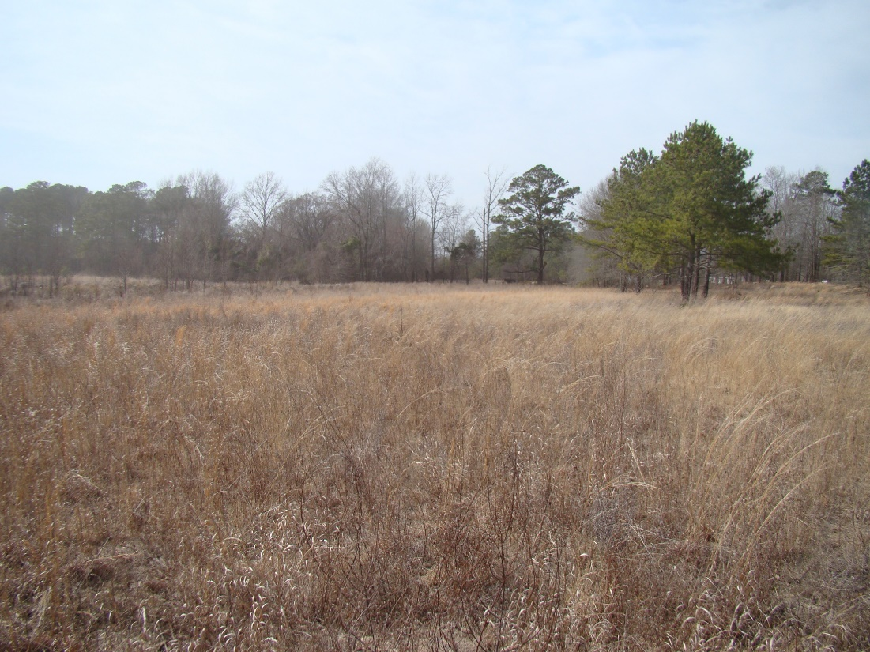

Slide 8
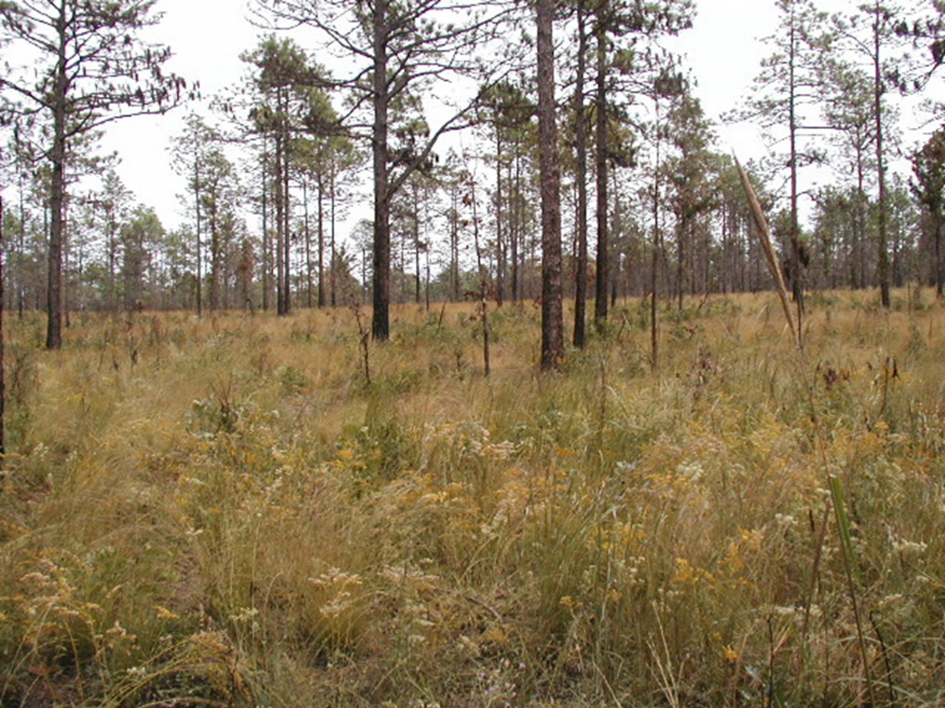
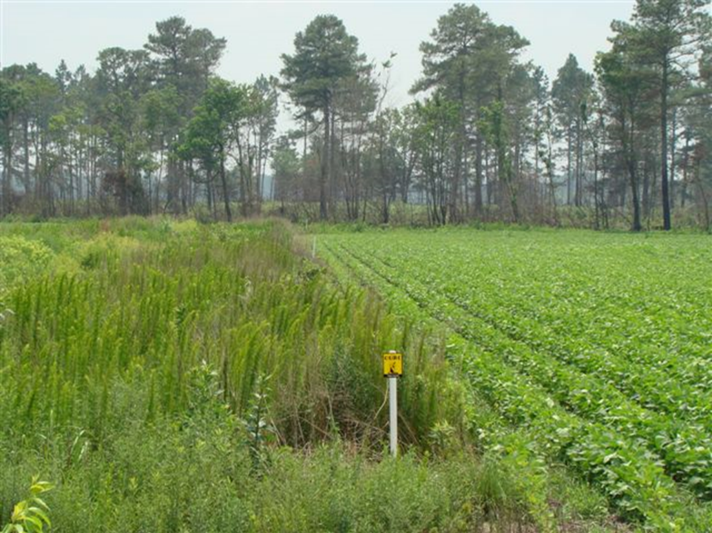
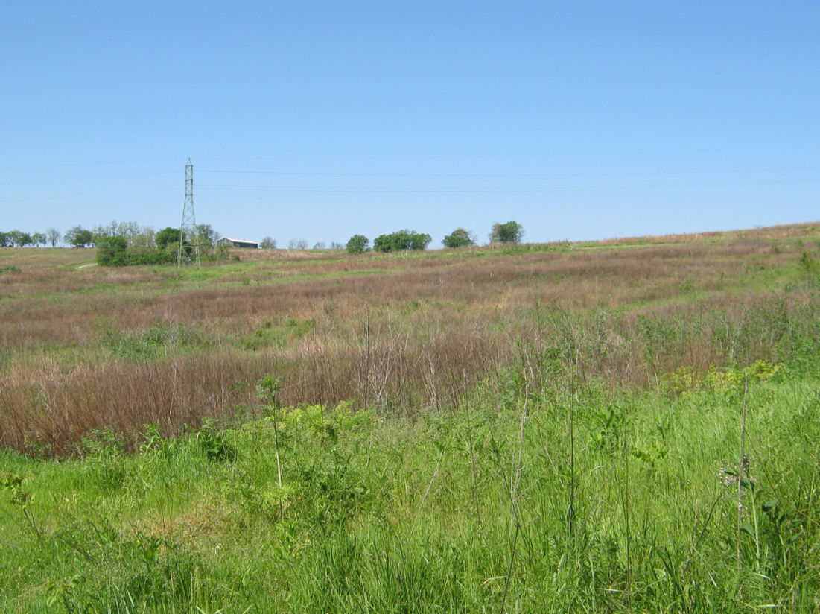
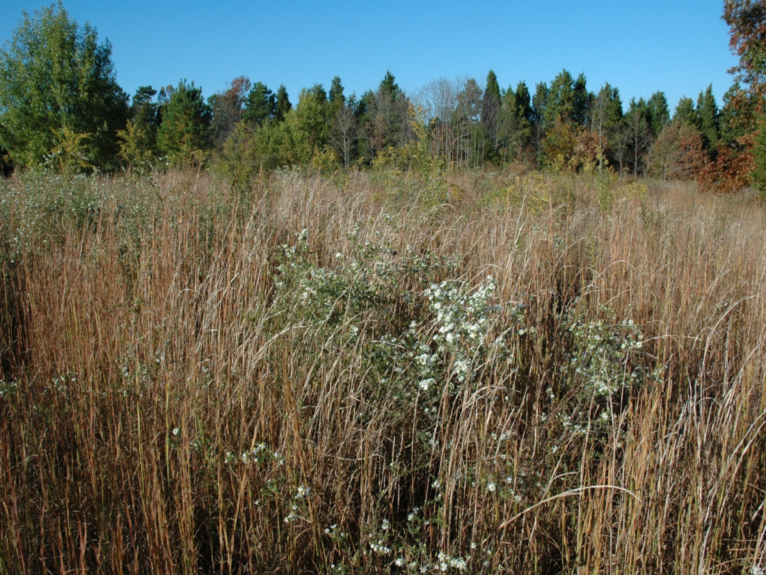

Slide 9
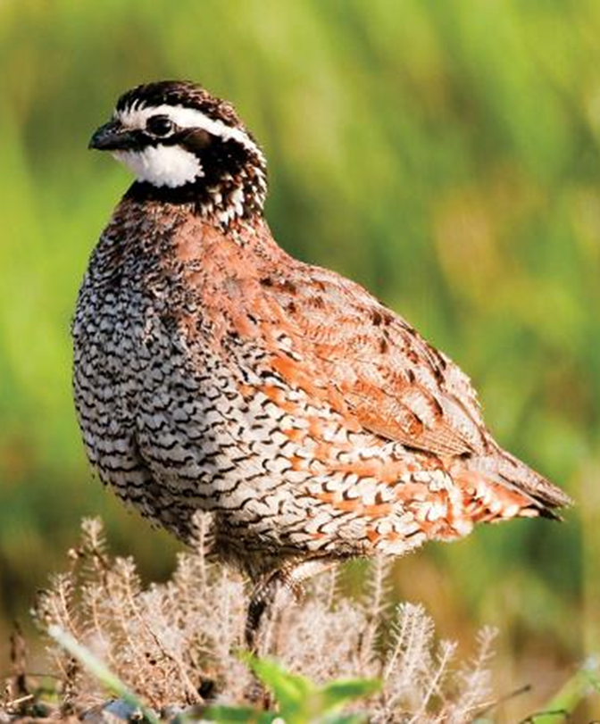
Current Challenges
Urban/suburban sprawl
Decline in grasslands
Sod forming grasses
Changing forestry
High basal area
Little understory
Intensification of agriculture
Maximizing production
Removal of fencerows
Mowing ditches
Increase use of pesticides

Slide 10
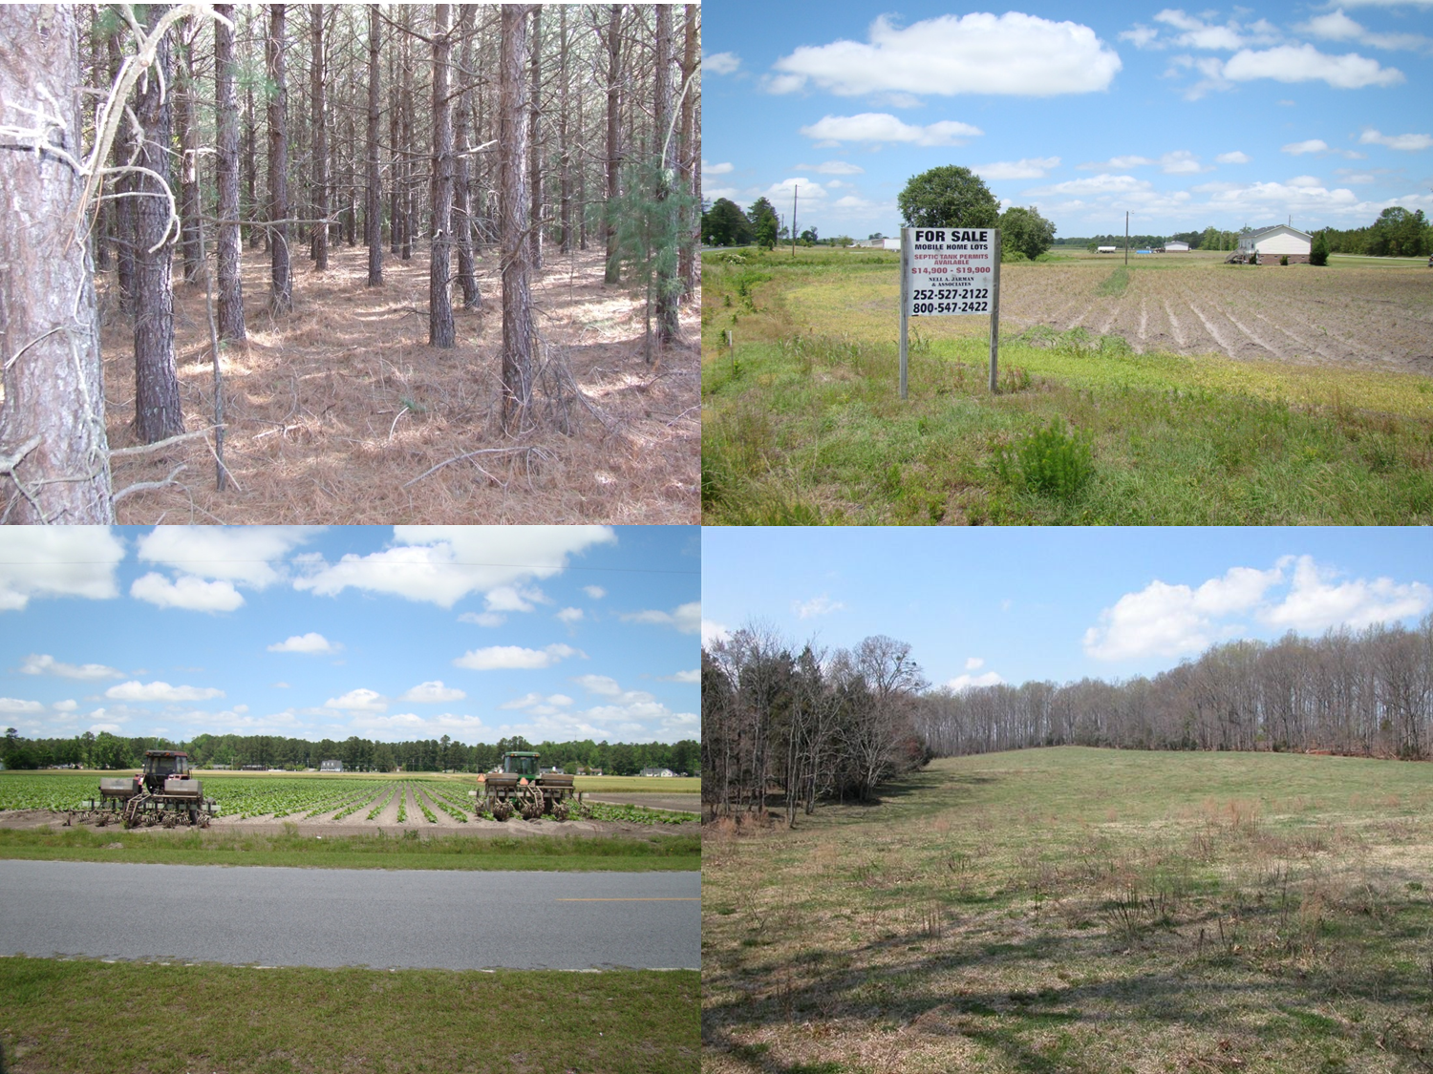

Slide 11
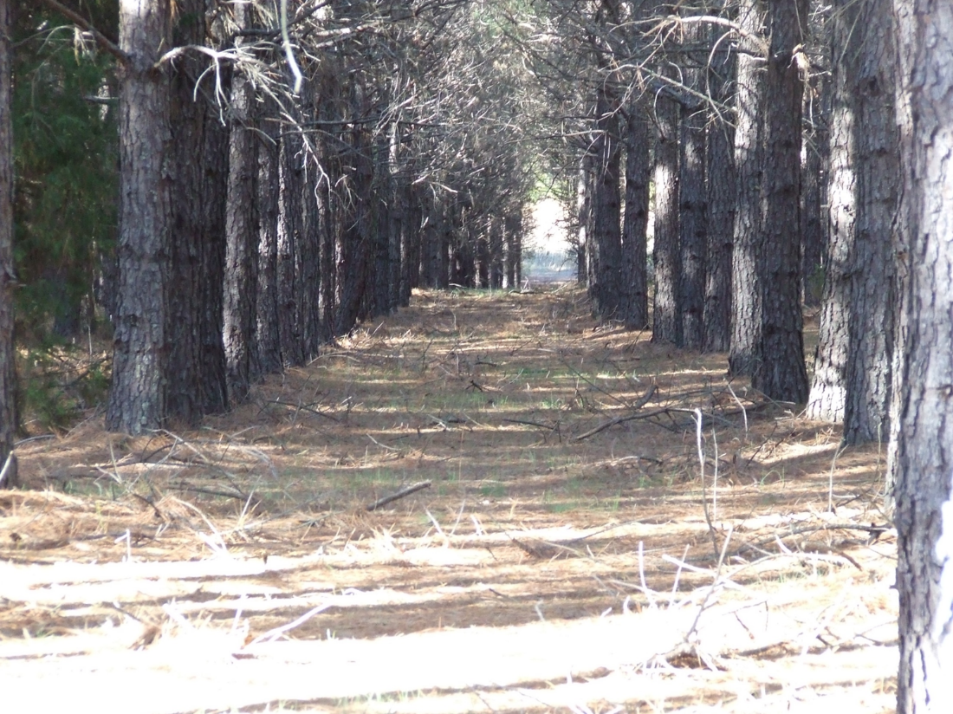
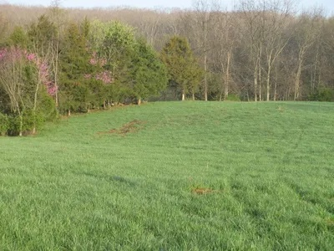
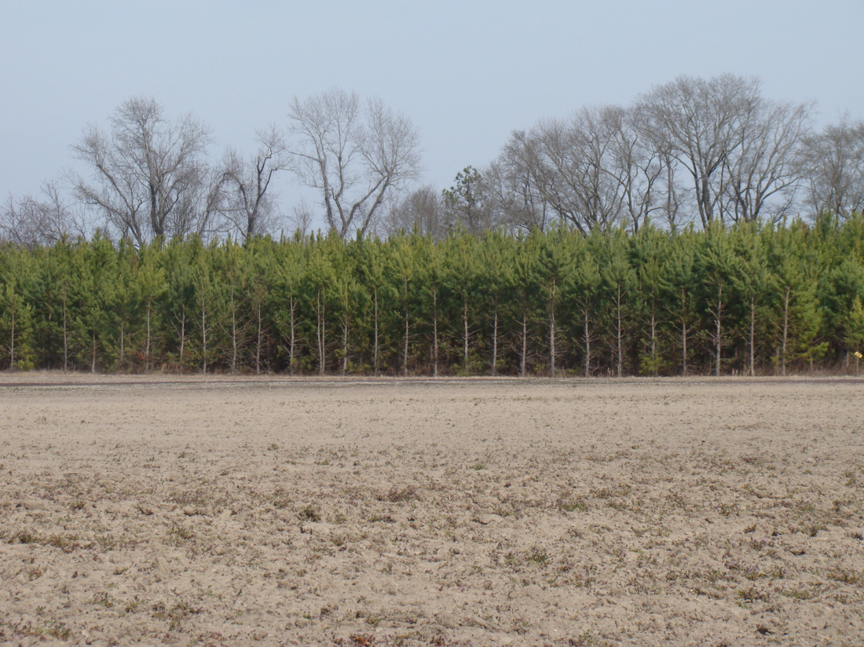
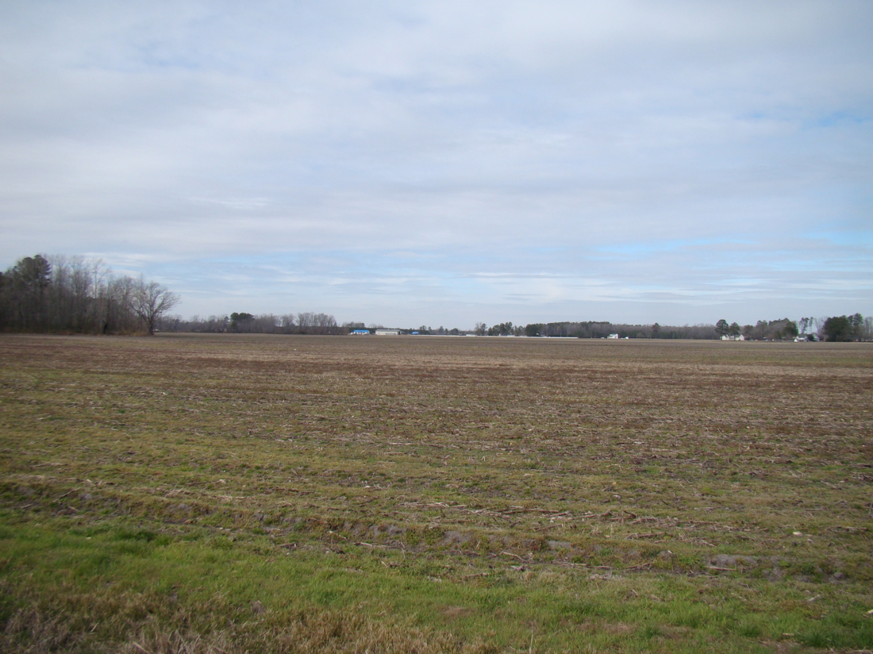

Slide 12
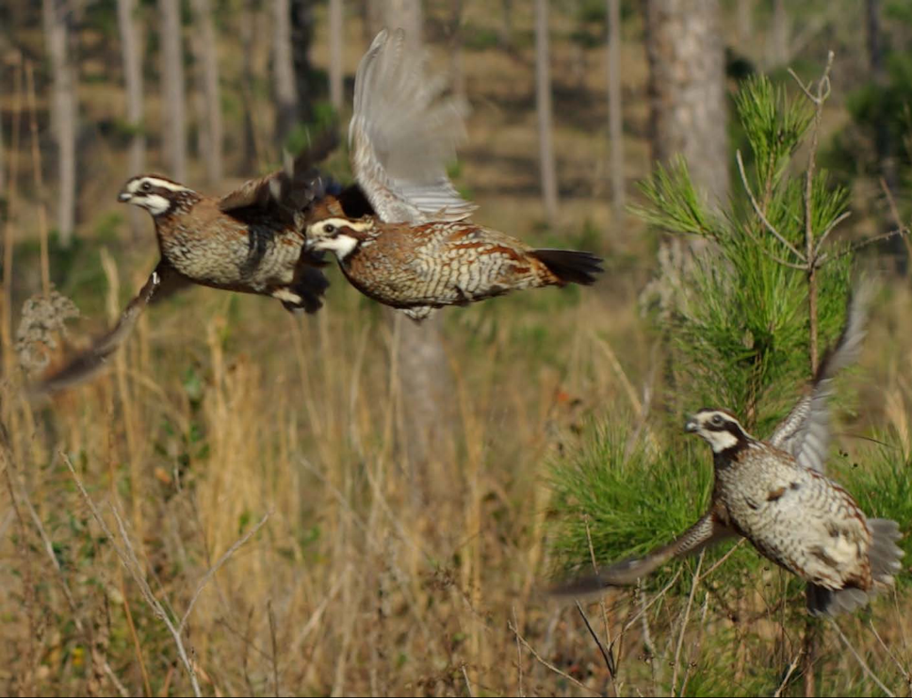
Current Challenges
Perception vs reality
Perceived good habitat
Pastures
Hard to maintain quality habitat
Long growing seasons
Need lots of disturbance
Labor intensive
Expensive
Need to stay on top of it

Slide 13
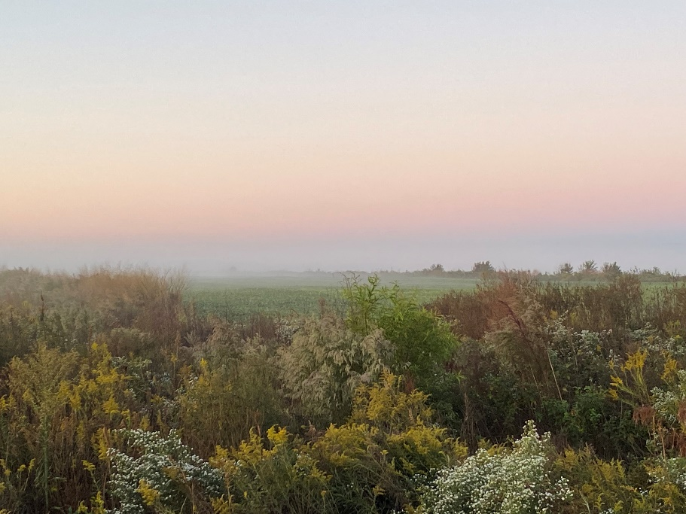
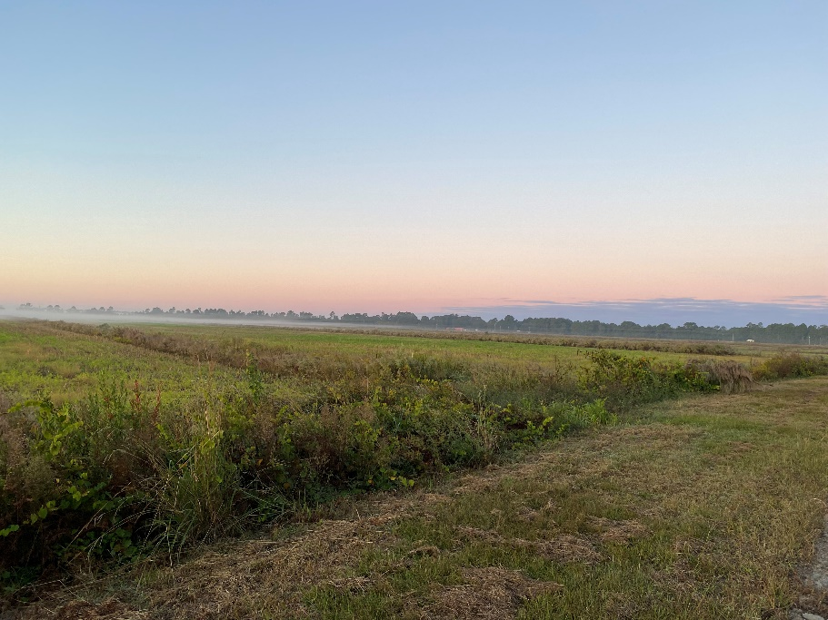
Habitat Practices
Fallow weedy areas
Establishment of native grasses
Warm season bunch grasses
Field boarders
Forest Management
Thinning
Installation of forest openings
Controlled Burning

Slide 14
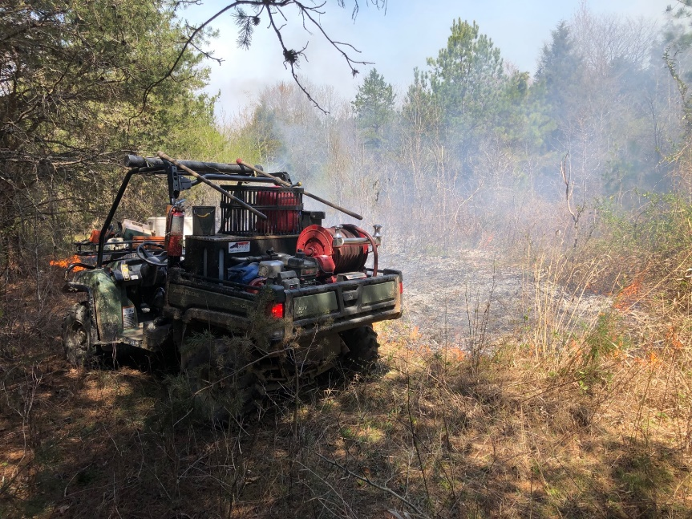
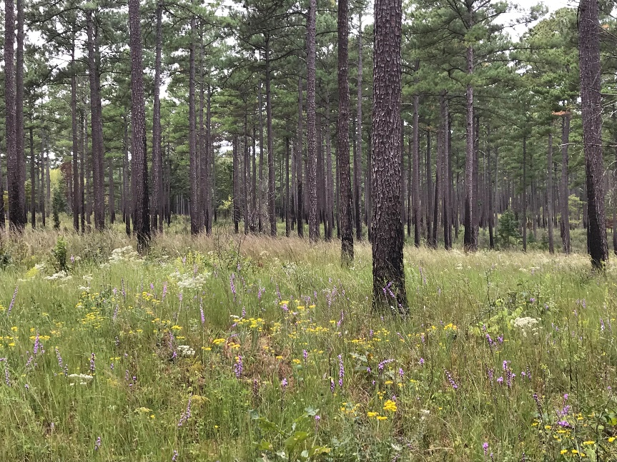
Biggest Limitations
Public Land
Not enough staff
Lots of okay habitat
Little great habitat
Caswell Small Game Focal Area
Private Lands
Don’t know how to do the work
Unable to find contractors
Small acre property

Slide 15
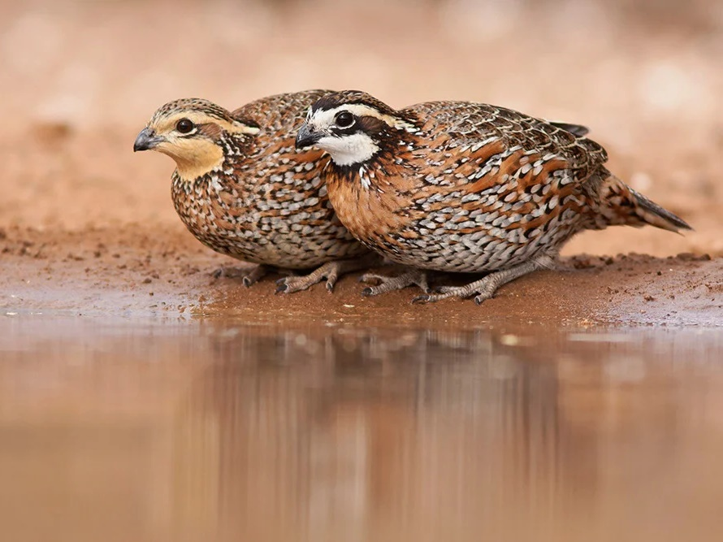
Conclusion
Hannah Plumpton
Upland Game Bird Biologist
hannah.plumpton@ncwildlife.org

