Slide 1
Spatial Analysis of Longleaf Pine Ecosystems in North Carolina
The Nature Conservancy

Slide 2
Objectives
Map the current extent of longleaf pine in North Carolina
Create and define categories of resilience and apply to identified longleaf blocks
Identify the optimal location of corridors to connect habitat blocks

Slide 3
Mapping Blocks of Longleaf Pine
Blocks delineated from the North Carolina Natural Heritage Program data
Mapped all longleaf pine-associated species, natural communities, and habitats
Habitat not contiguous if separated by more than 2km or a fragmenting feature (major road or water body)
Not all blocks protected

Slide 4
Longleaf Pine Habitat Blocks

Slide 5
Evaluating Resilience
Resilience - ability of an ecosystem to adapt or recover from large-scale disturbance or change
Categorization based on size and adjacency to other blocks
Category | Criteria
Resilient Habitat Cores | > 25,000 acres
Core Enhancement Areas | < 25,000 acres and > 10,000 acres or > 5,000 acres and adjacent to Cores
Non-Resilient Habitat | < 5,000 acres

Slide 6
Longleaf Pine Habitat Blocks Categorized by Resilience

Slide 7
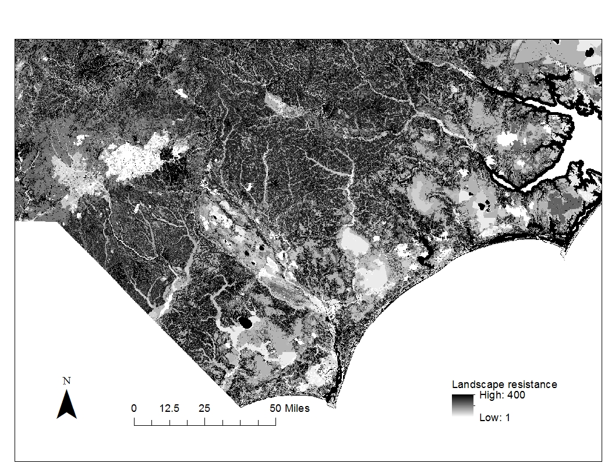
Identify Potential Corridors
Linkage Mapper to delineate least cost distance corridors between resilient and enhancement blocks
Resistance raster derived from
Soil suitability for longleaf/loblolly pine
Biodiversity/wildlife assessment
USGS landcover
Non-resilient habitat blocks

Slide 8
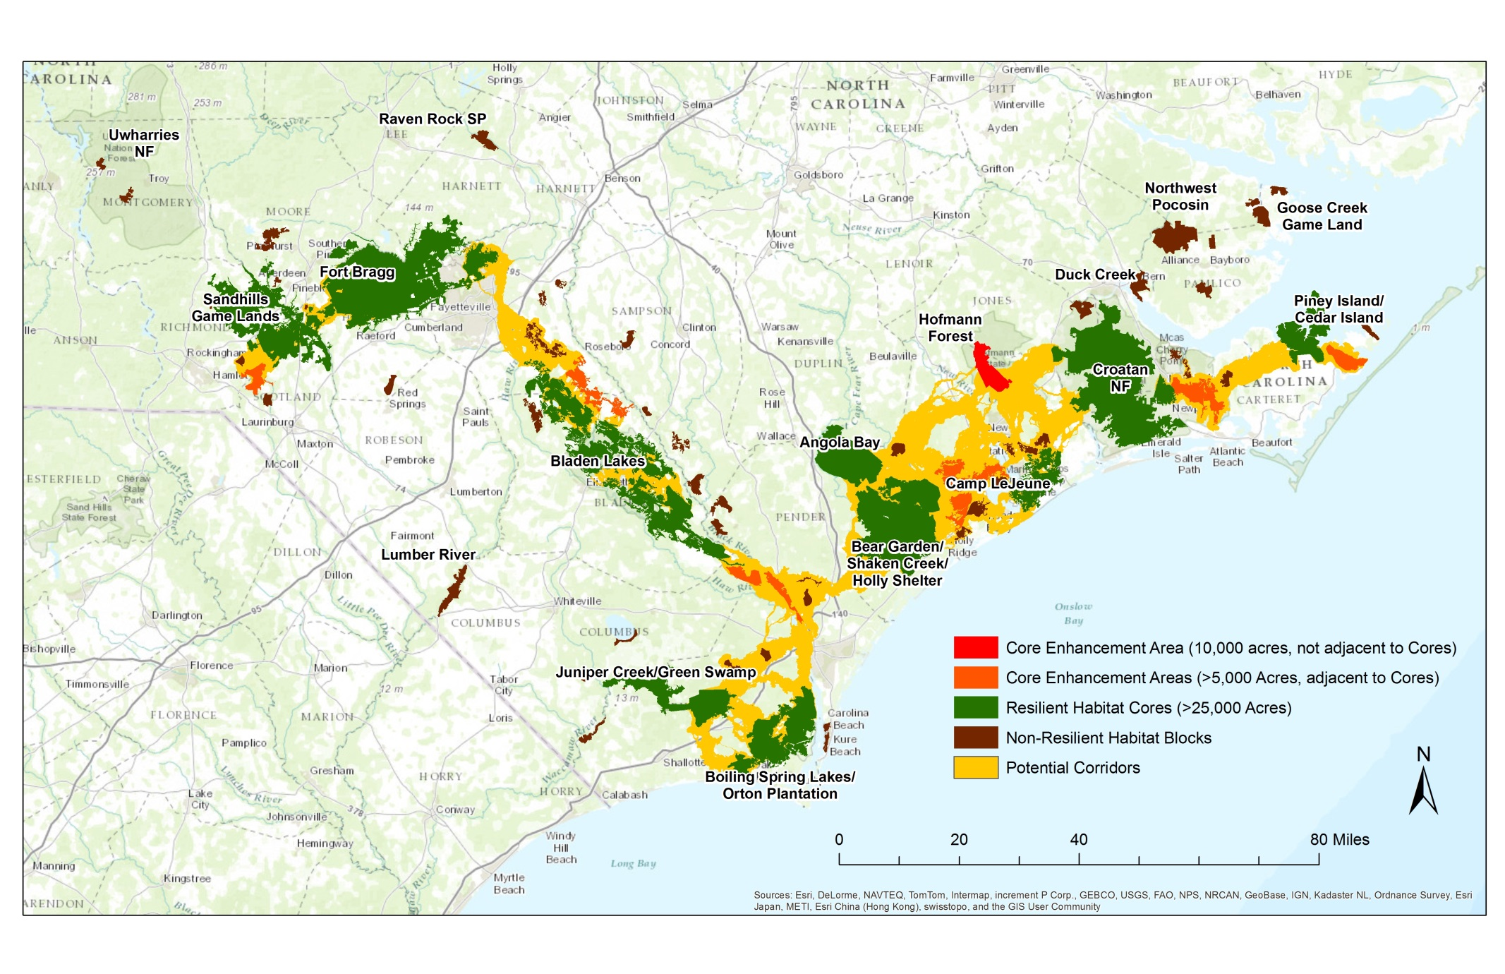
Longleaf Pine Corridors

Slide 9
Outcomes
Highest priority - protect and restore Resilient Habitat Cores and then Core Enhancement Areas
Use corridors to prioritize outreach efforts to private landowners

Slide 10
Possible Future Analysis
Incorporate habitat condition into block delineation or resilience categories
Connect to habitat in adjacent states or regions (e.g. Uwharries)
Account for future urban growth or sea level rise

