Slide 1
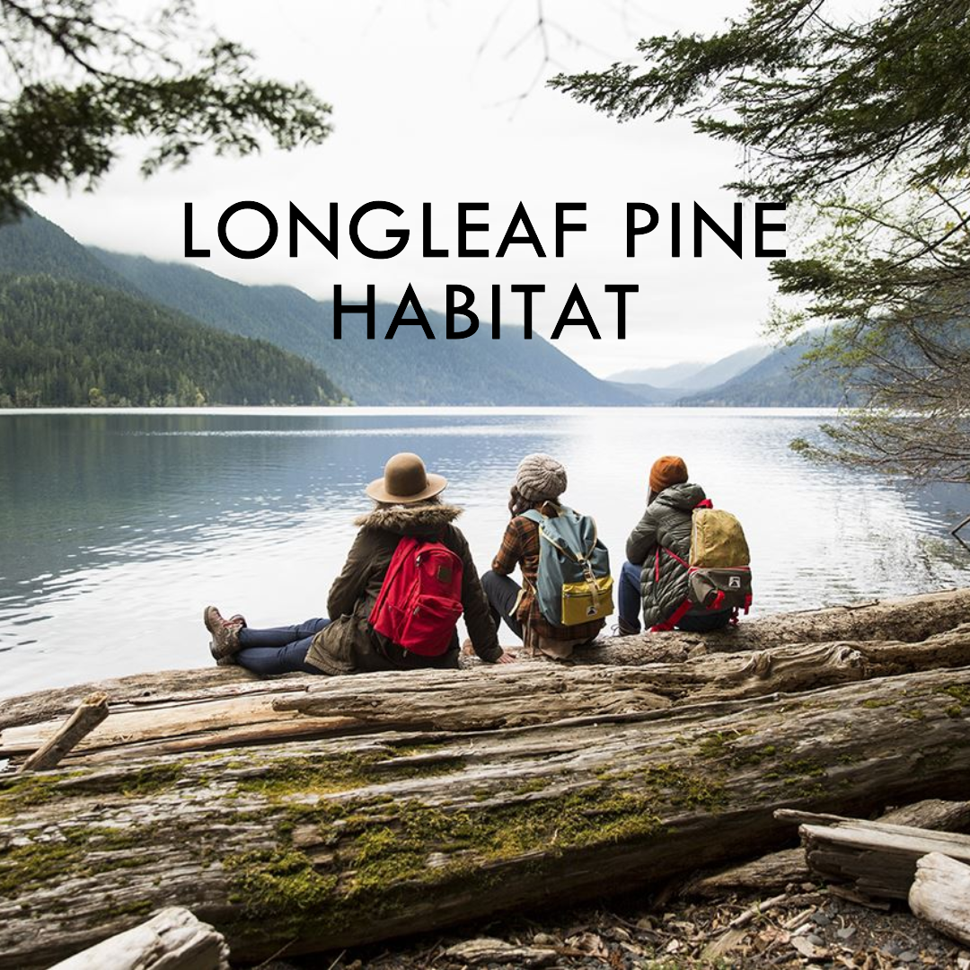
Reflections on Developing the
Strategic
Conservation Plan
Ryan Bollinger
Former ORISE Fellow

Slide 2
Conservation Planning Contributors
Core Team Contributors:
Ryan Bollinger- TNC/USFWS ORISE Fellow, Conservation Planner
Peter Campbell- USFWS, Wildlife Biologist
Ryan Elting- TNC, Sandhills Program Director
Neville Handel- TNC ORISE Fellow, Land Protection Specialist
Advisory Committee Contributors:
Kerry Brust- SEI, Senior Biologist
Charles Bryan- Ft. Bragg ESB, Wildlife Biologist
Emily Hill- NC Parks, Piedmont Region Biologist
Jeff Marcus- NCWRC, Piedmont Wildlife Diversity Supervisor
Allison Weakley- NCDENR NHP, Conservation Planner
Draft Strategic Conservation Plan Reviewers:
Sara DiBacco Childs- Duke Forest, Program Director
Gretchen Coll- TNC, Conservation Coordinator
George Hess- NC State Dept. of Forestry and Environmental Resources, Professor
Kevin McIntyre- Jones Center, Education Coordinator
Susan Miller- USFWS, Fish and Wildlife Biologist
Jeff Walters- Virginia Tech Dept. of Biological Sciences, Professor

Slide 3
Open Standards for the Practice of Conservation
Open Standards Approach
The main components of the Open Standards are broken into five steps that comprise the project management cycle (see figure 2, below). The basic structure of these generic steps is widely used in conservation and other fields that implement projects to achieve clearly defined goals. The steps include:
1. Conceptualize what will be achieved in the context of project location
2. Plan both Actions and Monitoring
3. Implement both Actions and Monitoring
4. Analyze data to evaluate the effectiveness of actions. Use results to Adapt project to maximize impact
5. Capture and Share results with key external and internal audiences to promote Learning

Slide 4

Our Planning Process

Slide 5
Our Planning Process
The planning process for the Plan focuses on steps 1 and 2. The Core Team applied the Open Standards framework within the Miradi Software to create conceptual models of our biological priorities that identify/validate/refine:
  a. Scope and Vision of the Partnership
  b. Conservation Targets and Target Goals
  c. Target Viability Assessment (highlight the current status of each target and facilitate monitoring of the target health and status over time) through identification of Key Ecological Attributes and Indicators
  d. Threats to Conservation Targets including Direct Threats and Stresses
  e. Strategies and associated specific Activities to abate threats and Objectives
Miradi software is based on developing a situation analysis in the form of a Conceptual Model that visually represents the inter-connection between conservation targets, direct threats, contributing factors, and strategies to abate the threats.

Slide 6
Threat Analysis

Slide 7
Conceptual Models

Slide 8
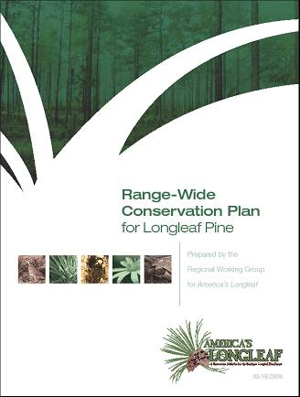
America’s Longleaf Restoration Initiative
Release of the 2009 Range-wide Conservation Plan for Longleaf Pine
Developed by Regional Working Group representing 22 Agencies/organizations
Supported by USDA Forest Service, NRCS, Department of Defense, and USFWS
Set target of 8M acres over 15 years
Identified 17 Significant Geographic Areas for longleaf restoration focus

Slide 9





Commitment from Federal Partners through the Federal Coordinating Committee
  Vital Federal support comes from Departments of Agriculture, Defense and Interior
  National MOU signed in 2010 pledged support and created the Federal Coordinating Committee

Slide 10
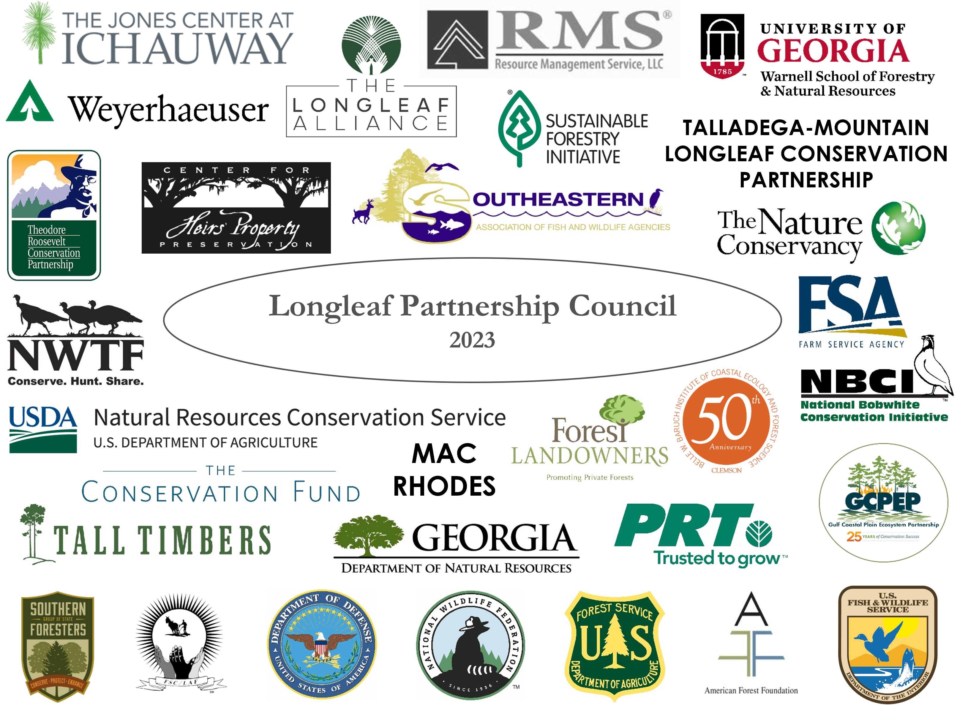
  33-member LPC formed in 2011
  Supports or coordinates wide-ranging efforts, including:
    18 Local Implementation Teams centered around SGAs
    Range-wide Working Groups
    Accomplishment reporting
Notes:
Add:
Gulf Coastal Plain Ecosystem Partnership
Talladega-Mountain Longleaf Conservation Partnership
Mac Rhodes
Shan Cammack (as Georgia DNR)
Remove:
TLT
SoLoACE
Will Owen
Sandhills PBA

Slide 11
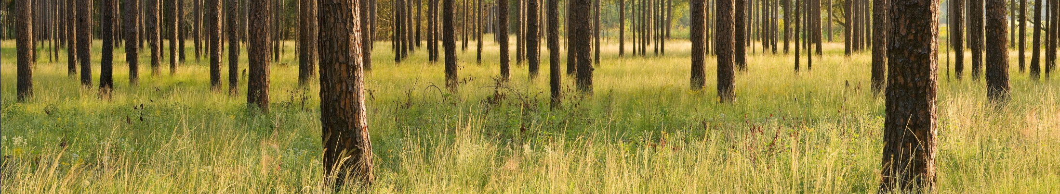
America’s Longleaf Restoration Initiative: Local Implementation Teams
Local implementation teams increase collaboration among the partners within each of the SGAs and provide avenues to share resources, conduct conservation planning/mapping, and increase outreach to private landowners.
Identify opportunities and lead on-the-ground longleaf restoration activities.

Slide 12
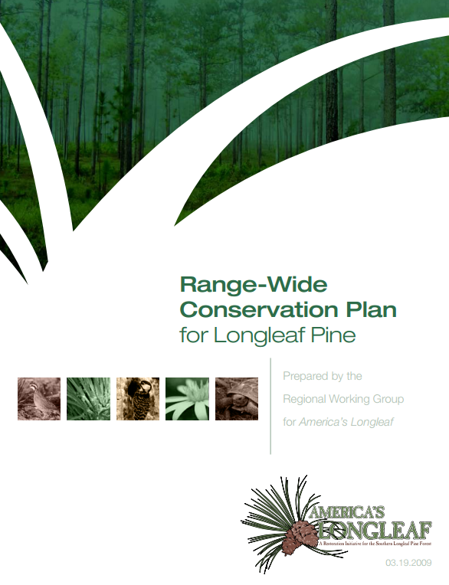

Range-Wide
Conservation Plan 2.0
2025-2040
2.0
Writing Charrette
Dec 5-6
First Draft
April 21
LPC Meeting Presentation
May 2-3
Review Deadline
June 9
Layout & Proofing
July-August
Document Finished
September
America’s Longleaf Celebration
Nov

Slide 13

Conservation Plan 2.0 Writing Team
Team Member | Affiliation
Tim Albritton | Natural Resources Conservation Service
Ryan Bollinger | The Longleaf Alliance
Gary Burger | SC Department of Natural Resources
Vernon Compton | The Longleaf Alliance
Colette DeGarady | The Nature Conservancy
Carol Denhof | The Longleaf Alliance
Jason Dockery | Alabama Forestry Commission
Chris Erwin | American Forest Foundation
Jennifer Fawcett | NC State Extension
Dan Frisk | US Fish & Wildlife Service
David Gonzales | US Fish & Wildlife Service
Team Member | Affiliation
Stephanie Hertz | Texas A&M University
Kyle Jones | US Forest Service
Ricky Lackey | National Wild Turkey Federation
Lisa Lord | The Longleaf Alliance
Kevin Mcintyre | Jones Center at Ichauway
Jenny Sanders | Texas Longleaf Team
Jonathan Scott | National Fish & Wildlife Foundation
Matthew Vandersande | Natural Resources Conservation Service
Jesse Wimberley | Sandhills Prescribed Burn Association
Tiffany Woods | National Wildlife Federation

Slide 14
Plan Structure & Organization
Draft Table of Contents
America’s Longleaf …………………………………………………………….. 2
The Longleaf Imperative ..........................................................2
Americas Longleaf Restoration Initiative ………………………………3
Goals and Guiding Principles………………………………………………...5
Conservation Plan Implementation .........................................7
Strategies for Longleaf Conservation.......................................9
Public Lands Strategy ...............................................................9
Private Lands Strategy………………………………………………………….12
Economic and Market-Based Financial Strategy ....................17
Prescribed Fire Management Strategy…………………………………20
Climate Resilience and Co-Benefits Strategy………………..……...23
Longleaf Reforestation Strategy……………………………………..……26
Evaluating Conservation Outcomes ........................................29

Slide 15
Conservation Plan Implementation
Implementation Section expanded to enshrine the structures put in place since 2009.
Working at Multiple Scales:
  Federal Coordinating Committee
  Longleaf Partnership Council
  Local Implementation Teams
5-Year Strategic Priorities and Actions Plans
Funding Structures

Slide 16
Conservation Plan 2.0 Goals
- New plan lays out broad goals and progress to date
- Keeping the overarching 8M acre goal. ALRI is a holistic, ecosystem-based approach, not just tree planting program
Maintain = good, excellent condition (goal 3M acres)
Improve = poor, fair condition
Restore = establish (at least 2M acres needed)
Need for monitoring system as dashboard for progress beyond acres
- Need to understand, reduce losses

Slide 17
Evaluating Conservation Outcomes
A careful evaluation of the Conservation Plan’s progress and outcomes is necessary to determine if the initiative’s conservation actions are being successfully implemented and if ecological goals are being met.
Objectives and Key Recommendations grouped into 4 Sections:
  Understanding our Baseline (extent and condition)
  Monitoring Acreage Goals (measuring change)
  Annual Accomplishment Reporting (measuring action)
  Non-Traditional Metrics (ex. partner & landowner engagement, climate, water, carbon)

