Slide 1
Calloway Forest Preserve
Significant Finds & Ancient Features
By: Harlen Chavis Jr.

Slide 2
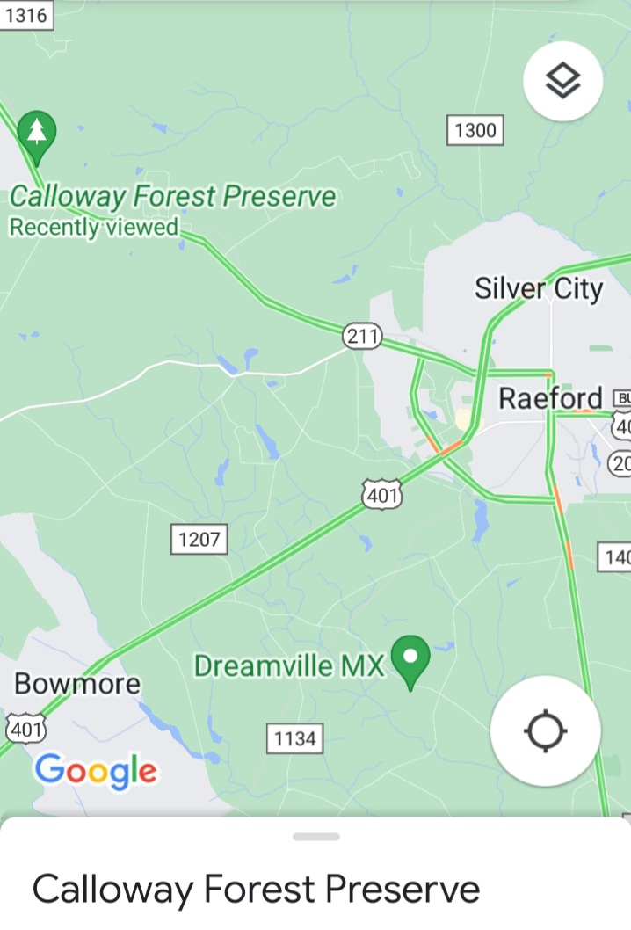
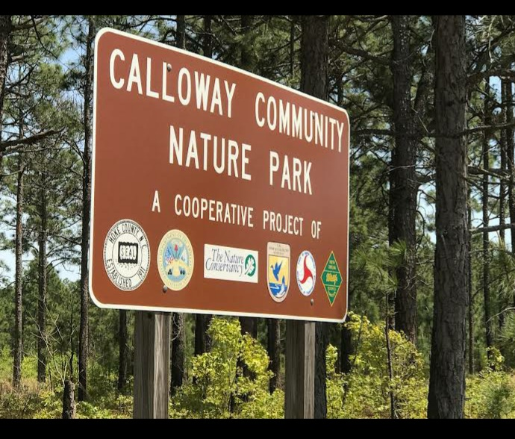
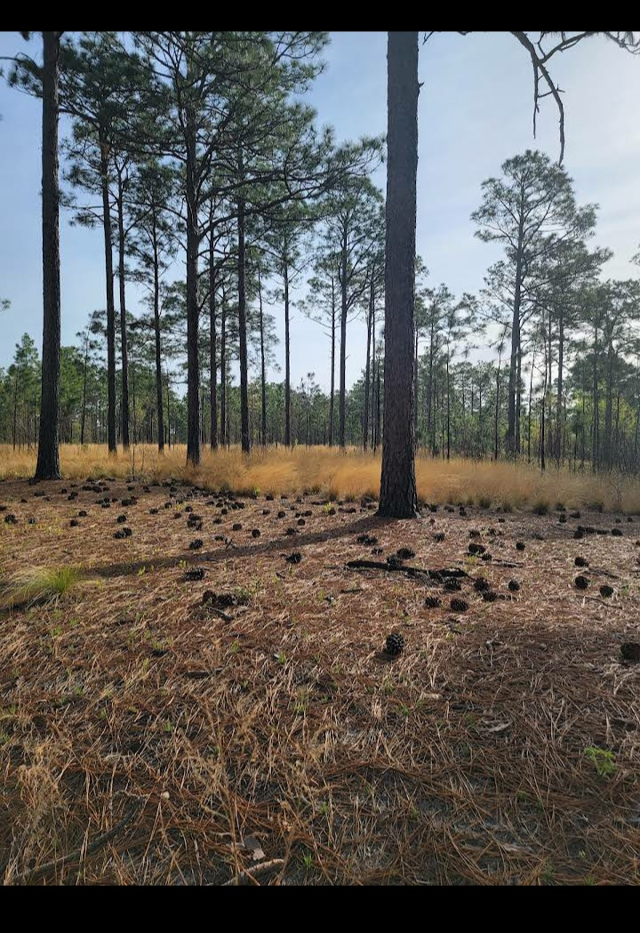
Maps of Calloway

Slide 3
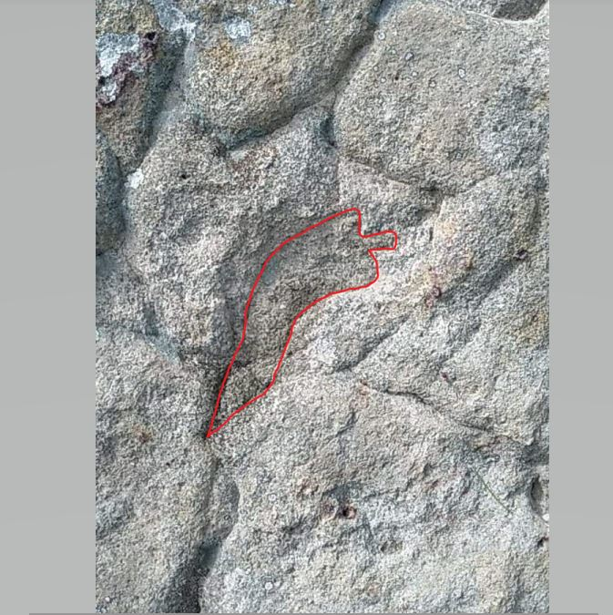
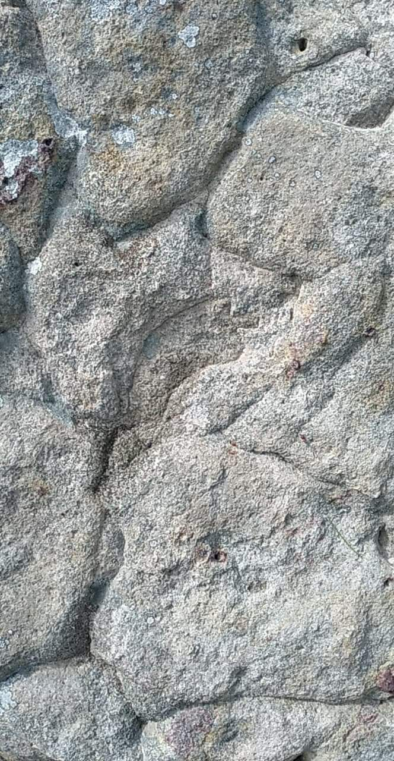
Petroglyph of Stone Knife
The location of a possible ancient stone petroglyph was located in Calloway Forest carved into a volcanic boulder in a rock outcropping. The Stone Knife carving has the appearance of having corner notches and a steam, similar to a Stone Blade or Lance that was a symbol of a Warriors Society during the Mississippian Era.

Slide 4

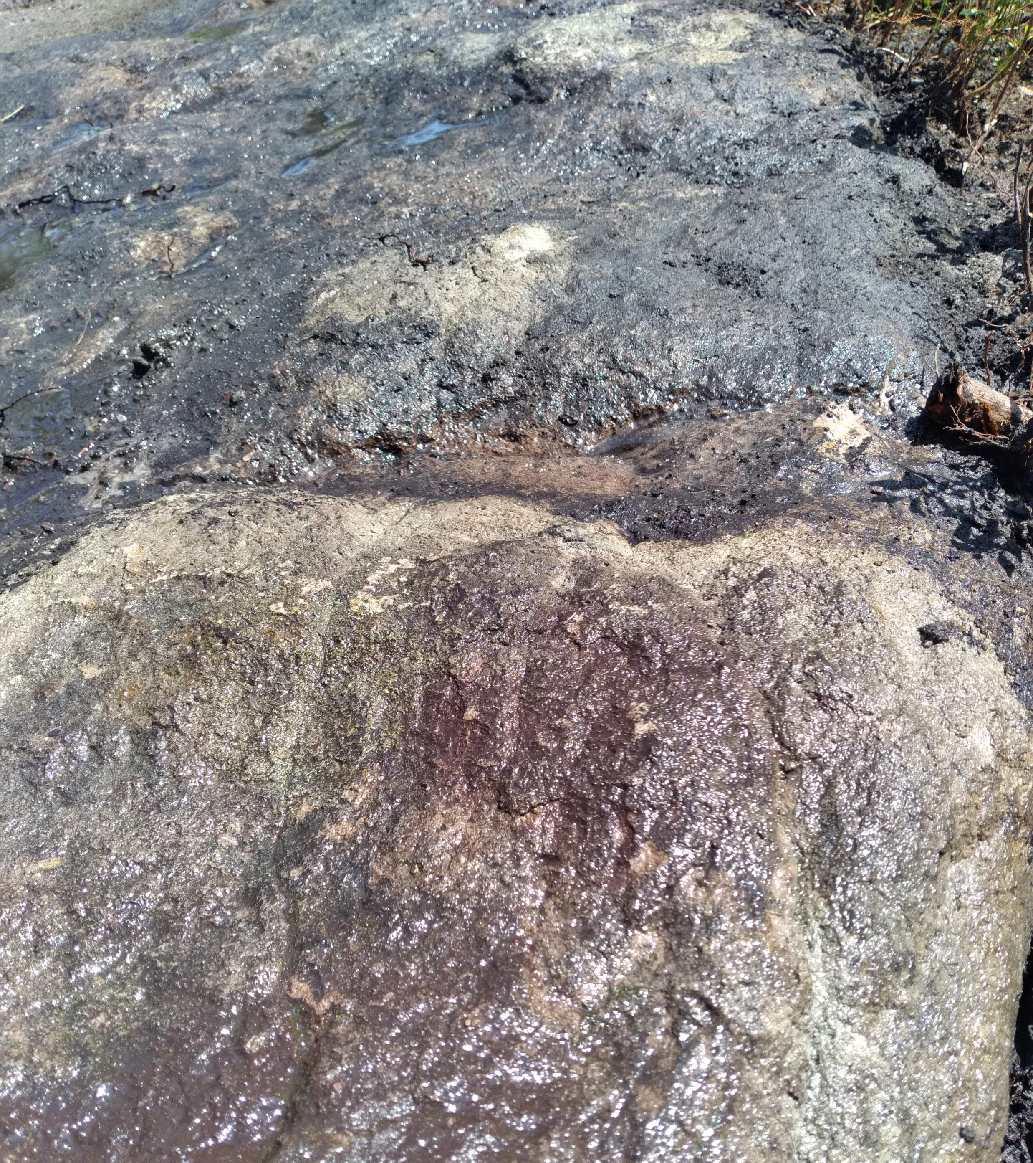
Overlapping Handprints in Stone
About 30 yards away from the Stone Knife petroglyph, exists a flat stone “altar” of volcanic tuff that is a definite natural formation that may have been altered or used as a ceremonial altar during Green Corn Ceremony in the sandhills. Within the stone altar, overlapping handprints seem to exists carved into the soft volcanic rock.Petroglyphs like this could be as old as the Archaic period & older. Handprints represent “Existence” in Native Culture.

Slide 5
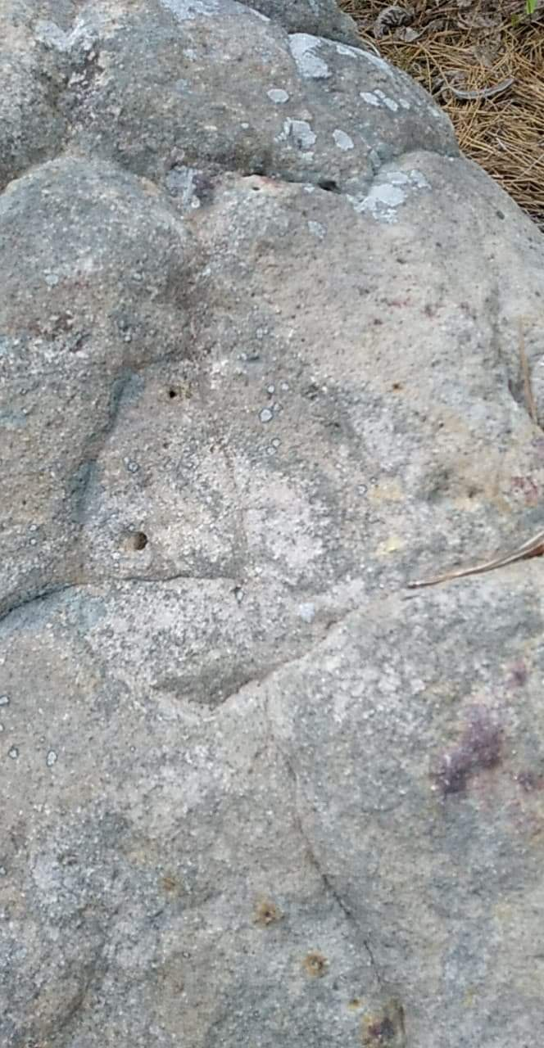
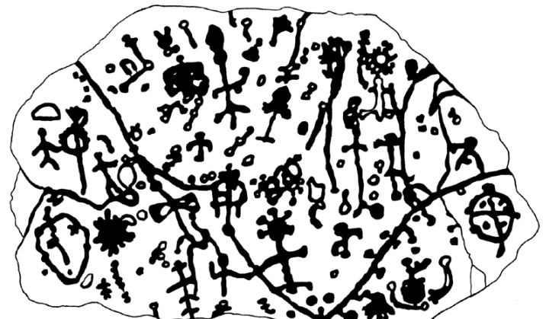
Medicine Wheel Petroglyph
The carved depiction of what appears to be a turtle shell, that we have realized, is a medicine wheel, is also carved into the same stone boulder that the stone knife petroglyph is carved in. This medicine wheel depiction seems to be similar to the one carved into Judaculla rock in Jackson County, NC. The Department of Agriculture has a Rock Art Survey that is currently locating and documenting petroglyphs, pictographs & mud glyphs.
www.fs.usda.gov

Slide 6
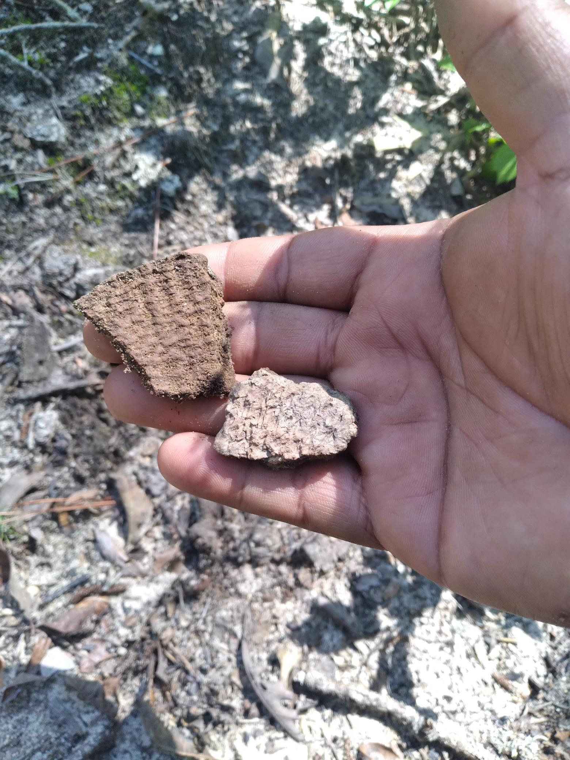
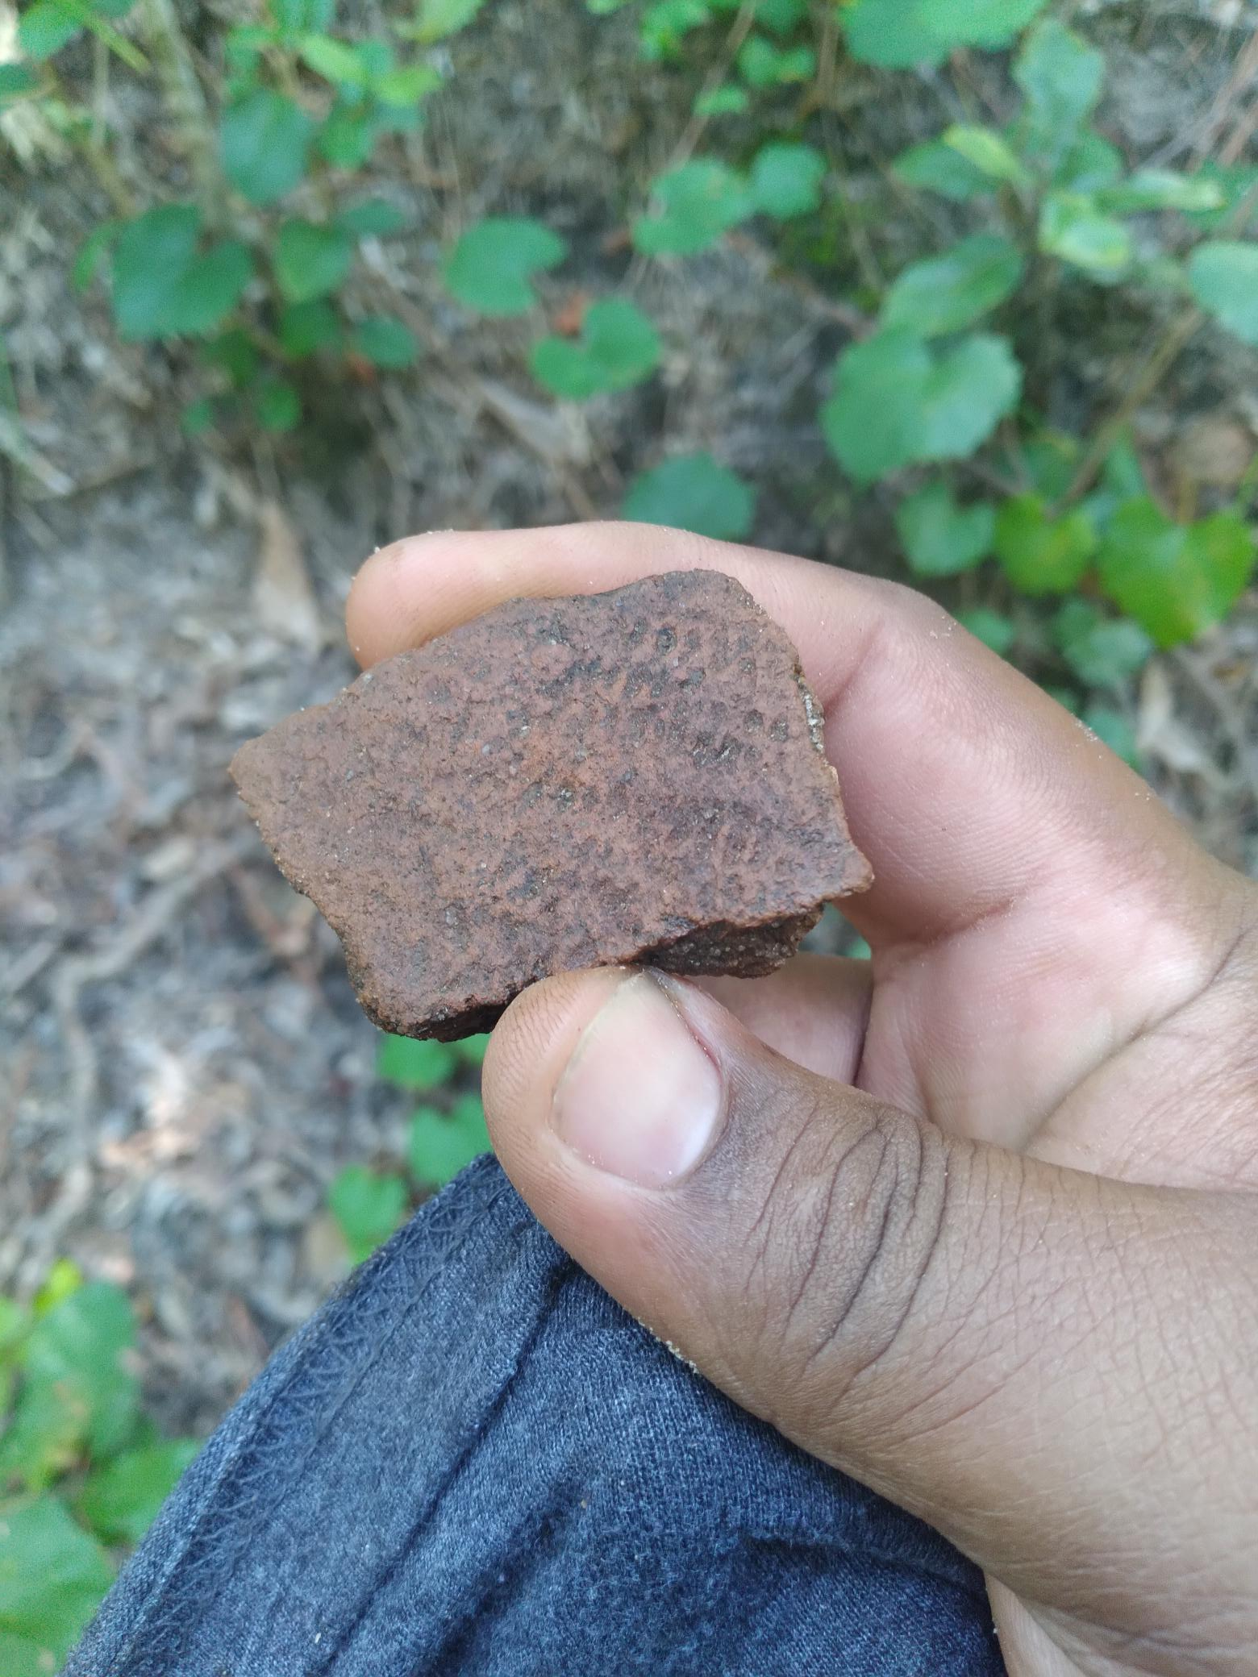
Fabric Stamped Pottery Sherds
Fabric stamped pottery is said to be made in the Late Woodland period 600-1000 A.D. Joffrey Coe suggest that the fabric was woven river cane, and then wrapped on a paddle and stamped on wet clay. This was the creation of sophisticated artist that were first nations engineers. These pottery sherds were found about 200 yards north of the petroglyph location.

Slide 7
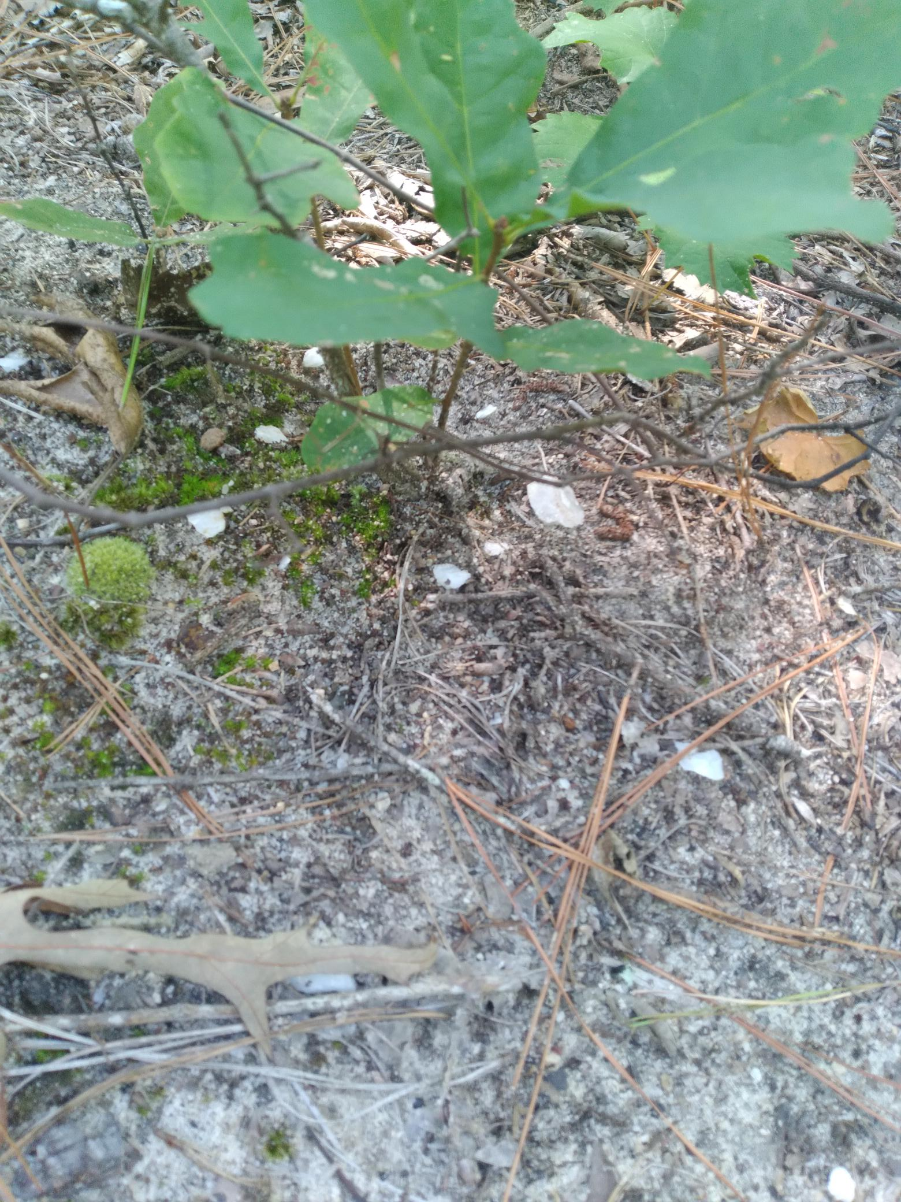
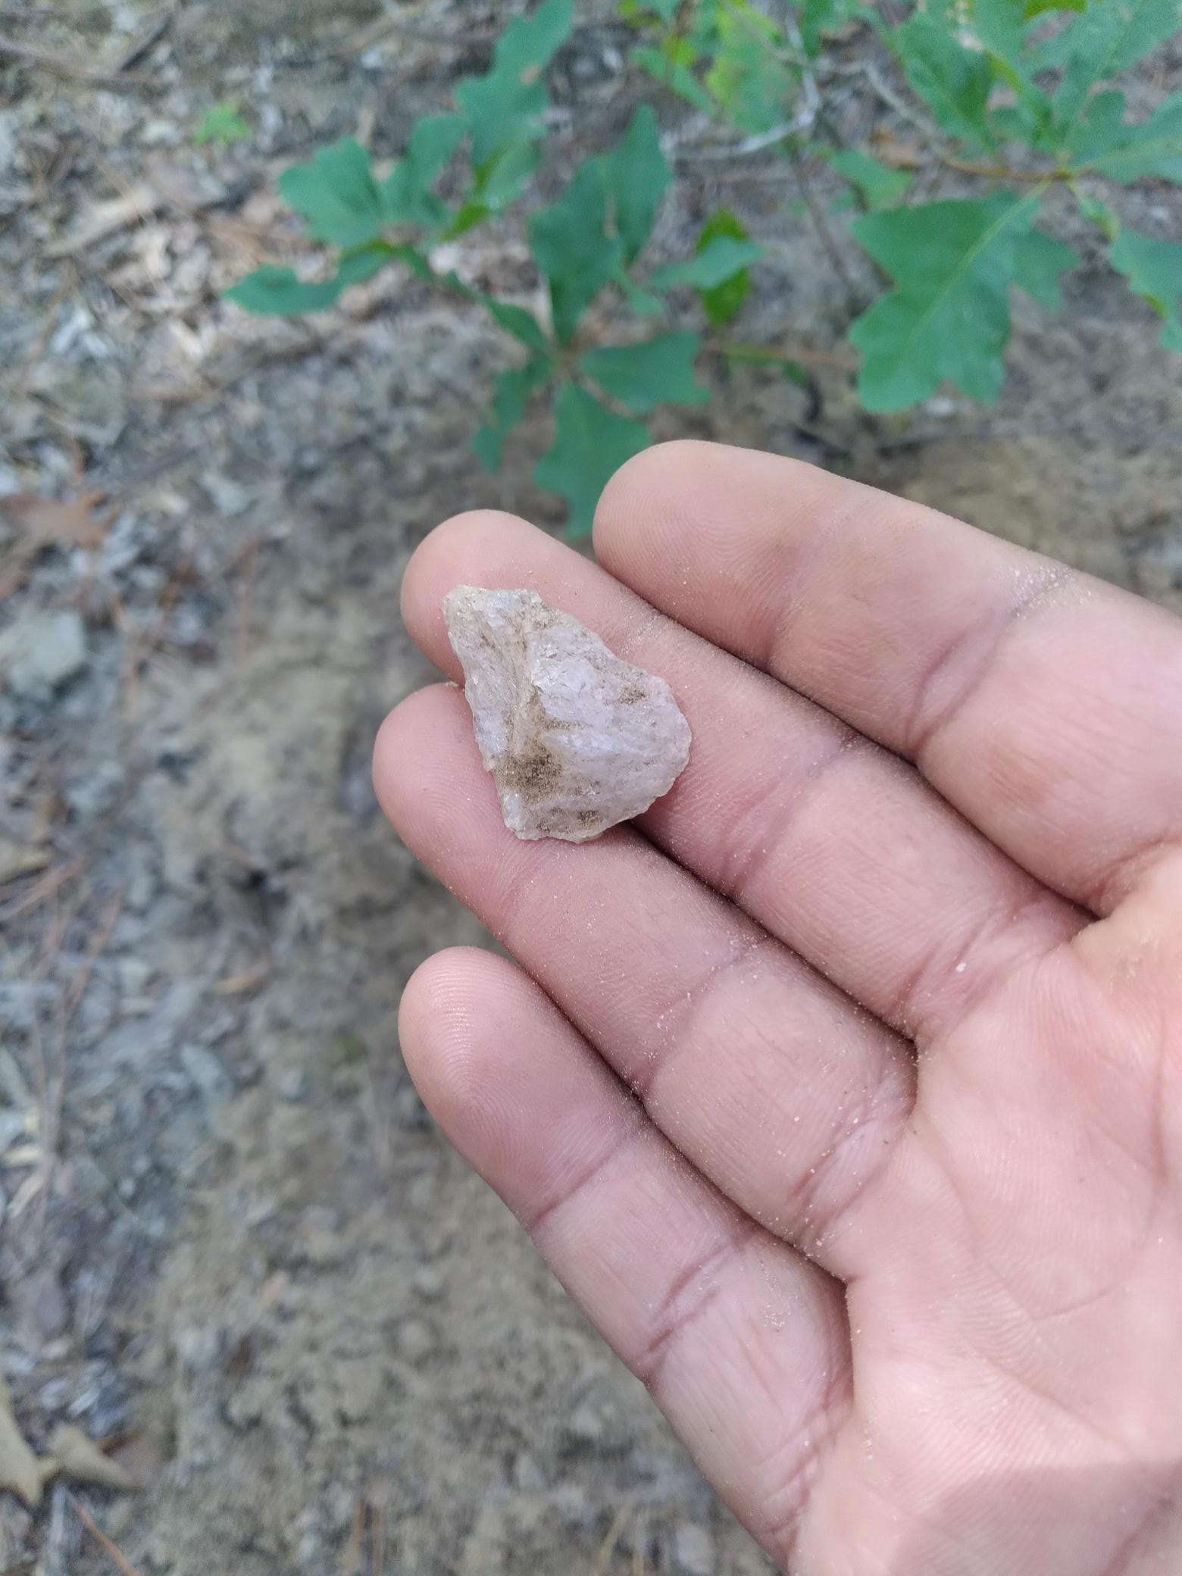
Randolph Projectile Point
A white quartz Randolph projectile point was found about 20 feet away from the fabric stamped pottery shards. The eye appeal of a cluster of white quartz flakes tipped me off that there was a projectile point around. Randolph points are said to be made from 1725-1800 A.D. Which suggest a later existence of Native people's during this time period.

Slide 8
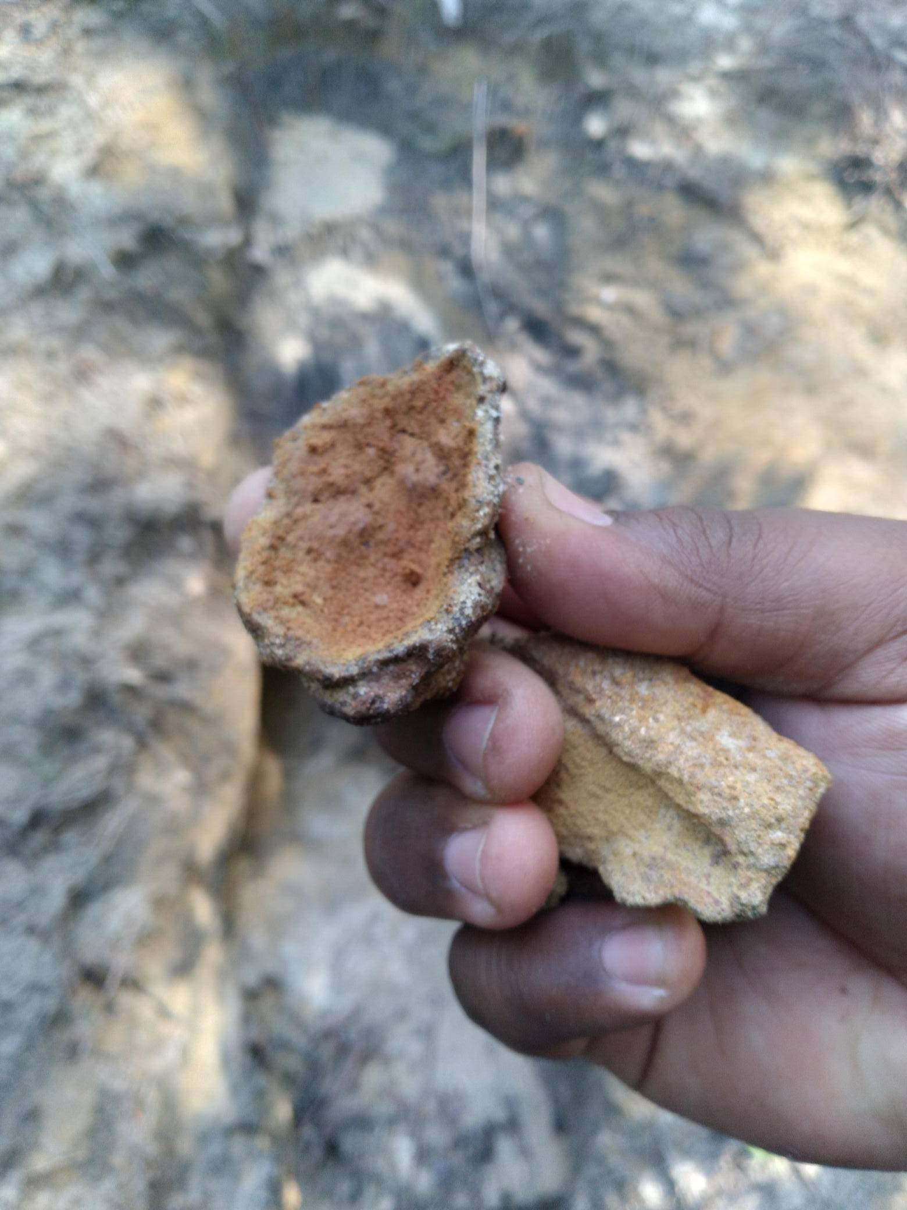
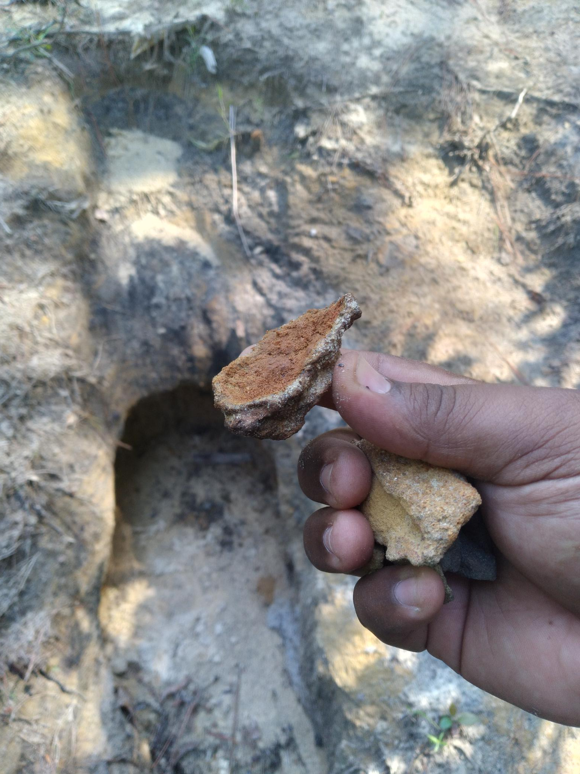
Paint Bowl
Recovered about 200 yards above the location of the petroglyphs. This paint bowl was made from Red Ochre (iron oxide) that is found in abundance at Calloway. The outside of the bowl glistens & shimmers with a natural inclusion of crystal and quartz embedded in the outer crust. Paint Bowl’s are believed to contain a natural red ochre powder that would have been used to make a paint used for art, ceremony and everyday use by Indigenous people.

Slide 9
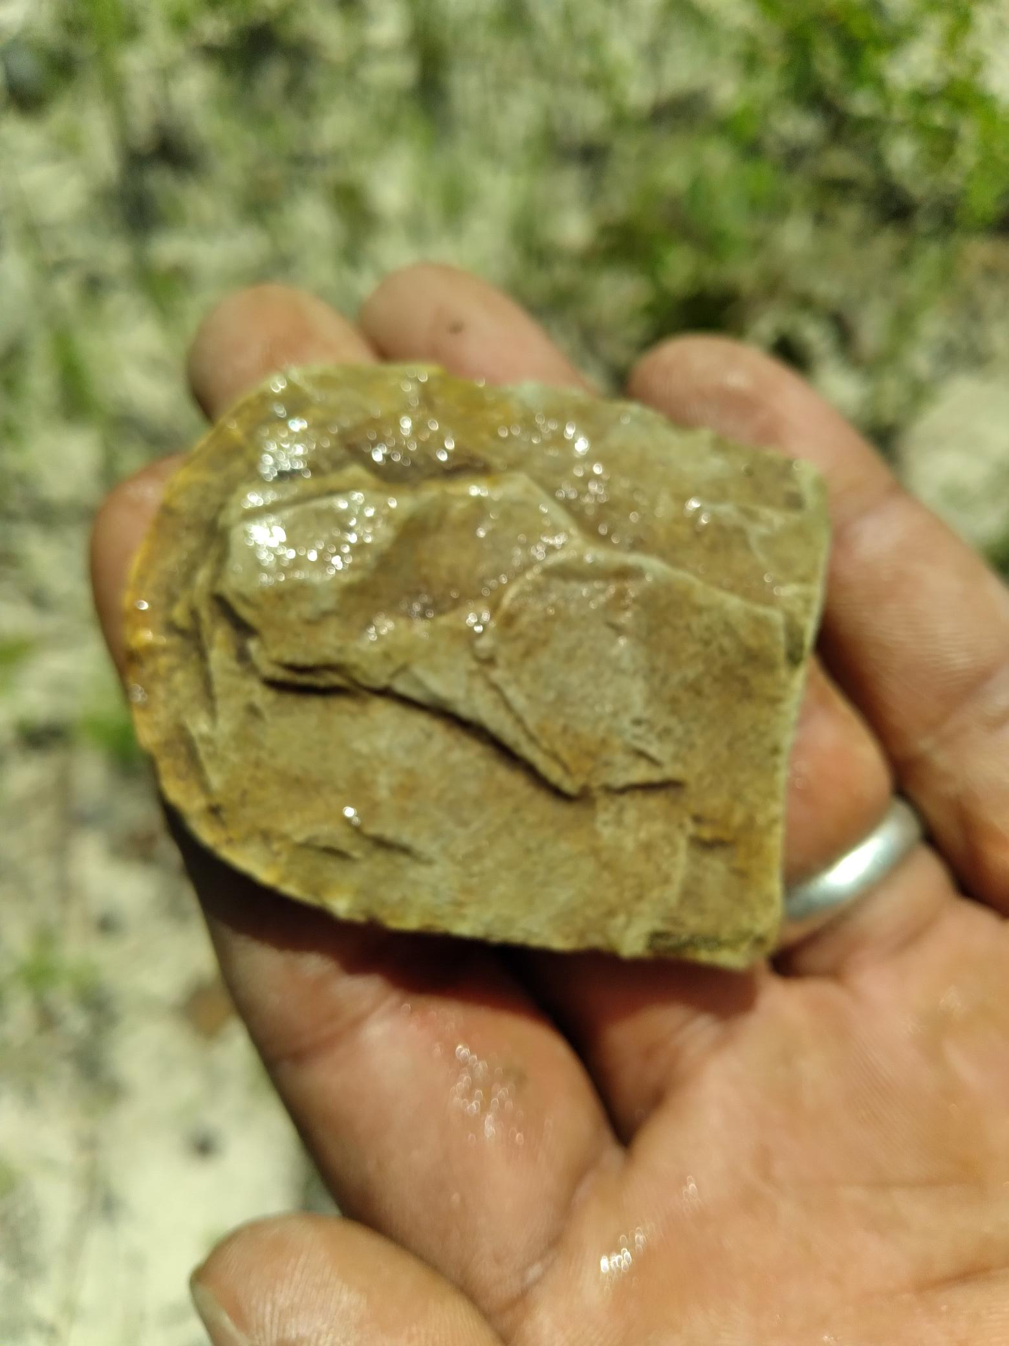
Broken Stone Adze Blade
This broken stone adze blade was recovered at the basin of the furthest two rock outcroppings on the property at Calloway Forest, on a pile of white sand. The adze blade seems to be made from rhyolite and would have been used in the late Woodland period to the Mississippian period to aid in the manufacture of dugout canoes and other wooden objects of necessity. This Artifact represents a time period of 4,000 B.C.-1,000 C.E. Just the presence of this Artifact at Calloway proves Continous occupation there.

Slide 10
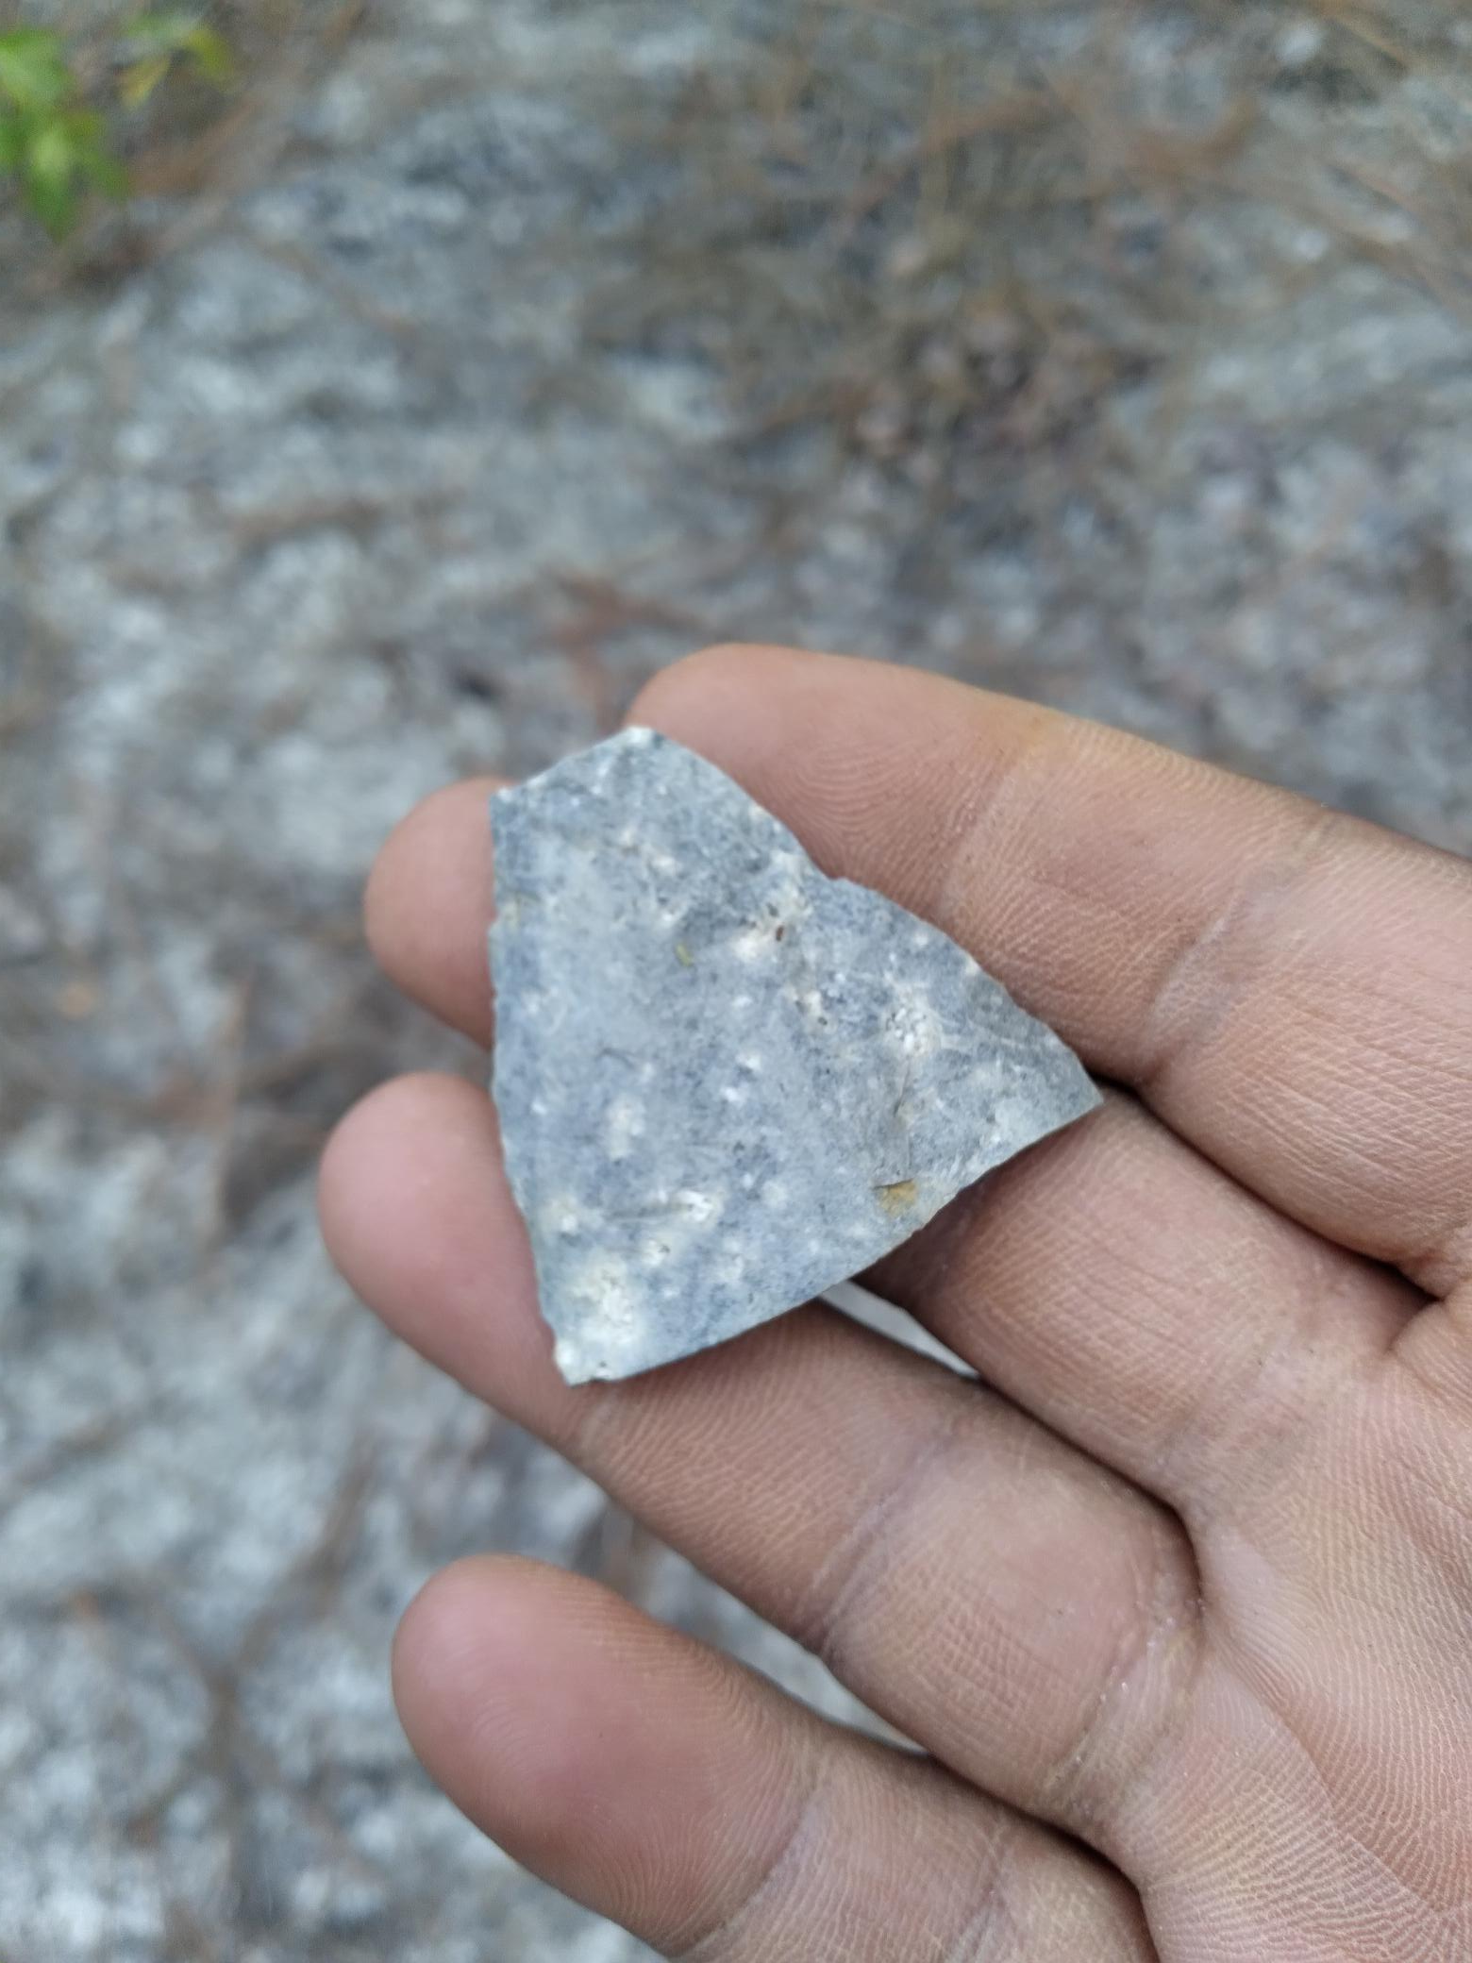
Broken Chert Spearhead
This broken spearhead was found at the intersection of two roads in Calloway Forest. This sandhills intersection is a great place to stop and take a break. While taking a break, I explored one of the small hills and discovered this broken spearhead or atlatl point laying atop the sand dune. This broken point is believed to be from the Archaic period 8,000-3,000 B.C. It seems to be made from “Spotted Chert” that was found in abundance at Morrow Mountain in the Uwharrie Mountains by Ancient Indigenous people. Chert is a volcanic rock type that was formed about 300-400 million years ago. The Uwharrie Mountains are believed to have formed at the same time of the Appalachian Mountains, the oldest Mountain range in North America.

Slide 11
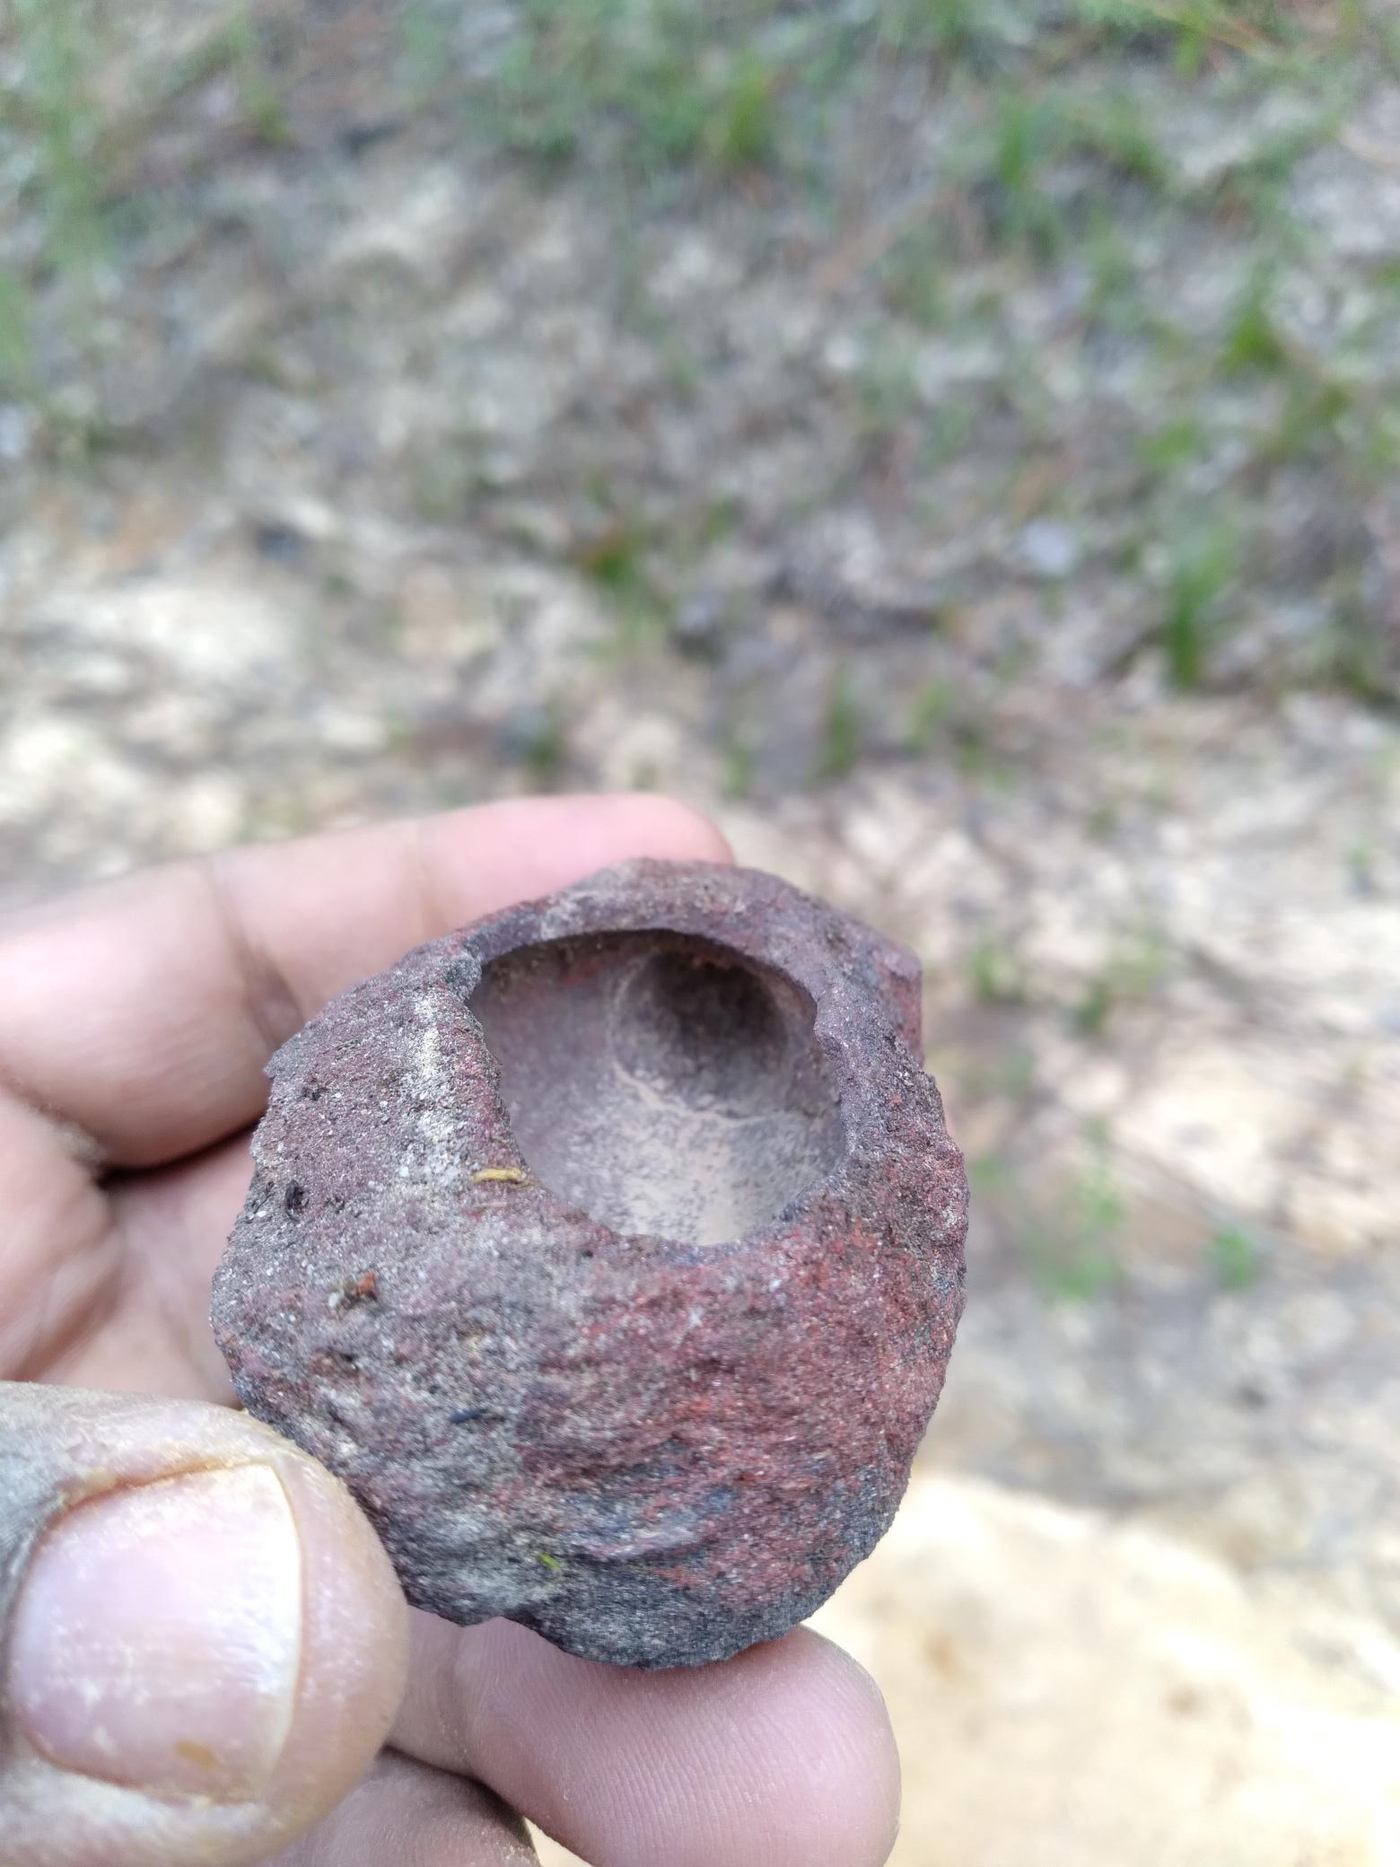
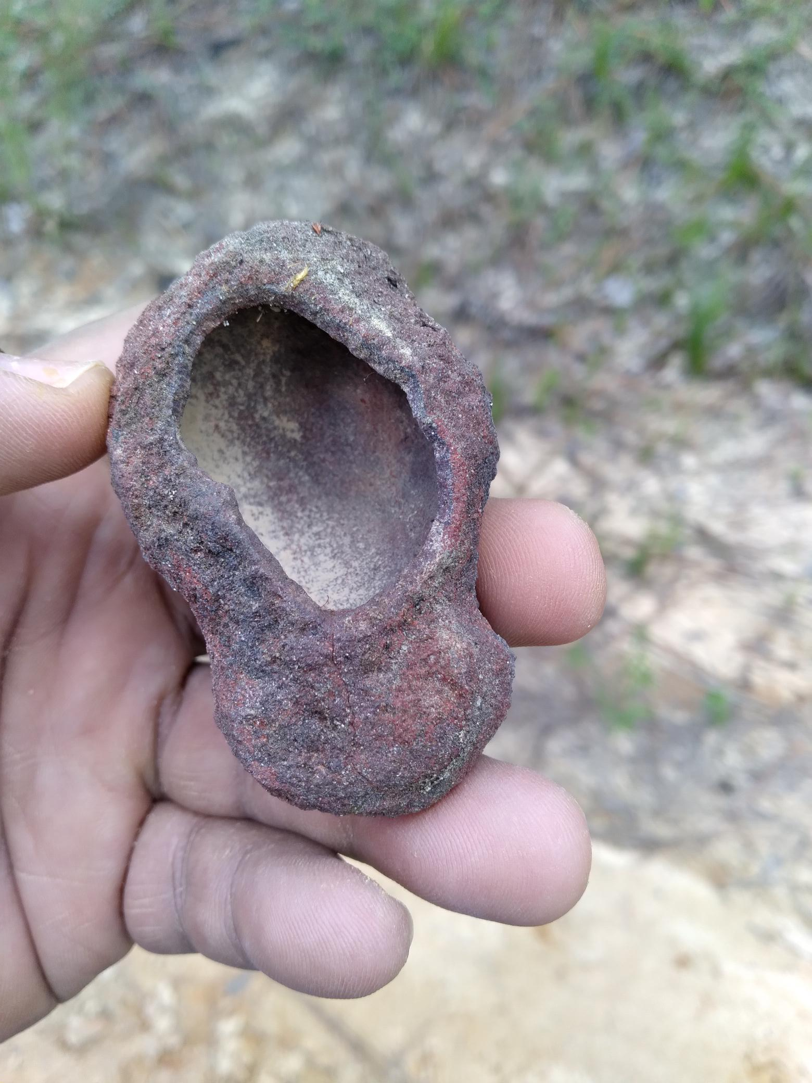
Red Ochre Pipe Pre-form
This Red Ochre pipe is rare and hardly never found in this state type, a pre-form state. The reason this pipe was found in a pre-form state is because it is believed that the mouth of the bowl was broken during it’s manufacture of the drilling process. When the mouth of the bowl broke, it was discarded. The pipe is suggested to be from at least 5,000 B.C. (Archaic period). It was found on the bank of a washed-out roadway in Calloway Forest. With the help of Mr. Perry Hurt at the NC Museum of Art, we were able to test this material and conclude that it is indeed “Red Ochre”, first discovered by John Lederer, “A source of Red Paint in Cheraw country close to the Yadkin river” & located Douglas L. Rights in Moore County, NC used as body paint. The Red Ochre general samples found at Calloway are now on display at the NC Museum of Art in Raleigh in an exhibit titled “Seeing Red”.

Slide 12
Conclusion
Calloway Forest is a vast Long Leaf Pine Savanah that is home to a lot of special species, several types of grasses such as wire grass, and a 3,000-acre variety of trees and geographical features. These geographical features come in the form of extrusive rock called “volcanic tuff” that peaks out from the sandhills here. Basalt (quickly cooled lava), would have formed Red Ochre, the volcanic tuff extruded from the earth’s surface also around 1.5 million years ago. The extrusive volcanic tuff would form bluffs or a type of cliff face here at Calloway, these volcanic rock outcroppings could have provided a special material for the first inhabitants living in this area some 10,000 years ago in the beginning of the Archaic period. Several petroglyphs were discovered here at Calloway carved into the same group of volcanic tuff rock group, the first one discovered was the depiction of a curved stone knife blade or “stone lance” that could date back as far as the Archaic period and as late as the Mississippian period 1,000-1600 A.D. The second petroglyph discovered was two handprints overlapping each other into a flat alter shaped out crop of volcanic tuff about 30 yards from the first petroglyph. The third carving or petroglyph appears to be a medicine wheel, this petroglyph has already shown up here in North Carolina, carved into the more famous “Judaculla” rock in Jackson County. My belief is that during an event termed the “Alta thermal” Natives living in the mountainous areas of North Carolina would have left higher elevated areas because of this time of “frozen drought” and traveled to seek a source of more abundant water. They would have found that areas like Calloway Forest and modern Robeson County & Scotland, Hoke, Moore and Cumberland counties would have been the best viable areas to sustain their way of life. Here at Calloway the First Nation people who would have first called it home also brought their culture and ceremony with them. They would have practiced Green Corn ceremony, they would have developed an epicenter for this ceremony, now deemed “Harlen’s Bluff” where the three petroglyphs reside. This site was where members of the clan would have broken many pottery vessels made from clay & red ochre, this was believed to have released the soul of the pottery vessel and they then would have made new pottery vessels. The men would have drunk a form of black drink made from the ink berry plant that seems to be more abundant than Yupon holly at Calloway, a form of cleansing the body. The women would have been scratched with fish teeth; this was meant to cleanse the body by bleeding out. These First Nation people saw value in the raw material on this landscape, they made smoking pipes from Red Ochre, they brought certain tools with them like the Adze blade made of rhyolite and they would have inhabited Calloway Forest for thousands of years. Until this day, we still dwell, live, exist and inhabit the lands surrounding Calloway Forest and are forever grateful for the friendship and relationships that have been forged with The Nature Conservancy and the State of North Carolina.

